Slide 1

Mini Project on
EAMCET WEB APP
TEAM MEMBERS:
MOHD WASEEM KHAN(160720733095)
M.ANUSHA (160720733078)
ANNAM SWARANI (160720733074)
UNDER THE GUIDANCE OF:
Mrs. A.SOWJANYA
Asst. Professor

Slide 2
Abstract
Our mini-project aims to predict the college of students based on their ranks of TS EAMCET.
It is very useful for students who are looking for Engineering College in Telangana State.
The project involves collecting latest data of previous EAMCET results.
Extracting relevant features, and implementing Dataset to analyze and predict the College.

Slide 3
Introduction
The Telangana State Engineering, Agriculture, and Medical Common Entrance Test (TS EAMCET) hold paramount importance as a gateway for ambitious students aspiring to pursue undergraduate courses in Engineering within the diverse educational landscape of Telangana, India.TS EAMCET serves as a comprehensive evaluation of students' knowledge and skills in subjects such as Mathematics, Physics, Chemistry, Biology, and Agriculture.
The exam is conducted annually, and its results play a crucial role in determining candidates' eligibility and admission into reputed institutions based on their ranks.
The purpose of TS EAMCET is to ensure a fair and transparent selection process for deserving candidates seeking admission to Engineering programs.
The exam evaluates candidates aptitude, problem-solving abilities, and subject knowledge, enabling colleges and universities to admit students who demonstrate the necessary skills and potential to excel in their chosen fields.
The examination is conducted in various test centers across the state, providing equal opportunities to students from different regions.

Slide 4
Existing System
In Existing System of Eamcet Web App it was not Predicting the correct or exact college.
In the previous years they predicted the college according to the predicted dataset.
Limitation
In the previous system the cut-off results would have been released in the Excel Format.
This made the students to manually download them from the portal and examine with their Eamcet Rank.
This made the process very Hectic and Confusing.

Slide 5
Proposed System
In the proposed EAMCET Web App system, users can obtain precise information about the colleges that match their rank.
Our project employs an exploratory dataset, meticulously curated to deliver accurate and reliable results.

Slide 6
Software Requirements:
Python
Integrated Development Environment(IDE)
Python Libraries:
Numpy
Pandas
Streamlit
Dataset ( Eamcet Final Cut-off 2022)

Slide 7
Hardware Requirements:
Processors
Memory(RAM)
Storage
Internet Connection

Slide 8
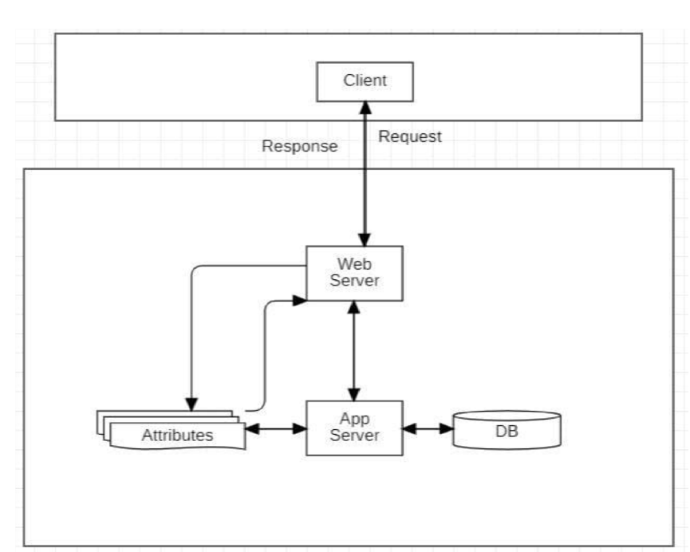
System Architecture

Slide 9
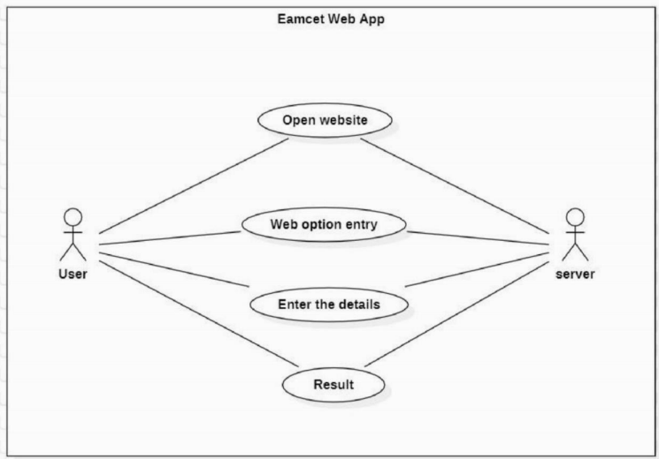
Use-Case Diagram:

Slide 10
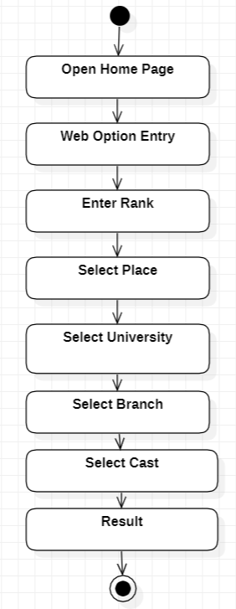
Activity Flow Diagram:

Slide 11
Conclusion
The ultimate goal of this project is to deliver accurate college recommendations based on students ranks, enhancing the decision-making process for their educational journey.
Our project ensures not only swift processing but also maintains a high degree of precision, optimizing the entire workflow for maximum efficiency.

Slide 12
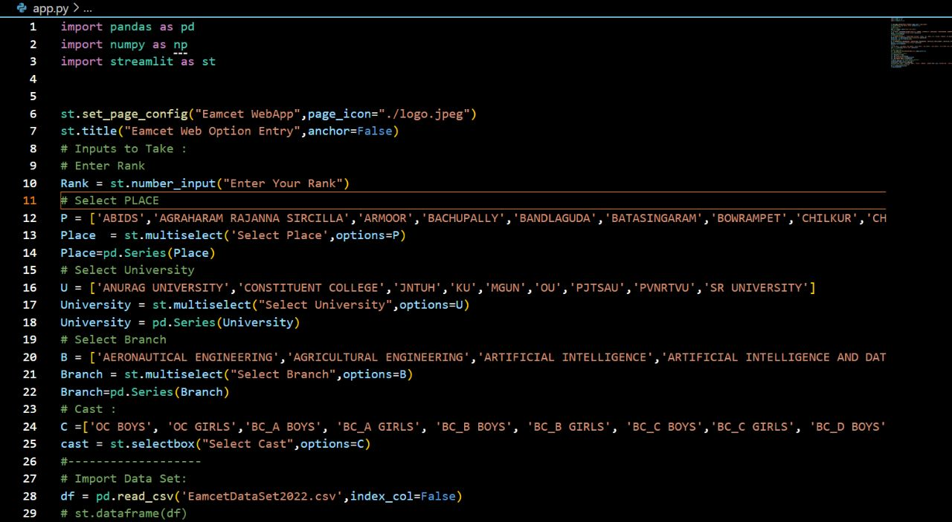
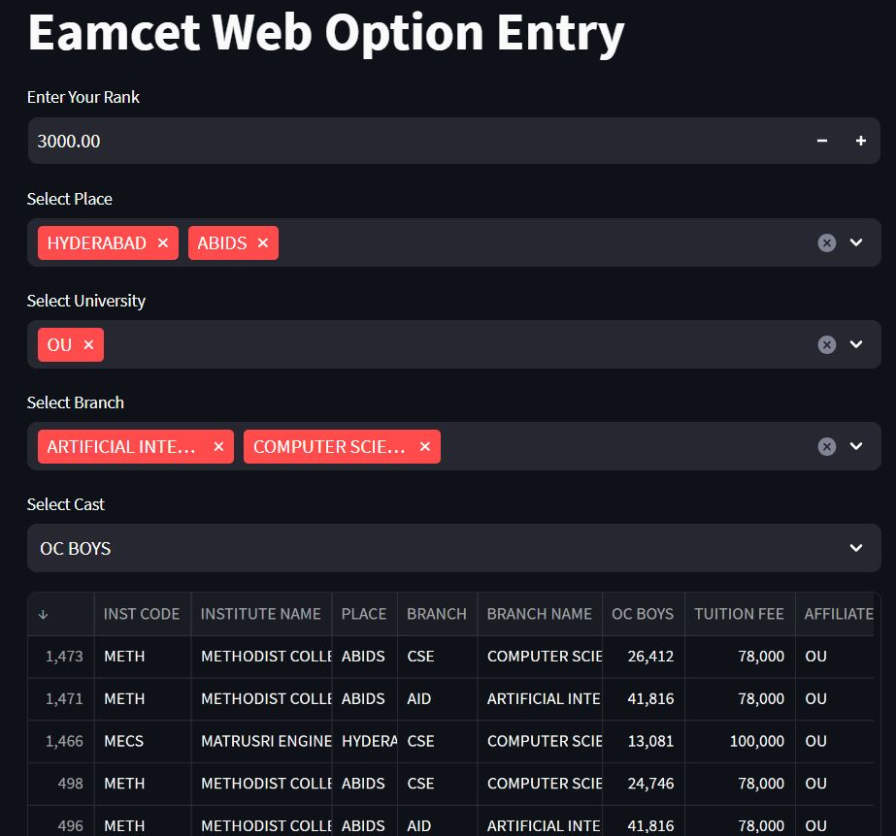
Result:

Slide 13
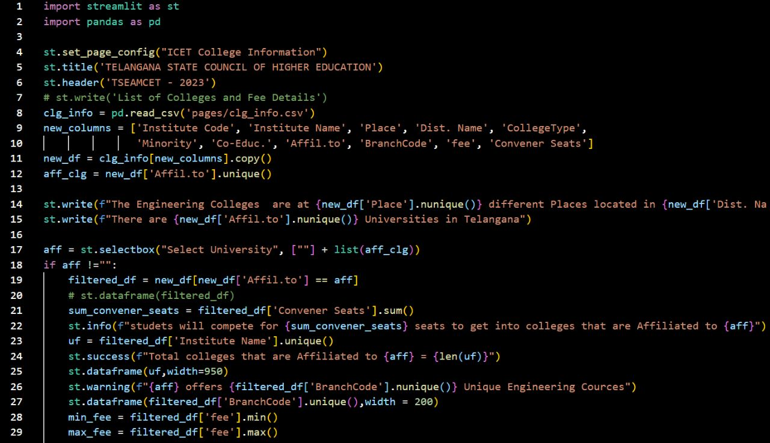
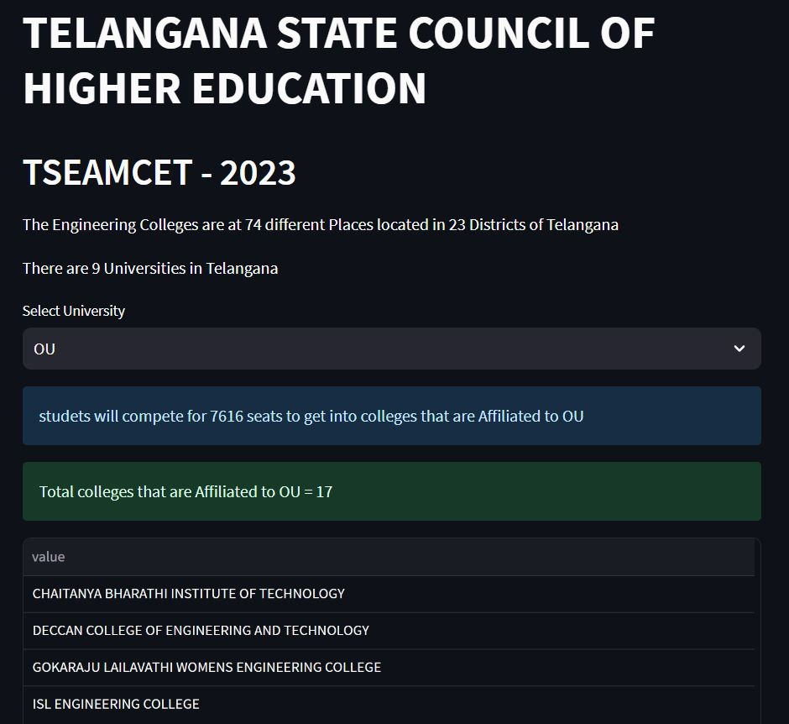

Slide 14
References
"EAMCET Rank Prediction using Machine Learning Techniques" by T. Naga Raju and D.Sreenivas Rao. (International Journal of Computer Science and Information Technologies, Vol. 8, Issue 5, 2017)
“Rank Prediction in EAMCET Using Machine Learning Algorithms" by M. Prasanna Latha and A. Rama Krishna. (International Journal of Advanced Research in Computer Science, Vol. 8, Issue 4, 2017)
"Rank Prediction in EAMCET using Multiple Linear Regression" by B. Harish and M. Sai Krishna. (International Journal of Computer Applications, Vol. 125, Issue 1, 2015)

Slide 15
Thank you

