Slide 1
Lecture # 3

Slide 2
Quotation & Citation
<abbr> Defines an abbreviation
<address> Defines contact information for the author/owner of a document
<bdo> Defines the text direction
<blockquote> Defines a section that is quoted from another source
<cite> Defines the title of a work
<q> Defines a short inline quotation
<blockquote cite="http://www.worldwildlife.org/who/index.html"> This is text </blockquote>

Slide 3
Quotation & Citation Con’t
<q> for short quotation
<p>WWF's goal is to: <q>Build a future where people live in harmony with nature.</q></p>
<abbr> tag defines an abbreviation
<p>The <abbr title="World Health Organization">WHO</abbr> was founded in 1948.</p>
<address> Written by John Doe.<br> Visit us at:<br> Example.com<br> Box 564, Disneyland<br> USA </address>
<cite> tag defines the title of a creative work
<p><cite>The Scream</cite> by Edvard Munch. Painted in 1893.</p>
<bdo dir="rtl">This line will be written from right to left</bdo>

Slide 4
Audio Tag
<audio> tag is used to embed sound e.g music or streams
<audio> tag contains one or more <source> tags with different audio sources. The browser will choose the first source it supports.
The text between the <audio> and </audio> tags will only be displayed in browsers that do not support the <audio> element.
Supported Audio Formats in HTML5
MP3, WAV, and OGG.

Slide 5
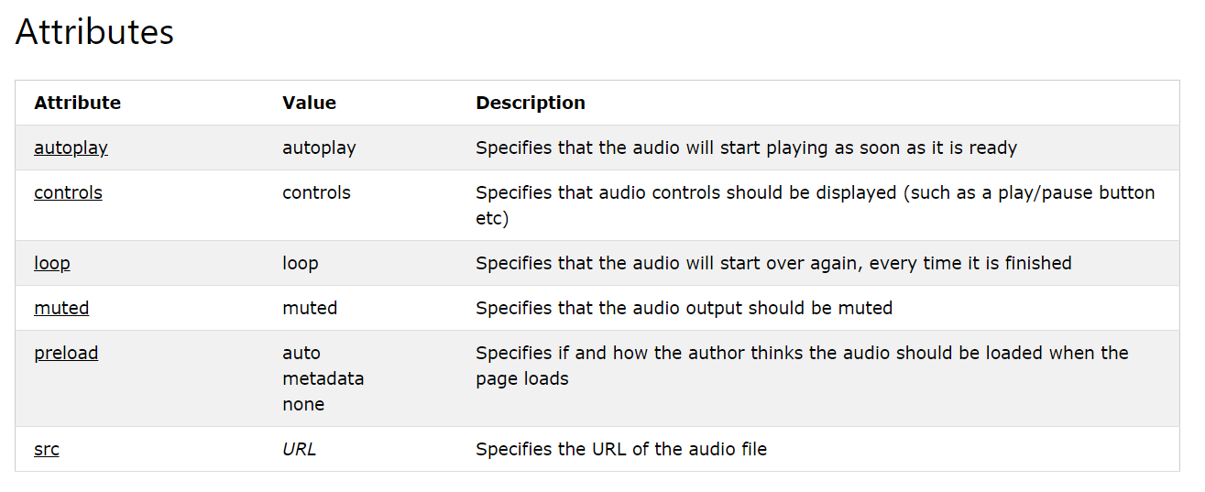
Con’t

Slide 6
Con’t
<audio autoplay controls loop muted preload=”none”>
<source src="horse.ogg" type="audio/ogg">
<source src="horse.mp3" type="audio/mpeg">
Your browser does not support the audio tag.
</audio>

Slide 7
Video
The <video> tag is used to embed video content e.g movie clip and other streams
The <video> tag contains one or more <source> tags with different video sources. The browser will choose the first source it supports.
The text between the <video> and </video> tags will only be displayed in browsers that do not support the <video> element.
Supported video formats in HTML5:
MP4, WebM, and OGG.

Slide 8
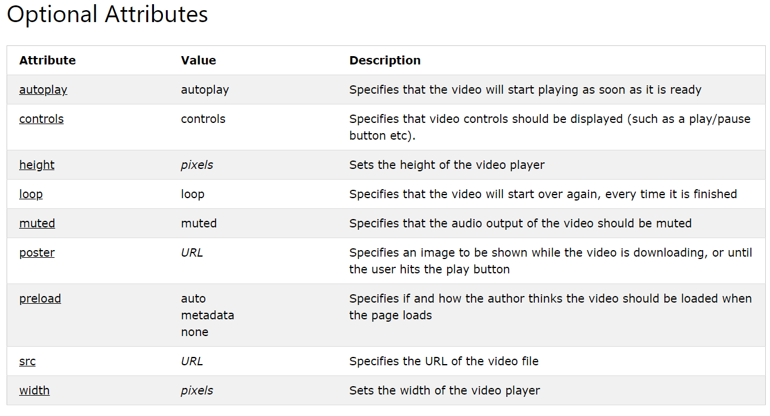
Con’t

Slide 9
Con’t
<video width="320" height="240" controls>
<source src="movie.mp4" type="video/mp4">
<source src="movie.ogg" type="video/ogg">
Your browser does not support the video tag.
</video>

