Slide 1
Lecture # 5

Slide 2
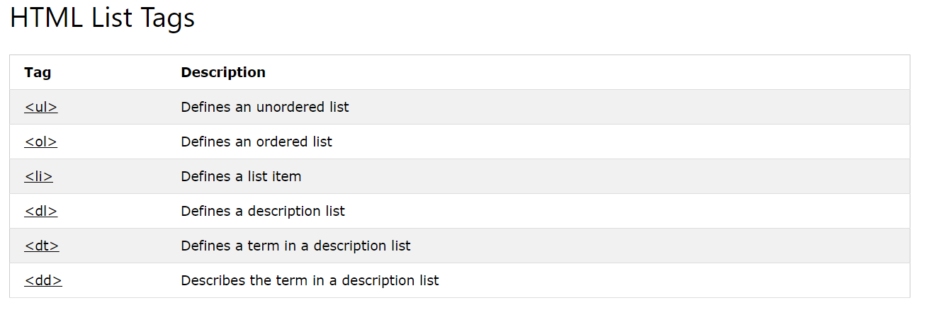
Lists
Ordered List
Un-Ordered List
Description List

Slide 3
Attributes
Start
Type
reversed = "reversed"

