Slide 1
Web Services and SOA
BY HERMAWAN

Slide 2
Web Services - Definition from W3C
“ A Web service is a software system identified by a URI, whose public interfaces and bindings are defined and described using XML. Its definition can be discovered by other software systems. These systems may then interact with the Web service in a manner prescribed by its definition, using XML based messages conveyed by internet protocols.”
Notes:
Our definition of the term "Web services" does not presuppose the use of SOAP as a packaging format or a processing model. Nor does it presuppose the use of WSDL as a service description language. There are, and will be in the future, plenty of Web services that use raw HTTP as a data transfer protocol and some mutually agreed-upon XML format as the message content. The Web Services *reference architecture* does, however, assume that the higher levels of the Web services protocol stack are built on the foundation of SOAP and WSDL.

Slide 3
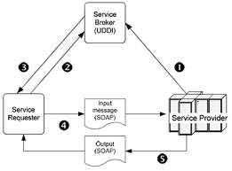
Type of Webservices Protocol
1. SOAP (Simple Object Access Protocol), is a messaging protocol specification for exchanging structured information in the implementation of web services in computer networks.

Slide 4
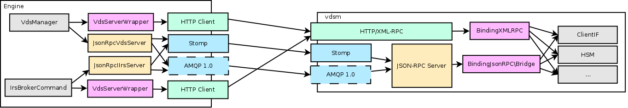
Type of Webservices Protocol
2. JSON-RPC (Java Script on Notation- Remote Procedural Call), JSON (JavaScript Object Notation) is a lightweight data-interchange format. It is easy for humans to read and write. It is easy for machines to parse and generate. It is based on a subset of the JavaScript Programming Language Standard ECMA-262 3rd Edition - December 1999.

Slide 5
Type of Webservices Protocol
3. UDDI, Universal Description, Discovery and Integration, is an Extensible Language Markup (XML)-based standard to describe, publish and find information about web services. It is also a registry for businesses providing web-based services to list themselves and find partners on the Internet.

Slide 6
Web Service Technology Stack
shopping web service?
WSDL URIs
Web Service
Client
UDDI
Discovery
Description
Web Service
WSDL
WSDL
SOAP pkg request
Packaging
Proxy
SOAP pkg response
Transport
Network

Slide 7
Step1. Write Web Service Method
shopping web service?
WSDL URIs
Web Service
Client
UDDI
Discovery
Description
Web Service
WSDL
WSDL
SOAP pkg request
Packaging
Proxy
SOAP pkg response
Transport
Network

Slide 8
Step2. Describe Web Service using WSDL
shopping web service?
WSDL URIs
Web Service
Client
UDDI
Discovery
Description
Web Service
WSDL
WSDL
SOAP pkg request
Packaging
Proxy
SOAP pkg response
Transport
Network

Slide 9
Step3. Write Proxy to Access Web Service
shopping web service?
WSDL URIs
Web Service
Client
UDDI
Discovery
Description
Web Service
WSDL
WSDL
SOAP pkg request
Packaging
Proxy
SOAP pkg response
Transport
Network

Slide 10
Step4. Write Client to Invoke Proxy
shopping web service?
WSDL URIs
Web Service
Client
UDDI
Discovery
Description
Web Service
WSDL
WSDL
SOAP pkg request
Packaging
Proxy
SOAP pkg response
Transport
Network

Slide 11
Step1. Create a Web Service
Functionality is implemented in .asmx.vb or .asmx.cs files.
  <%@WebService Language=“C#” Class=“helloWorld” %>
Use System.Web.Services Namespace
  Using System.Web.Services
Inherit your own class from WebService Base Class
  public class helloWorld : System.Web.Services.WebService
Declare the WebMethod Attribute
  [WebMethod]
  public string HelloWorld(string name)
  {…}

Slide 12
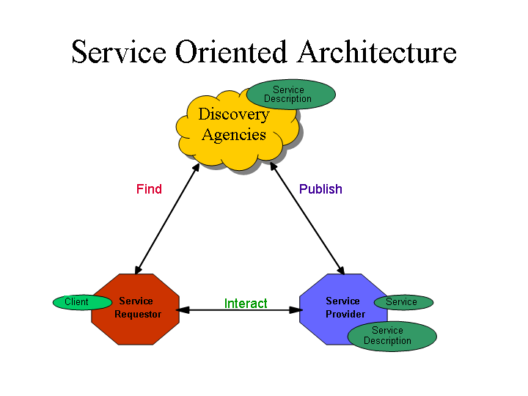
Service Oriented Architectures
Role
Technologies capable of:
Exchanging messages
Describing Web services
Publishing and discovering Web service descriptions
service requestor retrieves a service description
A service publishes its description
Operation
One-way, conversational, many-to-many
Component
Notes:
Components
The Service: Whereas a web service is an interface described by a service description, its implementation is the service. A service is a software module deployed on network accessible platforms provided by the service provider. It exists to be invoked by or to interact with a service requestor. It may also function as a requestor, using other web services in its implementation.
The Service Description: The service description contains the details of the interface and implementation of the service. This includes its data types, operations, binding information, and network location. It could also include categorization and other meta data to facilitate discovery and utilization by requestors. The complete description may be realized as a set of XML description documents. The service description may be published to a requestor directly or to a discovery agency.
Publish: In order to be accessible, a service needs to publish its description such that the requestor can subsequently find it. Where it is published can vary depending upon the requirements of the application (see Service Publication Stack discussion for more details)
Find: In the find operation, the service requestor retrieves a service description directly or queries the registry for the type of service required (see Service Discovery for more details). The find operation may be involved in two different lifecycle phases for the service requestor: at design time in order to retrieve the service's interface description for program development, and at runtime in order to retrieve the service's binding and location description for invocation.
Interact: Eventually, a service needs to be invoked. In the interact operation the service requestor invokes or initiates an interaction with the service at runtime using the binding details in the service description to locate, contact, and invoke the service. Examples of the interaction include: single message one way, broadcast from requester to many services, a multi message conversation, or a business process. Any of these types of interactions can be synchronous or asynchronous.

Slide 13
Web Services –
Architectural Extensions
  Incorporates additional features and functionality by extending technologies and components defined within the basic architecture, such as:
    Asynchronous messaging
    Attachment – typical usage : associating binary data with SOAP messages.
    Caching
    Message exchange pattern (MEP) - Describes a generalized pattern of message exchange between two services. e.g. : one-way, request/response, publish/subscribe, and broadcast.
    Reliable message - implementation of Reliable Messaging one MEP is a series of requests between two nodes with an acknowledgement SOAP Module.
    Message confidentiality – Can transmit the message via SSL or TLS, or have a SOAP Module provides for encryption and decryption.
    Message integrity – Can have a SOAP Module use digital signature.
    Session

Slide 14
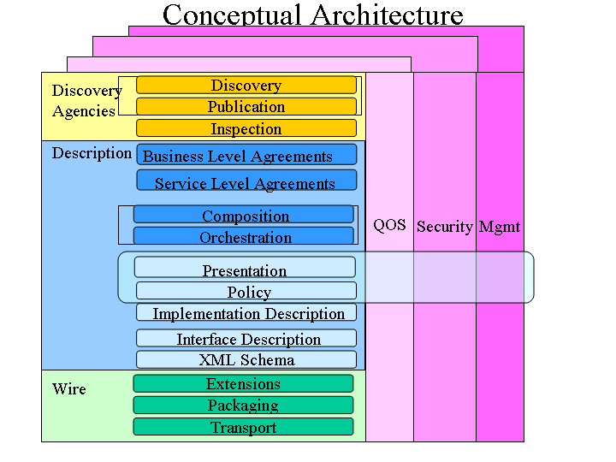
The Complete Web Services "Stack"
More
mature
technologies
Notes:
Independent stacks assembled into a single stack where each additional layer builds upon the capabilities provided by those below it. The vertical towers represent the variety of over arching concerns that must be addressed at every level of each of the stacks.

Slide 15
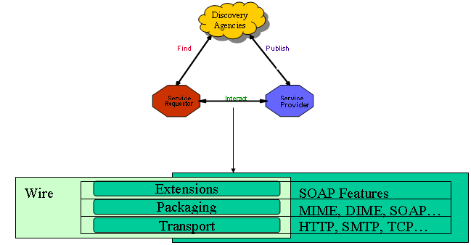
The Wire Stack
Transport: HTTP is the de facto, other may be supported.
Packaging: SOAP is the de facto standard for XML messaging.
Extensions : Additional information attached to web services messages.
Notes:
Transport : Because of its ubiquity, HTTP is the de facto standard network protocol for Internet-available web services. Other Internet protocols may be supported including SMTP and FTP.
Packaging : Packaging, represents the technologies that may be used to package information being exchanged.
XML has been broadly adopted as the basis for Web service message packaging protocols and SOAP is currently the de facto standard for XML messaging.
Extensions : Provides a framework that allows additional information to be attached to Web service messages representing a variety of additional concerns; such as context, routing, policy, etc. SOAP defines a mechanism to incorporate orthogonal extensions (also known as features) to the message in the form of headers and encoding rules.

Slide 16
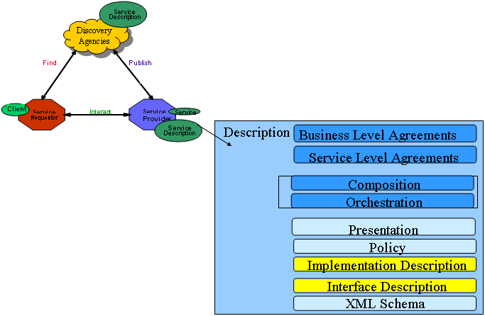
The Description Stack
It is actually a stack of description documents defined using XML Schema.
Not fully
specified
facts, or assertions, and
rules that apply to a
particular Web service
Input/
Output
rendering
minimum service description
necessary to support
interoperable Web services.
Satisfied
by WSDL
Notes:
WSDL is an XML document format for describing Web services as a set of endpoints operating on messages containing either document-oriented or procedure-oriented (RPC) messages. The operations and messages are described abstractly, and then bound to a concrete network protocol and message format to define an endpoint. Related concrete endpoints may be combined into services.
Interface Description maps to the Abstract interface in WSDL, explained later.
Implementation Description maps to the Deployment section in WSDL, explained later.
Policy would be used to describe or point to documents describing the owning business, associated products, keywords, taxonomies for the service, security policies, quality of service attributes, etc. Policy may be used by the over-arching concerns: security, quality of service, and management; as well as higher layers of the description stack.
The composition and orchestration layers describe how service-to-service communications, collaborations, and flows are performed.

Slide 17
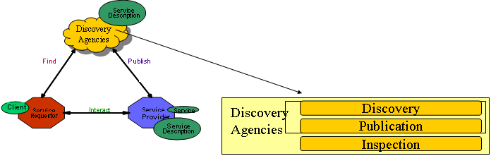
The Discovery Stack
WSIL : de-centralized service discovery method
  Service can be published using a variety of mechanisms:
    Direct publish: description sent directly to requestor;
    WSIL : HTTP GET retrieves descriptions from URL;
    Universal Description, Discovery and Integration (UDDI) registries: a Web-based distributed directory.
  Service requestors can retrieve a service description at design time (search by interface) or runtime (by communication and QoS) from a Web page (URL), a service description repository, a simple service registry or a UDDI registry. Discovery depends on how services are published;

Slide 18
The technology so far
  The WS technology is completely based on XML. Therefore, both the data format and the interaction protocols are XML-based:
  customized XML -> data format
  SOAP -> communication protocol
  WSDL -> the Interface definition language
  WSIL/UDDI -> standards for services discovery
  The lowest-level layers (the transport layer) should exploit some existing Internet protocols, like HTTP or SMTP

Slide 19
What is XML
  XML is a simple tag-based language for describing information in a structured way.
  Basic elements:
  Tags
  Attributes
  Text
LastName
Allen
StartTag
Attributes
Text
EndTag
<xhtml:table><xhtml:tr>
<xhtml:td width="40%">LastName</xhtml:td>
<xhtml:td width="60%">Allen</xhtml:td>
</xhtml:tr></xhtml:table>

Slide 20
How to work on XML
The tree-like structure of XML makes developers life hard.
  In practice there is not a standard way for editing and analyzing, but the best method depends on your need. Just choose among:
  SAX -> callback-based parser
  DOM -> tree representation
  XSLT -> “XML to XML” conversion
  XPATH -> queries
  XML Binding -> transparent conversion to objects

Slide 21
Simple Object Access Protocol
SOAP is a technology to support the exchange of XML-coded messages over a transport protocol, such as HTTP and SMTP. (wire stack)
HTTP
Client
Server
SOAP
  XML
XML  
XML
Stub
Skeleton
  SOAP
SOAP  
POST…
HTTP client
HTTP server
Protocols Folding
HTTP 1.1 200 OK
SOAP basic mechanism

Slide 22

Simple Object Access Protocol
A SOAP runtime engine basically adds a XML envelope to an existing XML document
SOAP Envelope
<soap:Envelope>
<soap:Header>
<axis:SessionKey>
SDHH37TYEW7R7
</axis:SessionKey>
</soap:Header>
<soap:Body>
<GetPrice>
<Item>Apples</Item>
</GetPrice>
</soap:Body>
</soap:Envelope>
SOAP Header
Communication Info
Example
SOAP Body
XML Document
Document Container
Session, Authentication, Routing, Security

Slide 23
SOAP Encoding
Dealing directly with XML messages is not easy.
Therefore, SOAP provides a “RPC emulation” technology
The result: developers work with web services like with traditional RPC (e.g. CORBA,DCOM,DCE)
The “RPC emulation” is named SOAP encoding.
Fundamentally it is a set of rules to map a procedure invocation to a XML document.

Slide 24
SOAP Encoding
The rules:
  method name -> first level element in the SOAP Body
  arguments identifiers -> second level elements
  arguments values -> third level elements
  arguments types -> attribute xsi:type
ClockService.getTime(location="USA");
<soap:Body>
<getTime>
<location xsi:type="xsd:string">USA</path>
</getTime>
</soap:Body>
Service Request

Slide 25
Web Service Description Language
WSDL is a standard format to describe a Web Service (description stack)
A WSDL document is composed by two sections:
  An abstract interface section -> like in traditional IDL, it defines the signatures of procedures (RPC-style) or messages (document-style)
  A deployment section -> it defines the service location and the supported transport protocols
  Fundamentally a client uses the WSDL to create the stub or to dinamically decode messages.

Slide 26
Web Service Introspection Language
WSIL and UDDI are the standard way to search Web Services. (Discovery stack)
WSIL is the decentralized approach.
Fundamentally a WSIL document contains a directory of the Web Services deployed on a server.
It is anologous to the index.html document for web pages.
In the future, specific crawlers will browse the Internet looking for WSIL documents, like Google does today for web pages.

Slide 27
Web Service Introspection Language
<inspection>
<abstract>Acme Industries Public Web Services</abstract> <service>
<name>Store Finder Service</name>
<abstract>
A service to perform a geographical search of Acme stores.
</abstract>
<description location="http://example.org/services/storefinder.wsdl"/>
</service>
<link location="http://example.org/services/ecommerce.wsil"/>
</inspection>
Service name
Link to an other WSIL page
Service location and description

Slide 28
UDDI
UDDI is a complimentary approach for searching based on a centralized repository.
The repository is an “electronic yellow pages” for firms that offer web services online. Besides the names of services and their WSDL descriptors, firms can add a description of their business, phone numbers, addresses...
UDDI repositories are offered by many agencies - e.g. IBM, Microsoft and HP.

Slide 29
References
  J2EE: A platform of choice for Web Services. http://www.sun.it/eventi/codecamps_2002/pdf/j2ee_a_platform_of_choice_for_web_services.pdf
  XML in J2EE Platform. http://www.sun.it/eventi/codecamps_2002/pdf/xml_in_j2ee_platform.pdf
  A Busy Developers Guide to WSDL 1.1 http://radio.weblogs.com/0101679/stories/2002/02/15/aBusyDevelopersGuideToWsdl11.html
  A Busy Developer's Guide to SOAP 1.1 . http://www.soapware.org/bdg
  A Young Person's Guide to The Simple Object Access Protocol. http://msdn.microsoft.com/msdnmag/issues/0300/soap/soap.asp
  An XML Overview Towards Understanding SOAP. http://msdn.microsoft.com/library/en-us/dnwebsrv/html/xmloverchap2.asp

Slide 30
References
  Deploying Web Services on Java 2, Enterprise Edition. http://developer.java.sun.com/developer/technicalArticles/WebServices/wsj2ee/
  The Python Web services developer. http://www-106.ibm.com/developerworks/webservices/library/ws-pyth1.html
  Understanding WSDL in a UDDI registry. http://www-106.ibm.com/developerworks/webservices/library/ws-wsdl/
  Dot-com builder overview of WSDL. http://dcb.sun.com/practices/webservices/overviews/overview_wsdl.jsp
  Getting Started with JAX-RPC. http://developer.java.sun.com/developer/technicalArticles/WebServices/getstartjaxrpc/
  Introduction to WSDL. http://www.devxpert.com/tutors/wsdl/wsdl.asp

Slide 31
References
  Integrating SOAP into ebXML. http://www.itworld.com/AppDev/1472/ITW010404ebXML/
  Top ten FAQs for Web Services. http://www.oreillynet.com/pub/a/webservices/2002/02/12/webservicefaqs.html
  Web Services Introduction. http://www.perfectxml.com/WebSvc1.asp
  SOAP archives. http://www.soap.org/archive.iphtml
  SOAP Introduction. http://www.w3schools.com/soap/soap_intro.asp
  Web Services Description Language (WSDL) Explained. http://msdn.microsoft.com/library/en-us/dnwebsrv/html/wsdlexplained.asp
  WSDL Interop Adventures. http://www.byte.com/documents/s=7031/byt1015007393289/0304_udell.html
  Java Web Services Tutorial. http://java.sun.com/webservices/docs/1.0/tutorial/doc/JavaWSTutorialTOC.html

