Slide 1
Large Systems Development
Post Compilation Analysis

Slide 2
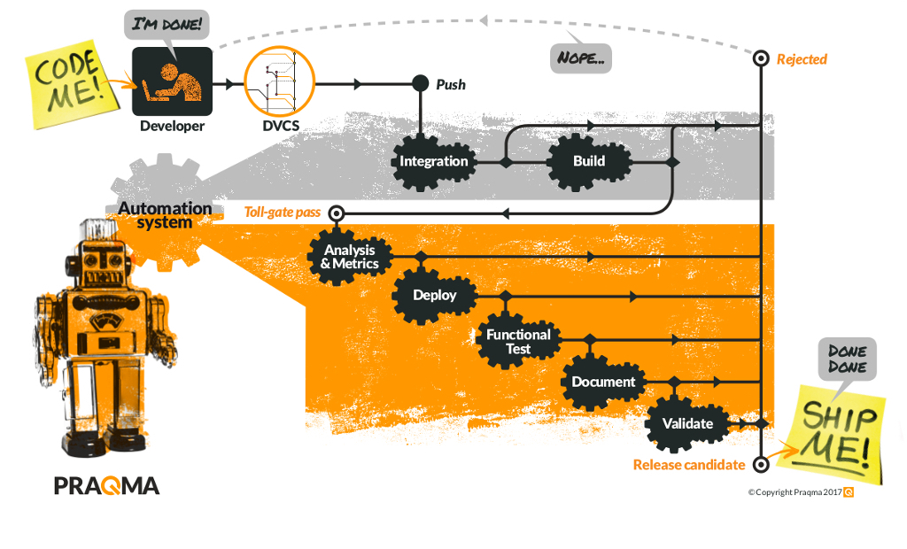

Slide 3
Code coverage
How much code is covered by tests
Strategies
At least XX% should be covered
The overall coverage should increase

Slide 4
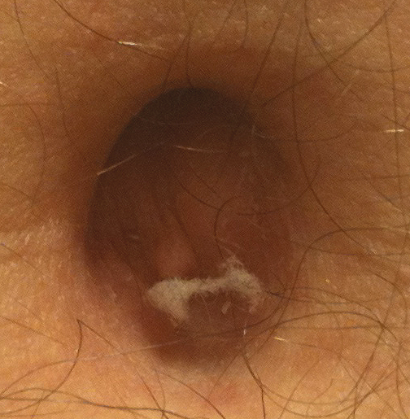
Linting
Naming conventions
Smelly code
Best practices
Indentation
Code style

Slide 5
JaCoCo
<plugin>
<groupId>org.jacoco</groupId>
<artifactId>jacoco-maven-plugin</artifactId>
<version>0.8.1</version>
<executions>
<execution>
<goals>
<goal>prepare-agent</goal>
</goals>
</execution>
<execution>
<id>report</id>
<phase>prepare-package</phase>
<goals>
<goal>report</goal>
</goals>
</execution>
</executions>
</plugin>

Slide 6
Checkstyle
<plugins>
<plugin>
<groupId>org.apache.maven.plugins</groupId>
<artifactId>maven-checkstyle-plugin</artifactId>
<version>3.0.0</version>
<configuration>
<configLocation>checkstyle.xml</configLocation>
</configuration>
</plugin>
</plugins>

