Slide 1


Bank of Baroda Hackathon - 2022
Technology Partner
Team Name : Trinity
Team bio : AI and Data Science
Date : 20/08/22

Slide 2
Problem Statement?
Why did you decide to solve this Problem statement?
Since My Class 12th I have been using the Cheque Book for conveying my transaction to the people but many of times people hesitate to take the cheque instead of cash because of slow cheque clearing process and the clearing of ambiguity takes time but it is one of the safest method for transaction. But the longer waiting time is reducing its usability.
From the last year it has been very crucial for automation of cheque specifically in Bank of Baroda because of Merging of Dena Bank and Vijaya bank with it. Due to this ,The customers has been increased in rapid way with lack of physical resources to handle them.
Since ,there are lot of technologies available now we can make use of them solve this problem.
We should be focused on reducing human effort and make use of AI/ML and OCR by reducing the time period.

Slide 3
Pre-Requisite
What are the alternatives/competitive products for the problem you are solving?
Currently , there are machine that traditionally scan and sort cheque by bank using MICR
Human interaction with cheque is there which increases risks and as well as labour efforts.
The number of cheque cleared takes minimum 1 day to 7 days which makes cheque system tedius
Changes in different policies of RBI like positive pay etc changes work system which makes it harder to change or adapt.
5 Cheque signature and payee details are being verified physically which is time consuming.

Slide 4
User Segment & Pain Points
Which user /advertiser segment would be early adopter of your product & why?
Any Bank who wants to opts for better clearing process is our stakeholder. Our product aims at achieving automating cheque processing with minimum processing time and with as little as possible digital footprints Considering the population inflation has made the need of automation. History is a proof whenever there is a change , It is being for complete society .
Being in 21st century we are in age of automation. As Banks have adapted automation in many other ways like mobile banking , E-passbook and many more. Still, Following same tedious clearing process for cheque is not feasible.
With increase of automation security and error free cheque clearing both are the challenges to deal with . Giving efficient clearing with less human interference is objective of project.

Slide 5
Azure tools or resources
Azure tools or resources which are likely to be used by you for the prototype, if your idea gets selected Form recognizers use artificial intelligence to extract data from digital or handwritten cheque and sign .Azure Form Recognizer does a fantastic job in creating a viable solution with just three sample sign documents. It performs end-to-end Optical Character Recognition (OCR) on handwritten as well as digital documents with an amazing accuracy score with less time period . We will use it for signature recognition for OCR. Different plugins like Jenkins , Chef will be used as automation pipeline platform .It will help in delievering the information faster and simultaneously checking it. For Security purpose We can use Azure Security Centre, Azure Web Application Firewall (WAF), Azure Sentinel as part of data security and integrity with other cloud .

Slide 6
SCALABLITY Of PROJECT
The system will be acting as a solely clearing of cheque and reducing the process time.
Customer can deposit any bank cheque at any branch which refers to unification or core banking system through this system.
System provide a platform that correctly classify the cheque and process accordingly For ex. genuineness check / processing time for dormant account and regular account is different. Similarly cheque is categorized on basis of frequency, amount , colour tone, date of issue etc.
Frequency wise categorization helps in reduction of overall verification and increases customer.
Easily accessible interface by the bankers and reduces the human manual efforts for repetitive verification.
Level wise features of our system makes it unique. As Every feature is on independent level so taking one or all gives bank their choice. Many decisions are independent of each other.

Slide 7
Key Differentiators & Adoption Plan
How is your solution better than alternatives and how do you plan to build adoption?
We are Using the Hash code function for exchange of the data in encrypted for regarding the cheque and the parties involved in the transaction and we can store the data still our operation end and make use of data efficiently and secuerly.
We are going to prioterize the cheques with respect to Date , amount and Frequency of the parties involved so we can provide the clearance to most prior one first and make less.
We have introduced detection of Outlier and Dormant Account cheque verification for reconfirmation of genuineness. Similarly, Frequency checkpoint is added for faster clearance for frequent customers.
Our system also focusses on priority ranking which helps in ordering of cheque according to the importance . It is set using different parameters and characterised accordingly
Use of both C++ as well as python for giving efficient algorithm for sign checking , characterization of bank using MICR and ICR reading .

Slide 8
We are reducing the chances of cancellation of valid cheque using below mentioned solutions . i)For sign verification we are adjusting the threshold instead of fixed threshold and setting the confidence level accordingly instead of fixed confidence level and we are making system very comfortable as multilingual. ii)We have applied ml at different positions to extract account number and details of marks on cheque especially crossed cheque , A/C payee cheque or non negotiable cheque as there position might vary to recognize data. iii) we are focussing on the error that can remain uncleared from machine while checking ink text (like confusion between 8&3) but we can provide data set to improve them accordingly and increase the accuracy level. If any ambiguity is found its priority is raised and keep on hold for schedule time.t We have introduce #mark for cleared cheque so that no cheque once cleared can bring same cheque no cheque again for clearing.
Key Differentiators & Adoption Plan

Slide 9
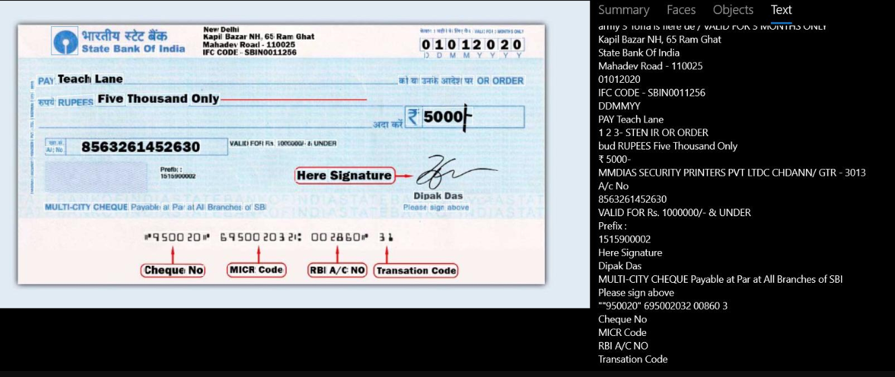
Extraction of Data from cheque using ocr
Categorization of Cheque according to extracted features

Slide 10
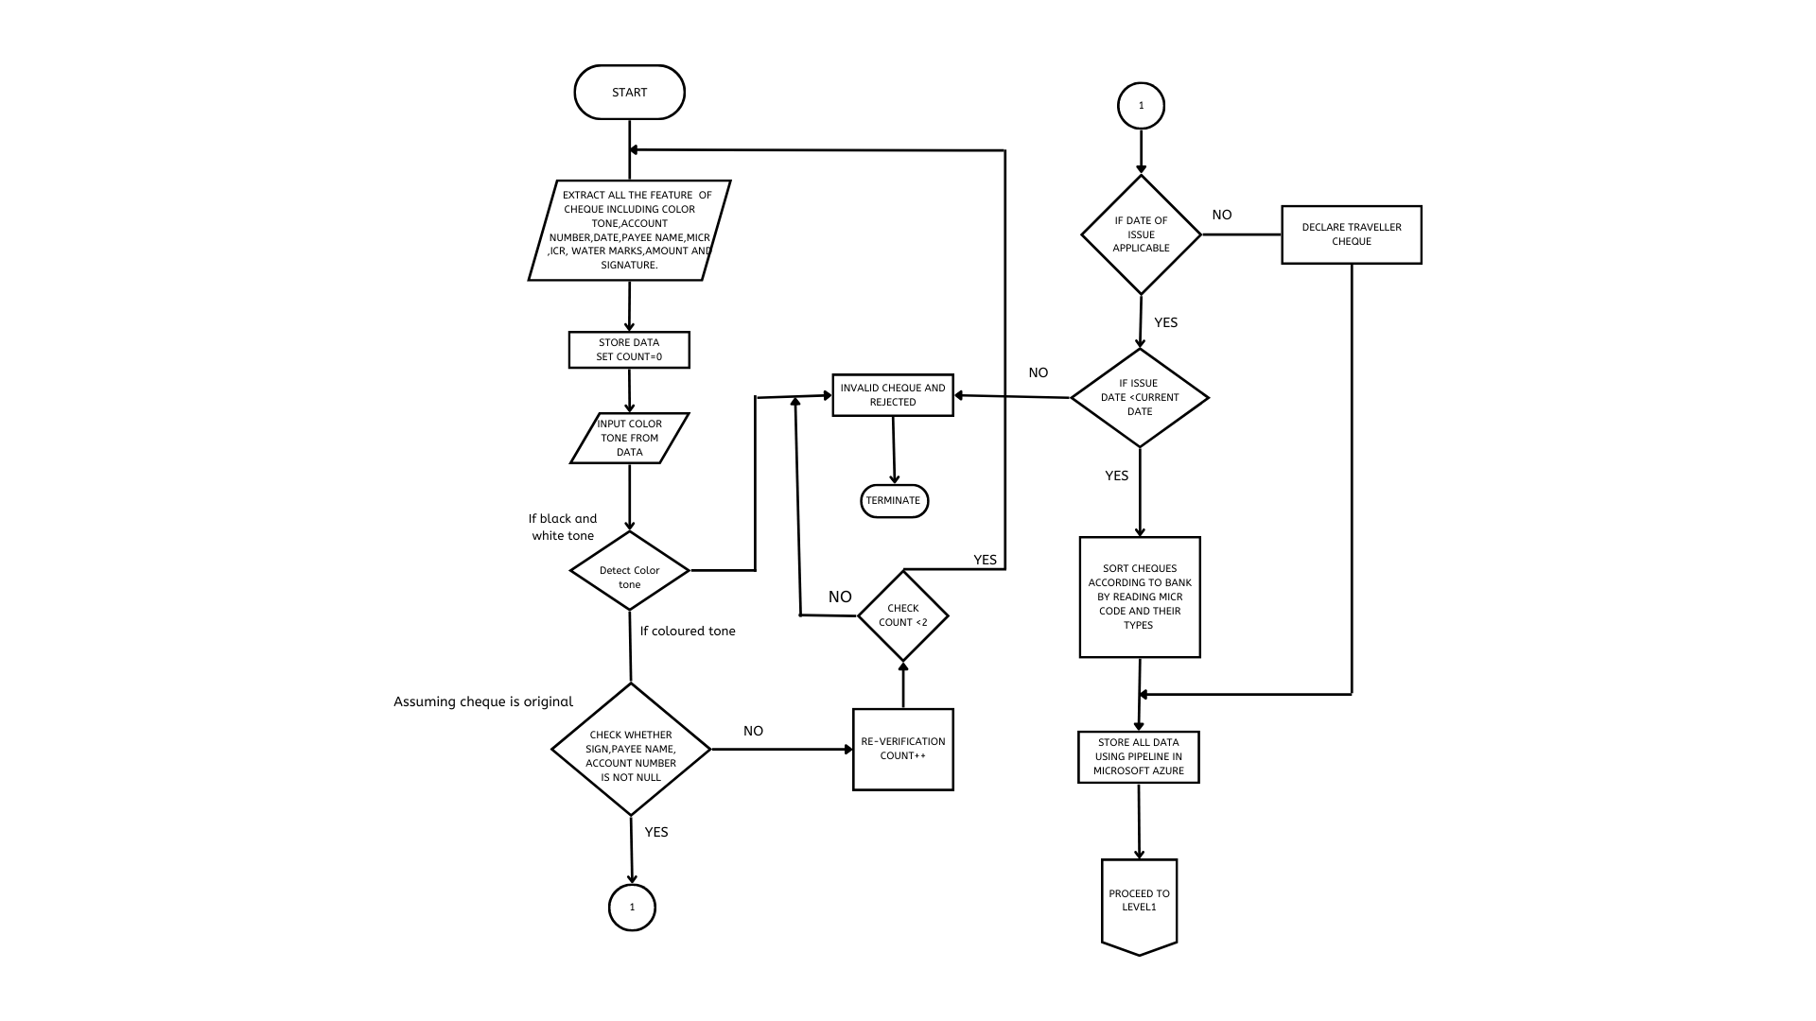
DFD Level 0

Slide 11
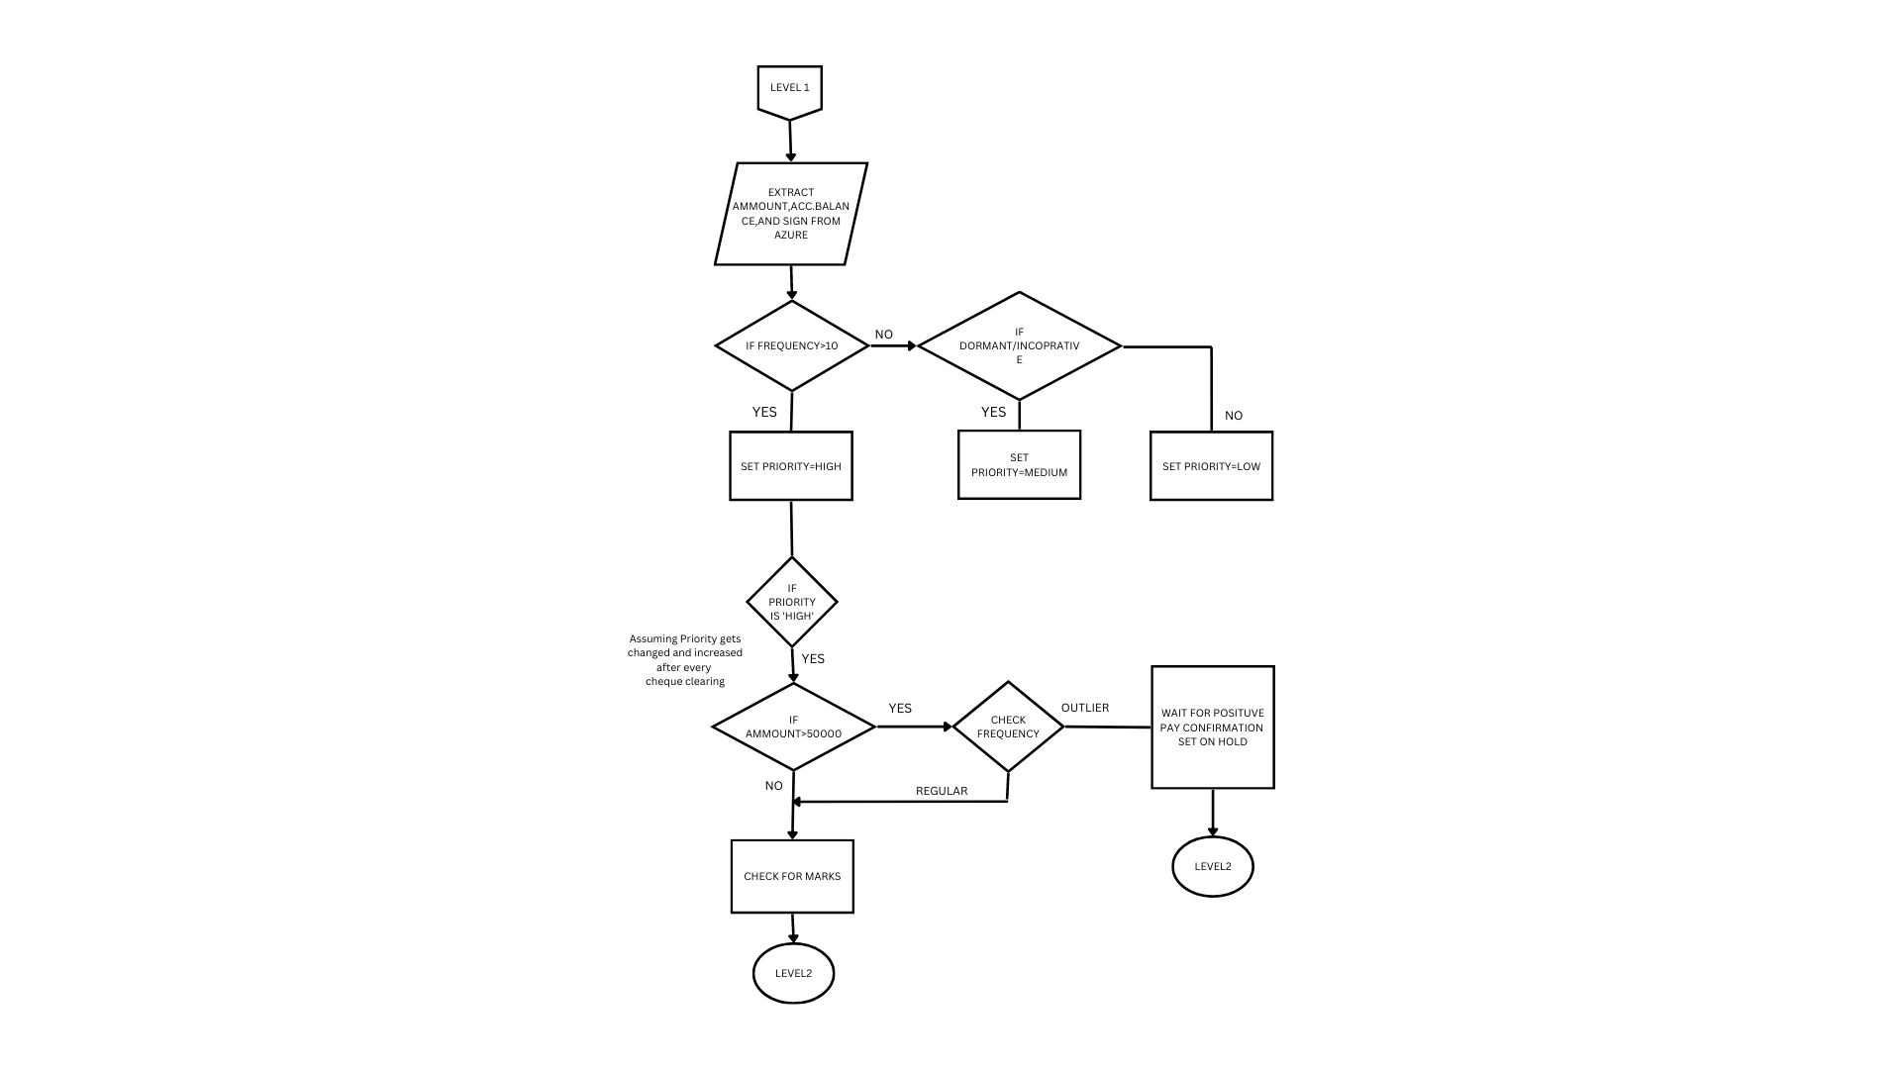
DFD Level 1

Slide 12
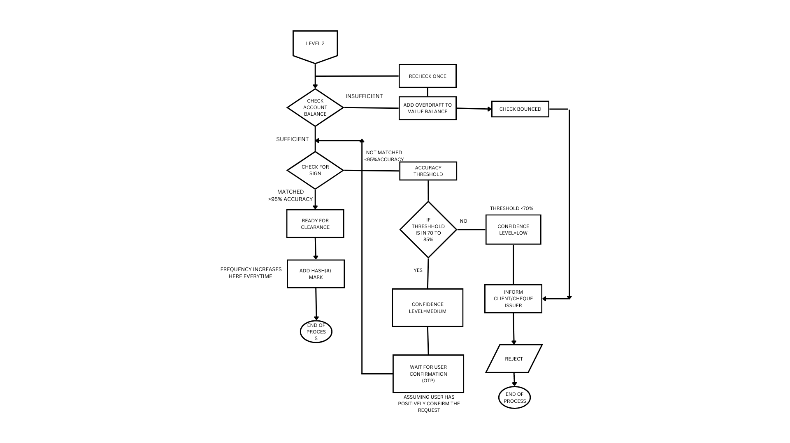
DFD Level 2

Slide 13
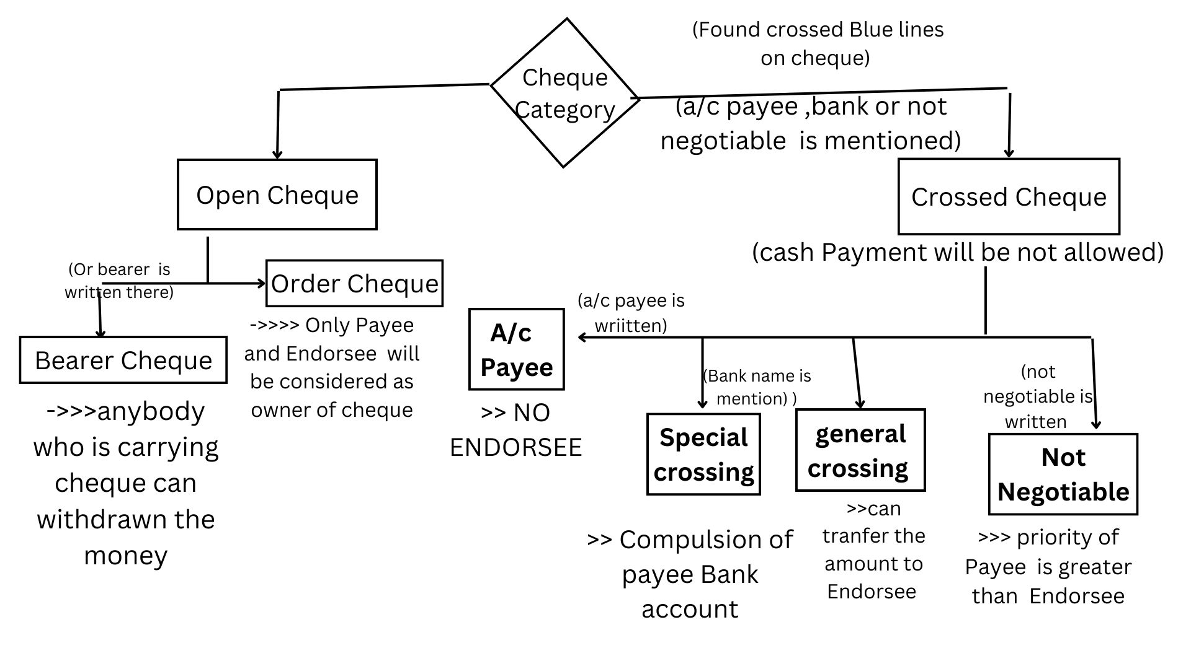
Categorization of Cheque according to extracted features .
Any cheque received will be categorised and given priority accordingly

Slide 14
METHODOLOGY
At First Cheque is being taken from the bank and it enters the scanner device where all its feature are being scanned. It is being transferred to Check Point 1
USE CASE 1: Checking of Colour Tone Here Cheque is being confirmed to be original by extracting colour tone and comparing it with original one. For sake of simplicity we checked it for B/W and coloured where coloured one is processed further and one with print or B/W will be rejected on spot .
Then All other things like # mark , sign and other details are checked .
Case1: If Sign or payee name or Amount or Date (date is Applicable ) is null
Cheque is in hold and later if no response or if same response then rejected
Else go to Case 1.1 Check # key if it matches with before then reject it
Case 1.2 Check # key If it not matches go to next step
Case2: If Sign or payee name or Amount or Date (date is Not Applicable ) is not null
Then it is considered as traveller cheque and it is proceed for next step

Slide 15
METHODOLOGY
Now date verification is done whether is expired or valid cheque and then MICR is read and sorted according to bank
We use Azure pipeline automation for storing of data and NoSQL for query refering.
Characterization is being using Date and cheque marks and set priority accordingly
Then valid cheque is then checked for account no and dormancy and other checkpoint is being passed .
We have also considered overdraft feature where saving acc default has ‘0’ while current account according to limit
Verification of sign is only done after sufficient balance is there in Drawee account.
After sign matched only cheque is being cleared
As all this checkpoint enhance security and also being automated reduces overall time.

Slide 16
SCALABLITY Of PROJECT
The system will be acting as a solely for clearing of cheque and reducing the process time.
Customer can deposit any bank cheque at any branch which refers to unification or core banking system through this system.
System provide a platform that correctly classify the cheque and process accordingly For ex. genuineness check / processing time for dormant account and regular account is different. Similarly cheque is categorized on basis of frequency, amount , colour tone, date of issue etc.
Frequency wise categorization helps in reduction of overall verification and increases customer.
Easily accessible interface by the bankers and reduces the human manual efforts for repetitive verification.
Level wise features of our system makes it unique. As Every feature is on independent level so taking one or all gives bank their choice. Many decisions are independent of each other.

Slide 17
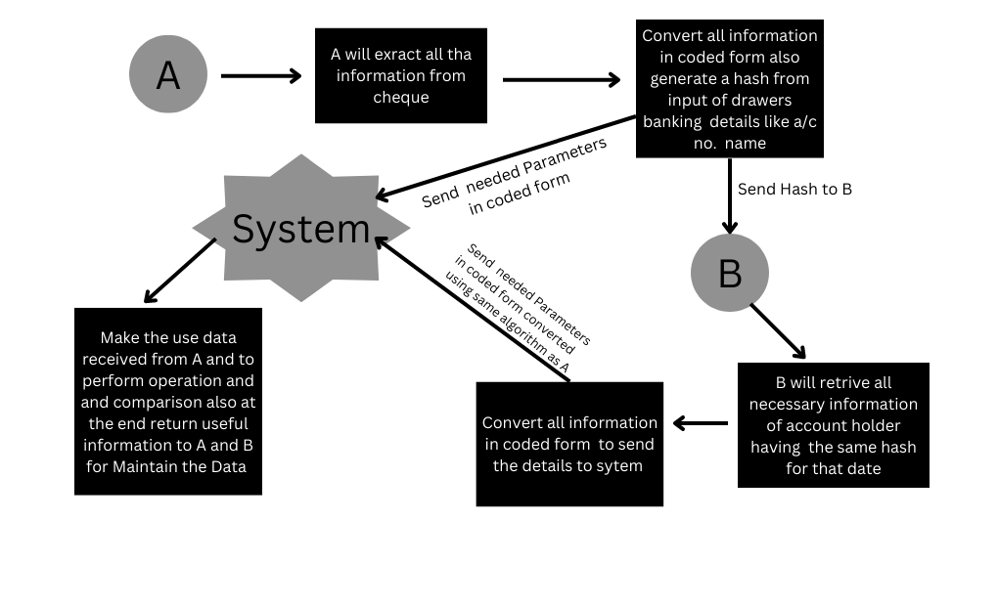
USE OF BLOCKCHAIN ‘S HASH FUNCTION FOR COMPLETE ENCRYPTED DATA TRANSFER
Here we have considered that Bank A has the cheque of B bank

Slide 18

Thank You !
Team members name:
Sr.no | Class | Name
1 | TE AI &DS | Jadhav Yash Kirankumar
2 | TE AI &DS | Hatkar Chetan Kaniram
3 | TE Comp | Shardul Mansi

