Slide 1



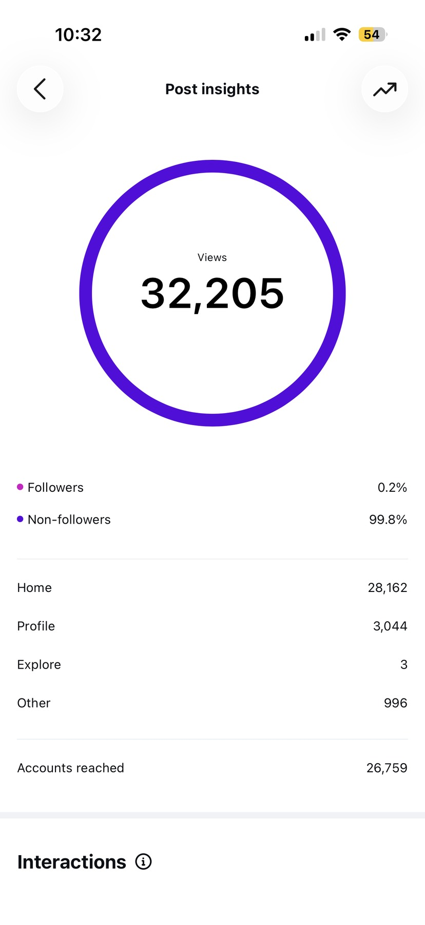

YASH KACHHADIYA
Content with a purpose
A portfolio for the Magnuson Center Student Social Media Content Creator role
Not a library of old posts. A transition story.
Social media | Strategy | Growth | Storytelling
Notes:
[Sources]
- User-provided job email and application material pasted in conversation.
- User-provided content assets in /Users/mac/Desktop/Content.
- Magnuson logo supplied by user in /Users/mac/Desktop/Content/Magnuson+Logo_Green.webp.

Slide 2
PORTFOLIO THESIS
The goal decides the content.
A creator page, an ecommerce brand, a local game zone, and a university entrepreneurship center should not post for the same reason.
Creator page
Ecommerce
Local venue
Magnuson
Attention, followers, monetization
Trust, product discovery, sales
Nearby customers and visits
Awareness, confidence, participation
Different job.
Different strategy.
Different job.
Different strategy.
Different job.
Different strategy.
Different job.
Different strategy.
I do not start with: What should we post?
I start with: What does this organization need students to understand, feel, or do?
Yash Kachhadiya | Magnuson Center Portfolio Draft | 02
Notes:
[Sources]
- Portfolio framing based on user's clarified request: show transition and goal-based strategy.
- User-provided resume and cover letter from /Users/mac/Desktop/JOBSTUFF/Resumes/Digital Marketing.

Slide 3
THE TRANSITION
The path is not random. Each experience trained a different muscle.
01
Attention
Fashion and lifestyle pages taught me what makes people stop, comment, save, and follow.
02
Analytics
@digitalysh turned content into measurable signals: reach, follows, profile visits, website clicks.
03
Business outcomes
Peter Field and Patlun connected social content to ecommerce, customers, and product positioning.
04
Audience strategy
Fun Strike taught me that local reach and partnerships can matter more than broad views.
05
Magnuson application
For Magnuson, the work becomes student confidence, program clarity, event participation, and founder community.
Yash Kachhadiya | Magnuson Center Portfolio Draft | 03
Notes:
[Sources]
- User-provided resume and cover letter.
- User clarification about Fun Strike consulting role and Magnuson content strategy goal.

Slide 4
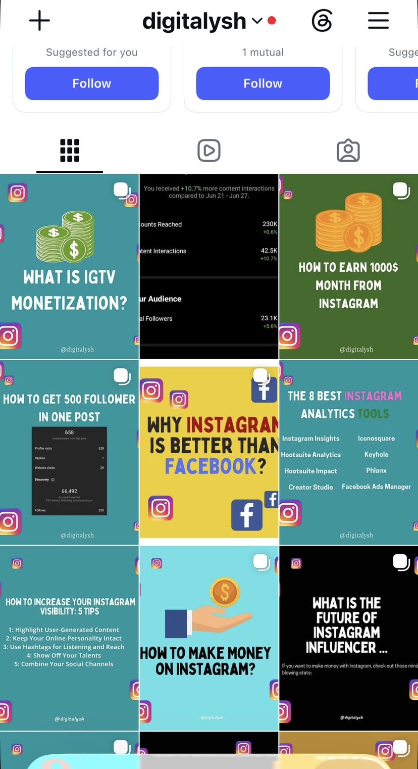
LEARNING ATTENTION
I learned by publishing first.
Across earlier fashion and lifestyle pages, I created roughly 3,000 posts and managed comments, DMs, and audience interactions. The accounts were later sold, so the complete analytics archive is no longer available.
~3,000
Replies
Hooks
pieces of content
tested through fashion
comments + DMs
The lesson: attention is earned through pattern recognition, hooks, taste, and conversation.
Yash Kachhadiya | Magnuson Center Portfolio Draft | 04
Notes:
[Sources]
- User-described prior fashion/lifestyle Instagram experience and content volume.
- User-provided @digitalysh screenshot in /Users/mac/Desktop/Content/Social meida view and follers stuff.

Slide 5
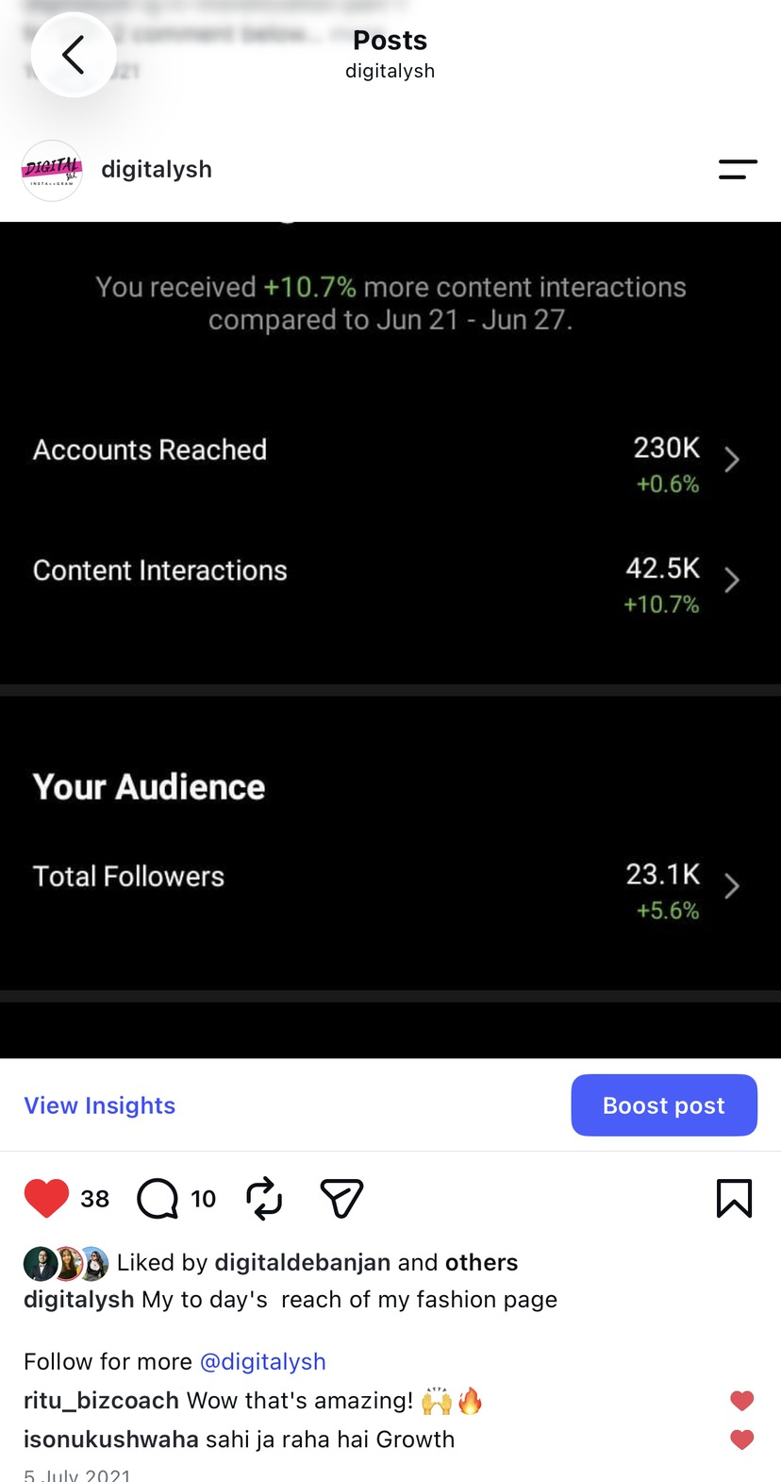
LEARNING ANALYTICS
@digitalysh taught me that content is not just visual. It leaves signals.
23.1K
230K
42.5K
followers documented
accounts reached
content interactions
A strong post is not only a view count. It can move someone from content to profile visit, follow, and website click.
That thinking matters at Magnuson because the content should create a next step: attend, ask, apply, register, or start a conversation.
Yash Kachhadiya | Magnuson Center Portfolio Draft | 05
Notes:
[Sources]
- User-provided @digitalysh analytics screenshot: /Users/mac/Desktop/Content/Social meida view and follers stuff/IMG_3013.PNG.

Slide 6
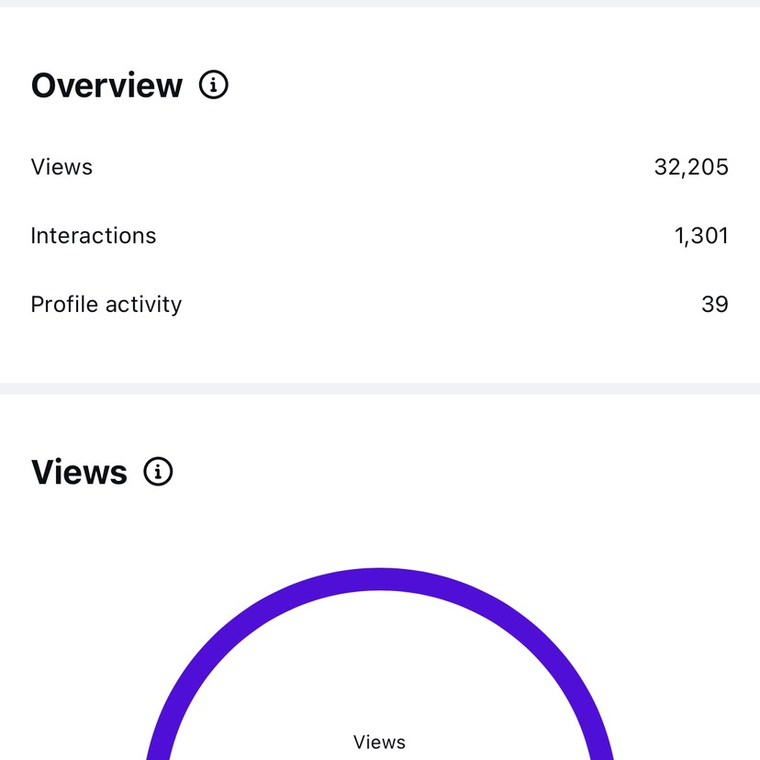
TESTING DISTRIBUTION
Founder’s Fuel tested a harder question: can a fresh account reach non-followers?
32,205
26,759
99.8%
views
accounts reached
views from non-followers
434
314
1,301
saves
sends
interactions
The honest lesson: distribution is powerful, but distribution is not the same as community. Magnuson needs both attention and belonging.
Yash Kachhadiya | Magnuson Center Portfolio Draft | 06
Notes:
[Sources]
- User-provided Founder’s Fuel screenshots: /Users/mac/Desktop/Content/Social meida view and follers stuff/IMG_3020.PNG and IMG_3021.PNG.

Slide 7
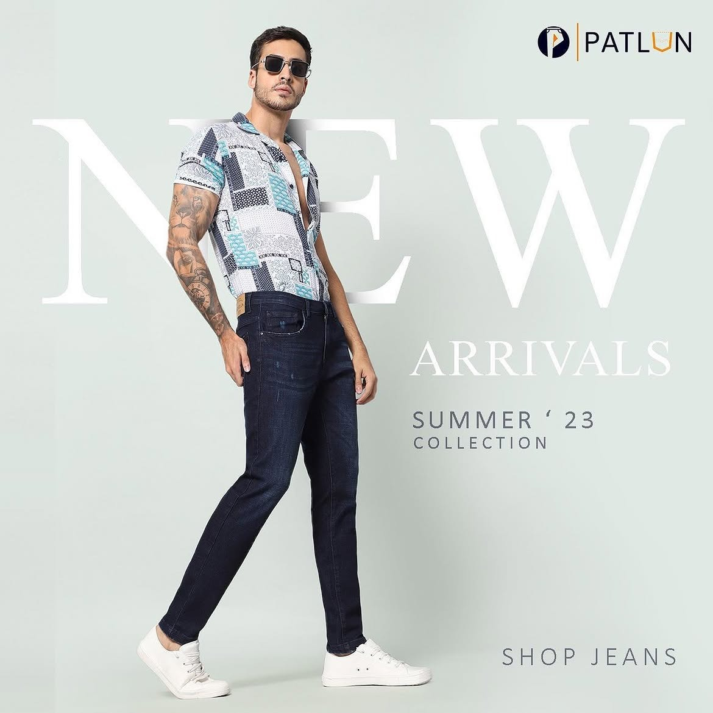

LEARNING BUSINESS OUTCOMES
Peter Field and Patlun connected content to commerce.
Here, the objective was not abstract popularity. It was product discovery, trust, positioning, conversion, and repeat customers.
Peter Field
Patlun
Co-founded and scaled a men’s fashion ecommerce venture to INR 3.5 Cr revenue and 100,000+ units sold.
Worked on ecommerce product decisions, marketing campaigns, assortment, and customer behavior insights.
Takeaway for Magnuson: I can separate “content that gets attention” from “content that serves the organization’s real outcome.”
Yash Kachhadiya | Magnuson Center Portfolio Draft | 07
Notes:
[Sources]
- User-provided resume: /Users/mac/Desktop/JOBSTUFF/Resumes/Digital Marketing/Resume.pdf.
- User-provided Patlun assets in /Users/mac/Desktop/Content/Patlun video and post.

Slide 8
LEARNING LOCAL STRATEGY
Fun Strike was strategy work, not content ownership.
My role was consulting: help shape the digital team, identify the right audience, and recommend collaborations that could bring local customers into a physical game zone.
What I contributed
Collaboration model
Influencer locality logic
Discount-for-content idea
Selective paid creators
Community-channel reach
Problem
Low traction from normal posting.
Audience
Local families, students, creators, community groups.
Strategy
Surat-based influencers, daily vloggers, community figures, cross-posting.
Reason
A game zone does not need distant views. It needs nearby people who may visit.
This matters because Magnuson also needs strategy by objective, not one-size-fits-all posting.
Yash Kachhadiya | Magnuson Center Portfolio Draft | 08
Notes:
[Sources]
- User clarification in conversation: Fun Strike role was consulting, collaboration strategy, and local influencer/community strategy, not personal content creation.
- User-provided resume includes Fun Strike growth-marketing consulting entry.

Slide 9


VISUAL EXECUTION
Strategy still needs taste on the screen.
The portfolio should show that I can think strategically and still produce polished visual assets when the work calls for it.
Armaan Textile: business-facing campaign graphics and brand communication.
AR2: a small friend-brand logo/poster project, included as design proof rather than a full campaign.
Yash Kachhadiya | Magnuson Center Portfolio Draft | 09
Notes:
[Sources]
- User-provided Armaan Textile and AR2 design assets in /Users/mac/Desktop/Content.
- User clarified AR2 was a small creative project for a friend, not a full marketing campaign.

Slide 10
UNDERSTANDING MAGNUSON
Magnuson’s content job is different.
Magnuson serves Dartmouth students, alumni, faculty, and staff across the entrepreneurial journey through hands-on learning, mentorship, events, and resources.
Make it visible
Students should see real people building real things.
Make it understandable
Programs, grants, office hours, and events should feel clear.
Make it approachable
Students with only an abstract interest should still feel invited.
Make it actionable
Content should lead to a next step: attend, apply, ask, join.
So the question is not: Can this post go viral?
The question is: Does this post move a Dartmouth student closer to entrepreneurship?
Yash Kachhadiya | Magnuson Center Portfolio Draft | 10
Notes:
[Sources]
- Magnuson Center homepage: https://magnuson.dartmouth.edu/.
- Magnuson Our Story/About page: https://magnuson.dartmouth.edu/about.
- User-provided job description pasted in conversation.

Slide 11
THE STUDENT PROBLEM
Many students do not need more announcements. They need a first step.
Entrepreneurship can feel intimidating when students do not know who belongs, where to start, what programs mean, or what failure looks like in real life.
Content can lower the barrier.
Fear
“I do not have a real idea yet.”
Show the process.
Explain the entry points.
Make builders relatable.
Make action feel possible.
Confusion
“What is a Founder Grant, Venture Studio, or office hour?”
Distance
“Are people like me actually building here?”
Inaction
“I will think about it later.”
Yash Kachhadiya | Magnuson Center Portfolio Draft | 11
Notes:
[Sources]
- Magnuson About page states students with abstract interest can explore entrepreneurship through programs and events: https://magnuson.dartmouth.edu/about.
- Magnuson Venture Studio page lists resources including Founder Grant, office hours, startup weekend, mentor network: https://magnuson.dartmouth.edu/venture-studio.

Slide 12
CONTENT SYSTEM PROPOSAL
A repeatable system around four content pillars.
Founder Stories
What I Got Wrong
What are you building? What problem are you solving? What surprised you?
Short failure/learning posts that make entrepreneurship feel human.
How It Works
In the Room
Simple explainers for grants, office hours, accelerators, events, and applications.
Event recaps, pitch practice, behind-the-scenes, whiteboards, and student conversations.
Each pillar serves a purpose: reduce fear, clarify programs, celebrate community, and convert attention into participation.
Yash Kachhadiya | Magnuson Center Portfolio Draft | 12
Notes:
[Sources]
- User-requested Magnuson-specific content proposal direction.
- Magnuson official pages on mission, student support, grants, office hours, programs, and events: https://magnuson.dartmouth.edu/, https://magnuson.dartmouth.edu/about, https://magnuson.dartmouth.edu/venture-studio.

Slide 13
FIRST 30 DAYS
Test formats. Learn quickly.
The first month should create enough evidence to learn what students actually respond to.
EXPERIMENT 01
EXPERIMENT 02
EXPERIMENT 03
Founder story Reel
Grant or program explainer
Event recap / in the room
Hypothesis: students save/share real builder stories more than generic announcements.
Hypothesis: simpler entry-point content increases DMs, clicks, and application intent.
Hypothesis: behind-the-scenes content builds FOMO and belonging.
Measure: retention, saves, shares, profile visits.
Measure: saves, link clicks, DMs, profile actions.
Measure: shares, comments, RSVPs, repeat engagement.
Success is not only followers. It is useful attention: saves, shares, DMs, profile visits, event interest, and program action.
Yash Kachhadiya | Magnuson Center Portfolio Draft | 13
Notes:
[Sources]
- User-requested proposal for Magnuson content that serves awareness, confidence, participation, and program understanding.
- Job description pasted by user mentions analytics, engagement monitoring, campaign support, and content creation.

Slide 14
SAMPLE POST SLOT
A sample Magnuson post will make the strategy tangible.
POST MOCKUP
Once the event or program is selected, I will turn it into a finished post mockup that shows visual style, copy angle, and student-facing clarity.
How to take your first step at Magnuson
Visual
One clean branded graphic, not a busy collage.
Hook
A first line that answers why a student should care.
Event/program details to be added
CTA
A simple action: register, apply, DM, visit, or attend.
This slide is intentionally left as a live slot for your chosen recent Magnuson event/program.
Yash Kachhadiya | Magnuson Center Portfolio Draft | 14
Notes:
[Sources]
- Placeholder based on user's instruction that a specific Magnuson event/program will be supplied later.
- Magnuson brand/source context from official website and user-provided Magnuson logo.

Slide 15
What I can bring to Magnuson
Not just posts. A way of thinking.
I can earn attention without worshipping views.
I can connect content to the real organizational goal.
I can make entrepreneurship feel less intimidating.
Yash Kachhadiya
Social Media | Strategy | Growth | Storytelling
I can test, measure, and improve formats over time.
I can turn real student-founder moments into stories students want to watch and share.
yashkachhadiyawork@gmail.com
Notes:
[Sources]
- Synthesis based on user-provided resume, cover letter, content assets, job description, and clarified positioning for Magnuson.

