Slide 1

Notes:
The Challenger Takes Form: Spyder Math stands his ground as ProofMotion gathers itself out of raw geometry — vertices, chords, and intent. Neither moves first.
Round One: The Chasm: ProofMotion strings a chasm on a hanging cable. Spyder Math answers with a pendulum: grab, swing, release, catch. The rope does the mathematics; he just holds on.
Round Two: The Tilted Ground: The floor itself betrays him, curling into a smooth cubic ramp. He leans into the slope and runs it, feet tracing the curve exactly — a derivative kept underfoot.
Round Three: The Quantized Stair: ProofMotion shatters the slope into discrete steps. Continuous is forbidden now — so Spyder Math goes discrete too, hopping parabola after parabola, landing every tread.
Final Round: The Golden Coil: Its final form: the golden spiral, coiled to swallow him toward the center. He does not resist the mathematics. He rides it, arc by shrinking arc.

Slide 2
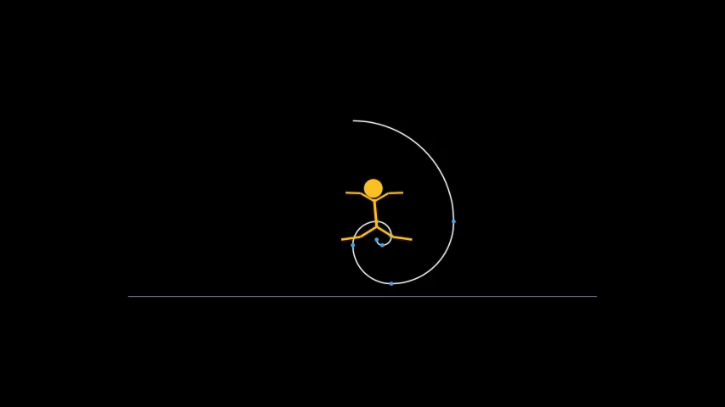
Notes:
Geometry Yields: And ProofMotion, out of forms, dissolves back into theorems. Spyder Math celebrates the only way a mathematician should.

