Slide 1


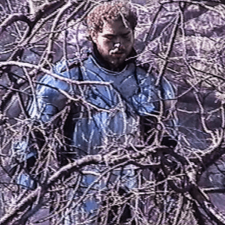

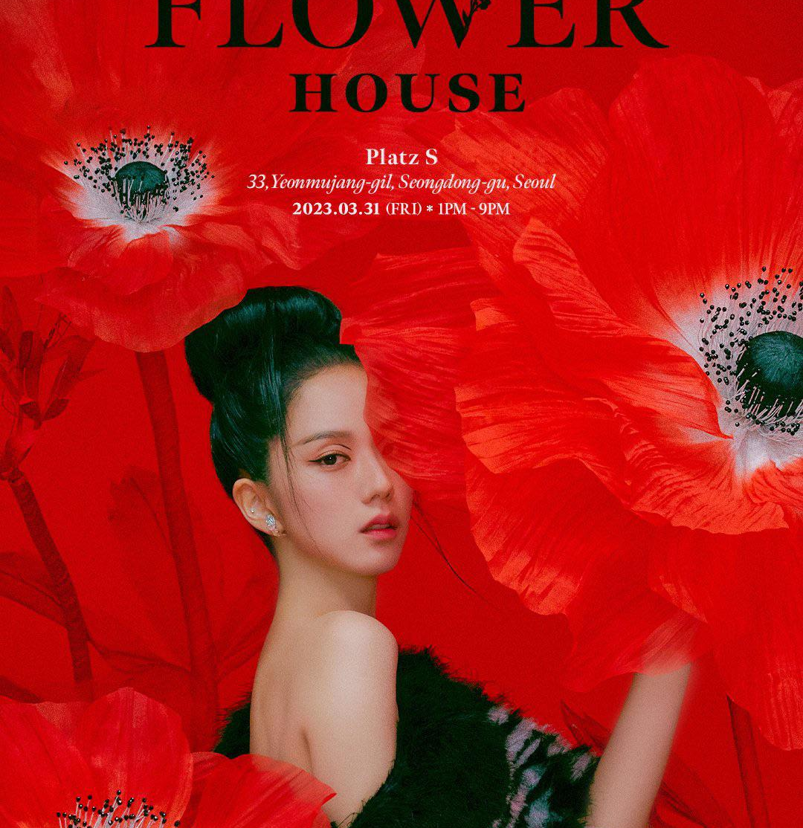

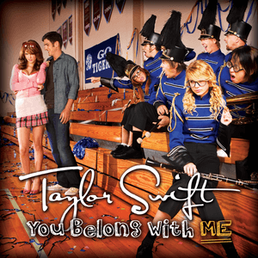
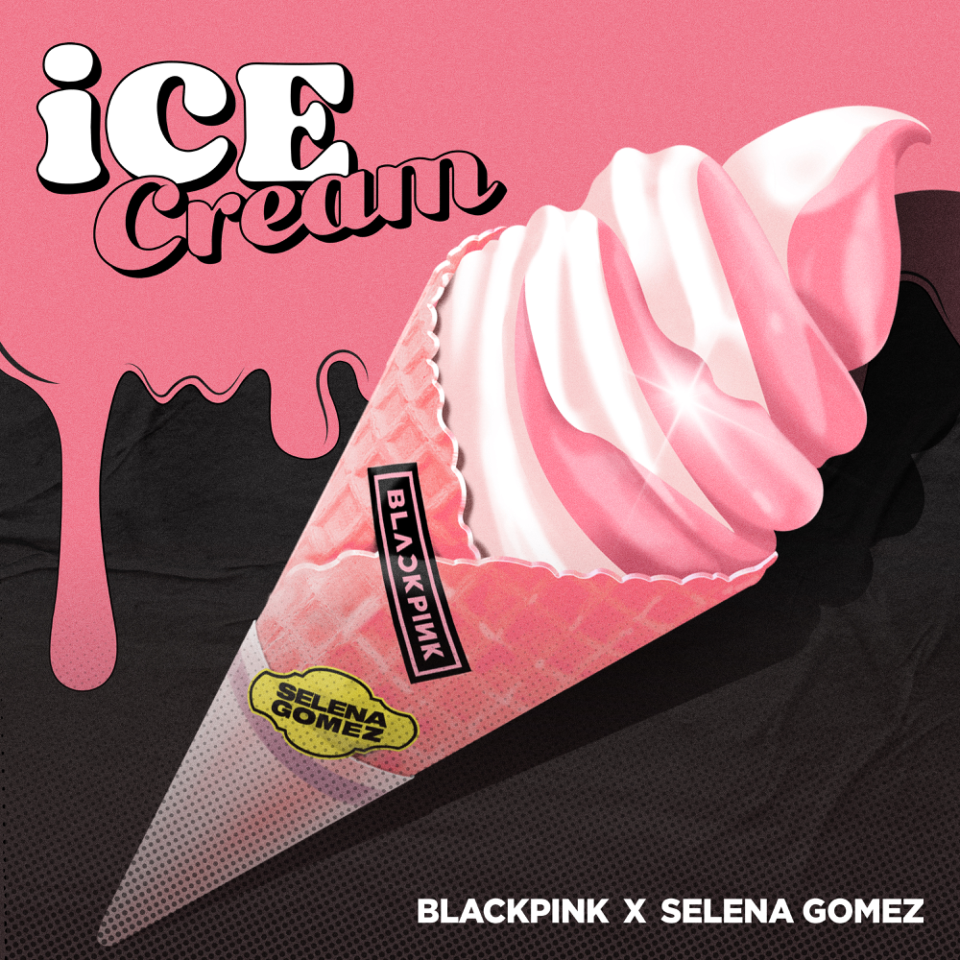






Post Malone - Circle
Duration – 3:36
Jisoo - Flower
Duration – 3:05
Taylar Swift - You Belo…
Duration – 3:49
Black Pink – Ice Cream
Duration – 3:03
Justin Bieber - Anyone
Duration – 3:11
Rosé - Gone
Duration – 3:36
Now Playing: Post Malone - Circle
Post Malone - Circle
Duration – 3:36

Slide 2

APP LOGO
Type to search
Search
Post Malone - Circle
Duration – 3:36
Home
Post Malone - Circle
Library
Duration – 3:36
Option
Post Malone - Circle
Duration – 3:36
Post Malone - Circle
Duration – 3:36
Post Malone - Circle
Duration – 3:36
Post Malone - Circle
Duration – 3:36
Now Playing: Post Malone - Circle

Slide 3
Post Malone
-
Circle
Duration – 3:36

Slide 4
Now Playing: Post Malone - Circle

