Slide 1
Project 1

Slide 2
Homework : Post Office Simulator
Implementing a discrete event simulator to evaluate the performance of a post office
Basic Requirement (85%):
Two Servers and a Single Queue
Bonus 1 (10%):
Two Servers and Two Queues
Bonus 2 (15%)
Basic Requirement (General distribution) + Restroom Events
Note: no other bonus!!

Slide 3
Basic Requirement: Two Servers and Single Queue
Two servers have the same service rate
FIFO queue
Infinite queue capacity
Inter-arrival and service time: i.i.d. and exponential distribution

Slide 4
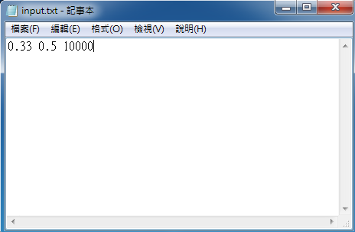
Basic Requirement: Two Servers and Single Queue
input.txt
Inter-arrival time (time unit): float(mean)
Service time (time unit): float(mean)
Simulation time (time unit): int (Max: 2³¹-1)

Slide 5
Basic Requirement: Two Servers and Single Queue
output.txt (free format)
Average waiting time: T_{start_service} - T_{arrival}
Average system time: T_{end_service} - T_{arrival}
System utilization ratio: the probability that at least one staff is busy
Full utilization ratio: the probability that both two staffs are busy

Slide 6
Bonus 1 (10%): Two Servers and Two Queues
Each server has a single queue
The policy for queue selection: choosing the queue having fewer customers
After entering a queue, a customer can not change his queue
Other setups = “Basic Requirement”

Slide 7
Bonus 2 (15%): G/G/2 + restroom events
Single queue
Inter-arrival and service time: normal distribution (<0)
A staff would go to the restroom
Single restroom (service time: exponential distribution)
Single queue for the restroom: a staff needs to line up while the washroom is busy

Slide 8
Bonus 2 (15%): M/M/2 + restroom events
A staff can not go to the restroom while serving a customer
Alice needs to go to the bathroom
@ 08:28:36
Staff Alice begins serving customer Bob
@ 08:23:10
Staff Alice finishes serving customer Bob
@ 08:33:42
time
Alice goes to the restroom

Slide 9
Bonus 2 (15%): M/M/2 + restroom events
Inter-rest-time: T_{need_to_restroom}(Staff) – T_{finish_restroom}(Staff)
Exponential Dis.
The restroom finishes serving staff Alice
@ T_{finish_restroom}(Alice)
Alice needs to go to the bathroom
@ T_{need_to_restroom}(Alice)
The restroom finishes serving staff Jane
@ T_{finish_restroom}(Jane)
time
Inter-rest-time for Alice
Alice goes to the restroom and lines up
@ T_{go_to_restroom}(Alice)
The restroom begins serving staff Alice
@ T_{start_restroom}(Alice)

Slide 10
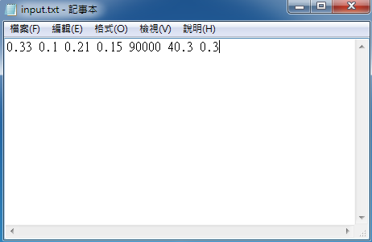
Bonus 2 (15%): M/M/2 + restroom events
input.txt
Inter-arrival time (time unit): float(mean) float(variance)
Service time (time unit): float(mean) float(variance)
Simulation time (time unit): int (2³¹-1)
Inter-rest-time (time unit): float
Service rate of the restroom (# of staffs/time unit): float
Normal Dis.
Exp.
Dis.

Slide 11
Bonus 2 (15%): M/M/2 + restroom events
output.txt (free format)
Average waiting time: T_{start_service} - T_{arrival}
Average system time: T_{end_service} - T_{arrival}
System utilization ratio: the probability that at least one staff is busy
Full utilization ratio: the probability that both two staffs are busy
Average waiting time for restroom events: T_{start_restroom} - T_{need_to_restroom}

Slide 12
Notes
Deadline: 2016/4/27 14:20
Email to: r03922038@ntu.edu.tw
r03922060@ntu.edu.tw
Subject: [Perf.] Project 1 submit
Programming language: C/C++/Java
Student ID_v1.rar (EX: r03922038_v1.rar)
Including: readme.txt and source codes
readme.txt
How to execute (compile) the code?
OS platform: linux or windows
Don’t implement simulation with “time-slices approach”
0 pt !!!!

