Slide 1
Modeling and Performance Analysis of BitTorrent-Like Peer-to-Peer Networks
Presented by: 鍾毓安 許詠翔 張君瑋
{b01902040, b01902029, b01902051}@ntu.edu.tw
2016.6.15
Notes:
這篇 paper 主要就是 propose 一些 model 來模擬一個 BitTorrent network.

Slide 2




Outline
Introduction to P2P network
Introduction to BitTorrent
A simple fluid model
The incentive mechanism
Experiments
Conclusions

Slide 3
Outline
Introduction to P2P network
Introduction to BitTorrent
A simple fluid model
The incentive mechanism
Experiments
Conclusions

Slide 4
Peer-to-peer network
Client-Server network vs. Peer-to-peer (P2P) network
Peers in a P2P network operate as both servers and clients.
P2P traffic is starting to dominate the bandwidth of the Internet.
Among P2P applications, file sharing is the most popular one.
P2P file sharing system is scalable.
BitTorrent, one of the most popular P2P applications, will be studied in this paper.
Notes:
在傳統的 client-server network 裡，假設 client 要某個檔案，那他就要跟 server 連線下載；而 P2P network 裡沒有所謂的 server / client 的分別，或是要說成大家都是 server 也都是 client 也行，每個 peer 都有部分或是全部的檔案，然後互相要自己沒有的部分。
在 client-server network 裡，每個要檔案的 client 都要跟 server 建立一個連線，所以當 client 數量越來越大時，會給 network bandwidth 很大的負擔；P2P network 則不然，因為大家既要檔案，也傳檔案，因此理論上整體的 performance 是很 scalable 的！
The performance of traditional file sharing applications (like the client-server network) deteriorates rapidly as the number of clients increases, while in a well-designed P2P file sharing system, more peers generally means better performance.

Slide 5
Outline
Introduction to P2P network
Introduction to BitTorrent
A simple fluid model
The incentive mechanism
Experiments
Conclusions
Notes:
BitTorrent 就是採用 P2P 架構的 file sharing application.

Slide 6
BitTorrent
Some concepts of BitTorrent:
A server, called the seed, has the entire file of interest.
The file is separated into many pieces, where each piece is of 256 KB.
As peers arrive, they download random pieces of the file from the seed.
Now there are many peers in the system with different or overlapping pieces of the file.
The peers can act as servers even they only have parts of the file.
Peers can then download from each other!
In a traditional client-server system (such as FTP), clients can only download from a single server.
Notes:
在最初的 network 應該至少存在一個 seed 吧（不然根本無法開始）！當開始有 peers 進來 network 時，就會開始跟 seed 隨機下載部分檔案。

Slide 7


How do BitTorrent work?
Peer 1
In this network, there are 4 peers downloading pieces of the file of interest.
Peer 2
Web Server
Peer 3
Peer 4
Tracker
Notes:
A brief description of how BitTorrent operates when a single file is downloaded by many users.

Slide 8
How do BitTorrent work?
Peer 1
In this network, there are 4 peers downloading pieces of the file of interest.
Peer 2
Peer 5 joins the network to download the file.
Peer 5
Web Server
Peer 3
Peer 4
Tracker
Notes:
新進來一個 peer

Slide 9
How do BitTorrent work?
Peer 1
In this network, there are 4 peers downloading pieces of the file of interest.
Peer 2
Peer 5 joins the network to download the file.
.torrent file
Peer 5
It first downloads a .torrent file from the web server.
Web Server
Peer 3
Peer 4
Tracker
Notes:
從 .torrent file 先知道 tracker 在哪！

Slide 10
How do BitTorrent work?
Peer 1
In this network, there are 4 peers downloading pieces of the file of interest.
Peer 2
Peer 5 joins the network to download the file.
Peer 5
It first downloads a .torrent file from the web server.
Web Server
Peer 3
Next, it connects to the tracker.
Peer 4
Tracker

Slide 11
How do BitTorrent work?
Peer 1
In this network, there are 4 peers downloading pieces of the file of interest.
Peer 2
Peer 5 joins the network to download the file.
Peer 5
It first downloads a .torrent file from the web server.
Web Server
Peer 3
Next, it connects to the tracker.
peer information
The tracker returns the peer information.
Peer 4
Tracker
Notes:
The tracker returns a random list of peers that have the file.

Slide 12
How do BitTorrent work?
Peer 1
In this network, there are 4 peers downloading pieces of the file of interest.
Peer 2
Peer 5 joins the network to download the file.
Peer 5
It first downloads a .torrent file from the web server.
Web Server
Peer 3
Next, it connects to the tracker.
The tracker returns the peer information.
Peer 4
Peer 5 connects to 4 other peers and begins downloading and exchanging.
Tracker
Notes:
The downloader establishes a connection to these other peers and finds out what pieces reside in each of the other files.
Then it requests pieces which it does not have from all the peers to which it is connected.
現在 peer 5 就會是屬於這個 P2P network 的一份子了！

Slide 13
Some notes behind the operation of BitTorrent
Downloaders are peers who only have a part (or none) of the file while seeds are peers who have all the pieces (the complete file) but stay in the system to allow other peers to download from them.
Each peer is allowed to upload only to a fixed number (by default 4) of other peers at a given time.
What is and why unchocking? To prevent free-riding, the most important concern in BitTorrent.
The mechanism of Optimistic Unchocking → to search for potential peer with high uploading/downloading speed.
Notes:
Seeds only perform uploading while downloaders download pieces that they do not have and upload pieces that they have.
Chocking: 拒絕
Unchocking: 接受 → 接受那些現在正上傳檔案給我、而且速度最快的前 4 個人！
(Reference: http://mmdays.com/2007/04/06/bt1/)
每 30 secs 取一次 max

Slide 14
How do Optimistic Unchocking work
Peer 1
Peer 5 is now connecting with peer 1 ~ 4 for downloading / uploading the file of interest.
Peer 2
Peer 5
Peer 3
Peer 4
Notes:
針對 peer 5 解釋 optimistic unchocking 怎麼運作的。

Slide 15
How do Optimistic Unchocking work
Peer 1
Peer 5 is now connecting with peer 1 ~ 4 for downloading / uploading the file of interest.
Peer 2
After 30 seconds, peer 5 randomly connects to another peer, say peer 6, and finds that the transmission speed of peer 6 does not exceed any of the peers that peer 5 has already connected to.
Peer 5
Peer 6
Peer 3
Peer 4

Slide 16
How do Optimistic Unchocking work
Peer 1
Peer 5 is now connecting with peer 1 ~ 4 for downloading / uploading the file of interest.
Peer 7
Peer 2
After 30 seconds, peer 5 randomly connects to another peer, say peer 6, and finds that the transmission speed of peer 6 does not exceed any of the peers that peer 5 has already connected to.
Peer 5
Peer 3
Peer 4
Therefore, after another 30 seconds, peer 5 disconnects with peer 6, and connects with another peer, say peer 7.

Slide 17
How do Optimistic Unchocking work
Peer 1
Peer 5 finds that after it connects to peer 7, peer 2 becomes the one that has the slowest transmission speed.
Peer 7
Peer 2
Peer 5
Peer 3
Peer 4

Slide 18
How do Optimistic Unchocking work
Peer 1
Peer 5 finds that after it connects to peer 7, peer 2 becomes the one that has the slowest transmission speed.
Peer 7
Therefore, peer 5 disconnects with peer 2 after another 30 seconds.
Peer 5
Peer 3
Peer 4

Slide 19
How do Optimistic Unchocking work
Peer 1
Peer 5 finds that after it connects to peer 7, peer 2 becomes the one that has the slowest transmission speed.
Peer 7
Therefore, peer 5 disconnects with peer 2 after another 30 seconds.
Peer 5
The same process is repeated again and again …
Peer 3
Peer 4

Slide 20
Some Issues of BitTorrent
Peer Evolution: how the number of peers evolves as a function of the request arrival rate, the peer departure rate, the uploading/downloading bandwidth of each peer, etc.
Scalability: as the size of the network (number of peers) grows, the network performance (average file downloading time) should preferably to actually improve.
File Sharing Efficiency: as peers often have different uploading/downloading bandwidths, it is important to design a good file-sharing protocol such that the uploading/downloading bandwidths are fully utilized.
Incentives to prevent free-riding: need to a mechanism to deter peers from free-riding (download from other peers while not uploading to others).
Notes:
For a BitTorrent network, several issues have to be addressed in order to understand the behavior of the system.
對 BitTorrent 需要探討的議題。

Slide 21
Outline
Introduction to P2P network
Introduction to BitTorrent
A simple fluid model
The incentive mechanism
Experiments
Conclusions

Slide 22
Fluid Model
x(t) - number of downloaders in the system at time t.
y(t) - number of seeds in the system at time t.
λ - the arrival rate of new requests (Poisson process)
µ - the uploading bandwidth of a given peer (normalized by file size)
C - the downloading bandwidth of a given peer (normalized by file size).
θ - the rate at which downloaders abort the download (Poisson process)
γ- the rate at which seeds leave the system (Poisson process)
η - indicates the effectiveness of the file sharing , takes values in [0, 1].

Slide 23
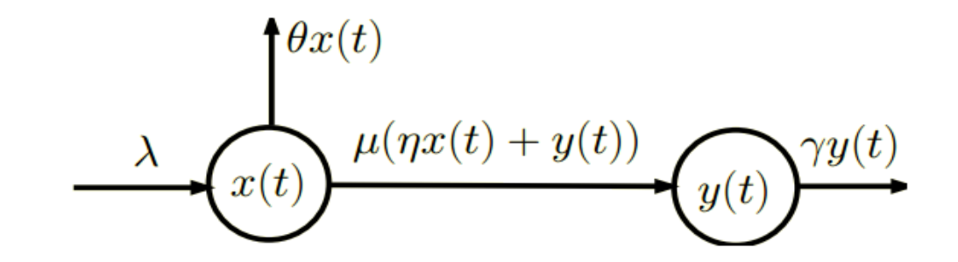
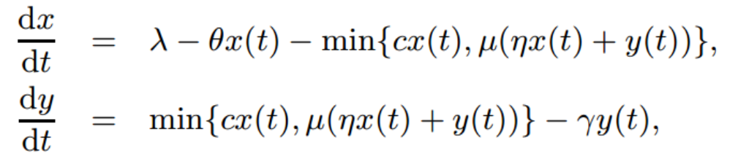
Fluid Model

Slide 24
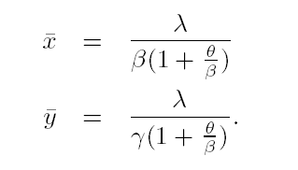
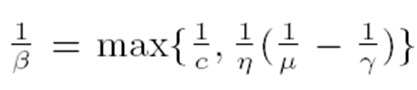
Steady-State Performance
To study the system in steady-state, we let
X¯ , Y ¯ are equilibrium values
β is determined by the bottleneck between download rate and upload rate

Slide 25
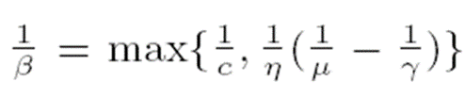
Steady-State Performance(cont.)
Little’s law: Average download time
Scalability: T is not a function of λ, the request arrival rate
Need for incentives: When the seed departure rate γ increases, T increases
Initially when the downloading rate c increases, T decreases. However, beyond a point the uploading rate becomes the bottleneck

Slide 26
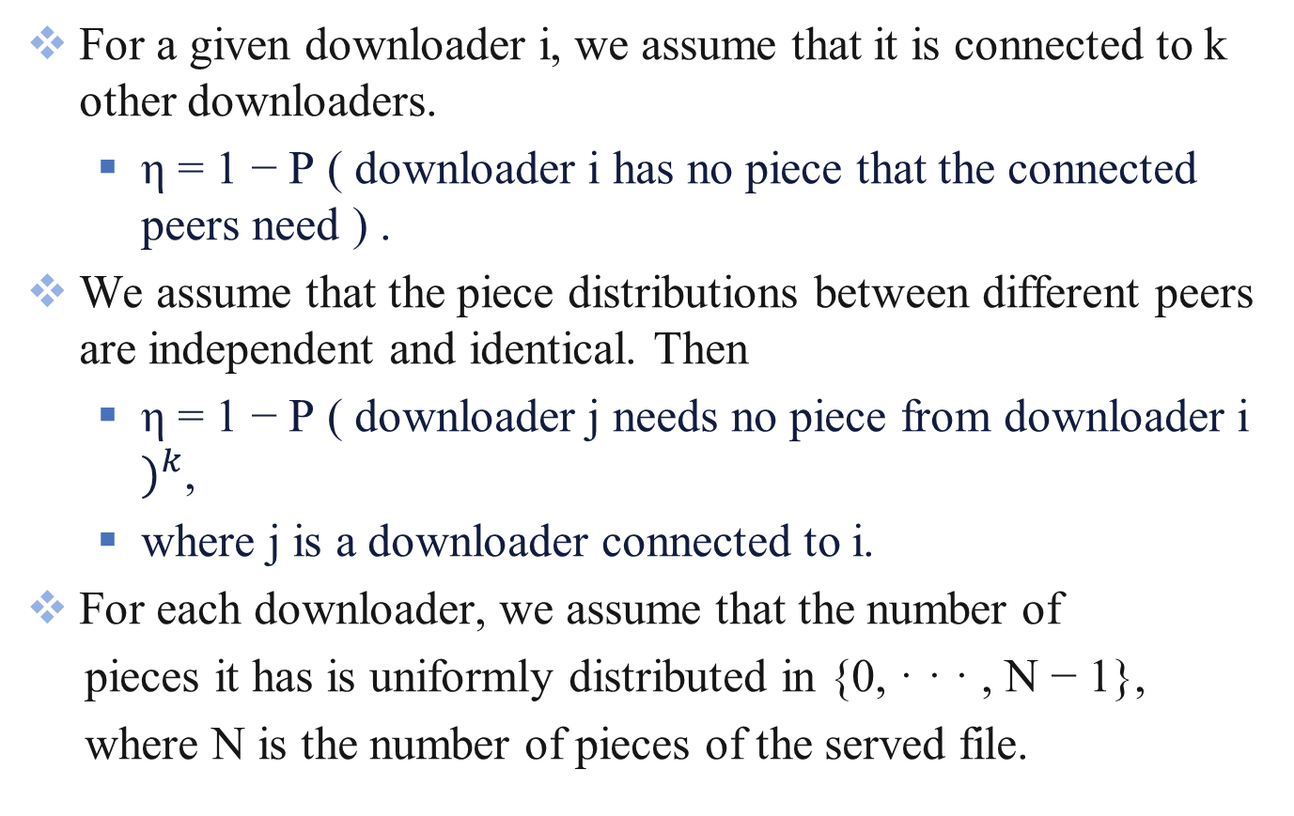
Effectiveness of File Sharing
For a given downloader i, we assume that it is connected to k other downloaders.
η = 1 − P ( downloader i has no piece that the connected peers need ) .
We assume that the piece distributions between different peers are independent and identical. Then
η = 1 − P ( downloader j needs no piece from downloader i $)^{k}$,
where j is a downloader connected to i.
For each downloader, we assume that the number of
pieces it has is uniformly distributed in {0, · · · , N − 1},
where N is the number of pieces of the served file.

Slide 27

Effectiveness of File Sharing(cont.)
Let $n_{i}$ be number of pieces at downloader i.

Slide 28
Effectiveness of File Sharing(cont.)
In BitTorrent, each piece is typically 256KB. For a file that is a few hundreds of megabytes in size, N is of the order of several hundreds.
Even if k = 1, η is very close to one.
When k increases, η also increases but very slowly and the network performance increases slowly. Hence, when λ increases, the network performance increases but very slowly.
When k = 0, η = 0.

Slide 29
Local Stability
eigenvalues of A1 and A2 have negative real parts – system is stable.

Slide 30
Outline
Introduction to P2P network
Introduction to BitTorrent
A simple fluid model
The incentive mechanism
Experiments
Conclusions

Slide 31
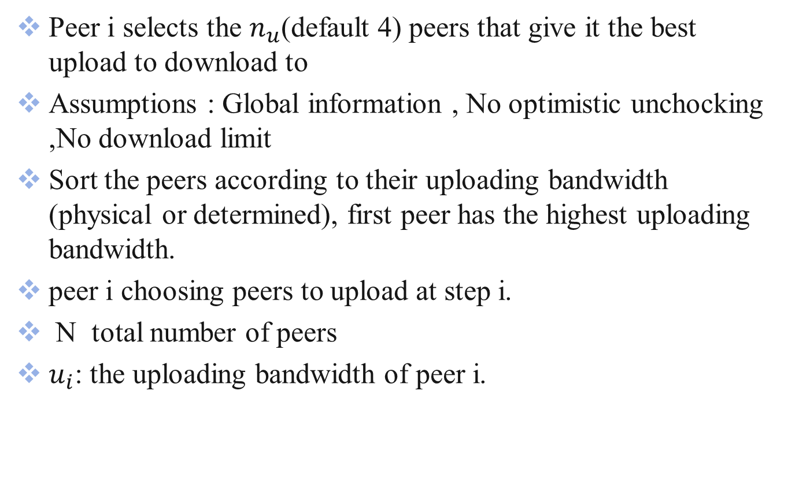
Peer Selection Algorithm
Peer i selects the $n_{u}$(default 4) peers that give it the best upload to download to
Assumptions : Global information , No optimistic unchocking ,No download limit
Sort the peers according to their uploading bandwidth (physical or determined), first peer has the highest uploading bandwidth.
peer i choosing peers to upload at step i.
N total number of peers
$u_{i}$: the uploading bandwidth of peer i.

Slide 32
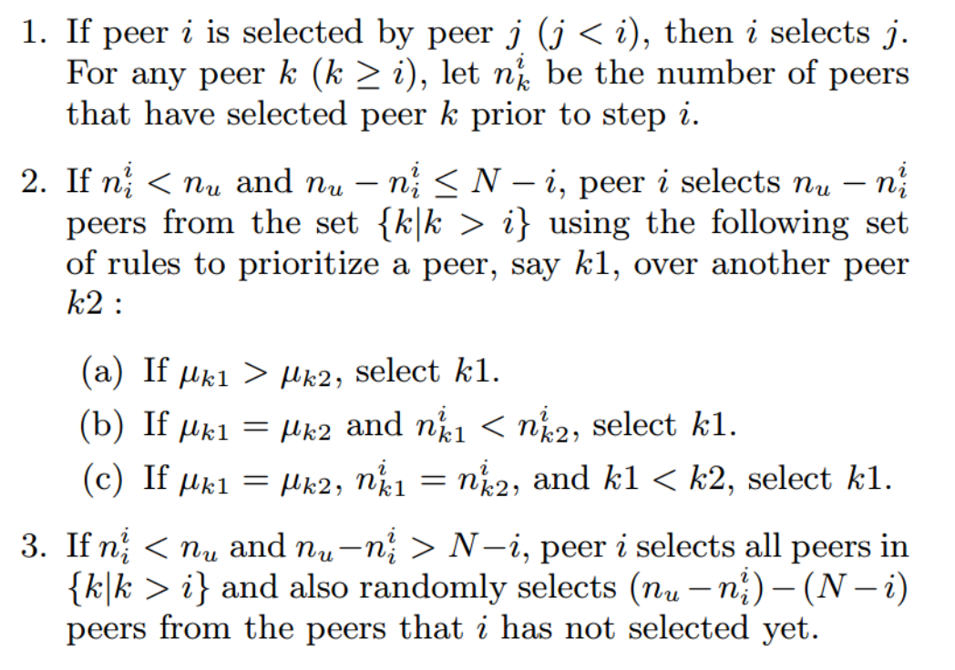
Peer Selection Algorithm(cont.)

Slide 33
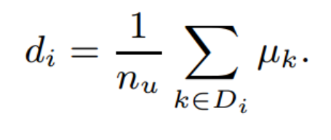
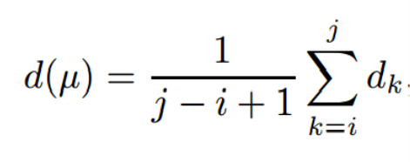
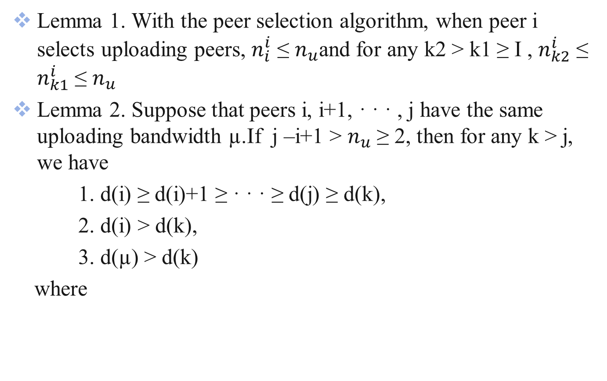
Peer Selection Algorithm(cont.)
Lemma 1. With the peer selection algorithm, when peer i selects uploading peers, $n_{i}^{i}$ ≤ $n_{u}$and for any k2 > k1 ≥ I , $n_{k2}^{i}$ ≤ $n_{k1}^{i}$ ≤ $n_{u}$
Lemma 2. Suppose that peers i, i+1, · · · , j have the same uploading bandwidth µ.If j –i+1 > $n_{u}$ ≥ 2, then for any k > j, we have
1. d(i) ≥ d(i)+1 ≥ · · · ≥ d(j) ≥ d(k),
2. d(i) > d(k),
3. d(µ) > d(k)
where

Slide 34
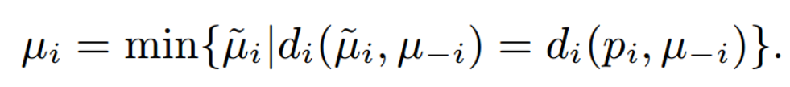
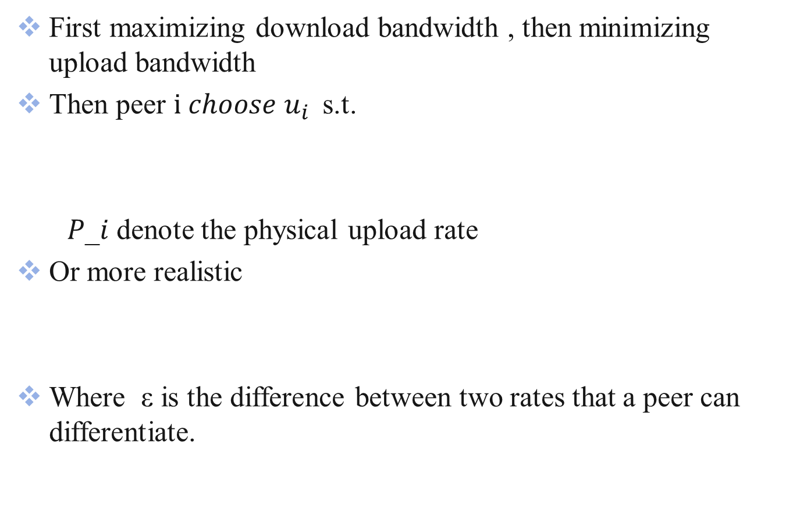
Peer Strategy
First maximizing download bandwidth , then minimizing upload bandwidth
Then peer $i choose$ $u_{i }$ s.t.
𝑃_𝑖 denote the physical upload rate
Or more realistic
Where ε is the difference between two rates that a peer can differentiate.

Slide 35

Peer Strategy(ex.)
consider a small BitTorrent network with 6 peers
The number of uploads $n_{u}$ = 4 for all peers
peers have different physical uploading bandwidth
If d the minimum uploading bandwidth min{$p_{i}$} > 2ε, there is no Nash equilibrium point for the system

Slide 36
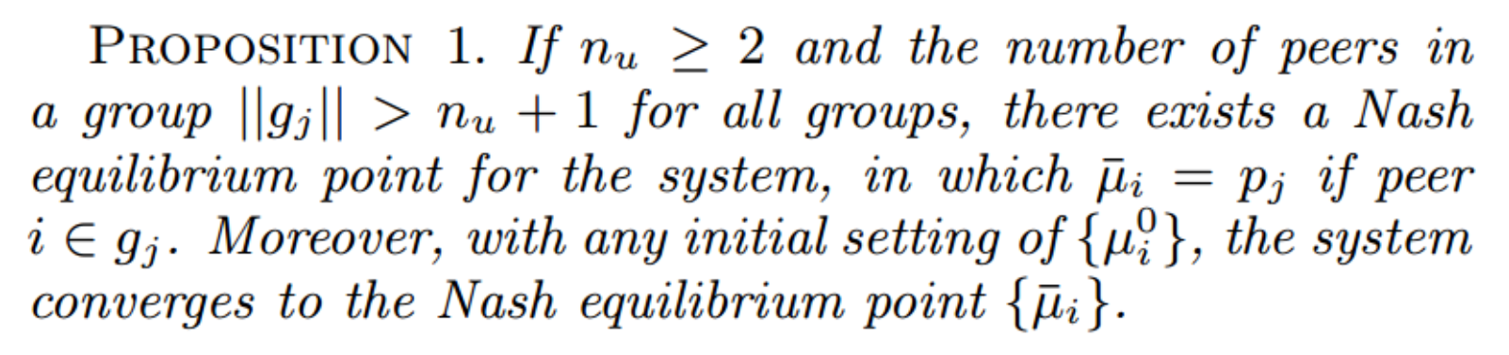

Nash Equilibrium Point
Divide the network to sub-groups . In each group j, all peers have the same physical uploading bandwidth $p_{j}$.

Slide 37
Outline
Introduction to P2P network
Introduction to BitTorrent
A simple fluid model
The incentive mechanism
Experiments
Conclusions

Slide 38
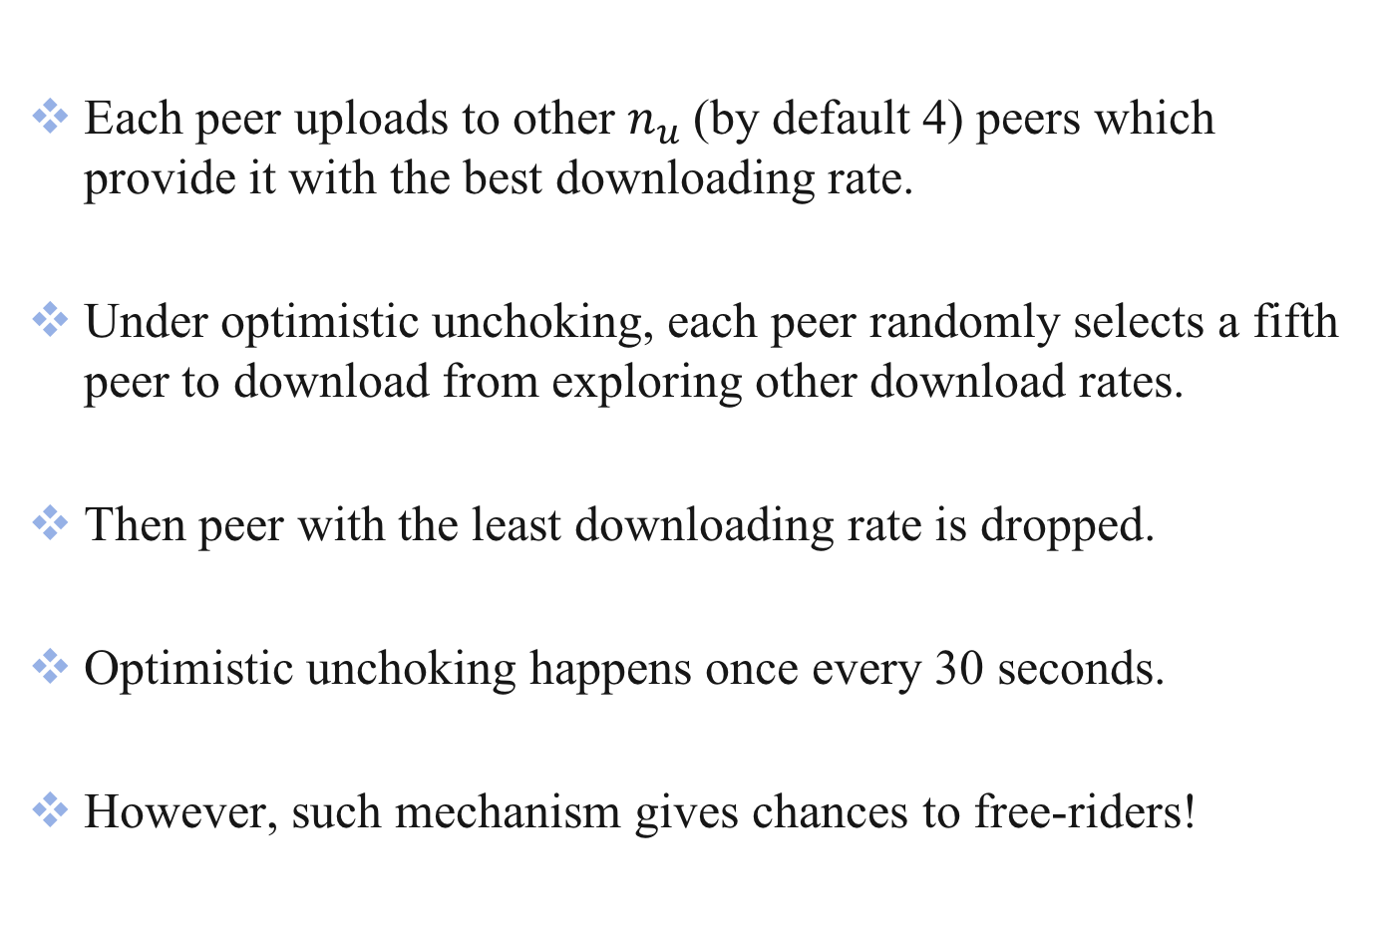
Optimistic Unchoking Recap
Each peer uploads to other $n_{u}$(by default 4) peers which provide it with the best downloading rate.
Under optimistic unchoking, each peer randomly selects a fifth peer to download from exploring other download rates.
Then peer with the least downloading rate is dropped.
Optimistic unchoking happens once every 30 seconds.
However, such mechanism gives chances to free-riders!

Slide 39
Free-riding Recap
Free-riding means that a peer does not contribute anything to the system, but attempts to obtain service (or downloading) from other peers.
Lack of global knowledge (full downloading rates information) requires the use of optimistic unchoking.
This allows for peers with no uploading bandwidth to get download bandwidth.

Slide 40
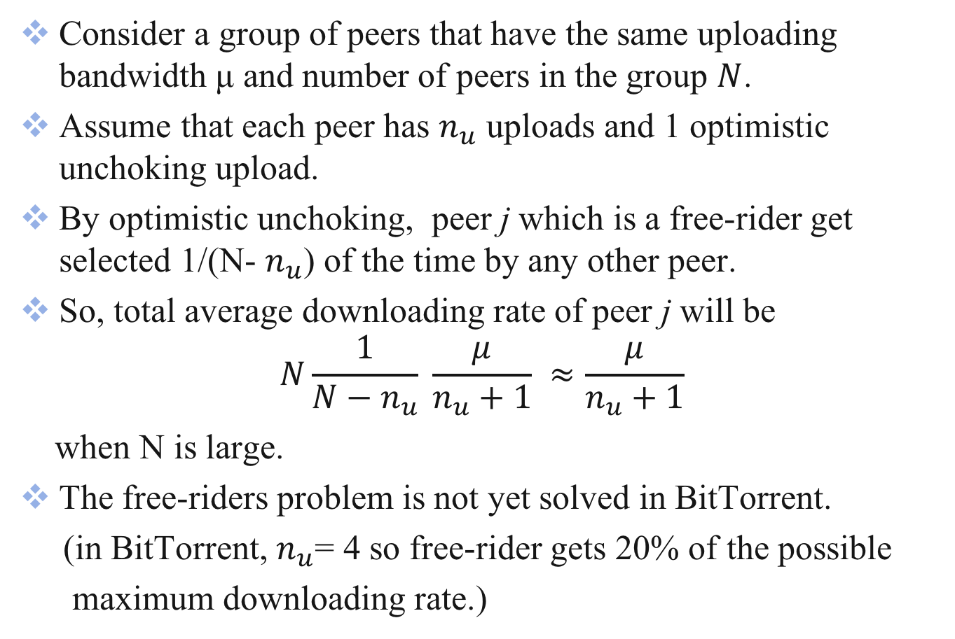
Free-riding Formulation
Consider a group of peers that have the same uploading bandwidth μ and number of peers in the group $N$.
Assume that each peer has $n_{u}$ uploads and 1 optimistic unchoking upload.
By optimistic unchoking, peer j which is a free-rider get selected 1/(N- $n_{u}$) of the time by any other peer.
So, total average downloading rate of peer j will be
$$N\frac{1}{N−n_{u}} \frac{μ}{n_{u}+1} ≈\frac{μ}{n_{u}+1}$$
when N is large.
The free-riders problem is not yet solved in BitTorrent.
(in BitTorrent, $n_{u}$= 4 so free-rider gets 20% of the possible
maximum downloading rate.)

Slide 41
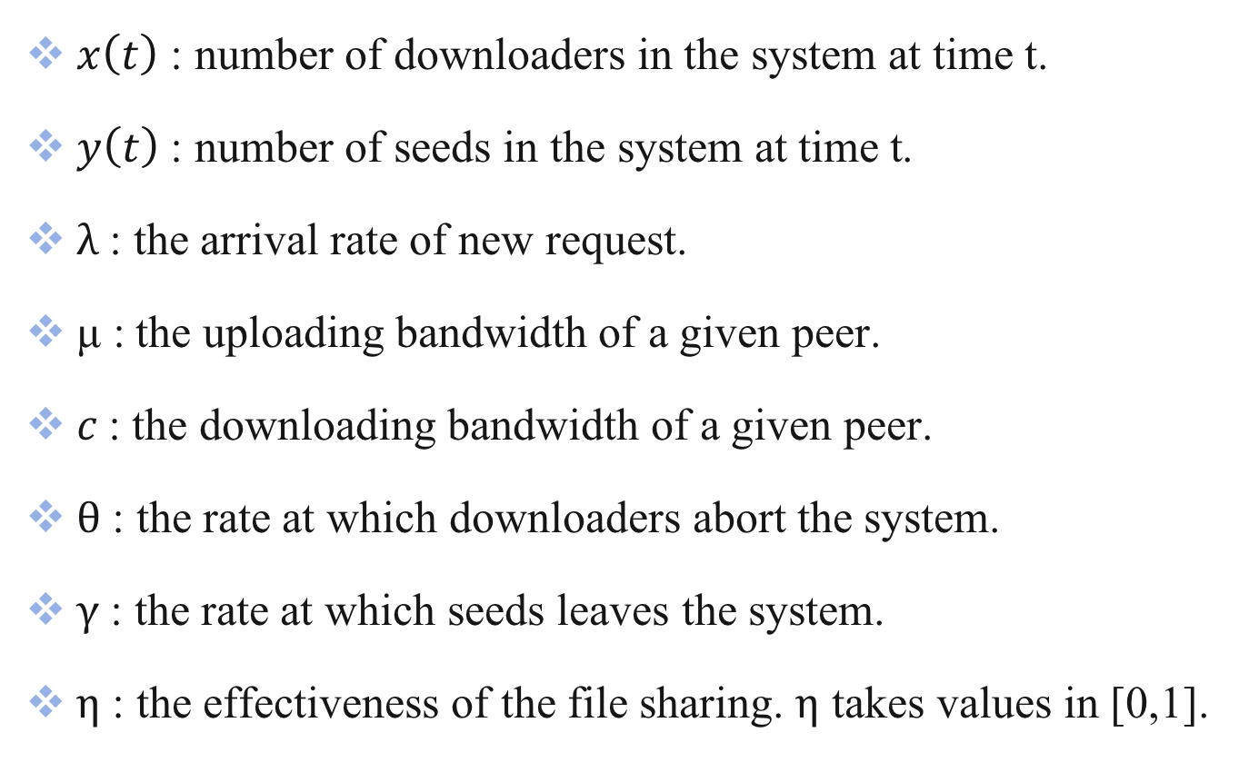
Notations Recap
$x\left(t\right)$ : number of downloaders in the system at time t.
$y\left(t\right) \text{: }\text{number} \text{of} \text{seeds} \text{in} \text{the} \text{system} \text{at} \text{time} \text{t}$.
$λ$ : the arrival rate of new request.
μ$\text{:}$ the uploading bandwidth of a given peer.
$c$: the downloading bandwidth of a given peer.
$θ$ : the rate at which downloaders abort the system.
$γ$ : the rate at which seeds leaves the system.
$η$ : the effectiveness of the file sharing. $η$ takes values in [0,1].

Slide 42
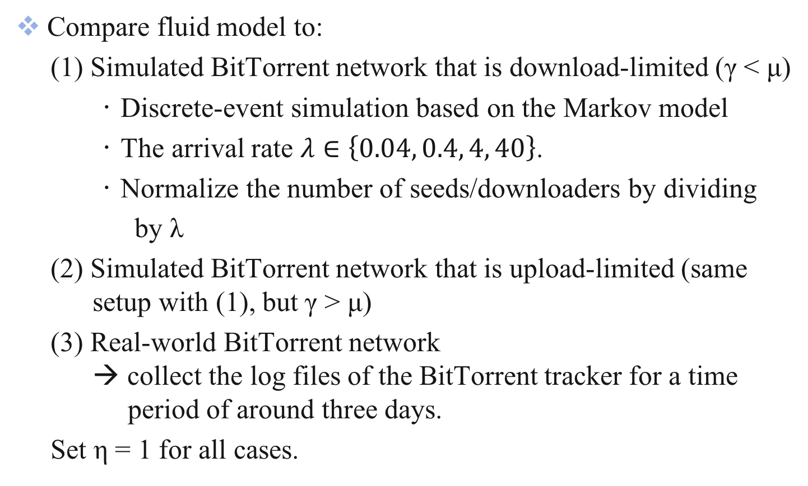
Experiment Setup
Compare fluid model to:
(1) Simulated BitTorrent network that is download-limited (γ < μ)
‧ Discrete-event simulation based on the Markov model
‧ The arrival rate $λ∈\left\{0.04, 0.4, 4, 40\right\}$.
‧ Normalize the number of seeds/downloaders by dividing
by λ
(2) Simulated BitTorrent network that is upload-limited (same setup with (1), but γ > μ)
(3) Real-world BitTorrent network → collect the log files of the BitTorrent tracker for a time period of around three days.
Set η = 1 for all cases.

Slide 43
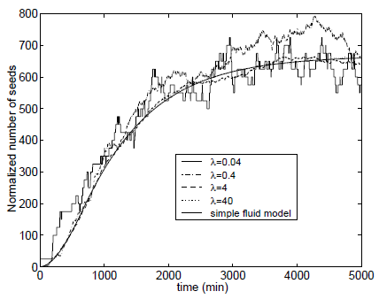
Experiment 1
μ = 0.00125
θ = 0.001
c = 0.002
γ = 0.001
λ : arrival rate of new request
Notes:
μ = 0.00125 uploading bandwidth
θ = 0.001 rate at which downloaders abort the download
c = 0.002 downloading bandwidth
γ = 0.001 the rate at which seeds leave the system

Slide 44
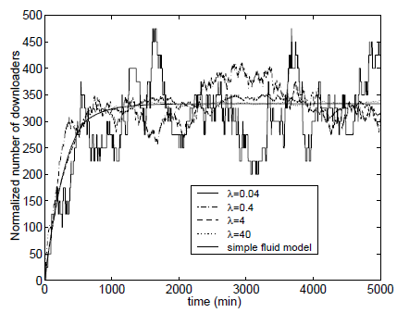
Experiment 1
μ = 0.00125
θ = 0.001
c = 0.002
γ = 0.001
λ : arrival rate of new request

Slide 45
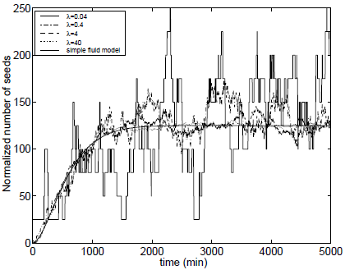
Experiment 2
μ = 0.00125
θ = 0.001
c = 0.002
γ = 0.005
λ : arrival rate of new request

Slide 46
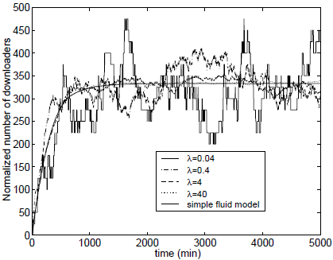
Experiment 2
μ = 0.00125
θ = 0.001
c = 0.002
γ = 0.005
λ : arrival rate of new request

Slide 47

Analysis of (1) & (2)
The fluid model is a good approximation when the arrival rate λ is large regardless of the relationship between $μ$ and $γ$.
The approximation is also good for small λ.

Slide 48
Experiment 3 – Real-world Data
Assume the system is upload-limited (γ > μ).
Measured λ and γ are time-dependent
– for t < 800 min, λ = 0.06 γ = 0.001
– for t > 1300 min, λ = 0.03 γ = 0.0044
– in between, they vary linearly
Also numerically calculate the expected variation from the model as a 95% confidence interval.

Slide 49
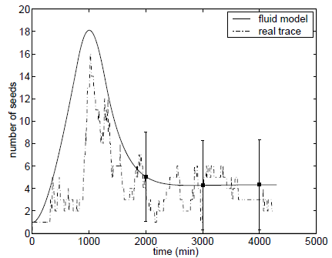
Experiment 3

Slide 50
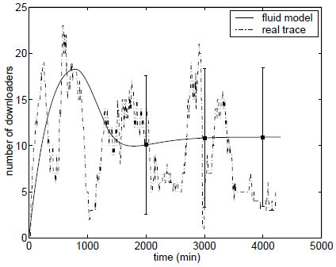
Experiment 3

Slide 51
Outline
Introduction to P2P network
Introduction to BitTorrent
A simple fluid model
The incentive mechanism
Experiments
Conclusions

Slide 52
Conclusions
Presented a simple fluid model for BitTorrent-like networks.
Studied the steady-state network performance and stability.
Obtained insight into the effect of different parameters on network performance.
The effect of optimistic unchoking on free-riding.
The experiments show that the simple fluid model is able to capture the behavior of the system even when the arrival rate is small.

