Slide 1
Word Cloud
on PTT
for 柯文哲

Slide 2
Content
01
Introduction
The project aims at finding keywords for 柯文哲
on ‘Hate Politics’ and ‘Gossiping’ sub-forum from PTT forum.
02
Implementation
Process includes 4 parts, collecting data from ptt, splitting vocabulary, calculating TF-IDF, and producing word cloud.
03
Results
Show results of the 2 sub-forum.
04
Conclusion

Slide 3
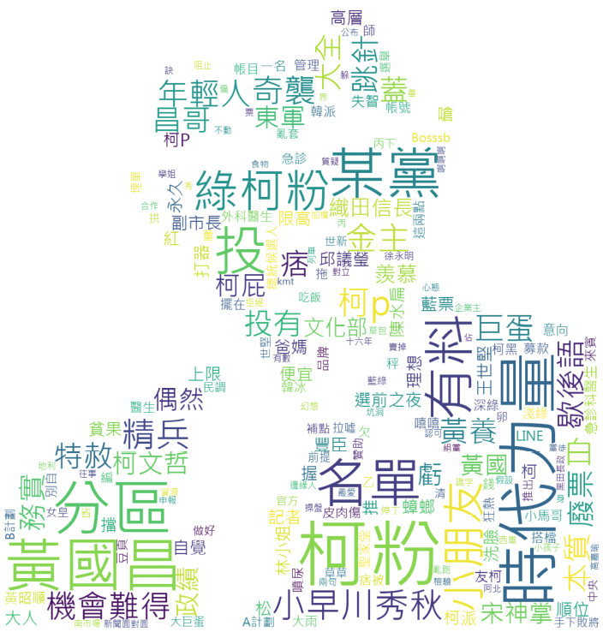
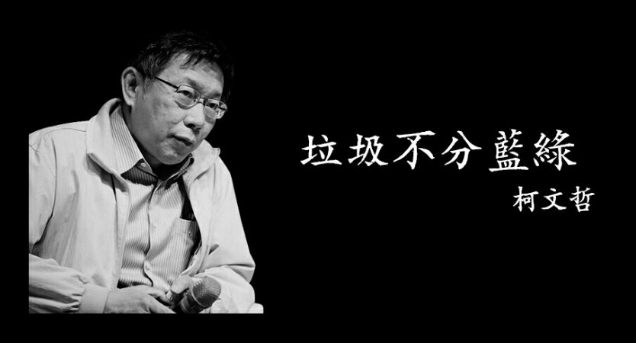
Introduction
Generating word cloud for 柯文哲 on ‘HatePolitics’ and ‘Gossiping’

Slide 4
Implementation
title:
class=‘title’
Step 1: Web Crawler on PTT
date:
class=‘date’
Article 1
Link: find(‘a’,’href’)
author:
class=‘author’
Articles:
class=‘r-ent’
Article 2
content:
class=‘main-content’
Article 3
comment:
class=‘push’
…

Slide 5
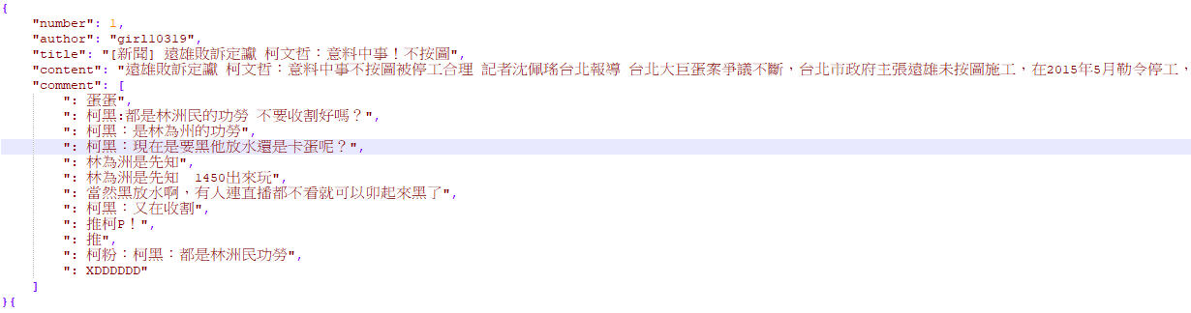
Implementation
Step 1: Web Crawler on PTT
Results are saved in json format
with key of ‘number’, ‘author’, ‘title’, ‘content’, and ‘comment’.

Slide 6
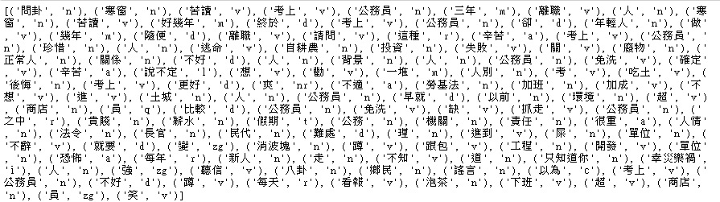
Implementation
Step 2: Splitting words
from udicOpenData import *
data = article['title'] + '\n' + article['content'] + '\n' + str(article['comment'])
seg_list = list(rmsw(data['content'], flag=True))
title:
class=‘title’
udicOpenData library for splitting dictionary
content:
class=‘main-content’
comment:
class=‘push’

Slide 7



Implementation
$${tfidf}_{i,j}={tf}_{i,j}×{idf}_{i}$$
Step 3: Calculating TF-IDF
$${tf}_{i,j}=\frac{n_{i,j}}{\sum_{k}{n_{k,j}}}$$
$${idf}_{i}=\log{\frac{\left|D\right|}{\left|\left\{j:t_{i}∈d_{j}\right\}\right|}}$$
$${tfidf}_{某篇文章,柯文哲}=\frac{柯文哲出現在此文章次數}{此文章所有詞語數}×\log{\frac{柯文哲出現在所有文章次數}{所有文章數}}$$

Slide 8
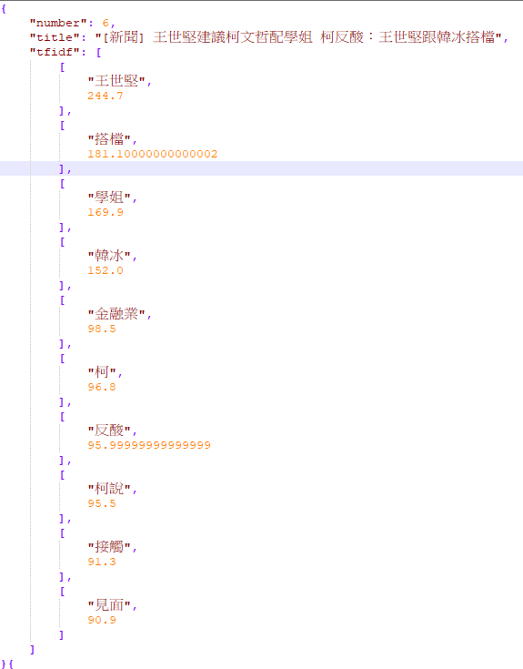
Implementation
Step 3: Calculating TF-IDF

Slide 9
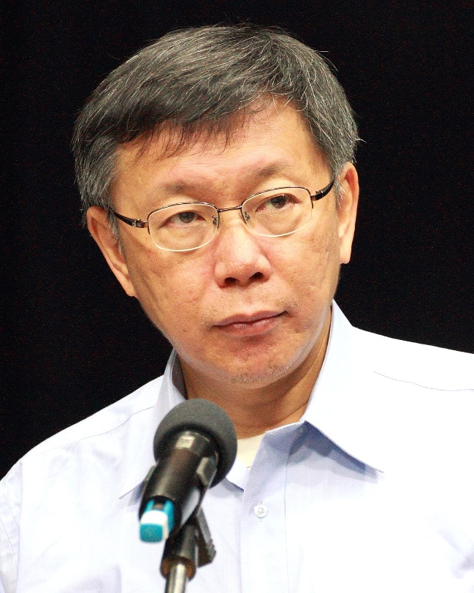

Implementation
Step 4: Generating Keyword cloud
Keywords

Slide 10

Results
Gossiping
HatePolitics

Slide 11
Results
鄉民討論韓國瑜脫黨參選
2020總統大選 柯文哲自比織田信長
鄉民討論韓國瑜跟柯文哲，順便酸北漂青年
鄉民討論柯文哲跟民進黨
鄉民討論韓國瑜跟柯文哲，刷一波留言對韓國瑜看走眼
鄉民討論遠雄停工
Gossiping

Slide 12
Results
鄉民討論不分區立委，柯p若不推出人選，就選時代力量黃國昌
柯p說自己是織田信長，
鄉民酸應該是小早川秀秋
鄉民討論韓國瑜跟柯p選總統，留言酸爆柯粉崩潰
鄉民討論選舉，常常提到某黨
HatePolitics

Slide 13
Conclusion
Results are highly affected by shitposts
The results for 柯文哲 didn’t show obvious political affiliation of GREEN or BLUE, because 柯文哲 belongs to neither of them.

Slide 14
Thank You
Insert the Sub Title of Your Presentation

