Slide 1
Group 3 IoT Product Development Presentation
Group Members:
Katrina Duong, Jason Less, Yun Xu, Erynn Phan

Slide 2
Problem Statement
First Design:
We first implemented a simple password-authenticated IoT system to unlock a door using the Intel Edison.
Used a light sensor to generate a four-digit binary password.
Sent password to server with username, and waited for verification from the server.
Problem:
Brute Force Attack
Man-in-the-Middle Attack
Notes:
Yun
•Please include the problem statement
•Which system is designed?
•What is the problem you are trying to solve?
•What is the limitation of the simple implementation that you have tested?
•This may include one or two slides

Slide 3

Problem Statement
Limitations of our simple implementation include:
The password is too short and simple
No limit on number of attempts
No encryption is implemented, allowing man-in-the-middle attacks
Notes:
Yun
•Please include the problem statement
•Which system is designed?
•What is the problem you are trying to solve?
•What is the limitation of the simple implementation that you have tested?
•This may include one or two slides

Slide 4
Design Overview: Technical Approach
A button and 4 light sensors receive user input.
The button designates which light sensor is active.
Two possible digits are assigned to each light sensor:
Light sensor 0 produces either 0 or 1.
Light sensor 1 produces either 2 or 3, etc.
Covering a light sensor produces the lower number for that light sensor, and not covering it produces the higher number.
Notes:
Erynn
•This is a summary that should describe your planned methods, algorithms, and systems
•This only requires several bullet points and one slide. This can be extended to a second slide as desired.

Slide 5
IoT System Implementation
Protection against brute force attacks:
8 digit password where each digit has a range of 0-7.
generated using a button and four light sensors
Penalty for entering the wrong password: After 3 failed attempts, our Intel Edison will be locked from retrying for 5 minutes.
Protection against man-in-the-middle attacks:
Encryption and decryption upon sending and receiving messages to/from the server.
Notes:
Katrina
•This describes your system implementation and includes one (or more slides)
•This could include a photograph or photographs of your system that permit the audience of your presentation to visualize your IoT development.
•This could include diagrams or schematics followed by detailed description of your system.
•This can also include a video of a system demonstration (this is optional)
•This can also include a live system demonstration. (This is also optional and can be viewed after class or by arrangement depending on time available.)

Slide 6
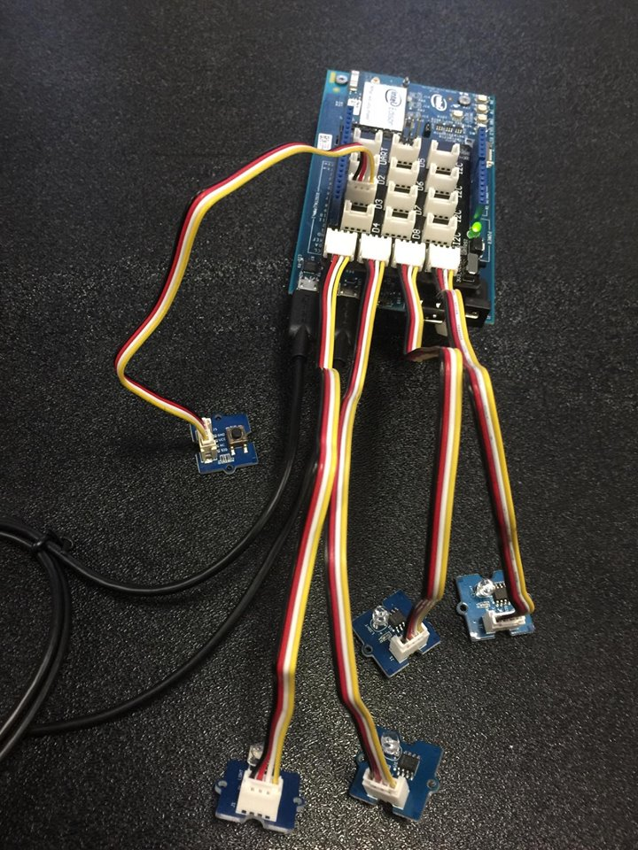
Notes:
Katrina

Slide 7
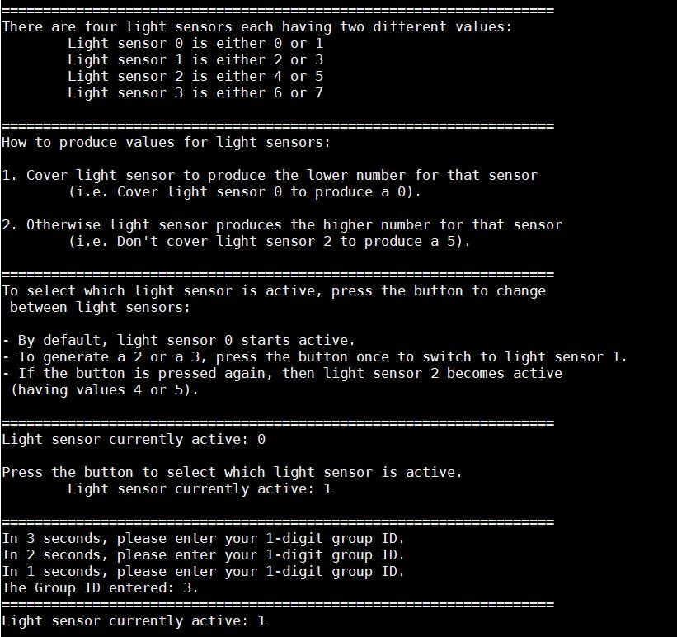
Notes:
Katrina

Slide 8
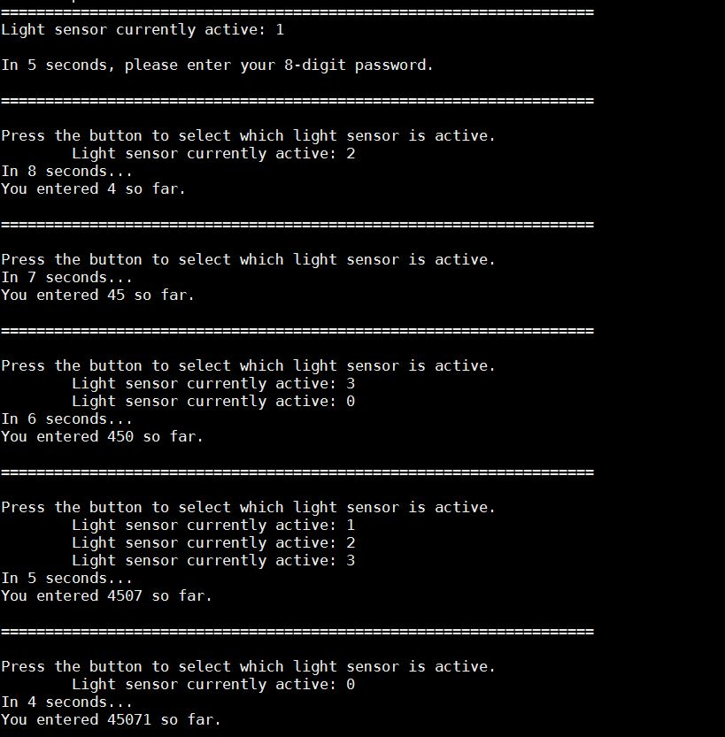
Notes:
Katrina

Slide 9
Team and Responsibilities and Contribution
Katrina Duong and Erynn Phan
worked on implementing SSL/TLS encryption on top of our existing client code
debugged the code
Jason Less
worked on improving the client by adding extra light sensors to input an 8 digit password
looped the code so the user can try 3 times
Yun Xu
worked on the simple implementation, helped improving the simple implementation, and worked on our presentation
Notes:
Jason
•Each team member should include one or two bullets describing their responsibilities and contributions. This can include one or two slides.

Slide 10
Questions?
Notes:
Jason

Slide 11


