Slide 1
Operating Systems

Slide 2
6. Mechanism: Limited Direct Execution

Slide 3
How to efficiently virtualize the CPU with control?
The OS needs to share the physical CPU by time sharing.
Issue
Performance: How can we implement virtualization without adding excessive overhead to the system?
Control: How can we run processes efficiently while retaining control over the CPU?

Slide 4
Direct Execution
Just run the program directly on the CPU.
OS | Program
1. Create entry for process list 2. Allocate memory for program 3. Load program into memory 4. Set up stack with argc / argv 5. Clear registers 6. Execute call main() 9. Free memory of process 10. Remove from process list | 7. Run main() 8. Execute return from main()
Without limits on running programs,
the OS wouldn’t be in control of anything and
thus would be “just a library”

Slide 5
Recap: Process Creation
Load a program code into memory, into the address space of the process.
Programs initially reside on disk in executable format.
OS perform the loading process lazily.
Loading pieces of code or data only as they are needed during program execution.
The program’s run-time stack is allocated.
Use the stack for local variables, function parameters, and return address.
Initialize the stack with arguments → argc and the argv array of main() function

Slide 6
Recap: Process Creation (Cont.)
The program’s heap is created.
Used for explicitly requested dynamically allocated data.
Program request such space by calling malloc() and free it by calling free().
The OS do some other initialization tasks.
input/output (I/O) setup
Each process by default has three open file descriptors.
Standard input, output and error
Start the program running at the entry point, namely main().
The OS transfers control of the CPU to the newly-created process.

Slide 7
Problem
Issue 1
User can do wrong thing.
What if?
int *i ;
i = 0 ;
*i = 1 ;
Issue 2
Getting the control back from CPU is not easy.
What if?
i = -1 ;
while (i <0)
do something;

Slide 8
Problem 1: Restricted Operation
What if a process wishes to perform some kind of restricted operation such as …
Issuing an I/O request to a disk
Gaining access to more system resources such as CPU or memory
Solution 1: Grant everything.
Solution: Use protected control transfer
User mode: Applications do not have full access to hardware resources.
Kernel mode: The OS has access to the full resources of the machine

Slide 9
System Call
Allow the kernel to carefully expose certain key pieces of functionality to user program, such as …
Accessing the file system
Creating and destroying processes
Communicating with other processes
Allocating more memory

Slide 10
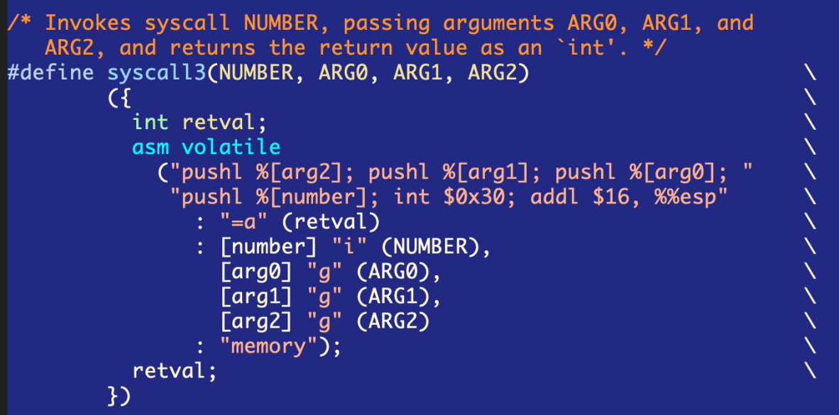
Call flow(Pintos): write()
User program
main()
{
write(“……”)
}
pintos/src/lib/user/syscall.c
int write(…)
{
return syscall3(SYS_WRITE, fd, buffer, size);
}
…
syscall3(…)
{
…
push arg2
push arg1
push arg0
push number
int 0x30
}
User stack
.
.
.
arg2
arg1
arg0
number
Stack Pointer(esp)

Slide 11
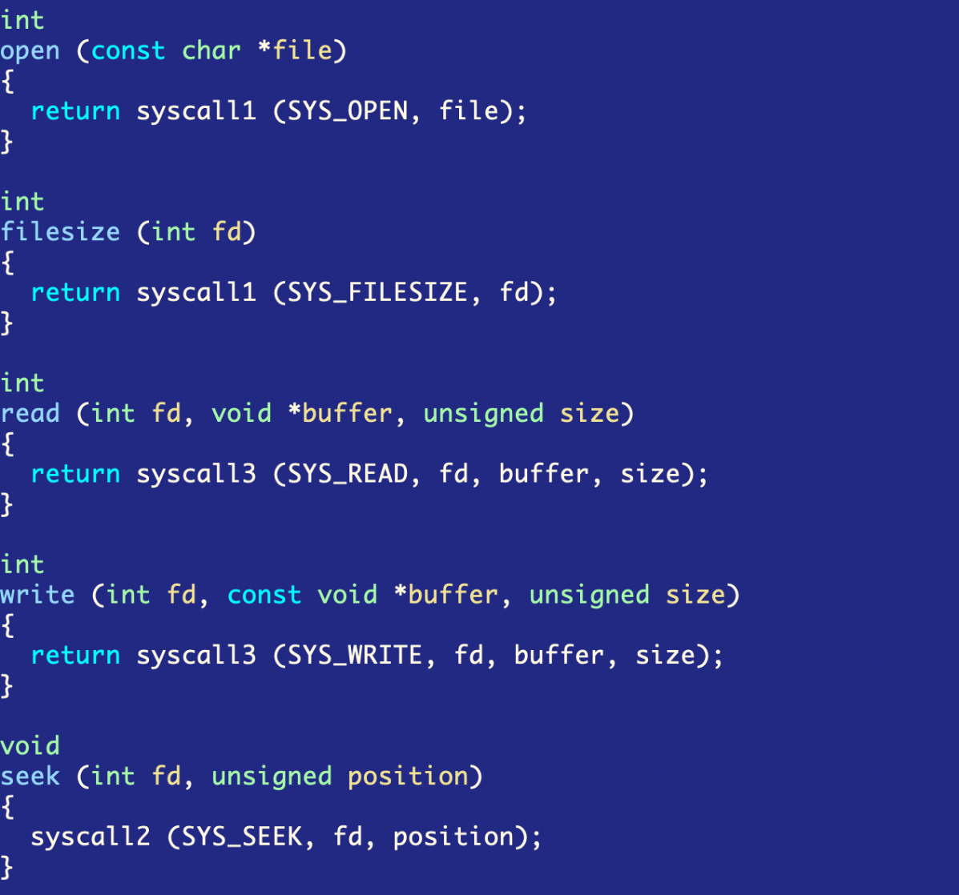
Definitions of system calls (src/lib/user/syscall.c)

Slide 12
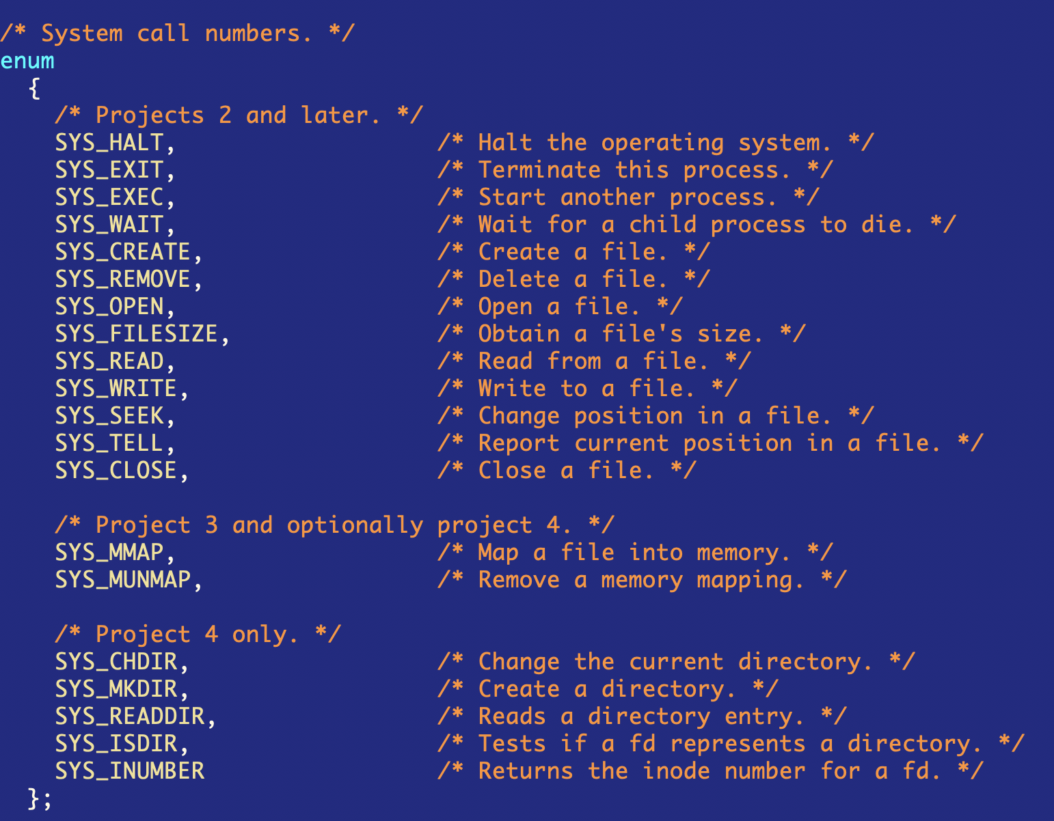
Systemcall in pintos(systemcall-nr.h)

Slide 13
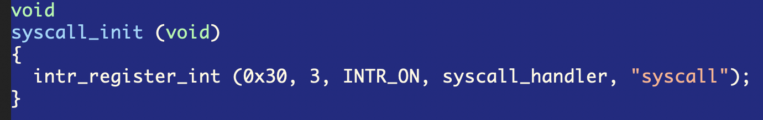
Register systemcall handler at IDT
Interrupt descriptor table
Table of the locations of the interrupt handlers for the associated interrupt number.
Register the systemcall handler at interrupt 0x30(src/userprog/syscall.c).
Interrupt Descriptor table
0x0
divide_error()
debug()
debug()
debug()
nmi()
nmi()
nmi()
…
…
0x30
syscall_handler()
…

Slide 14
Call flow(Pintos): write()
User
Kernel
User program
Interrupt Vector table
0x0
divide_error()
main()
{
write(“……”)
}
debug()
debug()
debug()
nmi()
nmi()
nmi()
…
…
pintos/src/lib/user/syscall.c
0x30
int write(…)
{ return syscall3(…); }
…
syscall3(…)
{
…
push arg2
push arg1
push arg0
push number
int 0x30
}
syscall_handler()
…
User stack
.
.
.
arg2
arg1
arg0
number
Stack Pointer(esp)

Slide 15
Call process of System call (Pintos)
User
Kernel
User program
Interrupt Vector table
0x0
divide_error()
Currently empty.
main()
{
write(“……”)
}
debug()
debug()
debug()
pintos/src/userprog/syscall.c
nmi()
syscall_handler(
intr_frame *f)
{
printf ("system call!\n");
thread_exit ();
}
nmi()
nmi()
…
return
call
…
pintos/src/lib/user/syscall.c
0x30
int write(…)
{ return syscall3(…); }
…
syscall3(…)
{
…
push arg2
push arg1
push arg0
push number
int 0x30
}
syscall_handler()
…
User stack
.
.
.
arg2
arg1
arg0
number
Stack Pointer(esp)

Slide 16
Implementation of write()(src/filesys.c)
How do you bind the write() system call to file_write()?
off_t file_write (struct file *file, const void *buffer, off_t size) {
off_t bytes_written = inode_write_at (file->inode, buffer, size, file->pos); file->pos += bytes_written;
return bytes_written;
}
divide_error()
debug()
syscall_handler(
intr_frame *f)
{
???
}
debug()
debug()
main()
{
write(“……”)
}
nmi()
nmi()
nmi()
int write(…)
{ return syscall3(…); }
…
…
file_write()
syscall_handler()
…
Youjip Won
16

Slide 17
Key Concept of System Call
Trap instruction
int n
Raise the privilege level to kernel mode
Save registers at the kernel stack. (eip, cs, eflags, esp, ss)
Locates the destination in the kernel
Jumps to the destination.
Interrupt number for system call : 0x64 @ xv6, 0x30 @Pintos
e.g. int 0x64
Return-from-trap instruction
Return into the calling user program
Reduce the privilege level back to user mode

Slide 18
What code to run in trap?
Sources of trap
Completion of disk IO
Keyboard interrupt
System call
trap handler: the code to run for each interrupt number (trap number)
Trap table
The address of the trap handlers.
Hardware Informs the location of the trap table to OS when booting.
The instruction to inform the location of the trap table is also privileged instruction.
You cannot execute this instruction in user mode.

Slide 19
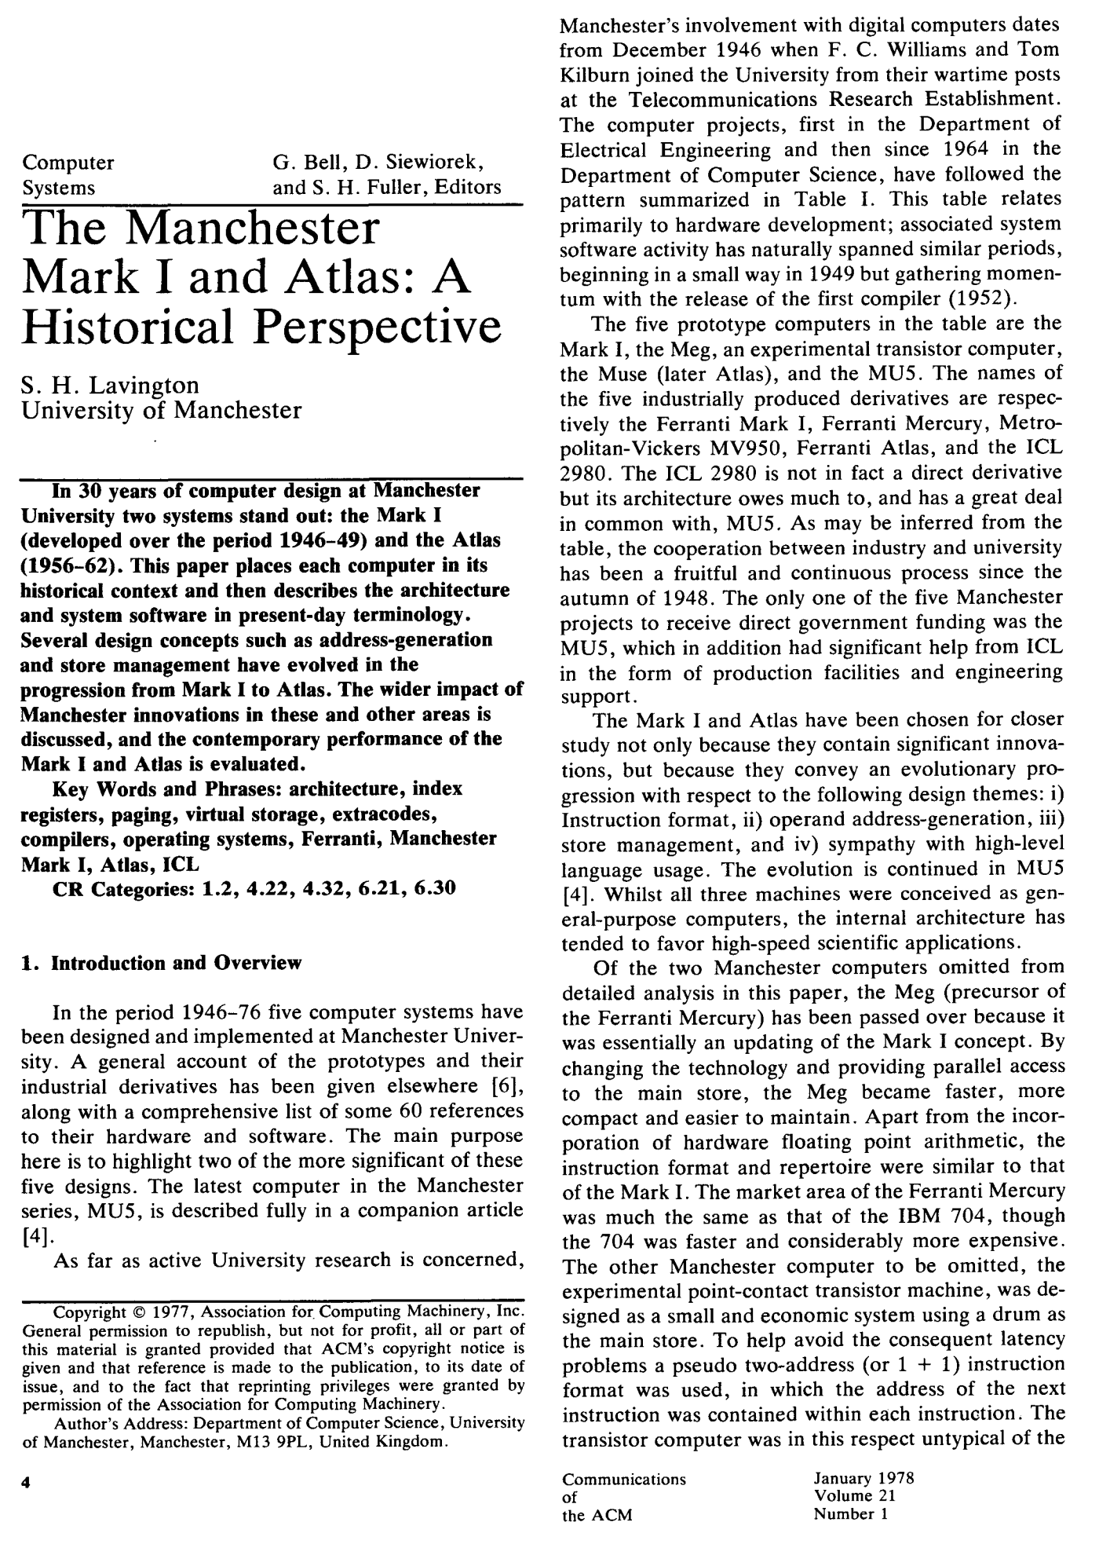
Invention of System Call
ATLAS (1962-1971)
World’s first supercomputer with virtual memory(paging), extracode (system call),…

Slide 20
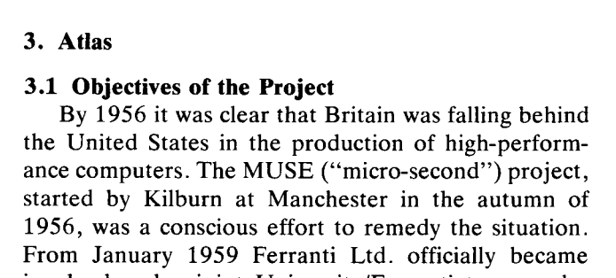

Computer invented by Britain.
Britain declares war on Germany in 1939

Slide 21
Limited Direction Execution
OS @ boot
(kernel mode)
Hardware
initialize trap table
remember address of …
syscall handler
OS @ run
(kernel mode)
Hardware
Program
(user mode)
Create entry for process list
Allocate memory for program
Load program into memory
Setup user stack with argv
Fill kernel stack with reg/PC
return-from -trap
restore regs from kernel stack
move to user mode
jump to main
Run main()
…
Call system
trap into OS

Slide 22
Limited Direction Execution (Cont.)
OS @ run
(kernel mode)
Hardware
Program
(user mode)
(Cont.)
save regs to kernel stack
move to kernel mode
jump to trap handler
Handle trap
Do work of syscall
return-from-trap
restore regs from kernel stack
move to user mode
jump to PC after trap
…
return from main
trap (via exit())
Free memory of process
Remove from process list

Slide 23
Problem 2: Switching Between Processes
How can the OS regain control of the CPU so that it can switch between processes?
A cooperative Approach: Wait for system calls
A Non-Cooperative Approach: The OS takes control

Slide 24
A cooperative Approach: Wait for system calls
Processes periodically give up the CPU by making system calls such as yield.
The OS decides to run some other task.
Application also transfer control to the OS when they do something illegal.
Divide by zero
Try to access memory that it shouldn’t be able to access
Ex) Early versions of the Macintosh OS, The old Xerox Alto system
A process gets stuck in an infinite loop.
→ Reboot the machine

Slide 25
A Non-Cooperative Approach: OS Takes Control
A timer interrupt
During the boot sequence, the OS start the timer.
The timer raise an interrupt every few milliseconds.
When the interrupt is raised :
The currently running process is suspended.
Save enough of the state of the process.
A pre-configured interrupt handler in the OS runs.
A timer interrupt gives OS the ability to
run again on a CPU.

Slide 26
Timer interrupt
Programming the timer interval
Programmed to interrupt CPU periodically
Single CPU: PIT (Programmable Interval Timer)
Multiple CPU: APIC(Advanced Programmable Interrupt Controller)
LAPIC: Local APIC per processor
IO APIC on system bus
// timer
while (1)
i = INTERVAL ;
while (--i > 0) ;
raise interrupt ;

Slide 27
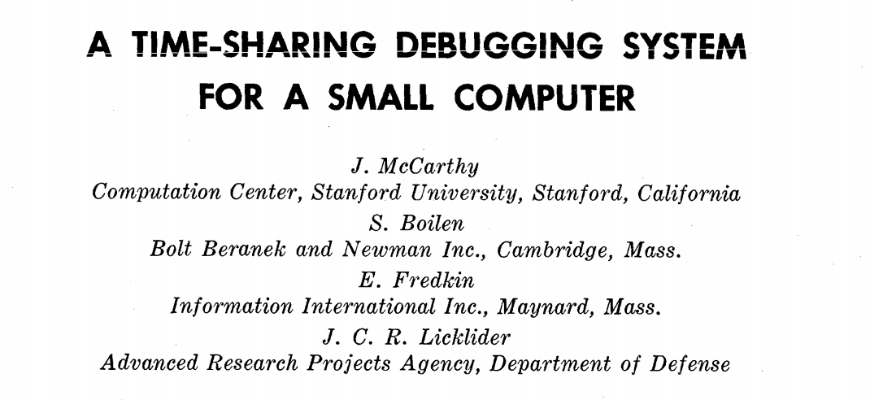
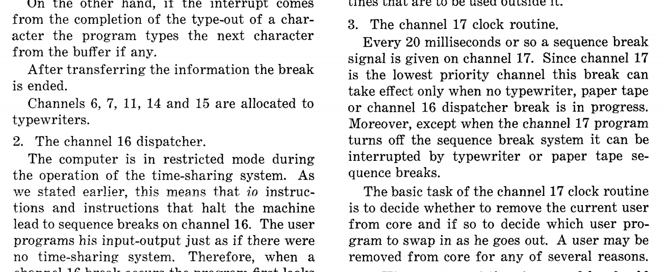
Timer interrupt (1963)

Slide 28
J. McCarthy (1927 – 2011)
Pioneers of AI along with Alan Turing, Marvin Minsky, Allen Newell.
The first to use the term “Artificial Intelligence.”
Inventor of ‘Lisp’ which is a mother of ‘scheme’, a function programming language.

Slide 29
Saving and Restoring Context
Scheduler makes a decision:
Whether to continue running the current process, or switch to a different one.
If the decision is made to switch, the OS executes context switch.

Slide 30
Context Switch
A low-level piece of assembly code
Save a few register values for the current process onto its kernel stack
General purpose registers
PC
kernel stack pointer
Restore a few for the soon-to-be-executing process from its kernel stack
Switch to the kernel stack for the soon-to-be-executing process

Slide 31
Limited Direct Execution Protocol (Timer interrupt)
OS @ boot
(kernel mode)
Hardware
initialize trap table
remember address of …
syscall handler
timer handler
start interrupt timer
start timer
interrupt CPU in X ms
OS @ run
(kernel mode)
Hardware
Program
(user mode)
Process A
…
timer interrupt
save regs(A) to k-stack(A)
move to kernel mode
jump to trap handler

Slide 32
Limited Direct Execution Protocol (Timer interrupt)
OS @ run
(kernel mode)
Hardware
Program
(user mode)
(Cont.)
Handle the trap
Call switch() routine
save regs(A) to proc-struct(A)
restore regs(B) from proc-struct(B)
switch to k-stack(B)
return-from-trap (into B)
restore regs(B) from k-stack(B)
move to user mode
jump to B’s PC
Process B
…

Slide 33
The xv6 Context Switch Code
1 # void swtch(struct context **old, struct context *new);
2 #
3 # Save current register context in old
4 # and then load register context from new.
5 .globl swtch
6 swtch:
7 # Save old registers
8 movl 4(%esp), %eax # put old ptr into eax
9 popl 0(%eax) # save the old IP
10 movl %esp, 4(%eax) # and stack
11 movl %ebx, 8(%eax) # and other registers
12 movl %ecx, 12(%eax)
13 movl %edx, 16(%eax)
14 movl %esi, 20(%eax)
15 movl %edi, 24(%eax)
16 movl %ebp, 28(%eax)
17
18 # Load new registers
19 movl 4(%esp), %eax # put new ptr into eax
20 movl 28(%eax), %ebp # restore other registers
21 movl 24(%eax), %edi
22 movl 20(%eax), %esi
23 movl 16(%eax), %edx
24 movl 12(%eax), %ecx
25 movl 8(%eax), %ebx
26 movl 4(%eax), %esp # stack is switched here
27 pushl 0(%eax) # return addr put in place
28 ret # finally return into new ctxt

Slide 34
Worried About Concurrency?
What happens if, during interrupt or trap handling, another interrupt occurs?
OS handles these situations:
Disable interrupts during interrupt processing
Use a number of sophisticated locking schemes to protect concurrent access to internal data structures.

