Slide 1
Operating Systems

Slide 2
9: Scheduling: Proportional Share

Slide 3
Proportional Share Scheduler
Fair-share scheduler
Guarantee that each job obtain a certain percentage of CPU time.
Not optimized for turnaround or response time

Slide 4
Basic Concept
Tickets
Represent the share of a resource that a process should receive
The percent of tickets represents its share of the system resource in question.
Example
There are two processes, A and B.
Process A has 75 tickets → receive 75% of the CPU
Process B has 25 tickets → receive 25% of the CPU

Slide 5
Lottery scheduling
The scheduler picks a winning ticket.
Load the state of that winning process and runs it.
Example
There are 100 tickets
Process A has 75 tickets: 0 ~ 74
Process B has 25 tickets: 75 ~ 99
Scheduler’s winning tickets:
63 85 70 39 76 17 29 41 36 39 10 99 68 83 63
Resulting scheduler:
A
B
A
A
B
A
A
A
A
A
A
B
A
B
A
The longer these two jobs compete,
The more likely they are to achieve the desired percentages.

Slide 6
Ticket Mechanisms
Ticket currency
A user allocates tickets among their own jobs in whatever currency they would like.
The system converts the currency into the correct global value.
Example
There are 200 tickets (Global currency)
Process A has 100 tickets
Process B has 100 tickets
User A → 500 (A’s currency) to A1 → 50 (global currency)
→ 500 (A’s currency) to A2 → 50 (global currency)
User B → 10 (B’s currency) to B1 → 100 (global currency)

Slide 7
Ticket Mechanisms (Cont.)
Ticket transfer
A process can temporarily hand off its tickets to another process.
Ticket inflation
A process can temporarily raise or lower the number of tickets it owns.
If any one process needs more CPU time, it can boost its tickets.

Slide 8
Implementation
Example: There are there processes, A, B, and C.
Keep the processes in a list sorted with the ticket size: highest ticket first
Job:A
Tix:100
Job:B
Tix:50
Job:C
Tix:250
head
NULL
1 // counter: used to track if we’ve found the winner yet
2 int counter = 0;
3
4 // winner: use some call to a random number generator to
5 // get a value, between 0 and the total # of tickets
6 int winner = getrandom(0, totaltickets);
7
8 // current: use this to walk through the list of jobs
9 node_t *current = head;
10
11 // loop until the sum of ticket values is > the winner
12 while (current) {
13 counter = counter + current->tickets;
14 if (counter > winner)
15 break; // found the winner
16 current = current->next;
17 }
18 // ’current’ is the winner: schedule it...

Slide 9
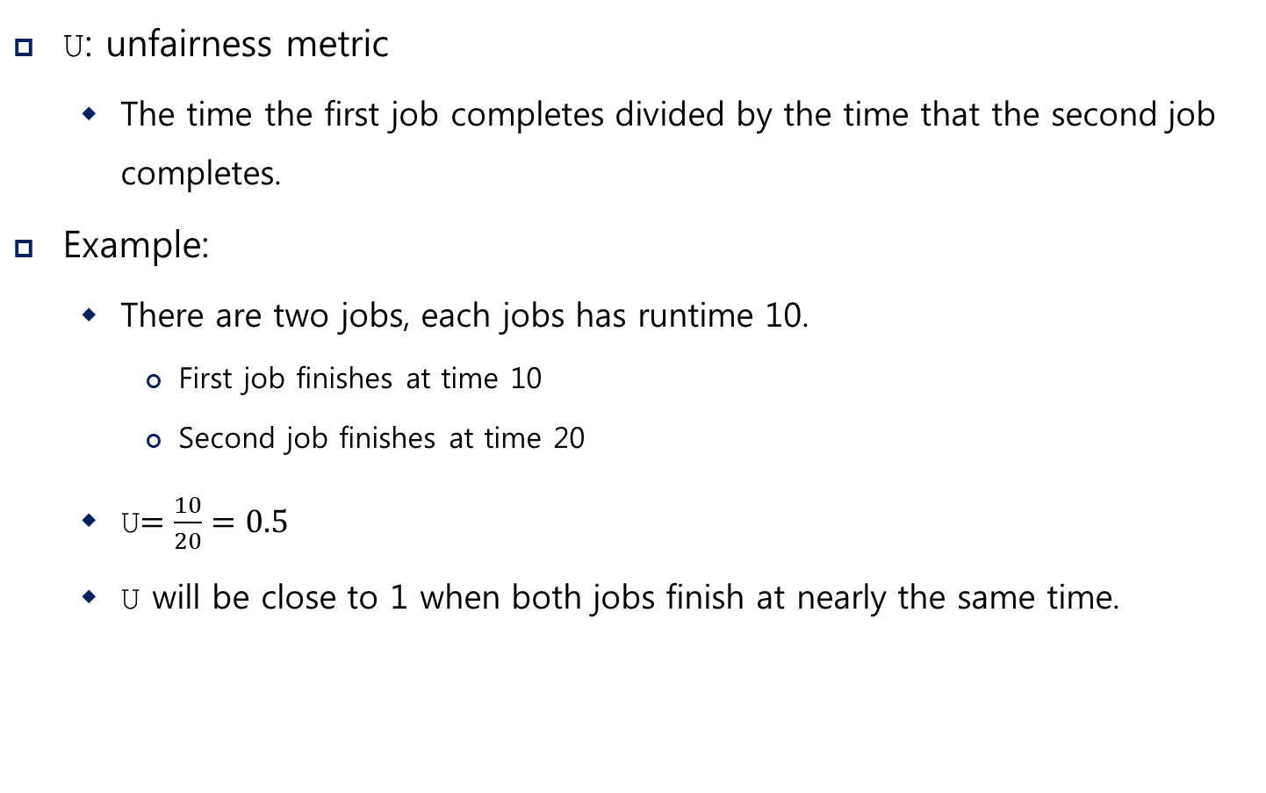
Implementation (Cont.)
U: unfairness metric
The time the first job completes divided by the time that the second job completes.
Example:
There are two jobs, each jobs has runtime 10.
First job finishes at time 10
Second job finishes at time 20
U$=\frac{10}{20}=0.5$
U will be close to 1 when both jobs finish at nearly the same time.

Slide 10
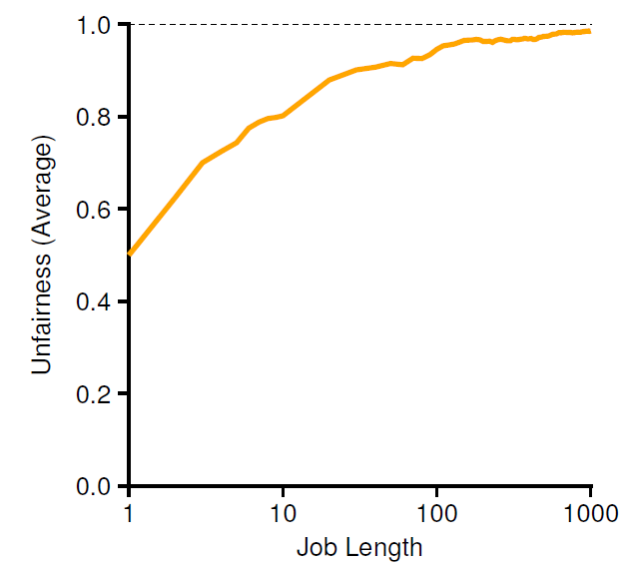
Lottery Fairness Study
There are two jobs.
Each jobs has the same number of tickets (100).
When the job length is not very long,
average unfairness can be quite severe.

Slide 11
Deterministic Approach: Stride Scheduling
Stride of each process
(A large number) / (the number of tickets of the process)
Example: A large number = 10,000
Process A has 100 tickets → stride of A is 100
Process B has 50 tickets → stride of B is 200
A process runs, increment a counter(=pass value) for it by its stride.
Pick the process to run that has the lowest pass value
current = remove_min(queue); // pick client with minimum pass
schedule(current); // use resource for quantum
current->pass += current->stride; // compute next pass using stride
insert(queue, current); // put back into the queue
A pseudo code implementation

Slide 12
Stride Scheduling Example
Pass(A)
(stride=100)
Pass(B)
(stride=200)
Pass(C)
(stride=40)
Who Runs?
0
100
100
100
100
100
200
200
200
0
0
200
200
200
200
200
200
200
0
0
0
40
80
120
120
160
200
A
B
C
C
C
A
C
C
…
Stride scheduling needs to maintain the per process pass value.
If new job enters with pass value 0 it will monopolize the CPU!
Advantage of Lottery scheduling: no per-process state

Slide 13
The Linux Completely Fair Scheduling (CFS)
Completely Fair Scheduling (CFS)
The current CPU scheduler in Linux
Non-fixed timeslice.
CFS assigns process`s timeslice a proportion of the processor.
Priority
Enables control over priority by using nice value.
Efficient data structure.
Use red-black tree for efficient search, insertion and deletion of a process.
Notes:
The current Linux approach achieves similar goals in an alternate manner.
Fair-sharing scheduling, but spending little time making scheduling decision.
Scheduling uses about 5% of overall datacenter CPU time. (Study of Google datacenters, Kanev et al)
Recuing overhead is a key goal in modern scheduler architecture.

Slide 14
Basic
Virtual runtime (vruntime)
Denote how long the process has been executing.
Per-process variable
Increase in proportion with physical (real) time when it runs.
CFS will pick the process with the lowest vruntime to run next.
sched_latency
A typical value is 48 (milliseconds)
process`s timeslice = sched_latency / (the number of process)

Slide 15
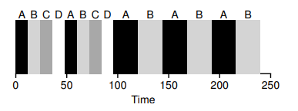
Example
Simple Example
4 processes ( A,B,C,D ) and then 2 processes(C,D) complete.
min_granularity
The minimum timeslice ( 6ms)
Ensure that not too much time is spent in scheduling overhead, When there are too many processes running.

Slide 16
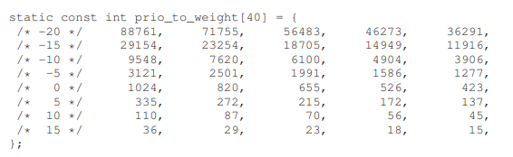
Weight
Nice value
CFS enables controls over process priority.
Nice parameter is integer value and can be set from -20 to +19.
The nice value is mapped to a weight ( value is not important )

Slide 17

Weighting (Niceness)
New timeslice formula
$$time_slice_{k}=\frac{weight_{k}}{\sum_{n=0}^{n−1}{weight_{i}}}∙sched_latency$$
Simple Example
Assign Process `A` a nice value of -5 and process `B` a nice value of 0.
Process | nice value | weight | Time slice
A | -5 | 3121 | 36 ms
B | 0 | 1024 | 12 ms

Slide 18

vruntime with weight
Weighting (Niceness)
vruntime formula
Calculate the actual run time. Scales it inversely by the weight of process.
$$vruntime_{i}=vruntime_{i}+\frac{weight_{0}}{weight_{i}}∙runtime_{i}$$
Simple Example
Process | nice value | weight | Accumulated value
A | -5 | 3121 | 1 * runtime
B | 0 | 1024 | 3 * runtime

Slide 19
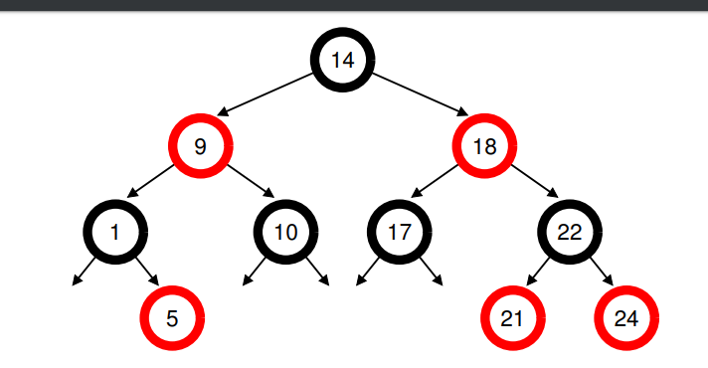
Structure of ready queue
Red-Black Tree
Balanced binary tree ( can address worst-case insertion )
Ordering of Red-Black Tree : O(log n)
Efficiently find the process with minimum virtual runtime.
Only running (or runnable) processes are kept therein.

Slide 20
IO and sleeping process
Dealing with I/O and Sleeping processes
Avoid the situation where some process monopolizes the CPU, if process have significantly small vruntime after sleeping.
Set the vruntime of process to the minimum value found in tree when it wakes up.
Process that sleep for short periods of time frequently do not ever get their fair share of the CPU.
Notes:
만약 2개의 프로세스가 실행되고 있고, 하나의 프로세스가 반복적으로 Sleeping 상태에 들어간다고 가정하자.
2 개의 프로세스의 vruntime의 꾸준히 높아지고 남은 하나는 반복적으로 같은 vruntime을 할당 받는다.
이로 인해 슬립 프로세스는 CPU를 할당 받지 못하였음에도 vruntime이 지속적으로 올라간다.

