Slide 1
Operating Systems

Slide 2
13. The Abstraction: Address Space

Slide 3
Memory Virtualization
What is memory virtualization?
OS virtualizes its physical memory.
OS provides an illusion memory space per each process.
It seems to be seen like each process uses the whole memory .

Slide 4
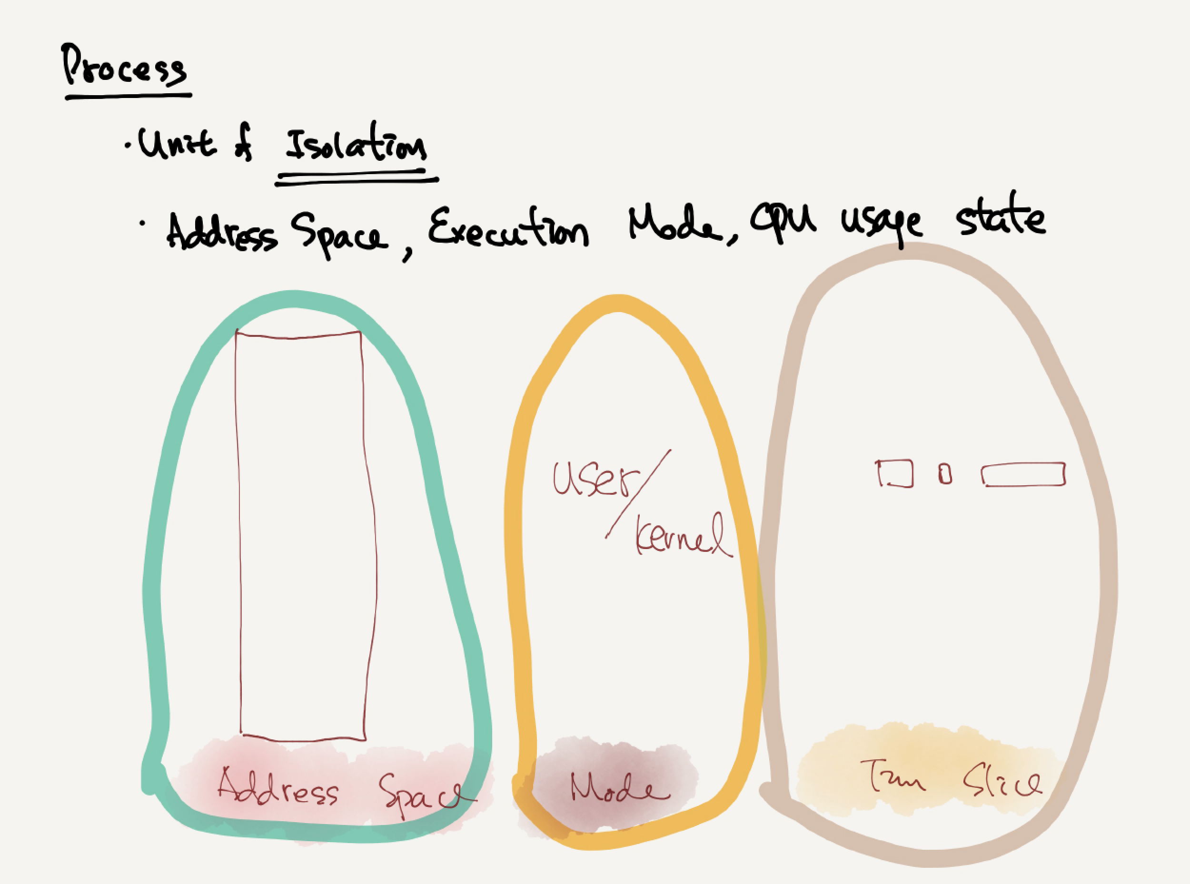

Slide 5
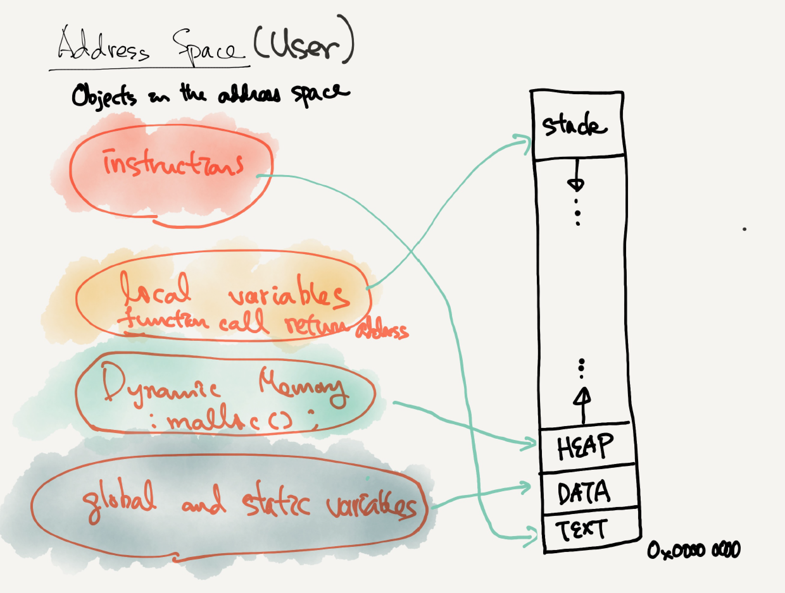

Slide 6
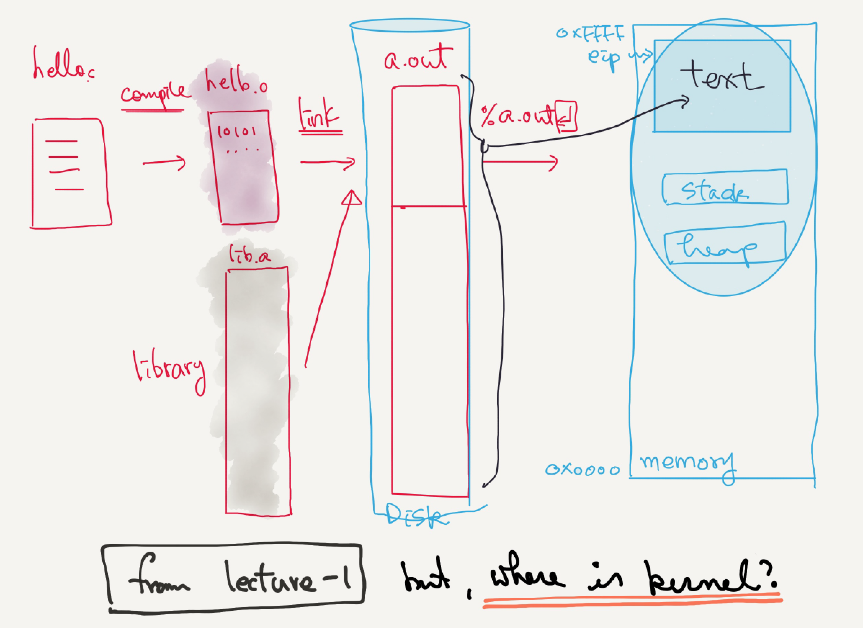

Slide 7
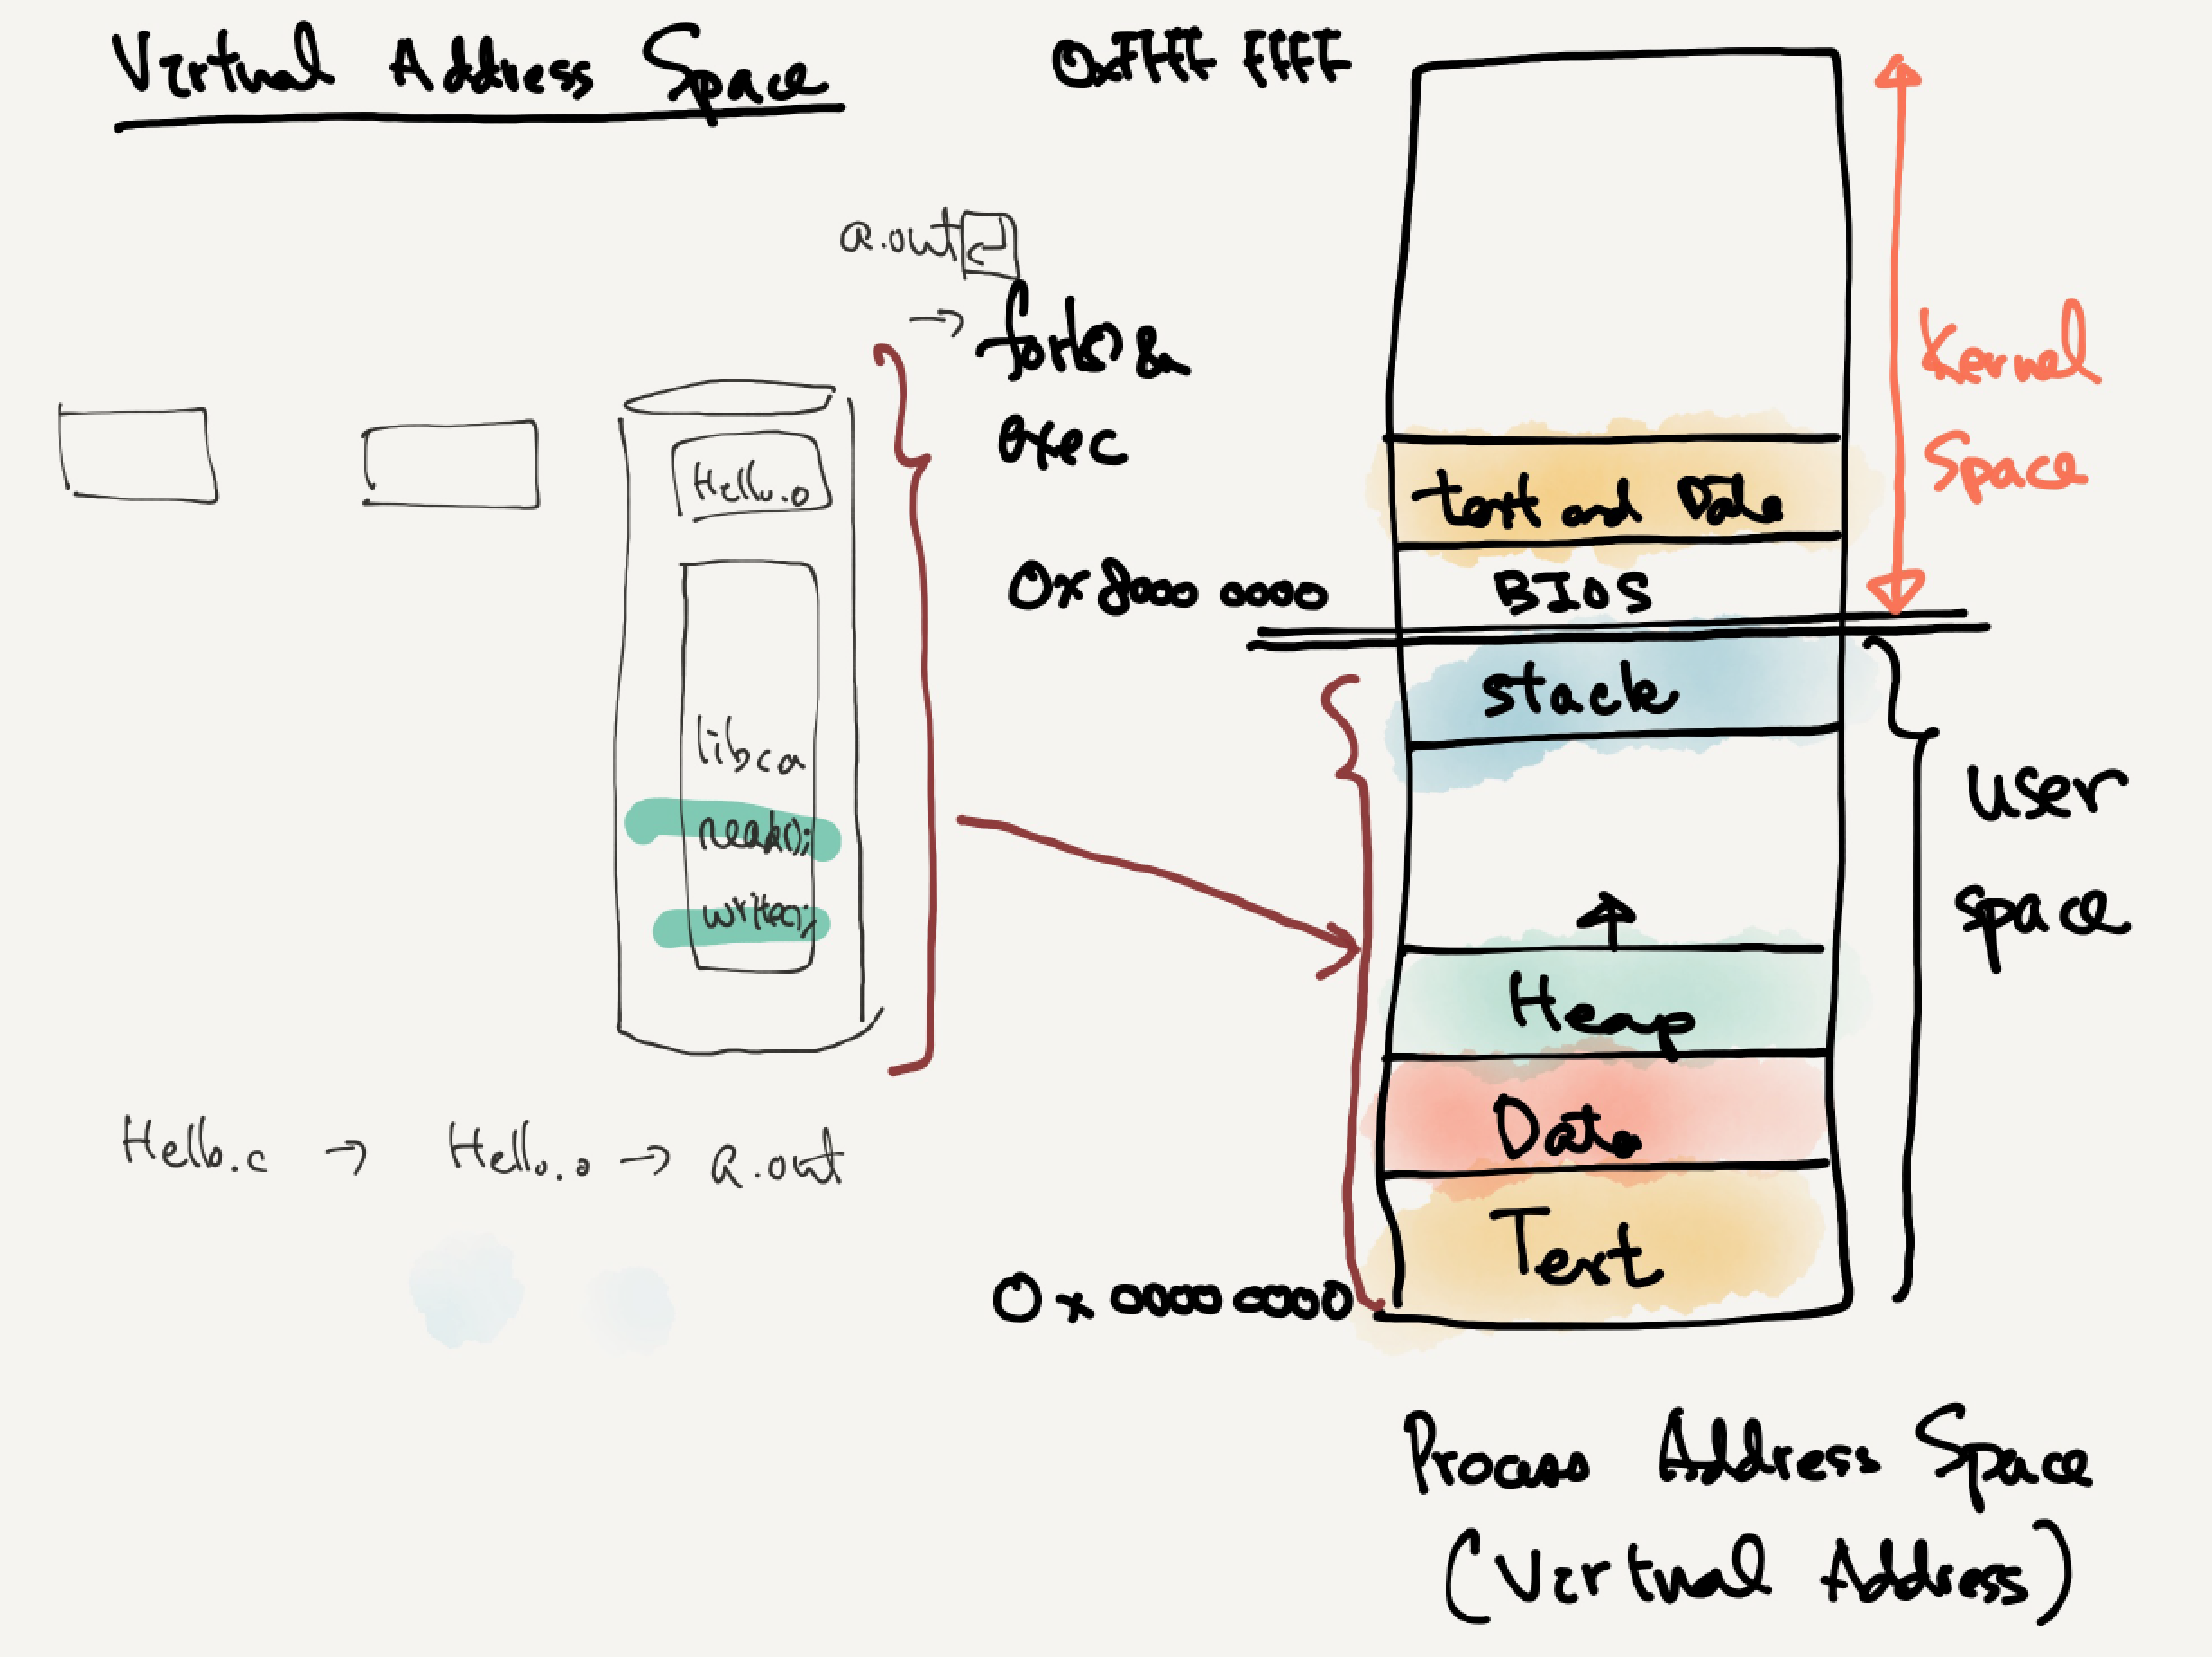

Slide 8
Process structure: struct thread
enum thread_status
{
THREAD_RUNNING, /* Running thread. */
THREAD_READY, /* Not running but ready to run. */
THREAD_BLOCKED, /* Waiting for an event to trigger. */
THREAD_DYING /* About to be destroyed. */
};
pintos/src/threads/thread.h
struct thread
{
/* Owned by thread.c. */
tid_t tid; /* Thread identifier. */
enum thread_status status; /* Thread state. */
char name[16]; /* Name (for debugging purposes). */
uint8_t *stack; /* Saved stack pointer. */
int priority; /* Priority. */
struct list_elem allelem; /* List element for all threads list. */
/* Shared between thread.c and synch.c. */
struct list_elem elem; /* List element. */
#ifdef USERPROG
/* Owned by userprog/process.c. */
uint32_t *pagedir; /* Page directory. */
#endif
/* Owned by thread.c. */
unsigned magic; /* Detects stack overflow. */
};
Notes:
Process structure is probably one of the most important data structure in operating system kernel. he process is created the operating system first creates the object that represents a process that is the data structure. What you you see in the current screen the name of the data structure is tracked thread and Pincus it contains a thread ID and thread peters

Slide 9
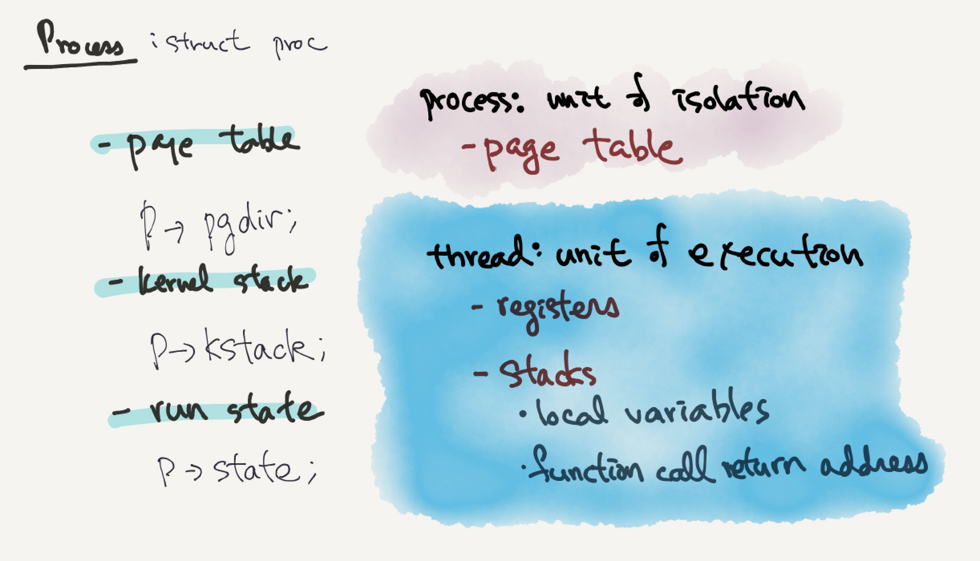
struct thread
p->pagedir
p->stack
p->status

Slide 10
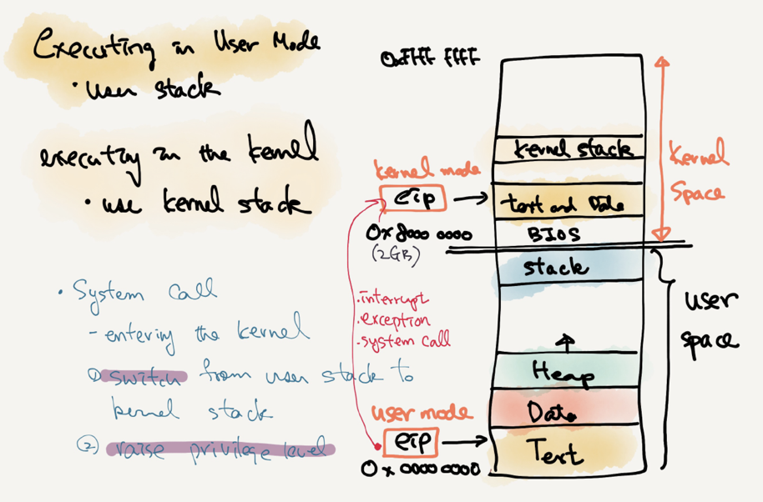
User stack vs. kernel stack
PHYS_BASE
C000 0000 (3GB)

Slide 11
Benefit of Memory Virtualization
Ease of use in programming
Memory efficiency in terms of times and space
The guarantee of isolation for processes as well as OS
Protection from errant accesses of other processes

Slide 12
OS in The Early System
Load only one process in memory.
Poor utilization and efficiency
0KB
Operating System
(code, data, etc.)
64KB
Current
Program
(code, data, etc.)
max
Physical Memory

Slide 13
Multiprogramming and Time Sharing
Load multiple processes in memory.
Execute one for a short while.
Switch processes between them in memory.
Increase utilization and efficiency.
Cause an important protection issue.
Errant memory accesses from other processes
0KB
Operating System
(code, data, etc.)
64KB
Free
128KB
Process C
(code, data, etc.)
192KB
Process B
(code, data, etc.)
256KB
Free
320KB
Process A
(code, data, etc.)
384KB
Free
448KB
Free
512KB
Physical Memory

Slide 14
Address Space
OS creates an abstraction of physical memory.
The address space contains all about a running process.
That is consist of program code, heap, stack and etc.
0KB
Program Code
1KB
Heap
2KB
(free)
15KB
Stack
16KB
Address Space

Slide 15
Address Space(Cont.)
Code
Where instructions live
Heap
Dynamically allocate memory.
malloc in C language
new in object-oriented language
Stack
Store return addresses or values.
Contain local variables arguments to routines.
Program Code
Heap
(free)
Stack
Address Space

Slide 16
Virtual Address
Every address in a running program is virtual.
OS translates the virtual address to physical address
#include <stdio.h>
#include <stdlib.h>
int main(int argc, char *argv[]){
printf("location of code : %p\n", (void *) main);
printf("location of heap : %p\n", (void *) malloc(1));
int x = 3;
printf("location of stack : %p\n", (void *) &x);
return x;
}
A simple program that prints out addresses

Slide 17
Virtual Address(Cont.)
The output in 64-bit Linux machine
Address Space
0x400000
Code
(Text)
location of code : 0x40057d
location of heap : 0xcf2010
location of stack : 0x7fff9ca45fcc
0x401000
Data
0xcf2000
Heap
0xd13000
(free)
heap
stack
0x7fff9ca28000
Stack
0x7fff9ca49000

Slide 18
Components of Virtual Address Space
#include <stdio.h>
#include <stdlib.h>
int InitializedGlobal[1024] = {0,};
int UnintGlobal[1024];
int main() {
int localVar1;
int localVar2;
int *dynamicLocalVar1;
int *dynamicLocalVar2;
dynamicLocalVar1 = malloc(sizeof(int));
dynamicLocalVar2 = malloc(sizeof(int));
printf("code : 0x%x\n", main);
printf("Data : 0x%x\n", &InitializedGlobal);
printf("BSS(Uninit Data) : 0x%x\n", &UnintGlobal);
printf("stack localVar1 : 0x%x\n", &localVar1);
printf("stack localVar2 : 0x%x\n", &localVar2);
printf("heap dynamicLocalVar1: 0x%x\n", dynamicLocalVar1);
printf("heap dynamicLocalVar2: 0x%x\n", dynamicLocalVar2);
return 0;
}

Slide 19
Components of Virtual Address Space
BulGok:~ yjwon$ ./a.out
code : 0xdffde0
Data : 0xe01020
BSS(Uninit Data) : 0xe02020
stack localVar1 : 0xeee00a88
stack localVar2 : 0xeee00a84
heap dynamicLocalVar1: 0xc4c01700
heap dynamicLocalVar2: 0xc4c01710
Minimum heap allocation unit: 16 Byte
0xeee00a88
localVar1
localVar2
Stack
0xeee00a84
(free)
Heap
0xc4c01710
dynamicLocalVar1
dynamicLocalVar1
0xc4c01700
0x00e02020
BSS
0x00e01020
Data
Code
(Text)
0x00dffde0

