Slide 1
Operating Systems

Slide 2
20. Advanced Page Tables

Slide 3

Paging: Linear Tables
We usually have one page table for every process in the system.
Assume that 32-bit address space with 4KB pages and 4-byte page-table entry.
4B
entry
4KB
Page 0
entry
entry
Page 1
…
Page 2
…
entry
Page n
Page Table of
Process A
Physical Memory
Page table size = $\frac{2^{32}}{2^{12}}∗4Byte=4MByte$
Page table are too big and thus consume too much memory.
Notes:
여백 감소 페이지 사이의 간격을 없애기.

Slide 4
Paging: Smaller Tables
Page tables are too big and thus consume too much memory.
Assume that 32-bit address space with 16KB pages and 4-byte page-table entry.
4B
entry
16KB
Page 0
entry
entry
Page 1
…
Page 2
…
entry
Page n
Page Table of
Process A
Physical Memory
$\frac{2^{32}}{2^{16}}∗4=1MB$ per page table
Big pages lead to internal fragmentation.
Notes:
여백 감소 페이지 사이의 간격을 없애기.

Slide 5
Problem
Single page table for the address space of process.
Virtual Address
Space
Physical Memory
0
1
2
3
4
5
6
7
8
9
10
11
12
13
14
15
16
17
18
19
20
21
22
23
24
25
PFN | valid | prot | present | dirty
10 | 1 | r-x | 1 | 0
- | 0 | - | - | -
- | 0 | - | - | -
- | 0 | - | - | -
15 | 1 | rw- | 1 | 1
… | … | … | … | …
- | 0 | - | - | -
3 | 1 | rw- | 1 | 1
23 | 1 | rw- | 1 | 1
code
 | 0
 | 1
 | 2
 | 3
 | 4
 | 5
 | 6
 | 7
 | 8
 | 9
 | 10
 | 11
 | 12
 | 13
 | 14 15
Allocate
heap
A Page Table For 16KB Address Space
stack
A 16KB Address Space with 1KB Pages

Slide 6
Problem
Most of the page table is unused, full of invalid entries.
Virtual Address
Space
Physical Memory
0
1
2
3
4
5
6
7
8
9
10
11
12
13
14
15
16
17
18
19
20
21
22
23
24
25
 | 0
 | 1
 | 2
 | 3
 | 4
 | 5
 | 6
 | 7
 | 8
 | 9
 | 10
 | 11
 | 12
 | 13
 | 14 15
PFN | valid | prot | present | dirty
9 | 1 | r-x | 1 | 0
- | 0 | - | - | -
- | 0 | - | - | -
- | 0 | - | - | -
15 | 1 | rw- | 1 | 1
… | … | … | … | …
- | 0 | - | - | -
3 | 1 | rw- | 1 | 1
23 | 1 | rw- | 1 | 1
code
Allocate
heap
A Page Table For 16KB Address Space
stack
A 16KB Address Space with 1KB Pages

Slide 7
Hybrid Approach: Paging and Segments
Page table for each segment
the base register for each of these segments contains the physical address of a linear page table for that segment.
The bound register: indicate the end of the page table.
Example: Each process has three page tables associated with it.
31 30 29 28 27 26 25 24 23 22 21 20 19 18 17 16 15 14 13 12 11 10 9 8 7 6 5 4 3 2 1 0
Seg
VPN
Offset
32-bit Virtual address space with 4KB pages
Seg value | Content
00 | unused segment
01 | code
10 | heap
11 | stack

Slide 8
TLB miss on Hybrid Approach
The hardware gets physical address from page table.
The hardware uses the segment bits(SN) to determine which base and bounds pair to use.
The hardware then takes the physical address therein and combines it with the VPN as follows to form the address of the page table entry(PTE) .
01: SN = (VirtualAddress & SEG_MASK) >> SN_SHIFT
02: VPN = (VirtualAddress & VPN_MASK) >> VPN_SHIFT
03: AddressOfPTE = Base[SN] + (VPN * sizeof(PTE))

Slide 9
Problem of Hybrid Approach
Hybrid Approach is not without problems.
If we have a large but sparsely-used heap, we can still end up with a lot of page table waste.
Causing external fragmentation to arise again.

Slide 10
Multi-level Page Tables
Turn the linear page table into something like a tree.
Chop up the page table into page-sized units.
If an entire page of page-table entries is invalid, don’t allocate that page of the page table at all.
To track whether a page of the page table is valid, use a new structure, called page directory.

Slide 11
Multi-level Page Tables: Page directory
Linear Page Table
PBTR
201
Multi-level Page Table
prot
PBTR
200
valid
1 | rx | 12
1 | rx | 13
0 | - | -
1 | rw | 100
0 | - | -
0 | - | -
0 | - | -
0 | - | -
0 | - | -
0 | - | -
0 | - | -
0 | - | -
PFN
valid
valid
prot
PFN
PFN201
PFN
1 | 201
0 | -
0 | -
1 | 203
1 | rx | 12
1 | rx | 13
0 | - | -
1 | rw | 100
PFN200
PFN201
PFN202
The Page Directory
[Page 1 of PT:Not Allocated]
PFN203
[Page 2 of PT: Not Allocated]
0 | - | -
0 | - | -
1 | rw | 86
1 | rw | 15
0 | - | -
0 | - | -
1 | rw | 86
1 | rw | 15
PFN204
PFN204

Slide 12
Multi-level Page Tables
Page Directory
The page directory contains one entry per page of the page table.
It consists of a number of page directory entries(PDE).
PDE has a valid bit and page frame number(PFN).
Advantage
Only allocates page-table space in proportion to the amount of address space you are using.
The OS can grab the next free page when it needs to allocate or grow a page table.
Disadvantage
Multi-level table is a small example of a time-space trade-off.
Complexity.

Slide 13
Example
code
code
(free)
(free)
heap
heap
(free)
(free)
stack
stack
Page 0,1: code
Page 4,5: heap
Page 254, 255: stack
0000 0000
0000 0001
...
0000 0100
0000 0101
…..
1111 1110
1111 1111

Slide 14
Example
Flag | Detail
Address space | 16 KB (2^14 Byte)
Page size | 64 byte
Virtual address | 14 bit
VPN | 8 bit
Offset | 6 bit
Page table entry | 4 Byte
A 16-KB Address Space With 64-byte Pages
13 | 12 | 11 | 10 | 9 | 8 | 7 | 6 | 5 | 4 | 3 | 2 | 1 | 0
VPN
Offset
Single level paging
256 page table entries: 2^8 entries
Page table size: 256 * 4 Byte = 1 Kbyte
Sixteen pages (64 byte each): 1024/64 = 16

Slide 15
Example: single level page table
PFN: 10
PFN: 23
Page 0
16 entries
PFN: 80
PFN: 59
2^8 page table entries
Page 1
. . .
Page 15
PFN: 55
PFN: 45

Slide 16
Example: two level paging
Page directory index
A page table consists of 16 pages.
16 entries for page directory: one entry per page of the page table.
16* 4 byte = 64 byte is required for page directory. → it can fit in a page.
4 bits for page directory index.
PDEAddr = PageDirBase + (PDIndex * sizeof(PDE))
If the page-directory entry is invalid, raise an exception (The access is invalid).
Page Directory Index
13 | 12 | 11 | 10 | 9 | 8 | 7 | 6 | 5 | 4 | 3 | 2 | 1 | 0
VPN
Offset

Slide 17
Example: two level paging
Page Table pages
16 entries
Page 0
Page page directory
16 entries
Page 1
16 entries
16 entries
Page 2
16 entries
Page 15

Slide 18
Example: Page Table index
Page table index
It is used to find the address of the page table entry.
PTEAddr = (PDE.PFN <<SHIFT) + (PTIndex * sizeof(PTE))
Page Directory Index
Page Table Index
13 | 12 | 11 | 10 | 9 | 8 | 7 | 6 | 5 | 4 | 3 | 2 | 1 | 0
VPN
Offset
14-bits Virtual address

Slide 19
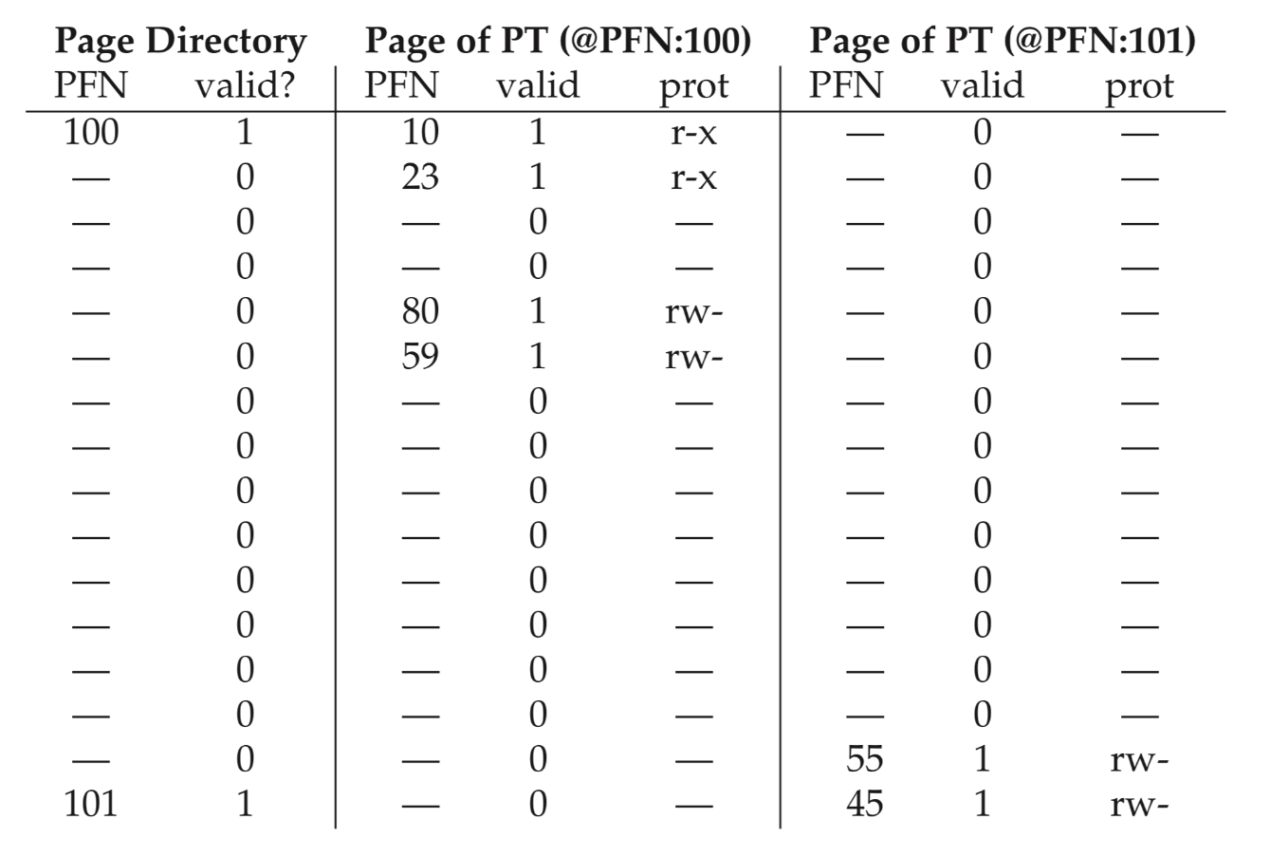
Examples
code
PFN: 10
PFN: 23
heap
PFN: 80
PFN: 59
Single level paging: 16 pages
→ Two level paging: 3 pages
stack
PFN: 55
PFN: 45

Slide 20
More than Two Levels
In some cases, a deeper tree is required.
Consider the following address space.
29 28 27 26 25 24 23 22 21 20 19 18 17 16 15 14 13 12 11 10 9 8 7 6 5 4 3 2 1 0
VPN
offset
Flag | Detail
Virtual address | 30 bit
Page size | 512 byte
VPN | 21 bit
Offset | 9 bit

Slide 21
More than Two Level : Page Table Index
Number of pages in a page table
2^21 page table entries
2^7 (128) PTE’s in a single page (512/4, 512 page size, 4 byte pte size)
2^14 pages in a page table
Number of page directory entries: 2^14
29 28 27 26 25 24 23 22 21 20 19 18 17 16 15 14 13 12 11 10 9 8 7 6 5 4 3 2 1 0
Page Directory Index
Page Table Index
VPN
offset
Flag | Detail
Virtual address | 30 bit
Page size | 512 byte
VPN | 21 bit
Offset | 9 bit
Page entry per page | 128 PTEs (512/4)

Slide 22
Single level page table
PFN: 10
PFN: 23
PFN: 80
PFN: 59
2^21
PFN: 55
PFN: 45

Slide 23
two level page table
Page directory
Page table page
0th
2^7
2^14
(2^14-1)th
2^7

Slide 24
More than Two Level : Page Directory
The number of pages in a page directory: 2^14/2^7 = 2^7 (128)
Page the page directory
30 29 28 27 26 25 24 23 22 21 20 19 18 17 16 15 14 13 12 11 10 9 8 7 6 5 4 3 2 1 0
PD Index 0
PD Index 1
Page Table Index
VPN
offset

Slide 25
three level page table
Page table page
Page table page
2^7
2^7
Page directory
2^7
2^7
Page table page
2^7
2^7

Slide 26
Multi-level Page Table Control Flow
01: VPN = (VirtualAddress & VPN_MASK) >> SHIFT
02: (Success,TlbEntry) = TLB_Lookup(VPN)
03: if(Success == True) //TLB Hit
04: if(CanAccess(TlbEntry.ProtectBits) == True)
05: Offset = VirtualAddress & OFFSET_MASK
06: PhysAddr = (TlbEntry.PFN << SHIFT) | Offset
07: Register = AccessMemory(PhysAddr)
08: else RaiseException(PROTECTION_FAULT);
09: else // perform the full multi-level lookup
(1 lines) extract the virtual page number(VPN)
(2 lines) check if the TLB holds the translation for this VPN
(5-8 lines) extract the page frame number from the relevant TLB entry, and form the desired physical address and access memory

Slide 27
Multi-level Page Table Control Flow
11: else
12: PDIndex = (VPN & PD_MASK) >> PD_SHIFT
13: PDEAddr = PDBR + (PDIndex * sizeof(PDE))
14: PDE = AccessMemory(PDEAddr)
15: if(PDE.Valid == False)
16: RaiseException(SEGMENTATION_FAULT)
17: else // PDE is Valid: now fetch PTE from PT
(11 lines) extract the Page Directory Index(PDIndex)
(13 lines) get Page Directory Entry(PDE)
(15-17 lines) Check PDE valid flag. If valid flag is true, fetch Page Table entry from Page Table

Slide 28
The Translation Process: Remember the TLB
18: PTIndex = (VPN & PT_MASK) >> PT_SHIFT
19: PTEAddr = (PDE.PFN << SHIFT) + (PTIndex * sizeof(PTE))
20: PTE = AccessMemory(PTEAddr)
21: if(PTE.Valid == False)
22: RaiseException(SEGMENTATION_FAULT)
23: else if(CanAccess(PTE.ProtectBits) == False)
24: RaiseException(PROTECTION_FAULT);
25: else
26: TLB_Insert(VPN, PTE.PFN , PTE.ProtectBits)
27: RetryInstruction()

Slide 29
Inverted Page Tables
Keeping a single page table that has an entry for each physical page of the system.
The entry tells us which process is using this page, and which virtual page of that process maps to this physical page.

Slide 30
Summary
Reducing the page table size
Per segment page table
Multi-level paging
Efficient use of memory
Severe TLB miss

