Slide 1
Operating Systems

Slide 2
29. Lock-based Concurrent Data Structures

Slide 3
Lock-based Concurrent Data structure
Adding locks to a data structure makes the structure thread safe.
How locks are added determine both the correctness and performance of the data structure.

Slide 4
Example: Concurrent Counters without Locks
Simple but not scalable
1 typedef struct __counter_t {
2 int value;
3 } counter_t;
4
5 void init(counter_t *c) {
6 c->value = 0;
7 }
8
9 void increment(counter_t *c) {
10 c->value++;
11 }
12
13 void decrement(counter_t *c) {
14 c->value--;
15 }
16
17 int get(counter_t *c) {
18 return c->value;
19 }
Notes:
Let look at the following data structure,, counter. We have four functions init, increment, decrement and get. Init function initializes the counter value to 0. increment and decrement increases and decreases the value of the counter, respectively. Get function retrieves the counter value.

Slide 5
Example: Concurrent Counters with Locks
Add a single lock.
The lock is acquired when calling a routine that manipulates the data structure.
1 typedef struct __counter_t {
2 int value;
3 pthread_lock_t lock;
4 } counter_t;
5
6 void init(counter_t *c) {
7 c->value = 0;
8 Pthread_mutex_init(&c->lock, NULL);
9 }
10
11 void increment(counter_t *c) {
12 Pthread_mutex_lock(&c->lock);
13 c->value++;
14 Pthread_mutex_unlock(&c->lock);
15 }
16
Notes:
To make this counter thread safe, we can add a lock to the counter structure as follows. Then, we can modify the associated functions as follows. For init function, we initizlie the counter. For increment, we protect the increase operation with the locks. We obtain the lock before updating the counter. We release the lock after we update the counter.

Slide 6
Example: Concurrent Counters with Locks (Cont.)
(Cont.)
17 void decrement(counter_t *c) {
18 Pthread_mutex_lock(&c->lock);
19 c->value--;
20 Pthread_mutex_unlock(&c->lock);
21 }
22
23 int get(counter_t *c) {
24 Pthread_mutex_lock(&c->lock);
25 int rc = c->value;
26 Pthread_mutex_unlock(&c->lock);
27 return rc;
28 }
Notes:
We do the similar thing to the decrement and get functions. We acquire and release the lock before we aceces the counter variable.

Slide 7
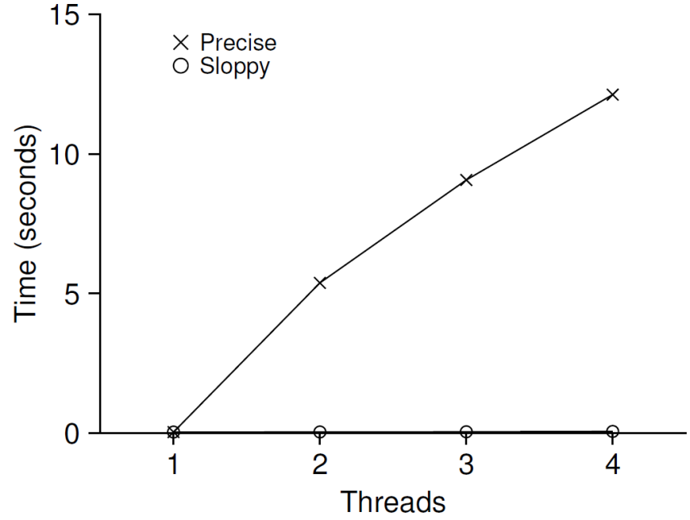
The performance costs of the simple approach
Each thread updates a single shared counter.
Each thread updates the counter one million times.
iMac with four Intel 2.7GHz i5 CPUs.
Performance of
Traditional vs. Sloppy Counters
(Threshold of Sloppy, S, is set to 1024)
Synchronized counter scales poorly.
Notes:
Adding a simple lock successfully avoid the race condition on updating and retrieving the counter value. However, what about the performance? We do simple experiment. Each thread increases the counter one million times. We measure the time to increase the counter value under varying number of threads. There are four CPU cores. Ideally, the total execution time should remain the same when we increase the number of threads. However, the totoal execution time increases linearly as we increase the number of threads. Even though the threads run on its own CPU core, they fail to be executed in parallel. Plain lock fails to scale. The reason is lock. A group of researcher has propposed a concept of “sloppy counter”.

Slide 8
Perfect Scaling
Even though more work is done, it is done in parallel.
The time taken to complete the task is not increased.

Slide 9
Sloppy counter
The sloppy counter works by representing …
A single logical counter via numerous local physical counters, on per CPU core
A single global counter
There are locks:
One fore each local counter and one for the global counter
Example: on a machine with four CPUs
Four local counters
One global counter
Notes:
Sloppy counter consists of one global counter and a number of local coiunters. Sloppy counter defines a local counter for each cpu core. If there are fou CPU’s there are four local counters and one global conters.

Slide 10
The basic idea of sloppy counting
When a thread running on a core wishes to increment the counter.
It increment its local counter.
Each CPU has its own local counter:
Threads across CPUs can update local counters without contention.
Thus counter updates are scalable.
The local values are periodically transferred to the global counter.
Acquire the global lock
Increment it by the local counter’s value
The local counter is then reset to zero.
Notes:
The basic idea of sloppy counting is as follows. When it needs to update the counter, it updates the local counter. There is no contention. The local counter value is periodically folded to the global counter. It is performed as follows. <read the lecture slide.>

Slide 11
The basic idea of sloppy counting (Cont.)
How often the local-to-global transfer occurs is determined by a threshold, S (sloppiness).
The smaller S:
The more the counter behaves like the non-scalable counter.
The bigger S:
The more scalable the counter.
The further off the global value might be from the actual count.
Notes:
Read the lecture

Slide 12

Sloppy counter example
Tracing the Sloppy Counters
The threshold S is set to 5.
There are threads on each of four CPUs
Each thread updates their local counters $L_{1}$… $L_{4}$.
Time |  |  |  |  | G
0 | 0 | 0 | 0 | 0 | 0
1 | 0 | 0 | 1 | 1 | 0
2 | 1 | 0 | 2 | 1 | 0
3 | 2 | 0 | 3 | 1 | 0
4 | 3 | 0 | 3 | 2 | 0
5 | 4 | 1 | 3 | 3 | 0
6 | 5 → 0 | 1 | 3 | 4 | 5 (from )
7 | 0 | 2 | 4 | 5 → 0 | 10 (from )

Slide 13
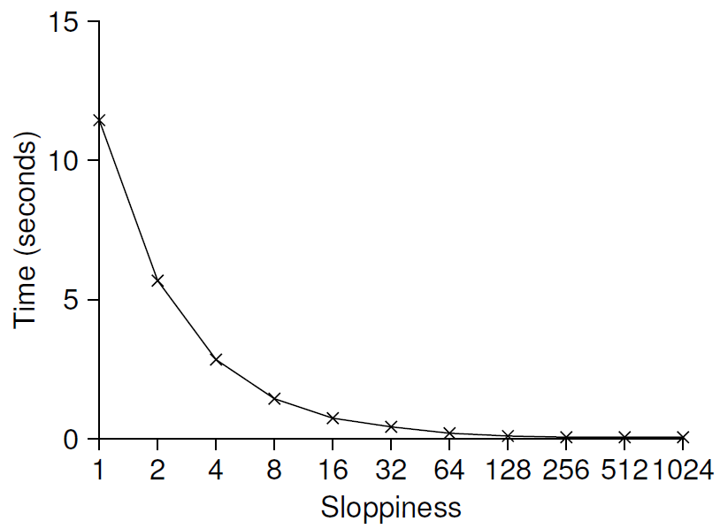
Importance of the threshold value S
Each of four threads increments a counter 1 million times on four CPUs.
Low S → Performance is poor, The global count is always quite accurate.
High S → Performance is excellent, The global count lags.
Scaling Sloppy Counters

Slide 14
Sloppy Counter Implementation
1 typedef struct __counter_t {
2 int global; // global count
3 pthread_mutex_t glock; // global lock
4 int local[NUMCPUS]; // local count (per cpu)
5 pthread_mutex_t llock[NUMCPUS]; // ... and locks
6 int threshold; // update frequency
7 } counter_t;
8
9 // init: record threshold, init locks, init values
10 // of all local counts and global count
11 void init(counter_t *c, int threshold) {
12 c->thres hold = threshold;
13
14 c->global = 0;
15 pthread_mutex_init(&c->glock, NULL);
16
17 int i;
18 for (i = 0; i < NUMCPUS; i++) {
19 c->local[i] = 0;
20 pthread_mutex_init(&c->llock[i], NULL);
21 }
22 }
23
Notes:
This is a code for sloppy counter. We first define the counter structure. It has global counter and a number of local counters. There are one lock for the global counter and one lock for each of the local counters. In ths init statement, it initializes all counters and locks.

Slide 15
Sloppy Counter Implementation (Cont.)
(Cont.)
24 // update: usually, just grab local lock and update local amount
25 // once local count has risen by ’threshold’, grab global
26 // lock and transfer local values to it
27 void update(counter_t *c, int threadID, int amt) {
28 pthread_mutex_lock(&c->llock[threadID]);
29 c->local[threadID] += amt; // assumes amt > 0
30 if (c->local[threadID] >= c->threshold) { // transfer to global
31 pthread_mutex_lock(&c->glock);
32 c->global += c->local[threadID];
33 pthread_mutex_unlock(&c->glock);
34 c->local[threadID] = 0;
35 }
36 pthread_mutex_unlock(&c->llock[threadID]);
37 }
38
39 // get: just return global amount (which may not be perfect)
40 int get(counter_t *c) {
41 pthread_mutex_lock(&c->glock);
42 int val = c->global;
43 pthread_mutex_unlock(&c->glock);
44 return val; // only approximate!
45 }
Notes:
Let us look at the update function. It first acquires a lock on the local counter it needs to update. Then, it updates the associated local counter with a predefined amount. When, the value of the local counter exceeds a predefined threeshold, it transfers the value of the local counter to the global counter and resets the value of the local counter to 0. When it adds the local counter to the global counter, it also acquires a lock on the global counter.
For get operation, we need to acquire the lock on the global variable before we retrieve the counter value. We release the lock on the global variable after we finish reading it.

Slide 16
Concurrent Linked Lists
1 // basic node structure
2 typedef struct __node_t {
3 int key;
4 struct __node_t *next;
5 } node_t;
6
7 // basic list structure (one used per list)
8 typedef struct __list_t {
9 node_t *head;
10 pthread_mutex_t lock;
11 } list_t;
12
13 void List_Init(list_t *L) {
14 L->head = NULL;
15 pthread_mutex_init(&L->lock, NULL);
16 }
Notes:
Now we examine the concurrent linked list. The linked list is protected by the lock. List is initialized with. When performing an insert operation, we first locks the structyure, peformnace

Slide 17
Concurrent Linked Lists (Cont.)
18 int List_Insert(list_t *L, int key) {
19 pthread_mutex_lock(&L->lock);
20 node_t *new = malloc(sizeof(node_t));
21 if (new == NULL) {
22 perror("malloc");
23 pthread_mutex_unlock(&L->lock);
24 return -1; // fail
25 }
26 new->key = key;
27 new->next = L->head;
28 L->head = new;
29 pthread_mutex_unlock(&L->lock);
30 return 0; // success
31 }
32
33 int List_Lookup(list_t *L, int key) {
34 pthread_mutex_lock(&L->lock);
35 node_t *curr = L->head;
36 while (curr) {
37 if (curr->key == key) {
38 pthread_mutex_unlock(&L->lock);
39 return 0; // success
40 }
41 curr = curr->next;
42 }
43 pthread_mutex_unlock(&L->lock);
44 return -1; // failure
45 }

Slide 18
Concurrent Linked Lists (Cont.)
The code acquires a lock in the insert routine upon entry.
The code releases the lock upon exit.
If malloc() happens to fail, the code must also release the lock before failing the insert.
This kind of exceptional control flow has been shown to be quite error prone.
Solution: The lock and release only surround the actual critical section in the insert code

Slide 19
Concurrent Linked List: Rewritten
1 void List_Init(list_t *L) {
2 L->head = NULL;
3 pthread_mutex_init(&L->lock, NULL);
4 }
5
6 void List_Insert(list_t *L, int key) {
7 // synchronization not needed
8 node_t *new = malloc(sizeof(node_t));
9 if (new == NULL) {
10 perror("malloc");
11 return;
12 }
13 new->key = key;
14
15 // just lock critical section
16 pthread_mutex_lock(&L->lock);
17 new->next = L->head;
18 L->head = new;
19 pthread_mutex_unlock(&L->lock);
20 }
21

Slide 20
Concurrent Linked List: Rewritten (Cont.)
(Cont.)
22 int List_Lookup(list_t *L, int key) {
23 int rv = -1;
24 pthread_mutex_lock(&L->lock);
25 node_t *curr = L->head;
26 while (curr) {
27 if (curr->key == key) {
28 rv = 0;
29 break;
30 }
31 curr = curr->next;
32 }
33 pthread_mutex_unlock(&L->lock);
34 return rv; // now both success and failure
35 }

Slide 21
Scaling Linked List
Hand-over-hand locking (lock coupling)
Add a lock per node of the list instead of having a single lock for the entire list.
When traversing the list,
First grabs the next node’s lock.
And then releases the current node’s lock.
Enable a high degree of concurrency in list operations.
However, in practice, the overheads of acquiring and releasing locks for each node of a list traversal is prohibitive.

Slide 22
Michael and Scott Concurrent Queues
There are two locks.
One for the head of the queue.
One for the tail.
The goal of these two locks is to enable concurrency of enqueue and dequeue operations.
Add a dummy node
Allocated in the queue initialization code
Enable the separation of head and tail operations

Slide 23
Concurrent Queues (Cont.)
1 typedef struct __node_t {
2 int value;
3 struct __node_t *next;
4 } node_t;
5
6 typedef struct __queue_t {
7 node_t *head;
8 node_t *tail;
9 pthread_mutex_t headLock;
10 pthread_mutex_t tailLock;
11 } queue_t;
12
13 void Queue_Init(queue_t *q) {
14 node_t *tmp = malloc(sizeof(node_t));
15 tmp->next = NULL;
16 q->head = q->tail = tmp;
17 pthread_mutex_init(&q->headLock, NULL);
18 pthread_mutex_init(&q->tailLock, NULL);
19 }
20

Slide 24
Concurrent Queues (Cont.)
21 void Queue_Enqueue(queue_t *q, int value) {
22 node_t *tmp = malloc(sizeof(node_t));
23 assert(tmp != NULL);
24 tmp->value = value;
25 tmp->next = NULL;
26
27 pthread_mutex_lock(&q->tailLock);
28 q->tail->next = tmp;
29 q->tail = tmp;
30 pthread_mutex_unlock(&q->tailLock);
31 }
32
33 int Queue_Dequeue(queue_t *q, int *value) {
34 pthread_mutex_lock(&q->headLock);
35 node_t *tmp = q->head;
36 node_t *newHead = tmp->next;
37 if (newHead == NULL) {
38 pthread_mutex_unlock(&q->headLock);
39 return -1; // queue was empty
40 }
41 *value = newHead->value;
42 q->head = newHead;
43 pthread_mutex_unlock(&q->headLock);
44 free(tmp);
45 return 0;
46 }

Slide 25
Concurrent Hash Table
Focus on a simple hash table
The hash table does not resize.
Built using the concurrent lists
It uses a lock per hash bucket each of which is represented by a list.

Slide 26
Concurrent Hash Table
1 #define BUCKETS (101)
2
3 typedef struct __hash_t {
4 list_t lists[BUCKETS];
5 } hash_t;
6
7 void Hash_Init(hash_t *H) {
8 int i;
9 for (i = 0; i < BUCKETS; i++) {
10 List_Init(&H->lists[i]);
11 }
12 }
13
14 int Hash_Insert(hash_t *H, int key) {
15 int bucket = key % BUCKETS;
16 return List_Insert(&H->lists[bucket], key);
17 }
18
19 int Hash_Lookup(hash_t *H, int key) {
20 int bucket = key % BUCKETS;
21 return List_Lookup(&H->lists[bucket], key);
22 }

Slide 27
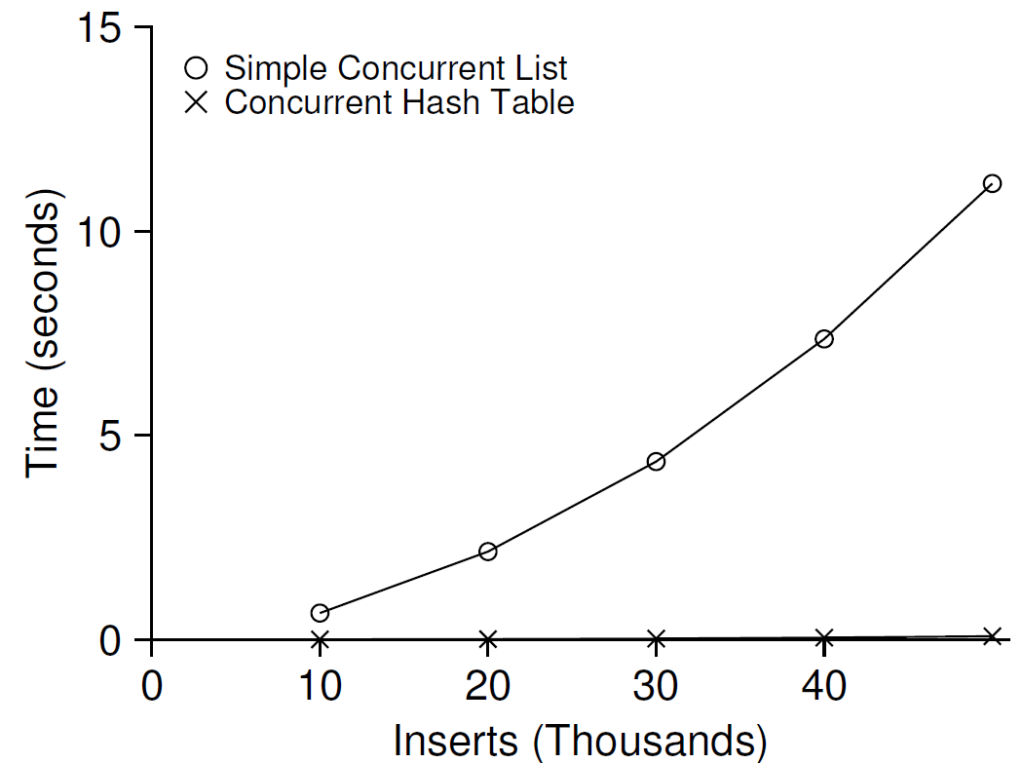
Performance of Concurrent Hash Table
From 10,000 to 50,000 concurrent updates from each of four threads.
iMac with four Intel 2.7GHz i5 CPUs.
The simple concurrent hash table scales magnificently.

Slide 28
Summary
Sloppy counter
Concurrent list
Concurrent queue
Concurrent hash table

