Slide 1
MetricLens AI
Lightweight time-series forecasting + integer-programming resizing for SLO-safe minimal allocation
Team Googling — Lee Yongwon · Seo Hannyeong · Song Simwoo

Slide 2










System architecture
3 logical layers + live GCP data plane · Cloud Run
Presentation
browser SPA on Cloud Run
React 19 SPA
Vite · ECharts (Canvas)
nginx
non-root static serving
REST / HTTPS (CORS)
Business
layered FastAPI + dependency-free Core
FastAPI
Controller · Service · Repository
Pure Core
forecaster · optimizer
SQLAlchemy 2.0
async ORM
SQLAlchemy 2.0 async
Data
managed Postgres (prod) · embedded SQLite (demo)
PostgreSQL
production (Cloud SQL)
SQLite
embedded demo (auto-seed)
ingest · GcpSyncService: list_time_series → persist (Metric/Host)
actuate: setMachineType
GCP managed fleet — external data plane
live CPU/memory telemetry + resize actuation
Compute Engine
VM inventory · setMachineType
Cloud Monitoring
instance/cpu/utilization
Ops Agent
memory/percent_used
Deployment infrastructure (cross-cutting)
Runtime platform
GCP-native, scale-to-zero
CI/CD pipeline
Cloud Build → Cloud Run
Cloud Run
serverless · scale-to-zero
Docker
non-root images
git push
GitHub · main branch
Cloud Build
lint·test·build → deploy
2/10

Slide 3
Runtime & CI/CD
Cloud Build -> Cloud Run · Monitoring ingest / Compute Engine resize loop
CI/CD pipeline (Cloud Build to Cloud Run)
git push -> lint -> test -> build image -> deploy -> health check
Developer
git push
trigger
Cloud Build
lint·test·build·deploy
image
Artifact Registry
container images
deploy
Cloud Run
scale-to-zero
Runtime serving (serverless)
browser -> frontend -> backend; secrets from Secret Manager
Browser
React SPA
HTTPS
Frontend
Cloud Run · nginx
REST
Backend
FastAPI · Cloud Run
secrets
Secret Manager
DB DSN / secrets
resize (budget-guarded)
Real-fleet monitoring & resize (Cloud Monitoring + Compute Engine)
backend reads live CPU/memory and resizes real VMs within the budget guard
read CPU/mem
Cloud Monitoring
CPU + memory
Compute Engine API
setMachineType
stop->change->start
Real fleet · ml-web/api/batch/idle
e2-small · load generator + Ops Agent
push metrics (Ops Agent)
3/10

Slide 4
Method pipeline
telemetry -> forecast -> SLO-constrained integer program -> resize
forecast + 95% interval
1
Metric history
2
Decomposition + AR
3
Robust peak (p95)
4
Integer program
5
GCP machine type
6
Resize + audit
CPU · memory · network
trend + seasonal
p95 of the forecast
smallest allocation
snap to the nearest
SLO preserved
time series (hourly)
+ rho·residual -> forecast
(ignores transient spikes)
s.t. headroom (exact)
E2/N2/C2/C3 instance
persisted to audit log
peak_load × safety_margin ≤ target_utilisation × allocation
exact enumeration of the smallest feasible integer size
4/10

Slide 5
Model mathematics
STL + AR(1) forecast and integer-programming resize: the exact equations
Decomposition model:
y_{t} = T_{t} + S_{t mod m} + r_{t}
m = period
A. Forecasting — seasonal-trend decomposition + AR(1) residual correction (CPU-only, stdlib)
1. Trend (OLS)
2. Seasonal index
3. Residual + AR(1)
4. Point forecast
5. 95% interval
T_{t} = b.t + a
d_{t} = y_{t} - T_{t}
r_{t} = d_{t} - S_{t mod m}
y^_{n-1+h} = T_{n-1+h}
RMSE: 1-step backtest
block means y_{k},
S_{j}=mean d (t mod m=j)
rho = Sr_{t}r_{t-1} / Sr_{t}²
+ S_{(n-1+h) mod m}
PI = y^ +/- 1.96.RMSE
centres c_{k} (deseason)
re-centred: sum S_{j}=0
rho in [0, 0.95]
+ rho^{h}.r_{n-1}
PICP ~ 0.93-0.98
forecast peak feeds the optimizer
B. Resizing — exact integer program over a bounded space (per resource: vCPU, memory blocks)
6. Robust peak
7. Load (in units)
8. Integer program
9. Allocation + cost
x = p95 of forecast
L = (x/100).u_{cur}.g
minimise u
u* = min(u_{cur}, ceil(L/t))
rank = ceil(0.95.N)
g = 1.2 (safety margin)
s.t. L <= t.u
M* = ceil(L_{m}/t).256MB
(nearest-rank, not max)
u_{cur}: current units
t=0.65, u in {1..u_cur}
save = avg D/cur .100%
-> snap to GCP machine type (E2 / N2 / C2 / C3), budget-guarded resize
5/10

Slide 6
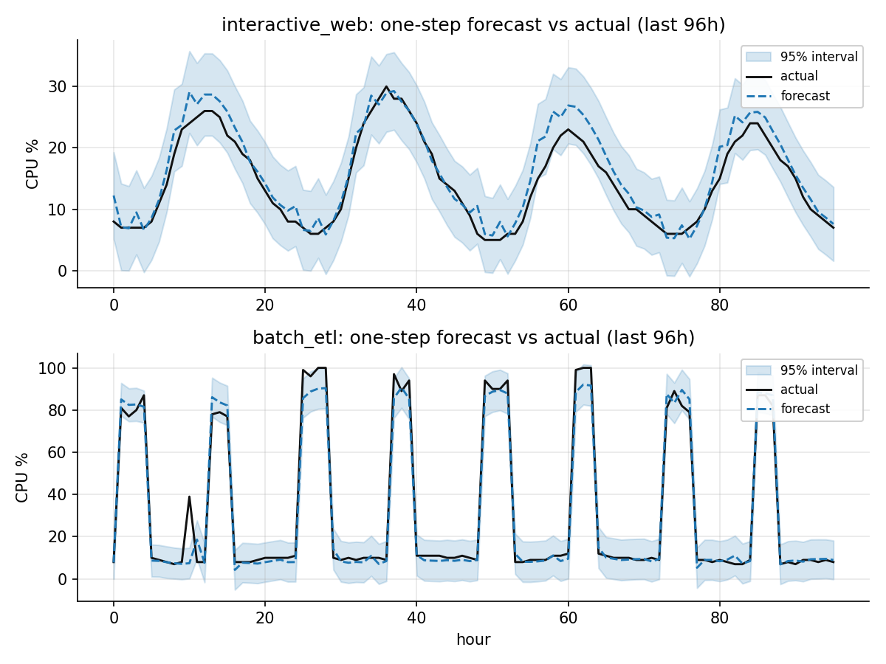
Forecast accuracy: predicted vs actual
one-step forecast with the 95% prediction interval
6/10

Slide 7
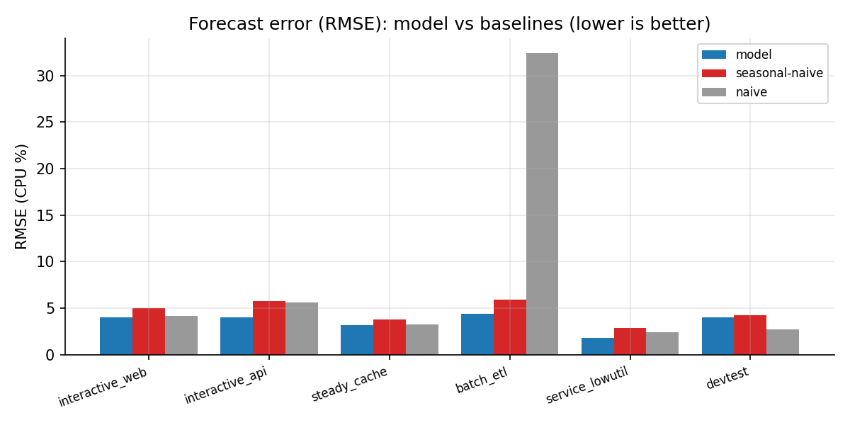
Forecast error (RMSE)
model vs last-value / seasonal-naive baselines (lower is better)
7/10

Slide 8
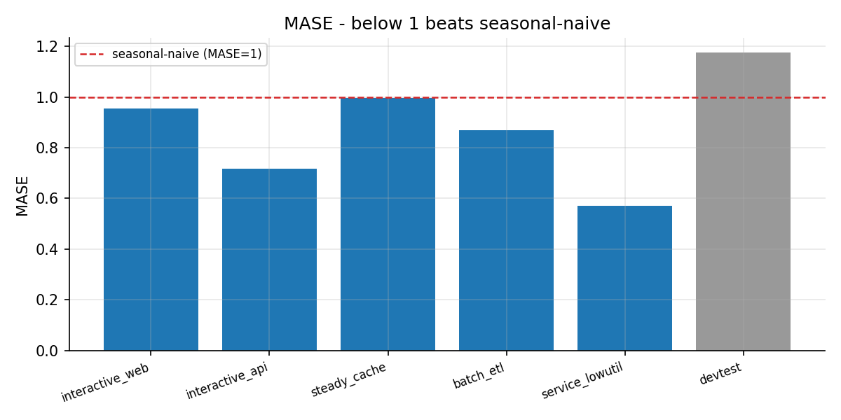
MASE
below 1 beats the seasonal-naive baseline
8/10

Slide 9
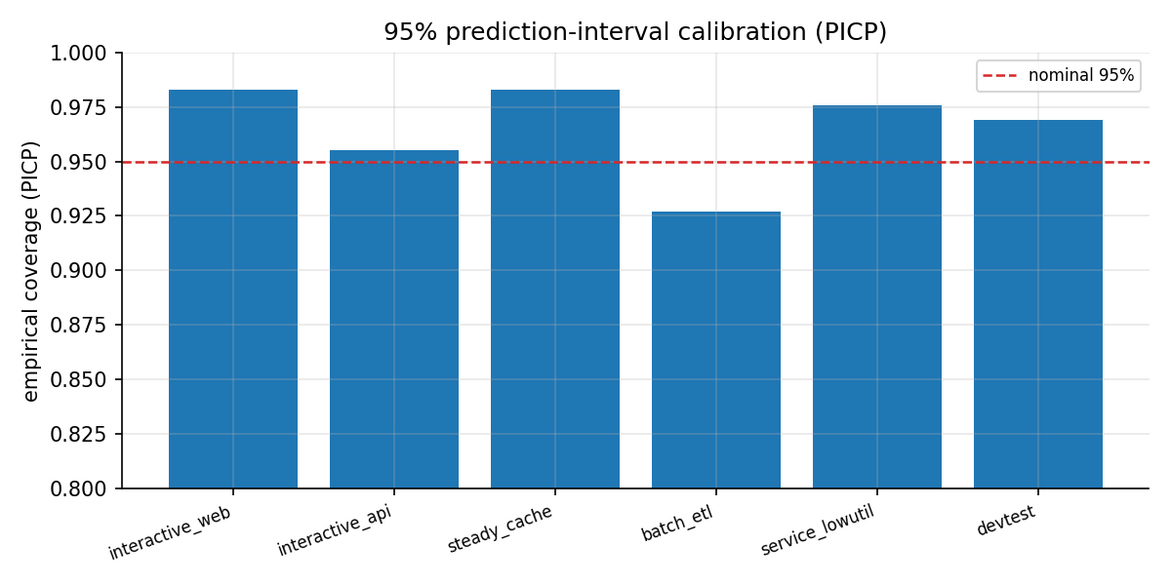
Prediction-interval calibration (PICP)
empirical coverage 0.93-0.98 vs nominal 0.95
9/10

Slide 10
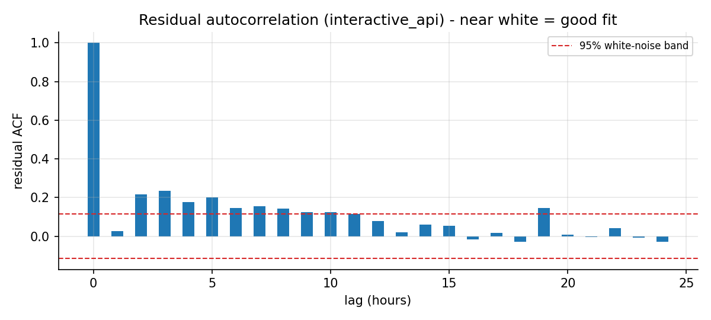
Residual autocorrelation (ACF)
within the white-noise band = good fit
10/10

