Slide 1
Literature review for “Model Assertions for Monitoring and Improving ML Models” (Kang et al., 2020)
2020.12

Slide 2
Outlines
Overview
Highlights
Limits

Slide 3
The problem
ML models can misbehave in unexpected ways
Deployment data may not having input schema, e.g. images
Deployment data may not having ground truth labels
Most existing QA solutions focus on test datasets

Slide 4
Solution
Model assertion:
An arbitrary function over a model’s input and output that returns a Boolean (0 or 1) or continuous (floating point) severity score
Experiments of model assertions:
Runtime monitoring
Find high confidence errors
Active learning – by using bandit-based active learning algorithm (BAL)
Weak supervision – by using an API for writing consistency assertions

Slide 5
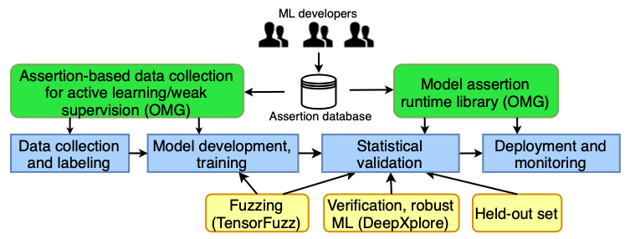
Solution
Figure 1: How model assertions integrate into the ML pipeline (Kang et al., 2020)
Notes:
Users can add to an assertion database.
model assertions can be used to validate human labels (data collection) or historical data (validation), and to monitor deployments (e.g., to populate dashboards).
model assertions can be used at training time to select which data points to label in active learning.
model assertions can be used to generate weak labels to further train ML models without additional human labels

Slide 6
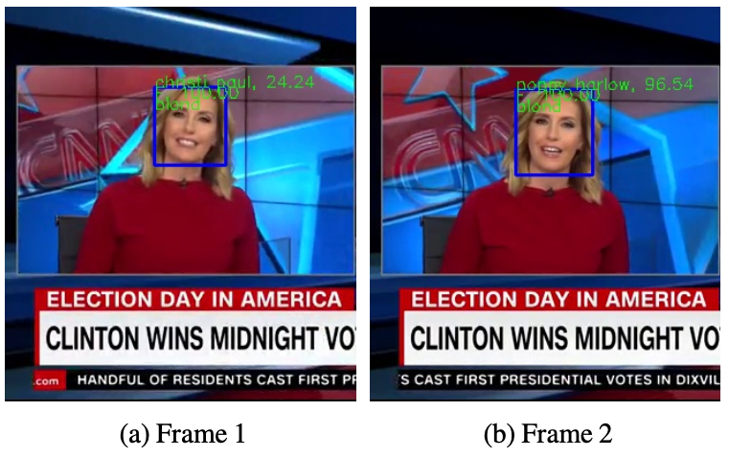
Use cases
Analyzing TV news
Detect attributes such as identity, gender, hair color, etc
Figure 2: Two frame from same scene with inconsistent attribute (the identity) (Kang et al., 2020)

Slide 7
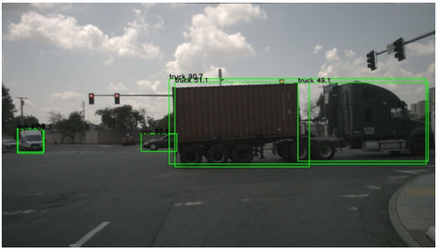
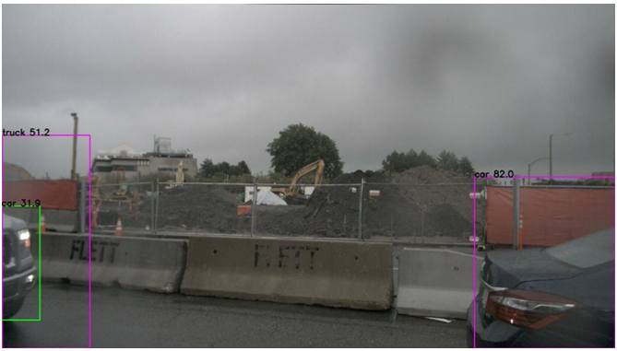
Use cases
Autonomous vehicles (AVs)
Detect object
Figure 3: Examples of errors that multibox and agree assertions catch.
SSD (Liu et al., 2016) boxes are in green, LIDAR model boxes are in pink, and they disagree (Kang et al., 2020)

Slide 8
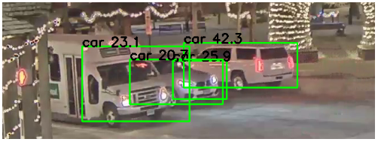
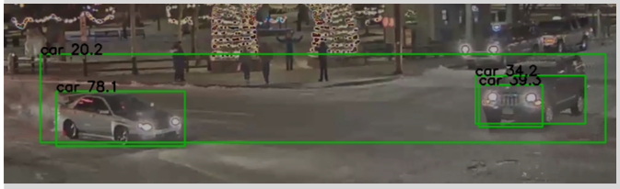
Use cases
Video analytics
Detect object
Figure 4: Examples of errors multibox assertions catch.
The boxes highly overlap (Kang et al., 2020)

Slide 9
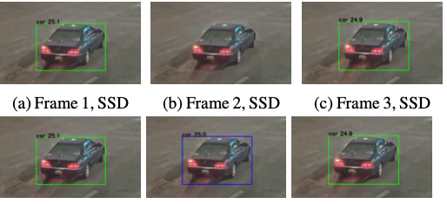
Use cases
Video analytics
Medical classification
Atrial fibrillation (AF, a form of heart condition) predictions can rapidly oscillate, require at least 30 sec of signal before calling a detection
Figure 5: Examples of flicker assertions catch (Kang et al., 2020)

Slide 10
Implementation
Model assertions in OMG (a Python lib)
OMG logs user-defined assertions as callbacks
OMG provides an API to add consistency assertions
For active learning, OMG take a batch of data and return indices for which data points to label (using BAL)
For weak supervision, OMG take data and return weak labels where valid

Slide 11
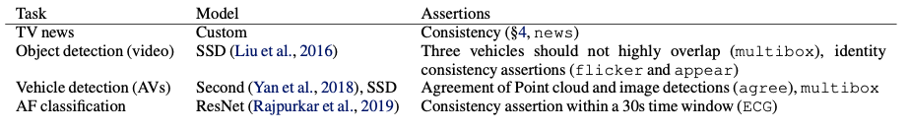
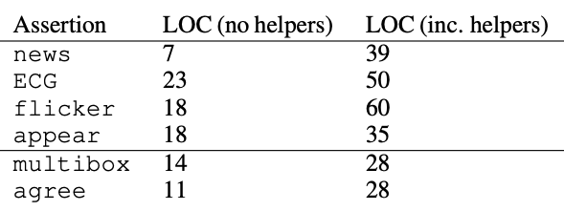
Evaluation
Table 1: A summary of tasks, models, and assertions used in user cases (Kang et al., 2020)
Table 2: Lines of code for each assertion (Kang et al., 2020)
Notes:
TV news as example:
person as identity, and gender/hair colour as attributes
Given the identity, attrs and T value, OMG automatically generates Boolean assertions to check for matching attributes and to check that when an identifier appears in the data, it persists for at least T seconds

Slide 12
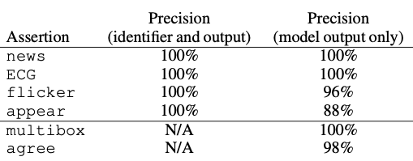
Evaluation
Table 3: Precision of model assertions (Kang et al., 2020)
Randomly sampled 50 data points
Check if the data point had an incorrect output from the ML model
Notes:
TV news as example:
person as identity, and gender/hair colour as attributes
Given the identity, attrs and T value, OMG automatically generates Boolean assertions to check for matching attributes and to check that when an identifier appears in the data, it persists for at least T seconds

Slide 13
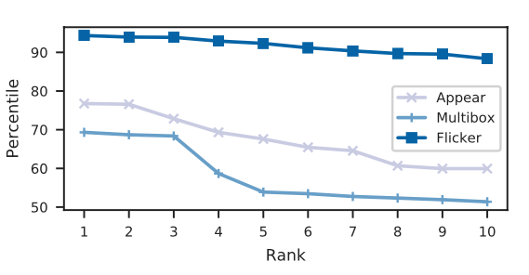
Evaluation
Figure 6: Confidence of the top-10 ranked errors for video analytics (Kang et al., 2020)
Notes:
TV news as example:
person as identity, and gender/hair colour as attributes
Given the identity, attrs and T value, OMG automatically generates Boolean assertions to check for matching attributes and to check that when an identifier appears in the data, it persists for at least T seconds

Slide 14
Highlights
Introduce the abstraction of model assertions for monitoring ML models
Show that model assertions can find high confidence errors
Show that model assertions using BAL for active learning, reduce labelling cost by up to 40%
Propose an API for consistency assertions for weak supervision, improve model quality by up to 46%

Slide 15
Limitation
Some model assertions may be difficult to express in the API (need domain-specific assertions)
Not evaluated in real-time system, assertions may add overhead
Still not solving bias in training sets

Slide 16
Reference
Kang, D. et al. (2020) ‘Model Assertions for Monitoring and Improving ML Models’, arXiv:2003.01668 [cs]. Available at: http://arxiv.org/abs/2003.01668 (Accessed: 8 December 2020).

