Slide 1
DATA WRANGLING I
MPA 630: Data Science for Public Management
September 27, 2018
Fill out your reading report on Learning Suite

Slide 2
PLAN FOR TODAY
¡Exam!
Reproducibility
Technical stuff
Answering your own questions with data

Slide 3
EXAM

Slide 4
BREAK

Slide 5
REPRODUCIBILITY

Slide 6
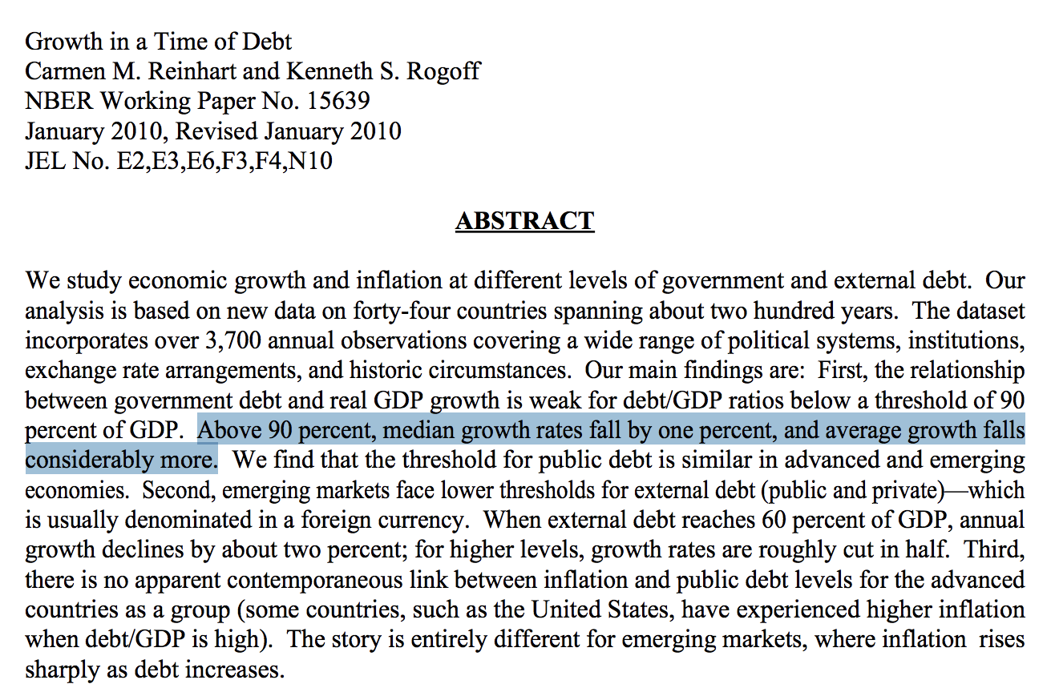

AUSTERITY AND EXCEL
Debt:GDP = 90%+ → −0.1% growth
Notes:
https://www.bloomberg.com/news/articles/2013-04-18/faq-reinhart-rogoff-and-the-excel-error-that-changed-history
https://www.fa-mag.com/news/reinhart-rogoff-paper-cited-by-ryan-faulted-by-umass-economists-13993.html

Slide 7

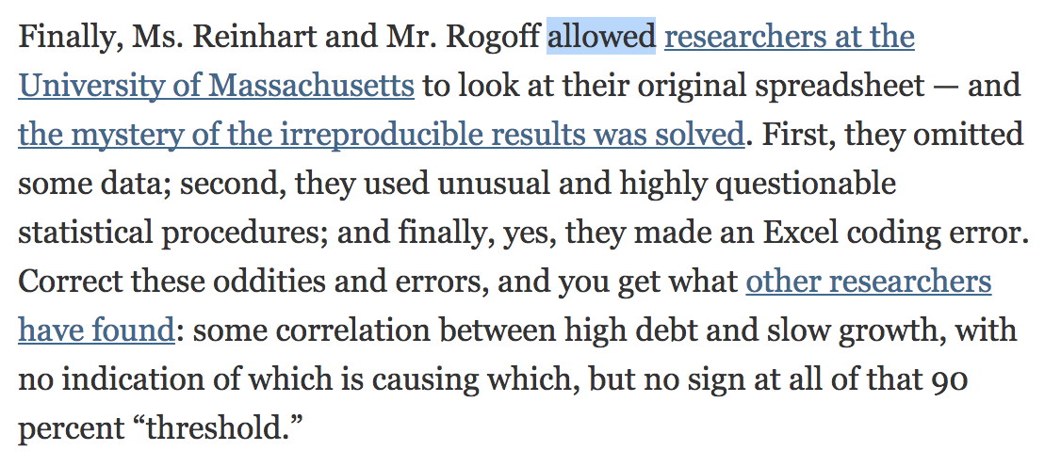
AUSTERITY AND EXCEL
Notes:
Thomas Herndon
http://www.bbc.com/news/magazine-22223190

Slide 8
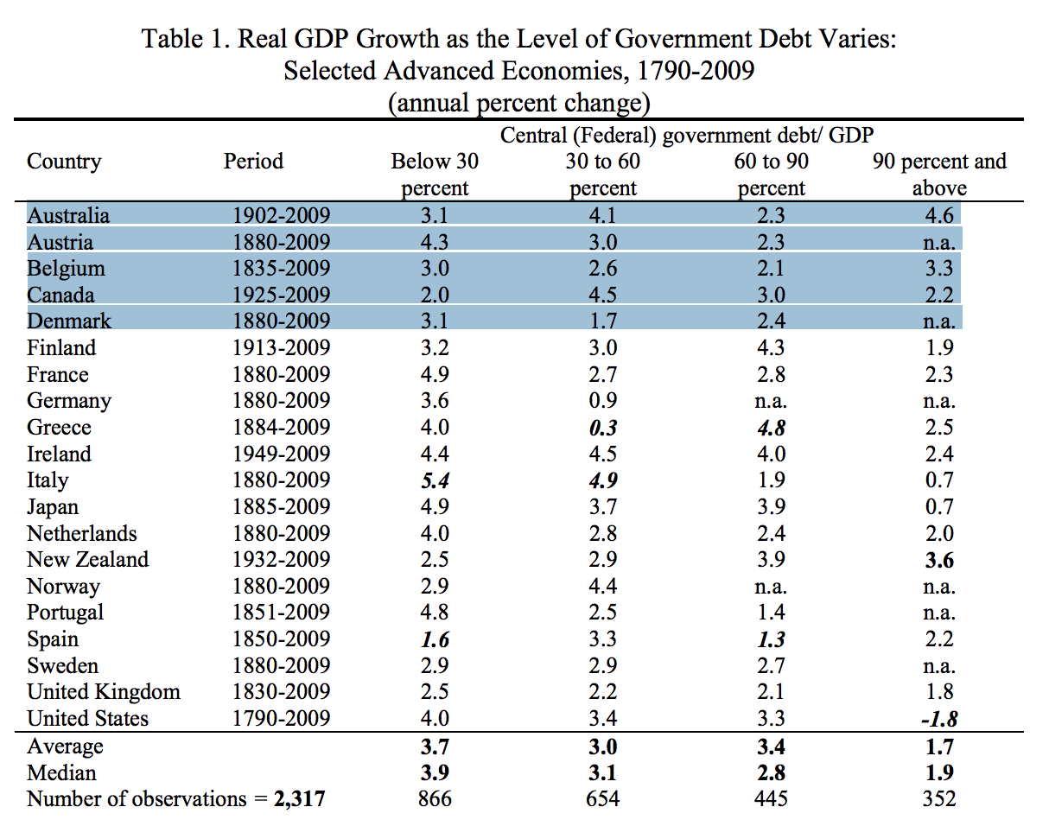
AUSTERITY AND EXCEL
Debt:GDP = 90%+ → 2.2% growth
Notes:
Australia, Austria, Belgium, Canada and Denmark - 15/20 were included
https://www.bloomberg.com/news/articles/2013-04-18/faq-reinhart-rogoff-and-the-excel-error-that-changed-history
https://www.fa-mag.com/news/reinhart-rogoff-paper-cited-by-ryan-faulted-by-umass-economists-13993.html

Slide 9
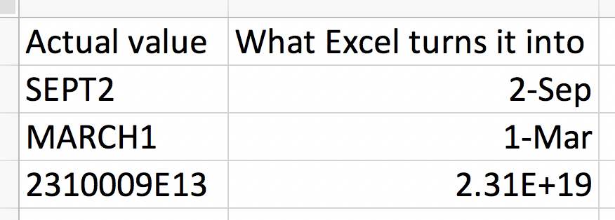
GENES AND EXCEL
Septin 2
Membrane-Associated Ring Finger (C3HC4) 1
2310009E13
20% of genetics papers between 2005–2015
Notes:
Septin 2 – SEPT2
Membrane-Associated Ring Finger (C3HC4) 1 – MARCH1
2310009E13
20% of papers between 2005-2015 – checked 35,000 lists of genes!

Slide 10
GENERAL GUIDELINES
Don’t touch the raw data
If you do, explain what you did!
Use self-documenting code
R Markdown!
Ensure code is reproducible
R Markdown!
Use open formats
Use .csv, not .xlsx

Slide 11
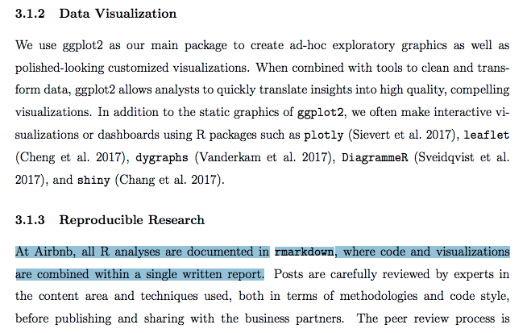
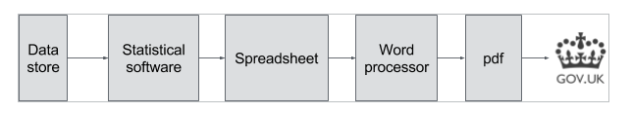
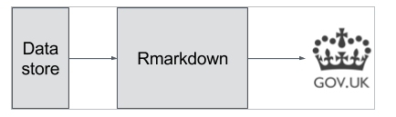
R MARKDOWN IN REAL LIFE
Notes:
https://peerj.com/preprints/3182.pdf + https://gdsdata.blog.gov.uk/2017/03/27/reproducible-analytical-pipeline/ + http://archive.somervillema.gov/dashboard/daily.html

Slide 12
TECHNICAL STUFF

Slide 13
LEFT_JOIN

Slide 14
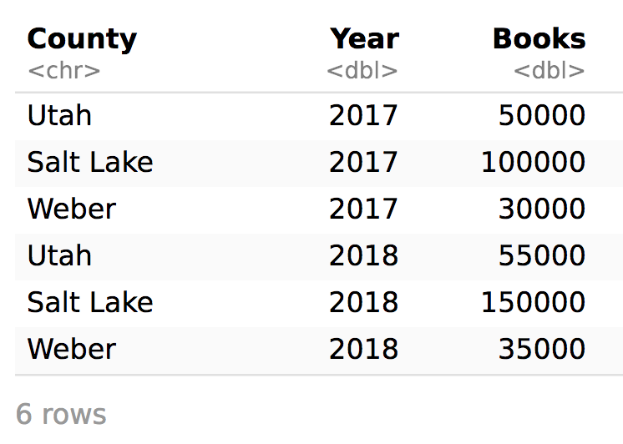
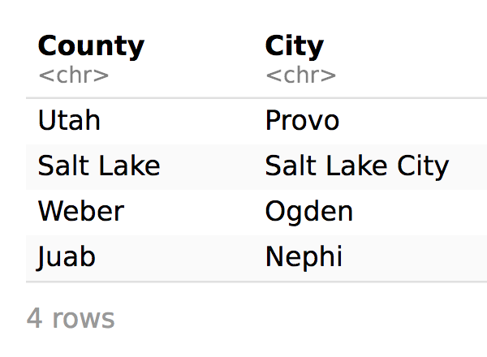
LEFT_JOIN
libraries %>%
left_join(county_seats, by = "County")

Slide 15
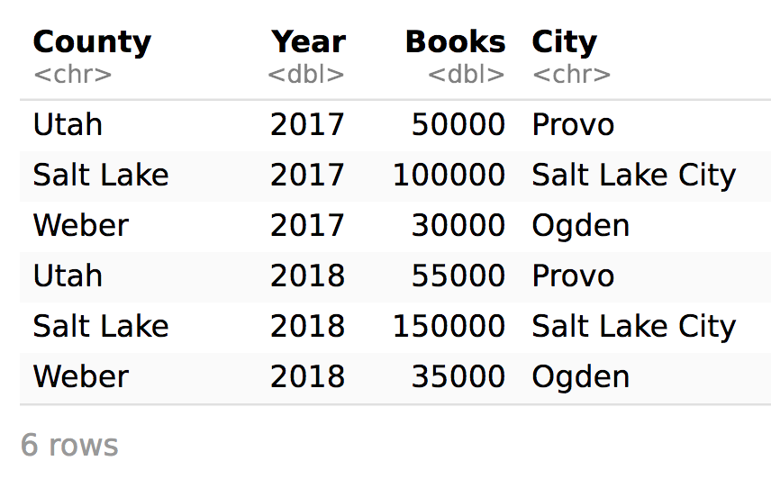
LEFT_JOIN

Slide 16
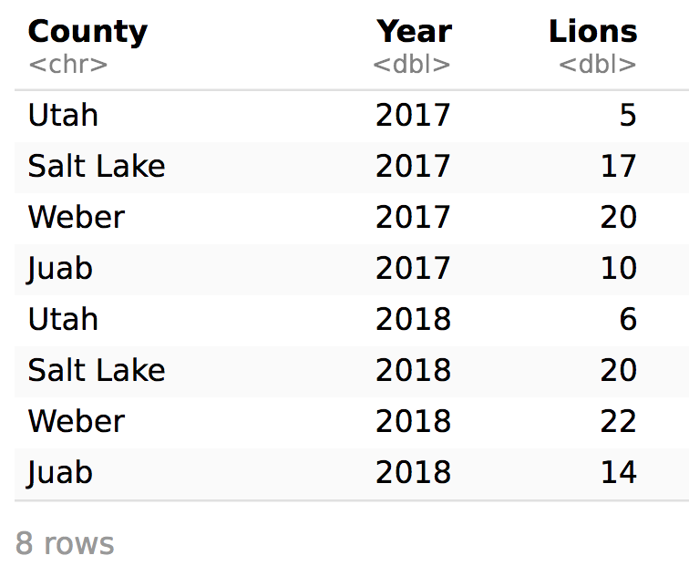
LEFT_JOIN
libraries %>%
left_join(lions, by = c("County", "Year"))

Slide 17
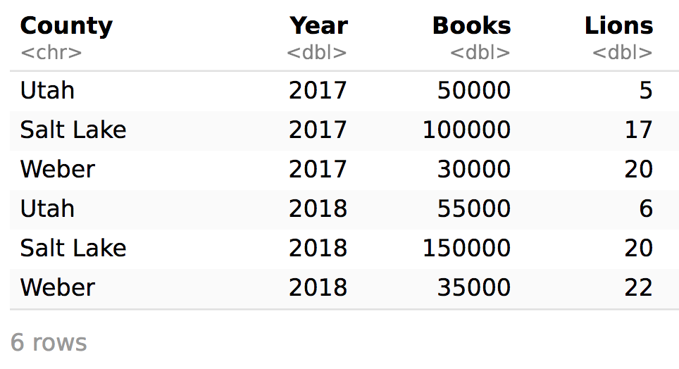
LEFT_JOIN

Slide 18
RIGHT_JOIN

Slide 19
RIGHT_JOIN
libraries %>%
right_join(lions, by = c("County", "Year"))

Slide 20
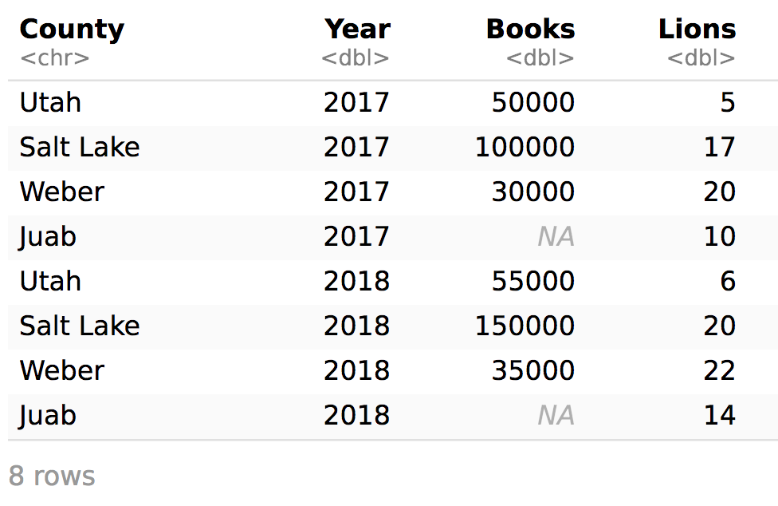
RIGHT_JOIN

Slide 21
LEFT_JOIN
libraries %>%
left_join(lions, by = c("County", "Year")) %>%
left_join(county_seats, by = "County")

Slide 22
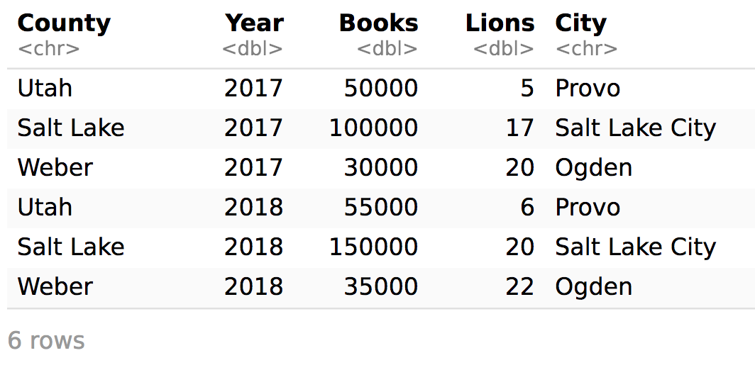
LEFT_JOIN

Slide 23
COMMON PROBLEM SET ISSUES
.ZIP files
Working directories and projects

Slide 24
ANSWERING YOUR OWN QUESTIONS WITH DATA

