Slide 1
DATA WRANGLING II
MPA 630: Data Science for Public Management
October 4, 2018
Fill out your reading report on Learning Suite

Slide 2
PLAN FOR TODAY
Missing data
Introduction to correlation
2016 elections, food security, and mortality

Slide 3
MISSING DATA

Slide 4
MATH TIME
oh no

Slide 5
CODE TIME
numbers <- c(1, 7, 4, 2, 4)
numbers <- c(1, 7, 4, NA, 4)
sum(numbers)
mean(numbers)
sum(numbers)
mean(numbers)
[1] 18
[1] 3.6
[1] NA
[1] NA
sum(numbers, na.rm = TRUE)
[1] 16
mean(numbers, na.rm = TRUE)
[1] 4

Slide 6
IS IT OKAY TO REMOVE MISSING DATA?
It depends!

Slide 7
REASONS FOR MISSING DATA
MCAR
MAR
MNAR
Missing completely at random
Missing (conditionally) at random
Missing not at random
No relationship between missingness and either observed or unobserved data
Relationship between missingness and observed data, but not unobserved data
Relationship between missingness and data
Notes:
https://www.theanalysisfactor.com/missing-data-mechanism/
https://www.theanalysisfactor.com/mar-and-mcar-missing-data/

Slide 8
EXAMPLES
MCAR
MAR
MNAR
Researcher accidentally doesn’t record some of the values
Men are less likely to fill out survey about depression, but not because of their depression (but because maleness makes them less likely to do so)
Men are less likely to fill out a survey about depression because of their depression

Slide 9
WHAT TO DO
MCAR
MAR
MNAR
Safely ignore!
Mostly safely ignore!
Account for the thing that makes it missing (e.g. look at maleness specifically when analyzing depression survey response)
Don’t ignore!
Explain why it’s missing and incorporate that into analysis

Slide 10
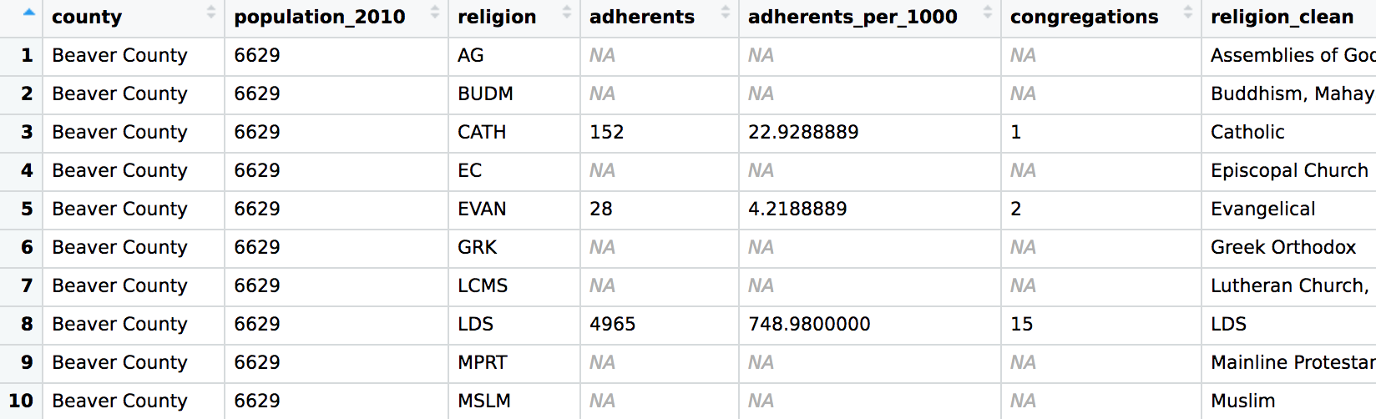
0 vs. NA
Sometimes NAs are really 0s
mutate(adherents = ifelse(is.na(adherents), 0, adherents))

Slide 11
INTRODUCTION TO CORRELATION

Slide 12
CORRELATION
How closely two variables are related + direction of relation
−1 to 1
−1 and 1 = perfectly correlated;
0 = perfectly uncorrelated

Slide 13
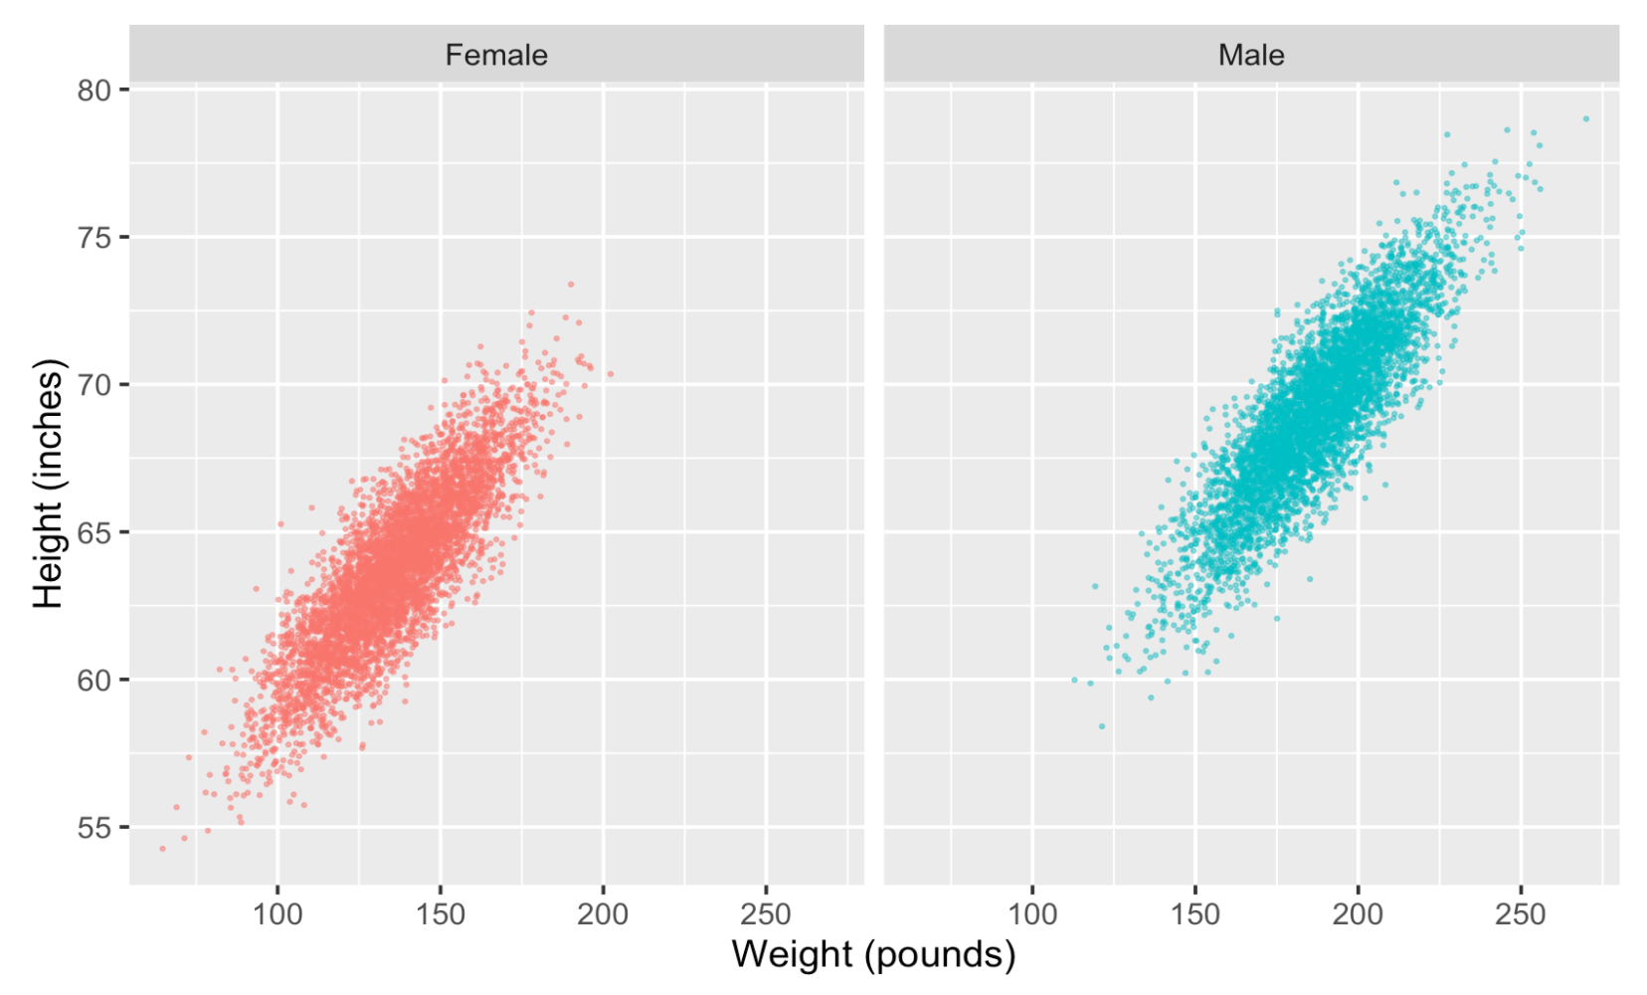
r = 0.849
r = 0.863

Slide 14
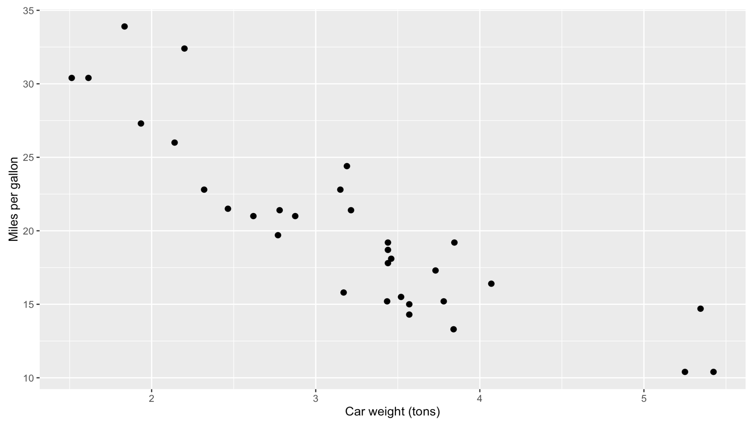
r = − 0.868

Slide 15
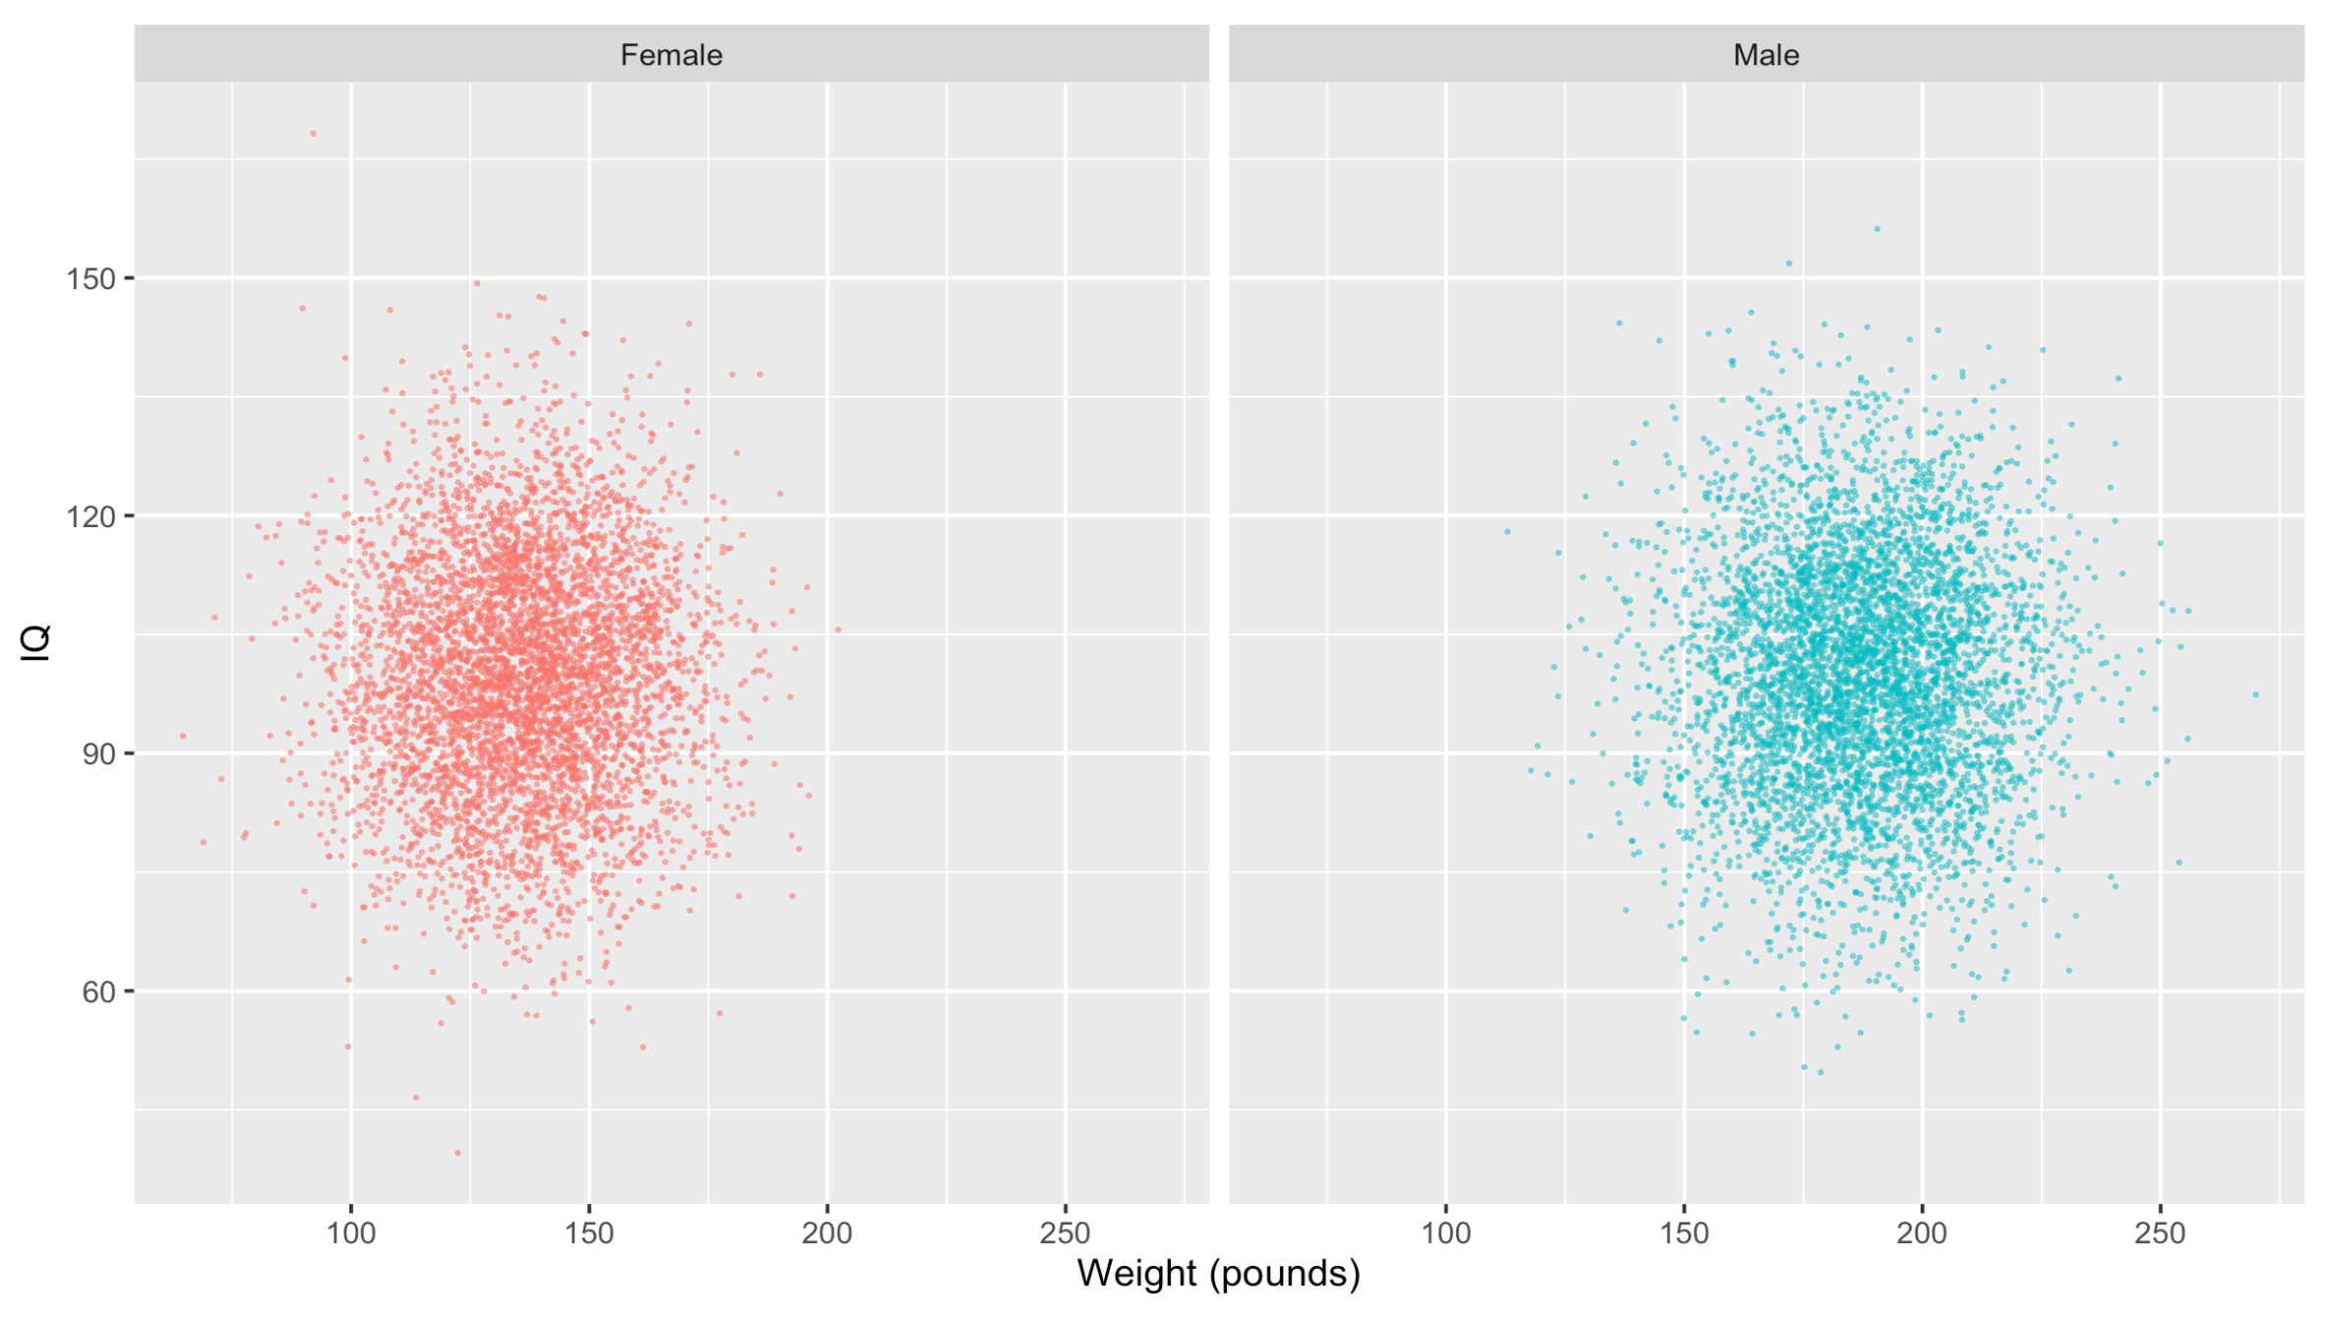
r = 0.021
r = 0.001

Slide 16
GENERAL GUIDELINES
0
No relationship
Can be positive or negative
0.01–0.19
Little to no relationship
0.20–0.29
Weak relationship
0.30–0.39
Moderate relationship
0.40–0.69
Strong relationship
0.70–0.99
Very strong relationship
1
Perfect relationship

Slide 17
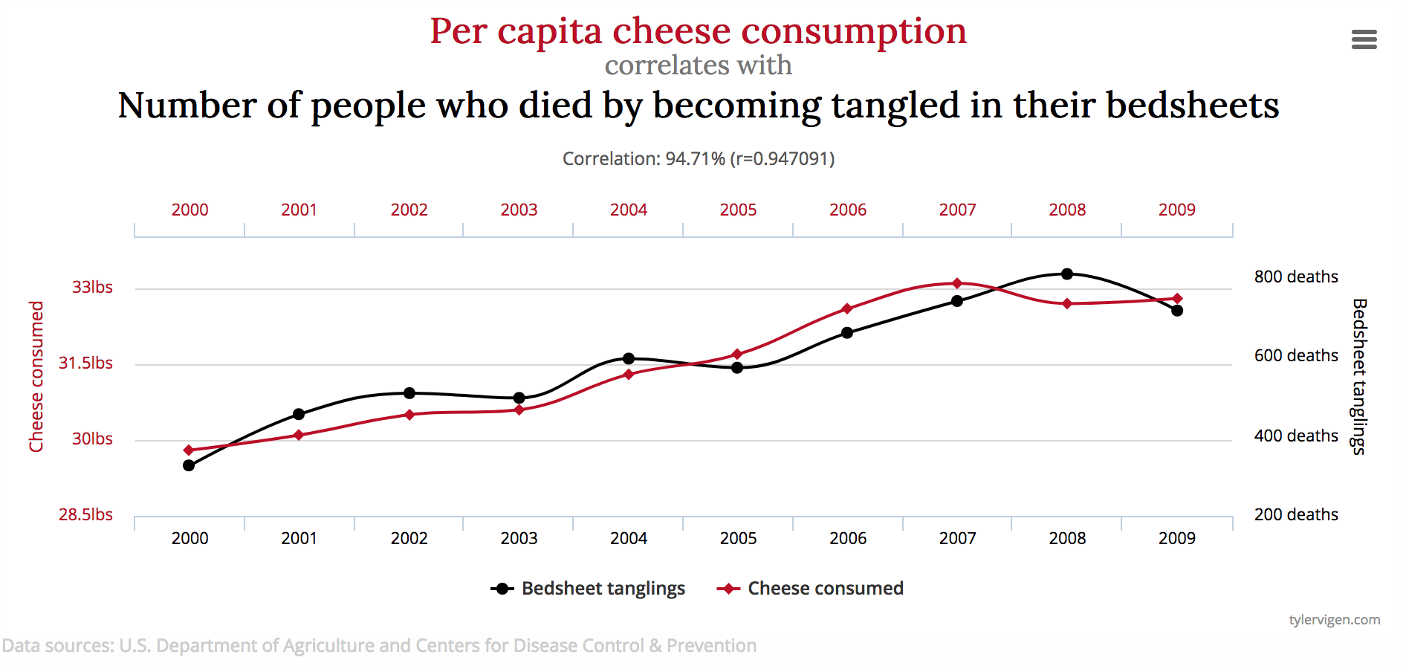
BEWARE OF CHEESE
Spurious correlations
Notes:
http://www.tylervigen.com/spurious-correlations

Slide 18
2016 ELECTIONS, FOOD SECURITY, AND MORTALITY

Slide 19
Vince Feula
Dallen Done
Aleni Regehr
Mike Hall
Stephanie Livsey
Angie Anderson
Cindy Tolman
Daniel Dudley
Spencer Foster
Michelle Stevenson
Colleen Kohler
Spencer Parkinson
Elyse Bradley
Brian Tuttle
Joel Cook
Natalie Gay
Rebecca Smoot
Mark Gefrom
Hilary O’Neil
Harvey Unga
Dave Hawks
Grant Gillum
Carina Alleman
Tim Anderson
Krista Gardner
Craig Haderlie
Rich Christianson
Phyllis Nielsen
Sara Donakey
Karla Ward
Sione Manoa
Brad Lester
Wallis Rothlisberger
Dallas Reynolds
Dane Larsen
Tracy McIntier
Heidi Hatch
Teri Chatterton
Lissa Camacho
Jeff Long
Julie Rash

