Slide 1
CORRELATION AND BASIC REGRESSION
MPA 630: Data Science for Public Management
October 11, 2018
Fill out your reading report on Learning Suite

Slide 2
PLAN FOR TODAY
Revisiting correlation
Introduction to regression
Drawing the best lines
Lines and math
Translating lines to stats

Slide 3
REVISITING CORRELATION

Slide 4
CORRELATION
How closely two variables are related + direction of relation
−1 to 1
−1 and 1 = perfectly correlated;
0 = perfectly uncorrelated

Slide 5
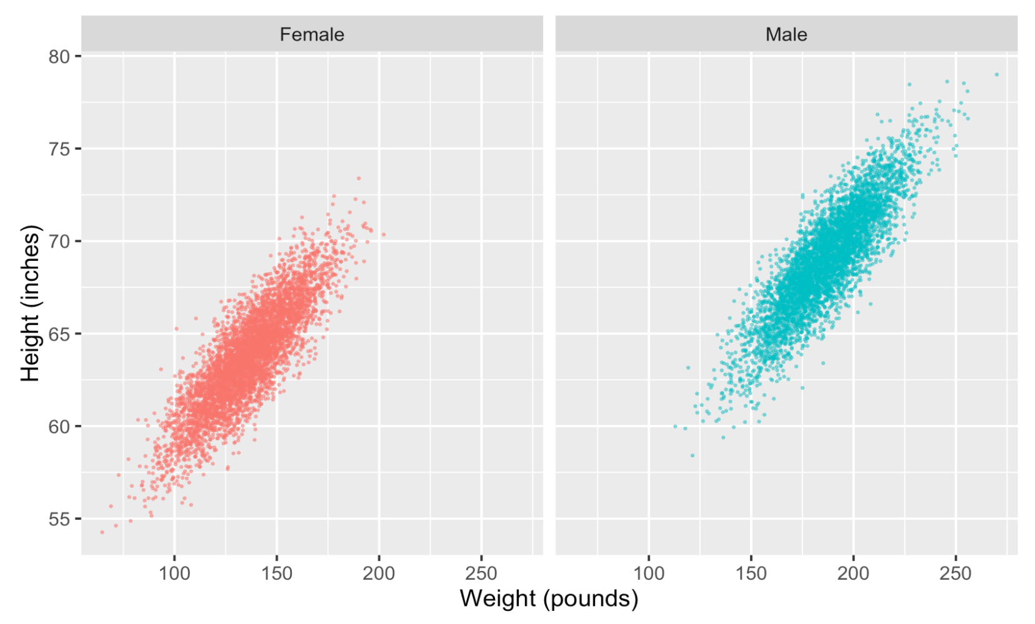
r = 0.849
r = 0.863

Slide 6
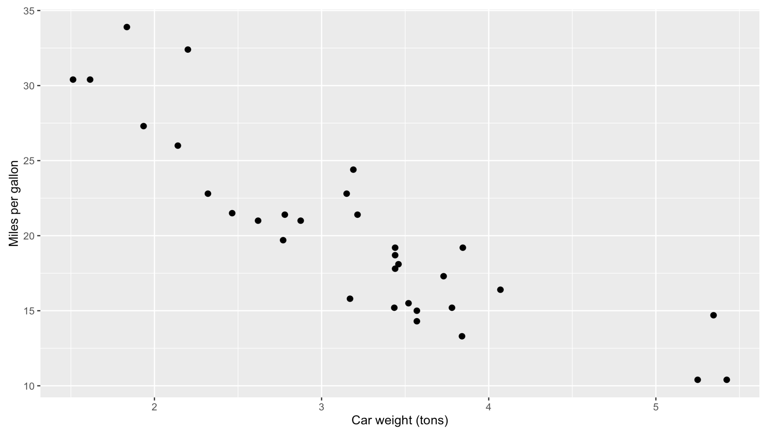
r = − 0.868

Slide 7
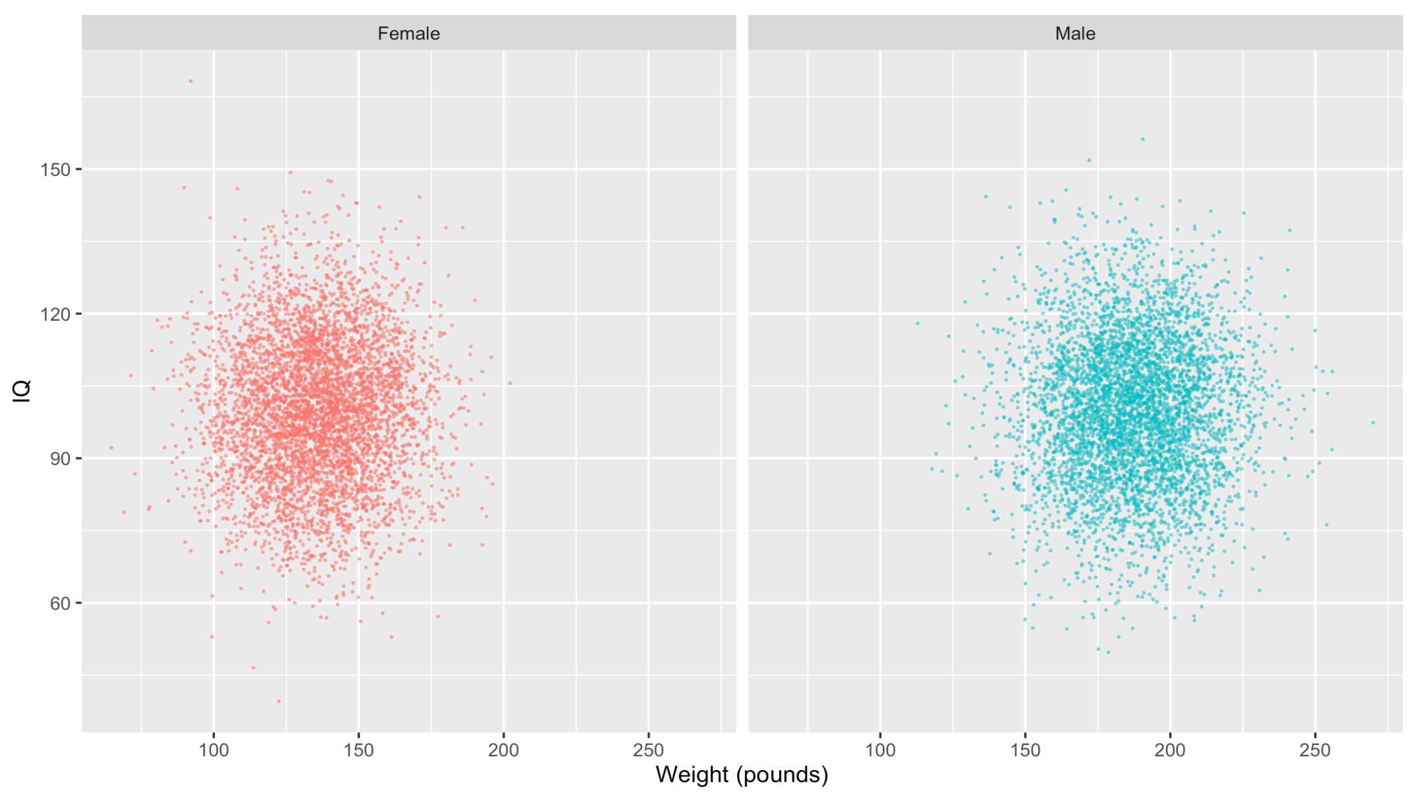
r = 0.021
r = 0.001

Slide 8
GENERAL GUIDELINES
0
No relationship
Can be positive or negative
0.01–0.19
Little to no relationship
0.20–0.29
Weak relationship
0.30–0.39
Moderate relationship
0.40–0.69
Strong relationship
0.70–0.99
Very strong relationship
1
Perfect relationship

Slide 9
TEMPLATE
As the value of X goes up, Y tends to go up (or down) a lot/a little/not at all

Slide 10
GUESS THE CORRELATION
X
Y
Vehicle velocity
Travel time
−
Salinity of water
Buoyancy
+
Alcohol consumed
Judgment
−
Income
Happiness
?
Age
Health
?
Hair length
Shampoo use
+
Tadpole age
Tadpole tail length
−

Slide 11
INTRODUCTION TO REGRESSION

Slide 12
WHY
Correlation between car weight and mileage (MPG) is −0.868
If you shave 1 ton off the weight of a car, how much will the car’s mileage improve?
Correlation shows direction and magnitude. That’s all.

Slide 13
ESSENTIAL PARTS
~
Y
X
(or lots of Xs)
Outcome variable
Explanatory variable
Response variable
Predictor variable
Dependent variable
Independent variable
Thing you want to explain or predict
Thing you use to explain changes in Y

Slide 14
IDENTIFY VARIABLES
A study examines the effect of smoking on lung cancer
You want to see if students taking more AP classes in high school improves their college grades
Researchers predict genocides by looking at negative media coverage, revolutions in neighboring countries, and economic growth
Netflix uses your past viewing history, the day of the week, and the time of the day to guess which show you want to watch next

Slide 15
TWO PURPOSES OF REGRESSION
Prediction
Explanation
Forecast the future
Explain effect of X on Y
Focus is on Y
Focus is on X
Netflix trying to guess your next show
Netflix looking at the effect of time of day on show selection
Predicting who will escape poverty
Looking at the effect of food stamps on poverty reduction

Slide 16
HOW
Plot X and Y
Draw a line that approximates the relationship
Find mathy parts of the line
Interpret the math

Slide 17
DRAWING THE BEST LINES

Slide 18
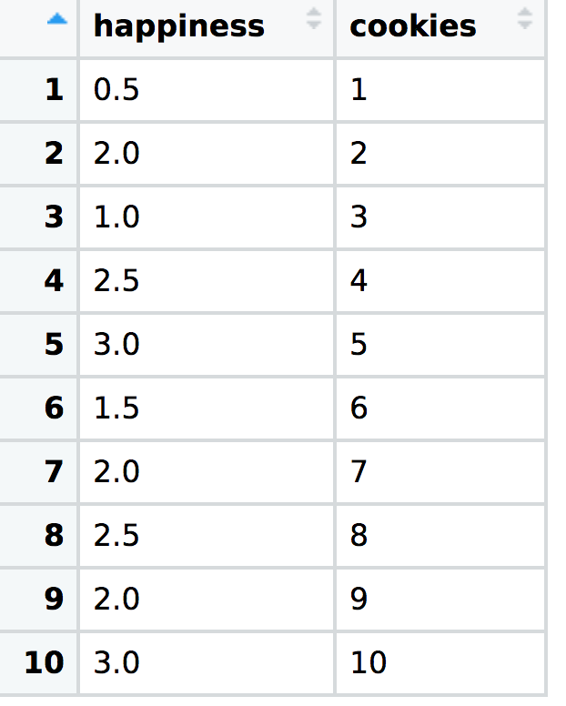
COOKIE CONSUMPTION AND HAPPINESS

Slide 19
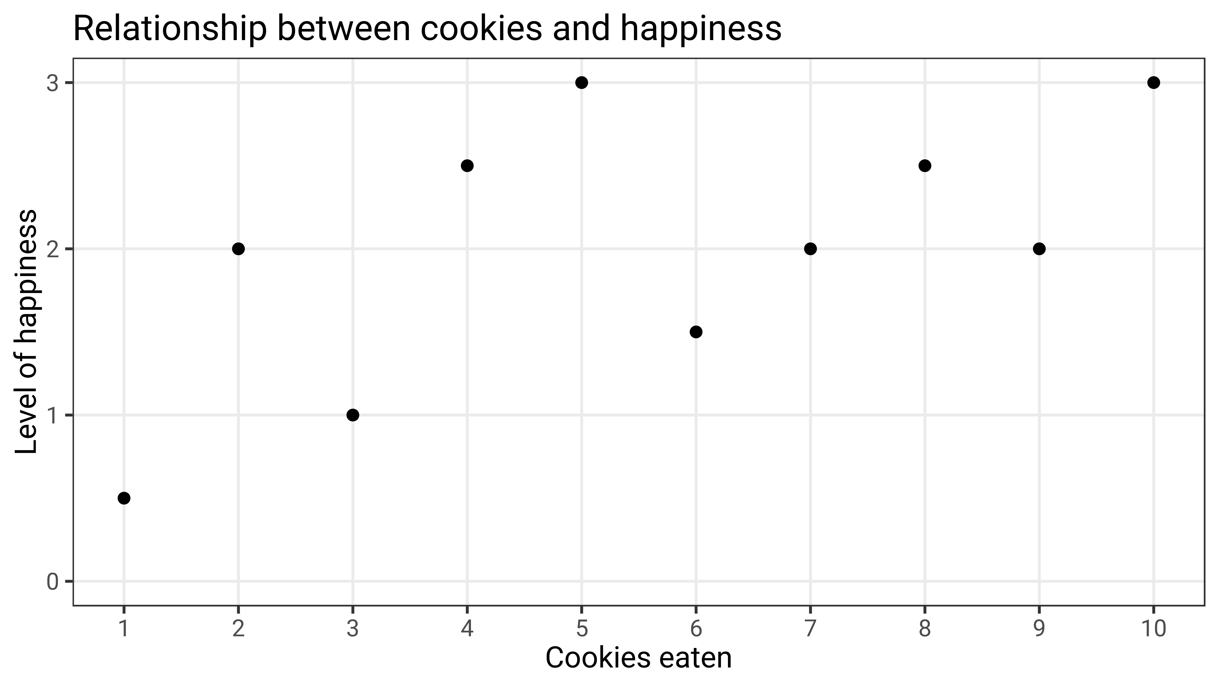
r = 0.607

Slide 20
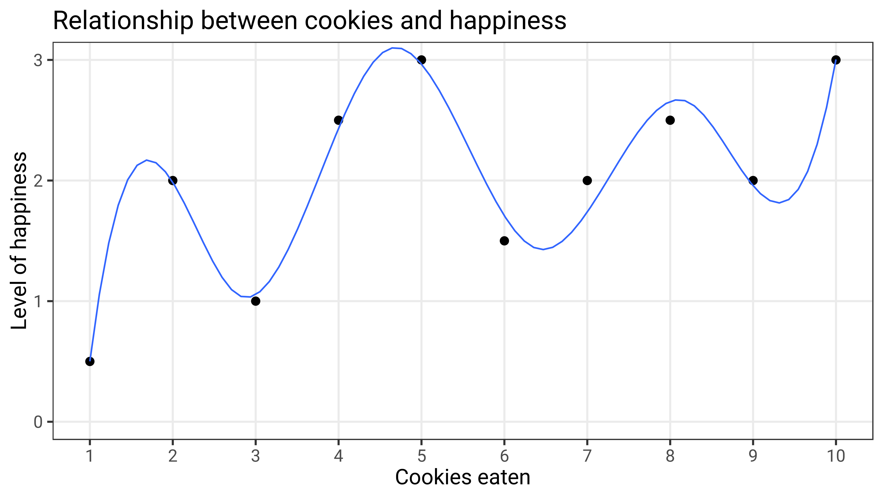

Slide 21
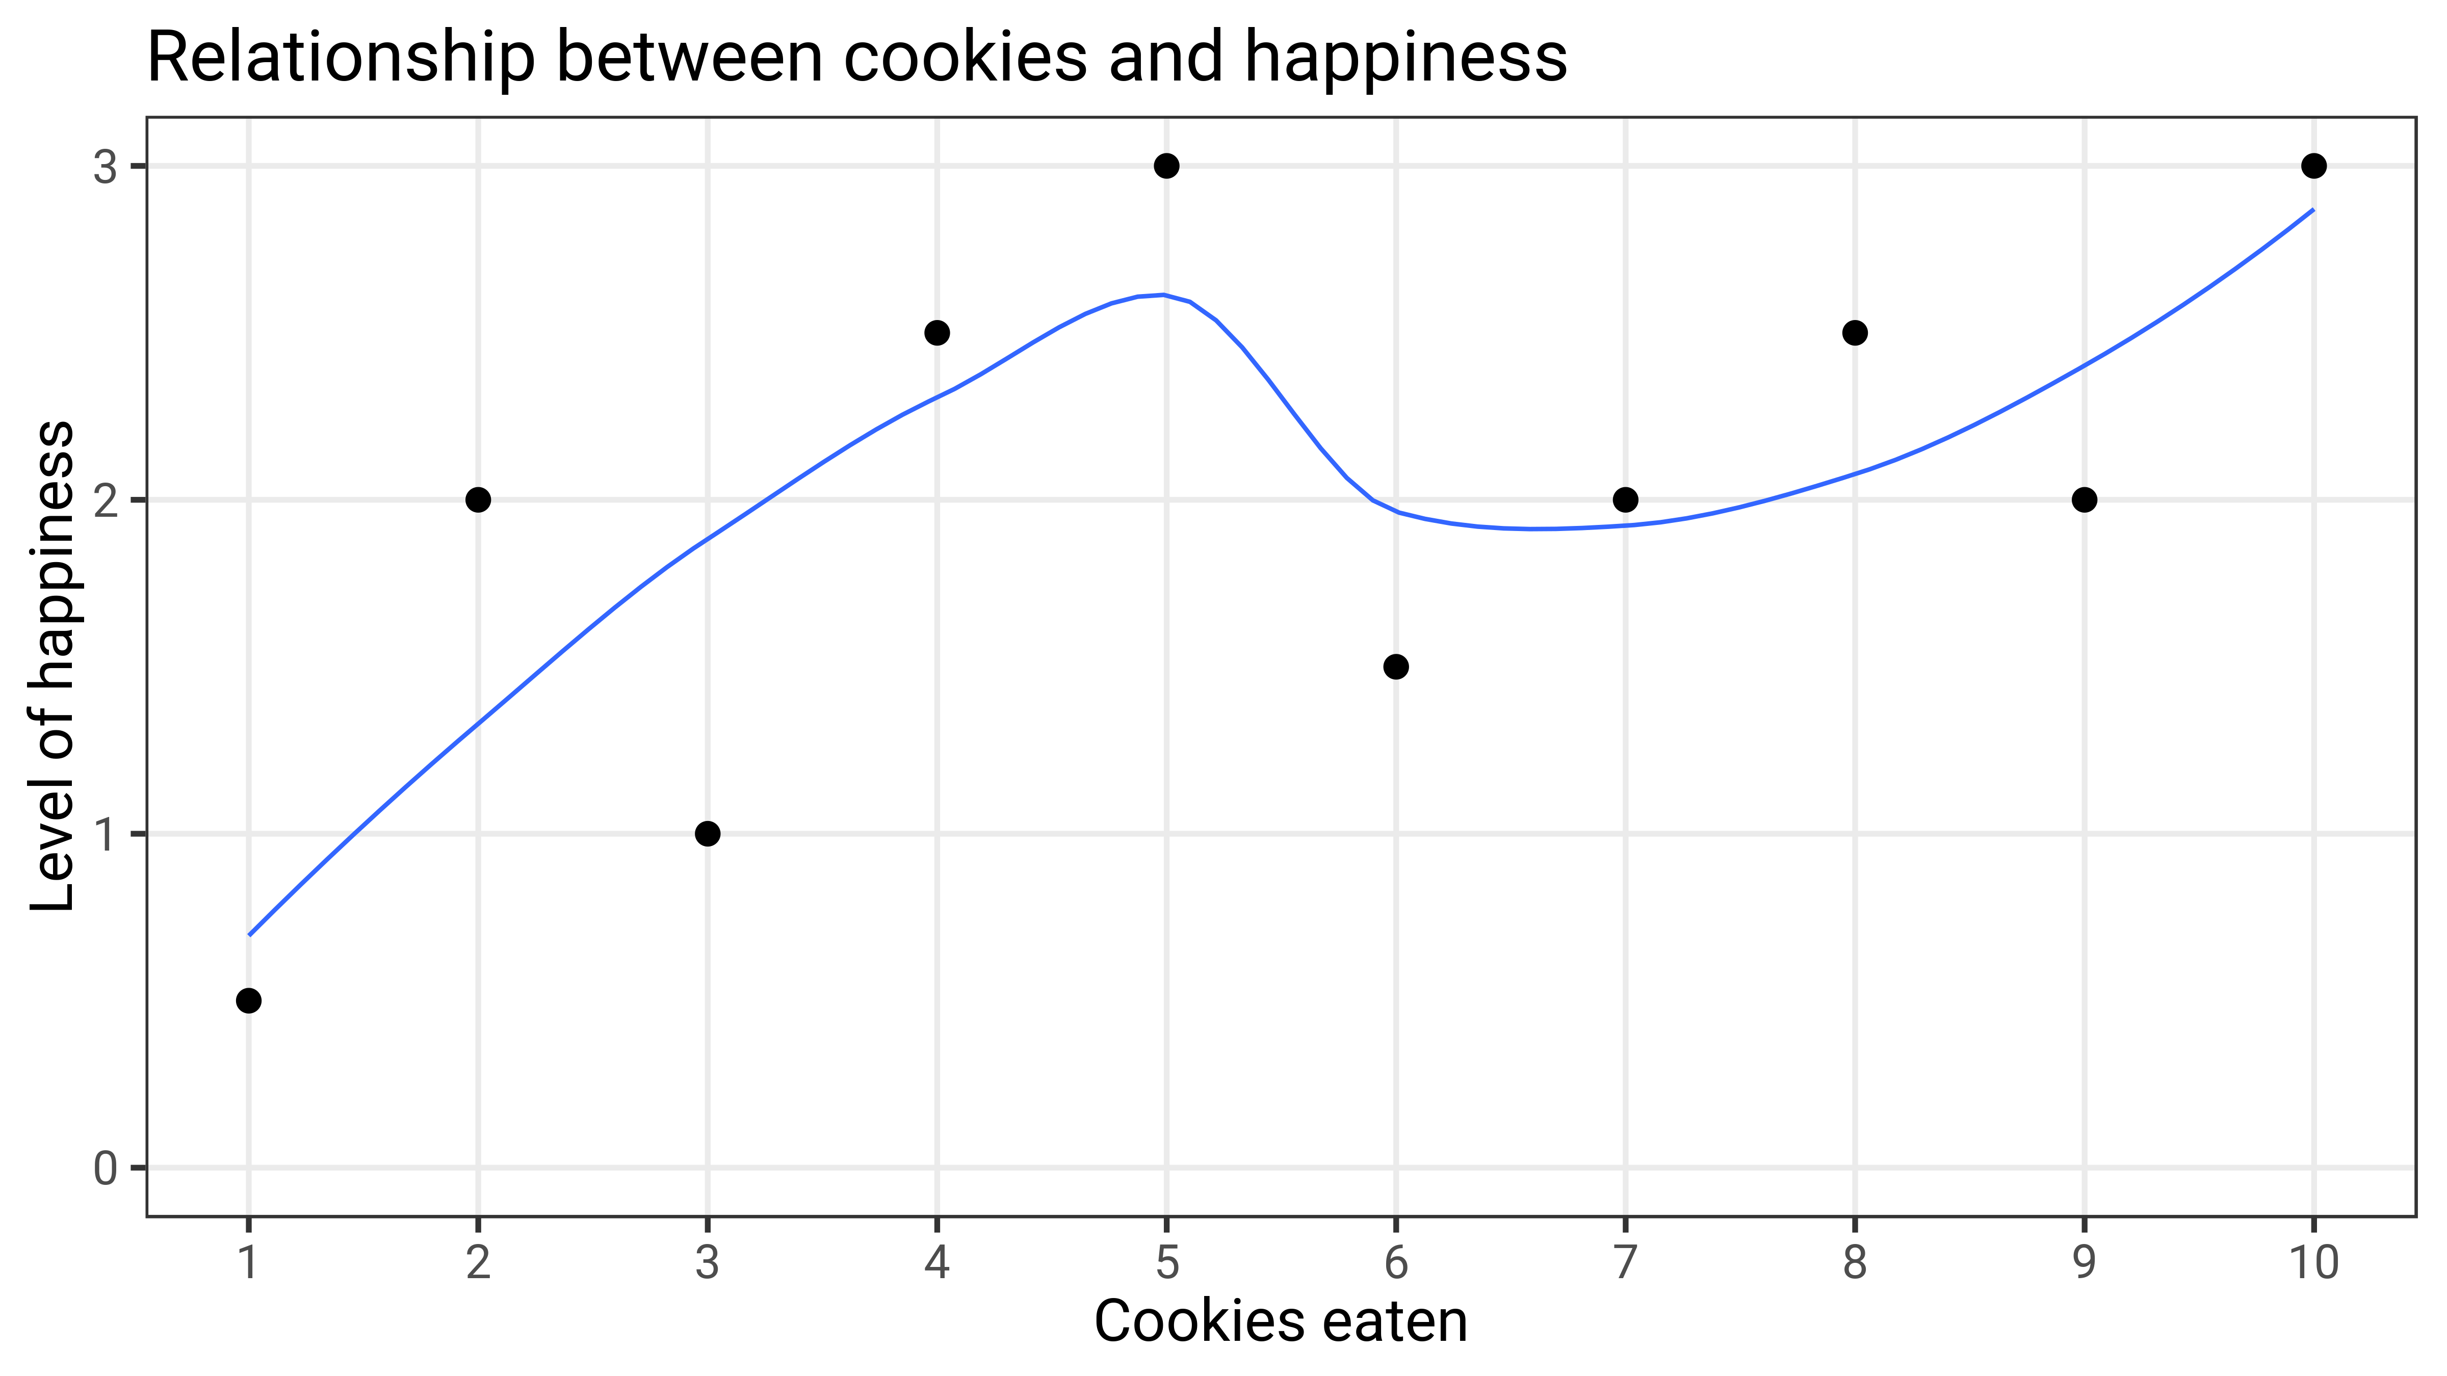

Slide 22
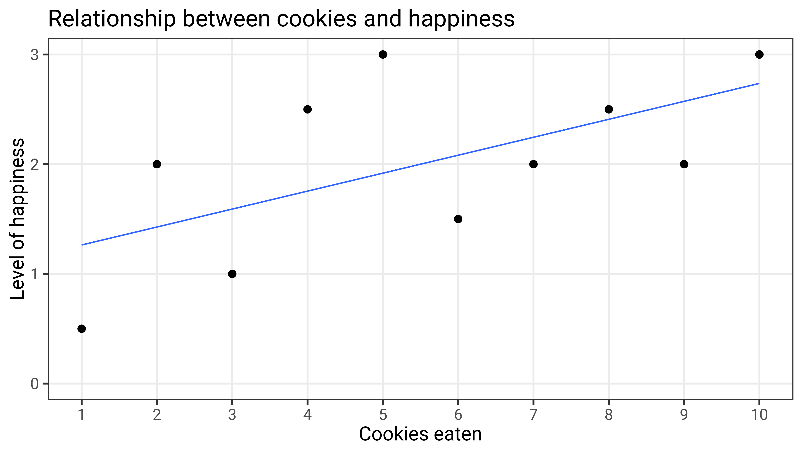

Slide 23
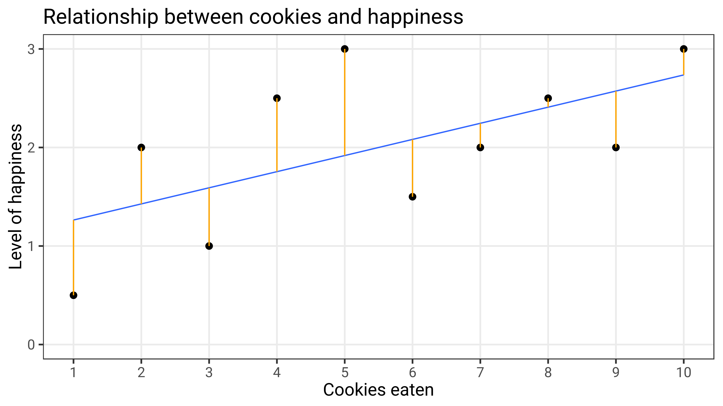

Slide 24
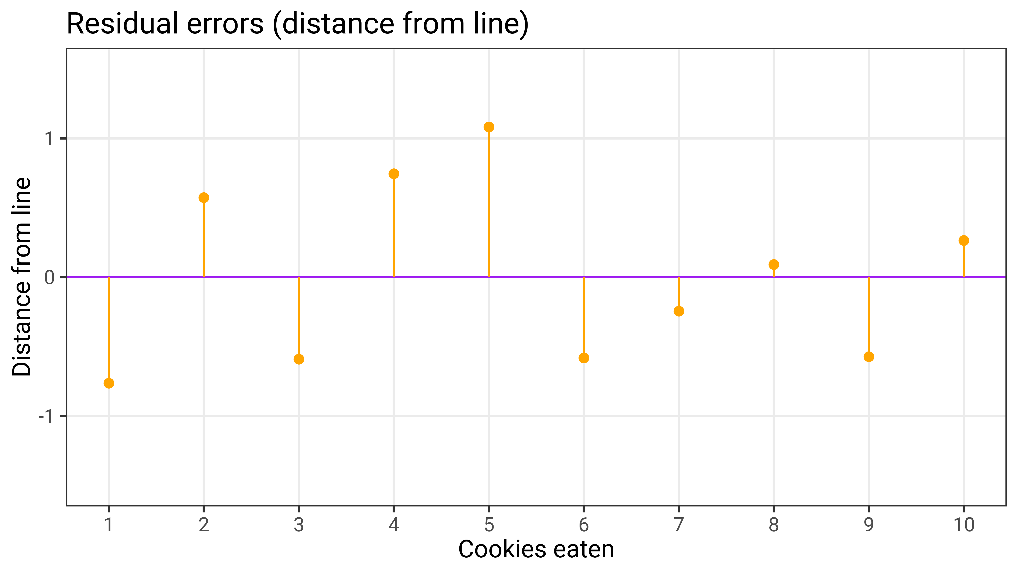

Slide 25
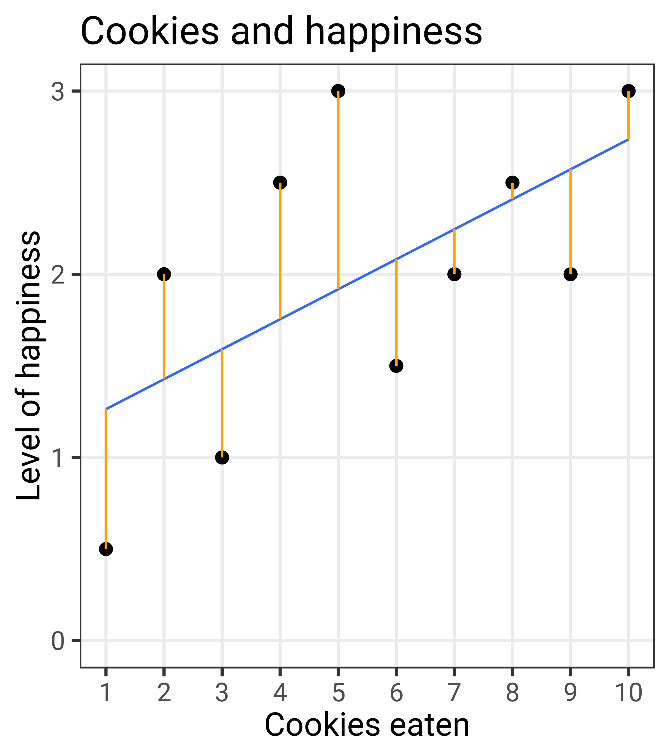
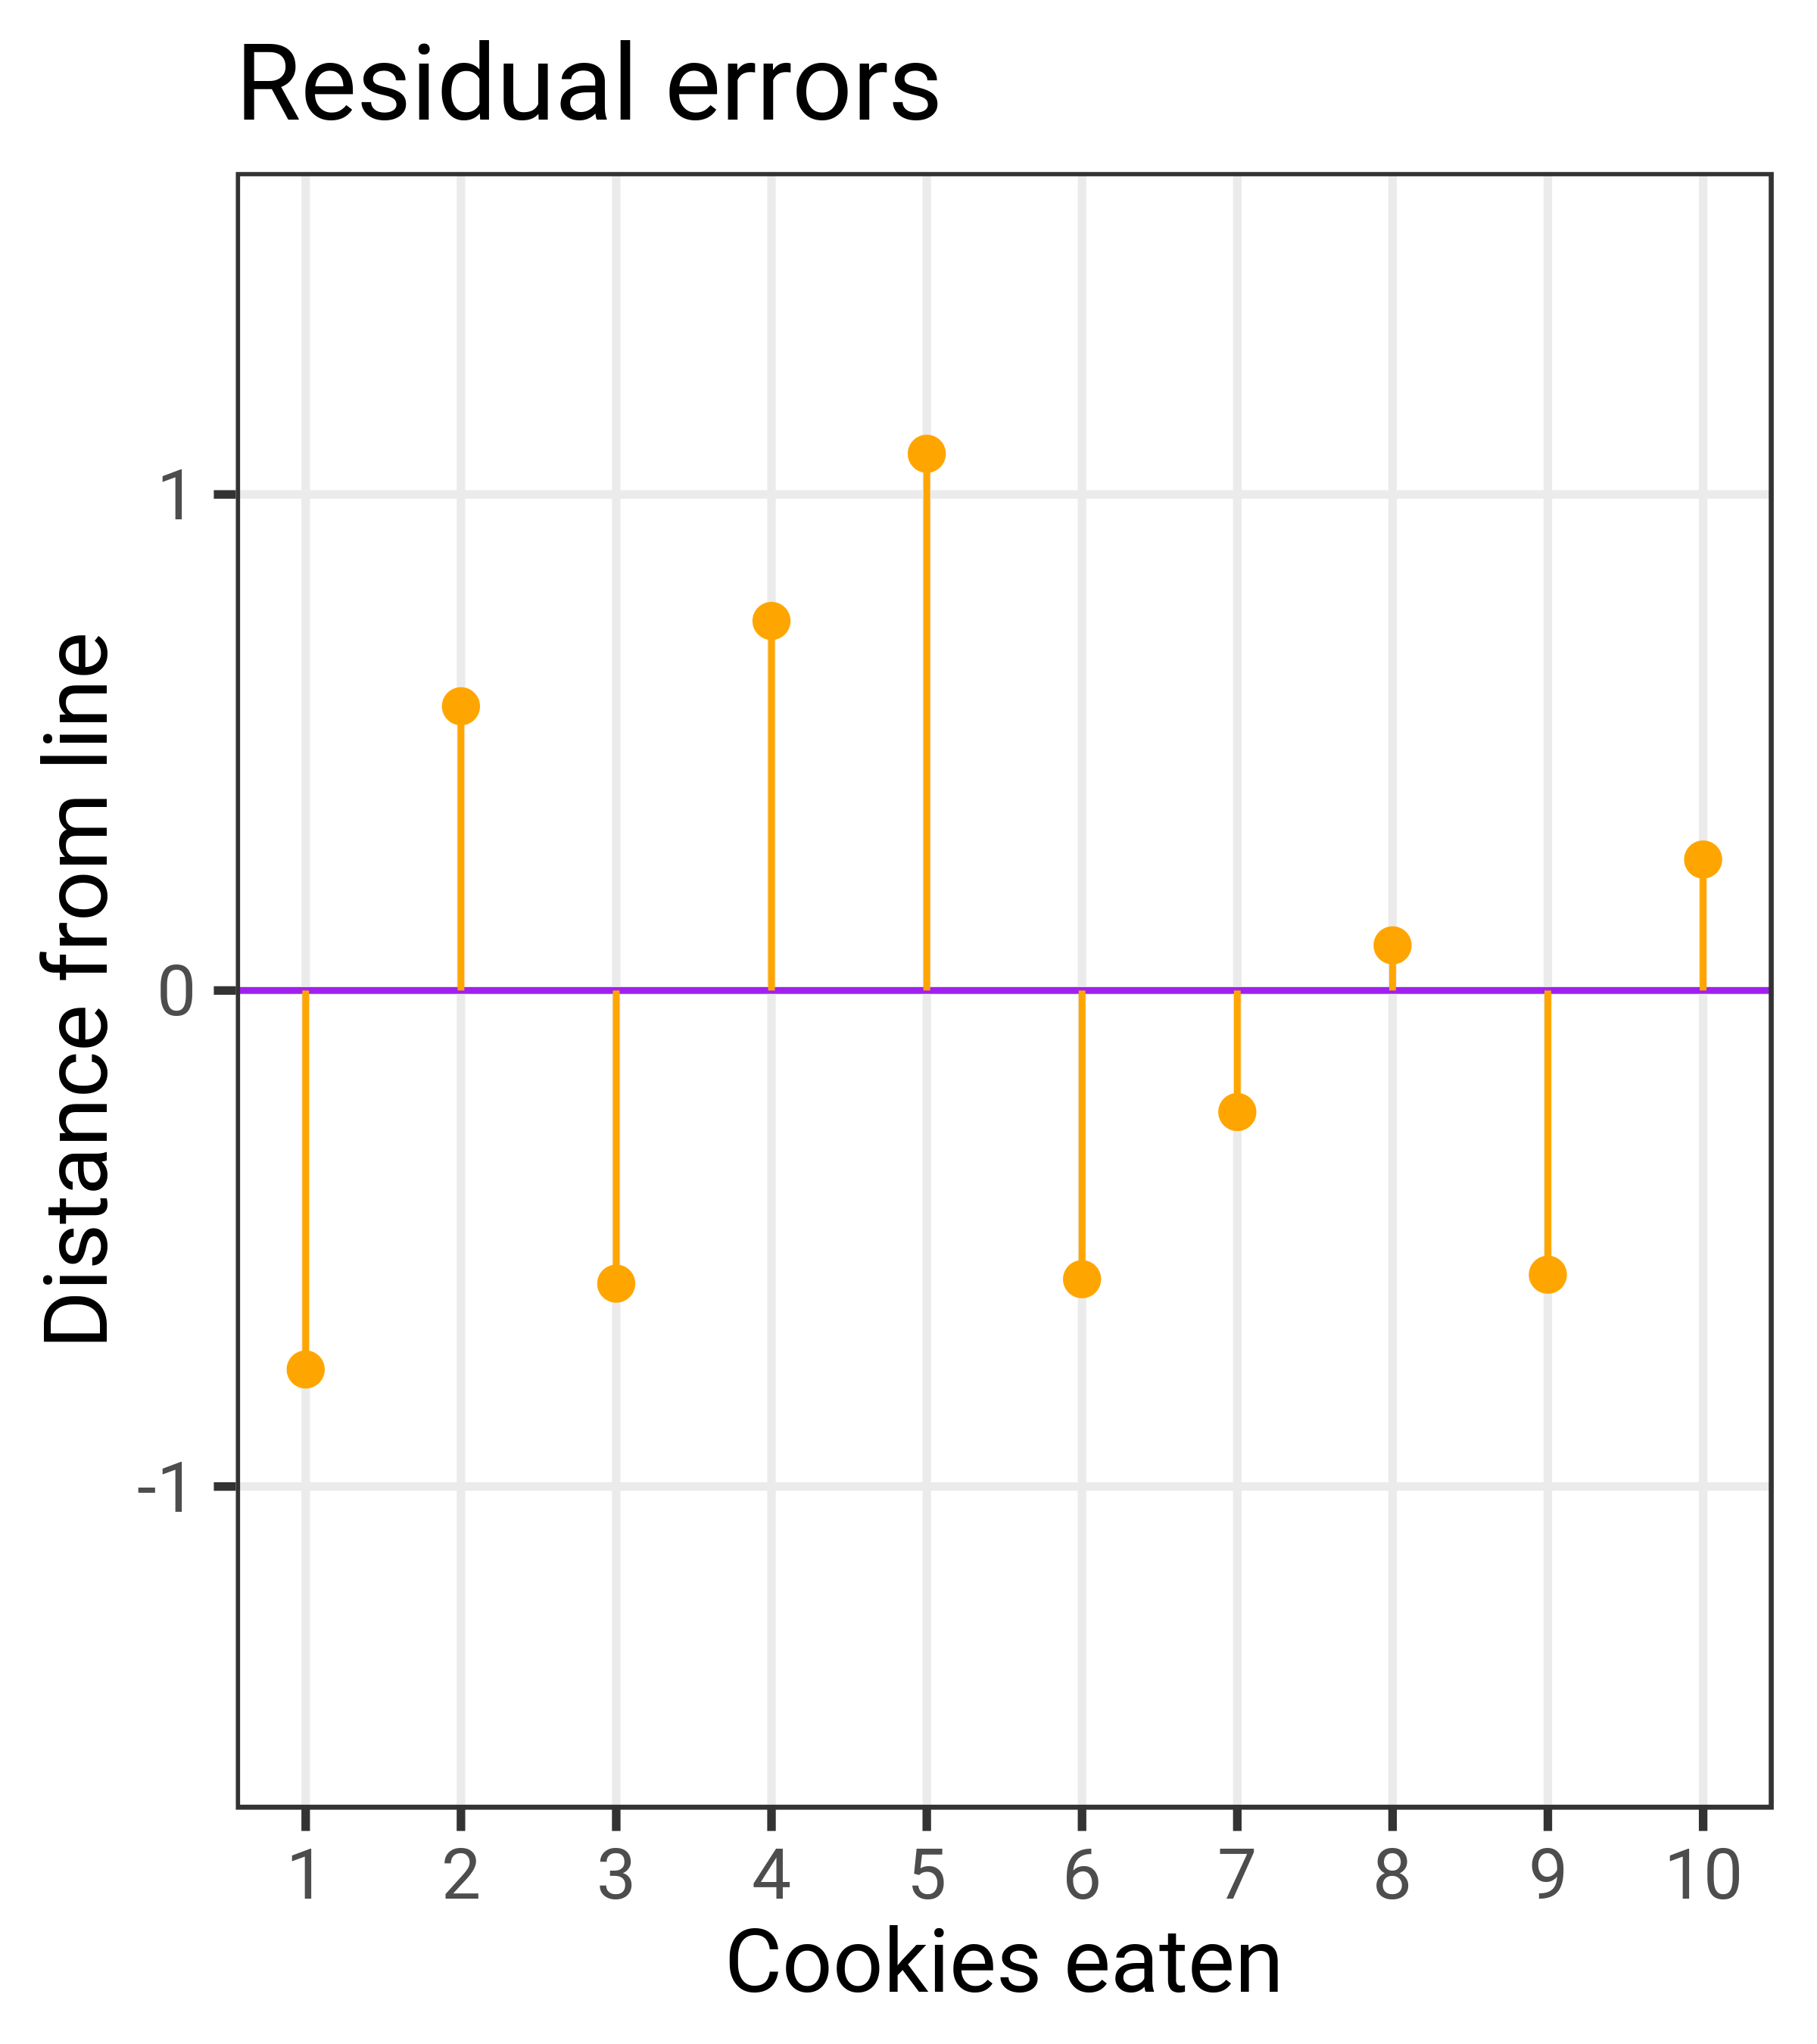

Slide 26
Ordinary least squares (OLS) regression

Slide 27
LINES AND MATH

Slide 28
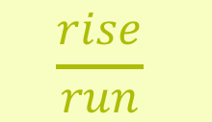

DRAWING LINES WITH MATH
$$y=mx+b$$
y
A number
x
A number
m
Slope
$$\frac{rise}{run}$$
b
y intercept

Slide 29
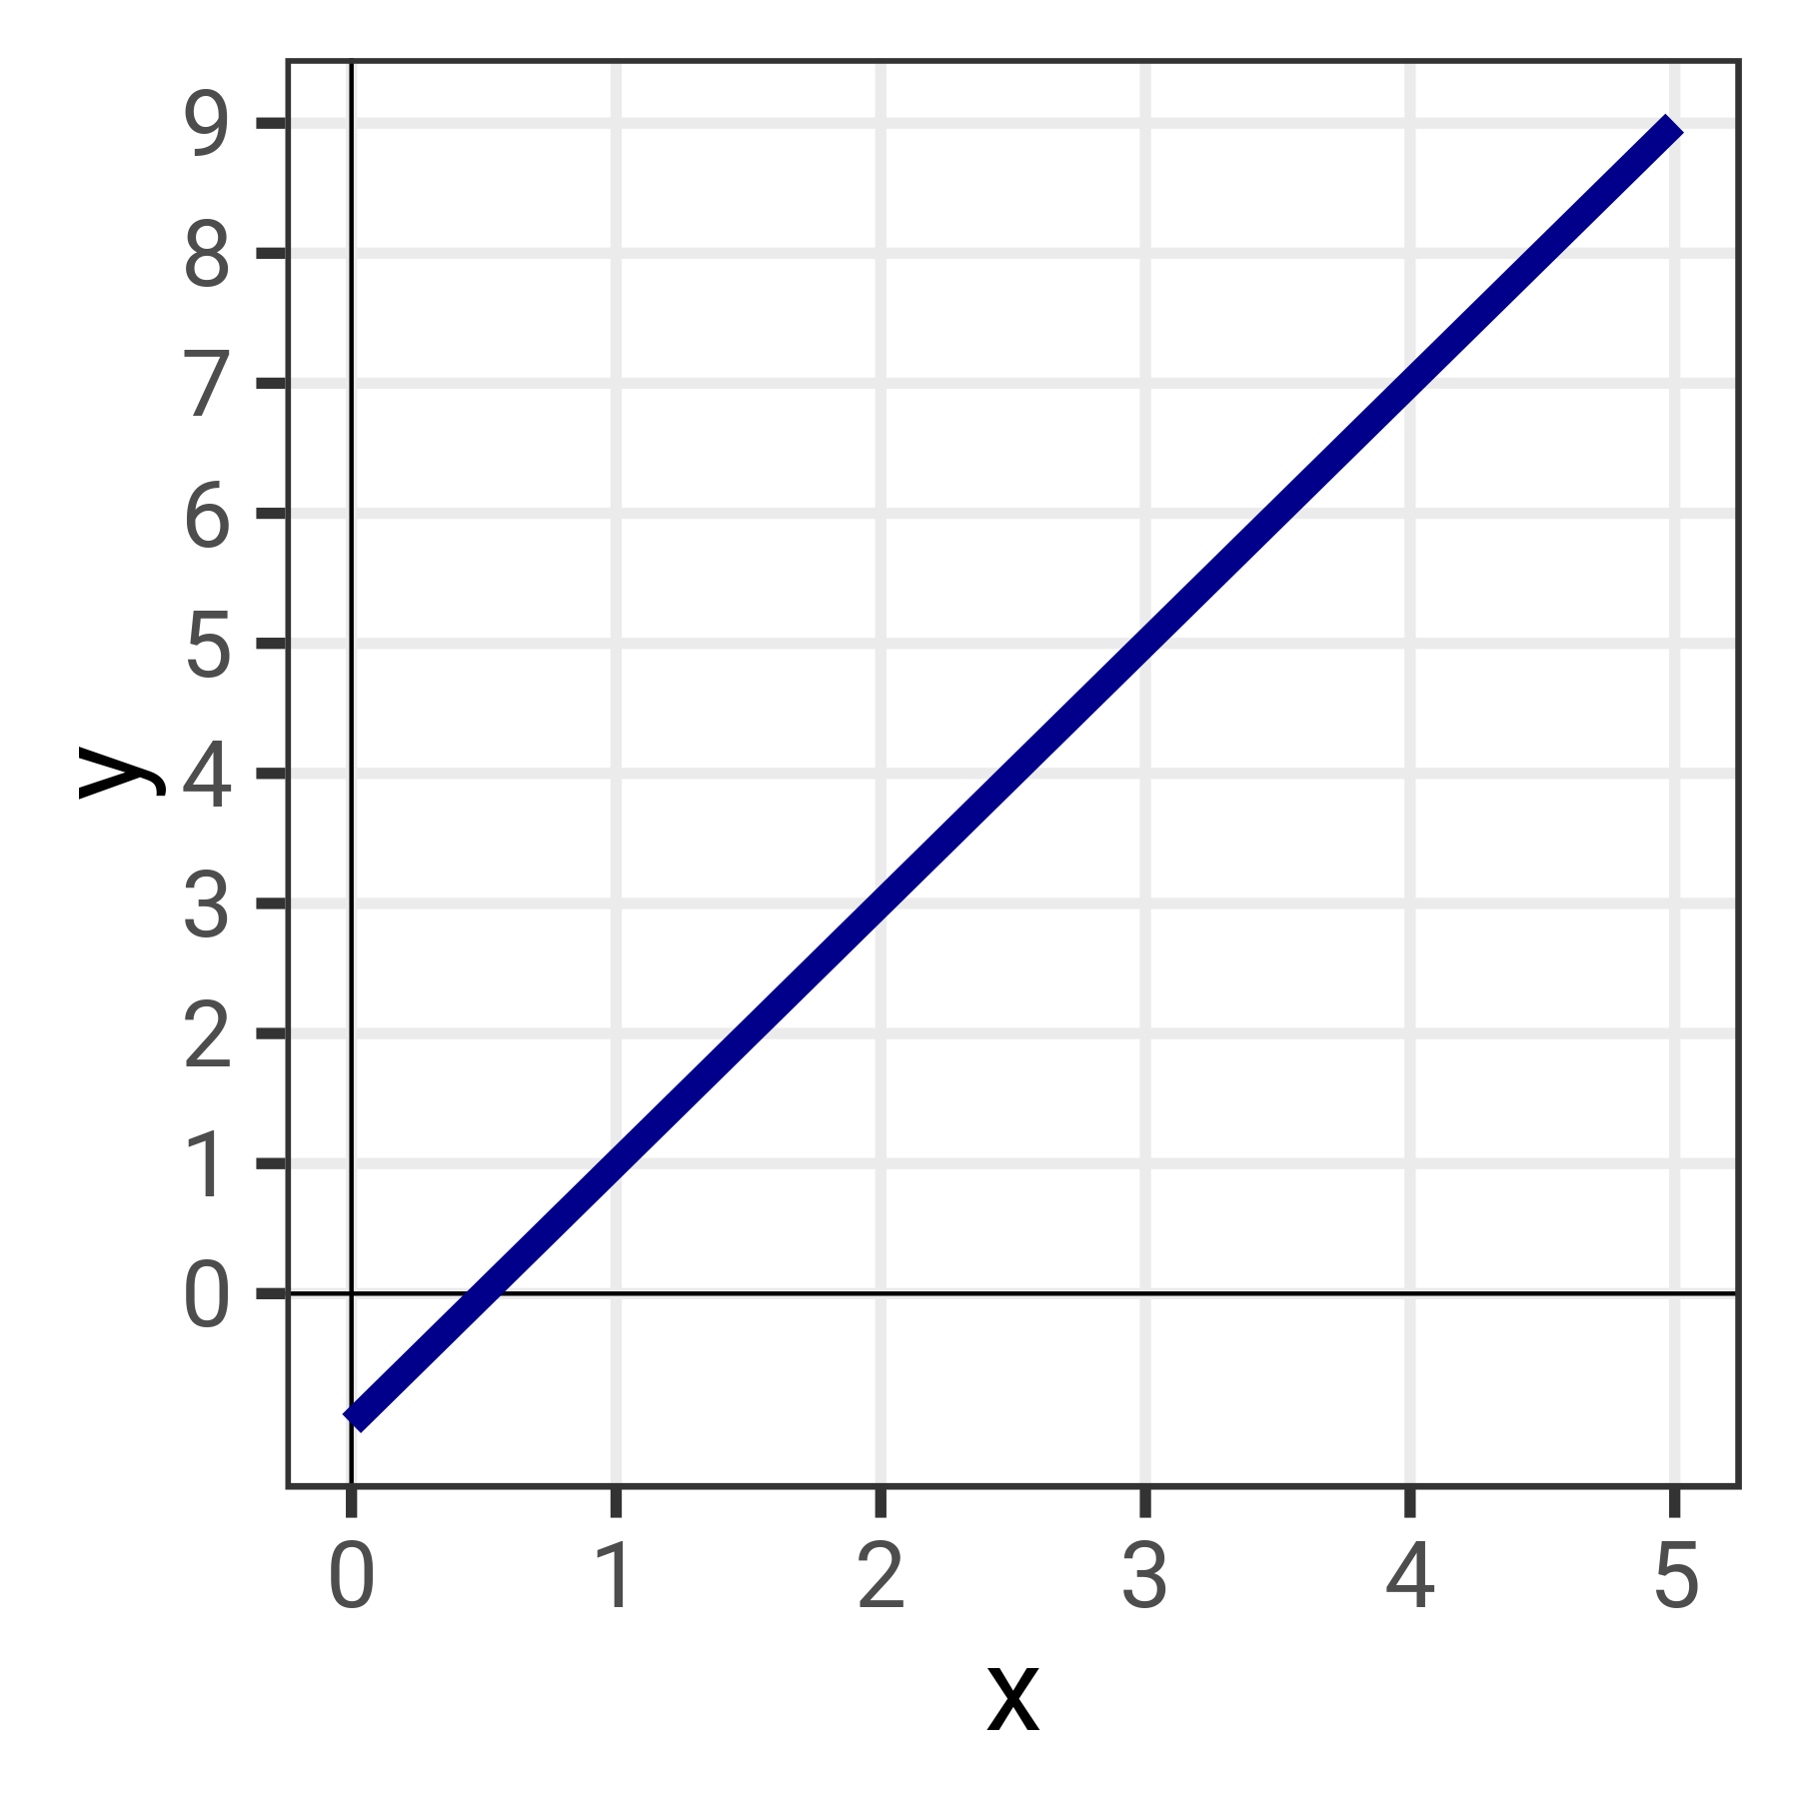
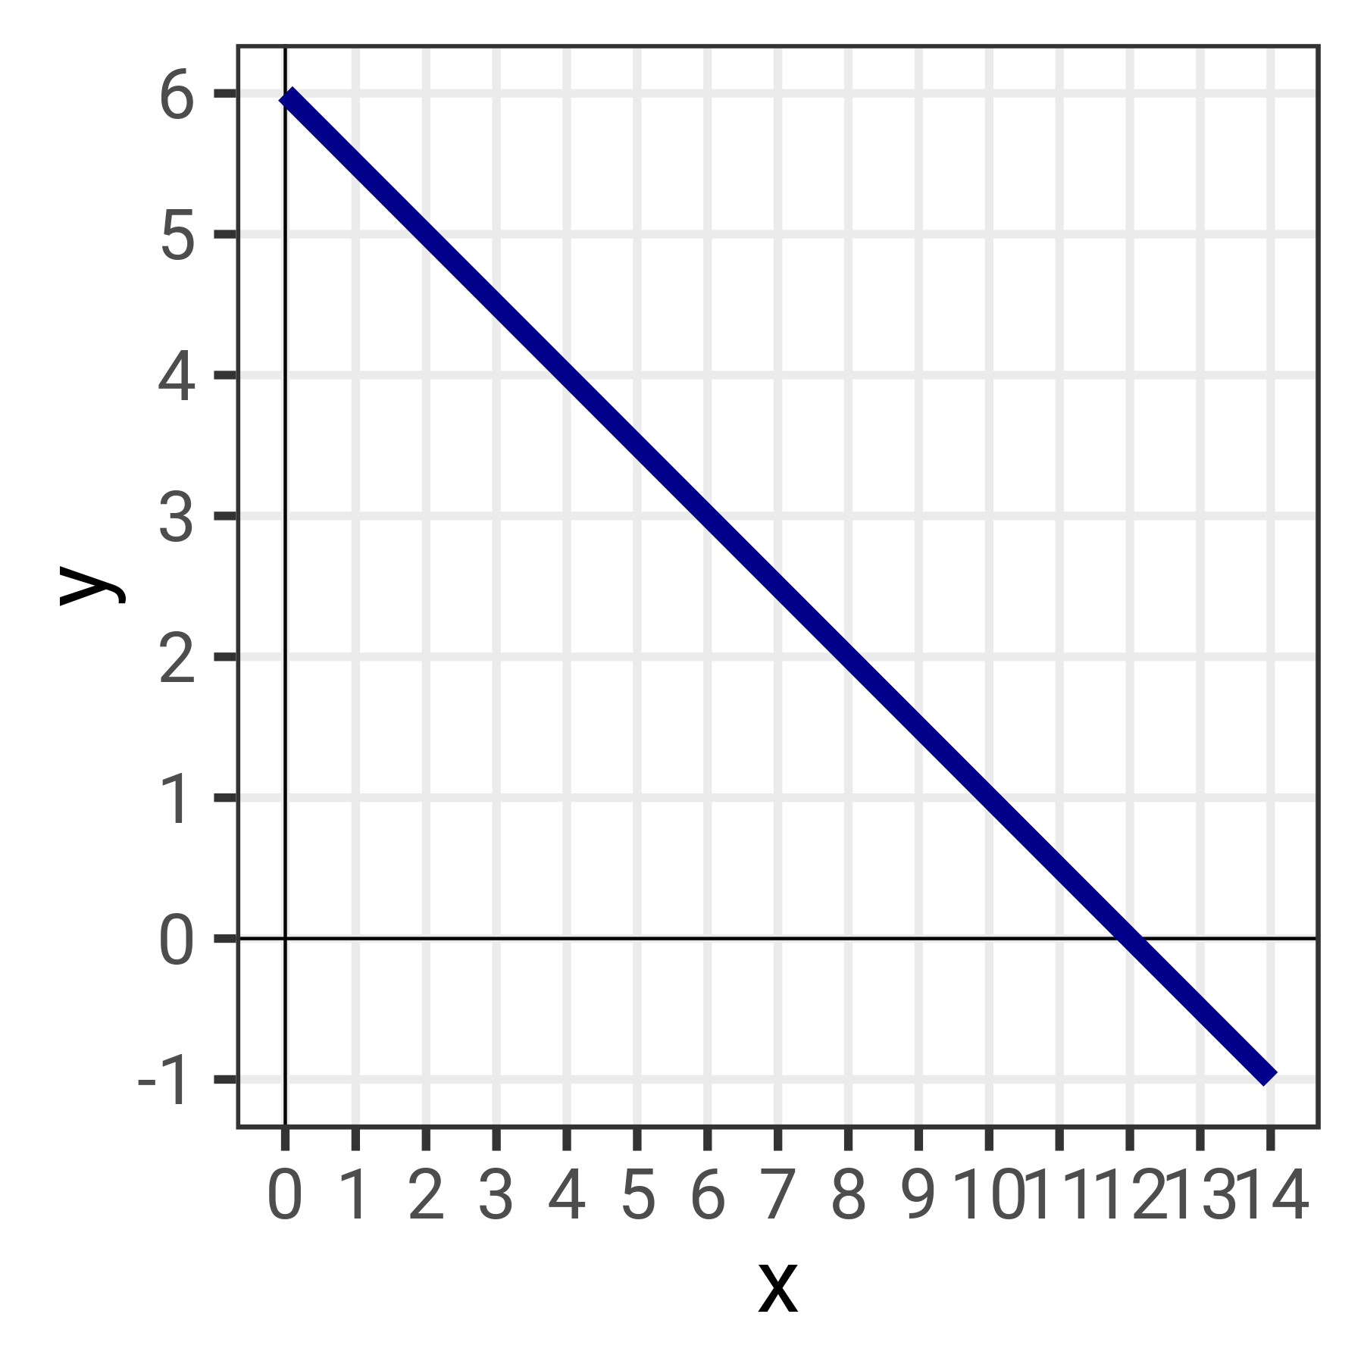


SLOPES AND INTERCEPTS
$$y=2x−1$$
$$y=−0.5x+6$$

Slide 30






GRAPH THESE
$$y=5x+2$$
$$y=x−1$$
$$y=−2x+11$$
$$y=6 −2x$$
$$y=0.33x−1$$
$$y=0.75x−3$$

Slide 31
TRANSLATING LINES TO STATISTICS

Slide 32



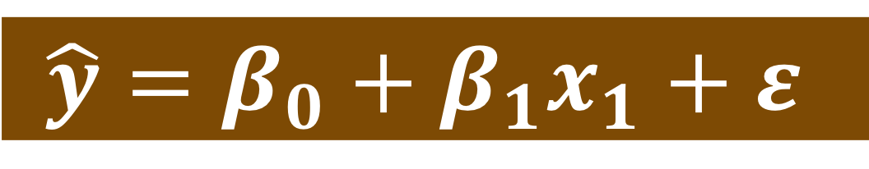



DRAWING LINES WITH STATS
$$\hat{y}=β_{0}+β_{1}x_{1}+ε$$
$$y=mx+b$$
y
$$\hat{y}$$
Outcome variable
x
$$x_{1}$$
Explanatory variable
m
$$β_{1}$$
Slope
b
$$β_{0}$$
y intercept
$$ε$$
Error (residuals)

Slide 33
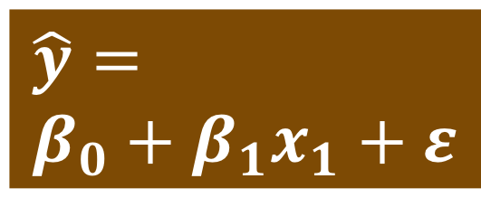
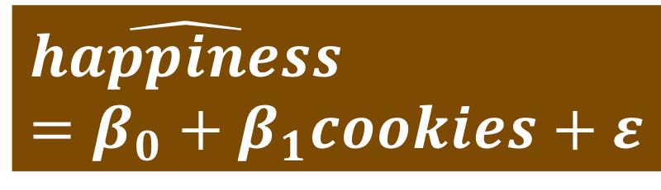
MODELING COOKIES AND HAPPINESS
$$\hat{y}= \\ β_{0}+β_{1}x_{1}+ε$$
$$\hat{happiness}=β_{0}+β_{1}cookies+ε$$

Slide 34
MODELING COOKIES AND HAPPINESS
cookies_model <- lm(happiness ~ cookies,
data = cookies_data)
cookies_model %>%
get_regression_table()
# A tibble: 2 x 7
term estimate std_error statistic p_value lower_ci upper_ci
<chr> <dbl> <dbl> <dbl> <dbl> <dbl> <dbl>
1 intercept 1.1 0.47 2.34 0.047 0.016 2.18
2 cookies 0.164 0.076 2.16 0.063 -0.011 0.338

Slide 35
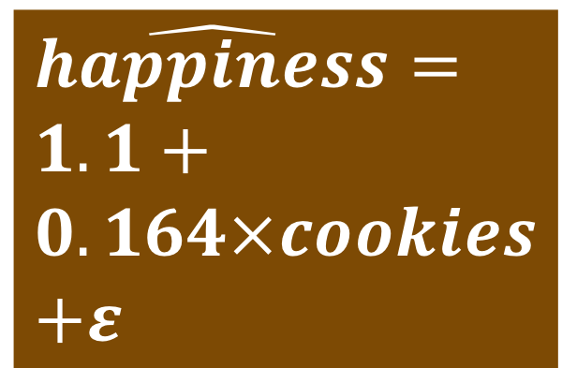
$$\hat{happiness}= \\ 1.1+ \\ 0.164×cookies \\ +ε$$
term | estimate | std_error | statistic | p_value | lower_ci | upper_ci
intercept | 1.1 | 0.47 | 2.339 | 0.047 | 0.016 | 2.184
cookies | 0.164 | 0.076 | 2.159 | 0.063 | -0.011 | 0.338
Chapter 10
Chapter 11
Chapter 11
Chapter 9
Chapter 9

Slide 36

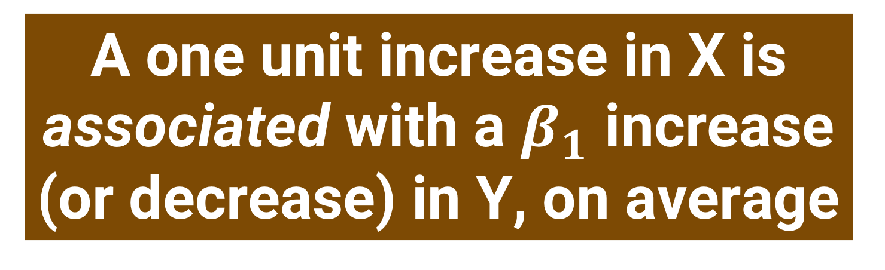
TEMPLATE
A one unit increase in X is associated with a $β_{1}$ increase (or decrease) in Y, on average
$$\hat{happiness}=1.1+0.164×cookies+ε$$

Slide 37
REAL LIFE EXAMPLE

