Slide 1
MULTIPLE REGRESSION
MPA 630: Data Science for Public Management
October 18, 2018
Fill out your reading report on Learning Suite

Slide 2
PLAN FOR TODAY
Slopes and intercepts again
Regression with categorical variables
Multiple regression
Interpretation practice

Slide 3
SLOPES AND INTERCEPTS AGAIN

Slide 4
GOAL OF REGRESSION
Explain (or predict) variation in an outcome using one or more explanatory variables

Slide 5







DRAWING LINES WITH STATS
$$\hat{y}=β_{0}+β_{1}x_{1}+ε$$
$$y=mx+b$$
y
$$\hat{y}$$
Outcome variable
x
$$x_{1}$$
Explanatory variable
m
$$β_{1}$$
Slope
b
$$β_{0}$$
y intercept
$$ε$$
Error (residuals)

Slide 6
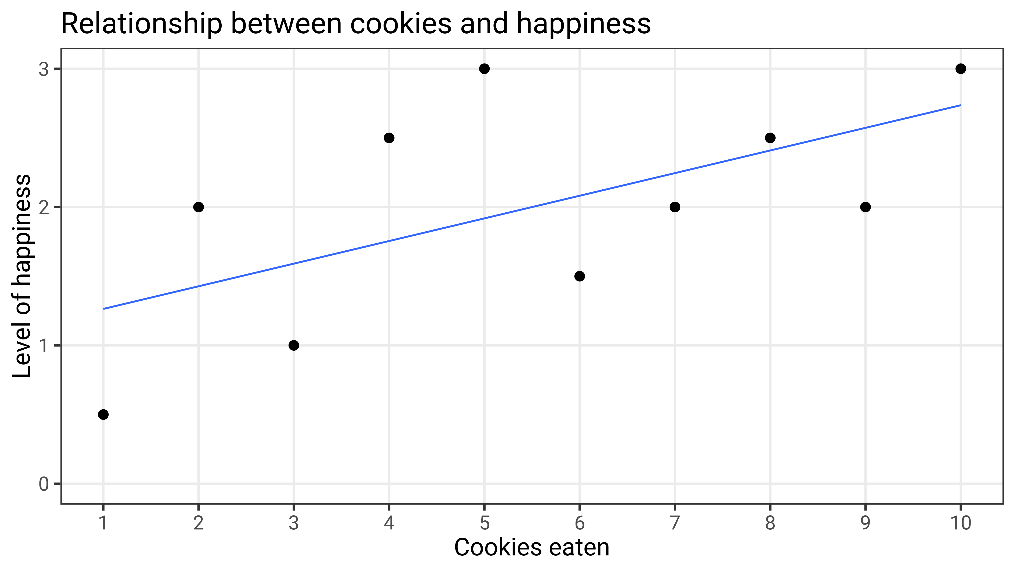
term | estimate | std_error | statistic | p_value | lower_ci | upper_ci
intercept | 1.1 | 0.47 | 2.339 | 0.047 | 0.016 | 2.184
cookies | 0.164 | 0.076 | 2.159 | 0.063 | -0.011 | 0.338
Chapter 10
Chapter 11
Chapter 11
Chapter 9
Chapter 9

Slide 7
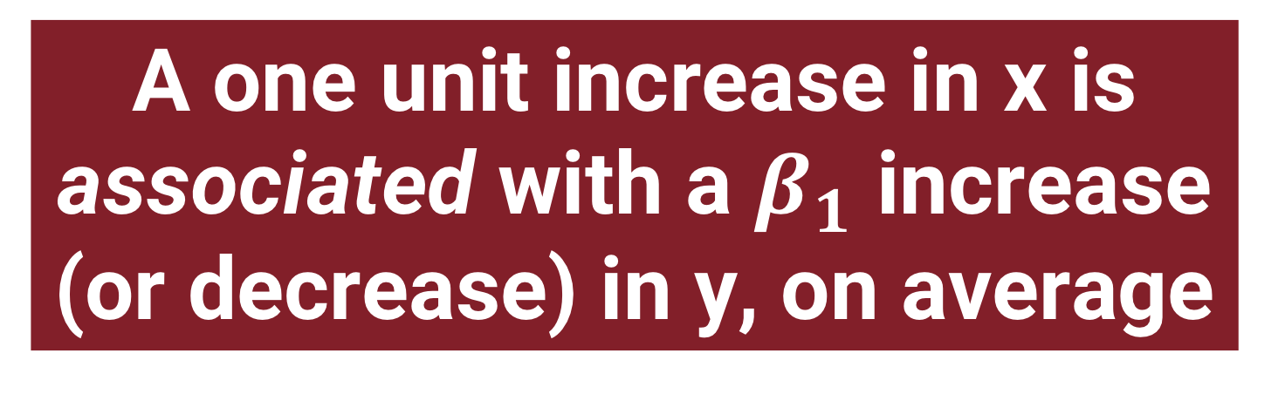
TEMPLATE
A one unit increase in x is associated with a $β_{1}$ increase (or decrease) in y, on average

Slide 8
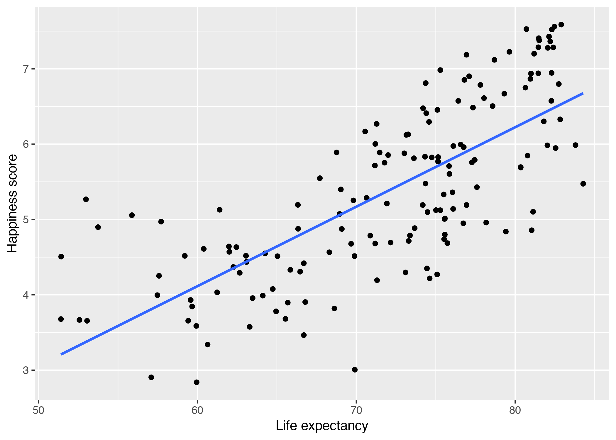
WORLD HAPPINESS

Slide 9
model1 <- lm(happiness_score ~ life_expectancy,
data = world_happiness)
model1 %>%
get_regression_table()
term | estimate | std_error | statistic | p_value | lower_ci | upper_ci
intercept | -2.215 | 0.556 | -3.983 | 0 | -3.313 | -1.116
life_expectancy | 0.105 | 0.008 | 13.73 | 0 | 0.09 | 0.121

Slide 10
WORLD HAPPINESS

Slide 11
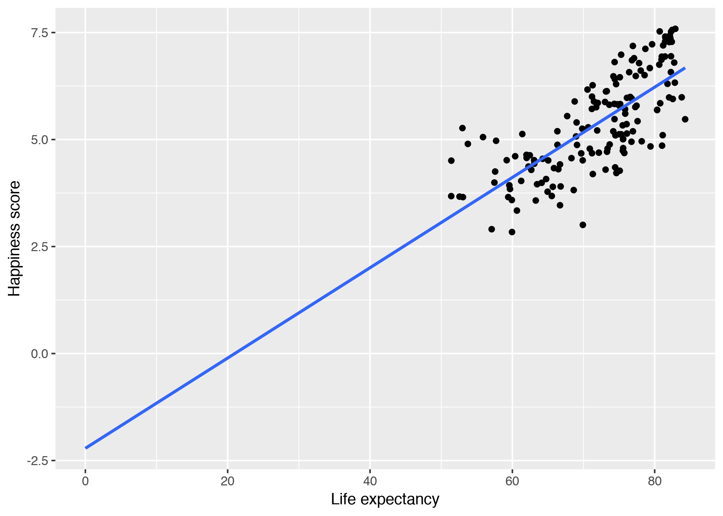
WORLD HAPPINESS

Slide 12
REGRESSION WITH CATEGORICAL VARIABLES

Slide 13
VARIABLE TYPES
Numeric variables
Categorical variables
(Continuous)
(Factors)
Numbers
Not numbers

Slide 14
NUMERIC OR CATEGORICAL?
Income
True/false
• 18–25
• 26–34
• 35–44
• 45–54
State
Weight
Tax rates
Political party
Gender
• Strongly agree
• Agree
• Disagree
• Strongly disagree
Year
Happiness
Age
Day of the week

Slide 15
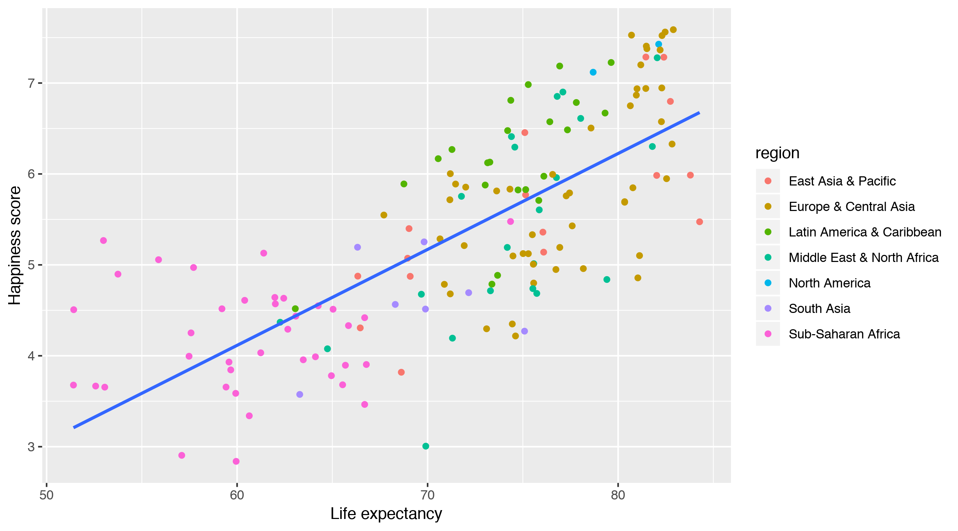
LIFE EXPECTANCY IS NOT THE FULL STORY

Slide 16
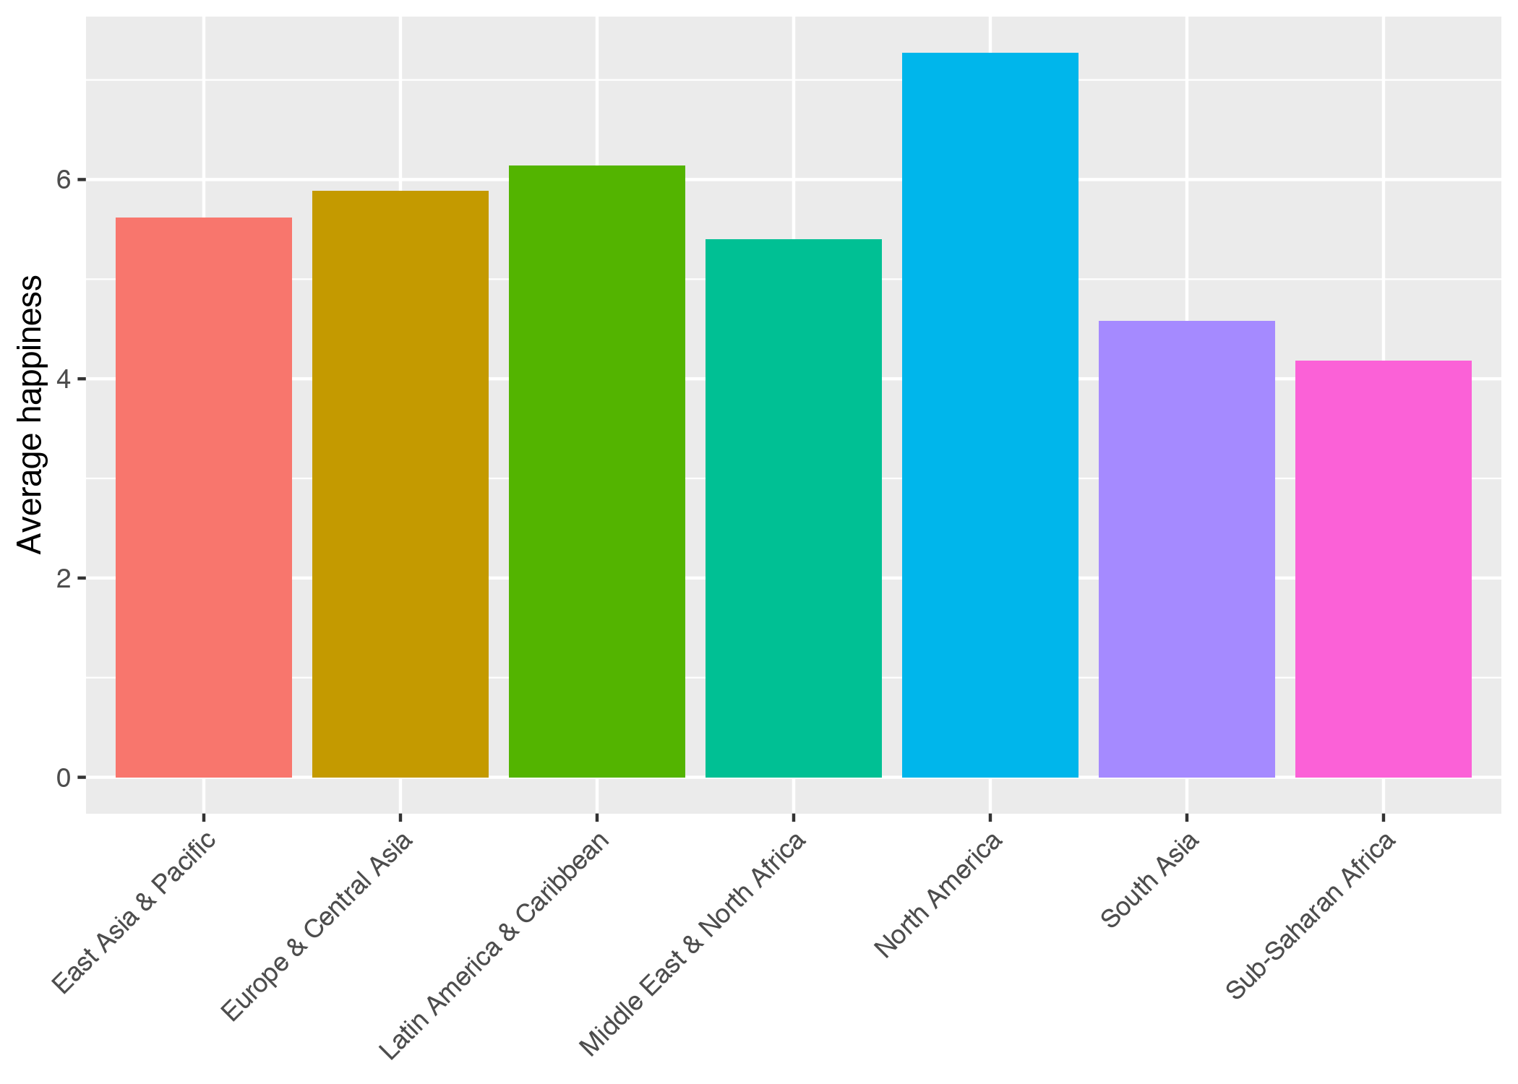
REGIONAL DIFFERENCES
region | avg
East Asia & Pacific | 5.618
Europe & Central Asia | 5.889
Latin America & Caribbean | 6.145
Middle East & North Africa | 5.404
North America | 7.273
South Asia | 4.581
Sub-Saharan Africa | 4.181

Slide 17
model2 <- lm(happiness_score ~ region, data = world_happiness)
term | estimate | std_error | statistic | p_value
intercept | 5.618 | 0.217 | 25.84 | 0
regionEurope & Central Asia | 0.271 | 0.25 | 1.084 | 0.28
regionLatin America & Caribbean | 0.527 | 0.286 | 1.844 | 0.067
regionMiddle East & North Africa | -0.214 | 0.289 | -0.742 | 0.459
regionNorth America | 1.655 | 0.652 | 2.538 | 0.012
regionSouth Asia | -1.037 | 0.394 | -2.631 | 0.009
regionSub-Saharan Africa | -1.437 | 0.259 | -5.544 | 0

Slide 18
model2 <- lm(happiness_score ~ region, data = world_happiness)
term | estimate | std_error | statistic | p_value
intercept | 5.618 | 0.217 | 25.84 | 0
regionEurope & Central Asia | 0.271 | 0.25 | 1.084 | 0.28
regionLatin America & Caribbean | 0.527 | 0.286 | 1.844 | 0.067
regionMiddle East & North Africa | -0.214 | 0.289 | -0.742 | 0.459
regionNorth America | 1.655 | 0.652 | 2.538 | 0.012
regionSouth Asia | -1.037 | 0.394 | -2.631 | 0.009
regionSub-Saharan Africa | -1.437 | 0.259 | -5.544 | 0

Slide 19
HAPPINESS IN EAST ASIA

Slide 20
HAPPINESS IN EUROPE

Slide 21
Regression coefficients
Averages
term | estimate
intercept | 5.618
regionEurope & Central Asia | 0.271
regionLatin America & Caribbean | 0.527
regionMiddle East & North Africa | -0.214
regionNorth America | 1.655
regionSouth Asia | -1.037
regionSub-Saharan Africa | -1.437
region | avg
East Asia & Pacific | 5.618
Europe & Central Asia | 5.889
Latin America & Caribbean | 6.145
Middle East & North Africa | 5.404
North America | 7.273
South Asia | 4.581
Sub-Saharan Africa | 4.181

Slide 22
TEMPLATE
On average, y is β_{n} units larger (or smaller) in x_{n}, compared to x₀
On average, national happiness is 1.65 points higher in North America than in East Asia
On average, compared to East Asia, national happiness is 1.44 points lower in Sub Saharan Africa

Slide 23
GETTING CLOSER

Slide 24
MULTIPLE REGRESSION

Slide 25

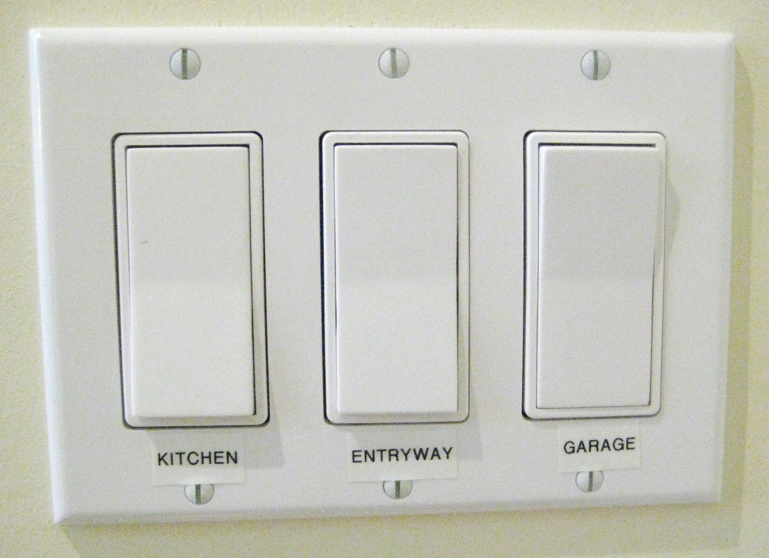
SLIDERS AND SWITCHES

Slide 26


ALL AT ONCE!

Slide 27
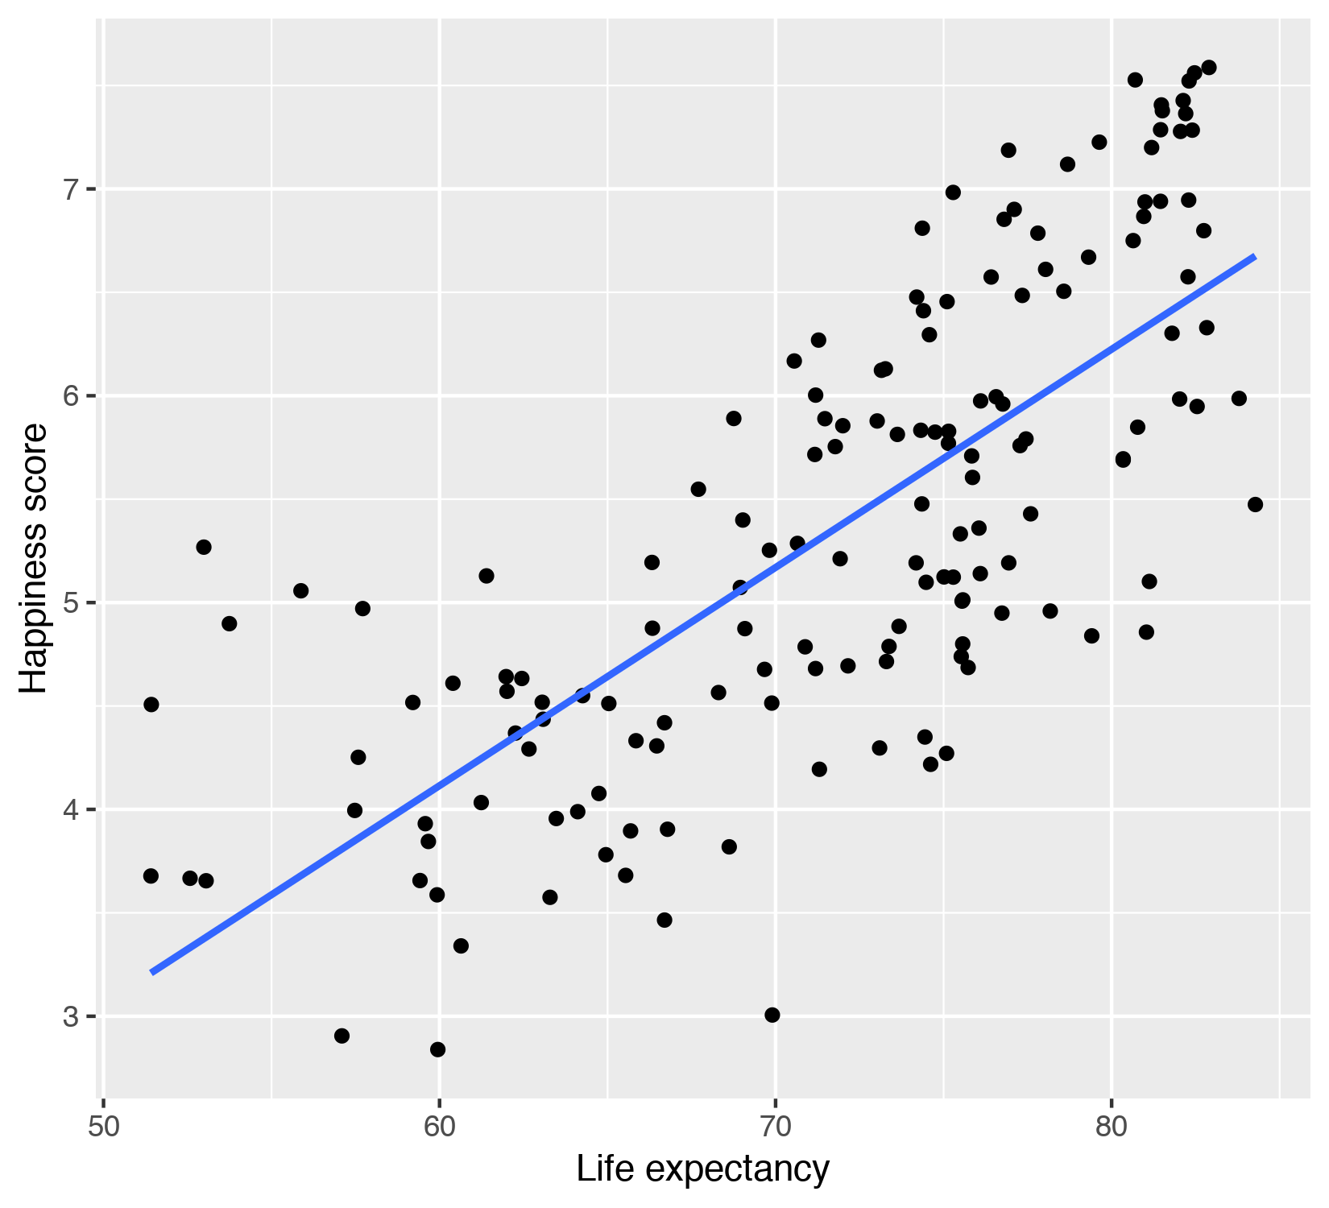
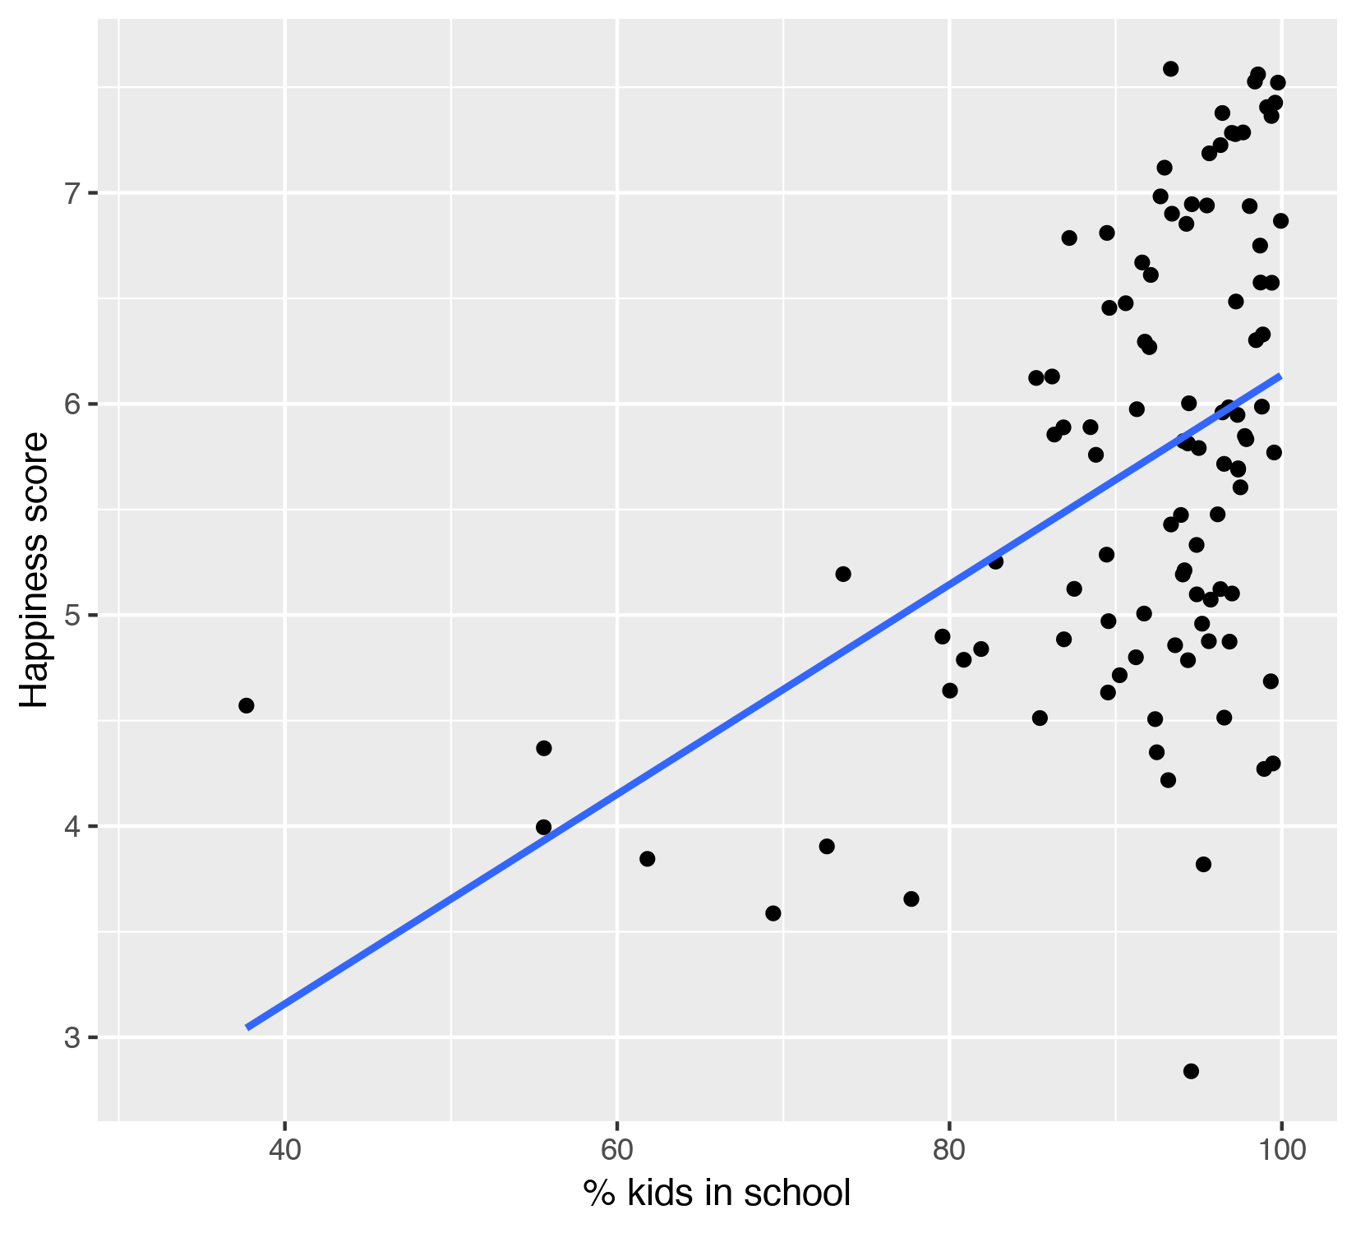
HAPPINESS ~ LIFE + SCHOOL

Slide 28
model_life <- lm(happiness_score ~ life_expectancy,
data = world_happiness)
term | estimate | std_error | statistic | p_value | lower_ci | upper_ci
intercept | -2.215 | 0.556 | -3.983 | 0 | -3.313 | -1.116
life_expectancy | 0.105 | 0.008 | 13.73 | 0 | 0.09 | 0.121
model_school <- lm(happiness_score ~ school_enrollment,
data = world_happiness)
term | estimate | std_error | statistic | p_value | lower_ci
intercept | 1.173 | 0.879 | 1.334 | 0.185 | -0.571
school_enrollment | 0.05 | 0.01 | 5.19 | 0 | 0.031

Slide 29
BOTH AT THE SAME TIME
Life expectancy and school enrollment both explain some variation in happiness
On its own, a 1 year increase in school enrollment is associated with a 0.105 point increase in happiness, on average
On its own, a 1% increase in school enrollment is associated with a 0.05 point increase in happiness, on average
Some of that explanation is shared!

Slide 30
model_life_school <- lm(happiness_score ~ life_expectancy +
school_enrollment,
data = world_happiness)
term | estimate | std_error | statistic | p_value | lower_ci
intercept | -2.111 | 0.835 | -2.529 | 0.013 | -3.767
life_expectancy | 0.101 | 0.014 | 7.447 | 0 | 0.074
school_enrollment | 0.003 | 0.01 | 0.331 | 0.741 | -0.016

Slide 31
FILTERING OUT VARIATION
Each x in the model explains some portion of the variation in y
This will often change the simple regression coefficients
Interpretation is a little trickier, since you can only ever move one switch or slider (or variable)

Slide 32
TEMPLATE
Taking all other variables in the model into account, a one unit increase in x_{n} is associated with a β_{n} increase (or decrease) in y, on average
Controlling for school enrollment, a 1 year increase in life expectancy is associated with a 0.1 point increase in national happiness, on average

Slide 33
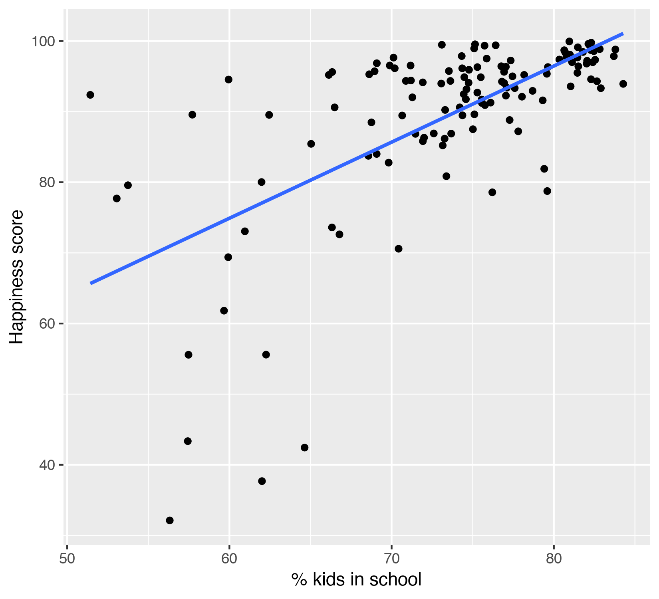
HAPPINESS ~ LIFE + SCHOOL + REGION

Slide 34
model_life_school_region <-
lm(happiness_score ~ life_expectancy + school_enrollment + region,
data = world_happiness)
term | estimate | std_error | statistic | p_value
intercept | -2.821 | 1.355 | -2.083 | 0.04
life_expectancy | 0.102 | 0.017 | 5.894 | 0
school_enrollment | 0.008 | 0.01 | 0.785 | 0.435
regionEurope & Central Asia | 0.031 | 0.255 | 0.123 | 0.902
regionLatin America & Caribbean | 0.732 | 0.294 | 2.489 | 0.015
regionMiddle East & North Africa | 0.189 | 0.317 | 0.597 | 0.552
regionNorth America | 1.114 | 0.581 | 1.917 | 0.058
regionSouth Asia | -0.249 | 0.45 | -0.553 | 0.582
regionSub-Saharan Africa | 0.326 | 0.407 | 0.802 | 0.425

Slide 35
Controlling for school enrollment and region, a 1 year increase in life expectancy is associated with a 0.102 point increase in national happiness, on average
Controlling for life expectancy and region, a 1% increase in school enrollment is associated with a 0.008 point increase in national happiness, on average
On average, controlling for life expectancy and school enrollment, North America is 1.114 points happier than East Asia
On average, controlling for life expectancy and school enrollment, South Asia is 0.249 points less happier than East Asia

Slide 36
INTERPRETATION PRACTICE

Slide 37
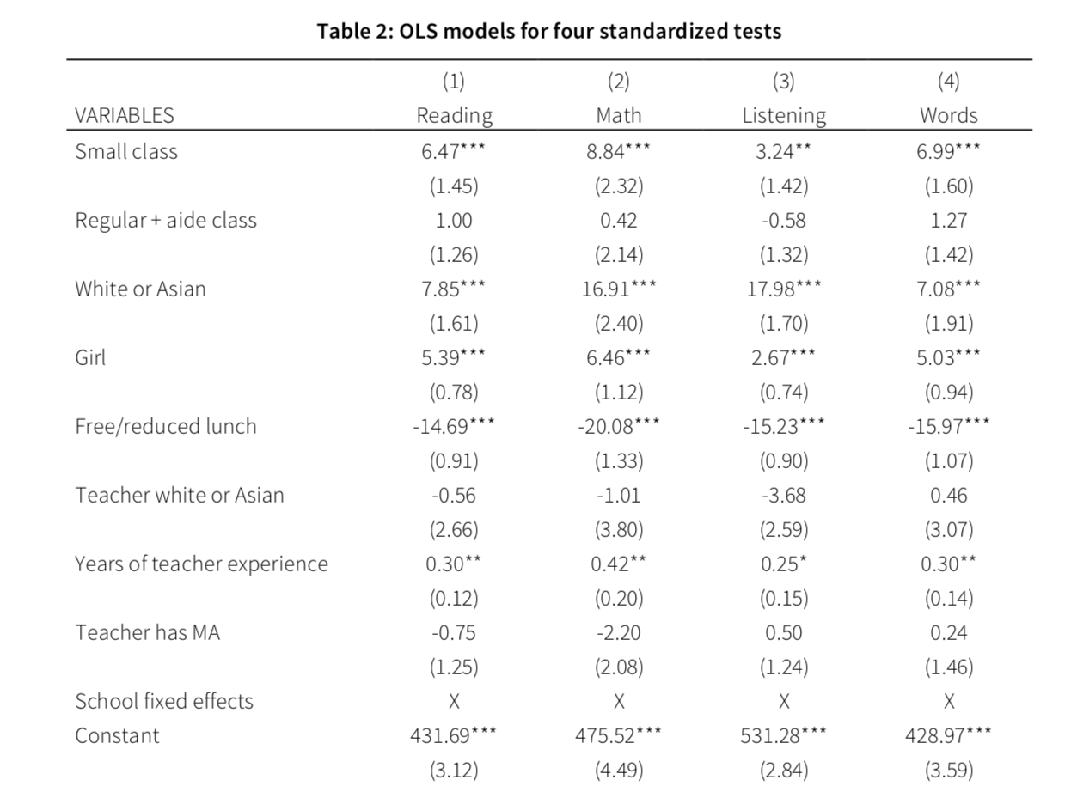
Y = test scores
Not small vs. small
Class doesn’t have aide vs. class has aide
Student not white/Asian vs. yes
Student is boy vs. girl
Student does not receive FRL vs. yes
Teacher not white/Asian vs. yes
Years (actual number)
Teacher does not have MA vs. yes

Slide 38
FOLLOW ALONG IN R

