Slide 1
REGRESSION DIAGNOSTICS AND PREDICTIONS
MPA 630: Data Science for Public Management
October 25, 2018
Fill out your reading report on Learning Suite

Slide 2
PLAN FOR TODAY
Miscellanea
What does it mean to control for things?
How do we know if a model is good?
Interpretation practice
Making predictions

Slide 3
MISCELLANEA

Slide 4
UPCOMING THINGS
Problem set 4
Exam 2
Final project
Code-through

Slide 5
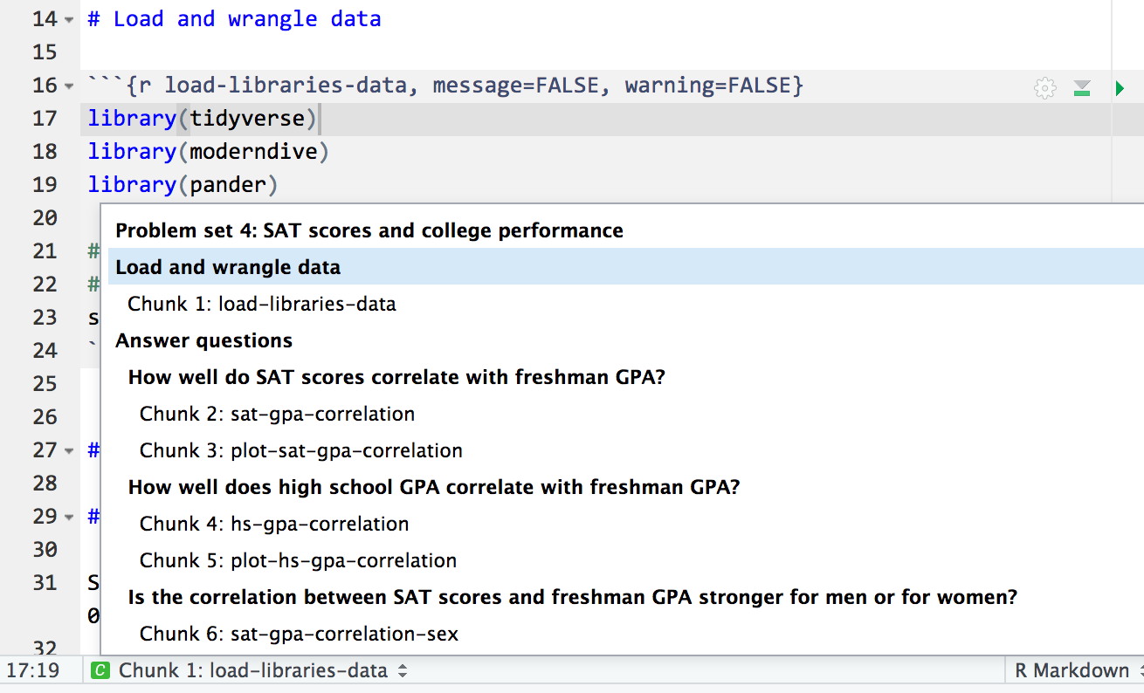
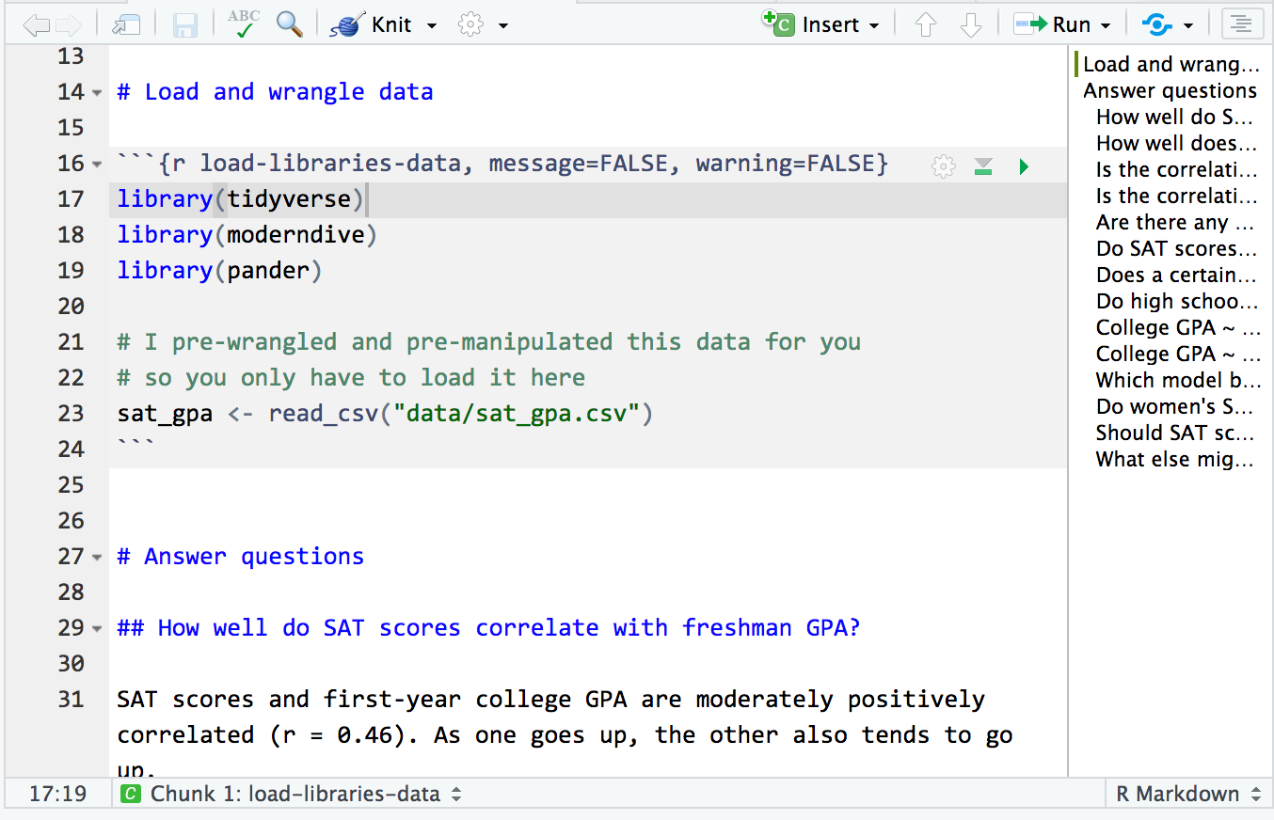
NAVIGATING R MARKDOWN
Dollar signs

Slide 6
WHAT DOES IT MEAN TO CONTROL FOR THINGS?

Slide 7

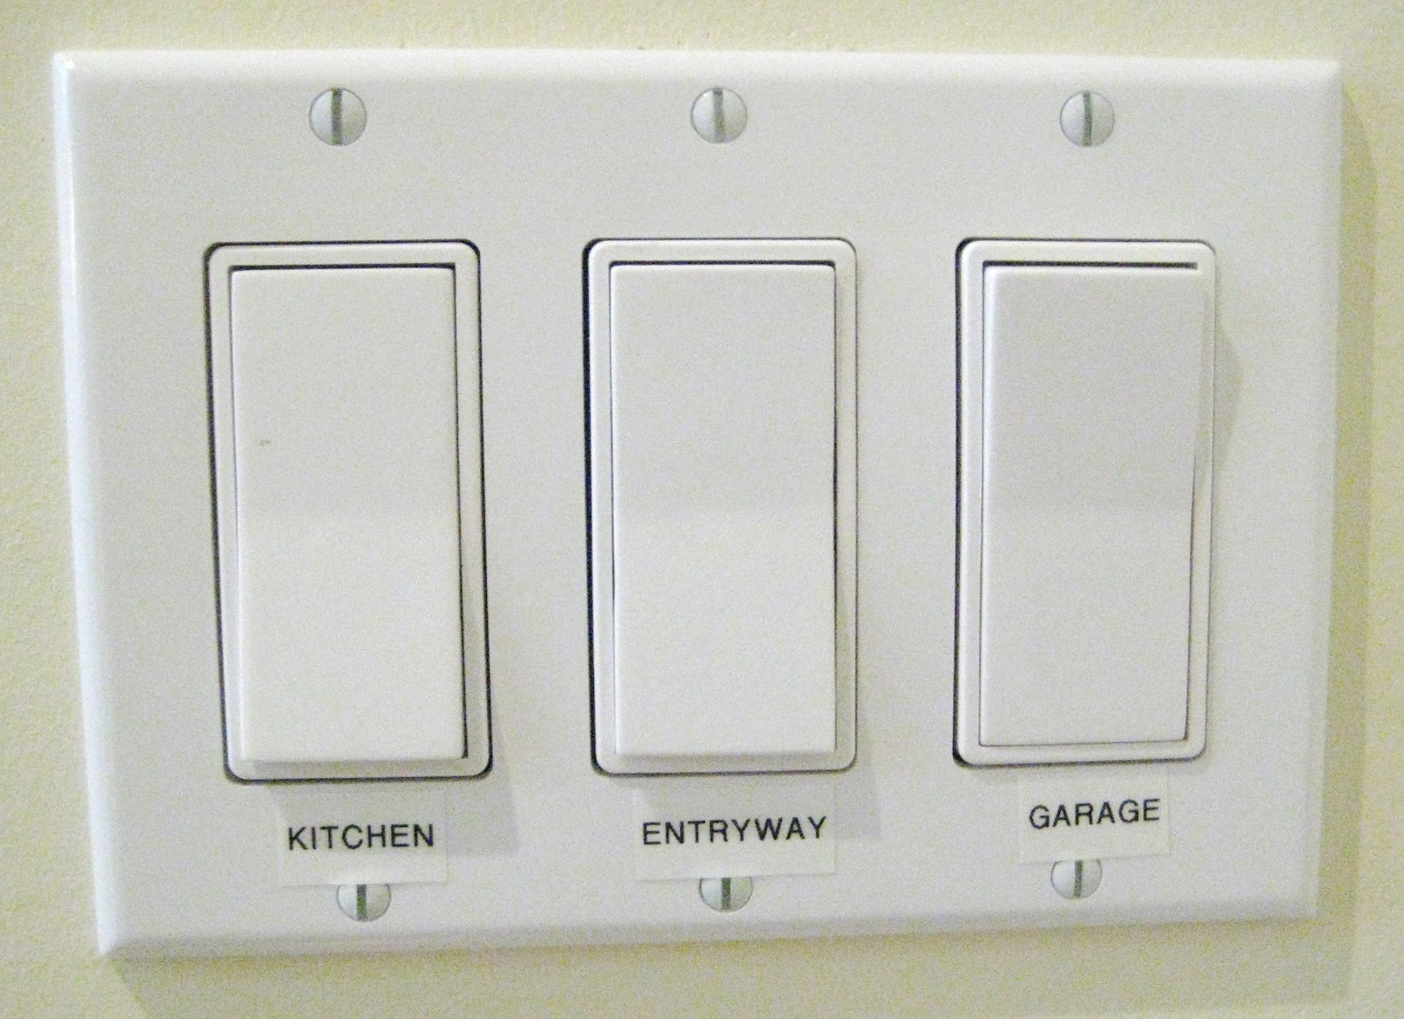
SLIDERS AND SWITCHES

Slide 8


ALL AT ONCE!

Slide 9
FILTERING OUT VARIATION
Each x in the model explains some portion of the variation in y
This will often change the simple regression coefficients
Interpretation is a little trickier, since you can only ever move one switch or slider (or variable)

Slide 10
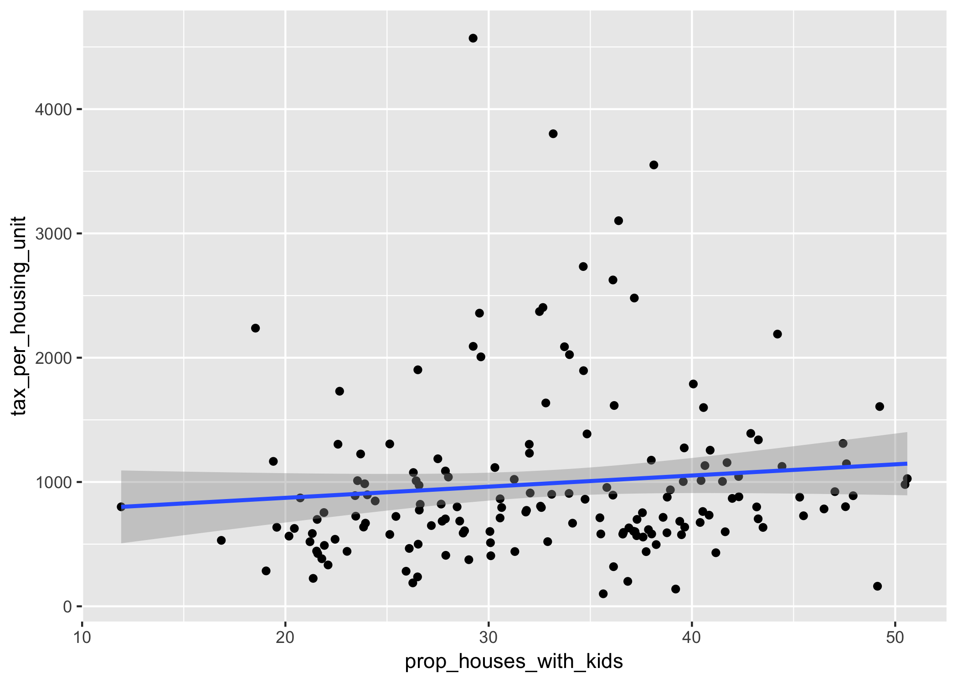
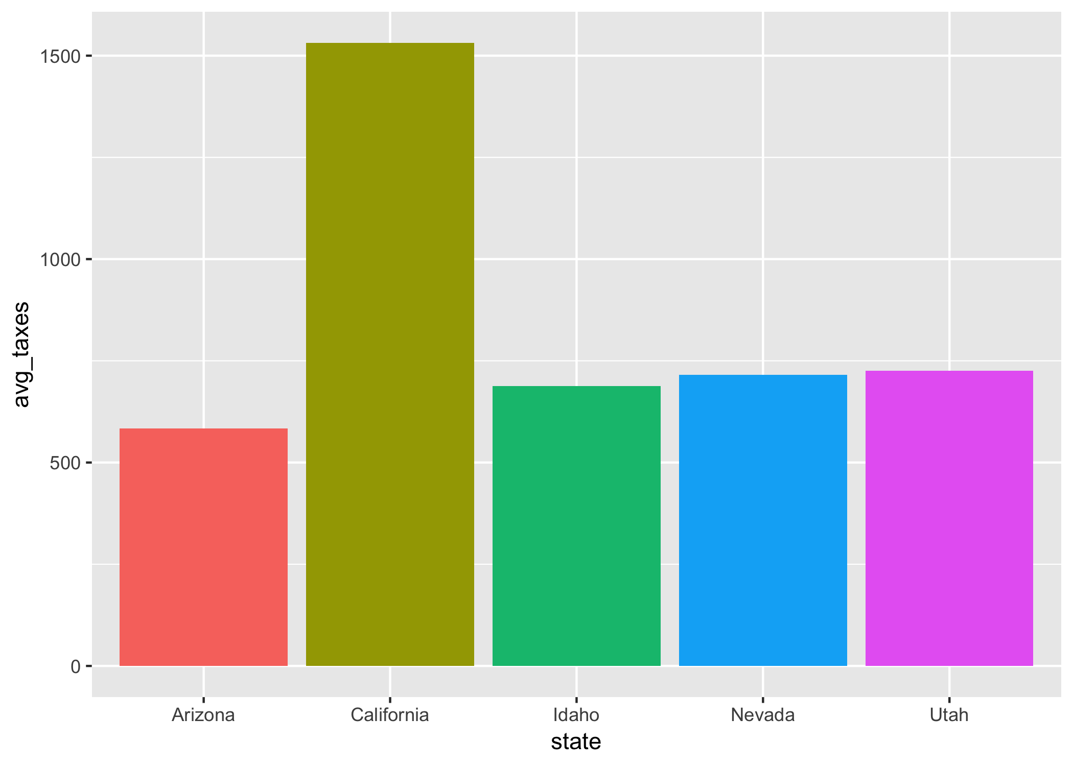
TAXES ~ KIDS & TAXES ~ STATE

Slide 11
BOTH AT THE SAME TIME
Kids and states both explain some variation in property tax rates
On its own, a 1% increase in the number of households with kids in them is associated with a $X increase in per-household taxes, on average
On its own, being in State X is associated with $X higher/lower per-household property taxes compared to Arizona, on average
Some of that explanation is shared!

Slide 12
WHY CONTROL?
“Taking into account” or “controlling for” essentially means filtering out the effects of other variables
It lets you isolate the effect of specific levers/switches/sliders/Xs

Slide 13
model4 <- lm(tax_per_housing_unit ~
median_home_value + prop_houses_with_kids + state,
data = world_happiness)
term | estimate | std_error | statistic | p_value
intercept | -412.5 | 118.1 | -3.493 | 0.001
median_home_value | 0.004 | 0 | 21.99 | 0
prop_houses_with_kids | 14.09 | 2.853 | 4.941 | 0
stateCalifornia | 123.3 | 88.22 | 1.397 | 0.164
stateIdaho | 9.526 | 82.74 | 0.115 | 0.908
stateNevada | 102.5 | 98.25 | 1.043 | 0.299
stateUtah | -213.2 | 91.21 | -2.337 | 0.021
Utah has high per capita taxes compared to the other states in the region. If we control for the number of households with kids, though, Utah is actually substantially undertaxed. Lots of the reason that Utah’s taxes are so high is because there are so many kids.

Slide 14
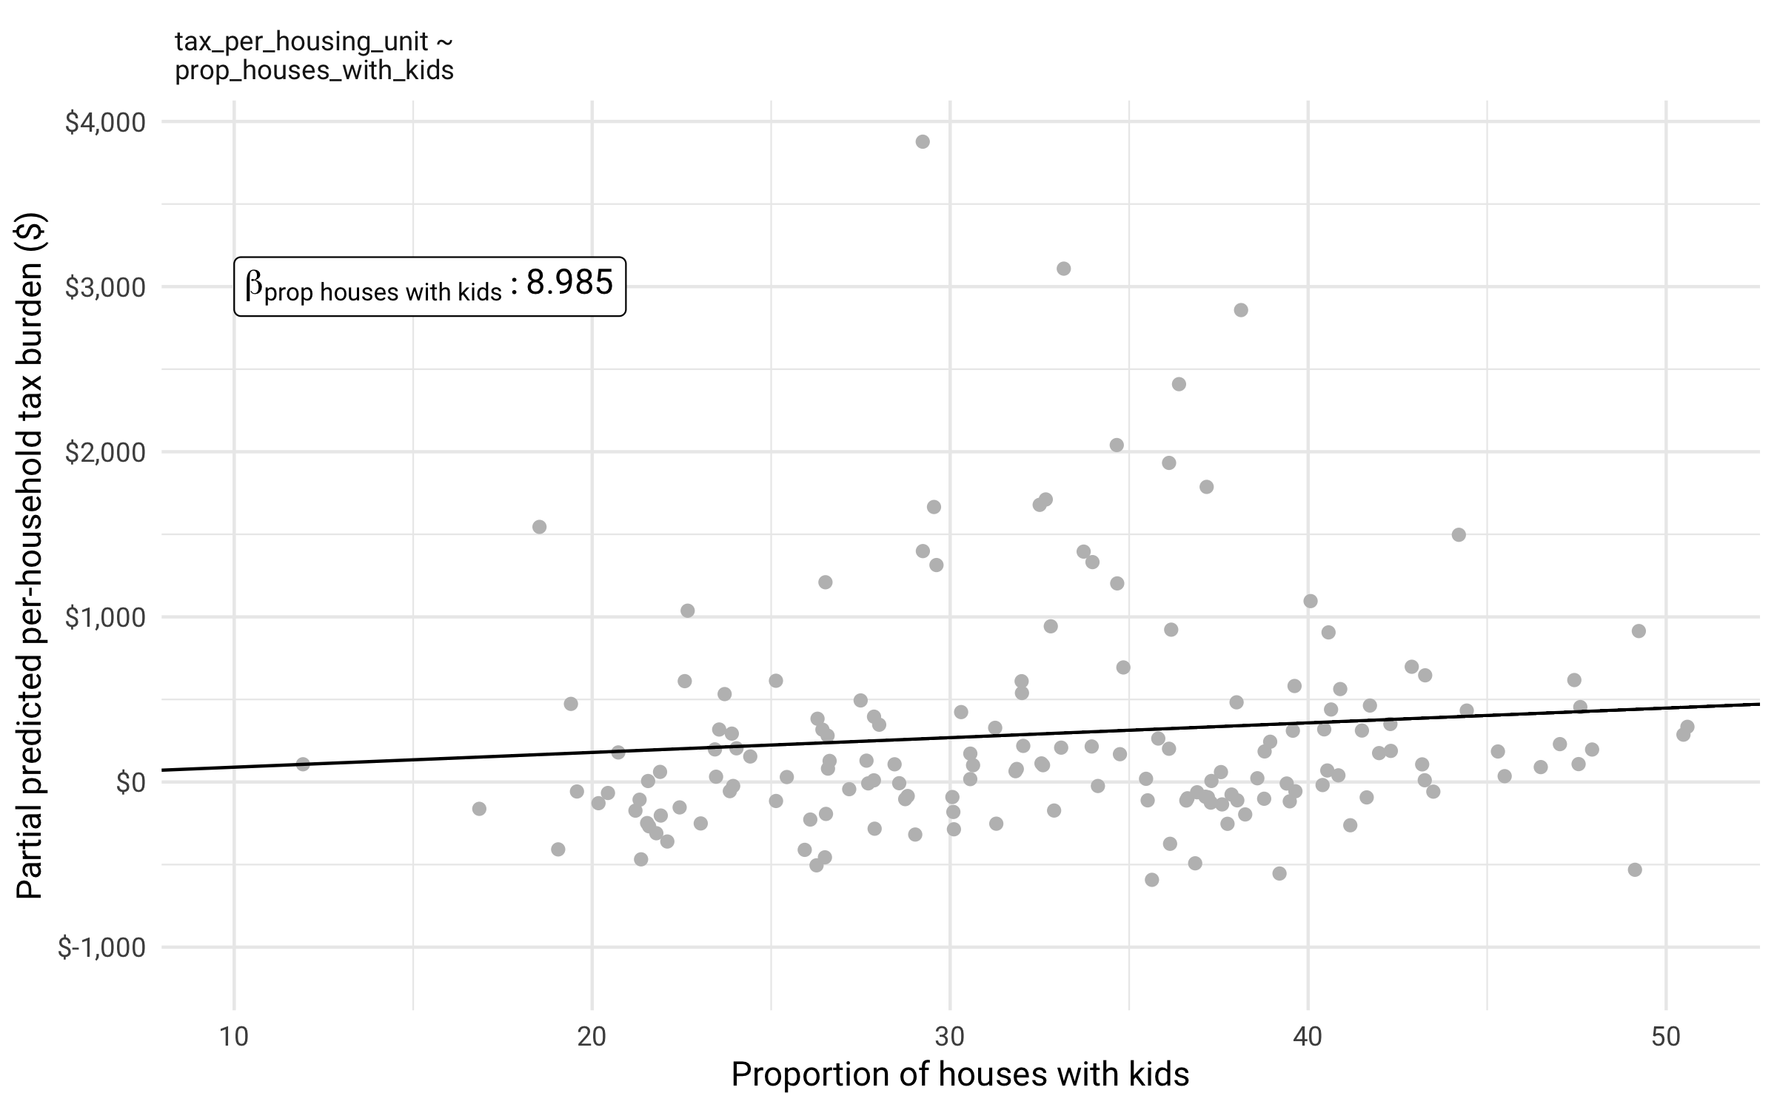

Slide 15
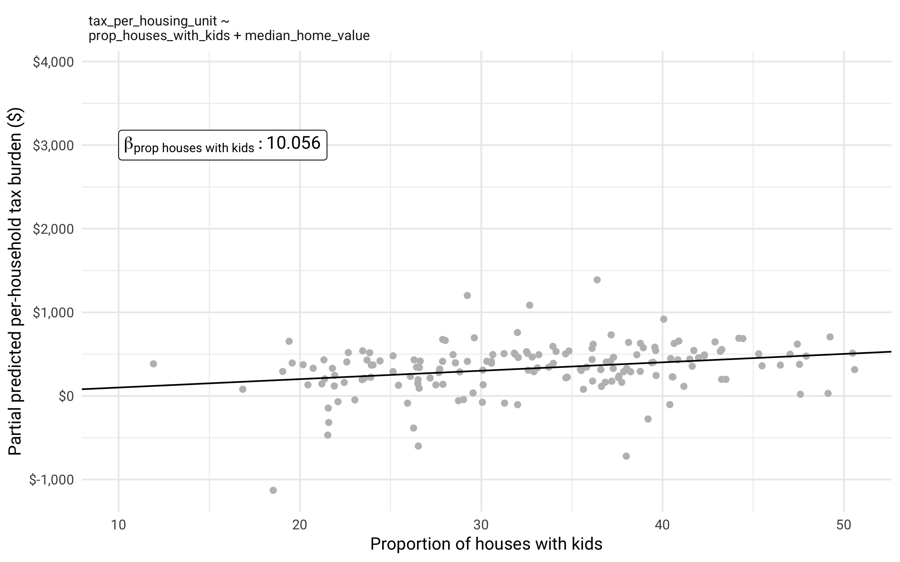

Slide 17
HOW DO WE KNOW IF A MODEL IS GOOD?
Or, how do we know what to control for?

Slide 18
WHICH VARIABLES TO INCLUDE?
Explanation
Prediction
Your goal is to explain what specific levers (Xs) do to Y.
Your goal is to make the best prediction of Y.
You need to have some theoretical reason to include each variable.
Include whatever
Basically

Slide 19
WHAT COUNTS AS “BEST”?
R²
How much variation in Y is explained by X
0–1 scale; represents %
Higher = better fit

Slide 20
TEMPLATE FOR R²
This model explains X% of the variation in Y

Slide 21
HOW TO FIND IT
model1 <- lm(tax_per_housing_unit ~ prop_houses_with_kids,
data = taxes)
get_regression_summaries(model1)
r_squared | adj_r_squared | mse | rmse | sigma | statistic | p_value | df
0.011 | 0.005 | 464890 | 681.8 | 686 | 1.851 | 0.176 | 2

Slide 22
CORRELATION AND R²
Remember how the letter for correlation is r?
This is the same r!
R² = correlation²

Slide 23
LIMITS OF R²
Correlation only works for y ~ x
What happens when a model has multiple Xs?
We can’t use the regular R²

Slide 24
ADJUSTED R²
Almost always lowers the R²
Penalizes you for small data and lots of variables

Slide 25
TEMPLATE FOR ADJUSTED R²
This model explains X% of the variation in Y

Slide 26
HOW TO FIND IT
model5 <- lm(tax_per_housing_unit ~
median_home_value + prop_houses_with_kids +
median_income + population + state,
data = taxes)
get_regression_summaries(model5)
r_squared | adj_r_squared | mse | rmse | sigma | statistic | p_value | df
0.854 | 0.846 | 68846 | 262.4 | 269.9 | 112.2 | 0 | 9

Slide 27
MODEL SELECTION
In general, the higher a model’s adjusted R², the better its fit
R² is not the best measure for model fit, but it’s good enough for this class. It’s intuitive.
r_squared | adj_r_squared | mse | rmse | sigma | statistic | p_value | df
0.854 | 0.846 | 68846 | 262.4 | 269.9 | 112.2 | 0 | 9
logLik | AIC | BIC | deviance | df.residual
-1139 | 2298 | 2329 | 11221939 | 154

Slide 28
GENERAL GUIDELINES
If your model has one explanatory variable (x), use R²
If your model has more than one explanatory variable (x), use the adjusted R²
Higher is better
No magic threshold for good or bad number; depends on domain

Slide 29
 | (1) | (2) | (3) | (4) | (5)
(Intercept) | 692.926 ** | 583.392 *** | 261.149 | -412.485 *** | -595.561 ***
prop_houses_ with_kids | 8.985 |  | 10.314 | 14.094 *** | 9.934 **
stateCalifornia |  | 948.197 *** | 932.986 *** | 123.282 | 160.820
stateIdaho |  | 104.530 | 101.385 | 9.526 | 32.713
stateNevada |  | 132.498 | 160.949 | 102.450 | 4.885
stateUtah |  | 142.387 | 67.274 | -213.191 * | -241.628 **
median_home_ value |  |  |  | 0.004 *** | 0.003 ***
median_income |  |  |  |  | 0.010 **
population |  |  |  |  | 0.000
N | 163 | 163 | 163 | 163 | 163
R2 | 0.011 | 0.350 | 0.363 | 0.845 | 0.854
logLik | -1294.826 | -1260.678 | -1259.023 | -1144.053 | -1139.167
AIC | 2595.652 | 2533.357 | 2532.046 | 2304.105 | 2298.334

Slide 30
CHOOSING VARIABLES
Forwards
Backwards
Add variables 1–2 at a time and see if they help or hurt
Start with a kitchen sink model, remove unhelpful variables
Better for explanatory work where you care about the x variables
Better for predictive work where you don’t care about the x variables
step(name_of_giant_model)

Slide 31
INTERPRETATION PRACTICE

Slide 32





ELECTIONS
2016
Brexit
Clinton vs. Trump
Stay vs. Leave

Slide 33
FOLLOW ALONG IN R

Slide 34
MAKING PREDICTIONS

Slide 35
HOW TO PREDICT
Plug in values for all the Xs, get a predicted Y

Slide 36
term | estimate | std_error | statistic | p_value
intercept | -412.5 | 118.1 | -3.493 | 0.001
median_home_value | 0.004 | 0 | 21.99 | 0
prop_houses_with_kids | 14.09 | 2.853 | 4.941 | 0
stateCalifornia | 123.3 | 88.22 | 1.397 | 0.164
stateIdaho | 9.526 | 82.74 | 0.115 | 0.908
stateNevada | 102.5 | 98.25 | 1.043 | 0.299
stateUtah | -213.2 | 91.21 | -2.337 | 0.021

Slide 37
What’s the predicted median per-household property tax rate for a county in Nevada where the median home value is $155,000 and 30% of the houses have kids?

Slide 38
model_thing <- lm(tax_per_housing_unit ~
median_home_value + prop_houses_with_kids + state,
data = taxes)
imaginary_county <- data_frame(prop_houses_with_kids = 30,
median_home_value = 155000,
state = "Nevada")
predict(model_thing, imaginary_county)
#> 741.0414
predict(model_thing, imaginary_county, interval = "prediction")
#> fit lwr upr
#> 1 741.0414 179.2417 1302.841

