Slide 1
BOOTSTRAPPING AND CONFIDENCE INTERVALS
MPA 630: Data Science for Public Management
November 8, 2018
Fill out your reading report on Learning Suite

Slide 2
PLAN FOR TODAY
Why are we even doing this?
Confidence intervals
Bootstrapping
Precision vs. accuracy

Slide 3
WHY ARE WE EVEN DOING THIS?

Slide 4
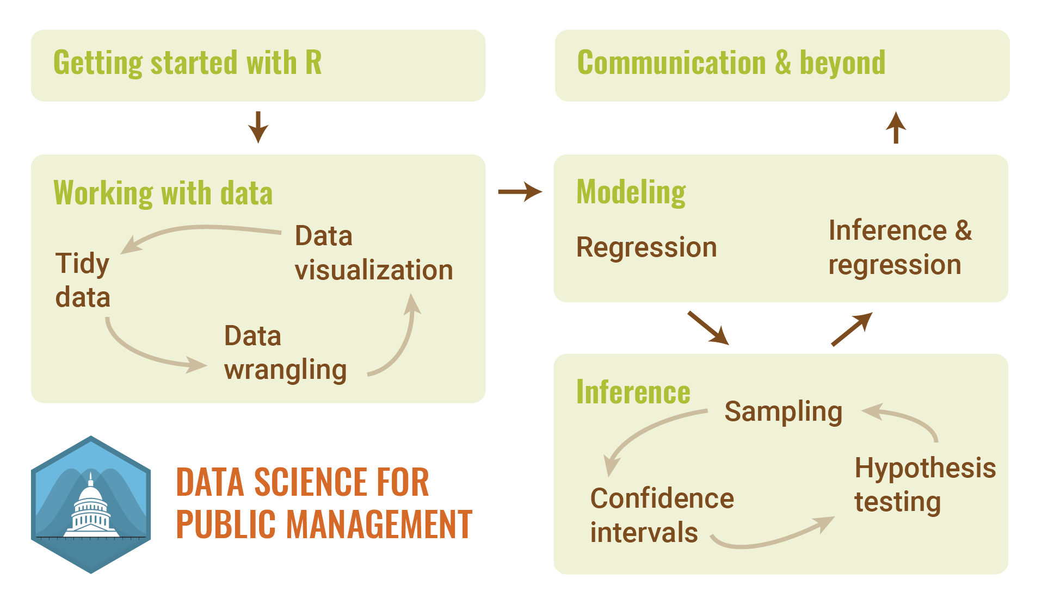

Slide 5
POPULATION PARAMETERS
Population
A collection of things in the world
Population parameter
Something we want to know about the population

Slide 6
TYPES OF PARAMETERS
Proportion
Mean / median
Intercept
Difference between proportions
Difference between means / medians
Slope
% of Mia Love supporters in Utah County
Difference in student loan default rates for private vs. public universities
Median commute time for workers in Idaho
Relationship between property taxes and # of households with kids in 5 Western states
Difference in average test scores in large and small classes in the US

Slide 7







TYPES OF PARAMETERS
Proportion
$$p$$
Mean
$$μ$$
Difference between proportions
$$p_{1} −p_{2}$$
Difference between means
$$μ_{1} −μ_{2}$$
Intercept
$$β_{0}$$
Slope
$$β_{1}$$
Standard deviation
$$σ$$

Slide 8
POPULATION PARAMETERS
Key assumption in the flavor of statistics we’re doing:
There are true, fixed population parameters out in the world

Slide 9
KNOWING THE POPULATION
In general, we cannot measure population parameters directly
How do we find out what they are?
Inference!

Slide 10
INFERENCE
Use sample data to make conclusions about the underlying population that the sample came from

Slide 11







POPULATION VS. SAMPLE
Proportion
$$p$$
$$\hat{p}$$
Mean
$$μ$$
$$\overline{x}$$
Difference between proportions
$$p_{1} −p_{2}$$
$${\hat{p}}_{1} −{\hat{p}}_{2}$$
Difference between means
$$μ_{1} −μ_{2}$$
$${\overline{x}}_{1} −{\overline{x}}_{2}$$
Intercept
$$β_{0}$$
$${\hat{β}}_{0}$$
Slope
$$β_{1}$$
$${\hat{β}}_{1}$$
Standard deviation
$$σ$$
$$s$$

Slide 12
SAMPLES AND SIZES
What happens to your sample statistic/point estimate as you increase the size of the sample?
What’s better: a small shovel you use a bunch of times or a big shovel you use a few times (or even once)?

Slide 13
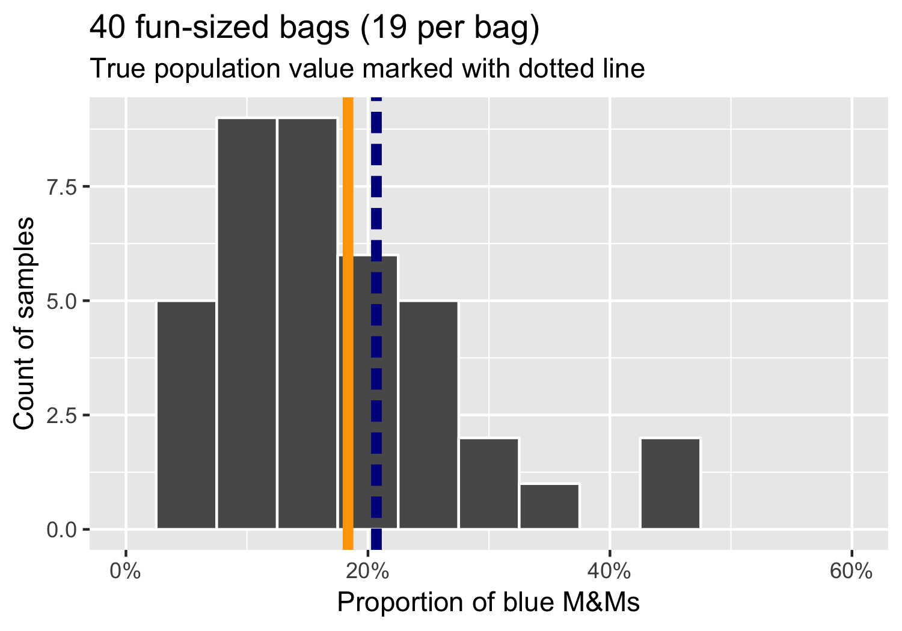
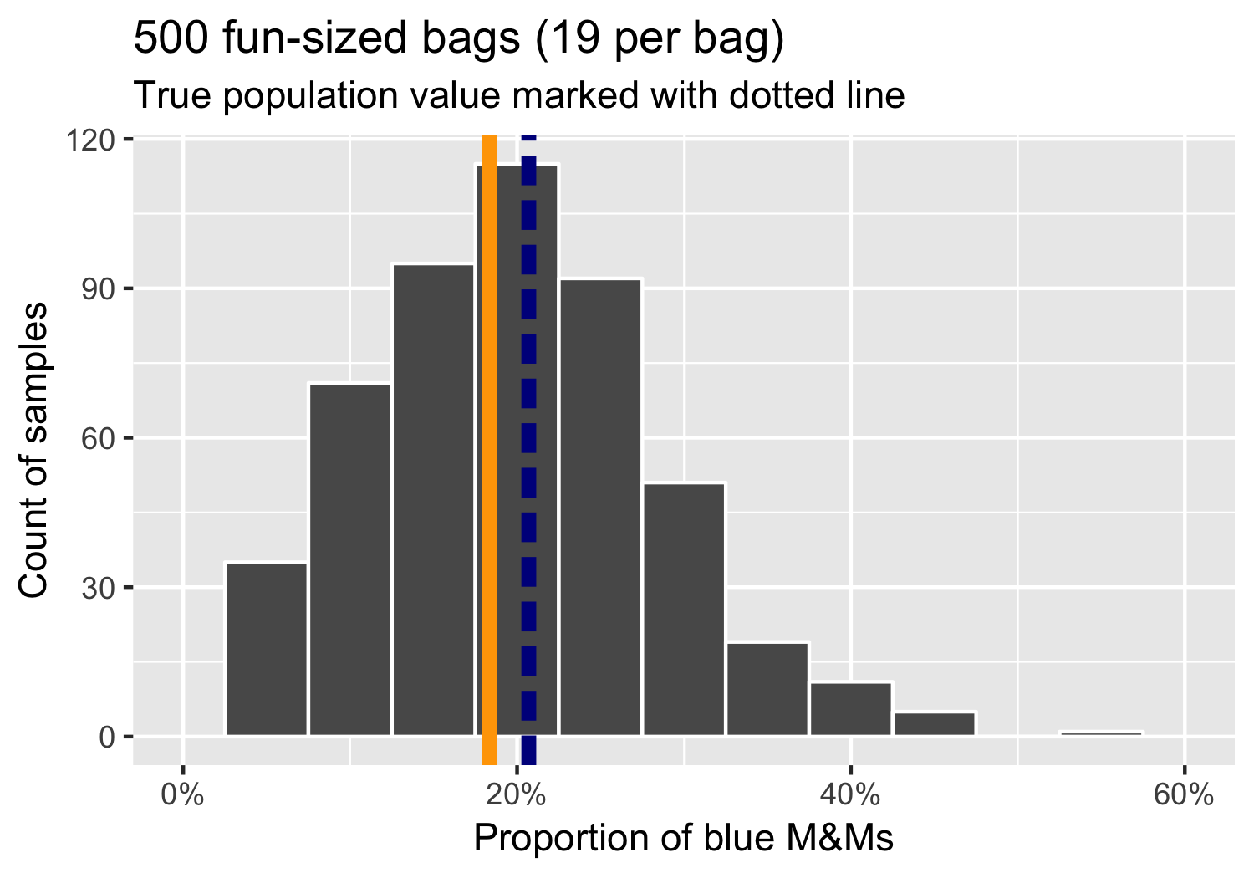
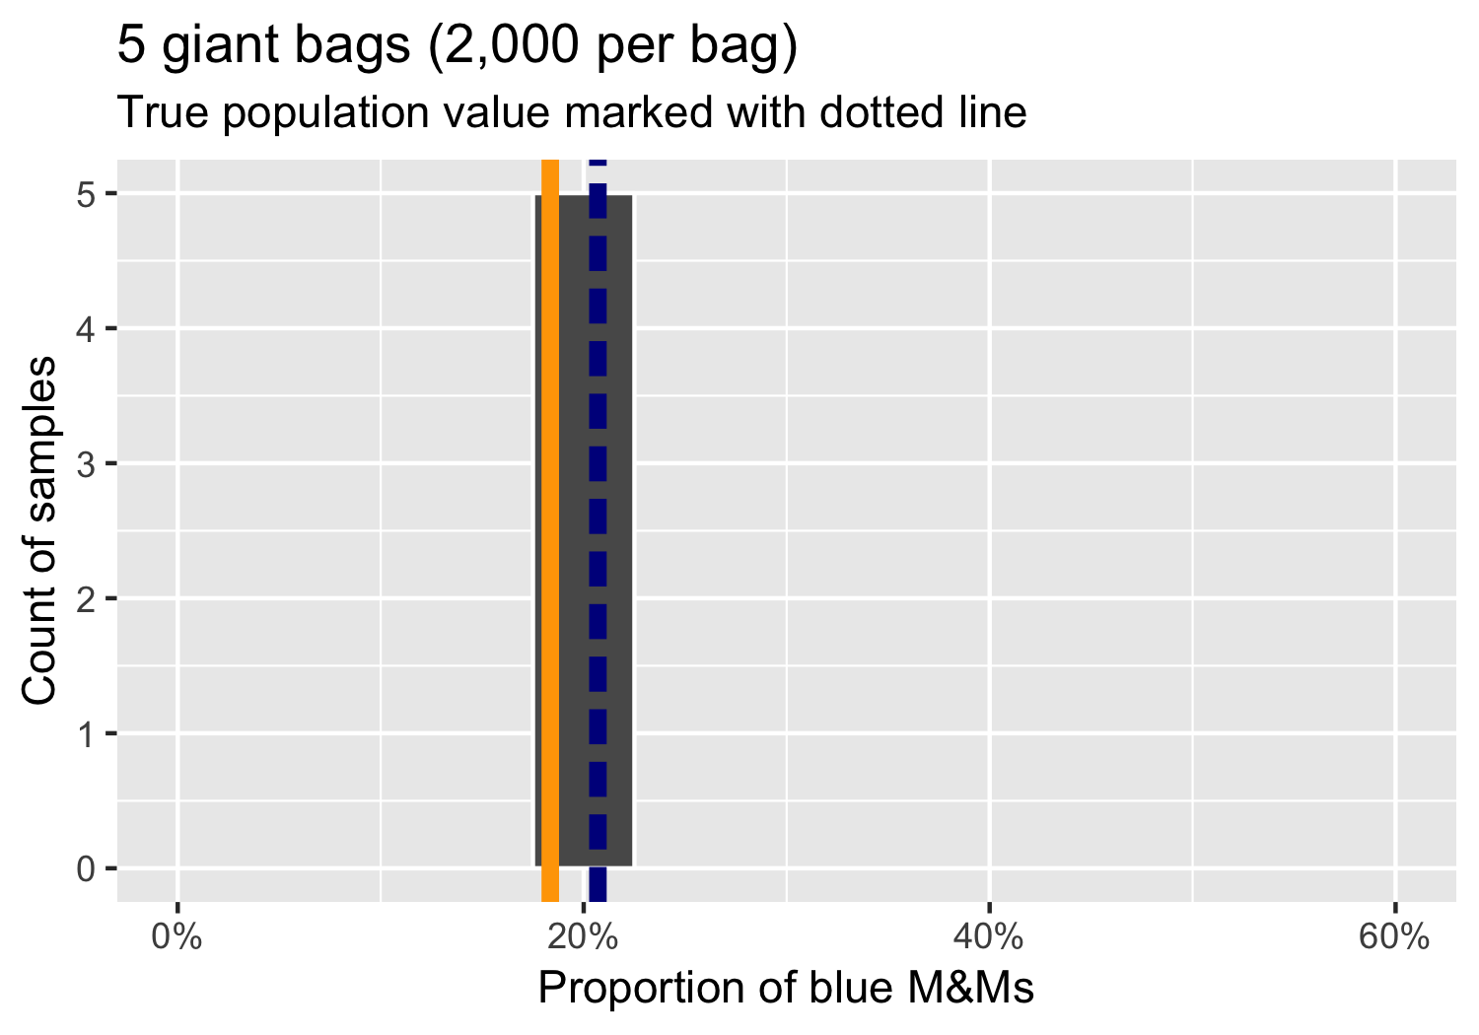
Notes:
With a big enough shovel, you only need one repetition. And this is what happens in real life anyway. You run one study, collect one set of data, field one poll and make sure it’s big enough to be a good enough guess of the population

Slide 14
CONFIDENCE INTERVALS

Slide 15
GOAL OF INFERENCE
Make a good enough guess about the true population parameter
How do we know if the guess is good?
How confident are we that we captured the true population parameter?

Slide 16


CONFIDENCE INTERVALS
A plausible range of values for the true population parameter

Slide 17
VARIABILITY
Every sample statistic has some variability
You have an average, but how different might that average be if you take another sample?

Slide 18
LEFT-HANDEDNESS
You take a random sample of BYU students and 5 are left-handed.
If you take a different random sample of 50 BYU students, how many would you expect to be left-handed?
3 are left-handed. Is that surprising?
40 are left-handed. Is that surprising?

Slide 19
VARIABILITY
How much you expect the mean to vary from sample to sample

Slide 20
MEASURING VARIABILITY
2 ways to get at variability of sample statistic
Theory and math
Simulation

Slide 21
BOOTSTRAPPING

Slide 22
PERFECT KNOWLEDGE
With infinite resources, you could take thousands of simultaneous samples (or even conduct a census) and get exact population parameter and know its exact variability
This is impossible.

Slide 23
IMPROVISE!
Why bootstrap?
We can do something nearly impossible with limited resources
Use the sample you have to make new samples

Slide 24
How much does a typical 1-bedroom apartment in Manhattan rent for per month?

Slide 25
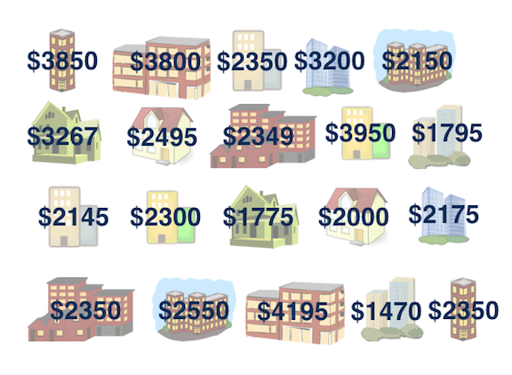
SAMPLE
Random sample of 20 apartments listed on Craigslist

Slide 26
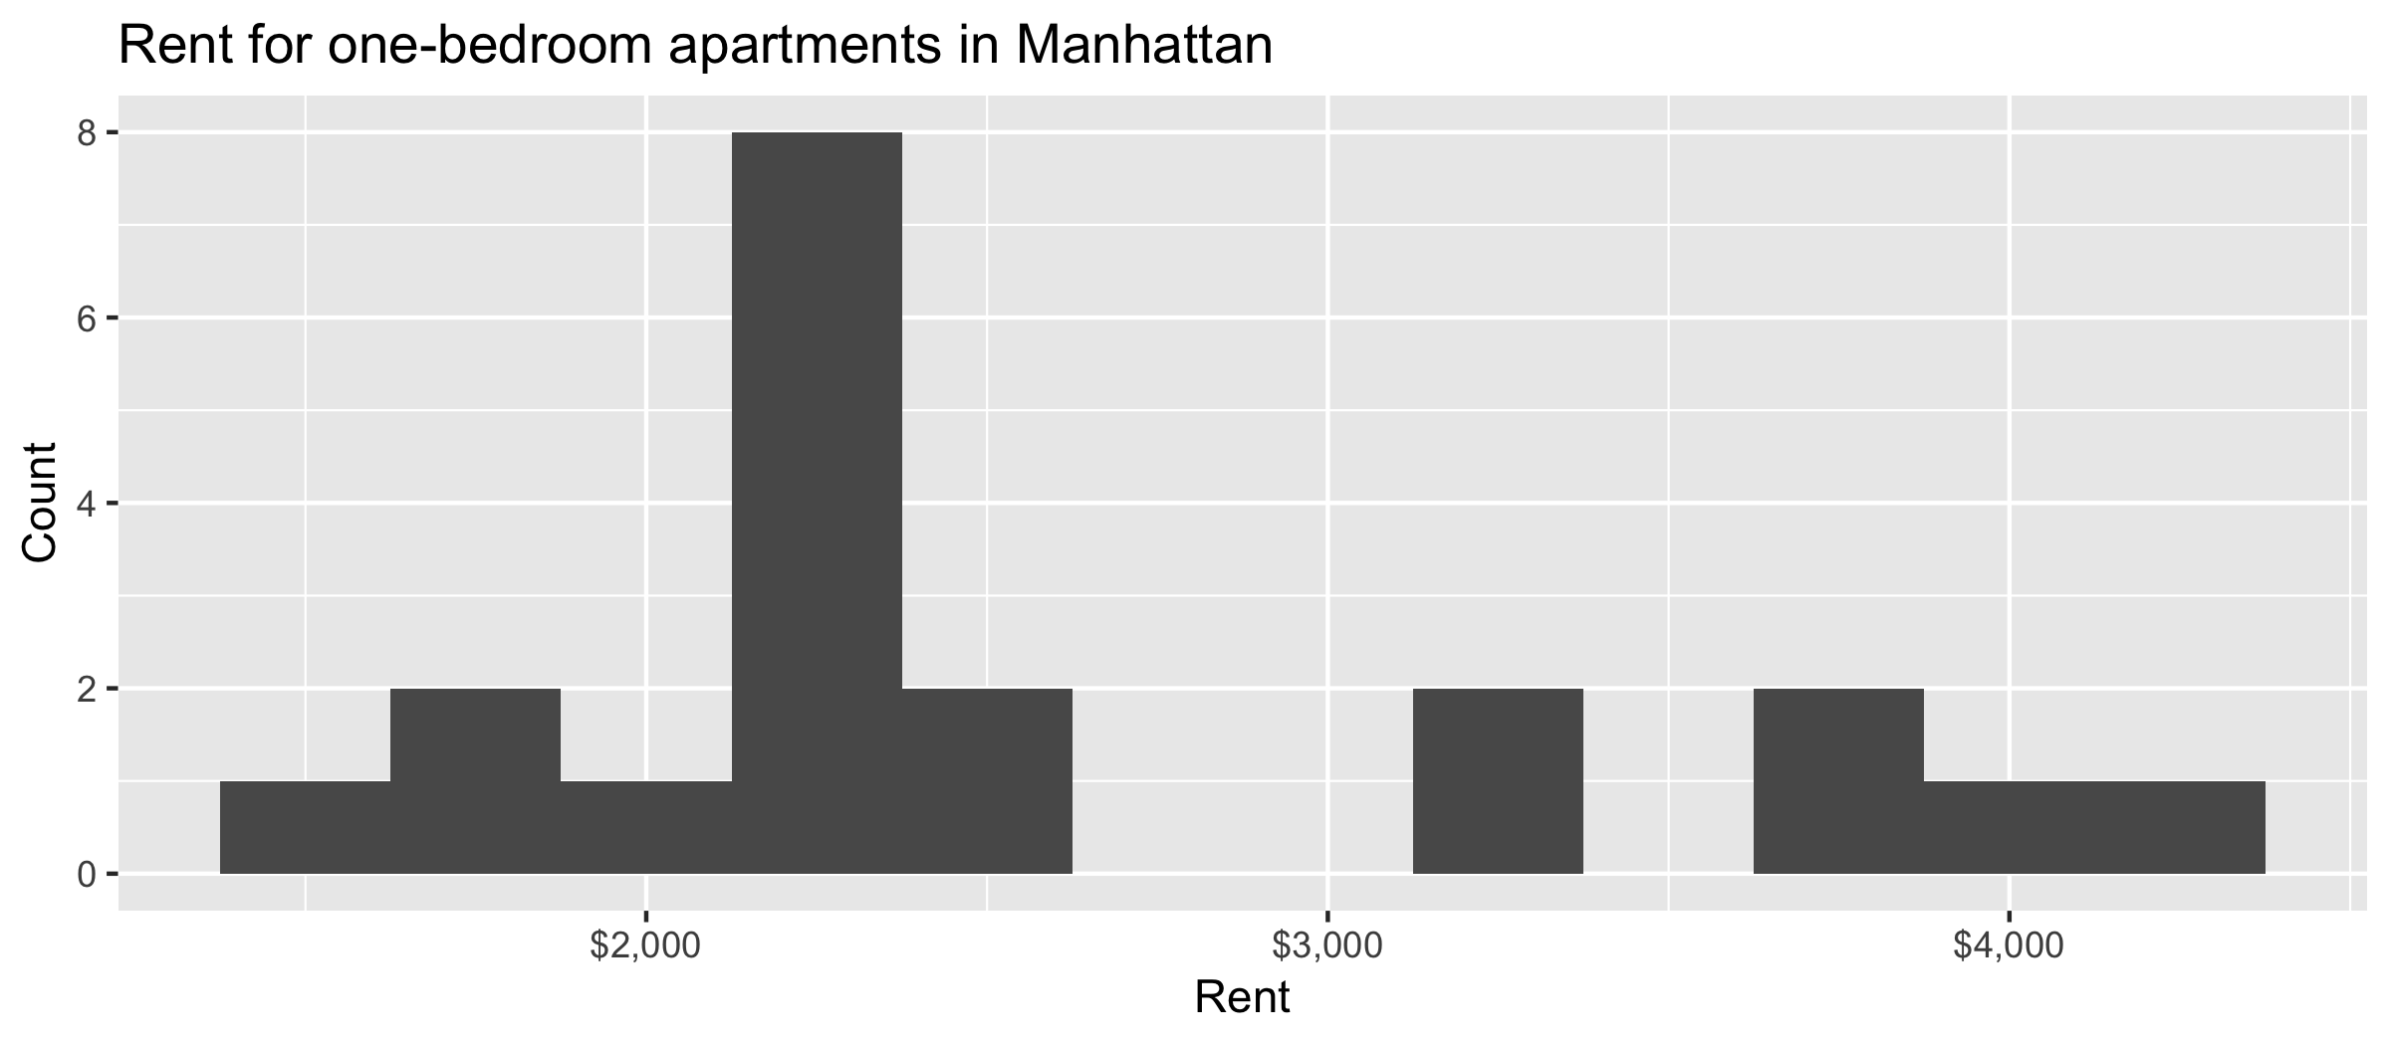
SAMPLE DISTRIBUTION
Median: $2,350
Mean: $2,626

Slide 27
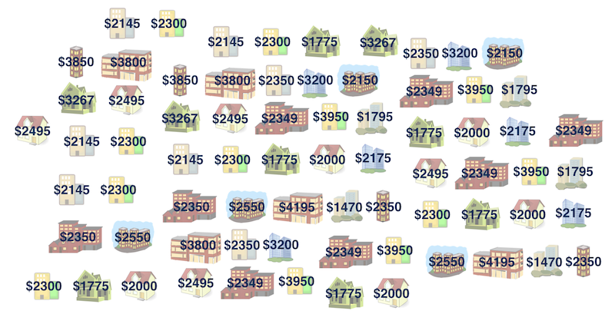
MAIN QUESTION
Does this sample match the population? How well?
Median: $2,350
Median: ???

Slide 28
HOW TO BOOTSTRAP
Take a bootstrap sample
Sample with replacement; same size as original
Calculate a bootstrap statistic
Mean, median, proportion, difference, etc.
Repeat a lot
Calculate the bounds of an X% confidence interval as the middle X% of the bootstrap distribution

Slide 29
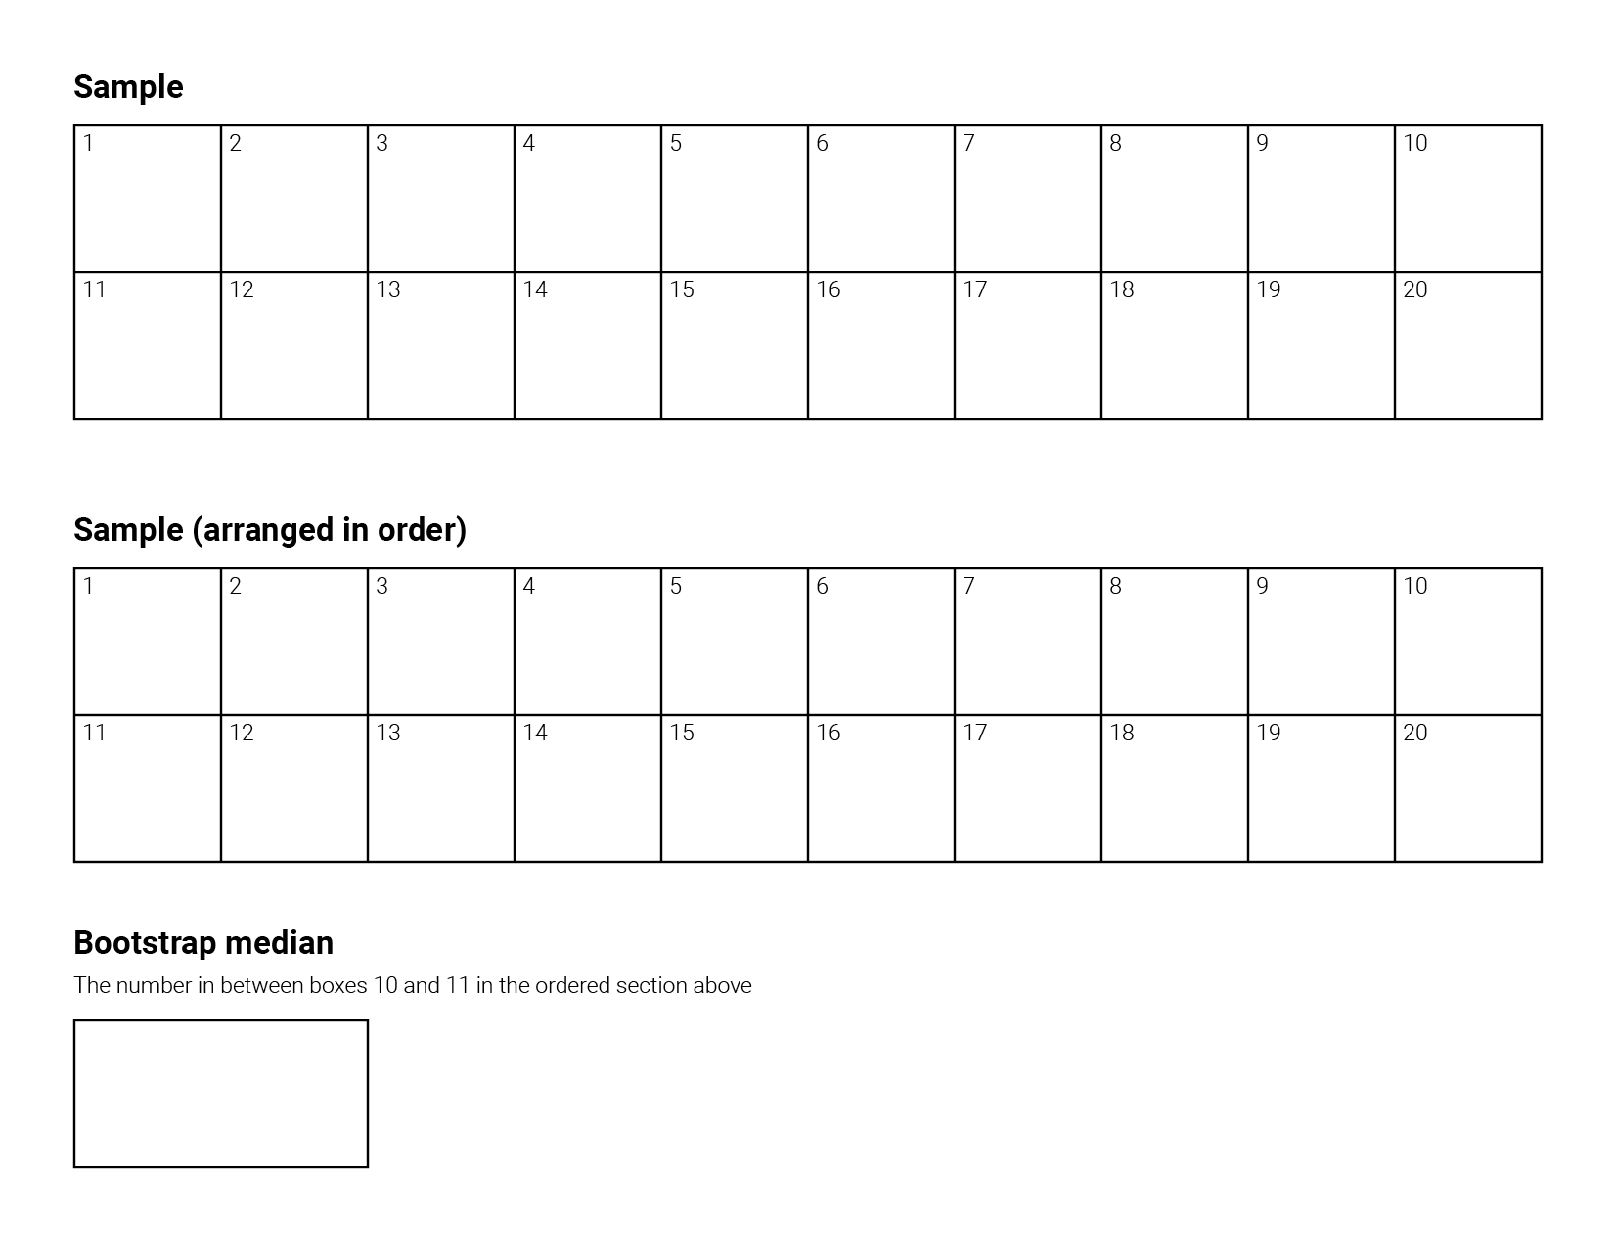

Slide 30
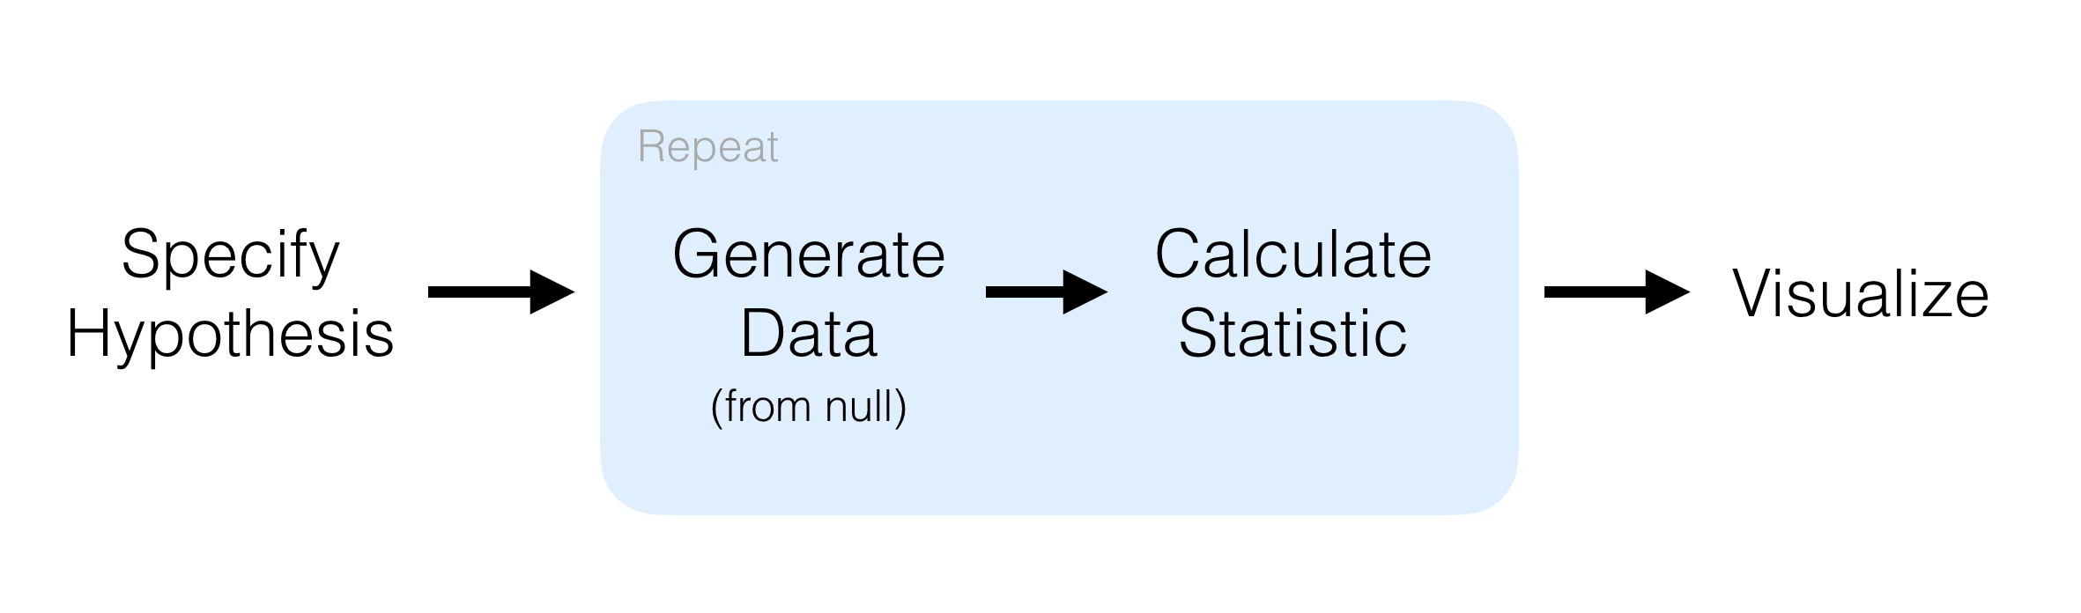
BOOTSTRAPPING WITH R
library(infer)

Slide 31
SEEDS
A seed ensures your random numbers are the same every time
set.seed(1234)
sample(1:100, 5)

Slide 32
BOOTSTRAPPING WITH R
set.seed(1234)
manhattan <- read_csv("http://andhs.co/rents")
manhattan %>%
# Specify the variable of interest
specify(response = rent)

Slide 33
BOOTSTRAPPING WITH R
set.seed(1234)
manhattan <- read_csv("http://andhs.co/rents")
manhattan %>%
# Specify the variable of interest
specify(response = rent) %>%
# Generate a bunch of bootstrap samples
generate(reps = 1000, type = "bootstrap")

Slide 34
BOOTSTRAPPING WITH R
set.seed(1234)
manhattan <- read_csv("http://andhs.co/rents")
manhattan %>%
# Specify the variable of interest
specify(response = rent) %>%
# Generate a bunch of bootstrap samples
generate(reps = 1000, type = "bootstrap") %>%
# Find the median of each sample
calculate(stat = "median")

Slide 35
BOOTSTRAPPING WITH R
set.seed(1234)
manhattan <- read_csv("http://andhs.co/rents")
# Save resulting bootstrap distribution
boot_rent <- manhattan %>%
# Specify the variable of interest
specify(response = rent) %>%
# Generate a bunch of bootstrap samples
generate(reps = 1000, type = "bootstrap") %>%
# Find the median of each sample
calculate(stat = "median")

Slide 36
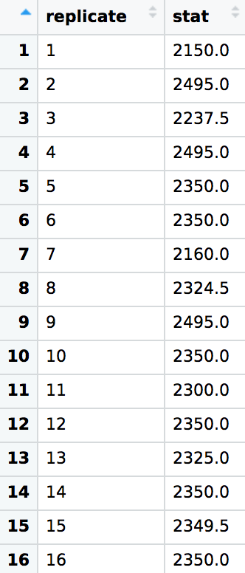
SEE BOOTSTRAP MEDIANS

Slide 37
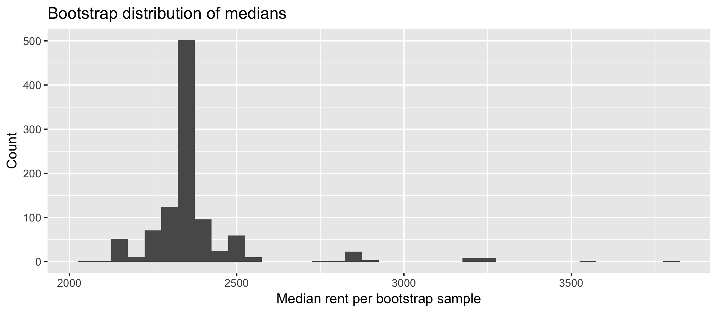
VISUALIZE BOOTSTRAP DISTRIBUTION
ggplot(boot_rent, aes(x = stat)) +
geom_histogram(binwidth = 50)

Slide 38
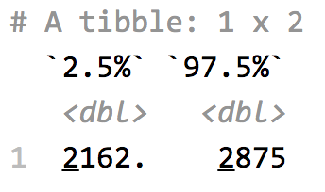
CALCULATE CONFIDENCE INTERVAL
95% confidence interval is the middle 95% of the the distribution
From 2.5% to 97.5%
boot_rent %>%
get_ci(level = 0.95, type = "percentile")

Slide 39
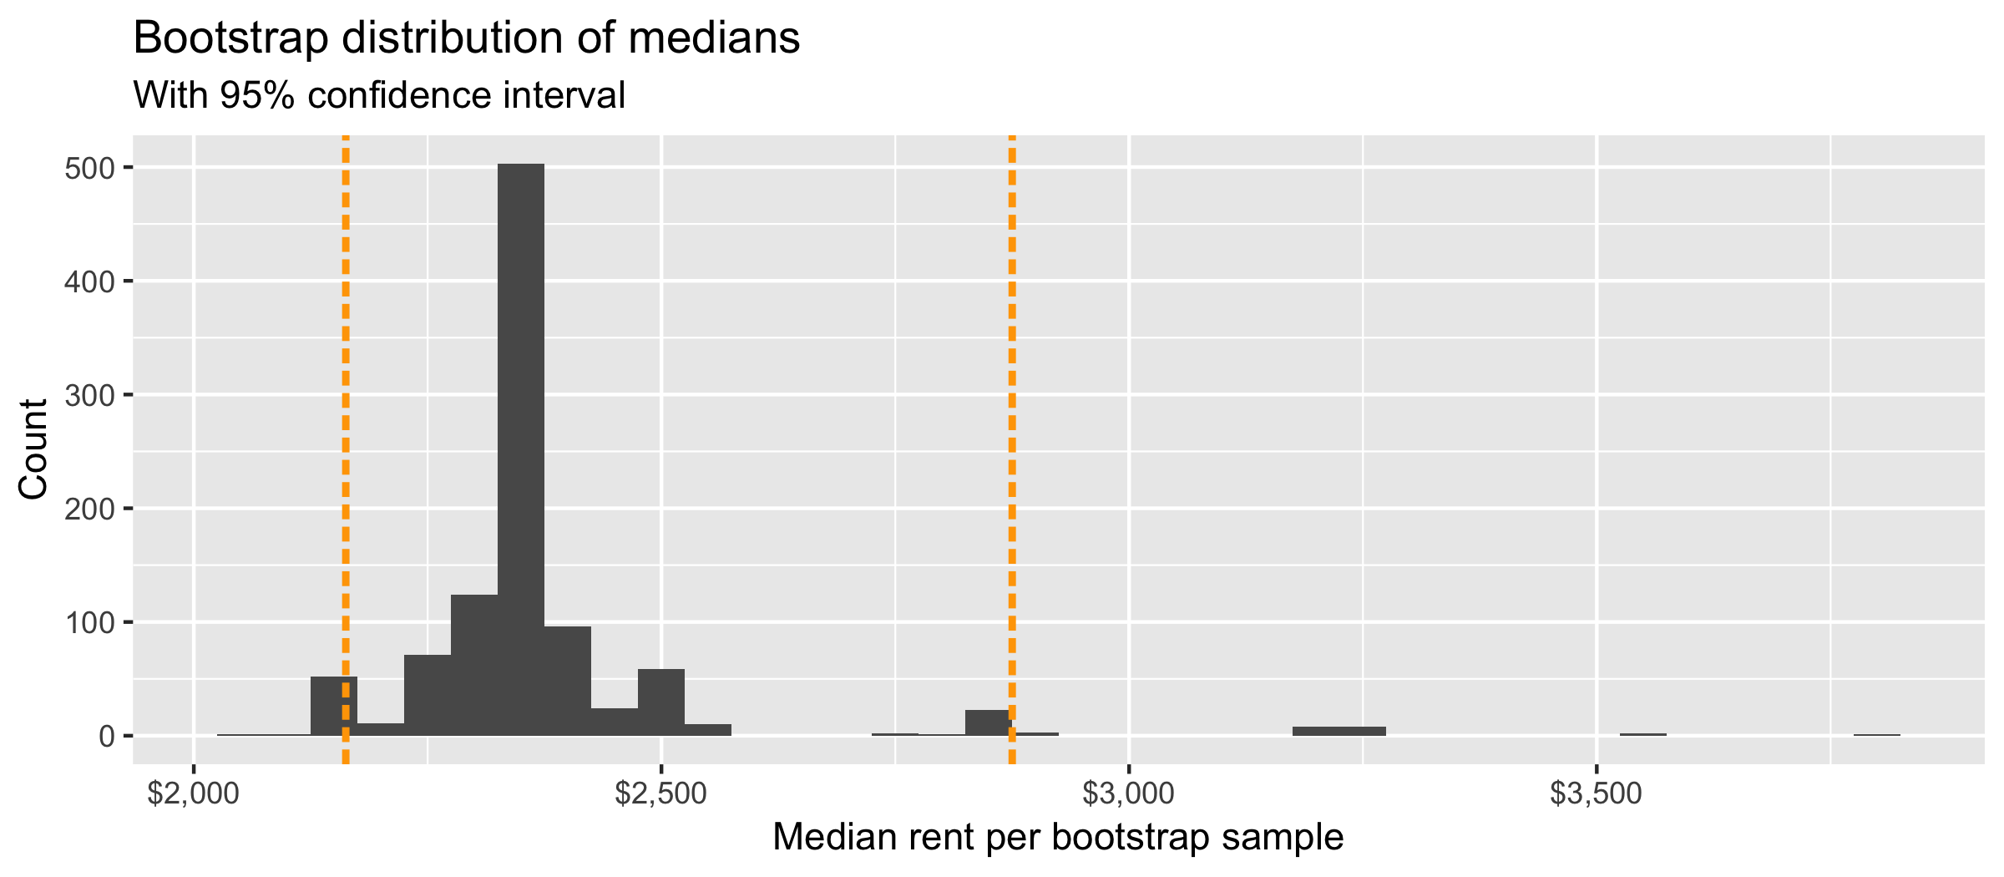

Slide 40
INTERPRET CONFIDENCE INTERVAL
The 95% confidence interval for the median rent of one bedroom apartments in Manhattan was calculated as (2162.5, 2875). Which of the following is the correct interpretation of this interval?
95% of the time the median rent one bedroom apartments in this sample is between $2,162.5 and $2,875.
95% of all one bedroom apartments in Manhattan have rents between $2,162.5 and $2,875.
We are 95% confident that the median rent of all one bedroom apartments is between $2162.5 and $2875.
We are 95% confident that the median rent of one bedroom apartments in this sample is between $2162.5 and $2875.

Slide 41
MORE ON CONFIDENCE INTERVALS
Confidence intervals are a net
If we took 100 samples, at least 95 of of them would have the true population parameter in their 95% confidence intervals

Slide 42
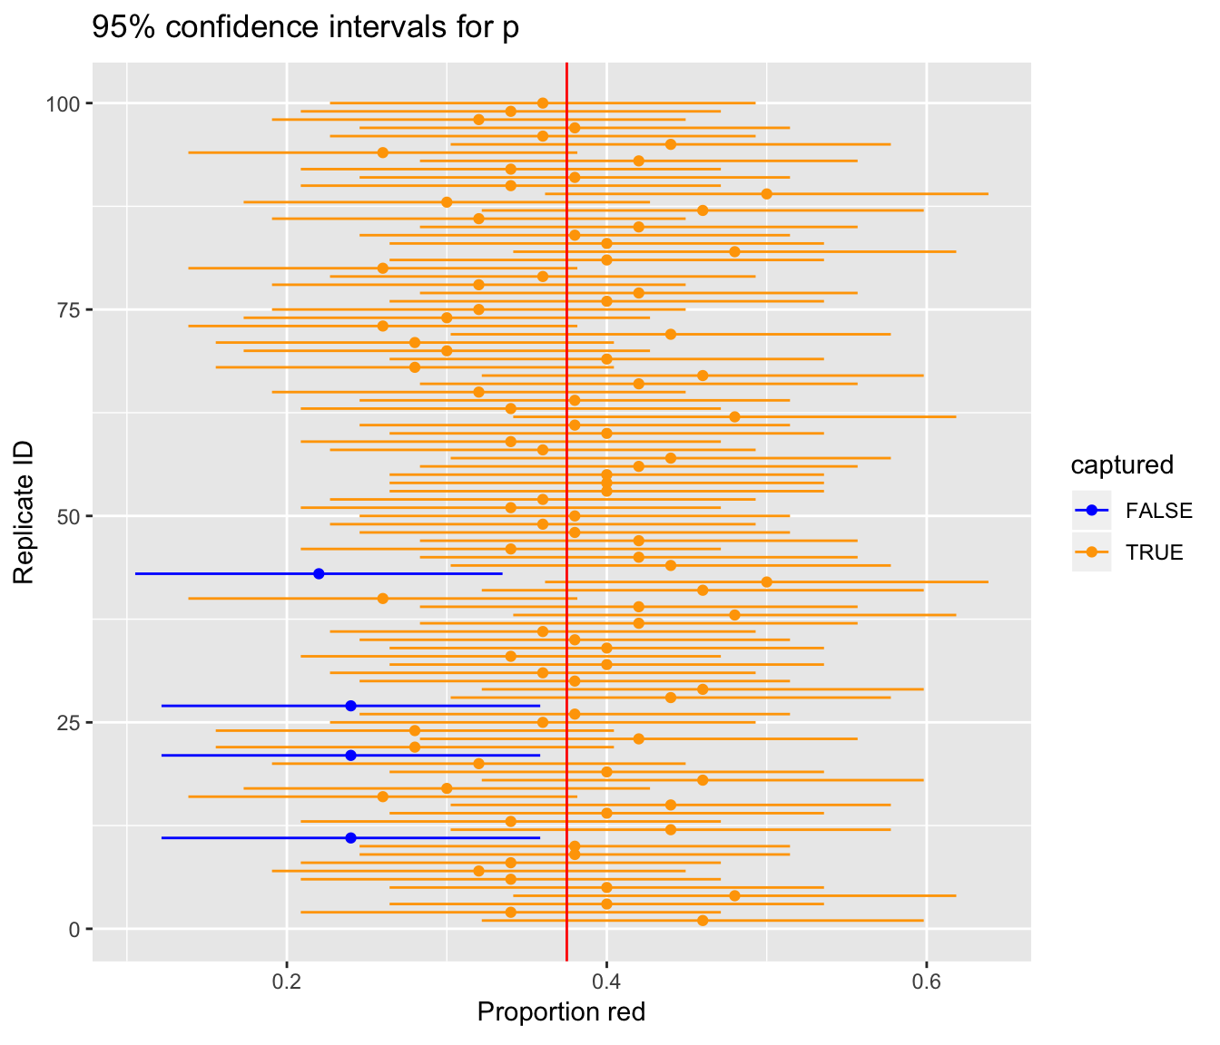

Slide 43
DON’T BE TEMPTED!
It is way too tempting to say “We’re 95% sure that the population parameter is X”
People do this all the time! People with PhDs!
YOU will try to do this too

Slide 44
ONLY LEGAL INTERPRETATION
“There is a 95% chance that when I compute a confidence interval from this data, the true population value will be in it.”

Slide 45
CNN conducts a poll among a random sample of 800 voters about whether they approve of the president’s performance. CNN analysts create a 90% confidence interval for the true proportion of all voters in the US who approve of the president’s performance.
If CNN conducts many identical polls on the same night, about 90% of the intervals produced will capture the true proportion of voters who approve of the president
About 90% of people who support the president will respond to the poll
If CNN repeats this poll 20 times on the same night and calculates 90% confidence intervals for each poll, we can expect that around 18 of those intervals will contain the true proportion of voters who approve of the president.
There’s a 90% chance that the actual population proportion is in the confidence interval

Slide 46
A city manager wants to know the true average property value of single-value homes in her city. She takes a random sample of 200 houses and builds a 95% confidence interval through bootstrapping. The interval is ($180,000, $300,000).
If the city manager took another random sample of 200 houses, there’s a 95% chance that sample mean would be between $180,000 and $300,000
About 95% of houses in the sample are valued between $180,000 and $300,000
We’re 95% confident that the interval ($180,000, $300,000) captured the true mean value
There’s a 95% chance that the true mean is between $180,000 and $300,000

Slide 47
PRECISION VS. ACCURACY

Slide 48
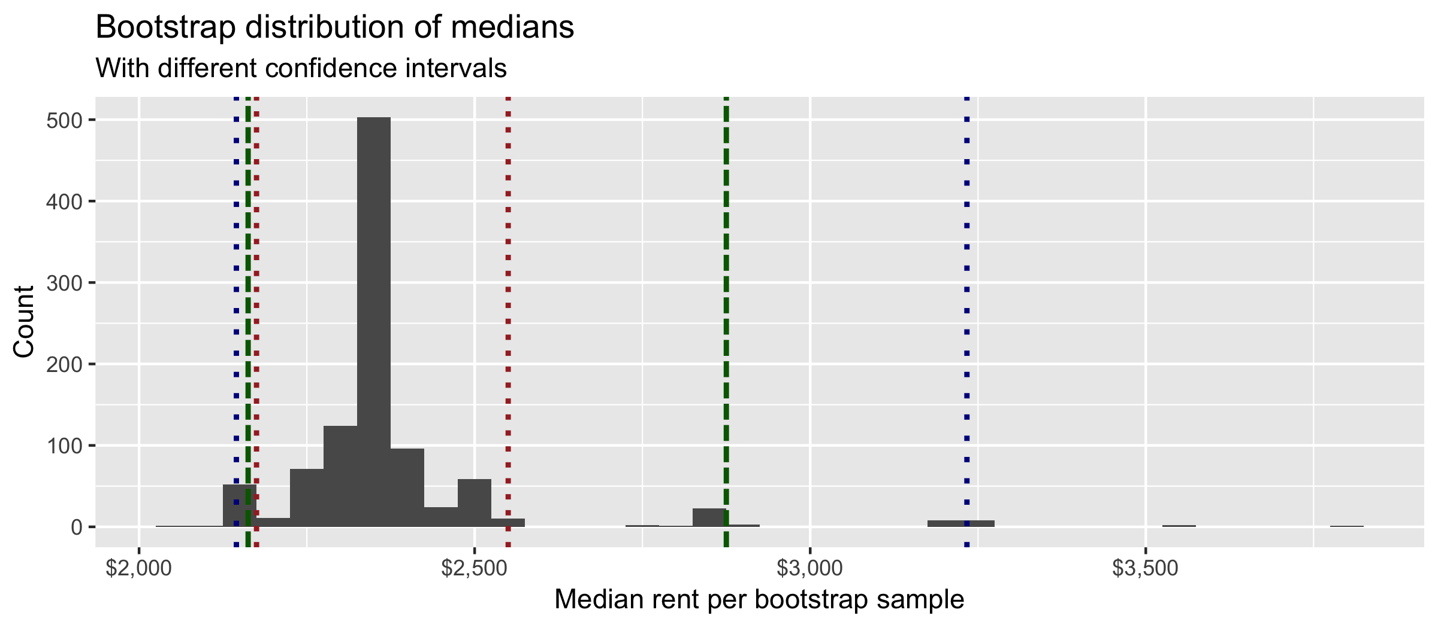
COMMON LEVELS
90%, 95%, 99%

Slide 49
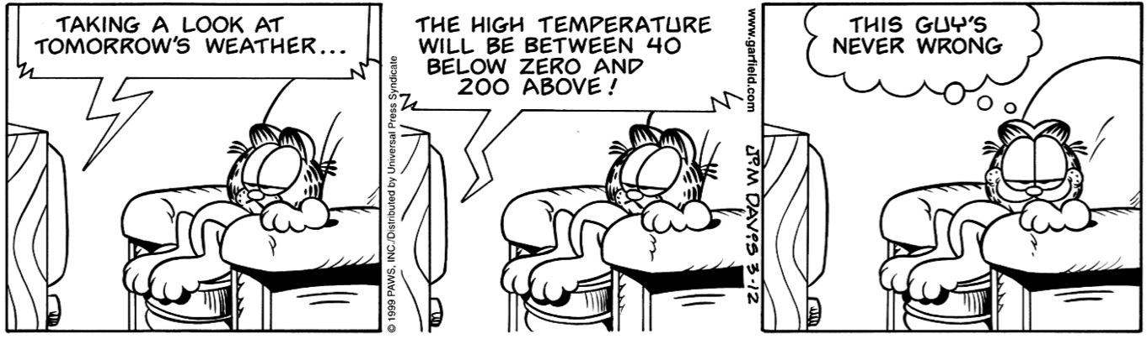
PRECISION VS. ACCURACY
If we want to be very certain that we capture the population parameter, should we use a wider interval or a narrower interval?

Slide 50
The city manager was to be more confident about home prices in her city, so she uses the same sample data and uses bootstrapping techniques to calculate a 99% confidence interval.
What will happen to the the interval when she changes the confidence level from 95% to 99%?
It’s impossible to say without seeing the sample data
Increasing the confidence to 99% will increase the margin of error and result in a wider interval
Increasing the confidence to 99% will decrease the margin of error and result in a narrower interval

Slide 51
MORAL OF THE STORY

Slide 52
Sample statistic ≠ population parameter
But if the sample is good, it can be a good estimate
Report estimate with confidence interval
Width of interval depends on how variable sample statistics would be from different samples
We can’t keep sampling from the population, so bootstrap
This lets us measure the variability

