Slide 1
Procuring Performance in Python
Ian J. Bertolacci Email: ian.bertolacci@gmail.com
Twitter: @ianbertolacci
Github: github.com/ian-bertolacci

Slide 2
About this talk
General overview of some modules and tools that you can use to write more performant code.
Share!
I am not an expert in fast Python (yet).
Code available on github
github.com/ian-bertolacci/procuring_python_performace_talk

Slide 3
General Classes of Tools
Compilers/Interpreters
CPython
PyPy
Low-level backed APIs
NumPy
Parallel modules
Multiprocessing
Threading
Low-level tie-ins
Cython * ^{compiler-y}
PyCUDA

Slide 4
Why is Python slow?
Because the implementation is slow.
Python's semantics are difficult to provide without a runtime that includes lots of overhead.
Where does this runtime overhead come from?
Dynamic typing
More memory requirements
Indirect accesses
explicit checking
Non-contiguous list elements
Large integers

Slide 5
Example of Overhead
Python code:
a = 1 b = 2 c = a + b
This example taken from "Why Python is Slow" by Jake VanderPlas (https://jakevdp.github.io/blog/2014/05/09/why-python-is-slow/)
Assign 1 to a
Set a->PyObject_HEAD->typecode to integer
Set a->val = 1
Assign 2 to b
Set b->PyObject_HEAD->typecode to integer
Set b->val = 2
call binary_add(a, b)
find typecode in a->PyObject_HEAD
a is an integer; value is a->val
find typecode in b->PyObject_HEAD
b is an integer; value is b->val
call binary_add<int, int>(a->val, b->val)
result of this is result, and is an integer.
Create a Python object c
set c->PyObject_HEAD->typecode to integer
set c->val to result

Slide 6
Basic Benchmarks
Two benchmarks are used here:
Fibonacci
Both recursive and iterative implementations.
N = 40
Jacobi 2D
Stencil computation.
1000² grid and 1000 timesteps
5 Giga FLOPS (1000² * 5 * 1000)
Machine:
Intel i7-6900K @ 3.20GHz
8 cores / 16 hyperthreads
Nvidia GeForce GTX 1080
8.5Gb On package RAM
32 Gb RAM
t
t+1
i
j

Slide 7
Baseline - Results
CPython
Fibonacci:
Iterative:
0.00065 seconds
Recursive:
59.2053 seconds
Jacobi:
488.244 seconds (~8 minutes)
10.24 Mega FLOPS/second

Slide 8
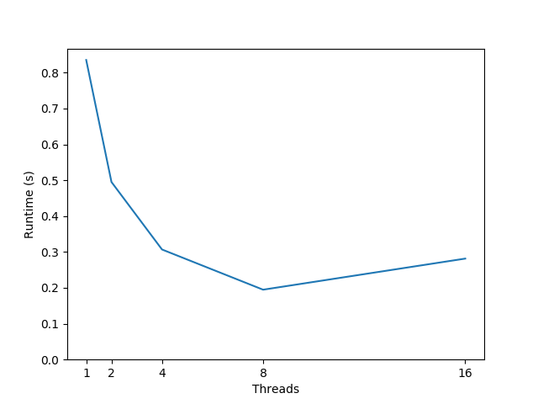
Baseline - Results
C
Fibonacci
Iterative
0.0000003 seconds
Recursive
0.433
Jacobi
Serial
0.897 seconds
OpenMP Jacobi

Slide 9
PyPy
Alternative Python interpreter.
Probably most popular after CPython
Written in RPython (a Python derivative). Work your head around that one.
Pros:
Usea a just in time (JIT) compiler that compiles python code to lower code closer to machine level
No modifications to code required (except…)
Cons:
Limited support for module using CPython's C-API
Support getting better, but performance could vary.
May require modified libraries

Slide 10
PyPy - Benchmark Results
Fibonacci
Iterative:
0.00007 seconds
Recursive:
5.102 seconds
Jacobi
9.09s (53.6x faster than CPython Jacobi)
549.67 Mega FLOPS/second

Slide 11
PyPy - Related
There are a gajillion python interpreters and compilers
Jython: JVM
Pyston: LLVM
Pyjion:
Hope
Falcon
PyDron
Nuitka: Compiler, almost all of Python.
Shed Skin: Compiler, limited subset of Python.
Pythran: Compiler, limited subset of Python
GT-Py: Intel's interpreter. Adds OpenMP and OpenACC annotations

Slide 12
NumPy
Non-standard (but wildly popular) module
Mainly C backed multi-dimensional arrays and some linear algebra tools
Pros:
Powerful array abstractions.
Basis of SciPy (scientific python module filled with magic).
Mostly written in C/C++/Fortran (fast).
Cons:
Need to modify code to use it.
Not a big deal, but would always like to avoid redevelopment.

Slide 13
NumPy - Benchmark Results
Jacobi
4.592 seconds (106.324x faster than CPython basline)
1088.850 Mega FLOPS/second

Slide 14
Multiprocessing
Standard module.
Parallelism through processes (not threads).
Provides mechanisms for usual task-based parallelism.
Pros:
API is fairly standard for a task-based parallelism ( create process objects, start, and join them; locks, pipe, semaphore).
Provides process pools that can easily map work across them.
Supposedly can use multiprocessing on a cluster.
Not limited by a Global Interpreter Lock (GIL).
Cons:
Very heavy weight (creates entirely new python interpreter process).
Requires you to be quite hands on.

Slide 15
Multiprocessing - Terse Example
processes = [ Process( target=work_function, args=(work_unit, result_queue) ) for work_unit in work_list ] # Start all processes for process in processes: process.start() # Wait for all processes to stop for process in processes: process.join()
pool = Pool( cpu_count() ) results = pool.map( work_function, work_list )

Slide 16
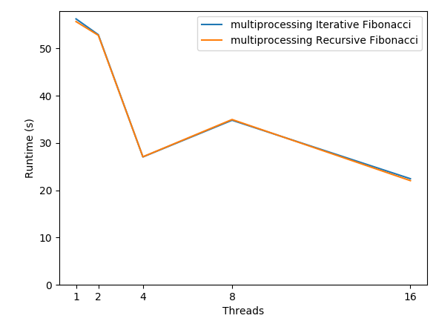
Multiprocessing - Fibonacci Results
Baseline was:
Iterative: 0.00065 seconds
Multiprocessing slower
Recursive: 59.20 seconds
Multiprocessing faster

Slide 17
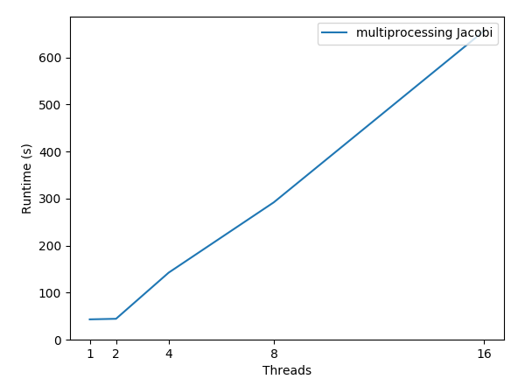
Multiprocessing - Jacobi Results
Uses NumPy arrays to simplify comms Baseline was:
488.244 seconds
Multiprocessing does worse (and keeps getting worse!)

Slide 18
Multiprocessing - Related
PyMPI, MPI4Py
Message Passing Interface (MPI) is a very old API for multiprocessing
These let you use the API in python
Global Arrays
Partitioned Global Addressing Space (PGAS) is a way of thinking about and writing distributed codes.
Global Arrays is one such implementation
Global Arrays seems to have some Python facing API

Slide 19
Threading
Standard module
"Parallelism" via threads
Very similar to multiprocessing
Thread objects, locks, et cetera.
Pros:
API is fairly standard for a task-based parallelism ( create process objects, start, and join them; locks, pipe, semaphore)
Cons:
Not concurrent! Bound by GIL.
All work and no gain.
Apparently used for more I/O parallelism...

Slide 20
Threading - Terse Example
# Create threads
threads = [
Thread( target=work_function, args=(work, result_queue) )
for work in worklist
]
# Start threads
for thread in threads:
thread.start()
# Join threads
for thread in threads:
thread.join()

Slide 21
Threading - Benchmark Results
Fibonacci
Iterative:
0.0079 seconds
Recursive:
176.43 seconds

Slide 22
Threading - Related
Any kind of asynchronous library is sure to work similarly to the threading module.
Probably about a billion of these, primarily used for web services

Slide 23
PyCUDA
Non-standard module
Write CUDA kernels in as strings, compile during runtime, and execute.
Very similar to how native OpenCL works (and PyOpenCL).
Pros:
Can utilize very powerful hardware in a manner similar (if not identical) to the native API.
Spoiler alert: Very fast
Cons:
Single Instruction Multiple Data (SIMD) paradigm limits its application to (essentially) array operations
Lots of setup that is confusing, unintuitive, and that can have a performance impact

Slide 24
PyCUDA - Terse Example
mod = SourceModule("""
__global__ void multiply_them(float *dest, float *a, float *b, int N){
const int i = threadIdx.x;
if( i < N )
dest[i] = a[i] * b[i];
}
""")
# Compile CUDA function
multiply_them = mod.get_function("multiply_them")
# Create Numpy arrays for input and out
a = numpy.array( data_a ).astype(numpy.float32)
b = numpy.array( data_b ).astype(numpy.float32)
dest = numpy.zeros_like(a)
# Caluclate blocksize and grid_size
block_size = 400
grid_size = int( math.ceil(N/float(block_size)) )
# Call CUDA function
multiply_them(
driver.Out(dest), driver.In(a), driver.In(b), numpy.int32( a.shape[0] ),
block=(400,1,1), grid=(grid_size), 1)
)

Slide 25
PyCUDA - Benchmark Results
Jacobi
0.0507 seconds (10693x faster CPython, 17.88x faster than C!)
98.619 Giga FLOPS/second

Slide 26
PyCUDA - Related
PyOpenCL
Same but with OpenCL codes
Developed by same person/group
PyChapel
Chapel is a high performance programming language from Cray.
PyChapel lets you write/use Chapel code and make calls to it from Python

Slide 27
Cython
Broadly, a Python/Cython-to-C compiler
Can compiler most Python code to a C-API implemented module
Has Cython language for writing
Pros:
Essentially compiled python
Seems to port relatively easily (some minor build process required)
Cons
Does not work in interpreters that dont implement the CPython C-API (limited PyPy support)

Slide 28
Cython - Benchmark Results
Fibonacci
Iterative
8.70227813721e-05s
Recursive
15.0813598633s
Jacobi
221.64 seconds (2.2x faster than CPython)
22.55 Mega FLOPS/second

Slide 29
Cython - Related
PyFort
Very similar.
Write Python-y Fortran that gets compiled and is callable from Python.
Pervasive in SciPy (~25% of project).
SWIG
More for creating interfaces between existing code in a language.
Grumpy
Python to Go transpiler + runtime
Rust?

Slide 30
Numba
Annotation system for Python (and maybe an interpreter?)
Annotate loops with @jit or @vectorize
JIT compiler lowers into LLVM, optimizes, and then to compiles machine code during runtime.
Pros:
Easy to use (on paper). Just annotate
Cons:
Not actually all that easy to use.
Confusing type system that does not seem to terminate.
When are things arrays? When are they not?
Sometimes need to modify code to make work at all.

Slide 31
Numba - Terse Example
#Tell numba to JIT foo, infer types
@jit
def foo( a,b ):
return a+b
# Tell numba to JIT foo, specifically for these types
@jit([ int32(int32,int32),
float32(float32,float32),
float64(float64,float64)])
def bar( a, b ):
return a-b

Slide 32
Numba - Benchmark Results
Fibonacci
Iterative
0.082 seconds (25% slower than CPython baseline)
Recursive
1.24985098839 (47x faster than CPython baseline)
Jacobi
542.145 seconds (11% slower than CPython baseline)

Slide 33
Conclusion
No magic wand.
This is the norm, and is not surprising.
Quite usable.
Writing high performance always requires fairly large code modifications.
Notably easier to modify in python than with than other languages, like C/C++
If you need peak performance, Python won't be your main application.
But Python will work for most people systems
You Aren't Google - Ozan Onay https://blog.bradfieldcs.com/you-are-not-google-84912cf44afb
Python can be used in other places, such as orchestration of your application(s)
Either as a bash replacement
Call low level operations (see PyCUDA)

