Slide 1
CS2300: File Structures and Introduction to Database Systems
Lecture 2: Database System Concepts
Katrina Ward
CS2300 - Dan Lin

Slide 2

How much data today?
Wayback Machine has 2 PB + 20 TB/month (2006)
NOAA has ~1 PB climate data (2007)
CERN’s LHC will generate 15 PB a year (2008)
Google processes 20 PB a day (2008)
“all words ever spoken by human beings” ~ 5 EB
https://www.youtube.com/watch?v=N7YLHYtUbiE
640K ought to be enough for anybody.

Slide 3
Types of Databases and Database Applications
Traditional Applications:
  Numeric and Textual Databases
More Recent Applications:
  Multimedia Databases
  Geographic Information Systems (GIS)
  Data Warehouses
  Real-time and Active Databases
  Many other applications
CS2300 - Dan Lin
Notes:
To start with, let’s take a look at what kind of applications can be supported by database systems.

Slide 4
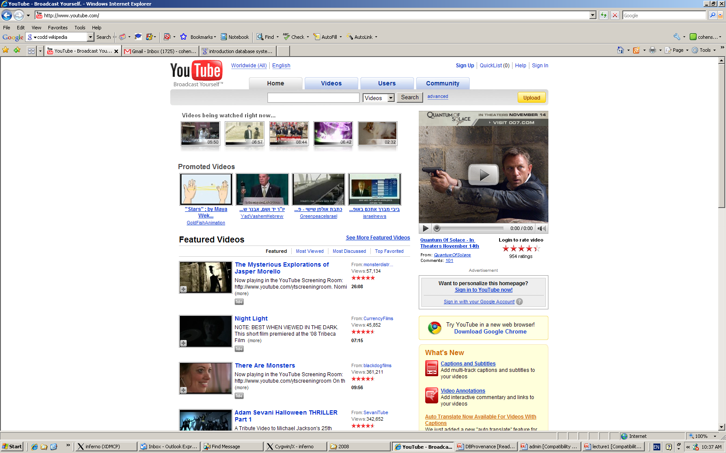

CS2300 - Dan Lin

Slide 5
Basic Definitions
A Database:
  A very large, integrated collection of related data.
A Database Management System (DBMS) is:
  A software system designed to store, manage, and facilitate access to databases.
A Database System
  The DBMS software together with the data itself. Sometimes, the applications are also included.
CS2300 - Dan Lin

Slide 6


Simplified Database System Environment
Raw Data
Application Server
Database system
Internal representation
DB
CS 2300 - Dan Lin

Slide 7
Database Users
Users may be divided into
  Actors on the Scene: who actually use and control the database content; who design, develop and maintain database applications.
  Workers Behind the Scene: who design and develop the DBMS software and related tools, and the computer systems operators.
CS2300 - Dan Lin

Slide 8
Database Users
Actors on the scene
  End-users:
    use the data for queries, reports and sometimes update the database content.
  Database administrators:
    Responsible for authorizing access to the database, for coordinating and monitoring its use, acquiring software and hardware resources, controlling its use and monitoring efficiency of operations.
  Database Designers:
    Responsible to define the content, the structure, the constraints, and functions or transactions.
CS2300 - Dan Lin

Slide 9
Typical DBMS Functionality
Define a particular database in terms of its data types, structures, and constraints
Construct or Load the initial database contents on a secondary storage medium
Manipulate the database:
  Retrieval: Querying, generating reports
  Modification: Insertions, deletions and updates to its content
  Accessing the database through Web applications
Processing and Sharing by a set of concurrent users and application programs – yet, keeping all data valid and consistent
CS2300 - Dan Lin
Notes:
Back to the database systems, now let’s summarize its functionality. What to store? How to store? How to query?

Slide 10
Typical DBMS Functionality
Other features:
  Protection or security measures to prevent unauthorized access
  Presentation and visualization of data
  Maintaining the database and associated programs over the lifetime of the database application
CS2300 - Dan Lin

Slide 11
Is a File System a DBMS?
CS2300 - Dan Lin

Slide 12
Database Management Systems
What more could we want than a file system?
  concurrency control
  recovery
  simple, efficient ad hoc queries
  benefits of good data modeling
  … …
CS2300 - Dan Lin

Slide 13
Data Models
CS2300 - Dan Lin

Slide 14
What is a Data Model?
An abstract representation
Hides low level details
Describes DB structure
  Data types
  Relationships
  Constraints
Categories of data models
  Conceptual data model
  Implementation data model
  Physical data model
CS2300 - Dan Lin
Notes:
It is used to model data in a standard, consistent, and predictable manner in order to manage it as a resource.

Slide 15
Conceptual Data Models
High level: from the user’s perspective
For end user/customer
For example: E-R diagrams
CS2300 - Dan Lin

Slide 16
An Example Database
Let’s build the joeSS together!
Entities: STUDENT, COURSE, SECTION (of COURSE), DEPARTMENT, INSTRUCTOR…
Relationships among entities:
  SECTION are of specific COURSE
  STUDENT take SECTION
  COURSE have prerequisite COURSE
  INSTRUCTOR teach SECTION
  COURSE are offered by DEPARTMENT
  STUDENT major in DEPARTMENT
  ……
CS2300 - Dan Lin

Slide 17
E-R Diagram for the Example
CS2300 - Dan Lin

Slide 18
Implementation Data Models
Also called representational data models
Meant for end user
With some of the data organizational information
Can be implemented directly in a computer
Example: Relational Model
CS2300 - Dan Lin

Slide 19
Relational Model for the Example
CS2300 - Dan Lin

Slide 20
Physical Data Models
Low level: For computer specialists/DBMS implementer
How data stored in computer
  Record formats
  Record orderings
  Access paths
Example: UML Diagram
CS2300 - Dan Lin

Slide 21
Physical Model for the Example
CS2300 - Dan Lin

Slide 22
DBMS Architecture
Let’s put data models together!
CS2300 - Dan Lin

Slide 23
Three-Schema Architecture
What is in each Schema?
Internal schema: physical data model
  Physical storage structure
  Data storage details, access path
Conceptual schema: conceptual or implementation data model
  Structure of the entire database
  Entities, data types, relationships, user operations, constraints
External schemas: describe the various user views.
  Usually uses the same data model as the conceptual schema.
CS2300 - Dan Lin

Slide 24
Three-Schema Architecture
Advantages of three-schema architecture
  Self-describing nature
    Use of catalogs for schemas
  Achieve Data Independence
    Support for multiple user views
    Insulation of programs and data
CS2300 - Dan Lin

Slide 25
Data Independence
Ability to change one level schema without affecting other levels of schema
  Three-schema architecture implements concept of data independence
  Only the mapping need to be changed
  Logical Data Independence
  Physical Data Independence
CS2300 - Dan Lin

Slide 26
Data Independence
Logical Data Independence
  The capacity to change the conceptual schema without having to change the external schemas and their associated application programs.
Physical Data Independence
  The capacity to change the internal schema without having to change the conceptual schema.
CS2300 - Dan Lin

Slide 27
Three-Schema Architecture
Mapping between Database Schemas
  Process of transforming requests among different database level (schemas)
  Is an overhead in compilation & execution of queries
  Time consuming
CS2300 - Dan Lin

Slide 28
Database Schema
The description of a database
Includes relationships between entities.
Schema Diagram:
  An illustrative display of (most aspects of) a database schema.
CS2300 - Dan Lin

Slide 29

Example of a Database Schema
CS2300 - Dan Lin

Slide 30
Database Instance
The actual data stored in a database at a particular moment in time
This includes the collection of all the data in the database
Also called database state (or occurrence or snapshot)
CS2300 - Dan Lin

Slide 31
Database State
Initial Database State
  the database state when it is initially loaded into the system.
Valid State
  A state that satisfies the structure and constraints of the database.
CS2300 - Dan Lin

Slide 32

Example of a Database State

Slide 33
Schemas versus Instances
Distinguish between the description of a database and database itself.
Database schema: description of a database.
Database instances: actual data stored in database.
CS238 - Dan Lin

Slide 34
Database Schema vs. Database State
Distinction
  The database schema changes very infrequently.
  The database state changes every time the database is updated.
Schema is also called intension.
State is also called extension.
CS2300 - Dan Lin

Slide 35
Database Systems
Main Characteristics
  1. Self-describing nature
  2. Insulation between programs and data
  3. Data Abstraction
  4. Support of multiple views of the data
  5. Sharing of data and multi-user transaction processing
CS2300 - Dan Lin

Slide 36
Main Characteristics of Database Systems
1. Self-describing nature of a database system:
  A DBMS catalog stores the description of a particular database (e.g. data structures, types, and constraints)
  This allows the DBMS software to work with different database applications.
2. Insulation between programs and data:
  Called program-data independence.
  Allows changing data structures and storage organization without having to change the DBMS access programs.
CS2300 - Dan Lin

Slide 37
Main Characteristics of Database Systems
3. Data Abstraction:
  A data model is used to hide storage details and present the users with a conceptual view of the database.
  Programs refer to the data model constructs rather than data storage details
4. Support of multiple views of the data:
  Each user may see a different view of the database, which describes only the data of interest to that user.
CS2300 - Dan Lin

Slide 38
Main Characteristics of Database Systems
5. Sharing of data and multi-user transaction processing:
  Allowing a set of concurrent users to retrieve from and to update the database.
  Concurrency control within the DBMS guarantees that each transaction is correctly executed or aborted
  Recovery subsystem ensures each completed transaction has its effect permanently recorded in the database
  OLTP (Online Transaction Processing) is a major part of database applications. This allows hundreds of concurrent transactions to execute per second.
CS2300 - Dan Lin

Slide 39
DBMS Languages
DDL (Data Definition Language)
  Describe conceptual schema
SDL (Storage Definition Language)
  Specify internal schema
VDL (View Definition Language)
  Specify external view
DML (Data Manipulation Language)
  Manipulate the populated data
Modern DB → All in one ☺ (E.g. SQL)
CS2300 - Dan Lin

Slide 40
What’s Next …
Please email your group information to me at kjw26b@mst.edu by 11:59pm Sep 1.
Entity-Relationship (ER) Model (Chapter 3)
CS2300 - Dan Lin

