Slide 1
CS2300: File Structures and Introduction to Database Systems
Katrina Ward
CS 2300 Slides - Dan Lin

Slide 2



CS 2300 - Dan Lin

Slide 3
What is a Database?
Database:
  A collection of related data.
Data:
  Known facts that can be recorded and have an implicit meaning.
Mini-world:
  Some part of the real world about which data is stored in a database.
CS 2300 - Dan Lin

Slide 4
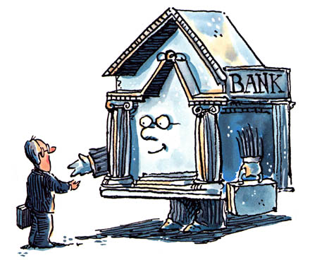
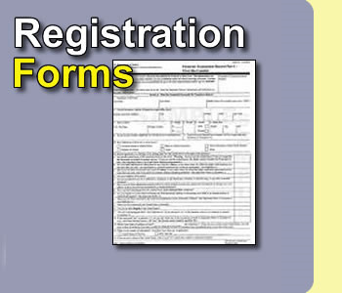





CS 238 - Dan Lin

Slide 5





Databases touch all aspects of our lives
http://www.amazon.com/
https://www.facebook.com/
https://www.bankofamerica.com/
http://www.expedia.com/
http://www.realtor.com
https://blackboard.mst.edu/webapps/login/
http://www.petfinder.com/
CS 2300 - Dan Lin

Slide 6
What is a Database System?
Database Management System (DBMS)
  A software package/ system to facilitate the creation and maintenance of a computerized database.
  Define (data types, structures, constraints)
  Construct (storing data on some storage medium controlled by DBMS)
  Manipulate (querying, update, report generation) databases for various applications.
Database System
  The DBMS software together with the data itself. Sometimes, the applications are also included.
CS 2300 - Dan Lin

Slide 7
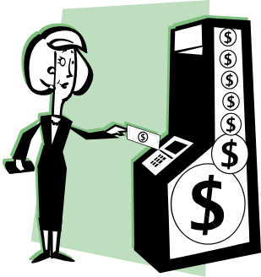
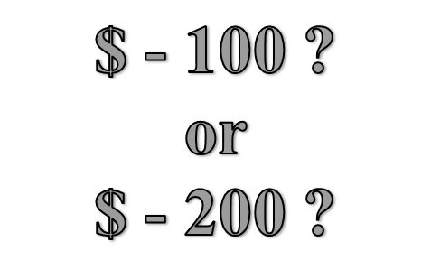
Database Systems
You and your Mom each take $100 from the same account but different ATM’s at about the same time.

Slide 8
Course Goal
Understand the foundations on which today’s work is built
  Existing database systems
Build your own database systems by the end of the semester
  Complete a 3-phase semester-long course project
Be the lead of the next generation database technology!
CS 2300 - Dan Lin

Slide 9
Course Information & Policies
CS 2300 - Dan Lin

Slide 10
Contact
Contact Information: Katrina Ward
  Office: CS346
  Office hours: Monday 2:00pm–3:00pm, Tuesday 1:00pm-3:00pm (or by appointments)
  Email: kjw26b@mst.edu
TA: TBD
Course Website: http://canvas.mst.edu
CS 2300 - Dan Lin

Slide 11
Course Outline
Course Introduction
Database System Concepts
Entity-Relationship Model
Enhanced Entity-Relationship Model
Relational Data Model
6. Relational Data Model Mapping
7. Relational Algebra
8. SQL
9. Functional Dependency
10. Disk storage, basic file structures and hashing
11. Indexing structures for files
The tentative course schedule is on canvas
CS 2300 - Dan Lin

Slide 12
Course Methodology
Lectures to present the concepts
  Unless otherwise noted, all the materials that you are expected to know will be covered in class
  Interaction (questions/discussion/thinking) encouraged
Reading will fill in the details
  Elmasri, R. and Navathe, S., Fundamentals of Database Systems, 7th Edition, Addison-Wesley Publishing Company
Homework and Projects get you to understand what you’ve read and heard
  4 written homework
  1 programming project including 3 phases
  4 quizzes
CS 2300 - Dan Lin

Slide 13
Evaluation and Grading
Points earned as follows:
  Midterm (20%), Final Exam (30%)
  Homework (20%), Projects (20%)
  Quiz (5%)
  Instructor’s evaluation (5%)
    In-class discussions/participation
    Overall perception of quality of your work in ways that may not be reflected in your scores
Late work penalized 20% per day within 48 hours of the time it is due. No credit after that.
Estimate of how final grades will be assigned
90‑100% A; 80‑89% B; 70-79% C; 60‑69% D; below 60% F.
CS 2300 - Dan Lin

Slide 14
Classroom Courtesy
Please have your phones on silent during the class.
CS 2300 - Dan Lin

Slide 15
Important Information
ACADEMIC DISHONESTY
  Any act of cheating will result in a score of 0 for the entire assignment and repeat offences will be reported to the Office
  http://registrar.mst.edu/academicregs/index.html
SPECIAL NEEDS
  If you have a documented disability and anticipate needing accommodations in this course, you will need to request that the Disability Services staff send a letter to me verifying your disability.
  http://counsel.mst.edu/
CS 2300 - Dan Lin

Slide 16
Course Project
Find your group members. Each group should not have more than 3 members.
Send an email to me (kjw26b@mst.edu) about your group no later than 11:59pm Sep 1.
If you have difficulty in finding your group members, also email me and let me know.
CS 2300 - Dan Lin

Slide 17
Start Your Project Now
To have a successful project, you need to start learning how to design a web interface by yourself NOW
XAMPP(MySQL+PHP) is recommended to implement your project. http://www.apachefriends.org/en/xampp.html
PhP tutorials:
  http://www.freewebmasterhelp.com/tutorials/phpmysql/1
  http://www.w3schools.com/PHP/default.asp
If there is time, I will teach a brief tutorial on PHP. Do NOT depend on this!

Slide 18
What’s Next …
Basic concepts of database systems
  Chapter 1 and 2
Please email your group information to me by 11:59pm Sept. 1.
  Each group needs only one person to email the full names of group members in a .docx or .pdf or .txt.
  If you need any help on finding a group, please email me as well
CS 2300 - Dan Lin

