Slide 1
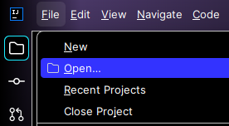
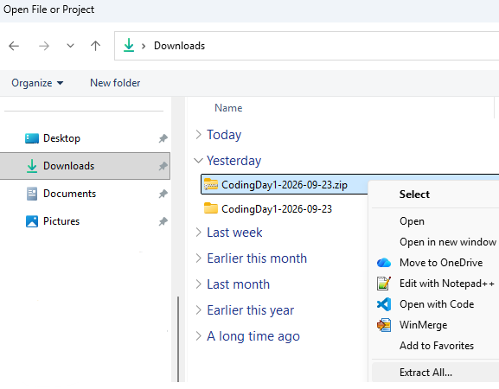
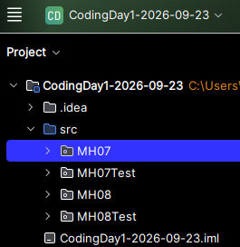
Importing the .zip Starter Code into IntelliJ
1. In IntelliJ, File > Open…
2. Right-click .zip to “Extract All…”, then open the folder.
3. Start coding!

