Slide 1
Suspect Phone Analysis
Ian McNichols, Cameron Ramos, JoEnid Acevedo

Slide 2
Data Analysis Techniques
Used custom Python script created by McNichols, Ramos, and Enid
Calculated GPS location of each suspect using phone bearing and lat/long changes over time
Grabbed any users that had locations overlapping by 250m or less at the same hour
Process Data
Compare Times
Sort data by the hour it was collected
Compare Locations
Find any data at the same
Calculate GPS coordinates from final location and Lat/Long delta
Use online tool to display geolocations at suspicious points
Display Paths

Slide 3
Process Data
To get location data, we took the collection point and subtracted the lat/long change for each datapoint, adding them to a list backwards to show the path from the end
Lat/long change had to be calculated using the bearing angle
Eventually we had a list of time, lat, long for each point recorded for each suspect
From here we could move forward with comparing data between suspects

Slide 4
Compare Times
The times were extremely precise, so we shifted to only using year, month, day, and hour for comparison
We were able to remove all data taken at unique times not found elsewhere in the data
At the end of this step we had lists of time: user data, user data, etc.
From here we could compare the locations for times that were shared between suspects, for instance all data taken at 12/12 9 p.m.

Slide 5
Compare Locations
We iterated through each time where multiple suspects’ data was taken and calculated distances between each suspect
Used geodesic python library, which is frequently used by GIS researches and scientists, to find distance between latitude and longitude points
From this point we were able to give a threshold value of distance where the code would alert us when 2 suspects were within the given distance at the same time
Started with 100 meters but that gave no results, so increased it to 250 meters

Slide 6
Display Paths
The code wrote text files of the paths of each suspects that overlapped
Online map plotter GPS Visualizer takes in that output and maps it on a real map
These are included in the following slides

Slide 7
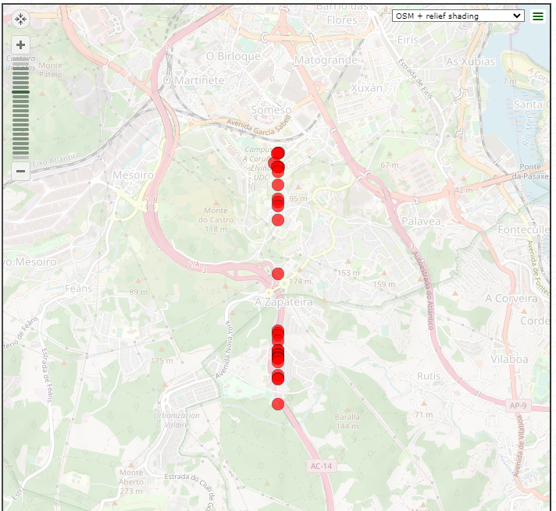
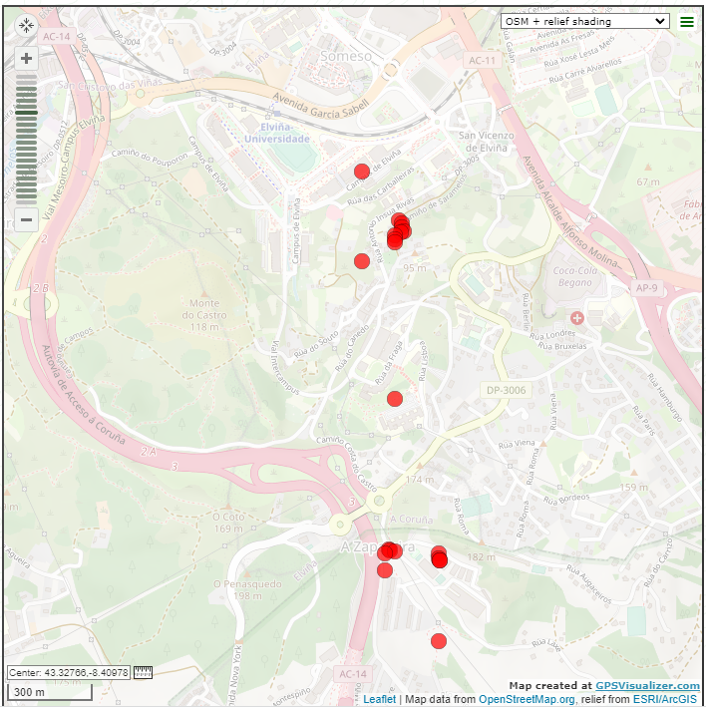
Suspects ID 8 and 13
241.16530843870947 meters away from each other at 2pm on 12/13

Slide 8
Suggestions:
These suspects probably had little to do with each other. Their closest point was 240 meters away and as you can see from the paths, suspect 13 only walked by suspect 8 in the middle of a much longer trip

Slide 9
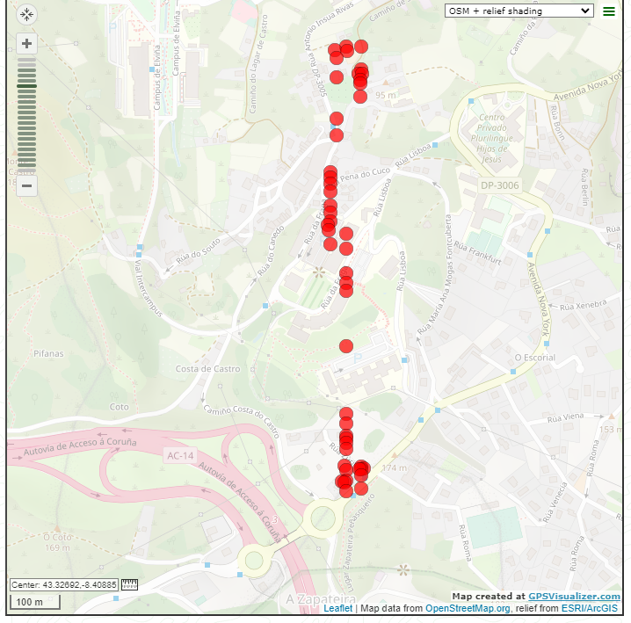
Suspects ID 3 and 13
168.41657051367866 meters away from each other at 4pm on 12/13

Slide 10
Suggestions:
These suspects should be more closely investigated. While they were 168 meters away from each other, they each spent extended amounts time in the same area. It’s possible there was a drop or related activity. Further investigation would help to clarify.

Slide 11
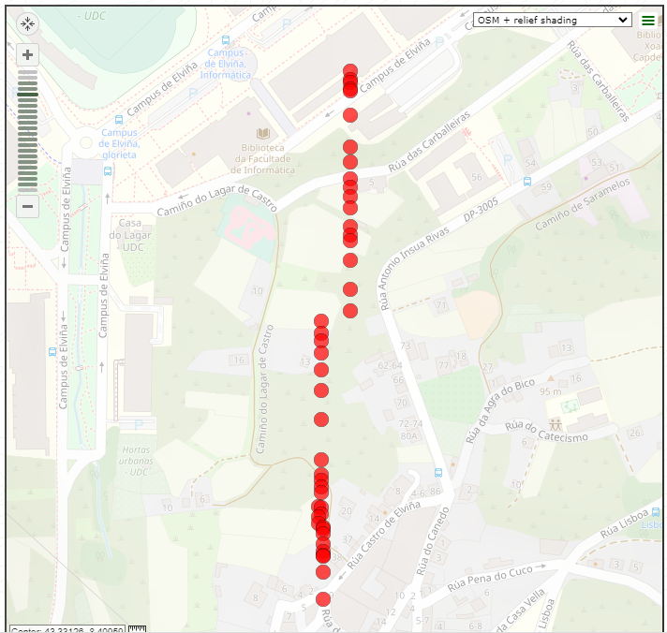
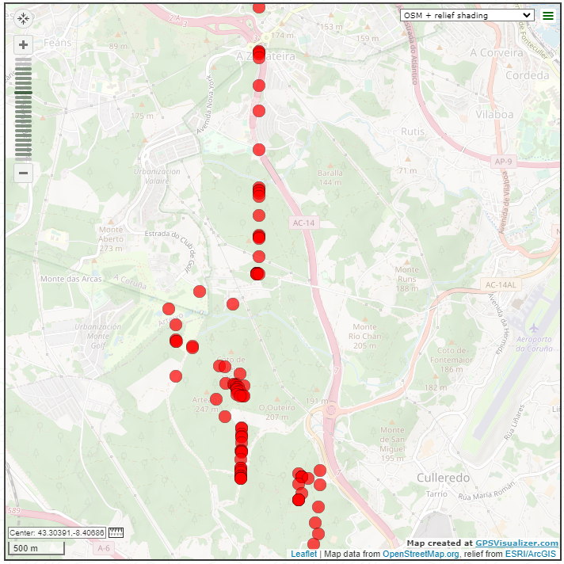
Suspects ID 12 and 18
107.38879720503698 meters away from each other at 9pm on 12/12

Slide 12
Suggestions:
These suspects should be investigated. The 107 meter distance is within error, so they could have been within 100 meters of each other, which is the limit.

Slide 13
Dimensionality Reduction Overview
Uses statistics to get rid of dimensions in data, like turning a plane into a line or a line into a point
Allows us to see the data displayed on a 2d or 3d plot even if it’s more than 3d data (like we have)
If there are distinct differences between different types of data (like walking, driving, etc.) they will cluster together
Increasing dimensions can help cluster better until there are too many dimensions for the number of classes
A nice way to see if there is a correlation between the data and types of activity

Slide 14
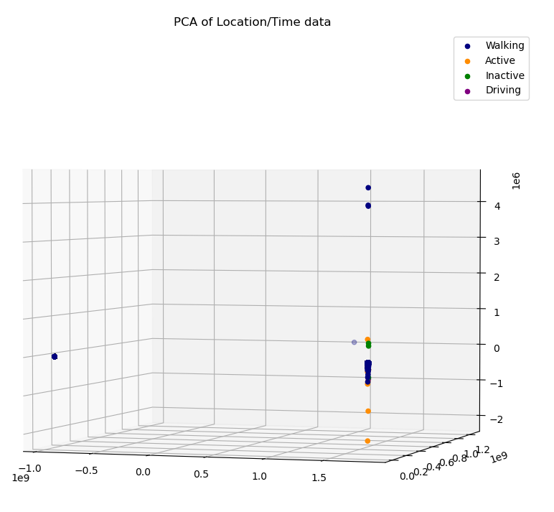
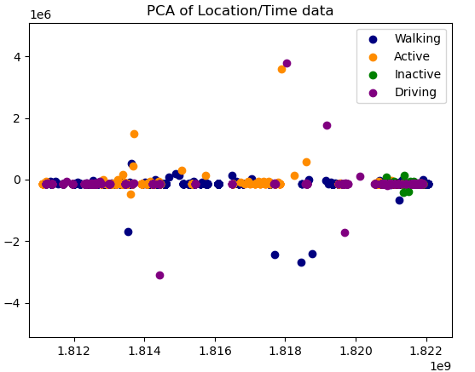
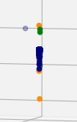
Dimensionality Reduction on Location/Time

Slide 15
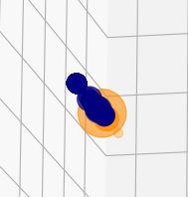
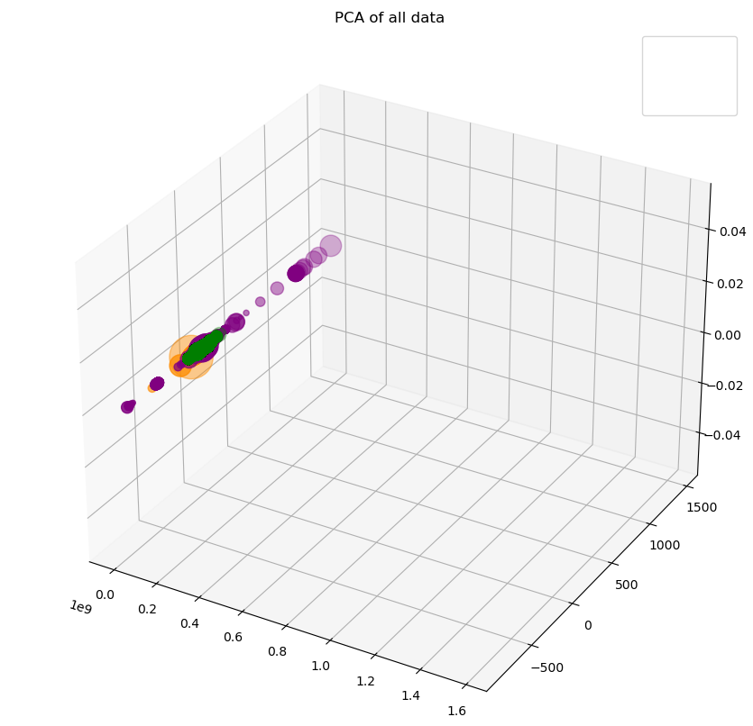
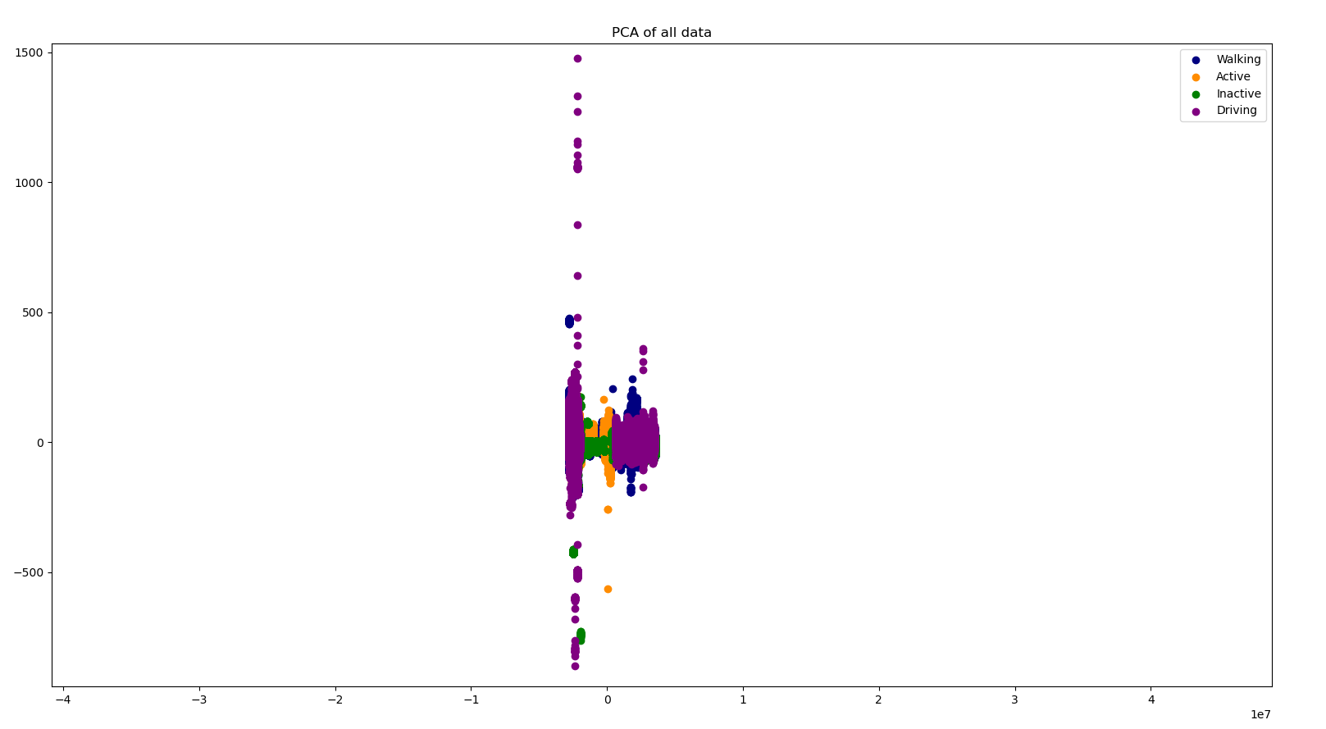
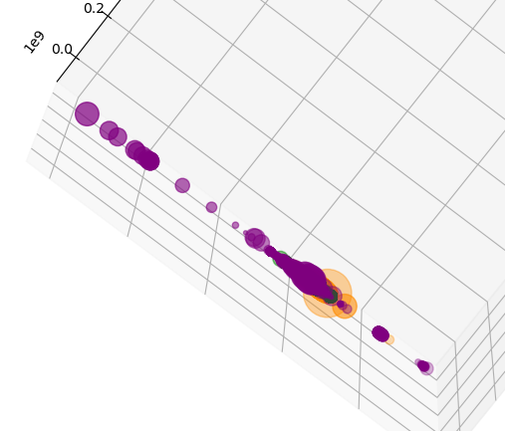
Dimensionality Reduction on all Data

Slide 16
Dimensionality Reduction on Location/Time Analysis
As dimensions increase, the 4 different types of activity cluster more
Clusters are visible from different angles, showing that they are at least somewhat distinct
Gives an indication that we will be able to find correlation with at least one method

Slide 17
Dimensionality Reduction on all Data Analysis
As dimensions increase, the 4 different types of activity cluster more
Actual data has latitude, longitude, timestamp
Clusters are visible, but have significant overlap
Explains why the SVM is correct half of the time, but not more
There are enough differences to guess the different types of activity some of the time, but not enough to guess every time

Slide 18
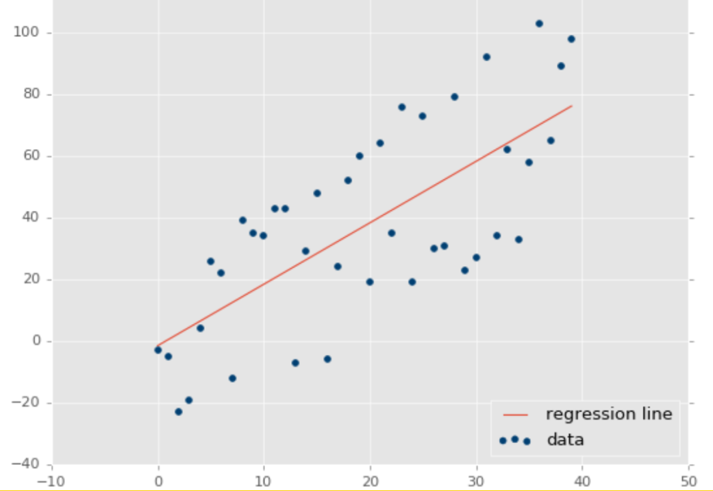
Linear Regression Overview
Linear regression takes 2 inputs and calculates the correlation between them in a linear matter
High correlation means the 2 inputs are related
Example:

Slide 19
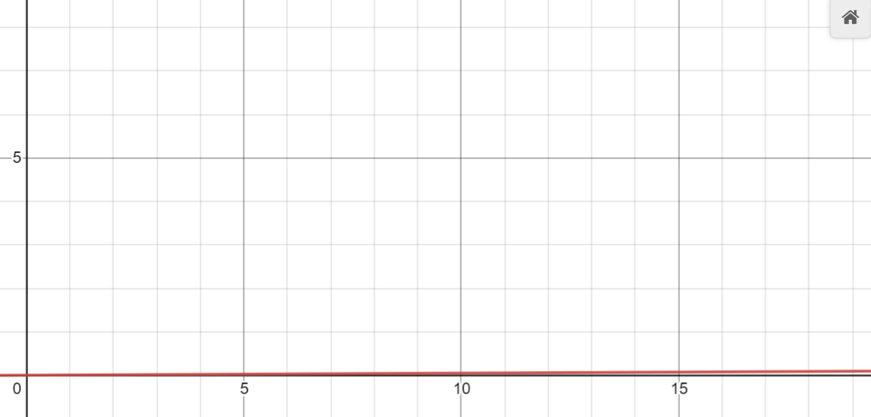
Calculating Correlation of Activity, Time, and Location Using Linear Regression
Using a linear regression model from sci-kit learn, there is a 0.005 coefficient of determination from time and location to activity type
Worst case = 0, Best case = 1
Conclusion: There is a low linear correlation between activity type and time/location
Calculated correlation:

Slide 20
Calculating Correlation of Activity and all Other Data Using Linear Regression
Using a linear regression model from sci-kit learn, there is a 0.016 coefficient of determination from all other data to activity type
Worst case = 0, Best case = 1
Conclusion: There is a low linear correlation between activity type and all other data
High correlation:
Calculated correlation:

Slide 21
Conclusion
There is not a linear correlation between the data and activity type, regardless if all data or just GPS data is used

Slide 22
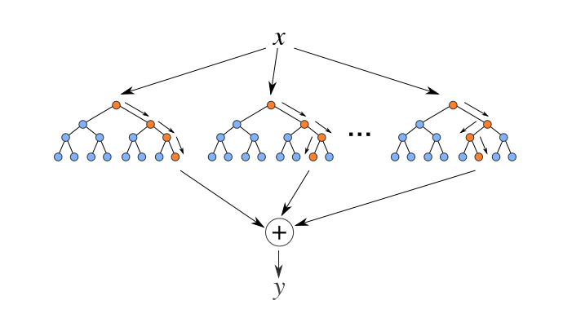
Random Forest Regression Overview
If data has many dimensions, linear relationships can be harder to find
There can still be other relationships in 3-n dimensions
For example, data can cluster or group in spheres
Random Forest Regression tests for non-linear relationships in data by exploring all classes and giving out the mean of each one

Slide 23
Calculating Correlation of Activity, Time, and Location Using Random Forest Regression
Using a Random Forest Regression model from sci-kit learn, there is a .3975 accuracy on guessing the activity type
The Random Forest Regression model was able to guess correctly the activity of a person given only their timestamp and location 39.75% of the time
Trained on 80% of the data, tested on 20%
Conclusion: There is a weak non-linear correlation between activity type and time/location

Slide 24
Calculating Correlation of Activity and all Other Data Using Random Forest Regression
Using a random forest regression model from sci-kit learn, there is a 0.975 accuracy from all other data to activity type
Trained with 60% of the data and tested on 40%, the model guessed correctly the activity type 97.5% of the time given phone data
Conclusion: There is a very strong correlation between activity type and all other data

Slide 25
SVM (Support Vector Machine) Overview
SVM’s work by sorting data into classes that are as different as possible
Maps to a higher dimension to find differences in the data
We chose to use a SVM on the GPS data to find a higher correlation than the Random Forest Regression method

Slide 26
Calculating Correlation of Activity, Time, and Location Using SVM’s
Using a Support Vector Machine with rbf kernel from sci-kit learn, there is a .5 accuracy on guessing the activity type
Worst case = 0, Best case = 1
The SVM model was able to guess correctly the activity of a person given only their timestamp and location 50% of the time
Conclusion: There is a weak non-linear correlation between activity type and time/location

Slide 27
Conclusions on Correlation
There is a very strong correlation of all the data to the activity type. Multiple apps such as car insurance and run trackers take advantage of this, so it makes sense.
The correlation between the location and activity type was much weaker. It was better than randomly guessing, but not by much. Going by maps of the paths, it does seem like the suspects frequently leave roads and paths. This would make it more difficult to find correlation between their location and activity because they are not always on the expected walking/driving path.
A wider range of data, like more suspects or a longer time period, we could have avoided the overfitting problem and had a more sure level of correlation. There was a lot of similarity in the data points.

