Slide 1
Suspect Phone Analysis
Ian McNichols, Cameron Ramos, JoEnid

Slide 2
Data Analysis Techniques
Used the DataAnalyzinator 3000™ created by McNichols, Ramos, and Enid
Calculated GPS location of each suspect using phone bearing and lat/long changes over time
Grabbed any users that had locations overlapping by 250m or less at the same hour

Slide 3
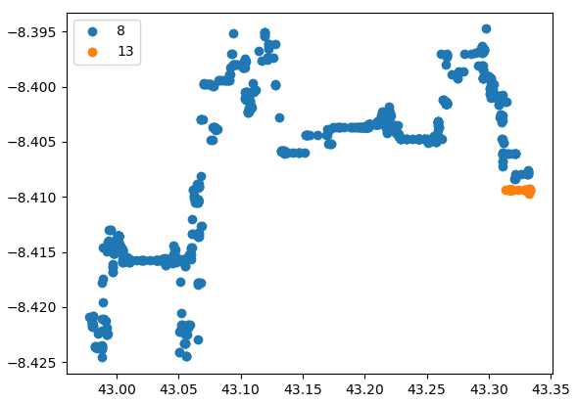
Suspects ID 8 and 13
241.16530843870947 meters away from each other at 2pm on 12/13

Slide 4
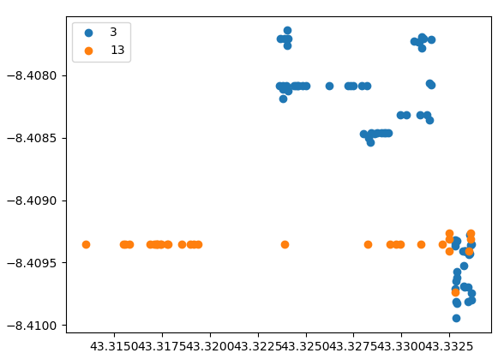
Suspects ID 3 and 13
168.41657051367866 meters away from each other at 4pm on 12/13

Slide 5
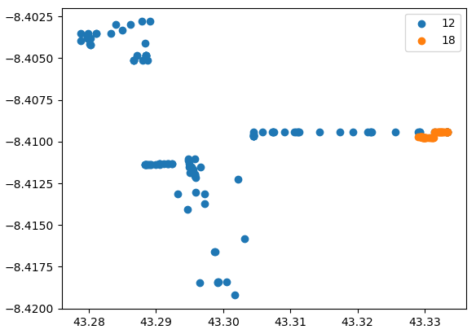
Suspects ID 12 and 18
107.38879720503698 meters away from each other at 9pm on 12/12

Slide 6
Calculating Correlation of Activity, Time, and Location
Using a linear regression model from sci-kit learn, there is a 0.005 coefficient of determination from time and location to activity type
Worst case = 0, Best case = 1
Conclusion: There is a low correlation between activity type and time/location

