Slide 1
Suspect Phone Analysis
Ian McNichols, Cameron Ramos, JoEnid

Slide 2
Data Analysis Techniques
Used custom Python script created by McNichols, Ramos, and Enid
Calculated GPS location of each suspect using phone bearing and lat/long changes over time
Grabbed any users that had locations overlapping by 250m or less at the same hour
Process Data
Compare Times
Sort data by the hour it was collected
Compare Locations
Find any data at the same
Calculate GPS coordinates from final location and Lat/Long delta
Use online tool to display geolocations at suspicious points
Display Paths

Slide 3
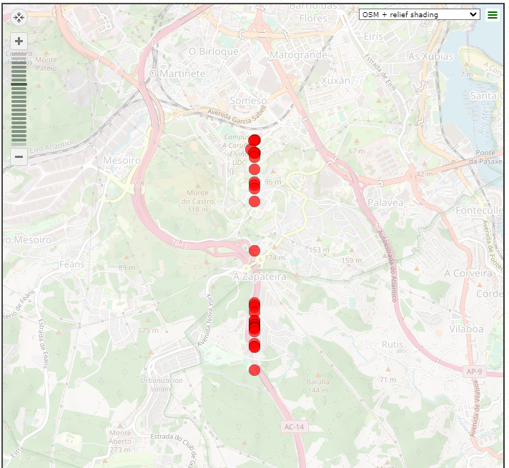
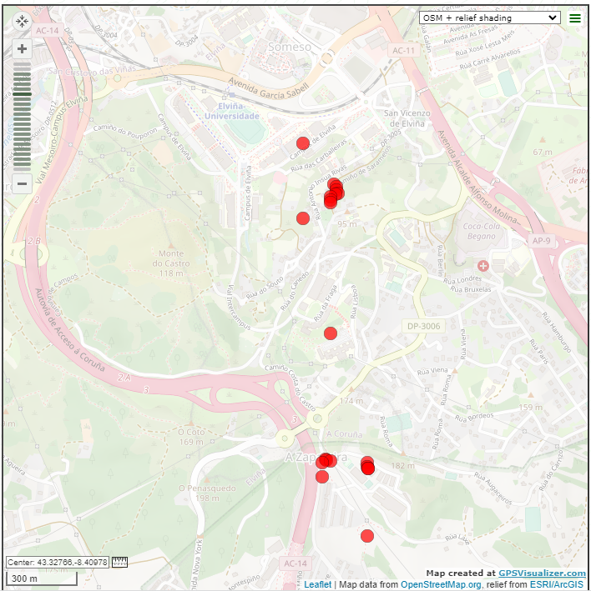
Suspects ID 8 and 13
241.16530843870947 meters away from each other at 2pm on 12/13

Slide 4
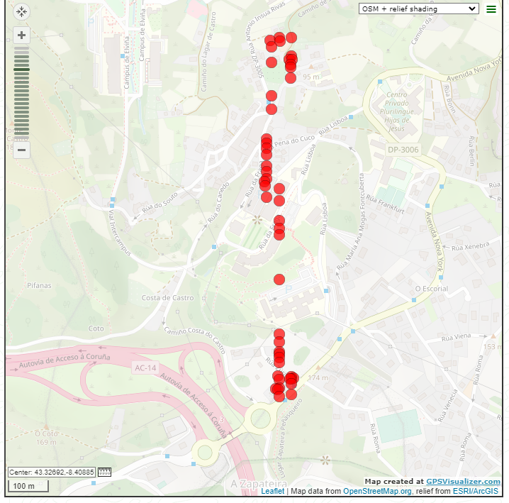
Suspects ID 3 and 13
168.41657051367866 meters away from each other at 4pm on 12/13

Slide 5
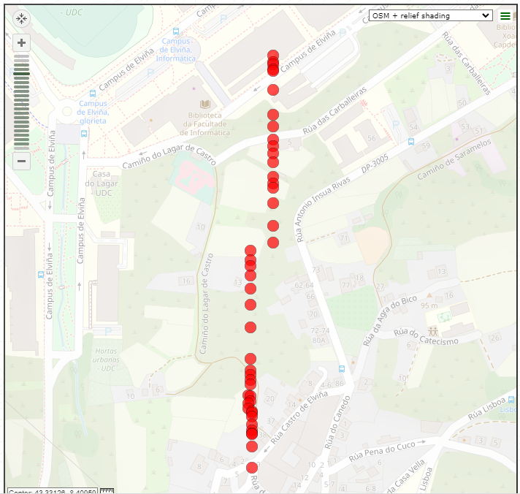
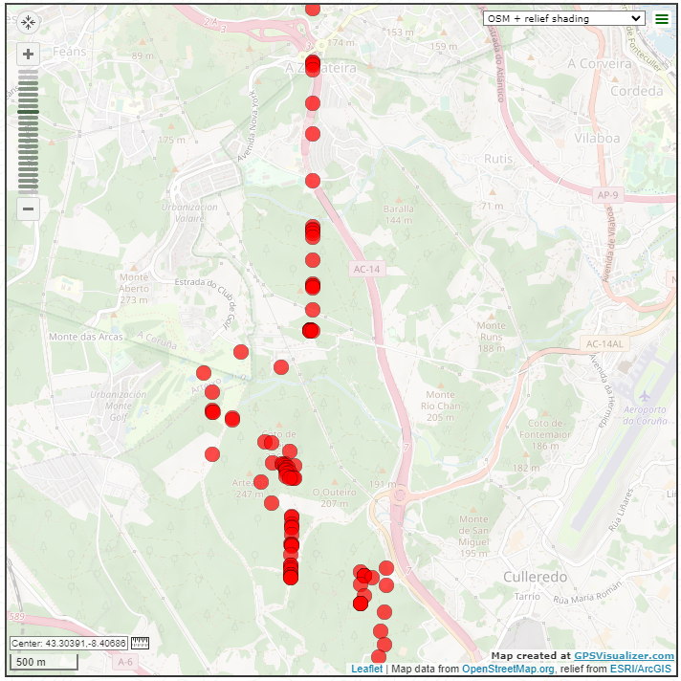
Suspects ID 12 and 18
107.38879720503698 meters away from each other at 9pm on 12/12

Slide 6
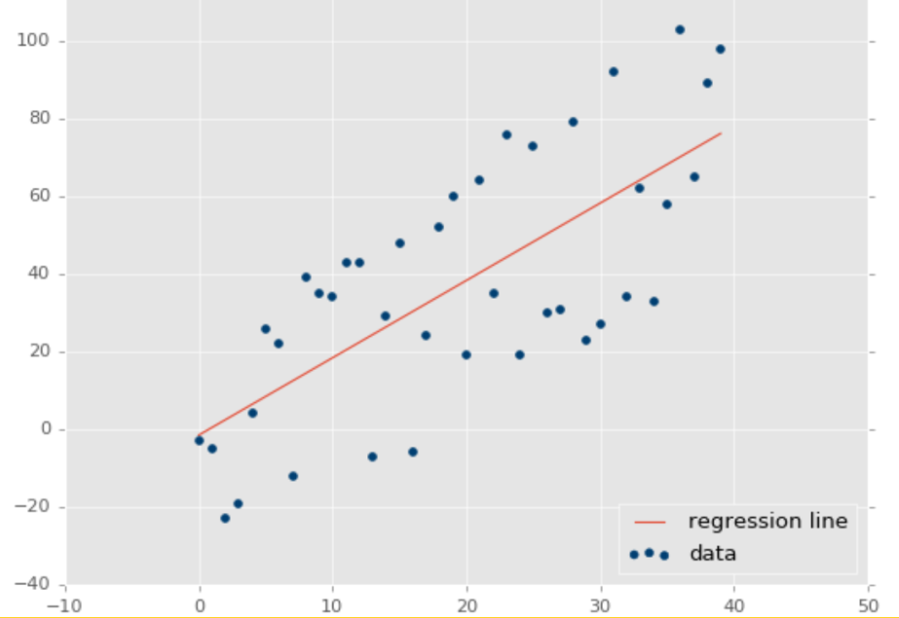
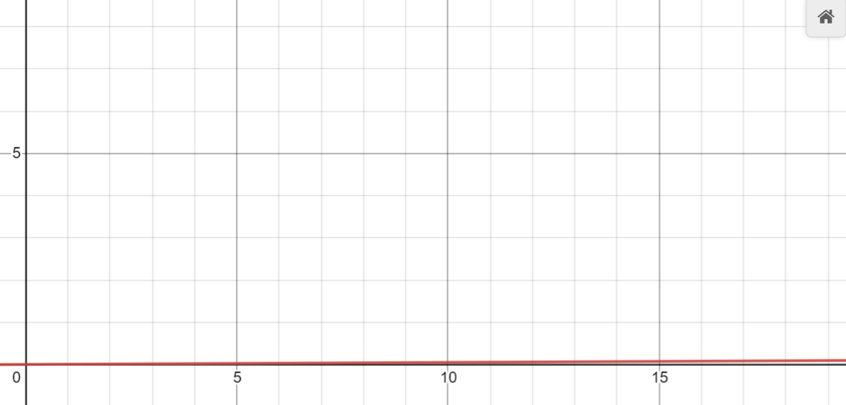
Calculating Correlation of Activity, Time, and Location Using Linear Regression
Using a linear regression model from sci-kit learn, there is a 0.005 coefficient of determination from time and location to activity type
Worst case = 0, Best case = 1
Conclusion: There is a low linear correlation between activity type and time/location
High correlation:
Calculated correlation:

Slide 7
Calculating Correlation of Activity, Time, and Location Using SVM’s
Using a Support Vector Machine with rbf kernel from sci-kit learn, there is a .5 accuracy on guessing the activity type
Worst case = 0, Best case = 1
The SVM model was able to guess correctly the activity of a person given only their timestamp and location 50% of the time
Conclusion: There is a positive non-linear correlation between activity type and time/location

Slide 8
Calculating Correlation of Activity, Time, and Location Using Random Forest Regression
Using a Random Forest Regression model from sci-kit learn, there is a .917 accuracy on guessing the activity type
Worst case = 0, Best case = 1
The Random Forest Regression model was able to guess correctly the activity of a person given only their timestamp and location 91.7% of the time
Conclusion: There is a strong positive non-linear correlation between activity type and time/location

Slide 9
Calculating Correlation of Activity and all Other Data Using Linear Regression
Using a linear regression model from sci-kit learn, there is a 0.016 coefficient of determination from all other data to activity type
Worst case = 0, Best case = 1
Conclusion: There is a low linear correlation between activity type and all other data
High correlation:
Calculated correlation:

Slide 10
Calculating Correlation of Activity and all Other Data Using Random Forest Regression
Using a random forest regression model from sci-kit learn, there is a 0.998-0.989 (depending on max samples) coefficient of determination from all other data to activity type
Worst case = 0, Best case = 1
Conclusion: There is a very strong positive linear correlation between activity type and all other data

