Slide 1
Suspect Phone Analysis
Ian McNichols, Cameron Ramos, JoEnid

Slide 2
Data Analysis Techniques
Used the DataAnalyzinator 3000™ created by McNichols, Ramos, and Enid
Calculated GPS location of each suspect using phone bearing and lat/long changes over time
Grabbed any users that had locations overlapping by 250m or less at the same hour

Slide 3
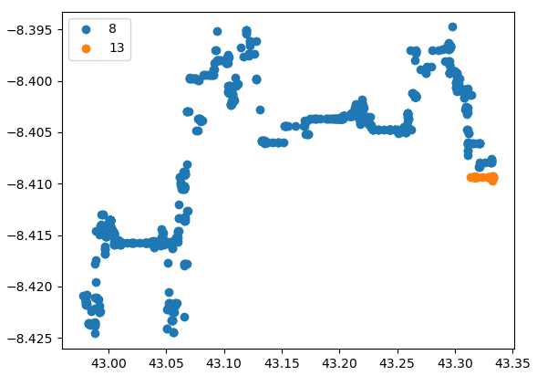
Suspects ID 8 and 13
241.16530843870947 meters away from each other at 2pm on 12/13

Slide 4
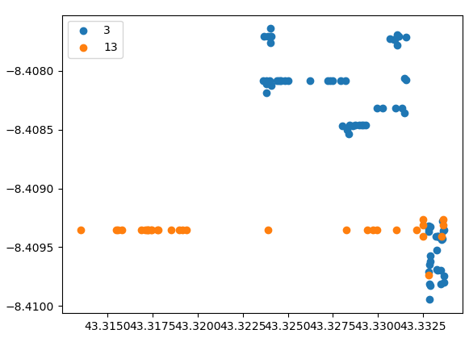
Suspects ID 3 and 13
168.41657051367866 meters away from each other at 4pm on 12/13

Slide 5
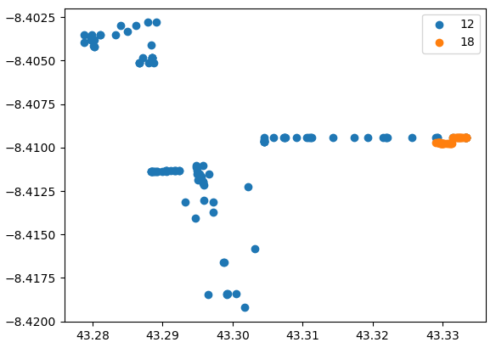
Suspects ID 12 and 18
107.38879720503698 meters away from each other at 9pm on 12/12

Slide 6
Calculating Correlation of Activity + Location
Used 3 separate correlation coefficient calculations from scipy:
Spearman
Kendall
Pearson
Correlation between latitude and activity less than .18
Correlation between longitude and activity less than .07
Conclusion: No correlation between activity and latitude or longitude separately

Slide 7
Calculating Correlation of Activity + Timestamp
Used same 3 correlation coefficient calculations from scipy:
Spearman
Kendall
Pearson
Correlation between time and activity .96, .69, .86
Conclusion: Positive correlation between activity and time

