Slide 1
Suspect Phone Analysis
Ian McNichols, Cameron Ramos, JoEnid

Slide 2
Data Analysis Techniques
Used custom Python script created by McNichols, Ramos, and Enid
Calculated GPS location of each suspect using phone bearing and lat/long changes over time
Grabbed any users that had locations overlapping by 250m or less at the same hour
Process Data
Compare Times
Sort data by the hour it was collected
Compare Locations
Find any data at the same time with similar locations
Calculate GPS coordinates from final location and Lat/Long delta

Slide 3
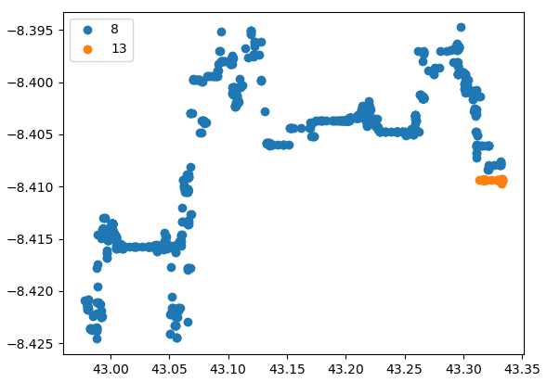
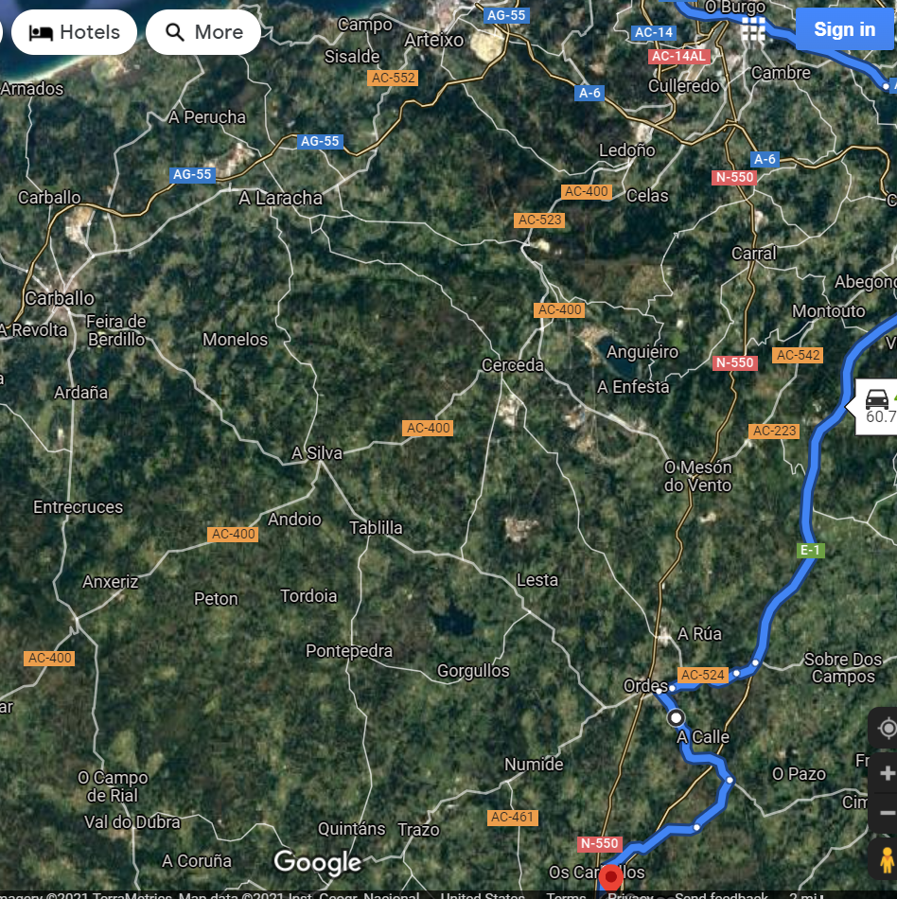
Suspects ID 8 and 13
241.16530843870947 meters away from each other at 2pm on 12/13

Slide 4
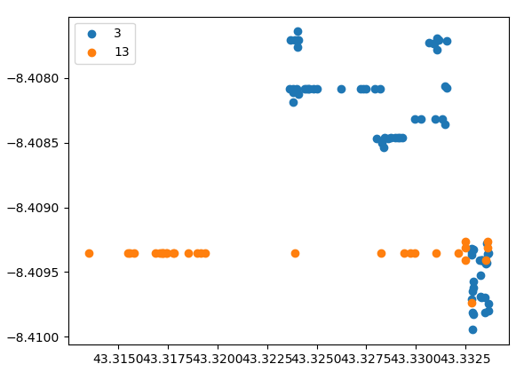
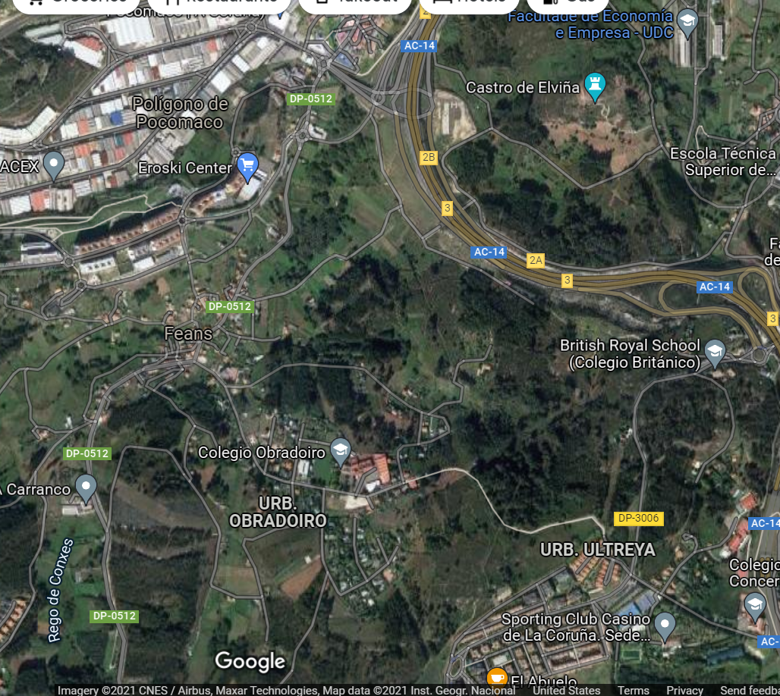
Suspects ID 3 and 13
168.41657051367866 meters away from each other at 4pm on 12/13

Slide 5
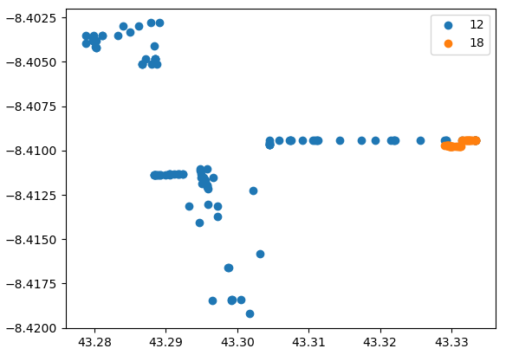
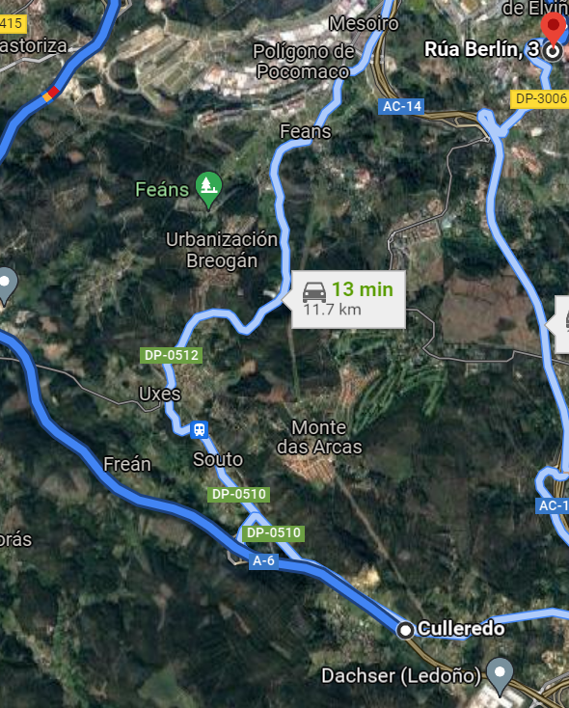
Suspects ID 12 and 18
107.38879720503698 meters away from each other at 9pm on 12/12

Slide 6
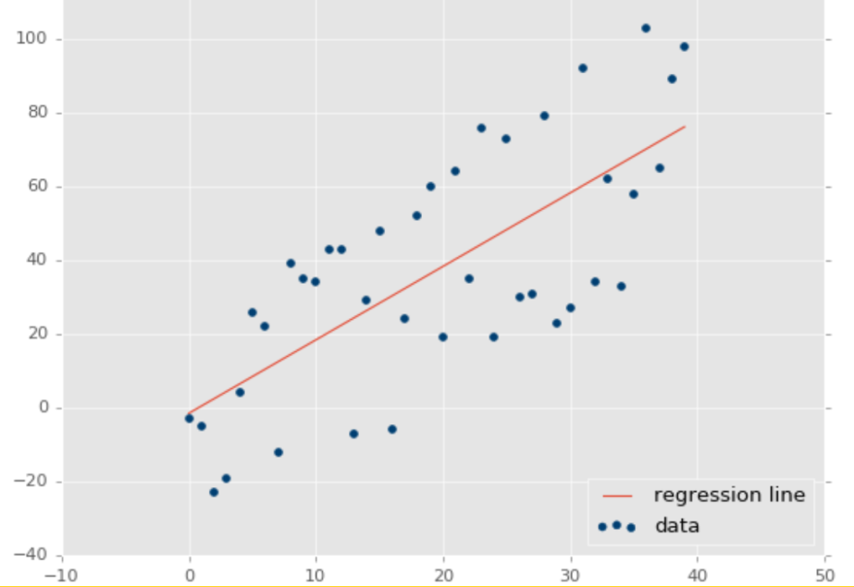
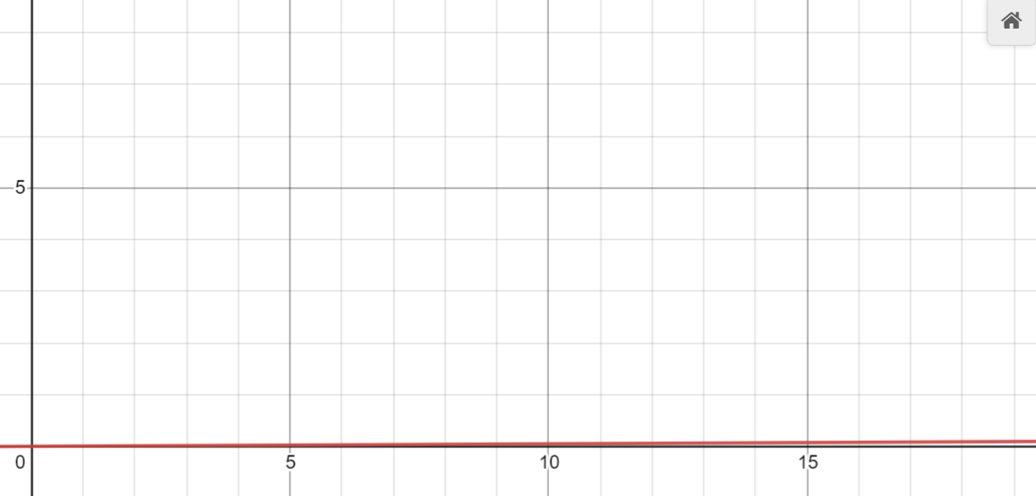
Calculating Correlation of Activity, Time, and Location
Using a linear regression model from sci-kit learn, there is a 0.005 coefficient of determination from time and location to activity type
Worst case = 0, Best case = 1
Conclusion: There is a low correlation between activity type and time/location
High correlation:
Calculated correlation:

