Slide 1
Suspect Phone Analysis
Ian McNichols, Cameron Ramos, JoEnid

Slide 2
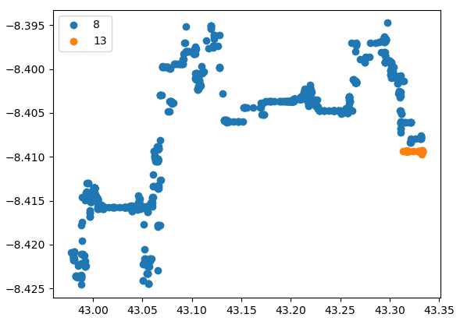
Suspects ID 8 and 13
241.16530843870947 meters away from each other at 2pm on 12/13

Slide 3
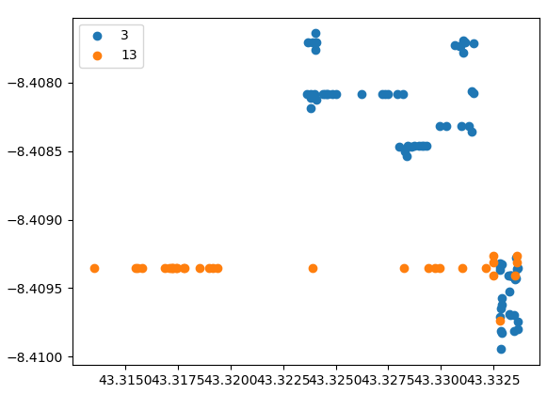
Suspects ID 3 and 13
168.41657051367866 meters away from each other at 4pm on 12/13

Slide 4
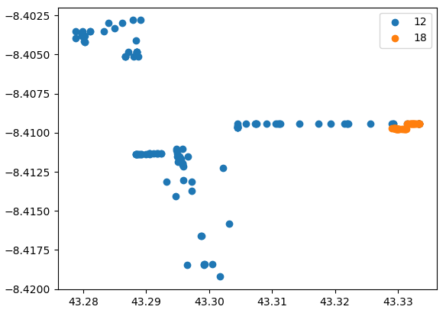
Suspects ID 12 and 18
107.38879720503698 meters away from each other at 9pm on 12/12

