Slide 1
Detecting Breast Cancer Based on Characteristics of Cell Nuclei
Ian Logan

Slide 2
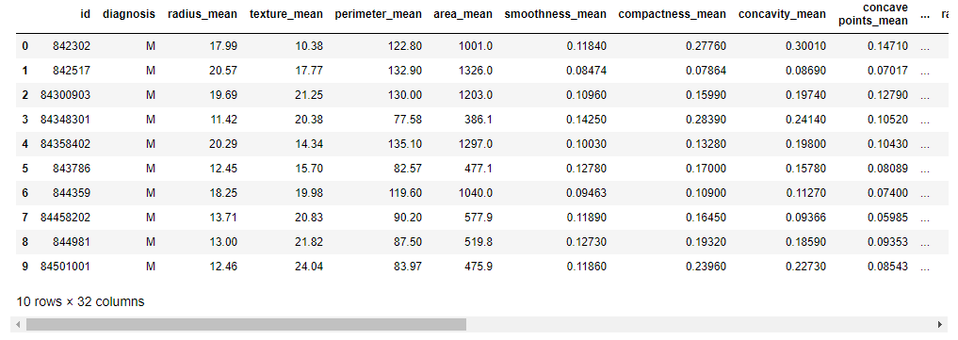
The Data
569 rows and 32 columns
Features describe characteristics of cell nuclei present in samples of breast mass tissue.

Slide 3
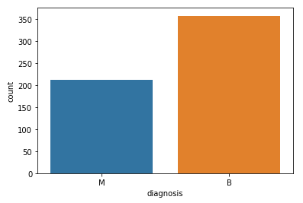
Exploring The Data
M = Malignant, B = Benign

Slide 4

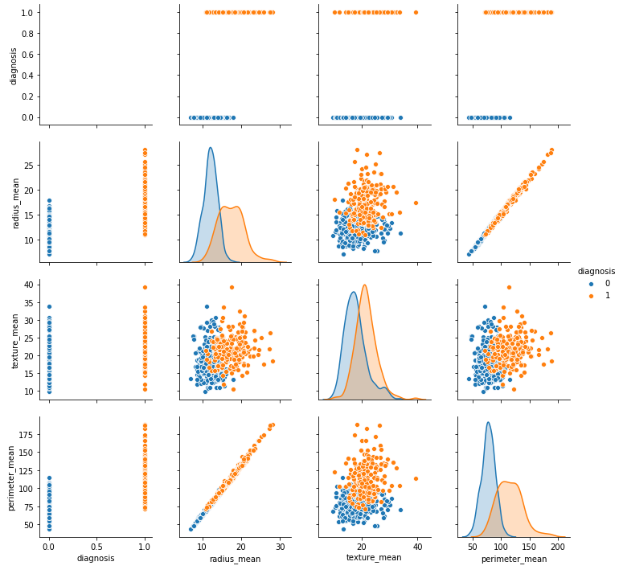
Exploring The Data

Slide 5
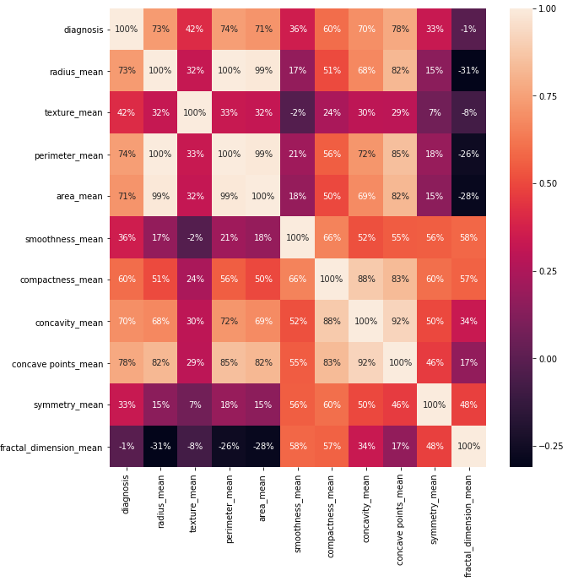
Exploring The Data

Slide 6
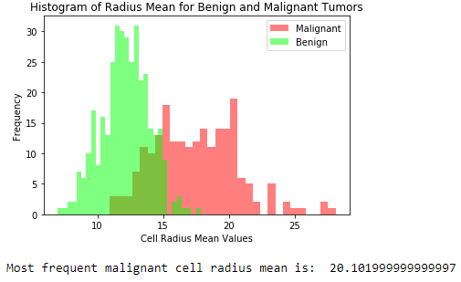
Exploring The Data
Radius Mean is the average distance from the center of the cell nucleus to the perimeter.

Slide 7
Training the Model
Split data into 75% training and 25% testing sets
Tested Model Accuracy on Training Data
Logistic Regression = .990610
Decision Tree = 1.0
Random Forest Classifier = .995305

Slide 8
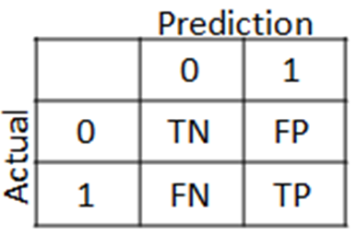
Testing the Model
Model Accuracy on Testing Data
Logistic Regression = .951049
[86 4]
[4 49]
Decision Tree = .937063
[84 6]
[1 52]
Random Forest Classifier = .965035
[87 3]
[2 51]
Best

Slide 9
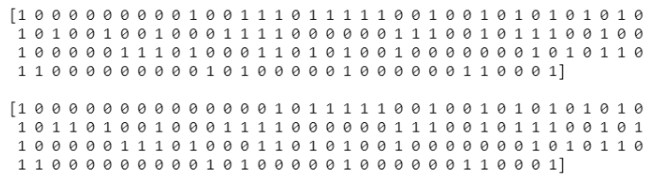
Random Forest Model vs Actual
Top: Random Forest Model, Bottom: Actual Patients

Slide 10
Questions
?

