Slide 1
TIME SERIES ANALYSIS

Slide 2
LEARNING OBJECTIVES
TIME SERIES ANALYSIS
Understand what time series data is and what is unique about it
Perform time series analysis in Pandas including rolling mean/median and autocorrelation

Slide 3
TIME SERIES ANALYSIS
In this class, we’ll discuss analyzing data that is changing over time.
In most of our previous examples, we didn’t care which data points were collected earlier or later than others.
We made assumptions that the data was not changing over time.
This class will focus on statistics around data that is changing over time and how to measure that change.

Slide 4
TIME SERIES ANALYSIS
In this lesson, we will focus on Identifying problems related to time series.
Additionally, we will discuss the unique aspects of Mining and Refining time series data.

Slide 5
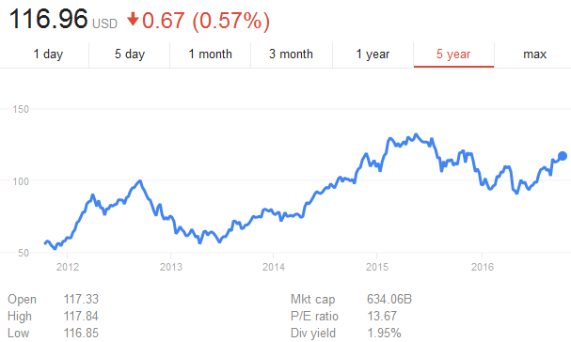
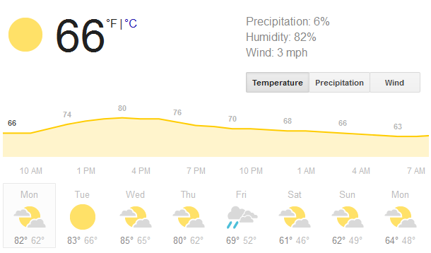
WHAT IS TIME SERIES DATA?
Time series data is any data where the individual data points change over time.
This is fairly common in sales and other business cases, as well as physical sciences where data would likely change according to seasons and trends.

Slide 6
WHAT IS TIME SERIES DATA?
Most datasets are likely to have an important time component, but typically we assume that it’s fairly minimal.
For example, if we were analyzing salaries in an industry, it’s clear that salaries shift over time and vary with the economic period.
However, if we are examining the problem on a smaller scale (e.g. 3-5 years), the effect of time on salaries is much smaller than other factors, like industry or position.

Slide 7
WHAT IS TIME SERIES DATA?
When the time component is important, we need to focus on identifying the aspects of the data that are influenced by time and those that aren’t.
Typically, time series data will be a sequence of values. We will be interested in studying the changes to this series and how related individual values are.
For example, how much does this week’s sales affect next week’s? How much does today’s stock price affect tomorrow’s?

Slide 8

ACTIVITY: KNOWLEDGE CHECK
ANSWER THE FOLLOWING QUESTIONS
EXERCISE
Think about the various datasets we’ve used so far. For each dataset, identify the time components of those datasets. What time related features might be important to our analysis?
What data have you worked with or seen that would be considered time series data?
What was the most frustrating part of working with this time series data?

Slide 9
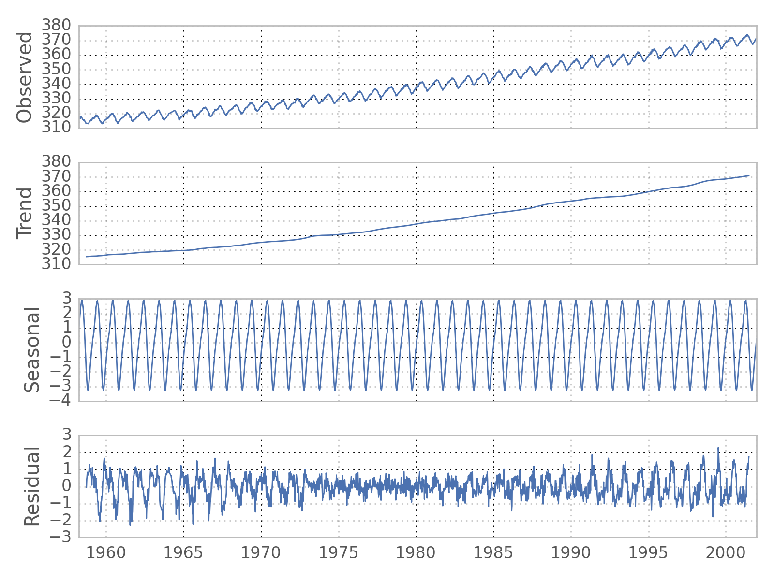
TREND AND SEASONALITY
Much of time series analysis focuses on separating the effects of time on our data into two main components.
Trend – significant, sustained increases or decreases in our data
Seasonality – regular, repeated patterns in our data

Slide 10
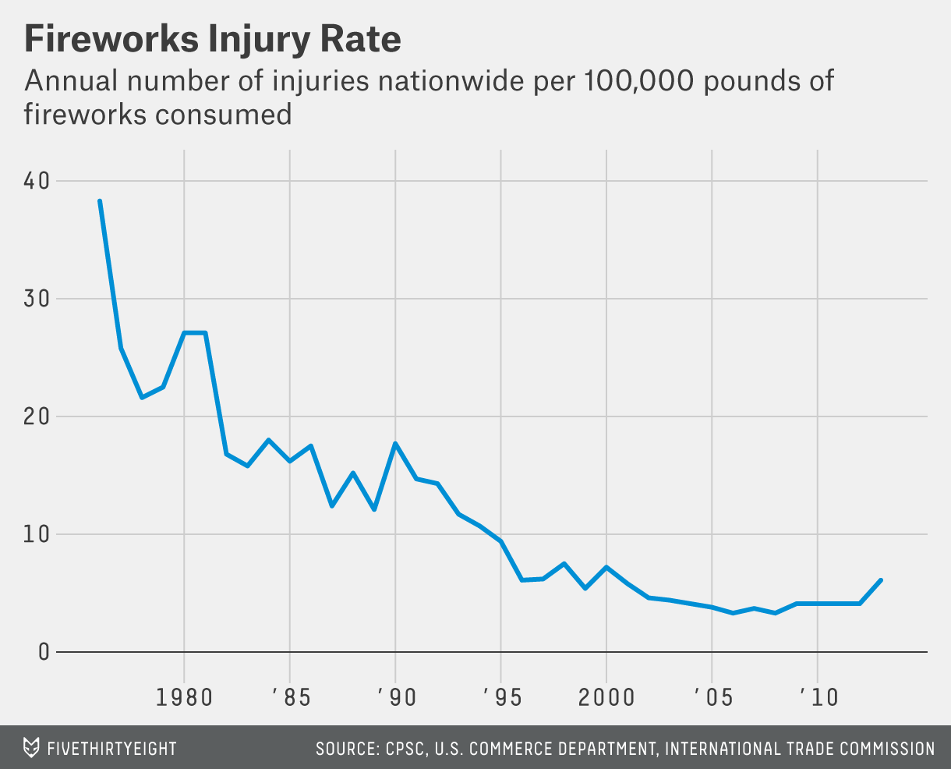
SEASONALITY
This plot of fireworks injury rates has an overall trend of fewer injuries with no seasonal pattern.

Slide 11
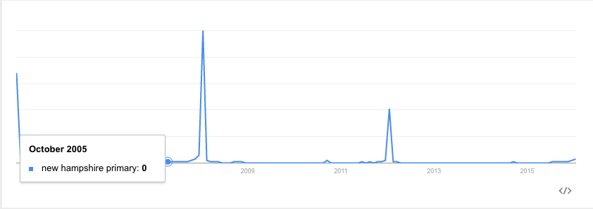
SEASONALITY
Meanwhile, the number of searches for the New Hampshire Primary has a clear seasonal component - it peaks every four years and on election years.

Slide 12
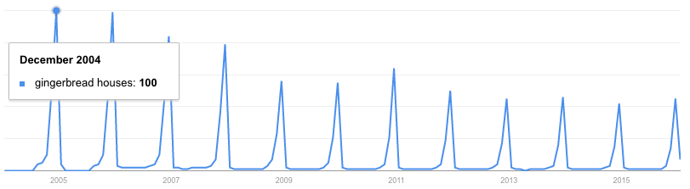
SEASONALITY
Similarly, searches for ‘gingerbread houses’ spike every year around the holiday season.
These spikes recur on a fixed time-scale, making them seasonal patterns.

Slide 13
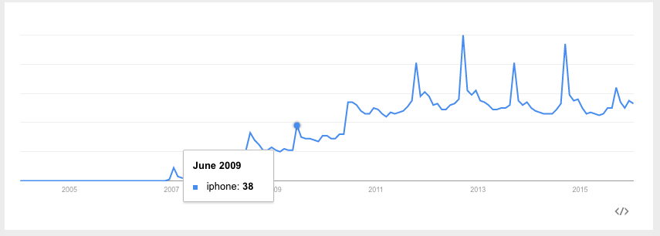
SEASONALITY AND TREND
Searches for “iphone” have both a general trend upwards (indicating more popularity for the phone) as well as a seasonal spike in September (which is when Apple typically announces new versions).

Slide 14
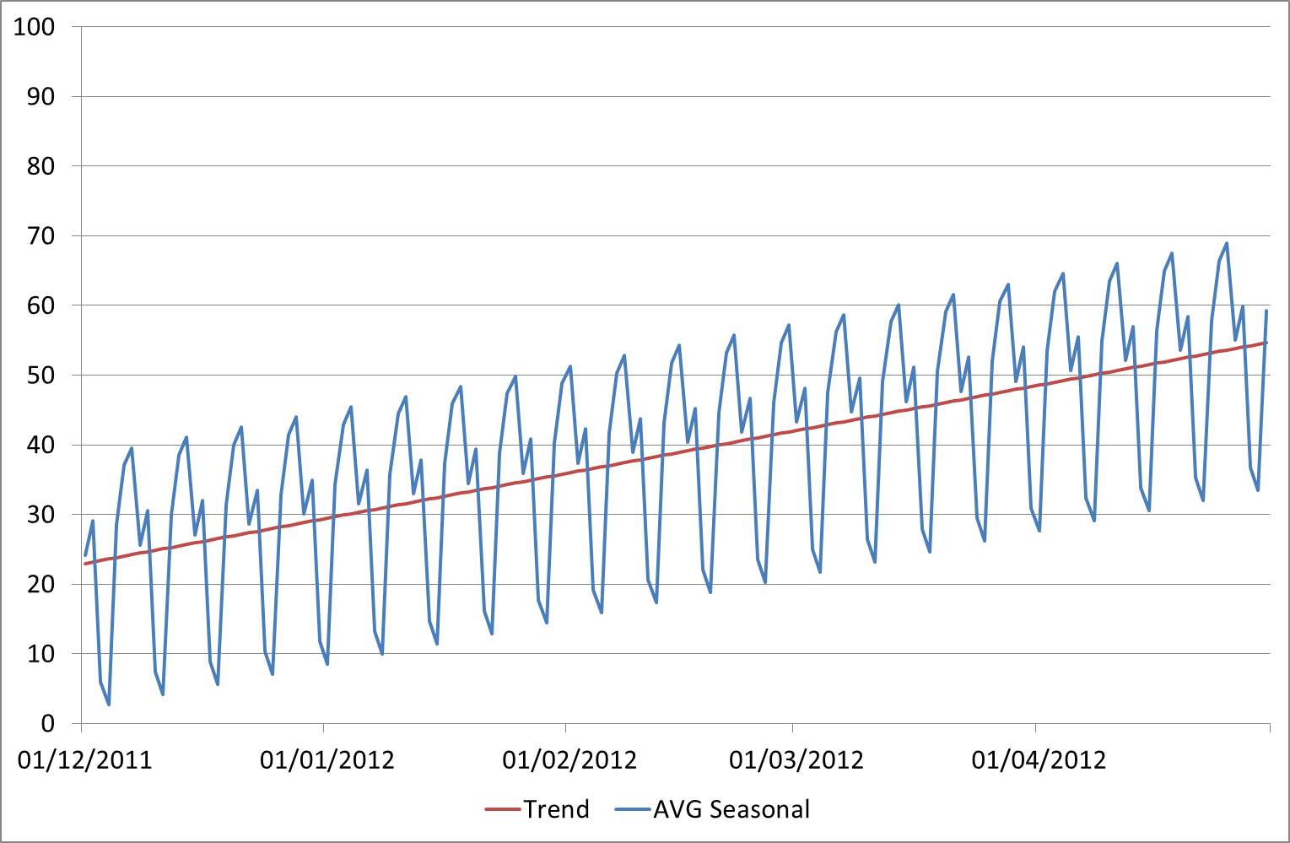
SEASONALITY AND TREND
Most often, we’re interested in studying the trend and not the seasonal fluctuations.
Therefore it is important to identify whether we think a change is due to an ongoing trend or seasonal change.

Slide 15
ACTIVITY: KNOWLEDGE CHECK
ANSWER THE FOLLOWING QUESTIONS
EXERCISE
Discuss one or two more time series examples from Google Trends..
Identify relevant trends and seasonal patterns.

Slide 16
COMMON ANALYSIS FOR TIME SERIES DATA

Slide 17
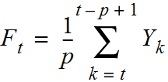
MOVING AVERAGES
A moving average replaces each data point with an average of k consecutive data points in time.
Typically, this is k/2 data points prior to and following a given time point, but it could also be the k preceding points.
These are often referred to as the “rolling” average.
The measure of average could be mean or median.
The formula for the rolling mean is

Slide 18
MOVING AVERAGES
A rolling mean would average all values in the window, but can be skewed by outliers (extremely small or large values).
This may be useful if we are looking to identify atypical periods or we want to evaluate these odd periods.
For example, this would be useful if we are trying to identify particularly successful or unsuccessful sales days.
The rolling median would provide the 50 percentile value for the period and would possibly be more representative of a “typical” day.

Slide 19
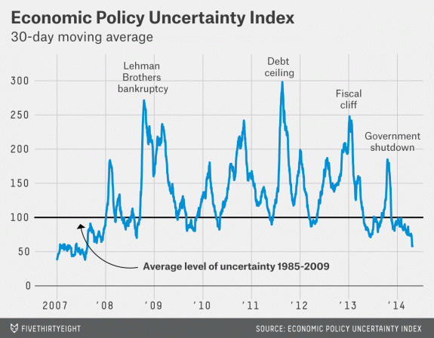
MOVING AVERAGES
This plot shows the 30-day moving average of the Economic Uncertainty Index.
Plotting the moving average allows us to more easily visualize trends by smoothing out random fluctuations and removing outliers.

Slide 20
MOVING AVERAGES
While this statistic weights all data evenly, it may make sense to weight data closer to our date of interest higher.
We do this by taking a weighted moving average, where we assign weights to certain time points.
Various formulas or schemes can be used to weight the data points.

Slide 21
MOVING AVERAGES
While this statistic weights all data evenly, it may make sense to weight data closer to our date of interest higher.
We do this by taking a weighted moving average, where we assign weights to certain time points.
Various formulas or schemes can be used to weight the data points.

Slide 22
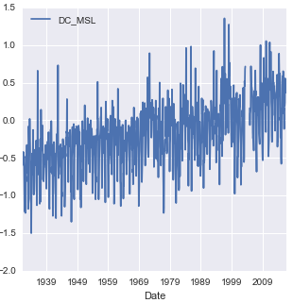
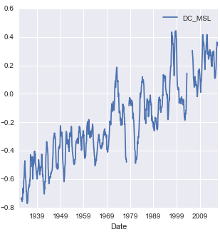
MOVING AVERAGES
The reason why moving averages are so popular is because they smooth out the noise in our data to give a clearer picture of the overall trend.
Moving Average
(with Window 12)

Slide 23
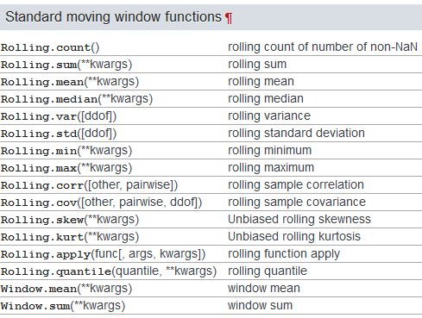
MOVING AVERAGES
If you have Pandas >= 0.18.0 installed, the syntax for these function (and some of the later ones) is similar but slightly different.

Slide 24
MOVING AVERAGES
While moving averages weight all data within our window evenly, it may make sense to weight data closer to our date of interest higher. This would indicate that the present is worth more to our calculation than the past.
We do this by taking a weighted moving average, where we assign particular weights to certain time points.
Various formulas or schemes can be used to weight the data points, the most common weighting is an exponential weighted moving average (EWMA) where we give increasingly less weight to older data points.

Slide 25
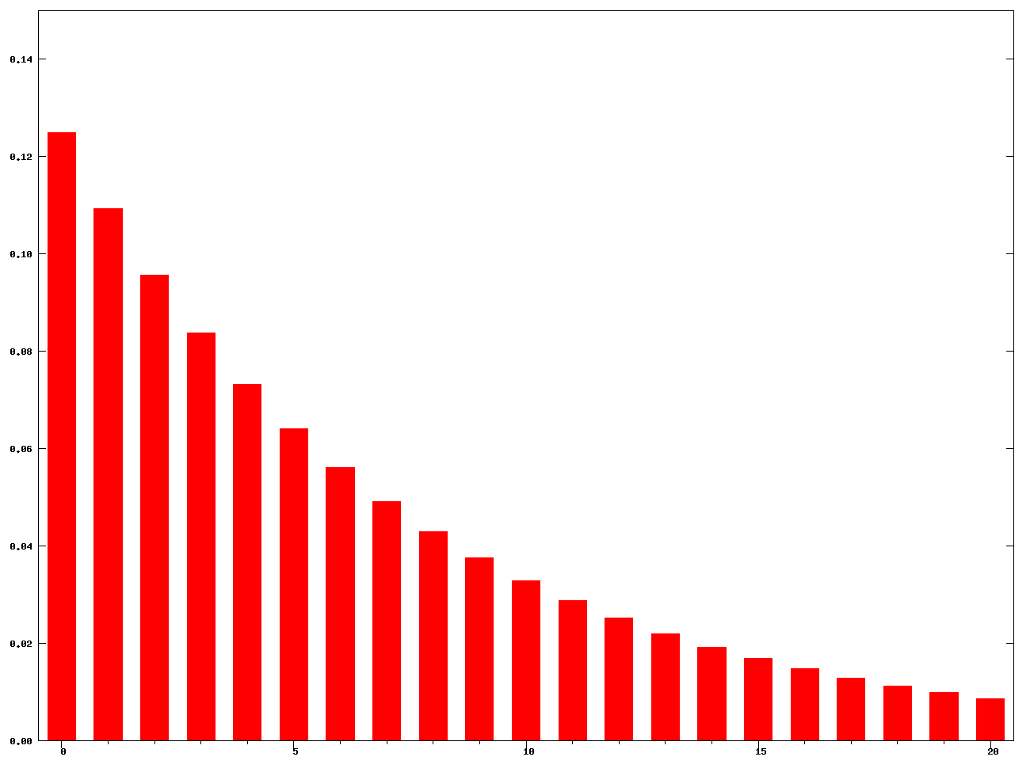
MOVING AVERAGES
The weights for an exponential weighted moving average with k = 15.

Slide 26
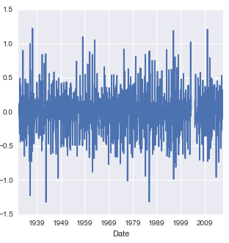
MOVING DIFFERENCES
Often, it can also be useful to calculate the moving/rolling differences to identify the change between past and current observations.
Moving Difference
(with Periods 1)

Slide 27
AUTOCORRELATION
In previous classes, we have been concerned with how two variables are correlated (e.g. height and weight, education and salary).
Autocorrelation is how correlated a variable is with itself. Specifically, how related are variables earlier in time with variables later in time.

Slide 28
AUTOCORRELATION
To compute autocorrelation, we fix a “lag” k. This is how many time points earlier we should use to compute the correlation.
A lag of 1 computes how correlated a value is with the prior one. A lag of 10 computes how correlated a value is with one 10 time points earlier.

Slide 29
AGGREGATION
It may also be useful to aggregate our data along specific timeframes such as turning monthly data into annual data as this removes any intra-annual seasonality.
In order to do this, we’ll need to specify a summary statistic to aggregate with though (e.g. average).

Slide 30
TIME SERIES MODELING

Slide 31
TIME SERIES MODELING
With a sequence of values (a time series), we will use the techniques in this class to predict a future value.
There are many times when you may want to use a series of values to predict a future value.
The number of sales in a future month
Anticipated website traffic when buying a server
Financial forecasting
The number of visitors to your store during the holidays

Slide 32
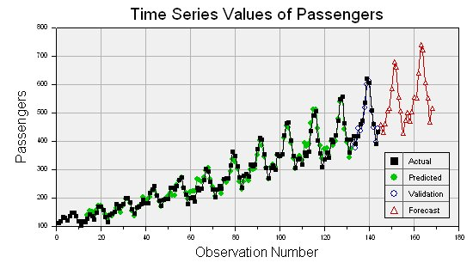
WHAT ARE TIME SERIES MODELS?
Time series models are models that will be used to predict a future value in the time series.
Like other predictive models, we will use prior history to predict the future.
Unlike previous models, we will use the earlier in time outcome variables as inputs for predictions.

Slide 33
WHAT ARE TIME SERIES MODELS?
Like previous modeling exercises, we will have to evaluate the different types of models to ensure we have chosen the best one.
We will want to evaluate on a held-out set or test data to ensure our model performs well on unseen data.

Slide 34
WHAT ARE TIME SERIES MODELS?
Unlike previous modeling exercises, we won’t be able to use standard cross-validation for evaluation.
Since there is a time component to our data, we cannot choose training and test examples at random.
Suppose we did select a random 80% sample of data points for training and a random 20% for testing. What could go wrong?

Slide 35
WHAT ARE TIME SERIES MODELS?
The training dataset would likely contain data from before AND after a test dataset.
This would not be possible in real life (you can’t use future, unseen data points when building your model). Therefore, it’s not a valid test of how our model would perform in practice.

Slide 36
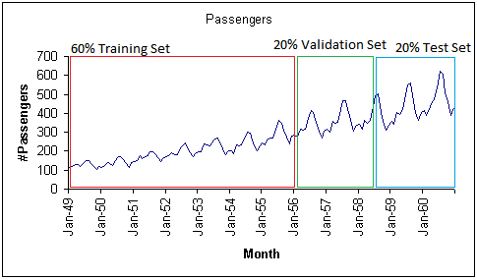
WHAT ARE TIME SERIES MODELS?
Instead, we will exclusively train on values earlier (in time) in our data and test our model on values at the end of the data period.

