Slide 1

Lamay.ai Process Analysis
Meriplex Communications
10111 Richmond Avenue
Suite 500
Houston, TX 77042
http://www.meriplex.com

Slide 2
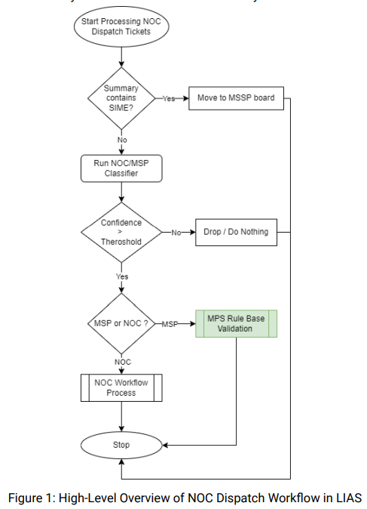
NOC Dispatch Workflow
In this deployment, the tickets identified as MPS tickets will first pass through a validation system before being moved to the MPS board. The validation system looks for keywords identified by the Leamy.ai team. When the system finds any keywords in the ticket, it will apply the default workflow. If no keyword is found, it will move the ticket to the MPS board.
A high-level change in the LIAS system can be seen in Figure 1. The change is highlighted in green.
The list of keywords used by the MPS rule-based validation system is listed in Table 2, ID 7

Slide 3
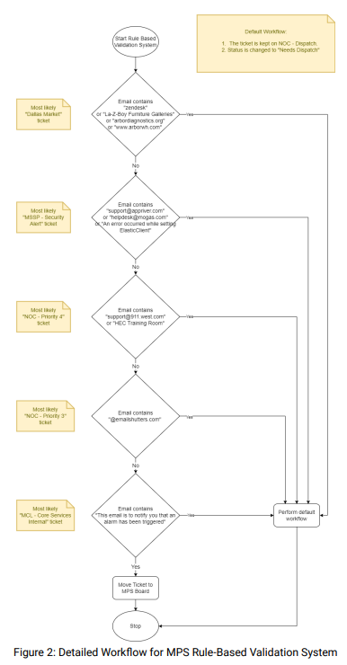
MPS Rule-Based Validation
Detailed processing of the MPS Rule-Based Validation system can be seen in Figure 2.
The list of keywords used by the MPS rule-based validation system is listed in Table 2, ID 7

Slide 4
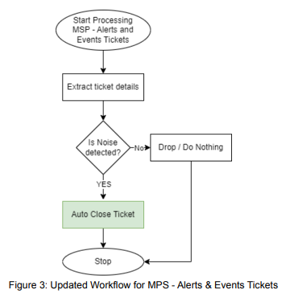
MPS Alerts & Events Tickets
The tickets identified as noise on the MPS - Alerts and Events board will no longer be moved to the NOC Spam board instead will remain on the MPS – Alerts and Events board and have their status changed to “>Closed”. Further details are mentioned in
Table 2, IDs 6.1 to 6.4 and Table 3, IDs 14.0 to 14.3. Figure 3 shows the change made in the workflow highlighted in green.

Slide 5
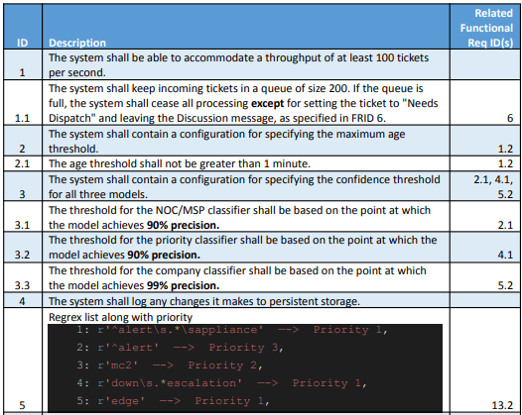
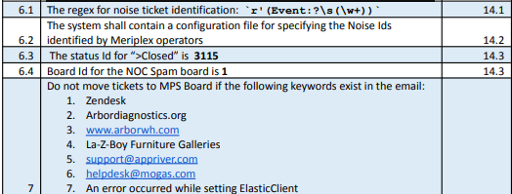

Non-Functional Requirements

Slide 6
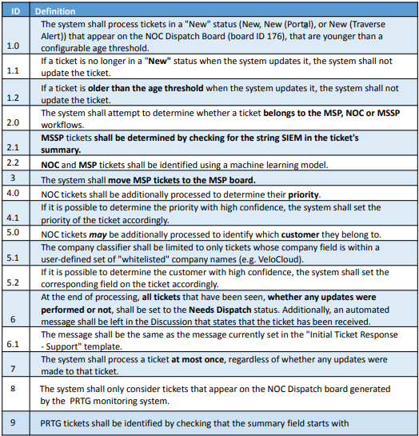
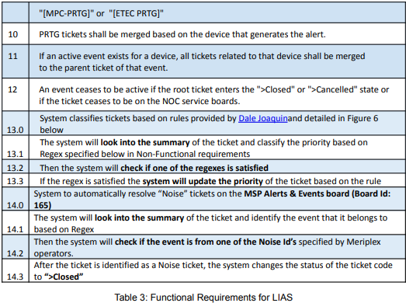
Functional Requirements

Slide 7
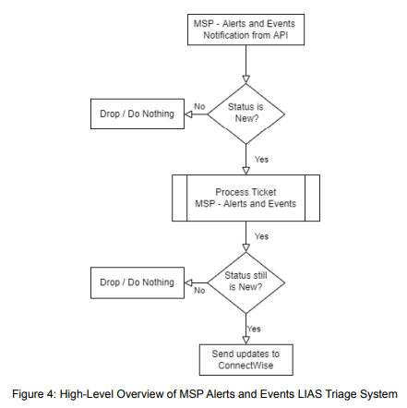
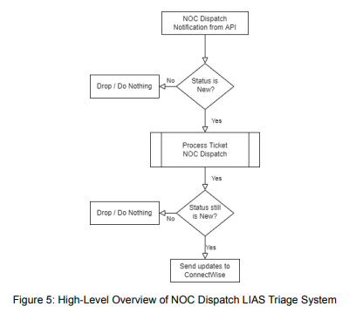
LIAS Triage System
The following flowcharts provide a high-level overview of the ticket triage logic. We have two copies of the codebase running on the production server. One copy processes the NOC Dispatch tickets, and the other processes MSP - Alerts & Events tickets for noise tickets only.
Figure 4 shows the flow of MSP - Alerts & Events ticket processing, and Figure 5 shows the flow of NOC Dispatch ticket processing.

Slide 8
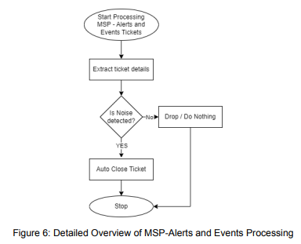
MSP Alerts & Events Processing

Slide 9
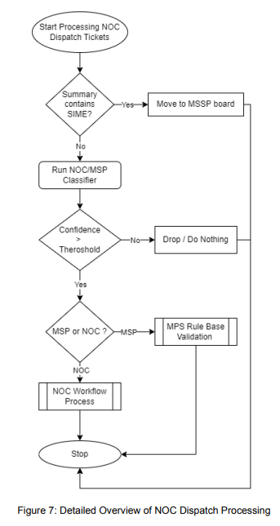
NOC Dispatch Processing

Slide 10
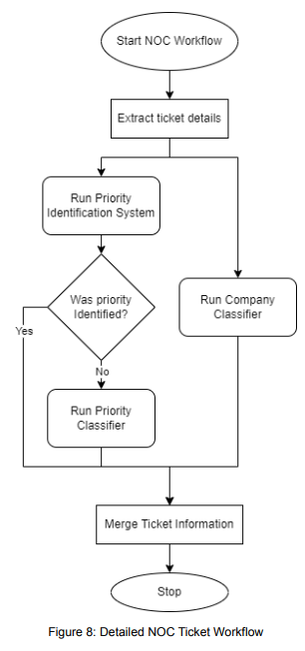
NOC Ticket Workflow

Slide 11
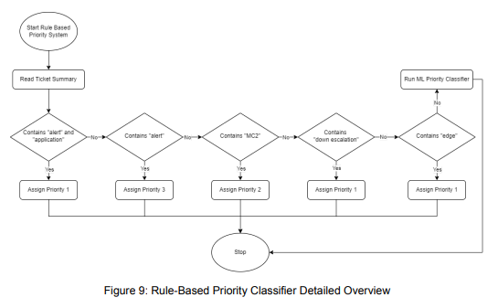
Priority Identification System
Figure 9 is a detailed overview of the “Run Priority Identification System” shown in Figure 8. The rule-based system goes from left to right to satisfy the rules. The rule that is satisfied first will assign its priority to the ticket. If no rule is satisfied, the system will run the ML model for the priority classifier.

Slide 12
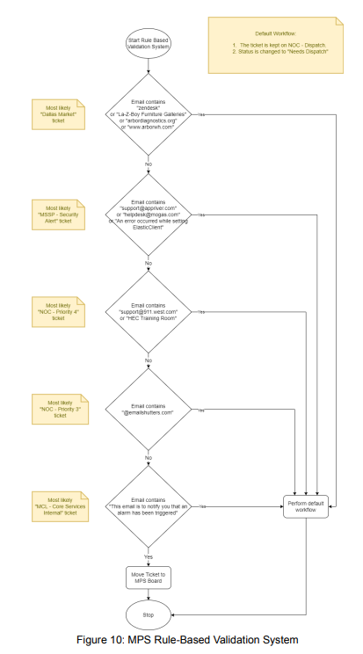
MPS Rule-Based Validation System
Figure 10 is a details overview of the “MPS Rule Based Validation” system shown in Figure 7.
This system looks for keywords in the ticket. If the keyword exists in the ticket the system will execute the default workflow and if the keyword does not exist it will move the ticket to MPS - Service Desk board.

