Slide 1
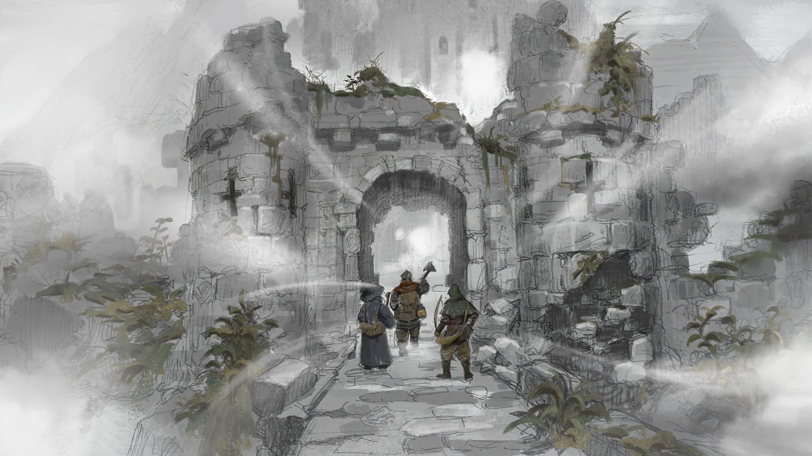
Item Value Prediction for Dark and Darker
Ian Clarke
UVic AI
February 24, 2025

Slide 2
Table of Contents
Introduction to Dark and Darker and Trading Challenges
Data Capture via Network Sniffing
Parsing and Processing Messages Using LLMs
Data Cleaning, Feature Engineering, and Model Training
Deploying a Web App with Custom OCR Pipeline

Slide 3
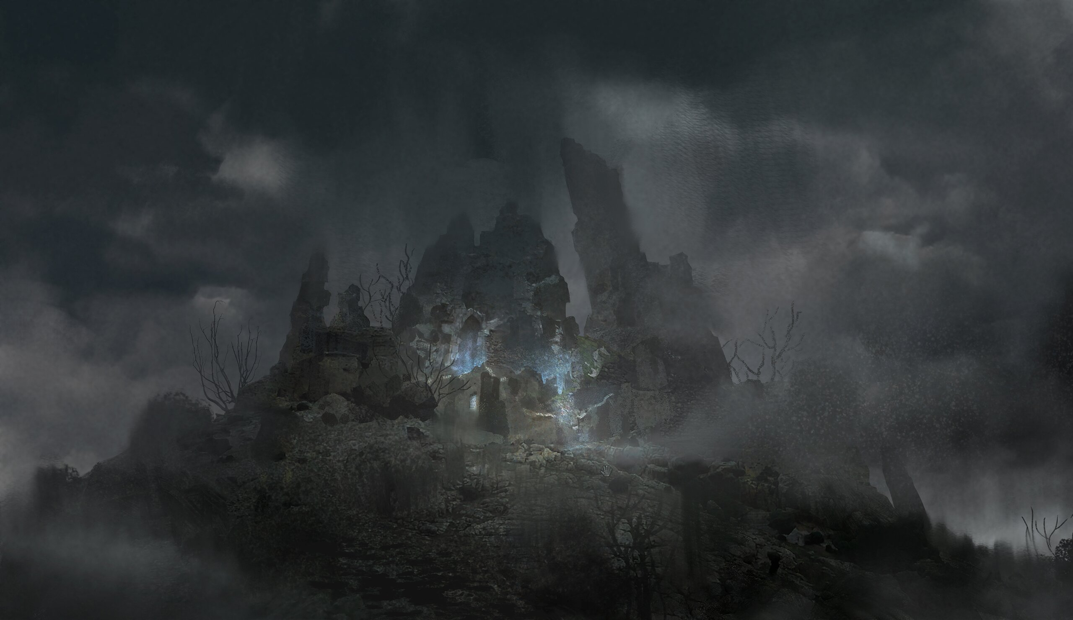
Introduction to Dark and Darker and Trading Challenges
What is Dark and Darker?
An unforgiving hardcore fantasy FPS dungeon PvPvE adventure. Band together with your friends and use your courage, wits, and cunning to uncover mythical treasures, defeat gruesome monsters, while staying one step ahead of the other devious treasure-hunters.
www.darkanddarker.com

Slide 4
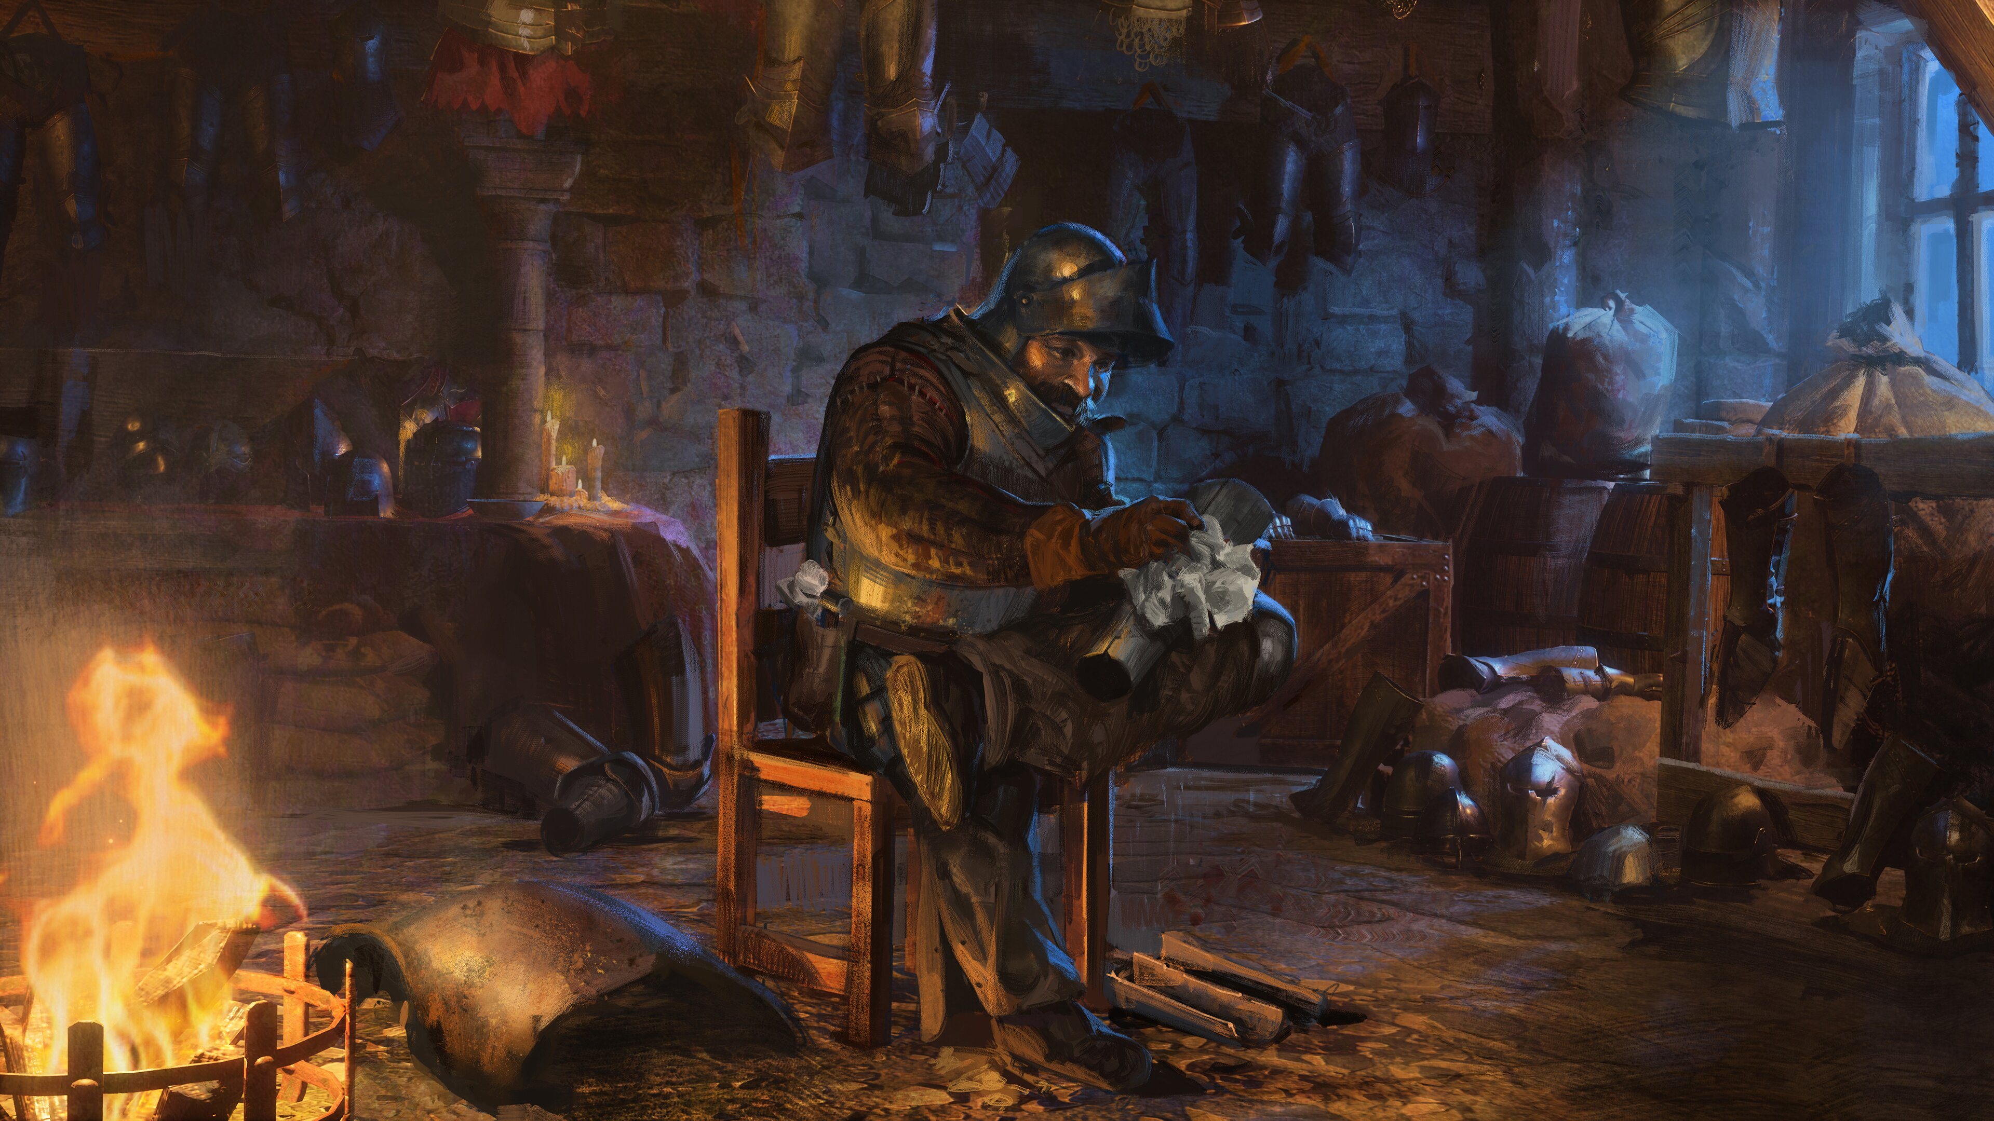
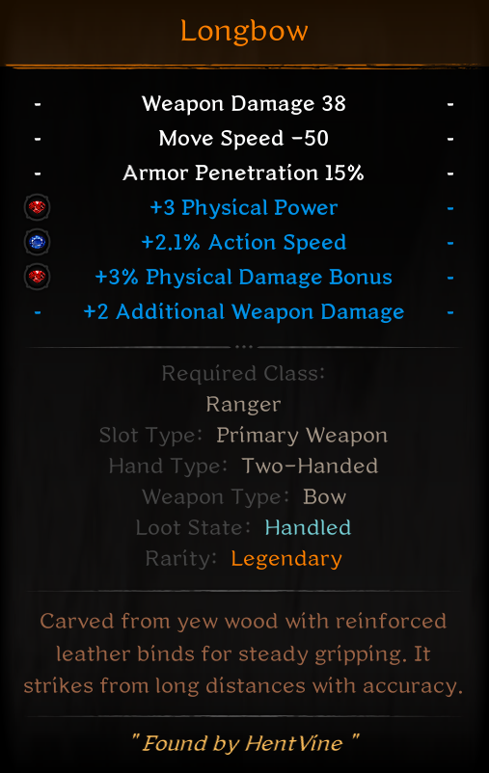
Introduction to Dark and Darker and Trading Challenges
The usefulness of these properties varies significantly, leading to substantial differences in item value.
Dark and Darker Items
Base Stats: Items core, always present
Attributes: Randomly selected additional modifiers

Slide 5
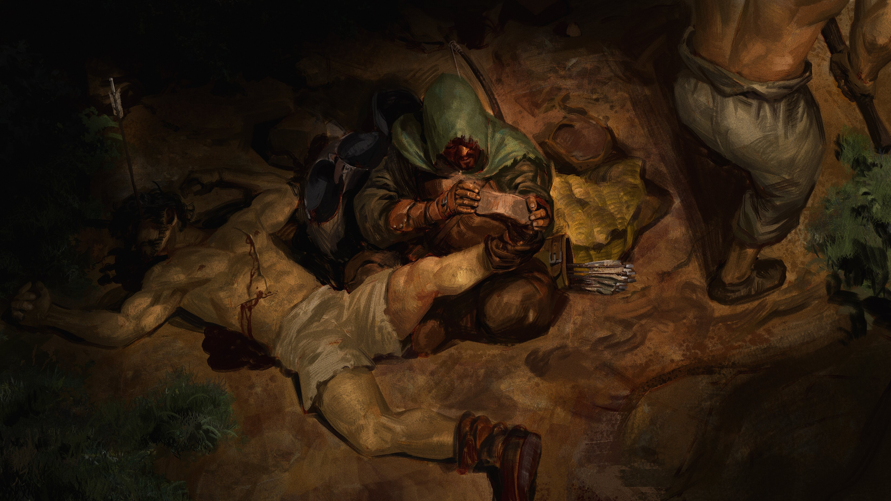
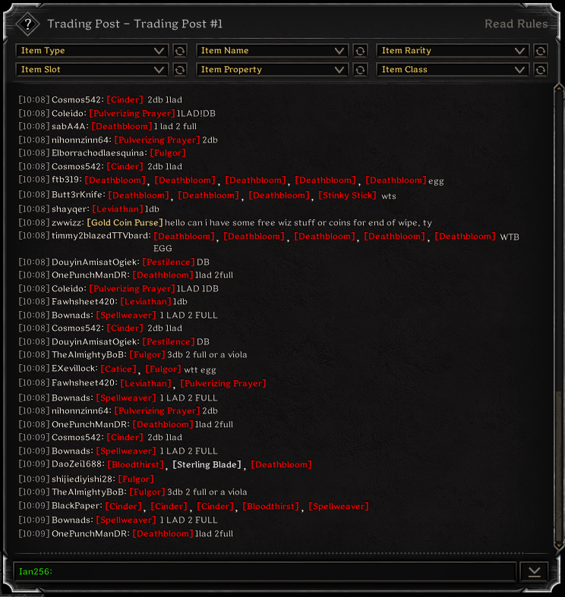
Introduction to Dark and Darker and Trading Challenges
Trading Challenges
High-value items are traded through the Trading Post by exchanging items of comparable value, but unclear pricing requires manual monitoring for accurate estimates.
Trade Post Example

Slide 6
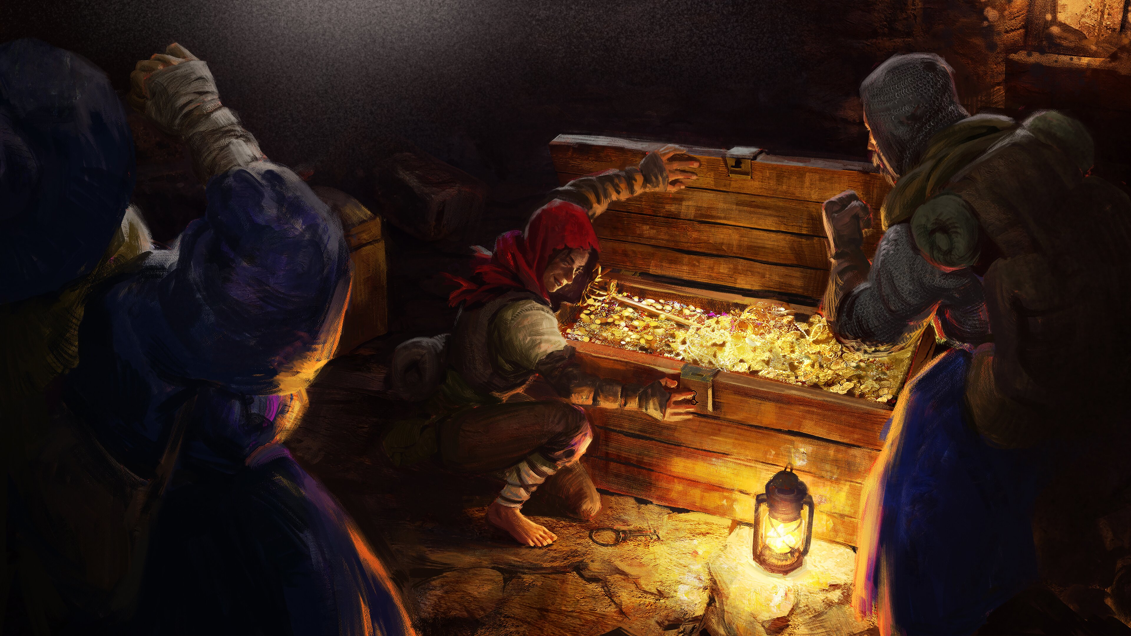
Introduction to Dark and Darker and Trading Challenges
Trading Solution
Automate Trade Post monitoring and use AI to estimate item prices. While simpler methods exist, this project explores AI as a solution.

Slide 7
Data Capture via Network Sniffing
Overview
Protocol Buffers (Protobuf) serialize structured data, and .proto files define the schema required by the compiler to encode and decode that data.
Sniff Network with Wireshark
Decode Packet using Protobuf
Proto Files
Save to JSON
Game Server
Game Client

Slide 8
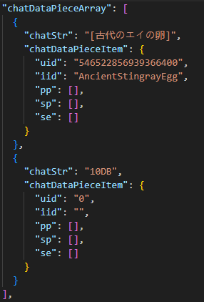
Data Capture via Network Sniffing
Output
After running the data capture overnight while monitoring the trade post, it captured ~56,000 trade messages.

Slide 9
Parsing and Processing Messages Using LLMs
Extracting Value Info
Manual message parsing requires programming many edge cases to get item value. LLMs can extract the value from many formats.
Items are traded using common currencies (which change), currently “db” and “lad,” short for Death Bloom and Life After Death (both rare weapons) are used.

Slide 10
Parsing and Processing Messages Using LLMs
Prompt and Results
What are the number of dbs for each item?
Respond in valid JSON only.
End your JSON with ###END###.
Format example:
{{"[X]": (number of dbs for X)}}###END###
Make an entry for each item in the message, where an item is in [].
If the item/items is not priced with dbs, respond with:
{{"result": "Fail"}}###END###
Message:
{message}
Answer:
I have set up llama.cpp with the Llama server using the DeepSeek-R1-Distill-Qwen-1.5B model and am currently implementing and testing it.

Slide 11
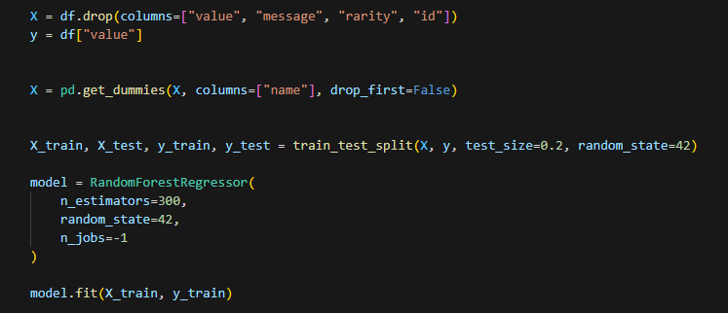
Data Cleaning, Feature Engineering, and Model Training
Overview

Slide 12
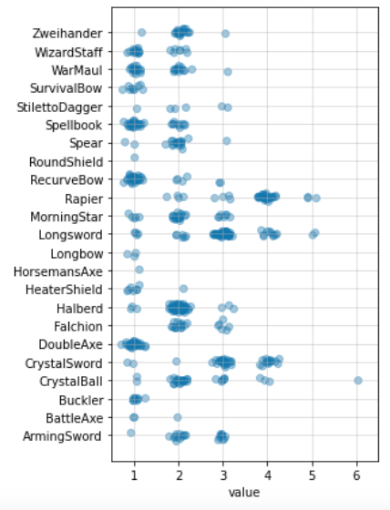
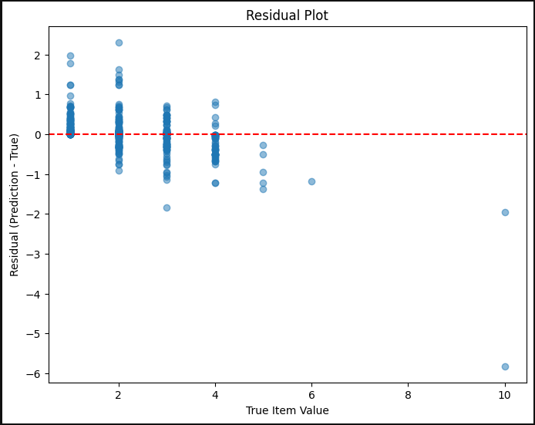
Data Cleaning, Feature Engineering, and Model Training
Results, Future Improvements

Slide 13
Deploying a Web App with Custom OCR Pipeline
Image to Text
“Weapon Damage 38
Move Speed -50
Armor Penetration 15%
+3 Physical Power
+2.1% Action Speed
+3% Physical Damage Bonus
+2 Additional Weapon Damage”
Tesseract OCR
The game’s font caused issues with the standard model, so Anders from DarkerDB created a custom model by labeling 100 item screenshots, enabling it to read the text accurately.

Slide 14
Deploying a Web App with Custom OCR Pipeline
Web Workflow
I used Python and Flask to build a simple web app that lets users upload images of their items.
User Screenshot
Flask App
OCR
Random Forest Regressor
Webpage Display

Slide 15
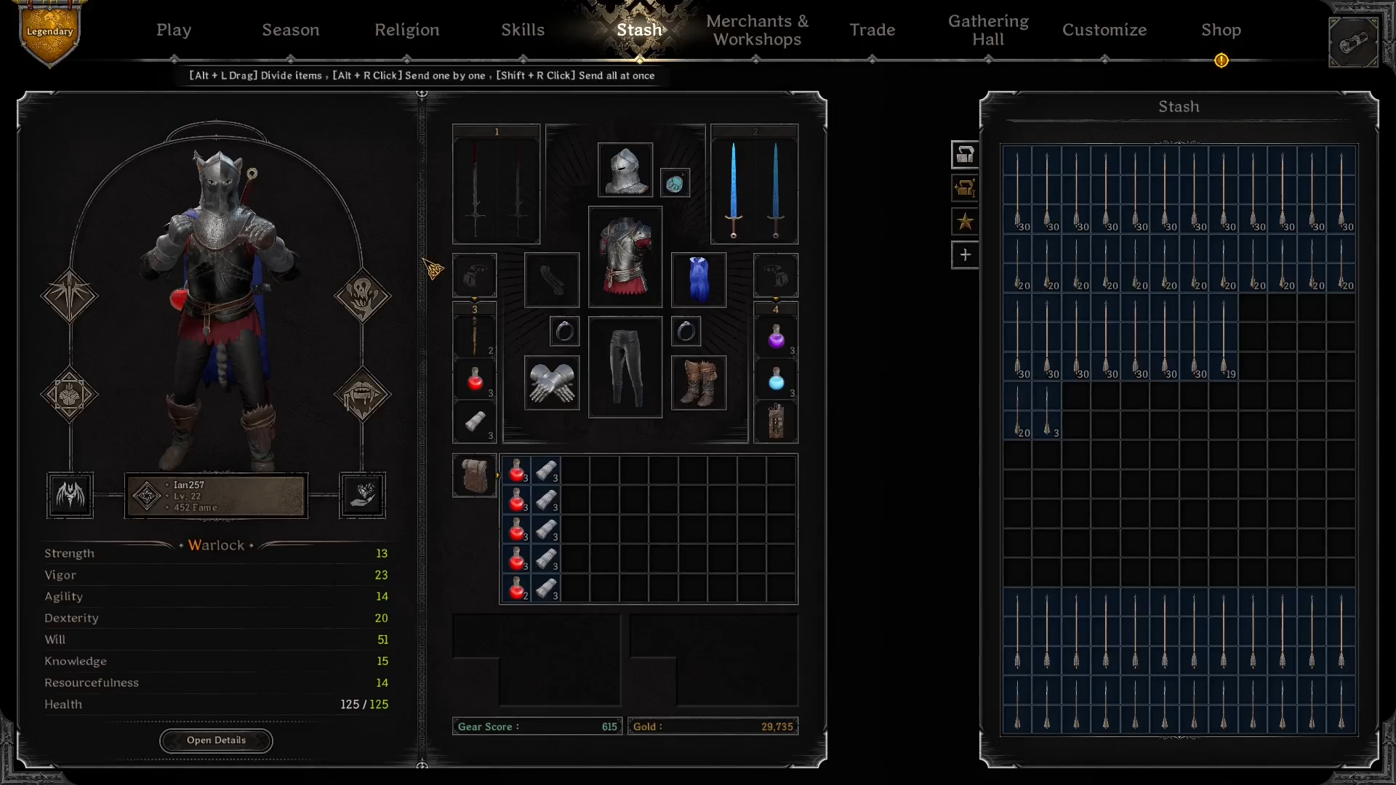
Prototype Demo

Slide 16
Resources
Github
https://github.com/ian2102/item-value-ai
Disclaimer
This project is not affiliated with or endorsed by Ironmace or Dark and Darker. Use responsibly and in accordance with the game's terms of service.
Questions?

