Slide 1
A Taxonomy of Architectural Design Decisions
Software Architecture Workshop Groningen, December 2-3, 2004

Slide 2
Presenter
Philippe Kruchten, Ph.D., P.Eng.
Professor
Department of Electrical and Computer Engineering
University of British Columbia
Vancouver, BC Canada
pbk@ece.ubc.ca

Slide 3

Architectural decision as 1st class elements
Design = Making choices
  Leonardo da Vinci : disegno
  Giambattista Vico : ingenio
  Un Dessin avec un Dessein
    “A drawing with an intent”
“Software architecture encompasses the set of significant decisions about the organization of a software system
… … (RUP, 1995)

Slide 4
Modeling the decisions
Not the design
But the decisions
Why?
Rationale
What if
Cross-cutting concerns
Political and organizational issues

Slide 5
Types of architectural design decisions
Ontocrises: existential decisions
  state what element will exist in the design
  also anticrises (ban, things that will not exist)
Diacrises: property decisions
  associate predicate to set of elements
  Cross cutting concerns, “aspects”
Pericrises: executive decisions
  constrain the above, the organization, etc.

Slide 6
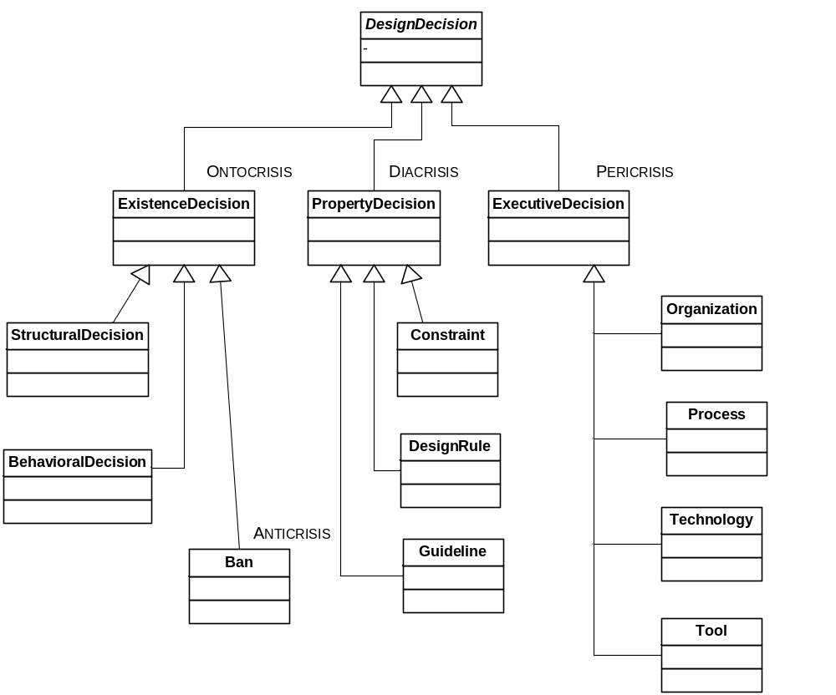
Taxonomy of decisions

Slide 7
Attributes of a decision
Epitome Text
Rationale Text or Pointer
Scope Text
State Enumeration
History List of
(time stamp + author + change)
Cost Value
Risk Exposure level

Slide 8
Relationship between decisions
Constrains
Forbids
Enables
Subsumes
Conflicts with
Overrides
Comprises (is made of)
Is bound to
Is an alternative to
Is related too
Traces to
Does not comply with

Slide 9
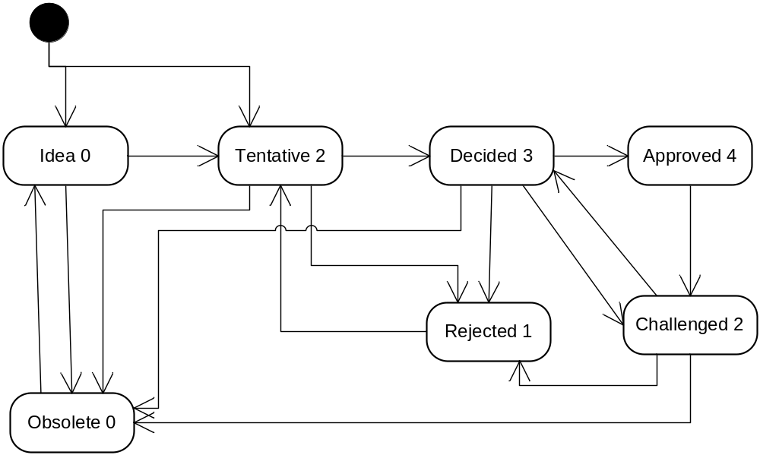
States of decision

Slide 10
What is the use of a decision graph
Rationale
  Connection between requirements, defect and implementation
Support for review
  Completeness, consistency
  Incremental reviews
Support for evolution
  Change analysis, “what if”
Support for reuse, for learning the architectural process itself, for extracting patterns of decisions

Slide 11
Capturing design decisions
Design Rationale support systems failed because of overhead of capture
  not enough immediate value, no incentive to capture
  tedious process, static diagrams
  QOC, DRL, InfoRAT, IBIS etc.
Automating capture with Daemons (agents)
  Instrument source of decision:
    Design tool
    Requirement management tool
    Defect tracking tool
    Configuration and change management tool
    Management tool (task allocation, issue/action items)

Slide 12
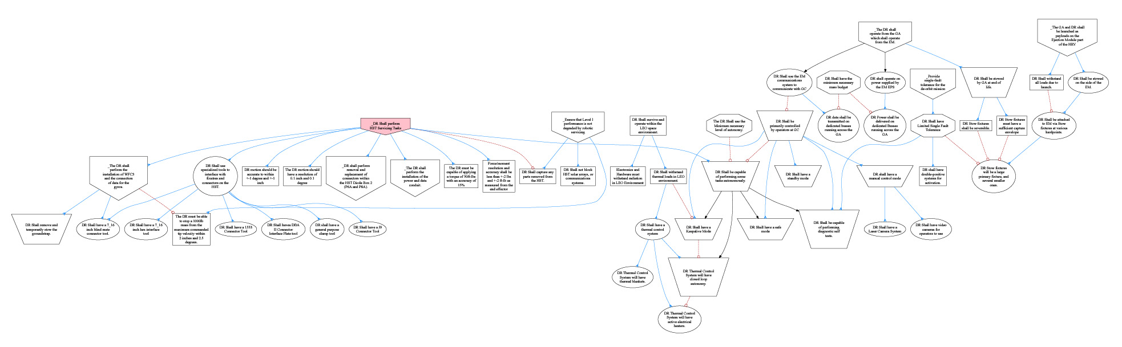

Experiment: Spar Aerospace Dexterous Robot
Dexterous Robot = arm used to fix the Hubble telescope
Michael Trauttmansdorff & Nicolas Kruchten
MySQL Database, SVG + GraphViz

Slide 13
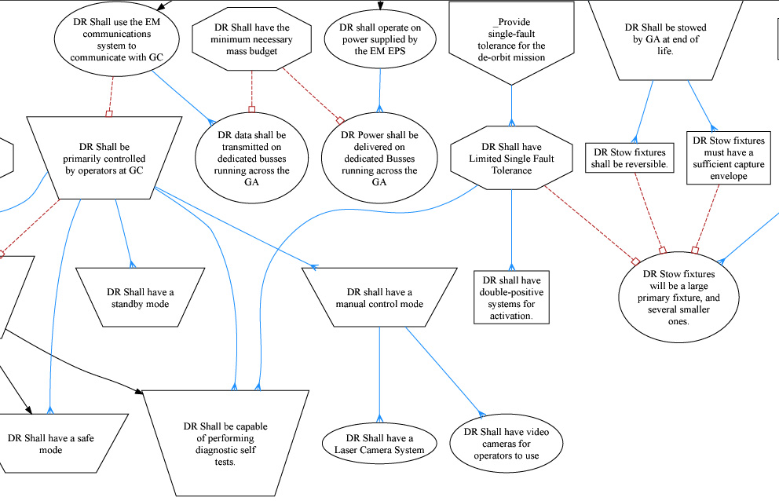
Fragment, enlarged

Slide 14
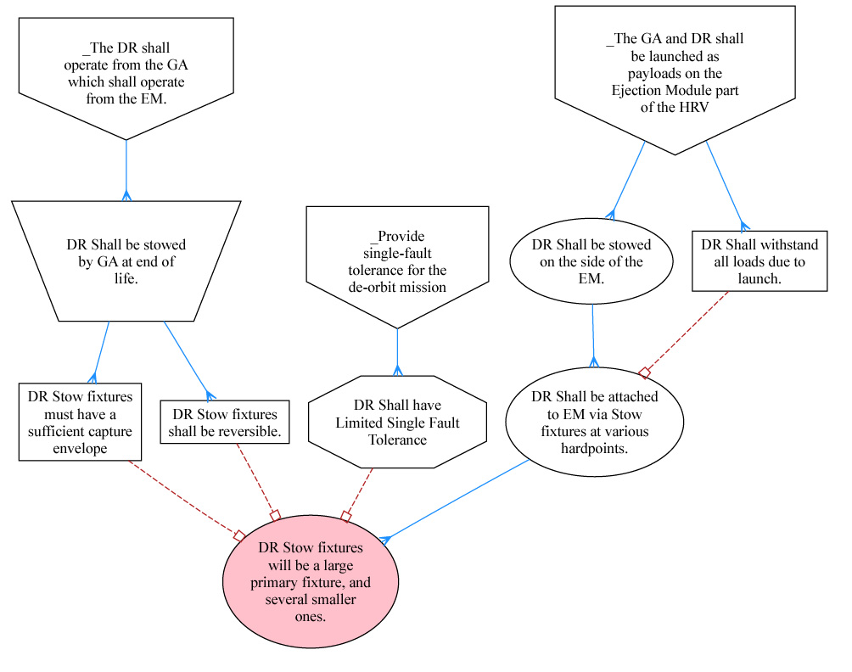
Extraction, around Stow Fixture

Slide 15
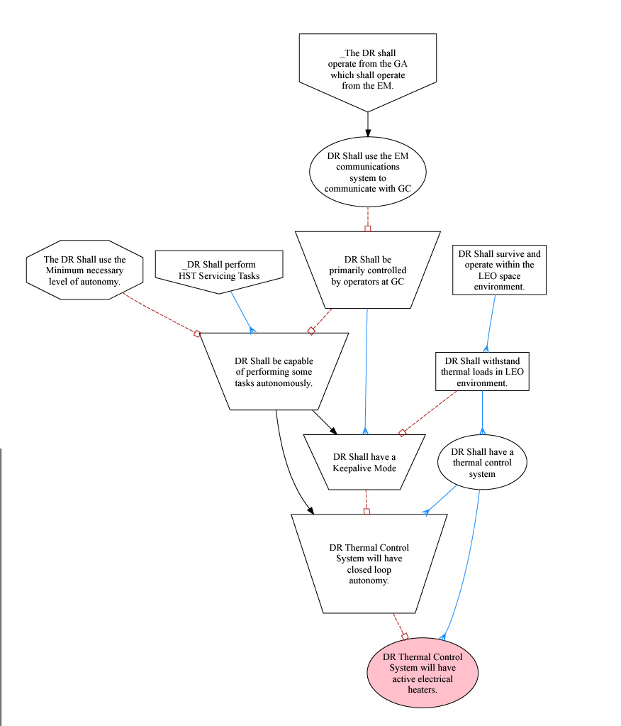
Heaters

Slide 16
Future work
Refine model
  Develop 3 or 4 more examples
    Raytheon: air traffic control,
    CapitalOne: Banking,
    ?? any idea ??
  Do mathemathical model, find patterns
Investigate visualization
  Icons, arrows, arrowhead, color, position
  Automatic layout
Capture mechanism
  Aim at Eclipse platform: EMF and Rational tool suite

