Slide 1

BSc Hons Computer Games Design and Development
GDV4000 Introduction to Games Industry Practice
Game Development Process - Methodologies

Slide 2
The Plan:
Recap
Development Phases
Methodologies
Prototyping

Slide 3
RECAP – Organisation of the Development Team
Senior Management
(Strategy / Development)
Managing Director
Publisher
Director of Development
Technical Director
Art Director
Project-Level Team
Support
Project Director / Lead
Lead (Senior) Programmer
Lead (Senior) Designer
Creative Lead
QA and Testing
Engine Programmers
Concept Artists
Marketing
Designers
Texture Artists
Legal
AI Programmers
Level designers
2D Artists
Physics Programmers
3D Modellers
Sub-contracting
GPU Programmers
Animators
Tools / Middleware Programmers
Sound Engineers
Gameplay Programmers
Composers
Engine Scripting

Slide 4
RECAP – Development Process
• Overview of the Development Process…
Pre-Release
Design
Initial idea / concept
Review
Prototype
Funding secured
Development/ Prototyping
The Pitch
(“Release To Manufacture”)
RTM /
Gold Master
Milestone
Testing
Crunch
Review / Design Eval
Pending deadline

Slide 5
Development Phases
1. Pre-Production
Initial idea / concept
Design
Review
Prototype
Funding secured
The Pitch

Slide 6
Development Phases
2. Main Production / Development
Pre-Release
Initial idea / concept
Design
Review
Prototype
Funding secured
Alpha testing – Complete run-through of game (not yet feature complete). Traditionally internal, but more open today (e.g. Early Access)
Beta testing – Feature complete game (bug fixes only!)
The Pitch
Development/ Prototyping
Milestone
Testing
Crunch
Review / Design Eval
Pending deadline

Slide 7
Development Phases
3. Post-Production (includes development of promotional materials, demos and manuals)
Pre-Release
Initial idea / concept
Design
Review
Prototype
Funding secured
The Pitch
Development/ Prototyping
(“Release To Manufacture”)
RTM /
Gold Master
Milestone
Testing
Crunch
Review / Design Eval
Pending deadline

Slide 8
Development Methodologies
• Approaches to developing software have evolved over the years. Key methodologies employed are:
Waterfall
Iterative / RAD (Rapid Application Development) – also known as the Spiral Model
Agile

Slide 9
Development Methodologies - Waterfall
• The Waterfall method involves a number of stages, each one completed and signed off before proceeding onto the next…
What does this look like for Games Dev?
Requirements
Analysis
Concept
Design
Design
Implementation
Implementation
Rigorous testing is vital for safety critical systems.
Verification / Testing
Testing
What if requirements don’t meet customer needs? Re-write / changes needed. This is the most costly stage!
Maintenance
Release

Slide 10
Development Methodologies – Iterative Development
• For user-centred systems, where requirements are less well known, iterative methodologies are more appropriate. The Spiral Model encapsulates this process, and underpins RAD (Rapid Application Development)…
Risk Assessment
Requirements Analysis
Implementation
Repeat until final implementation has been completed.
Contrast this with Evolutionary Prototyping, where a robust prototype is continually developed and refined and becomes the core of the final software.
Evaluation
In RAD (Rapid Application Development), throw-away prototyping is often employed. So, the developed systems do not make it into the final software.
Cost

Slide 11
Development Methodologies – Agile
• Agile development is an umbrella term used to describe a collection of approaches that subscribe to the following principles / priorities…
Individuals and Interactions more than processes and tools
Working Software more than comprehensive documentation
Customer Collaboration more than contract negotiation
Responding to Change more than following a plan
• Scrum is a common framework around which development is based. Lean principles can also be applied to optimise the development process and eliminate waste.

Slide 12
Development Methodologies – Agile
• Scrum
Scrum is not a methodology, but a framework that promotes collaboration and flexibility during the development process…
Start with the Product Backlog - a list of Product Backlog Items (PBIs) representing a prioritised list of features in the game
In Scrum, development is done in a series of Sprints. Sprints are 2–4-week timeboxes which aim to produce a working, potentially shippable game.
15 mins.
Daily Scrum
Animation
Share progress & problems being faced.
Sprint Review Meeting
Player Jump
Player input
Animation
2-4 week
Sprint
Sprint Review & Product Backlog update
Player attack
Physics
Player Stealth
Potentially
Shippable
Game
Sprint Retrospective
Sprints start with a selection of PBIs from the Product Backlog at the Sprint Planning Meeting. Here features are elaborated upon into manageable tasks. This forms the Sprint Backlog. These underpin the Sprint Theme.
NPC behaviour
Team reflection to improve practice

Slide 13
Development Methodologies – Agile
• What’s a Potentially Shippable Game?
Unless your game is very simple, it’s not realistic to expect to ship a full game in 2-4 weeks. But this is not the intent!
Sprint Backlog
Game Elements…
Choosing which components to implement early on is about mitigating risk. For example, the most complex part of the AI system may be the pathfinding algorithm. So the early sprints will have NPCs moving around but may only be shown as basic cubes or capsules. Once the key tech is in, later sprints can address lower-risk elements.
Each sprint aims to produce a game that contains key elements that make it playable.
The elements implemented cover the key components of the game. They will not be complete, but come together to form a working, playable output.
This is typically known as a vertical slice.
Player Input
Core Player movement
AI
Path Finding
Animations
Player rigging
Physics
Player physics
Scenery
Platforms etc.
Terrain
Basic terrain / world model
Rendering
Initial rendering pipeline / shaders (e.g. Deferred renderer)
“Vertical Slice”

Slide 14



Development Methodologies – Agile
• Who’s Who in a Scrum Project…
Stakeholders
(publisher / management, Customers)
Scrum Master
Ensure Scrum process is a success
Liaises with
Supports
Dev Team
Project Owner
Dev Team (programmers, artists, designers etc.)
Project Owner
Attends
Daily Scrum
Supports
Create
Manages
Sprint Backlog
2-4 week
Sprint
Sprint Review Meeting
Player Jump
Animation
Product Backlog
Player attack
Player input
Sprint Retrospective
Player Stealth
Animation
Potentially
Shippable
Game
NPC behaviour
Physics
Engages with
Dev Team

Slide 15
User Stories
• Communication is vital in any development project. It’s important to enable members of the development team to understand the priority of features as well as be aware of changes made to the design.
• User stories were created to address the following needs…
• Communicate feature priority and value
The development team needs to focus on delivering the highest-value features first.
• Enables change and communication of change
Changes will occur throughout a project and discussions about those changes need to happen regularly and frequently.
• Is a placeholder for future communication
Provide scope to elaborate on ideas further into development.
• Enables details to emerge as more information is learned
Facilitate the inclusion of new knowledge and elaborate on features or propose changes based on this.
• Enables continuing refinement of the work estimated for each feature as the team learns more
Uncertain features can’t have precise estimates. Accuracy can grow as the feature requirements are refined.

Slide 16
User Stories
• In any game development project there are many people involved, all speaking their respective languages (programmers use different jargon from artists for example). User Stories get around this by expressing features in terms of what they are, and the feature has for the user (the player, stakeholders or any member of the development team.)
• User Stories have a very basic structure:
As a <user role>, I want <goal> so that <reason>. The last (red) part is optional
• Some examples…
As a player, I want a player mute button so that I stop being distracted by some of the other players online.
As a player, I want to see how many lives I’ve got left
As an animator, I want to change animations directly in the game without restarting it so that I can iterate faster on animations.
As a 3D modeler, I want the exporter to report stats on the resulting file so that I can ensure the output fits into the game’s memory constraints.

Slide 17
User Stories
• User Stories can drive sprints in the Scrum framework. Typically, User Stories are prioritised and selected for implementation.
• High priority User Stories that are too big to be completed in a single 2–4-week sprint are referred to as epics. Epics are broken down into smaller User Stories, during which the related requirements are elaborated upon. This process allows more detail and clarity to emerge.
• Alternatively, when User Stories are broken down into smaller stories, these smaller stories can form “Conditions of Satisfaction”. These are testable outcomes that can be evaluated at the end of a sprint.

Slide 18
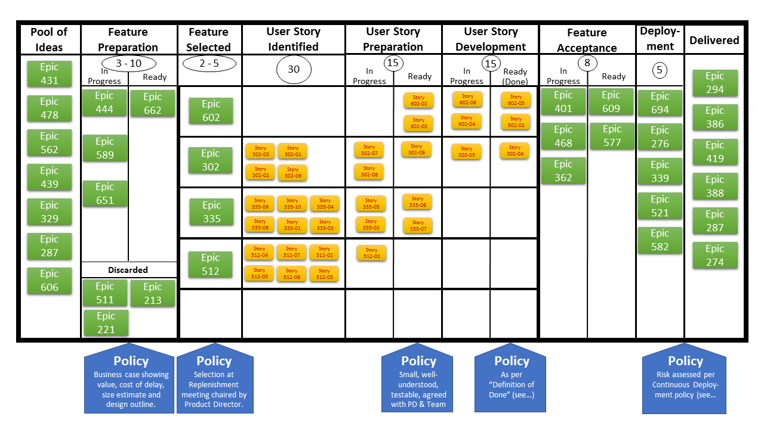
Kanban
• Building on the ideas of focusing on customer needs, Kanban is a visual approach that aims to give a better understanding of the work and workflow. It emphasises customer focus and evolutionary change.
• Work is shown on the Kanban board. This is application dependent, but shows the progression of work from initial Epics / User Stories to work-in-progress and then completed User Stories and Epics…
https://en.wikipedia.org/wiki/Kanban_(development)

Slide 19
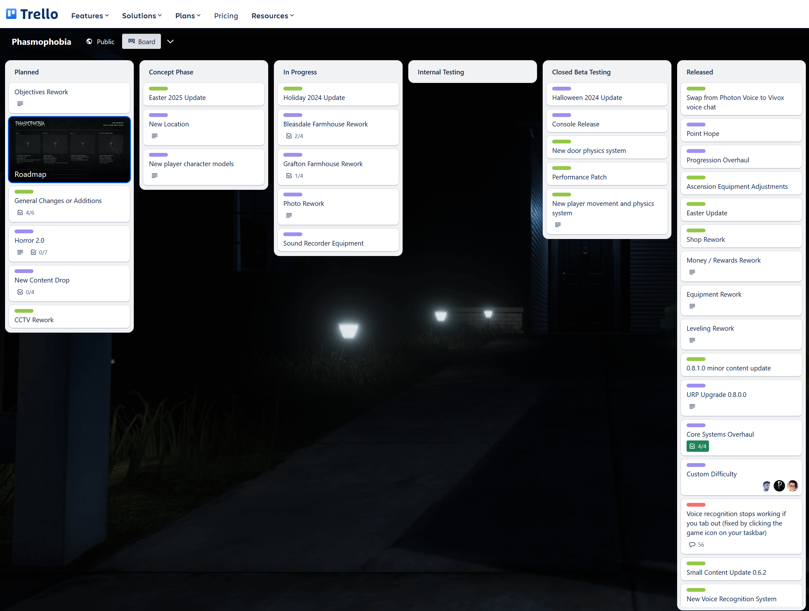
Kanban
• Kanban started in the Toyota factory in the late 1940s, as a way to visually track production and ordering new parts. It gained in popularity and soon found its way into the software industry.
Kanban started in the Toyota factory in the late 1940s, as a way to visually track production and ordering new parts. It gained in popularity and soon found its way into the software industry.
Kanban is less about sprints, like Scrum, and more flowing, where items on the board can move back and forth during development. Elements of Scrum can be used with Kanban, depending on the needs of the project and the team.
There are a few useful Kanban tools, such as Trello and Jira.
Phasmophobia Trello Board: https://trello.com/b/9QrnqQ1j/phasmophobia

Slide 20
Prototyping
• Prototyping is important in both testing gameplay and ideas as well as mitigating risk by exploring high-risk aspects of the software.
• We considered some approaches above – throwaway prototyping and evolutionary prototyping, and how they fit into wider methodologies. But other approaches are available to us…
Paper-based prototyping (throwaway) – A quick, rough method that allows the developer to test ideas out on paper. Elements can be moved, and system responses can be “played out” to test ideas.
Incremental Prototyping – The software is developed as a set of separate prototypes, each implementing and testing a different section of the system. These are then combined, according to a given design, the form the complete system.
Extreme Prototyping – This consists of 3 stages: UI layout, UI functionality, backend services. This is common in web development.

Slide 21
References / Resources
• “Agile Game Development with Scrum” Keith, Clinton. Addison-Wesley Professional
• Agile Development Manifesto
http://agilemanifesto.org/principles.html
• Overview of Agile Methodologies
https://en.wikipedia.org/wiki/Agile_software_development
• Lean principles in software development
https://msdn.microsoft.com/en-us/library/hh533841(v=vs.120).aspx

