Slide 1

Level 4 - Personal Academic Tutors
BSc. Games Design and Development
2025-2026

Slide 2

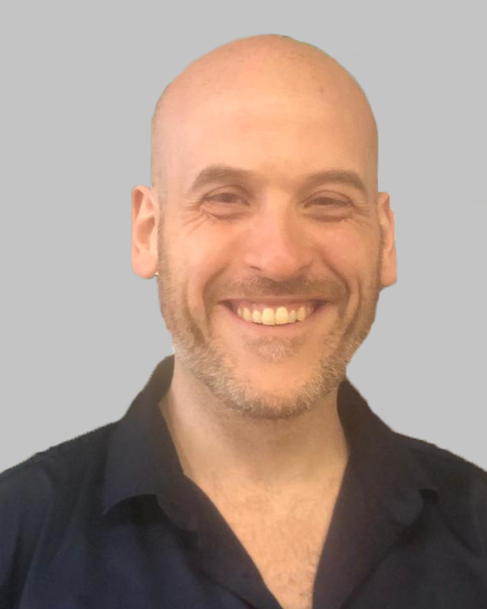
Program Details
Program
  BSc Computer Games Design and Development
  Level 4
Personal Tutor
  Ian Smith
  Email: ismith@cardiffmet.ac.uk
  Teams: No.
  Group: Games 2

Slide 3
About Me
History (Pertinent)
  Joined Cardiff Met in 2017 at the age of 40.
  Read BSc Computer Games Design and Development under Dr. Paul Angel and Dr. Glenn Jenkins.
  Became a Student Rep and then School Rep for CST.
  Graduated in 2021 with 1st Class honours.
  Continued to work as a Student Coach.
  Became an Associate Tutor in 2022.
  Became a full-time Lecturer the same year.

Slide 4
Your Turn!
Tell us your:
  Name
  What do you hope to get out of the programme?
  What do you want to do after graduation?

Slide 5
Cardiff Metropolitan University
Founded in the mid 1970s from a number of existing technical colleges
  Landaff School of Technology
  Cardiff College of Food Technology and Commerce
  Cardiff College of Education
The earliest of these traces its history to 1865
The Cardiff Technical School was established in 1889.
We've had a lot of names! - UWIC is perhaps the most well-known.

Slide 6
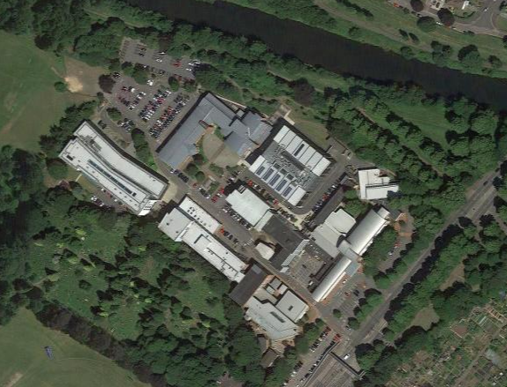
Campus
School of Technologies (ringed).
Coffee!!
The Atrium - CSM
The Gallery - CST
The Hub

Slide 7
Personal Academic Tutors
Personal tutor for the whole course
  Academic support across the course
  Signpost to other services
You’ll see a set of session with your PATs across the year
  You can also book One-to-Ones with us as well

Slide 8
Glossary
Programme (or course) – BSc Computer Game Design and Development.
Module – The individual subject i.e. Advanced Maths for Games.
Academic writing – The style of writing expected at University. It should be 3rd person and formal (no colloquialisms or contractions). All information should be based on peer-reviewed information with references and citations.
Referencing – Listing all the sources used in your work. Cardiff Met uses Harvard referencing (as per Cite Them Right).
Level 4 (L4) – This is the First Year.

Slide 9
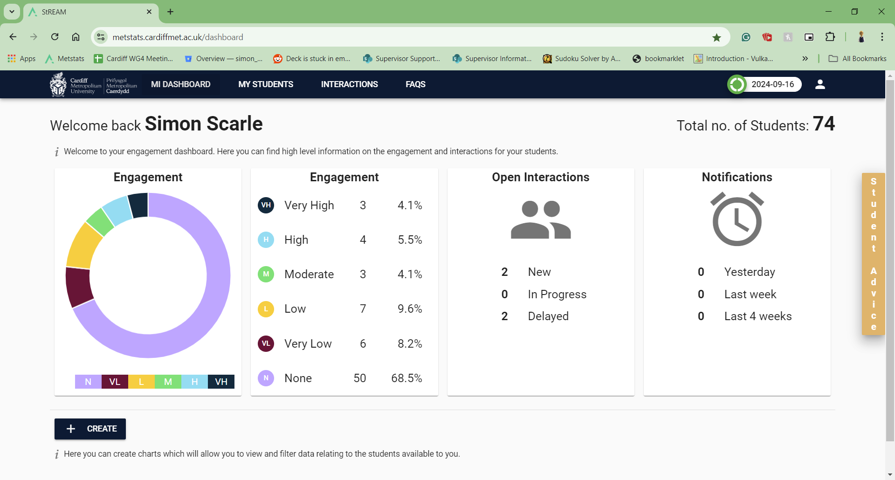
You can also see the data held on you from MetCentral!

Slide 10
Support Services
Lots of Student Support Services
https://www.cardiffmet.ac.uk/study/studentservices/Pages/default.aspx
  Student Finance
  Careers
  Student Support
    Mental health
    Additional learning requirements
    etc.
  GoWales (Placements)

Slide 11
Library and Information Services
Not just books!
  eBooks
  Online journals/papers
  Technical reports / white papers etc.
  IT (computers and support)
  Helpdesk
  Laptops
Support
  Help
  Training

Slide 12
Communication
Teaching and admin staff will contact you via:
  Student email
  Teams (maybe!)
All official correspondence will be though your student email
You are expected to check your student email regularly!
When sending ideally include:
  Student number
  Course
  Module (if applicable)
  Year

Slide 13
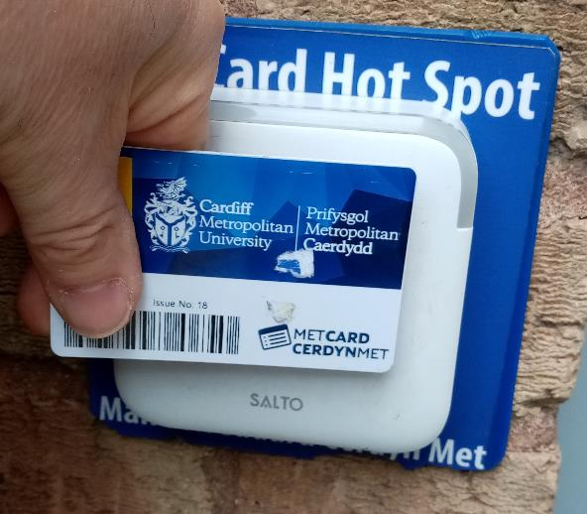
MET CARD COLLECTION
Where / When ?

Slide 14
Questions?
Ask now!

Slide 15


