Slide 1

Chronic pain in sexual and gender minority (SGM) youth
Ian A. Lane, RN, PhD Student
UMass Medical School
Pain Resource Nurse
Pediatric Intensive Care Unit (PICU)
June 14, 2024
Rapid Research Forum

Slide 2
Background
Rapid Research Forum
Prevalence rates of pain disparities in SGM are poorly understood
Emerging research suggests a significant pain disparity for SGM compared to non-SGM individuals
Fredriksen-Goldsen et al., 2017; Nagata et al., 2021; Roberts et al., 2013; Sandfort et al., 2006
Underlying mechanisms for these pain disparities remain (largely) elusive
Various hypotheses exist as to why this might be the case (e.g., allostatic load; minority stress; healthcare access or quality, etc.), but no high-quality mediation studies have yet been completed

Slide 3
Study Objective
Rapid Research Forum
Integrative Scoping Review
Initiated (2023) the first systematic integrative scoping review of this problem to address all existing research (both quantitative and qualitative) on all chronic pain conditions in any SGM subgroup
The primary objectives were to ascertain and understanding all available existing literature (from inception) around:
1) The rate of chronic pain (>3 months) in individuals who identify as SGM (i.e., LGBT)
2) Describe any common experiences of SGM individuals with chronic pain
[Foreshadowing here] Immediate challenges upon analysis:
Surprise surprise, there are substantial difference abound between LGBT subgroups and wide variability among pain conditions experienced

Slide 4
Methods
Rapid Research Forum
Mixed-Methods Systematic Review (i.e., Integrative Scoping Review)
Systematic review versus scoping review – the same but… different
Integrative? (We just added qualitative studies into the mix for depth and context.)
Important to note: There’s no meta-analysis (there couldn’t be with these data yet anyway)
1) Database query
Embase, PubMed/Medline, CINAHL, Scopus
2) Title & Abstract review (x 3 reviewers)
3) Full-text review for inclusion (x 3 reviewers)
Eligibility criteria: Discussion of chronic pain; Discussion of SGM/LGBTQ+ persons, including only specific subgroups; Primary research (i.e., dissertations, cross-sectional or longitudinal studies, qualitative studies, epidemiological studies, controlled trials, and meta-analyses)
3) Extraction phase (x 3 reviewers + expert consultation and group consensus)
4) PRISMA & MMAT
5) Manuscript development (submitting now)

Slide 5
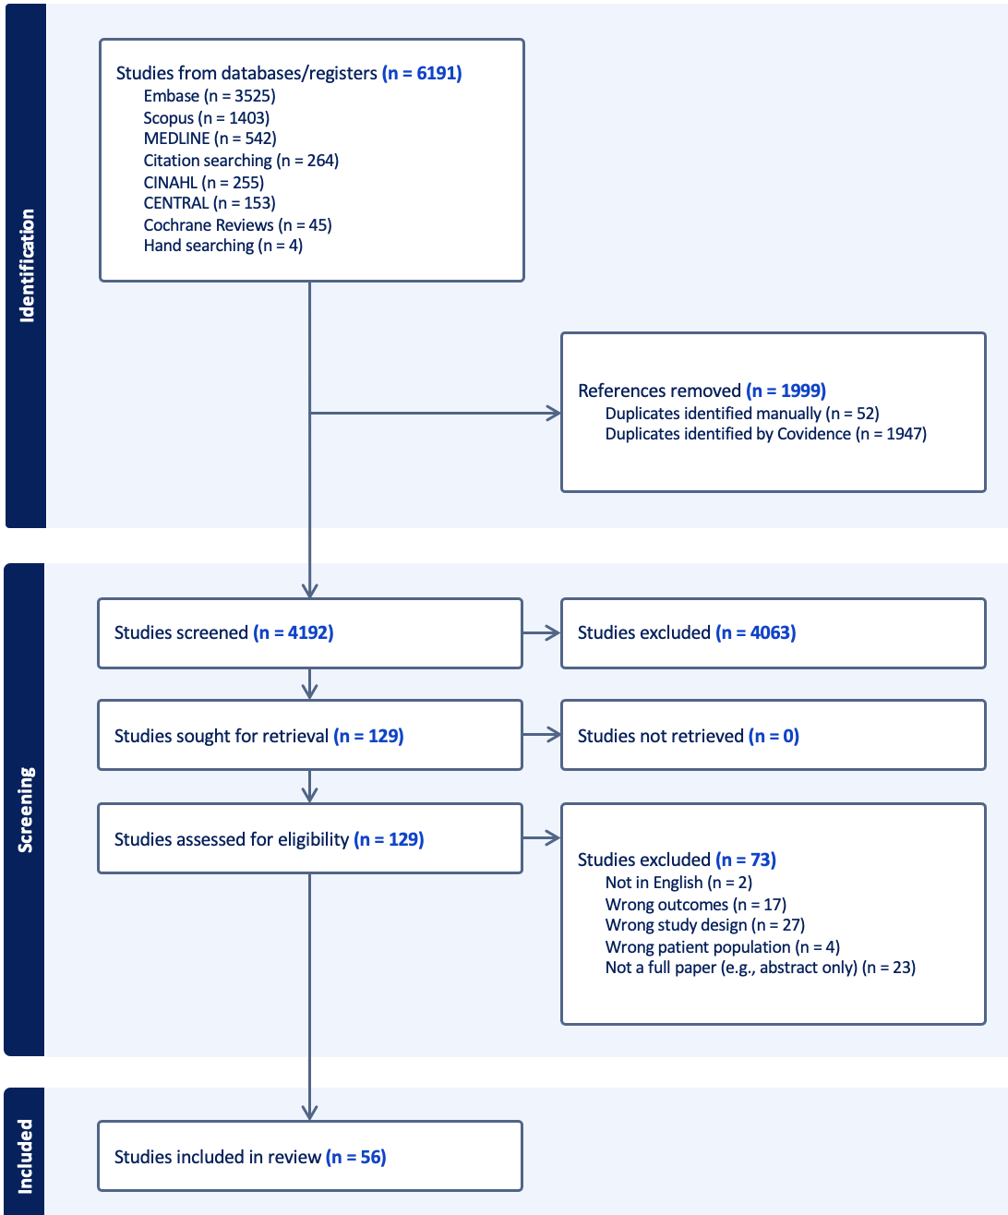
Results
PRISMA Flowchart
Rates of pain (n = 56 studies)
Abdominopelvic pain: Present in up to 75% of trans men (FtM); bisexual females face a 93% greater lifetime relative risk of pelvic pain than heterosexual females
Headache: 60% greater odds in gay/bisexual men (MSM); 20% higher rates in trans women (MtF) compared to cis-men
Genital pain: Present in ~38.5% in bisexual women (15.2% higher than in heterosexual women); ~24% of MSM experience anodyspareunia always or nearly always (and 60% identify this pain as life-long); nearly 64% of FtM trans men experience pain with sexual contact; and sexual pain in MtF trans women is seen chronically in up to 24% of cases
Postsurgical pain: 27.3% of FtM patients undergoing mastectomy may experience persistent postoperative pain
Chest pain: Largely d/t binding practices; 75% of chest-binding trans and non-binary individuals (usually FtM) experiencing significant, functionally impairing pain – and less than half discuss this with healthcare providers.
HIV-related pain: Nearly 60% of HIV-infected MSM experience chronic MSK pain as well as other types, including neuropathic pain
MSK pain: Sexual minority older male adults have nearly 60% greater odds of arthritis pain than straight older males; Sexual minority older females have a 215% greater odds than straight older females of arthritis-induced chronic MSK pain; 89% of trans women and 70% of trans men c/o chronic MSK pain

Slide 6
Conclusion
Rapid Research Forum
More research is needed, specifically regarding mediators and SDoH
Research is being conducted and published seemingly monthly on this topic in 2024
Much more work is needed to fully understand the extent and mechanisms of this problem
Common themes identified from our systematic review of the literature:
Extremely scant data examines youth under age 18 years (only 3 papers of 56 included youth under 18)
Disparities exist in nearly all chronic pain conditions (from headache to abdominopelvic pain) between SGM and non-SGM individuals
Trajectory analyses with longitudinal data are currently missing
Mechanisms are not understood:
Social Determinants of Health (SDoH) appear to be of paramount importance here
Part of the problem could well be lack of satisfactory healthcare and stigmatizing care that burdens patients
Next steps:
Longitudinal structural equation model (L-SEM) examining Social Determinants of Health and chronic pain in SGM

