Slide 1

Cyclistic Memberships
Transitioning casual riders to annual memberships

Slide 2
Ask
How do members/casual riders use Cyclistic bikes differently?
Business task: Recruit members from casual riders.
Stakeholders: Cyclistic executive team
Cyclistic marketing analytics team
Lily Moreno (director of marketing)

Slide 3
Prepare
Trip data located on Amazon Web Services (https://divvy-tripdata.s3.amazonaws.com/index.html)
Limited data license provided by Divvy. (https://www.divvybikes.com/data-license-agreement)
Reliable? Yes. Population data of Divvy bike users
Originial? Yes. Collected in-house, assumed to be credible.
Comprehensive? Limited. Enough for our analysis.
Current? Yes. Collected 2019 – 2020.

Slide 4
Process
Processing data using RStudio markdown, data.table package
Imported Quarter 2-4 2019 and Quarter 1 2020 data (prior 12 months)
Removed ‘member gender’ column (lots of missing data)
Removed ‘member birthyear’ column (lots of missing data)
Removed ‘rental bike ID’ column (irrelevant to analysis)
Removed ‘start station’, ‘end station’, ‘station ID’ (irrelevant to analysis)

Slide 5
More Process
Q1 2020 Removed ‘latitude’, ‘longitude’ columns (irrelevant)
Removed 1 NA from Q12020 (row 414427)
Renamed columns, reordered columns
Merged into single dataframe
Added columns for time data (‘minutes’, ‘hours’, ‘day’ (of the week))

Slide 6
Analysis
Separated into member/casual datasets
Counted number of rides by day of week (m/c)
Duration of ride per day of week (m/c)
Mean/median of duration per day of week

Slide 7
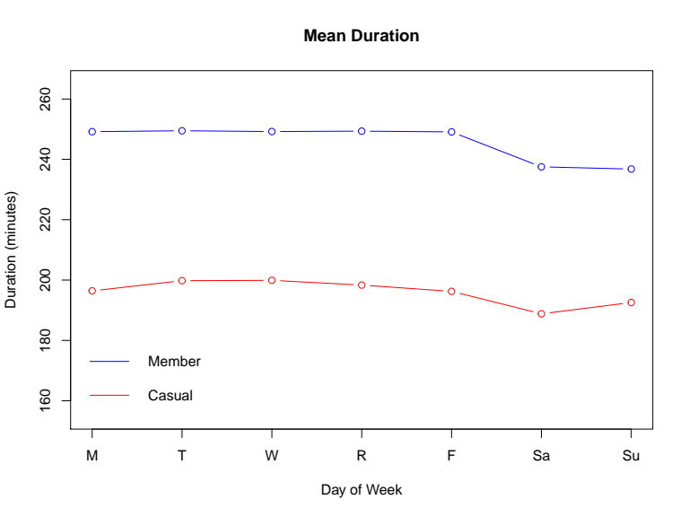
Mean Trip Length
Members use bikes for longer
Members consistent mid-week
Weekends = shorter trips

Slide 8
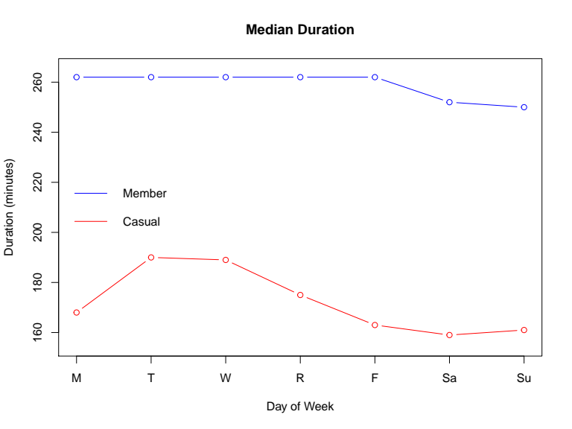
Median Trip Length
Members use bikes for longer
Members consistent mid-week
Weekends = shorter trips

Slide 9
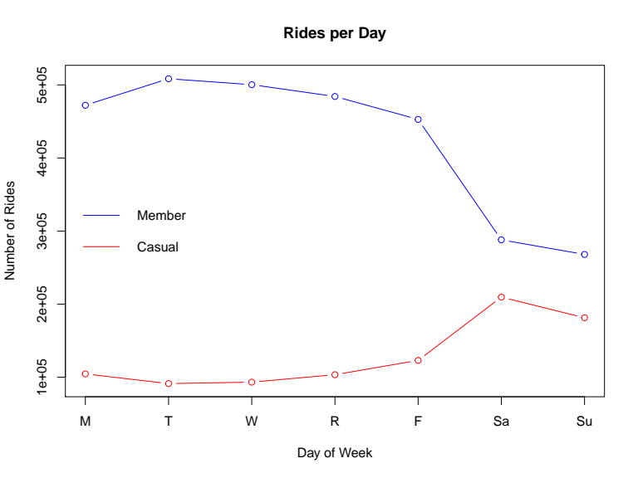
Rides per Day
Members = less rides on weekends
Casual = more rides on weekends

Slide 10
Act
Weekend-only memberships
Increase likelihood of casual riders buying a pass
Weekend membership may lead to full membership

