Slide 1
01
Analyzing metagenomic datasets from extreme environments to uncover biotechnologically valuable biomolecules
Presented by:
Ian Alves Machado

Slide 2
02
Motivation and objectives
Microorganisms found in hypersaline environments have the potential to produce various biomolecules of biotechnological interest;
Sequencing methodologies combined with bioinformatics tools have been developed to predict and reconstruct genomes, identifying potential biomolecules such as enzymes, biosurfactants, antimicrobials and anticancer agents;
Explore tools and databases to study and analyze biomolecules of microorganisms in hypersaline environments.

Slide 3
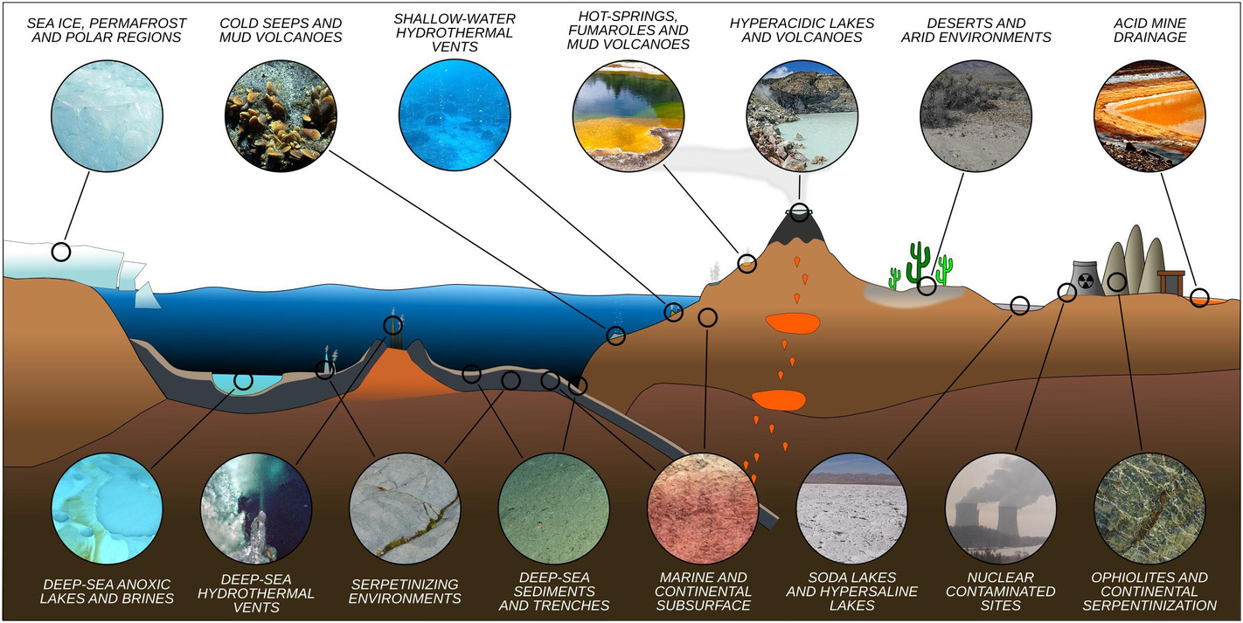

03
State of the Art
Extreme environments and extremophiles
Hypersaline environments and halophiles
Have salinity values greater than 10%;
These are mainly dominated by microorganisms called halophiles, which have developed multiple strategies that allow them to survive in high salt concentrations.
Fig. 1. Representative idealized cross section of Earth’s crust showing the diversity of extreme environments and their approximate location (Merino et al 2019).
Fig. 2. Salt Lake and the “Spiral Jetty” eco-sculpture on a salt crust coast (Hypersaline Environments, n.d.).

Slide 4
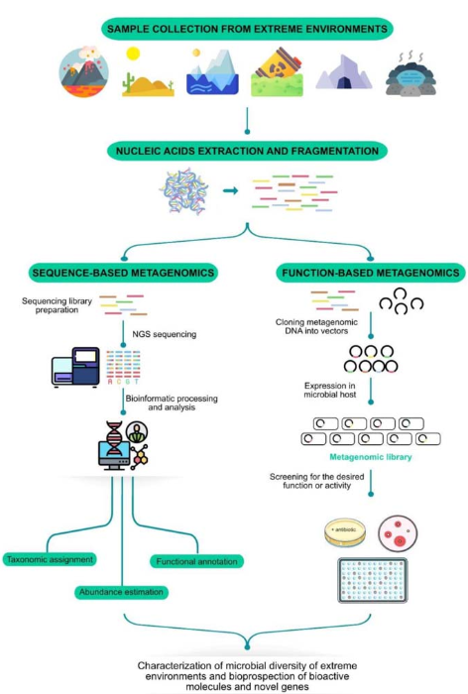
04
State of the Art
Metagenomics
Only 1% of microorganisms can be cultured in laboratory conditions.
Metagenomics, a culture-independent technique, is crucial for understanding microbial diversity.
Involves the extraction and analysis of total DNA from environmental samples.
Minimizes technical errors by avoiding selection processes.
Allows the study of biological networks at multiple hierarchical levels .
Fig. 3. Metagenomics workflow (Shah, 2023)

Slide 5
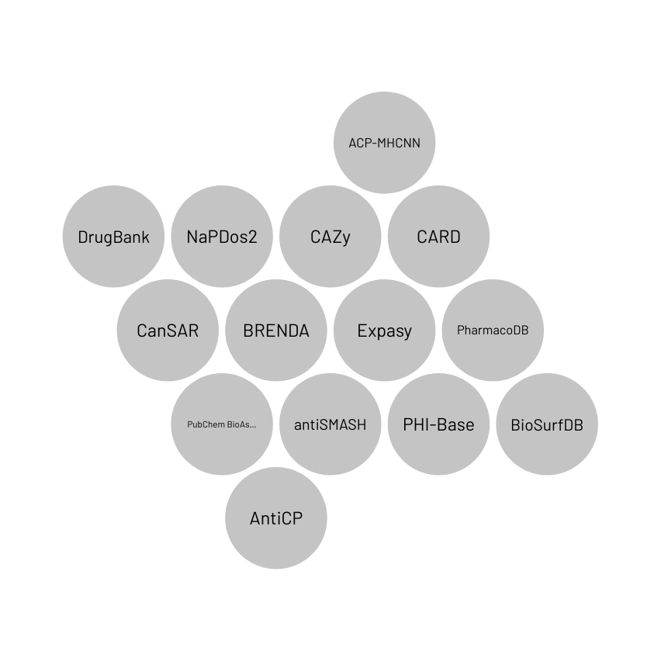
05
State of the Art
Table 1. Comparison of various biomolecule databases, highlighting their key features: database name, input data type, biomolecule type, local use possibility, and output data.
Database | Biomolecule | Input | Download | Output
CARD | Antimicrobial | FASTA formatted sequence, such as assembly contigs or multiple proteins | Yes | Predict resistomes from protein or nucleotide data based on homology and SNP models
Napdos2 | Secondary metabolite genes | FASTA formatted sequence | No | Detects and classifies ketosynthase (KS) and condensation (C)domains
AntiCP | Anticancer peptides | Peptide sequence in FASTA format | Yes | Predict whether the analogs are having anti cancer property or not.
ACP-MHCNN | Anticancer peptides | Peptide sequence in FASTA format | No | Predict whether the analogs are having anti cancer property or not.
AntiSMASH | Secondary metabolite | Sequence file (GenBank / EMBL / FASTA format) | Yes | Secondary metabolite biosynthetic gene clusters
BiossurfDB | Biosurfactant | FASTA formatted sequence | No | Biosurfactant-curated list, grouped by producing organism, surfactant name, class and reference
CAZy | Enzymes | Sequence file (GenBank / Uniprot) | Yes | Information about families of carbohydrate-active enzymes.
Databases

Slide 6
06
08
Methodology
Taxonomic assignment
Kaiju
Binning
(metaBAT2 CONCOCT MaxBin2)
DasTool
Quality control (FastQC)
Assembly (MEGAHIT)
Raw reads
Clean reads
Contigs
Bins
MAGs
Databases
DlAMOND
Functional annotation
Protein coding genes

Slide 7
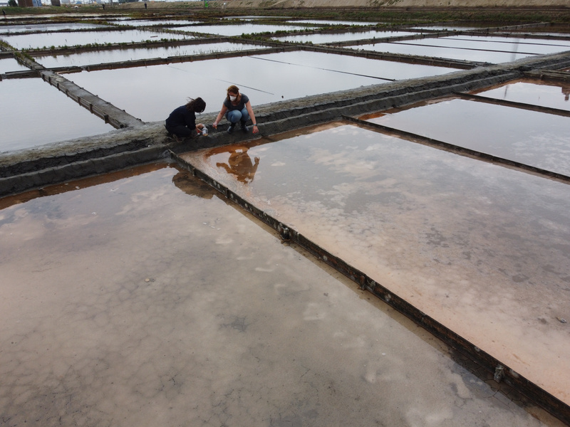
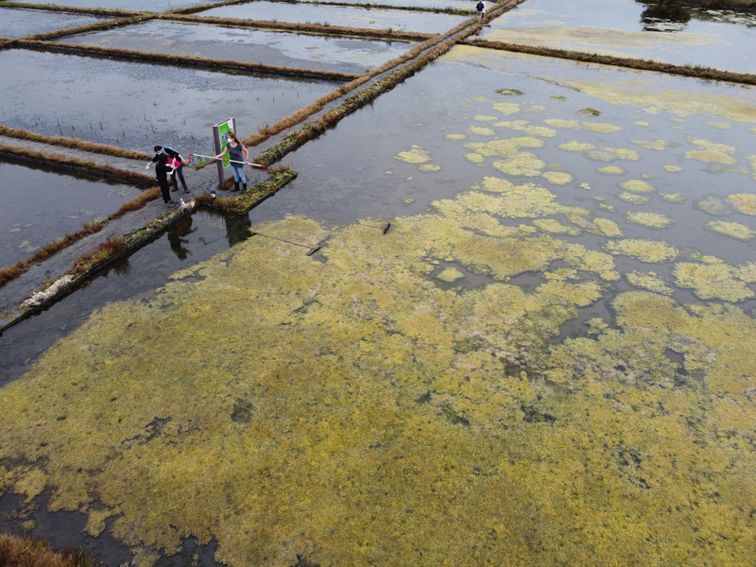
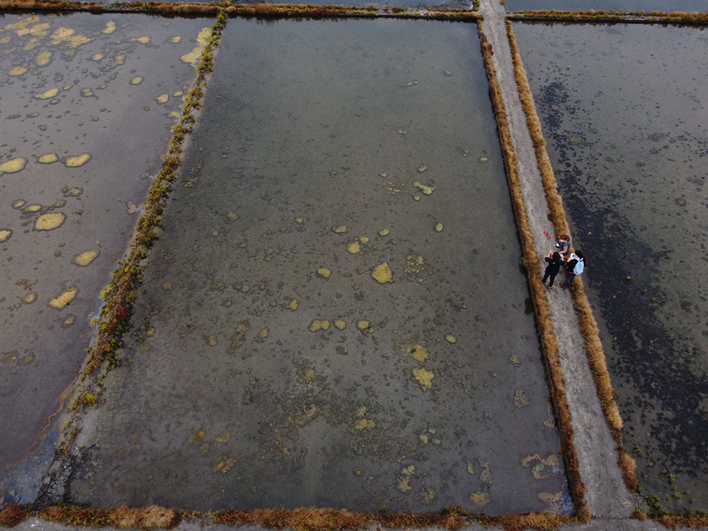
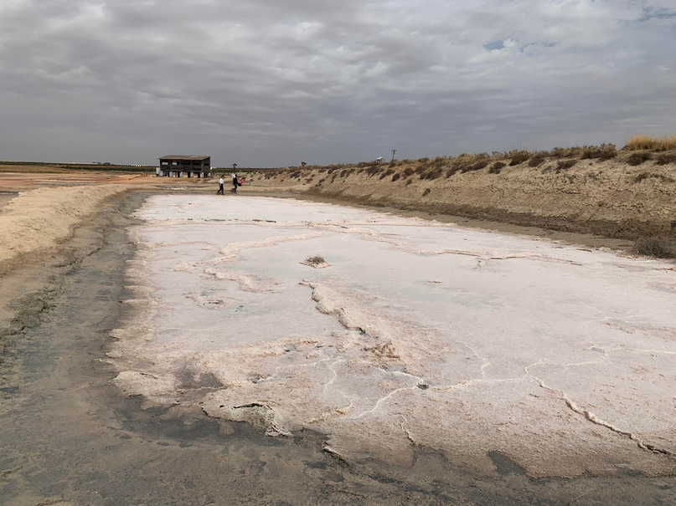
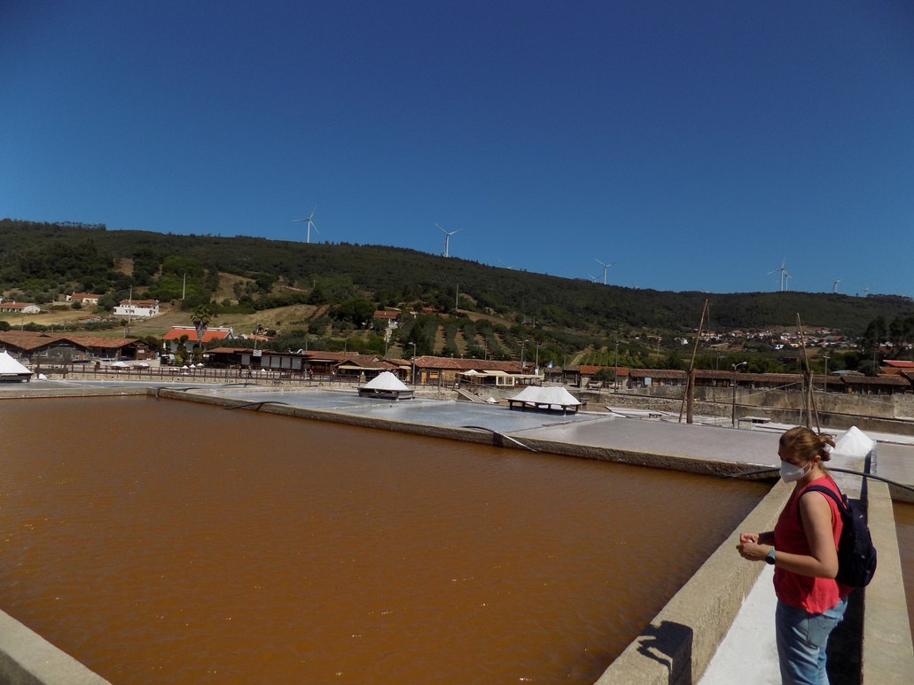
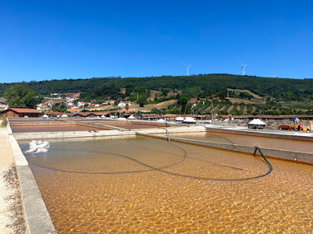
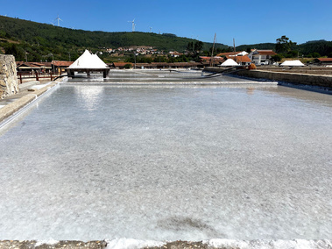
07
Results
Seven raw metagenomic sequencing datasets obtained from Aveiro salterns (Portugal), Rio Maior salterns (Portugal) and Peña Hueca hypersaline lagoon (Spain) will be used in this work to find novel molecules with interest for different industries and sectors.
Aveiro
Rio Maior
Peña Hueca

Slide 8
08
Results
Assembly analysis:
Parameters | Aveiro D1 | Aveiro G1 | Aveiro G3 | Aveiro H1 | Aveiro H3 | Rio Maior A | Rio Maior C | Rio Maior D1 | Rio Maior D2 | Pena Hueca PH
Raw reads | 88,892,162 | 75,725,214 | 67,313,292 | 73,288,356 | 67,808,662 | 79,514,900 | 105,343,554 | 110,356,200 | 98,914,676 | 134,313,112
Assembly length (bp) | 888,000,690 | 1,119,366,983 | 935,059,259 | 1,138,817,834 | 1,033,283,183 | 403,336,330 | 465,419,789 | 1,278,113,235 | 946,503,416 | 621,296,442
Number of contigs (> 0 bp) | 1,475,900 | 1,380,067 | 502,497 | 1,494,447 | 1,383,445 | 680,83 | 900,483 | 2,795,354 | 1,945,251 | 863,734
Largest contig (bp) | 168,745 | 601,99 | 1,318,237 | 336,566 | 584,432 | 1,222,312 | 558,573 | 294,882 | 338,724 | 866,352
Average contig length (bp) | 602 | 811 | 1,861 | 762 | 747 | 592 | 517 | 457 | 487 | 719
N50 (bp) | 1,053 | 1,483 | 1,309 | 1,364 | 1,402 | 2,158 | 1365 | 820 | 900 | 2265
L50 (bp) | 102,068 | 104,681 | 98,783 | 118,889 | 96,501 | 16612 | 31565 | 117195 | 86810 | 30832
N90 (bp) | 553 | 587 | 579 | 582 | 580 | 558 | 539 | 522 | 529 | 595
L90 (bp) | 395,759 | 502,497 | 437,365 | 522,101 | 453,338 | 111869 | 147298 | 427762 | 337634 | 188747
GC content (%) | 60 | 55 | 54 | 53 | 53 | 58 | 60 | 61 | 59 | 58
Number of scaffolds (> 1000 bp) | 113,091 | 199,455 | 159,722 | 201,54 | 170,863 | 44,116 | 48,306 | 73,67 | 69,062 | 92,435
Number of scaffolds (> 5000 bp) | 122 | 360 | 216 | 333 | 372 | 141 | 27 | 145 | 145 | 296
Assembly length (> 1000 bp) | 275,858,726 | 536,103,642 | 410,043,115 | 510,906,813 | 455,089,106 | 147,797,709 | 128,468,895 | 203,952,990 | 187,785,135 | 291,469,159
Assembly length (> 50000 bp) | 9,275,667 | 35,354,235 | 30,244,697 | 27,099,863 | 34,731,370 | 13,960,722 | 4,133,597 | 12,896,924 | 12,668,975 | 33,053,563
Table 2. Summary of sequencing reads and assembly.

Slide 9
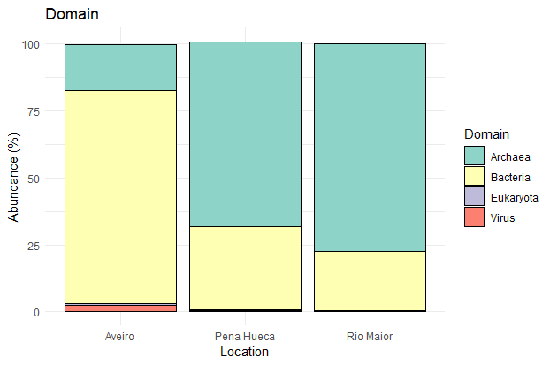
09
Results
Taxonomic analysis:
Fig. 4. Taxonomic overview of the samples Aveiro, Peña Hueca and Rio Maior. Taxonomic distribution of the metagenomes based on relative abundances of the clean metagenomic reads at domain level.o

Slide 10
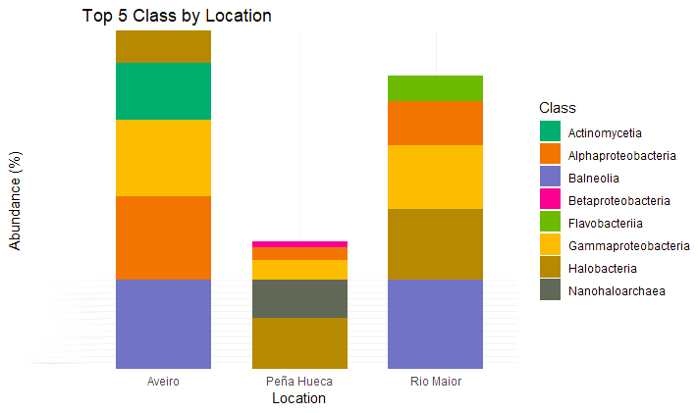
10
Results
Taxonomic analysis:
Fig. 5. Taxonomic overview of the samples Aveiro, Peña Hueca and Rio Maior. Taxonomic distribution of the metagenomes based on relative abundances of the clean metagenomic reads at Class level.

Slide 11
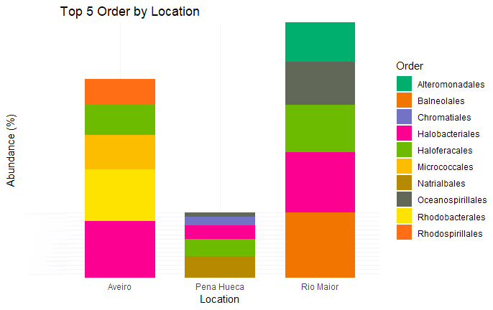
11
Results
Taxonomic analysis:
Fig. 6. Taxonomic overview of the samples Aveiro, Peña Hueca and Rio Maior. Taxonomic distribution of the metagenomes based on relative abundances of the clean metagenomic reads at Class Order.

Slide 12
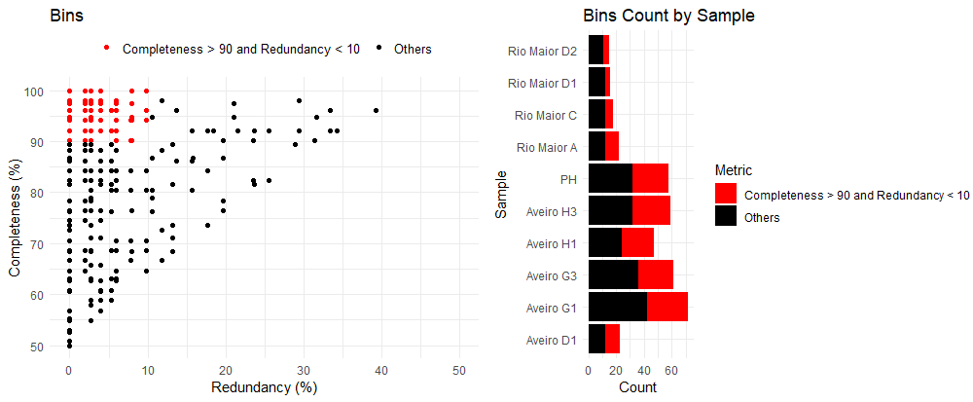
12
Results
Bins analysis:
Fig. 7. Bins quality and abundance.

Slide 13
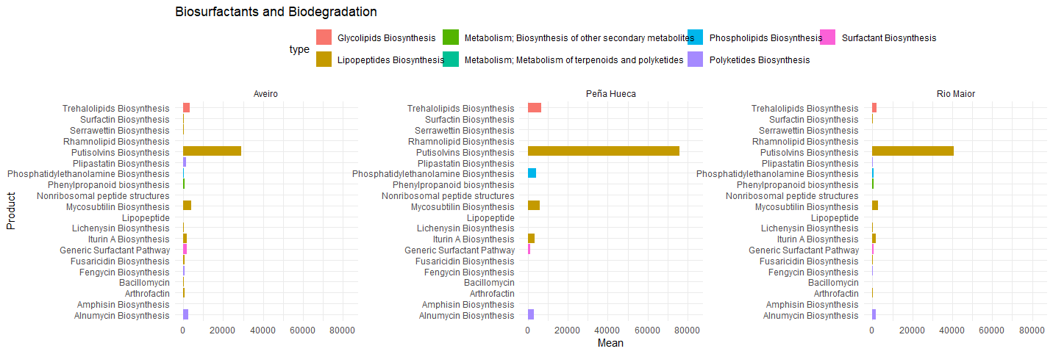
13
Results
Biomolecules Analysis:
Biosurfactants
Fig. 8. Functional and metabolic classification based on BiossurfDB database for Aveiro, Peña Hueca and Rio Maior samples.

Slide 14
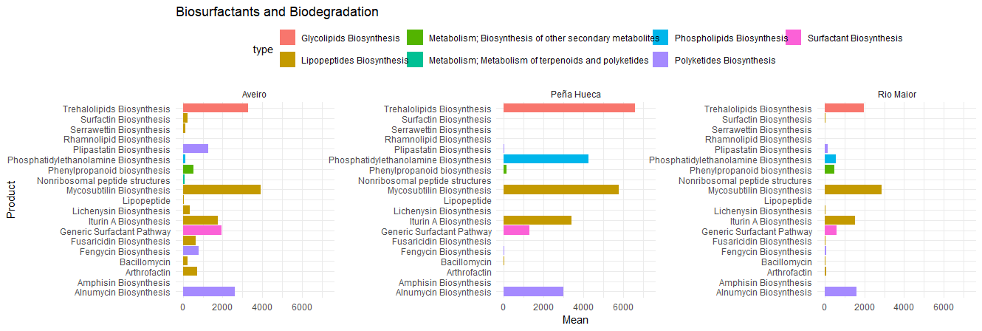
14
Results
Biomolecules Analysis:
Biosurfactants
Fig. 9. Functional and metabolic classification based on BiossurfDB database for Aveiro, Peña Hueca and Rio Maior samples.

Slide 15
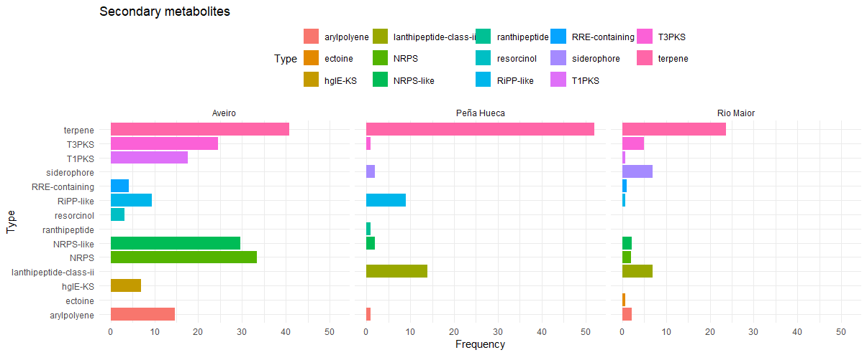
15
Results
Biomolecules Analysis:
Secundary metabolites
Fig. 10. Functional and metabolic classification based on antiSMASH database for Aveiro, Peña Hueca and Rio Maior samples.

Slide 16
16
Future perspectives
Biomolecules derived from hypersaline microorganisms hold significant biotechnological potential;
The development of novel techniques contributes to further exploration in these areas;
Thus far, this project has yielded intriguing results regarding the compounds produced by these microorganisms. However, further exploration of new databases is planned to uncover additional insights into antimicrobial and anticancer compounds.

Slide 17
Thank you!

