Slide 1
Verifying Correctness of a Chez Scheme compiler pass
Master’s Thesis Presentation by Ian Atol

Slide 2
Outline
Introduction
Background
Formalizing Scheme
Proof
Validation Frameworks
Conclusion / Future Work

Slide 3
Introduction
Why care about compiler correctness?
Why is proving compiler correctness difficult?
Project overview
Notes:
Before we get into specfiics about the Chez Scheme compiler, our proof, and other details... first we should think about why we care about compiler correctness?

Slide 4
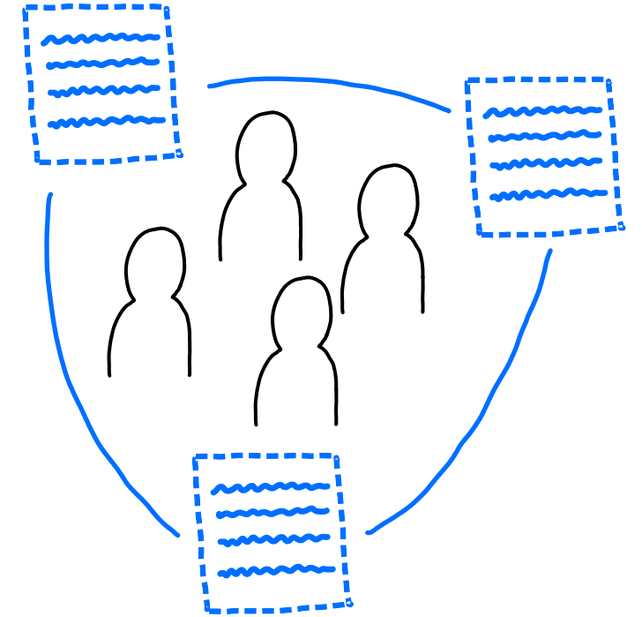
Software is all around us - ubiquitous
Notes:
As computer scientists, we already know this, but software is already present nearly everywhere in our lives
We’re on Zoom right now, phones in our pocket, air conditioning, etc

Slide 5
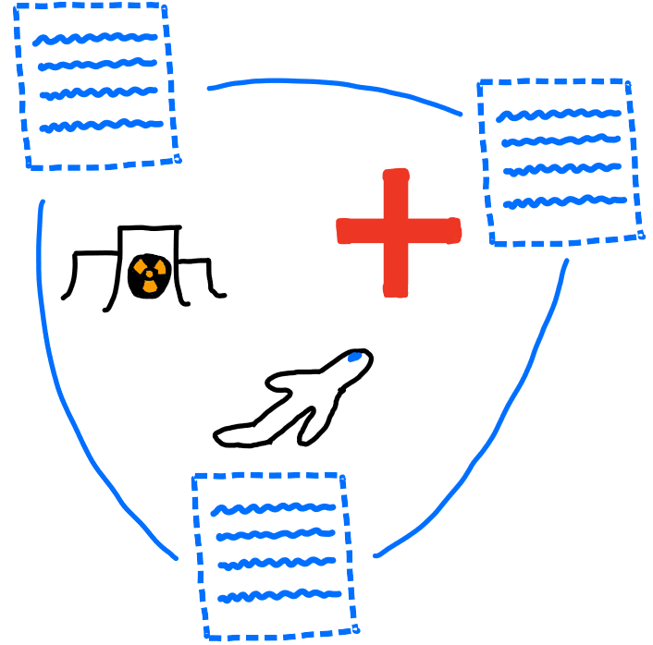
Software ubiquity means software significance
Notes:
Everywhere means everywhere - including in safety critical settings like airplanes, medical equipment, and nuclear reactors.

Slide 6

Software is imperfect
In 2011, 24% of medical device recalls were due to faulty software, and this number is increasing because of increasing complexity of devices [1, 2]
Notes:
We can observe this situation in many areas - complexity is increasing across the board
Needless to say, software errors in equipment thats controlling your heart or at the local nuclear power plant are very bad
So, can we fix?

Slide 7

One approach to errors – Static Analysis
Notes:
In general, static analysis is the process of examining source code.
By carefully analyzing source code, we can devise proofs that certain kinds of errors don’t occur
Some analysis can be performed completely based on the syntax of a program – for ex, every line ending in a semi-colon.
However, for more complex proofs, we give meaning to the source code using the semantics of its language, for ex to prove a program results in a certain value

Slide 8
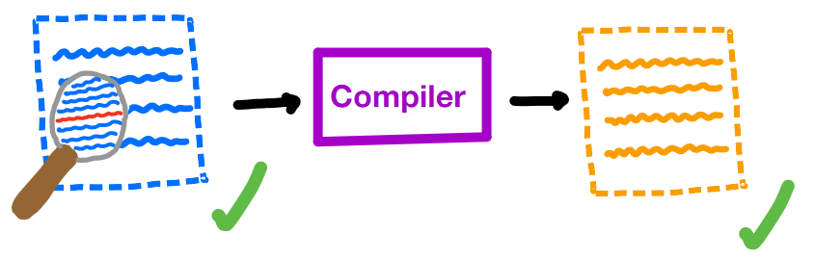
A critical assumption
Notes:
However, these proofs involving the semantics tend to make a critical assumption
We assume that our proof about a program holds for its compiled version - essentially we are trusting that our compiler didn’t make an error
For most cases, this is fine - mainstream compilers are pretty trustworthy, and most use cases aren’t critical
But if you have a pacemaker, for example, this assumption means trusting the compiler with your life

Slide 9

Minimizing assumptions
Notes:
In safety critical software, we want to minimize the assumptions we make.
Therefore, we are no longer assured that our compiled program is error free

Slide 10
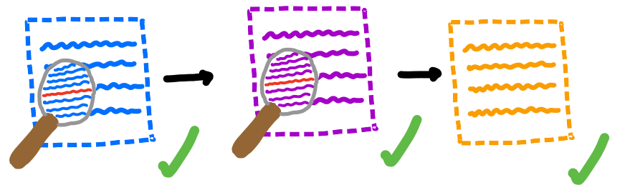
Trust, but verify (our compilers)
Notes:
Compilers are really just programs themselves, so we can apply static analysis to them as well
Specifically, we want to prove that our compilers translate correctly - that they preserve the semantics of programs that they compile
If we can prove correctness of our compilers, we can successfully remove an assumption and get closer to full trust of our software

Slide 11
Why aren’t all our compilers proven correct?
Compilers are big
Multiple languages involved
Consider ALL possible programs
Notes:
gcc ~15M lines of code
Compilers typically translate a program in a high level language to a program in a low level language. So we have to create a relationship between the semantics of these languages
Finally, to prove compiler correctness, we have to consider all possible programs in a language. Even for small languages, this can involve concepts that are difficult to reason about like recursion, mutation, etc.

Slide 12
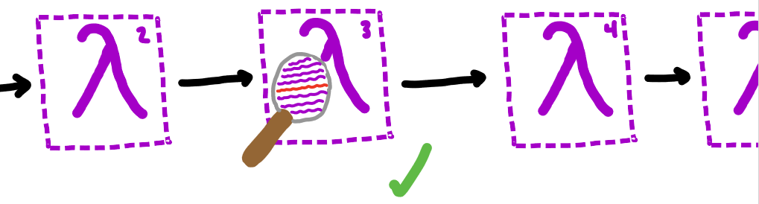
This project
Notes:
In this project, we give a proof of correctness of a single pass of the Chez Scheme compiler over a subset of Scheme
In this way, we simplify each of the problem areas:
Looking at a small part of the compiler
This pass translates from Scheme to Scheme so we can use the same semantics
We also cut out some of the language to reduce complexity

Slide 13

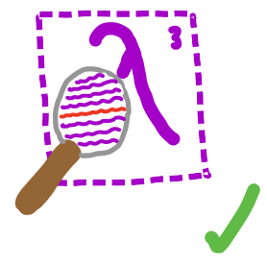

This project
Notes:
We also give two frameworks for validating our proof
The first, in Coq, was originally intended to be a complete mechanization of the proof.
While that ended up being outside of the scope of this work, we still provide an implementation of part of Scheme’s semantics and prove some basic properties about it
The second, in Racket, provides a way to show correctness of the pass (and our proof approach) for individual examples

Slide 14
Background
Compiler Correctness
Scheme

Slide 15
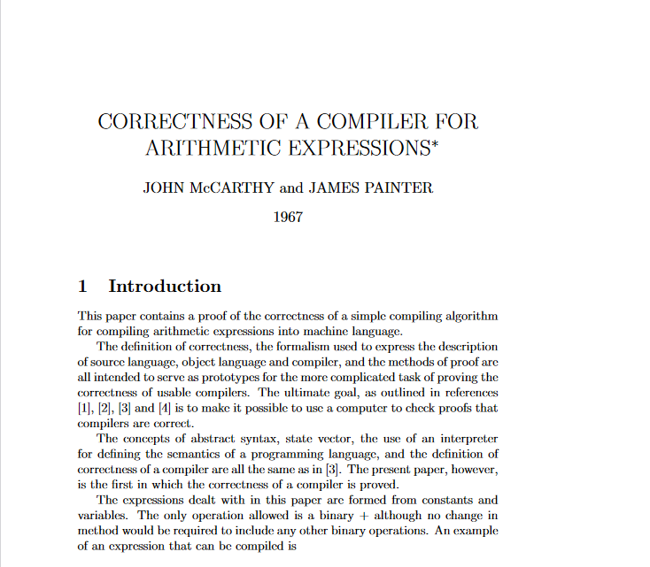
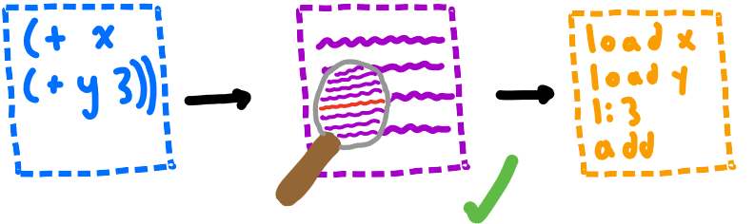
McCarthy, Painter 1967 [3]
Notes:
The first proof of compiler correctness comes from John McCarthy and James Painter
They provide a correctness proof for a simple compiler from arithmetic expressions to machine code
Their proof is intentionally simple, as they intended to create a framework for proving correctness of larger compilers

Slide 16
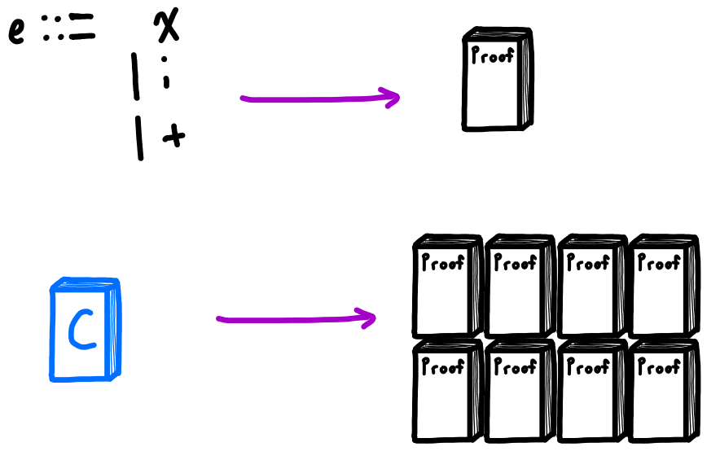
Correctness Proofs are Complex!
Notes:
McCarthy’s proof was about a tiny language of only 3 expressions, but still about 10 pages long
To reason about larger, practical languages, a proof would be very large. Still possible on paper, but checking such a proof by hand is difficult
Solution: use computers to help check

Slide 17
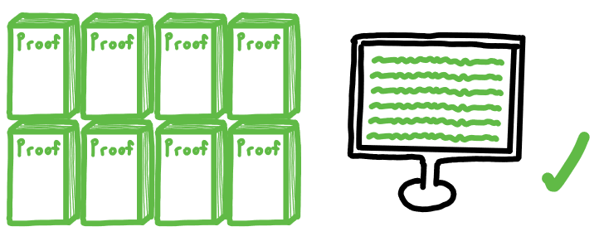
Solution: Mechanization
Notes:
Computers work perfectly and tirelessly – if we could get them to check our proofs, we would have a much higher degree of trust in their validity

Slide 18
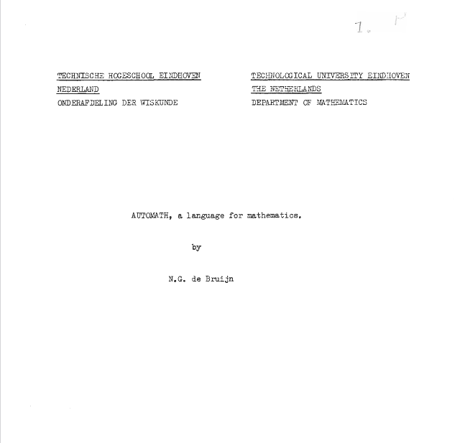
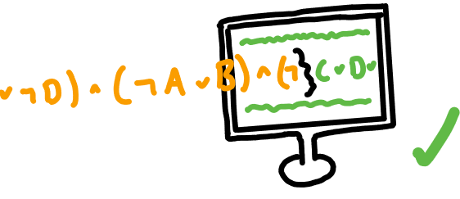
de Bruijn 1968 [4]
Notes:
In 1968, de Bruijn released Automath, a formal language for encoding and checking mathematical theories computationally
First system to utilize Curry-Howard correspondence between intuitionistic logic and dependent types

Slide 19
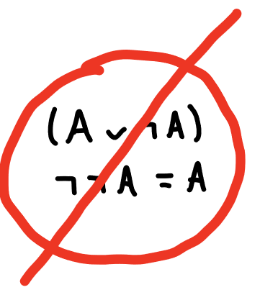

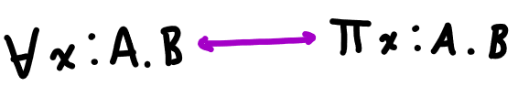
More on Automath and Intuitionistic Logic
Notes:
Automath works by exploiting a correspondence between intuitionistic logic and dependent types
But what is intuitionistic logic? Alternative to classical logic that requires direct, constructive proofs
Direct because no law of excluded middle
Constructive because of this requirement of directness – if you want to prove something exists, you must build it directly
Statements in intuitionistic logic correspond exactly to dependent types
Given a statement, if we can construct a term of its type, we have proven it – a statement is the type of its proof.

Slide 20
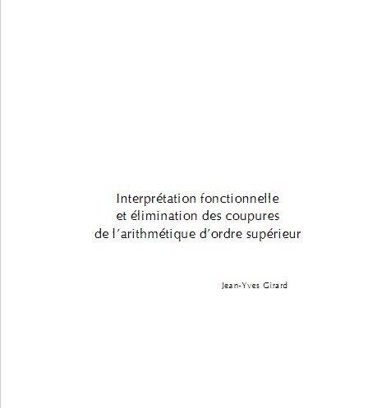
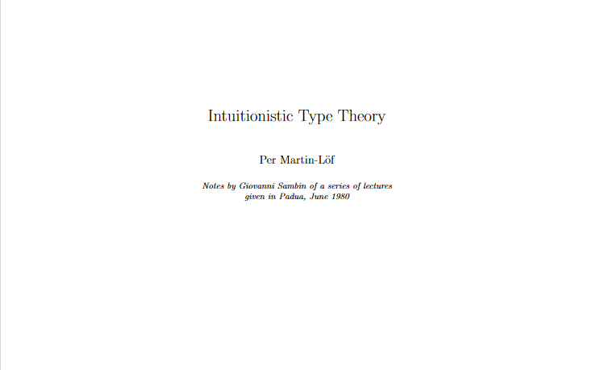
Girard 1972 [5], Martin-Lӧf ~1980 [6]
Notes:
Automath was based on a very simple dependent type theory
Martin-Lof and Girard advanced this connection by developing type theories with the correspondence, and computers, in mind
Girard’s System F extended the theory to allow for higher-order logic
Martin-Lof’s Intuitionistic Type Theory was an attempt at a foundation for mathematics, with the computational correspondence in mind
Indeed, Martin-Lof describes intuitionistic type theory as a programming language

Slide 21
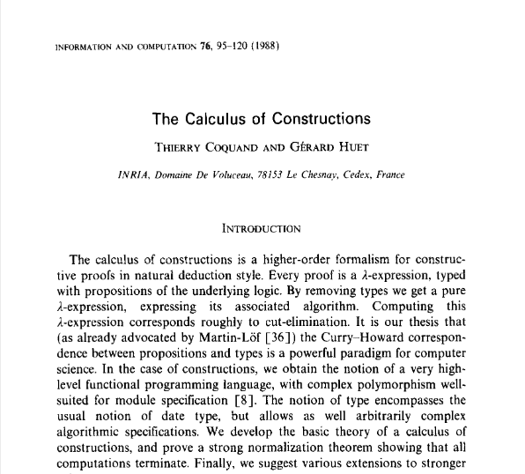
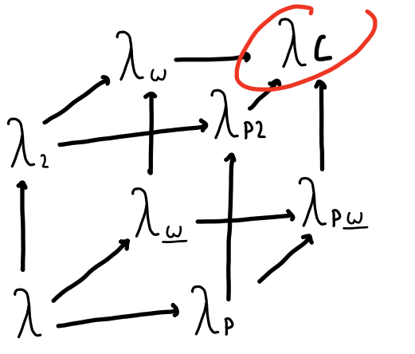
Coquand 1988 [7]
Notes:
Types and terms can depend on types and terms
Essentially the most powerful dependently typed lambda calculus

Slide 22

Coq
Notes:
Proof assistant based on Calculus of Constructions

Slide 23
Background
Compiler Correctness
Scheme

Slide 24
Outline
Introduction
Background
Formalizing Scheme
Proof
Validation Frameworks
Conclusion / Future Work

Slide 25
Formalizing Scheme
Syntax
Semantics

Slide 26
Proof
The convert-assignments pass
Deterministic Semantics
ca is a simulation relation
ca is semantic preserving

Slide 27
Validation Frameworks
Coq
Racket

Slide 28
Outline
Introduction
Background
Formalizing Scheme
Proof
Validation Frameworks
Conclusion / Future Work

Slide 29
Bibliography
K. Sandler, L. Ohrstrom, L. Moy, and R. McVay, “Killed by code: Software transparency in implantable medical devices,” Software Freedom Law Center, pp. 308–319, 2010.
I. Lee et al., “High-confidence medical device software and systems,” Computer, vol. 39, no. 4, pp. 33–38, 2006, doi: 10.1109/MC.2006.127.
J. Mccarthy and J. Painter, “Correctness of a compiler for arithmetic expressions,” 1967, pp. 33–41.
N. G. de Bruijn, “A Survey of the Project Automath**Reprinted from: Seldin, J. P. and Hindley, J. R., eds., To H. B. Curry: Essays on Combinatory Logic, Lambda Calculus and Formalism, p. 579-606, by courtesy of Academic Press Inc., Orlando.,” in Selected Papers on Automath, vol. 133, R. P. Nederpelt, J. H. Geuvers, and R. C. de Vrijer, Eds. Elsevier, 1994, pp. 141–161. doi: 10.1016/S0049-237X(08)70203-9.
J.-Y. Girard, “Interprétation fonctionnelle et élimination des coupures de l’arithmétique d’ordre supérieur,” PhD Thesis, Éditeur inconnu, 1972.
P. Martin-Löf, “An intuitionistic theory of types,” Twenty-five years of constructive type theory, vol. 36, pp. 127–172, 1998.
T. Coquand and G. Huet, “The calculus of constructions,” PhD Thesis, INRIA, 1986.

