Slide 1

Getting Started with MySQL
Notes:
‹#›

Slide 2
Introduction to MySQL
Fully Relational, Multi-user database
  Second most widely used open-source RDBMS (Wikipedia)
    First is SQL Lite
  Second most popular in DB-Engines ranking
Acquired by Sun Microsystems in 2008
  which has been acquired by Oracle in 2010…
  which has generated forks (MariaDB)
LAMP web application software stack
  Linux, Apache, MySQL, PHP/Perl/Python
Notes:
‹#›

Slide 3
Introduction to SQL
SQL (Structure query language)
  Query language for relational databases
  Declarative
  Standard (since 1986)
    … but most RDBMS implement their own “flavour”
Components
  Schema definition, data retrieval, data modification, indexes, constraints, views, triggers, transactions, authorization, etc.
Notes:
‹#›

Slide 4
Introduction to SQL
DDL - Data Definition Language
  Defines data structures (relations)
    CREATE
    DROP
    ALTER
    TRUNCATE…
DML - Data Manipulation Language
  Manipulates data
    SELECT
    INSERT
    UPDATE
    DELETE
Notes:
‹#›

Slide 5
Installing MySQL
Two options
  Install MySQL server in your own machine
    Instructions on the course website
  Use db4free
    http://db4free.net
    Testing service for MySQL
      “db4free.net is a testing service which means it is not suitable for production. There can be outages, data loss and security features do not meet the standards which you expect from a professional data hosting provider”
    Backup data - Your responsibility
MySQL Workbench
  Graphical client
Notes:
‹#›

Slide 6
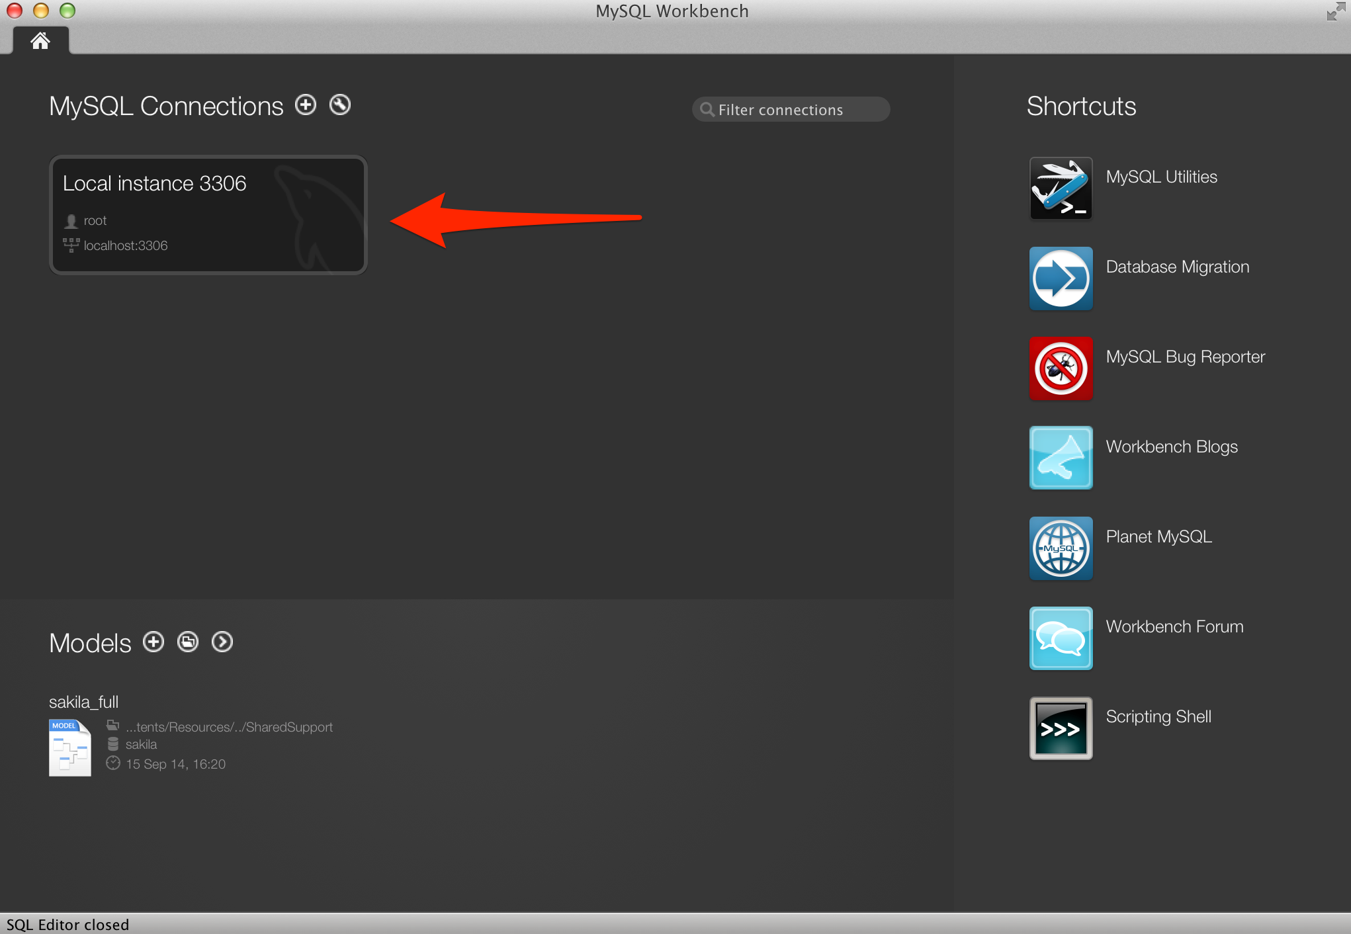
MySQL Workbench
Connect to the local server
Notes:
‹#›

Slide 7
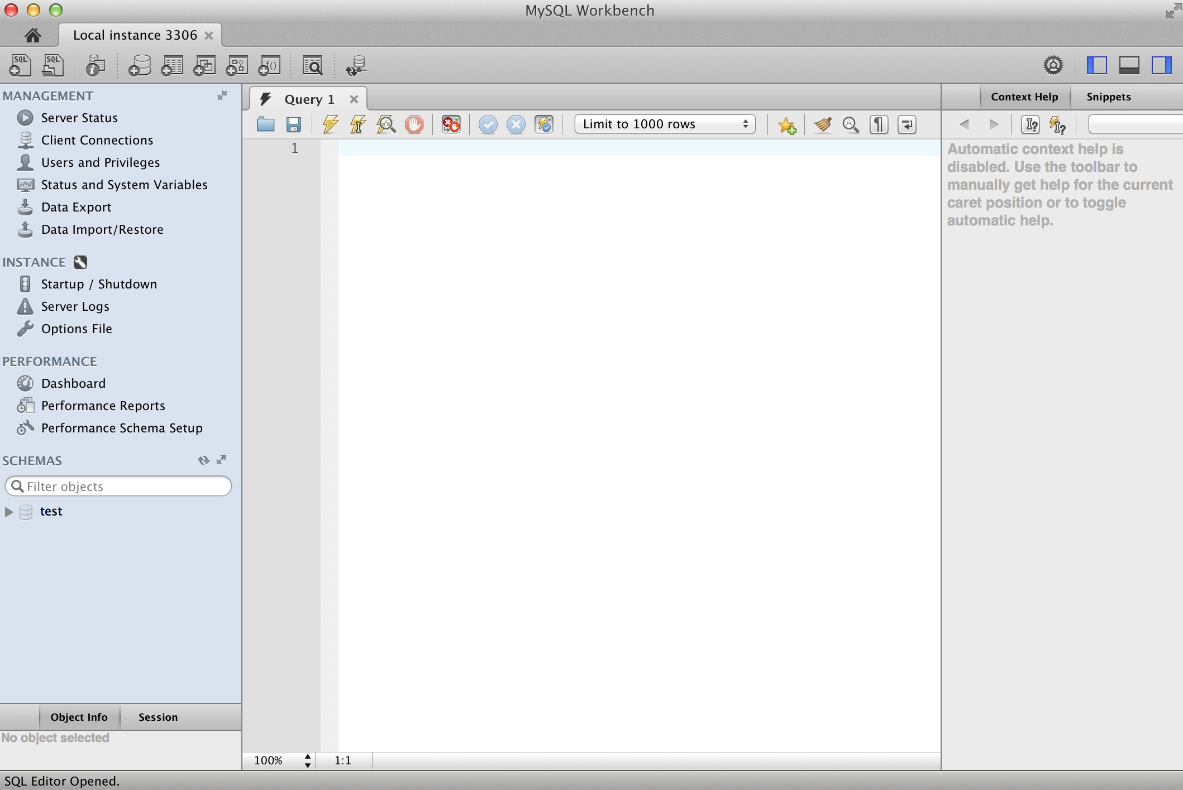
MySQL Workbench
Connect to the local server
Notes:
‹#›

Slide 8
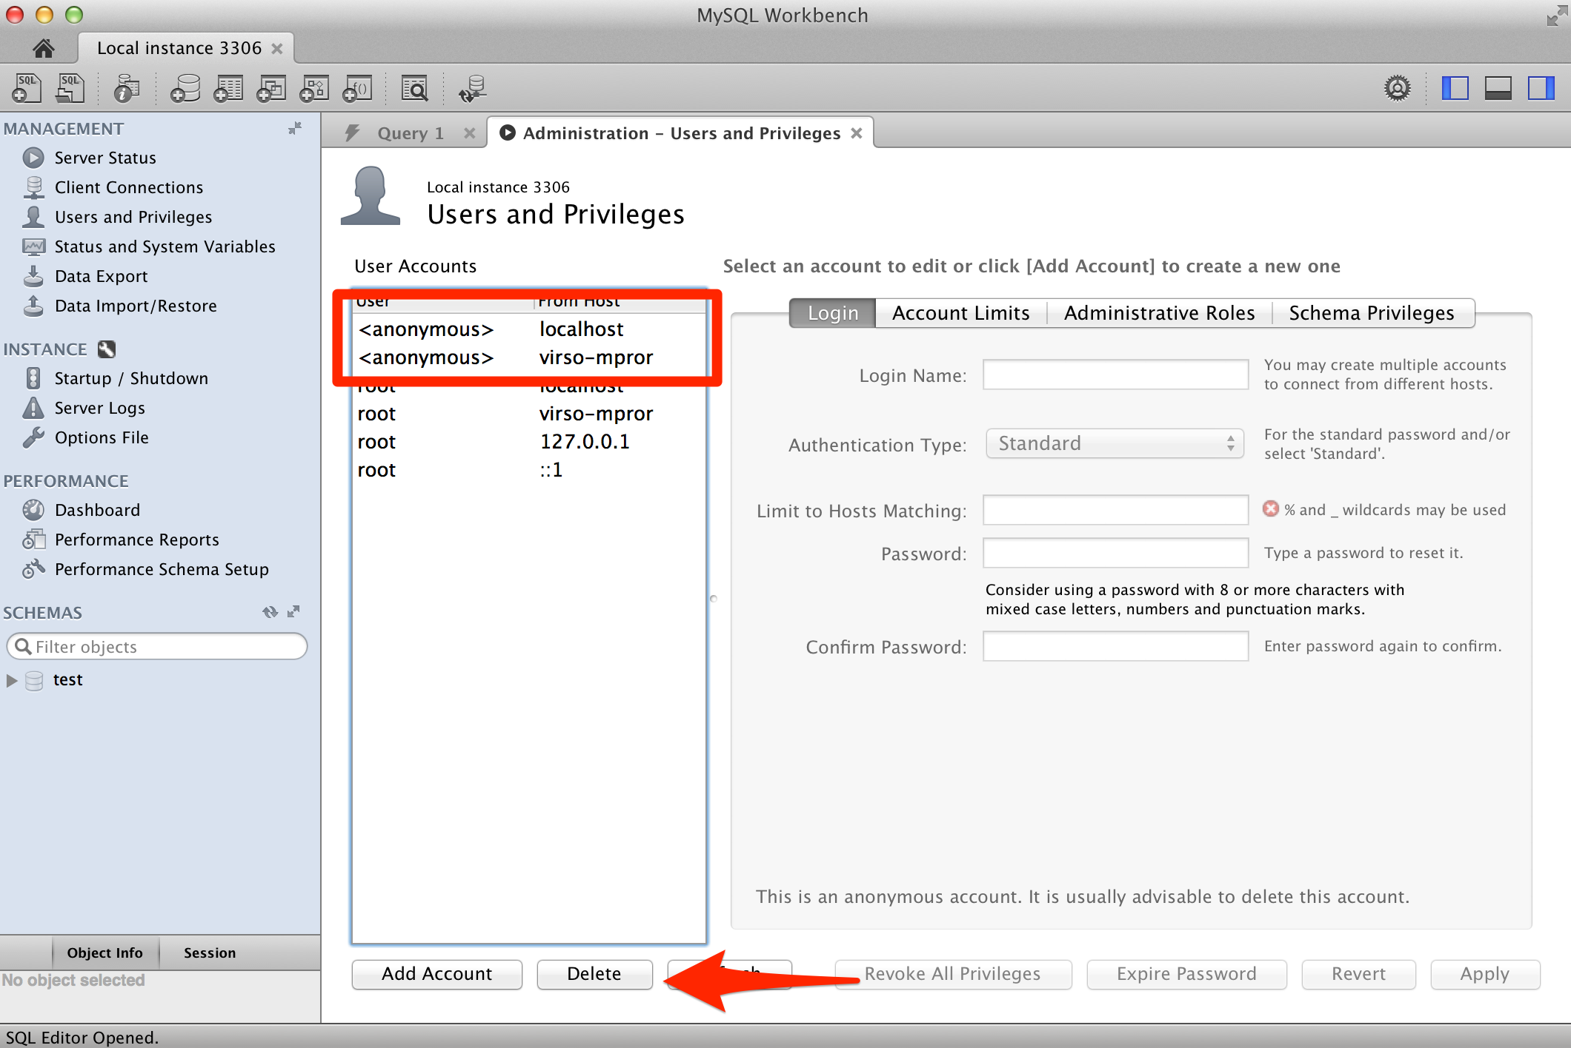
MySQL Workbench
Remove anonymous users
Notes:
‹#›

Slide 9
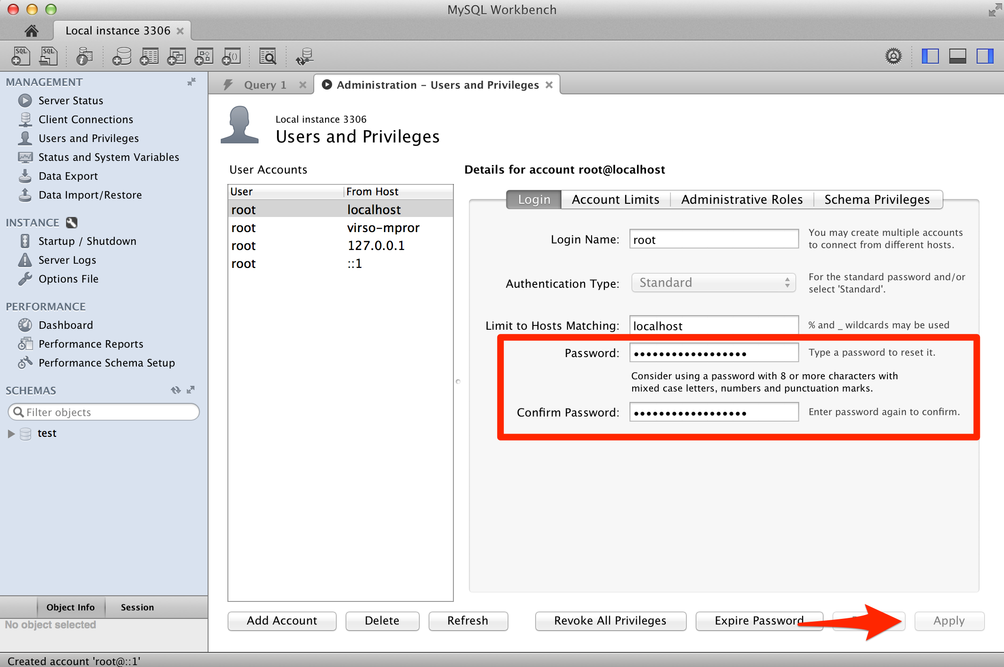
MySQL Workbench
Change root password
Notes:
‹#›

Slide 10
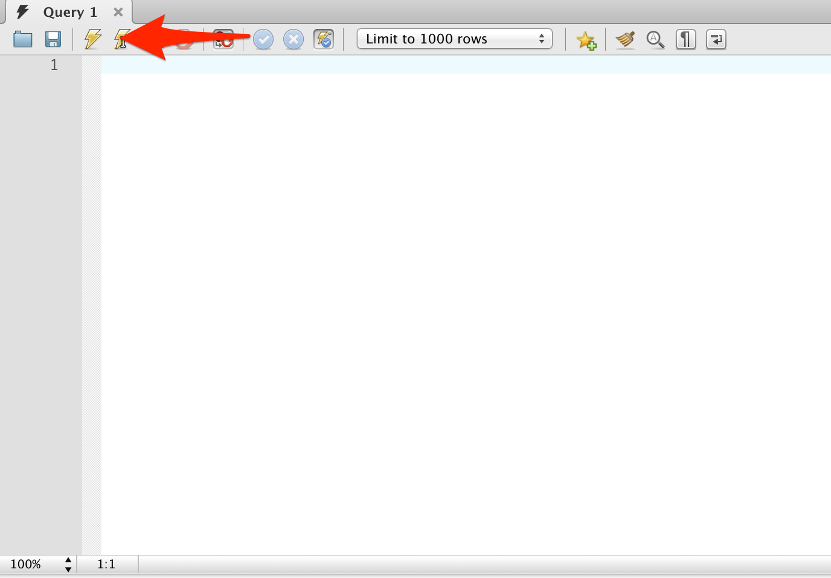
Entering SQL Commands
CREATE TABLE physician
( physid INT NOT NULL,
physname CHAR(30) NOT NULL,
specialty CHAR(15) NOT NULL,
street CHAR(20),
city CHAR(20),
province CHAR(2),
postal CHAR(6),
hired DATE,
PRIMARY KEY (physid) );
NOTE: ALL SQL Commands must end in a semicolon.
SQL Commands are CAPITALIZED only for emphasis; They can be entered in lowercase.
Column names are case-insensitive
Database and table names are case sensitive in SOME platforms

Slide 11
MySQL CLI
Command line interface
> mysql -u root -p Enter password: Welcome to the MySQL monitor. Commands end with ; or \g. Your MySQL connection id is 79 Server version: 5.6.21-log MySQL Community Server (GPL) Copyright (c) 2000, 2014, Oracle and/or its affiliates. All rights reserved. Oracle is a registered trademark of Oracle Corporation and/or its affiliates. Other names may be trademarks of their respective owners. Type 'help;' or '\h' for help. Type '\c' to clear the current input statement. mysql>
Notes:
‹#›

Slide 12
Managing Databases
Show databases
  SHOW DATABASES;
Create a database
  CREATE DATABASE <dbName>;
Select a database
  USE <dbName>;
Drop a database
  DROP DATABASE <dbName>;

Slide 13
Creating a Table
SYNTAX
  CREATE TABLE <tableName> (
  <list of attributes and their types>
  );
Note:
  Text can be entered in more than one line
  In case of multiple lines, end of command is when “;” character is received

Slide 14
Creating a Table - Example
CREATE TABLE Client (
Client_ID INT NOT NULL PRIMARY KEY,
Client_Name VARCHAR(30),
Street_Addr VARCHAR(30),
City VARCHAR(15),
Province VARCHAR(2),
Zip VARCHAR(6) NOT NULL
);

Slide 15
Creating a Table - Example
CREATE TABLE Client (
Client_ID INT NOT NULL,
Client_Name VARCHAR(30),
Street_Addr VARCHAR(30),
City VARCHAR(15),
Province VARCHAR(2),
Zip VARCHAR(6) NOT NULL,
PRIMARY KEY(Client_ID)
);

Slide 16
MySQL Datatypes
SMALLINT : -32768 to +32767
INT: -2147483648 to +2147483647
BIGINT: -9223372036854775808 to +9223372036854775807
DECIMAL (p, s): Numerical values with precision “p” and scale “s”.
  p is the total number of digits
  s is the number of digits after the decimal point
CHAR(n): Fixed length (size “n”) character data
VARCHAR(n): Variable length (maximum size “n”) character data
DATE: Date values in YYYY-MM-DD format (default)
Notes:
‹#›

Slide 17
MySQL Datatypes
AUTO_INCREMENT: Auto-increments, great for unique id’s.
CREATE TABLE example (
id BIGINT NOT NULL AUTO_INCREMENT,
PRIMARY KEY(id)
);

Slide 18
Inserting Data
SYNTAX
  INSERT INTO <tableName> [(<columns>)]
  VALUES (<list of attributes, in order>);
Examples
INSERT INTO Client VALUES ( 123, 'UWO', '555, Western Road', 'London', 'ON', 'N6G3A9' ); | INSERT INTO Client ( Client_ID, Client_Name, Zip ) VALUES ( 456, 'U of T', 'M1E2F5' );

Slide 19
Retrieving Data
SYNTAX - basic
  SELECT <attribute list or *>
  FROM <tableName>
  [WHERE <conditions>];
Examples
SELECT * FROM Client WHERE City IS NOT NULL; | SELECT Client_ID, Client_Name FROM Client WHERE Client_ID = 123;

Slide 20
Retrieving Data
SYNTAX - expanded
  SELECT Select_List
  FROM Table_List
  [WHERE Conditions]
  [GROUP BY Column_List]
  [UNION Clause]
  [HAVING Conditions]
  [ORDER BY Column_List]

Slide 21
Updating Data
SYNTAX
  UPDATE <tableName>
  SET <columnName_1> = <value_1>,…, <columnName_n> = <value_n>
  [WHERE <conditions>];
Examples
UPDATE Client SET Client_Name = 'Univ of Western Ontario', Street_Addr = '42, Western Road' WHERE Client_ID = 123;

Slide 22
Deleting Data
Removes only data from the table and leaves the structure intact.
SYNTAX
  DELETE FROM <tableName>
  [WHERE <condition>];
Examples
DELETE FROM Client WHERE Street_Addr IS NULL;

Slide 23
Dropping a Table
Removes the entire table (data as well as structure) from the database
SYNTAX
  DROP TABLE <tableName>;
Examples
DROP TABLE Client;

Slide 24
Primary Key
Use in CREATE and ALTER TABLE commands
  Primary key
    PRIMARY KEY (< column list>)
    <column name> <data type> PRIMARY KEY
  Required Data
    NOT NULL
Example:
CREATE TABLE person ( personID CHAR(9) NOT NULL, fName CHAR(9), lName CHAR(9) NOT NULL, age INT DEFAULT 30, PRIMARY KEY (personID) );
CREATE TABLE person ( personID CHAR(9) NOT NULL PRIMARY KEY, fName CHAR(9), lName CHAR(9) NOT NULL, age INT DEFAULT 30 );

Slide 25
Foreign Key
Foreign key
  Use in CREATE and ALTER TABLE commands
Example:
  PERSON table with personID already exists
CREATE TABLE address( addressId INT NOT NULL, streetName VARCHAR(40), city VARCHAR(20), personId CHAR(9), PRIMARY KEY (addressId), FOREIGN KEY (personId) REFERENCES Person(personId), );
Notes:
ON DELETE RESTRICT / NO ACTION
Rejects the delete or update operation for the parent table. Specifying RESTRICT (or NO ACTION) is the same as omitting the ON DELETE or ON UPDATE clause.
ON DELETE CASCADE
Delete or update the row from the parent table, and automatically delete or update the matching rows in the child table. Both ON DELETE CASCADE and ON UPDATE CASCADE are supported.
ON DELETE SET NULL
Delete or update the row from the parent table, and set the foreign key column or columns in the child table to NULL
‹#›

Slide 26
Database Catalog
Getting Information about your database
  List databases
    SHOW DATABASES;
  List tables (from currently selected database)
    SHOW TABLES;
  Describe the structure of a relation
    DESCRIBE <tableName>;
    SHOW COLUMNS FROM <tableName>;

Slide 27
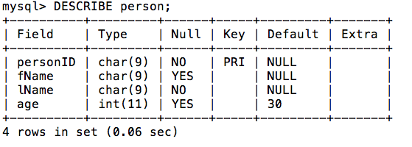
Database Catalog
Example:
  DESCRIBE person;

Slide 28
Database Catalog
Database schema is stored in information_schema schema in tables such as:
  TABLES
  COLUMNS
  VIEWS
  ….

Slide 29
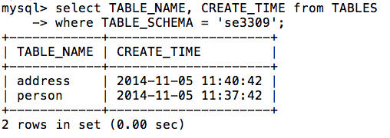
Database Catalog
Using catalog tables:
Example

Slide 30
Summary
DDL
  CREATE TABLE to create a table
  DROP TABLE to drop a table and all its data from the DB
Data Types: decimal, varchar, int, date…
DML
  INSERT to load data into a table
  SELECT to view data in a table
  UPDATE to change the value in a column
  DELETE to delete a row in the table

Slide 31

Questions

