Slide 1
Database Management Systems SE 3309a
Lecture #15
SQL Subqueries, Join and Updates
Dr. Miriam Capretz
The University of Western Ontario
11/12/2014
Dr. Miriam Capretz SE3309a DBMS
‹#›
Notes:
‹#›

Slide 2
Objectives
Use of SELECT embedded within another SELECT (Subqueries)
Retrieve data from database using SELECT and:
Join tables together.
Perform set operations (UNION, INTERSECT, EXCEPT).
Update database using INSERT, UPDATE, and DELETE.
11/12/2014
Dr. Miriam Capretz SE3309a DBMS
‹#›
Notes:
‹#›

Slide 3
Subqueries
Some SQL statements can have a SELECT embedded within them.
A subselect can be used in WHERE and HAVING clauses of an outer SELECT, where it is called a subquery or nested query.
Subselects may also appear in INSERT, UPDATE, and DELETE statements.
11/12/2014
Dr. Miriam Capretz SE3309a DBMS
‹#›
Notes:
‹#›

Slide 4
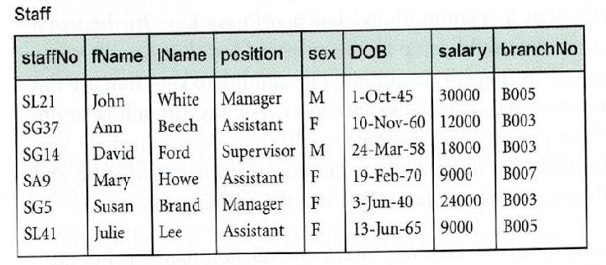

Subquery with Equality
List staff who work in branch at ‘163 Main St’.
SELECT staffNo, fName, lName, position
FROM Staff
WHERE branchNo =
Relational operator : =, <,>,<=, >=, <>
in WHERE or HAVING clause
11/12/2014
Dr. Miriam Capretz SE3309a DBMS
‹#›
Notes:
‹#›

Slide 5
Subquery with Equality
Inner SELECT finds branch number for branch at ‘163 Main St’ (‘B003’).
Outer SELECT then retrieves details of all staff who work at this branch.
Outer SELECT then becomes:
SELECT staffNo, fName, lName, position
FROM Staff
WHERE branchNo = ‘B003’;
11/12/2014
Dr. Miriam Capretz SE3309a DBMS
‹#›
Notes:
‹#›

Slide 6
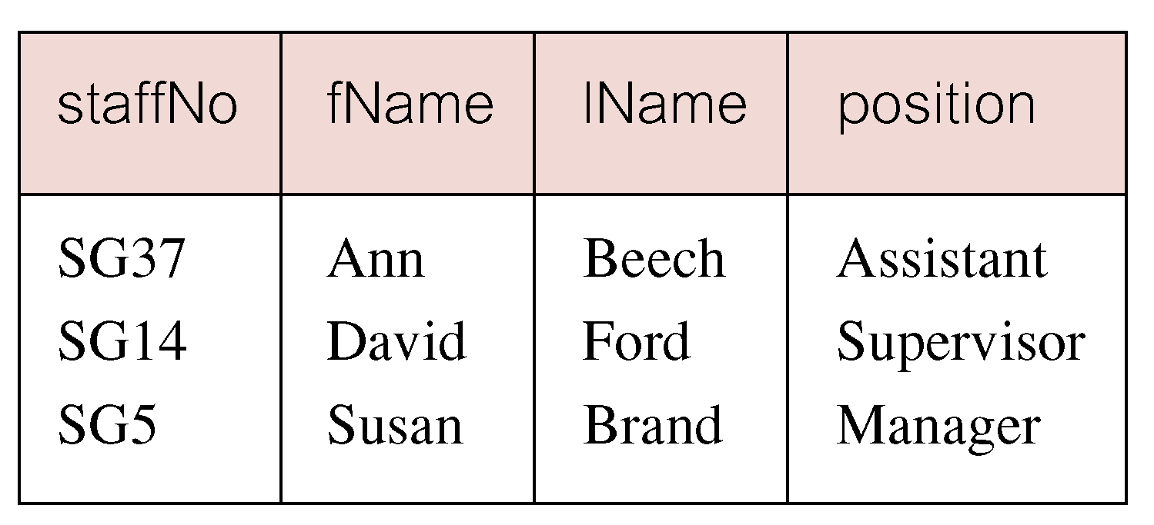
Subquery with Equality
11/12/2014
Dr. Miriam Capretz SE3309a DBMS
‹#›
Notes:
‹#›

Slide 7
Subquery with Aggregate
List all staff whose salary is greater than the average salary, and show by how much.
SELECT staffNo, fName, lName, position,
FROM Staff
WHERE
11/12/2014
Dr. Miriam Capretz SE3309a DBMS
‹#›
Notes:
‹#›

Slide 8
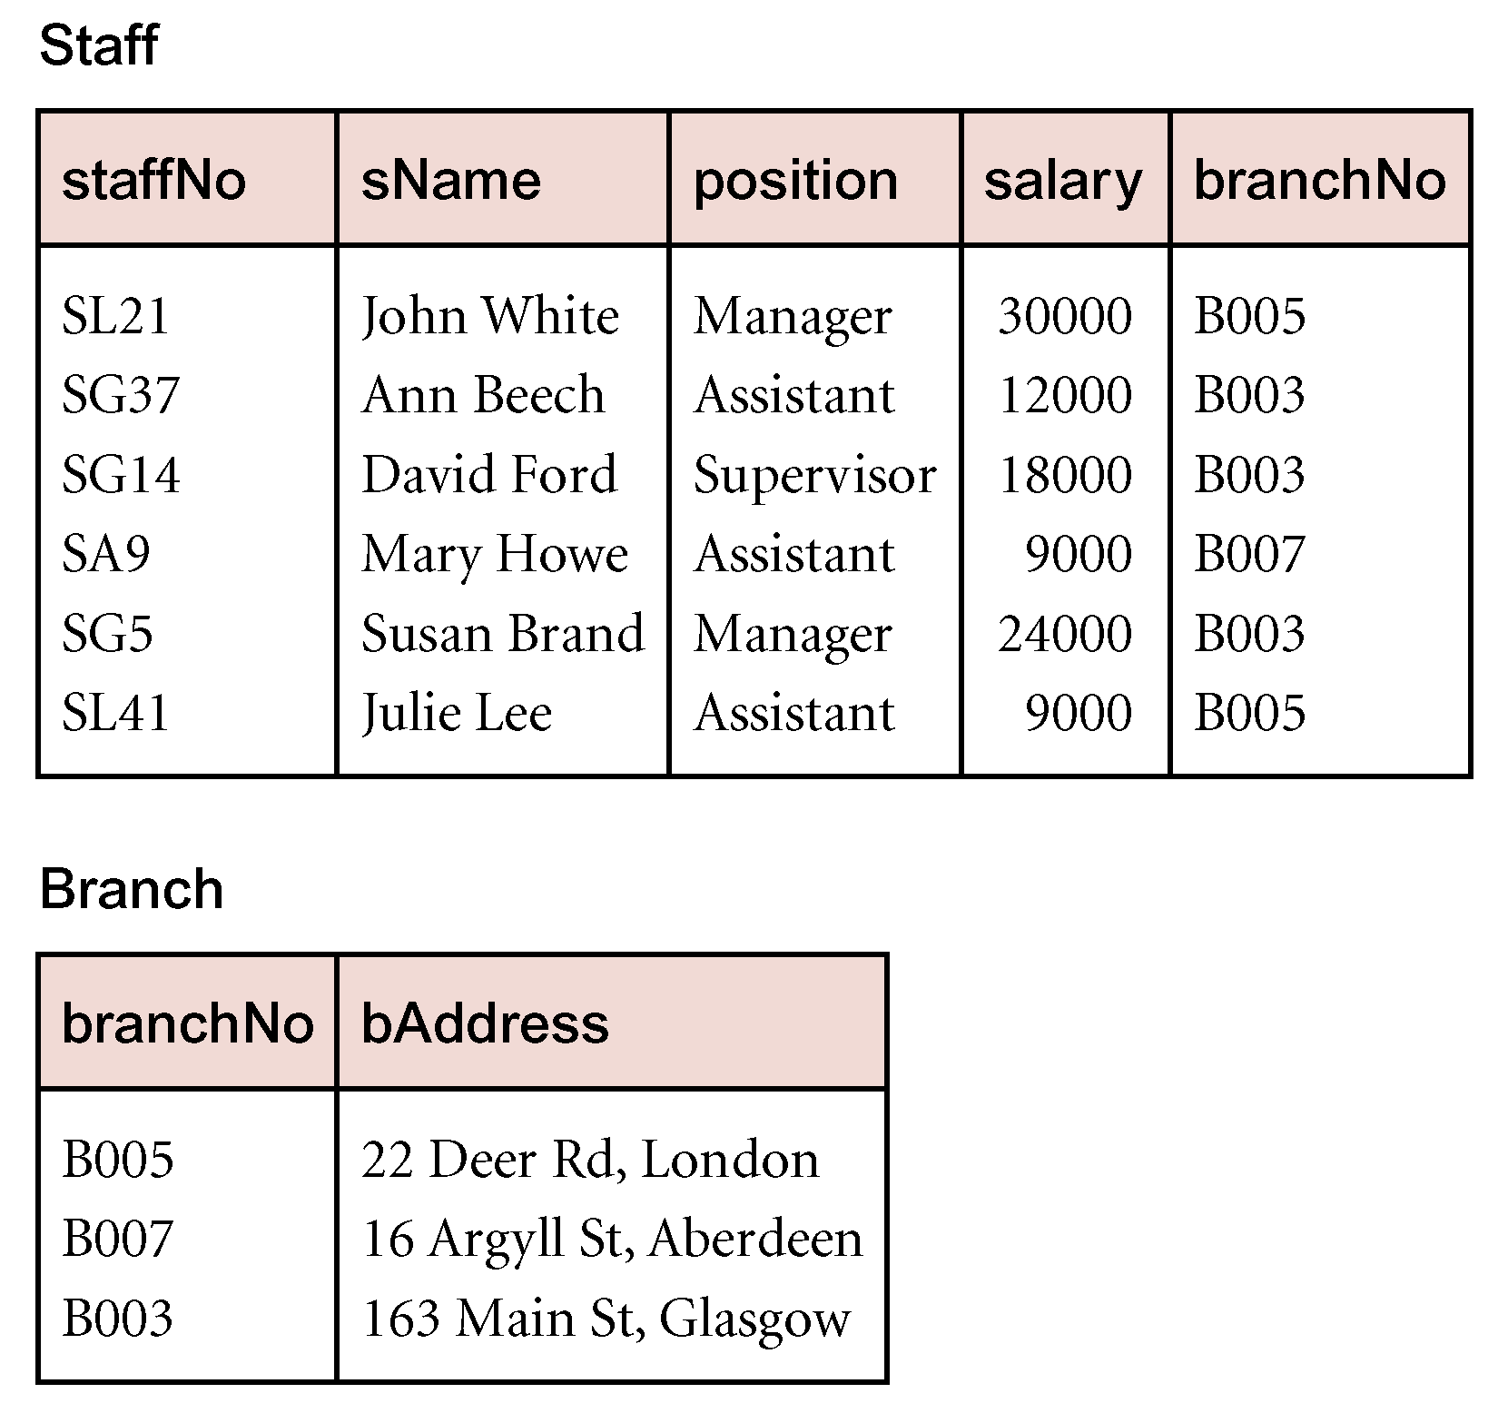
Subquery with Aggregate
Cannot write ‘WHERE salary > AVG(salary)’
Instead, use subquery to find average salary (17000), and then use outer SELECT to find those staff with salary greater than this:
SELECT staffNo, fName, lName, position,
salary – 17000 As salDiff
FROM Staff
WHERE salary > 17000;
11/12/2014
Dr. Miriam Capretz SE3309a DBMS
‹#›
Notes:
‹#›

Slide 9
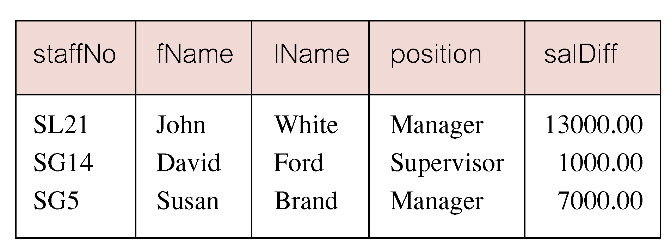
Subquery with Aggregate
11/12/2014
Dr. Miriam Capretz SE3309a DBMS
‹#›
Notes:
‹#›

Slide 10
Subquery Rules
ORDER BY clause may not be used in a subquery (although it may be used in outermost SELECT).
Subquery SELECT list must consist of a single column name or expression, except for subqueries that use EXISTS.
By default, column names refer to table name in FROM clause of subquery. Can refer to a table in FROM clause of an outer query by qualifying column name.
11/12/2014
Dr. Miriam Capretz SE3309a DBMS
‹#›
Notes:
‹#›

Slide 11
Subquery Rules
When subquery is an operand in a comparison, subquery must appear on right-hand side.
SELECT staffNo, fName, lName, position, salary
FROM Staff
WHERE (SELECT AVG(salary)FROM Staff) < salary;
X
11/12/2014
Dr. Miriam Capretz SE3309a DBMS
‹#›
Notes:
‹#›

Slide 12
Nested subquery: use of IN
List properties handled by staff at ‘163 Main St’.
SELECT propertyNo, street, city, postcode, type, rooms, rent
FROM PropertyForRent
WHERE
11/12/2014
Dr. Miriam Capretz SE3309a DBMS
‹#›
Notes:
‹#›

Slide 13
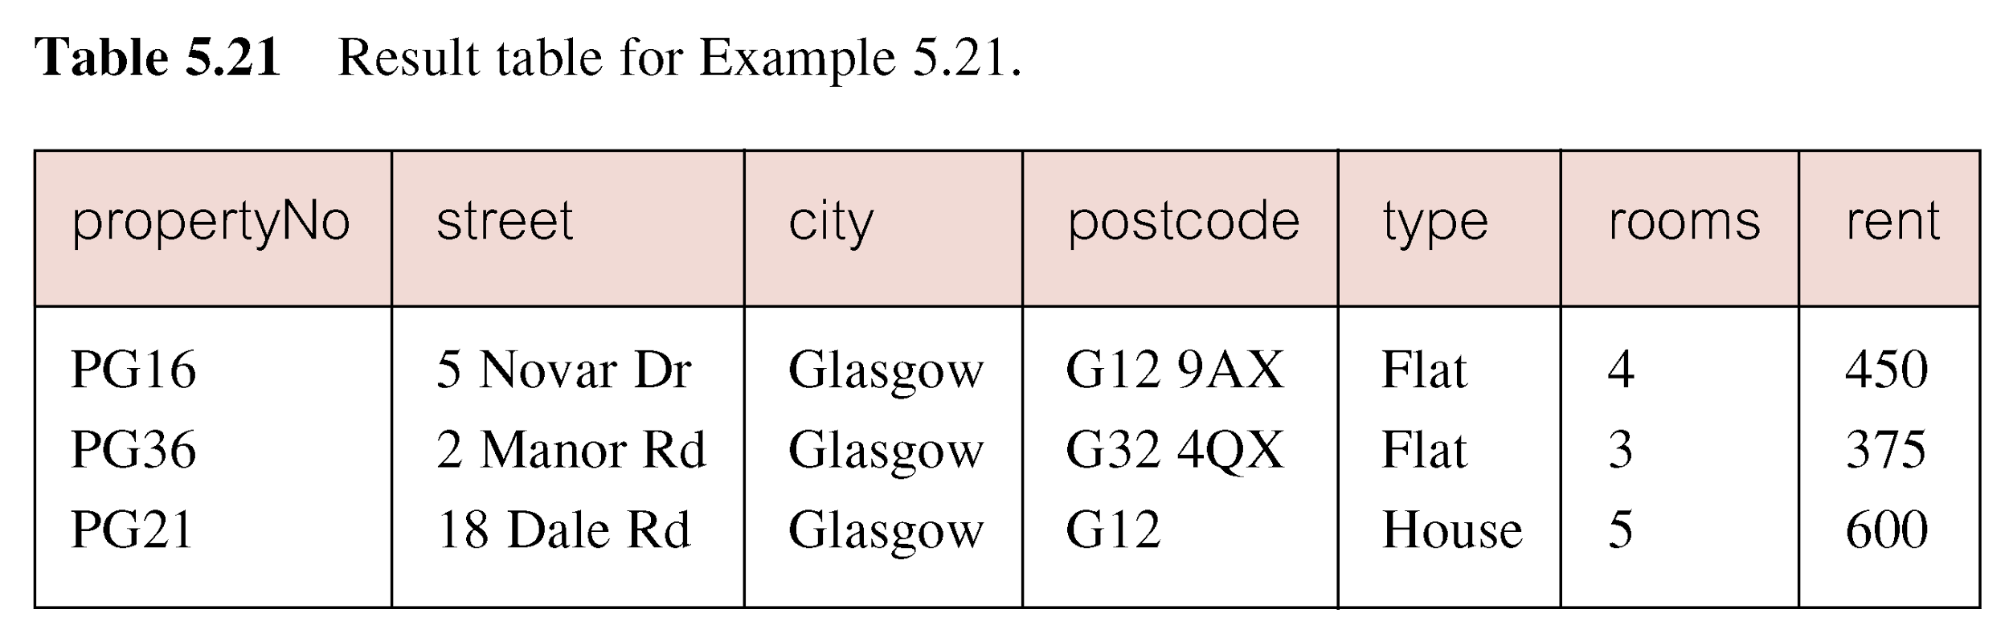
Nested subquery: use of IN
11/12/2014
Dr. Miriam Capretz SE3309a DBMS
‹#›
Notes:
‹#›

Slide 14
ANY and ALL
ANY and ALL may be used with subqueries that produce a single column of numbers.
With ALL, condition will only be true if it is satisfied by all values produced by subquery.
With ANY, condition will be true if it is satisfied by any values produced by subquery.
If subquery is empty, ALL returns true, ANY returns false.
SOME may be used in place of ANY.
11/12/2014
Dr. Miriam Capretz SE3309a DBMS
‹#›
Notes:
‹#›

Slide 15
Use of ANY/SOME
Find staff whose salary is larger than salary of at least one member of staff at branch B003.
SELECT staffNo, fName, lName, position, salary
FROM Staff
WHERE
11/12/2014
Dr. Miriam Capretz SE3309a DBMS
‹#›
Notes:
‹#›

Slide 16
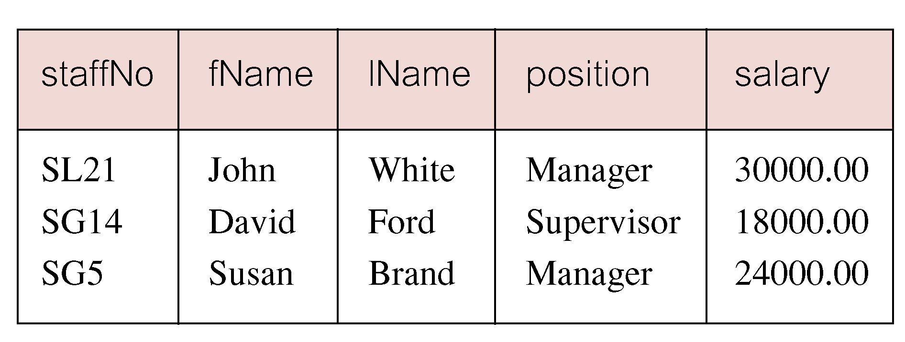
Use of ANY/SOME
Inner query produces set {12000, 18000, 24000} and outer query selects those staff whose salaries are greater than any of the values in this set.
11/12/2014
Dr. Miriam Capretz SE3309a DBMS
‹#›
Notes:
‹#›

Slide 17
Use of ALL
Find staff whose salary is larger than salary of every member of staff at branch B003.
SELECT staffNo, fName, lName, position, salary
FROM Staff
WHERE
11/12/2014
Dr. Miriam Capretz SE3309a DBMS
‹#›
Notes:
‹#›

Slide 18
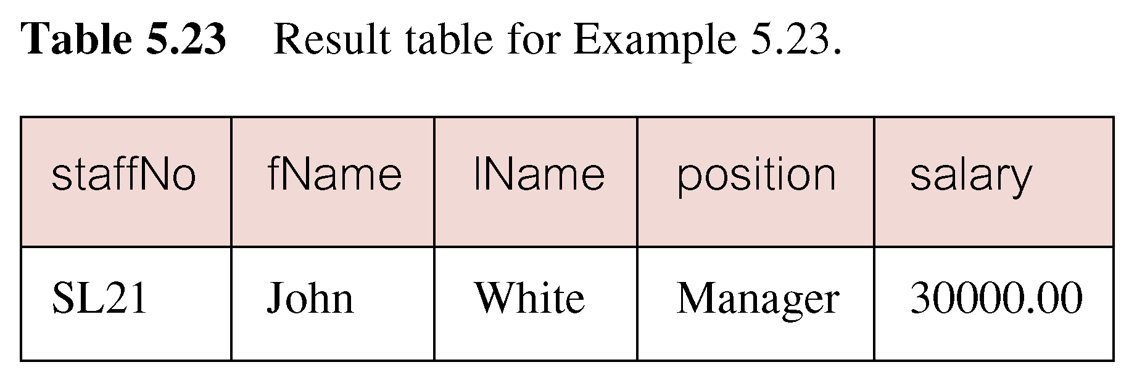
Use of ALL
11/12/2014
Dr. Miriam Capretz SE3309a DBMS
‹#›
Notes:
‹#›

Slide 19
Multi-Table Queries
Can use subqueries provided result columns come from same table.
If the result columns come from more than one table then we must use a join.
To perform join, include more than one table in the FROM clause.
Use comma as separator and typically include the WHERE clause to specify the join column(s).
11/12/2014
Dr. Miriam Capretz SE3309a DBMS
‹#›
Notes:
‹#›

Slide 20
Multi-Table Queries
Also possible to use an alias for a table named in the FROM clause.
Alias is separated from the table name with a space.
Alias can be used to qualify column names when there is ambiguity.
11/12/2014
Dr. Miriam Capretz SE3309a DBMS
‹#›
Notes:
‹#›

Slide 21
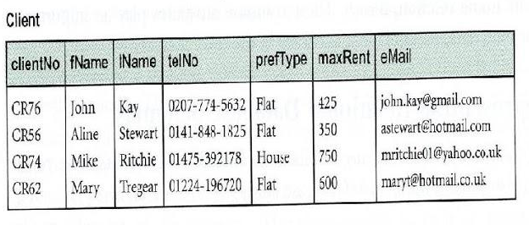
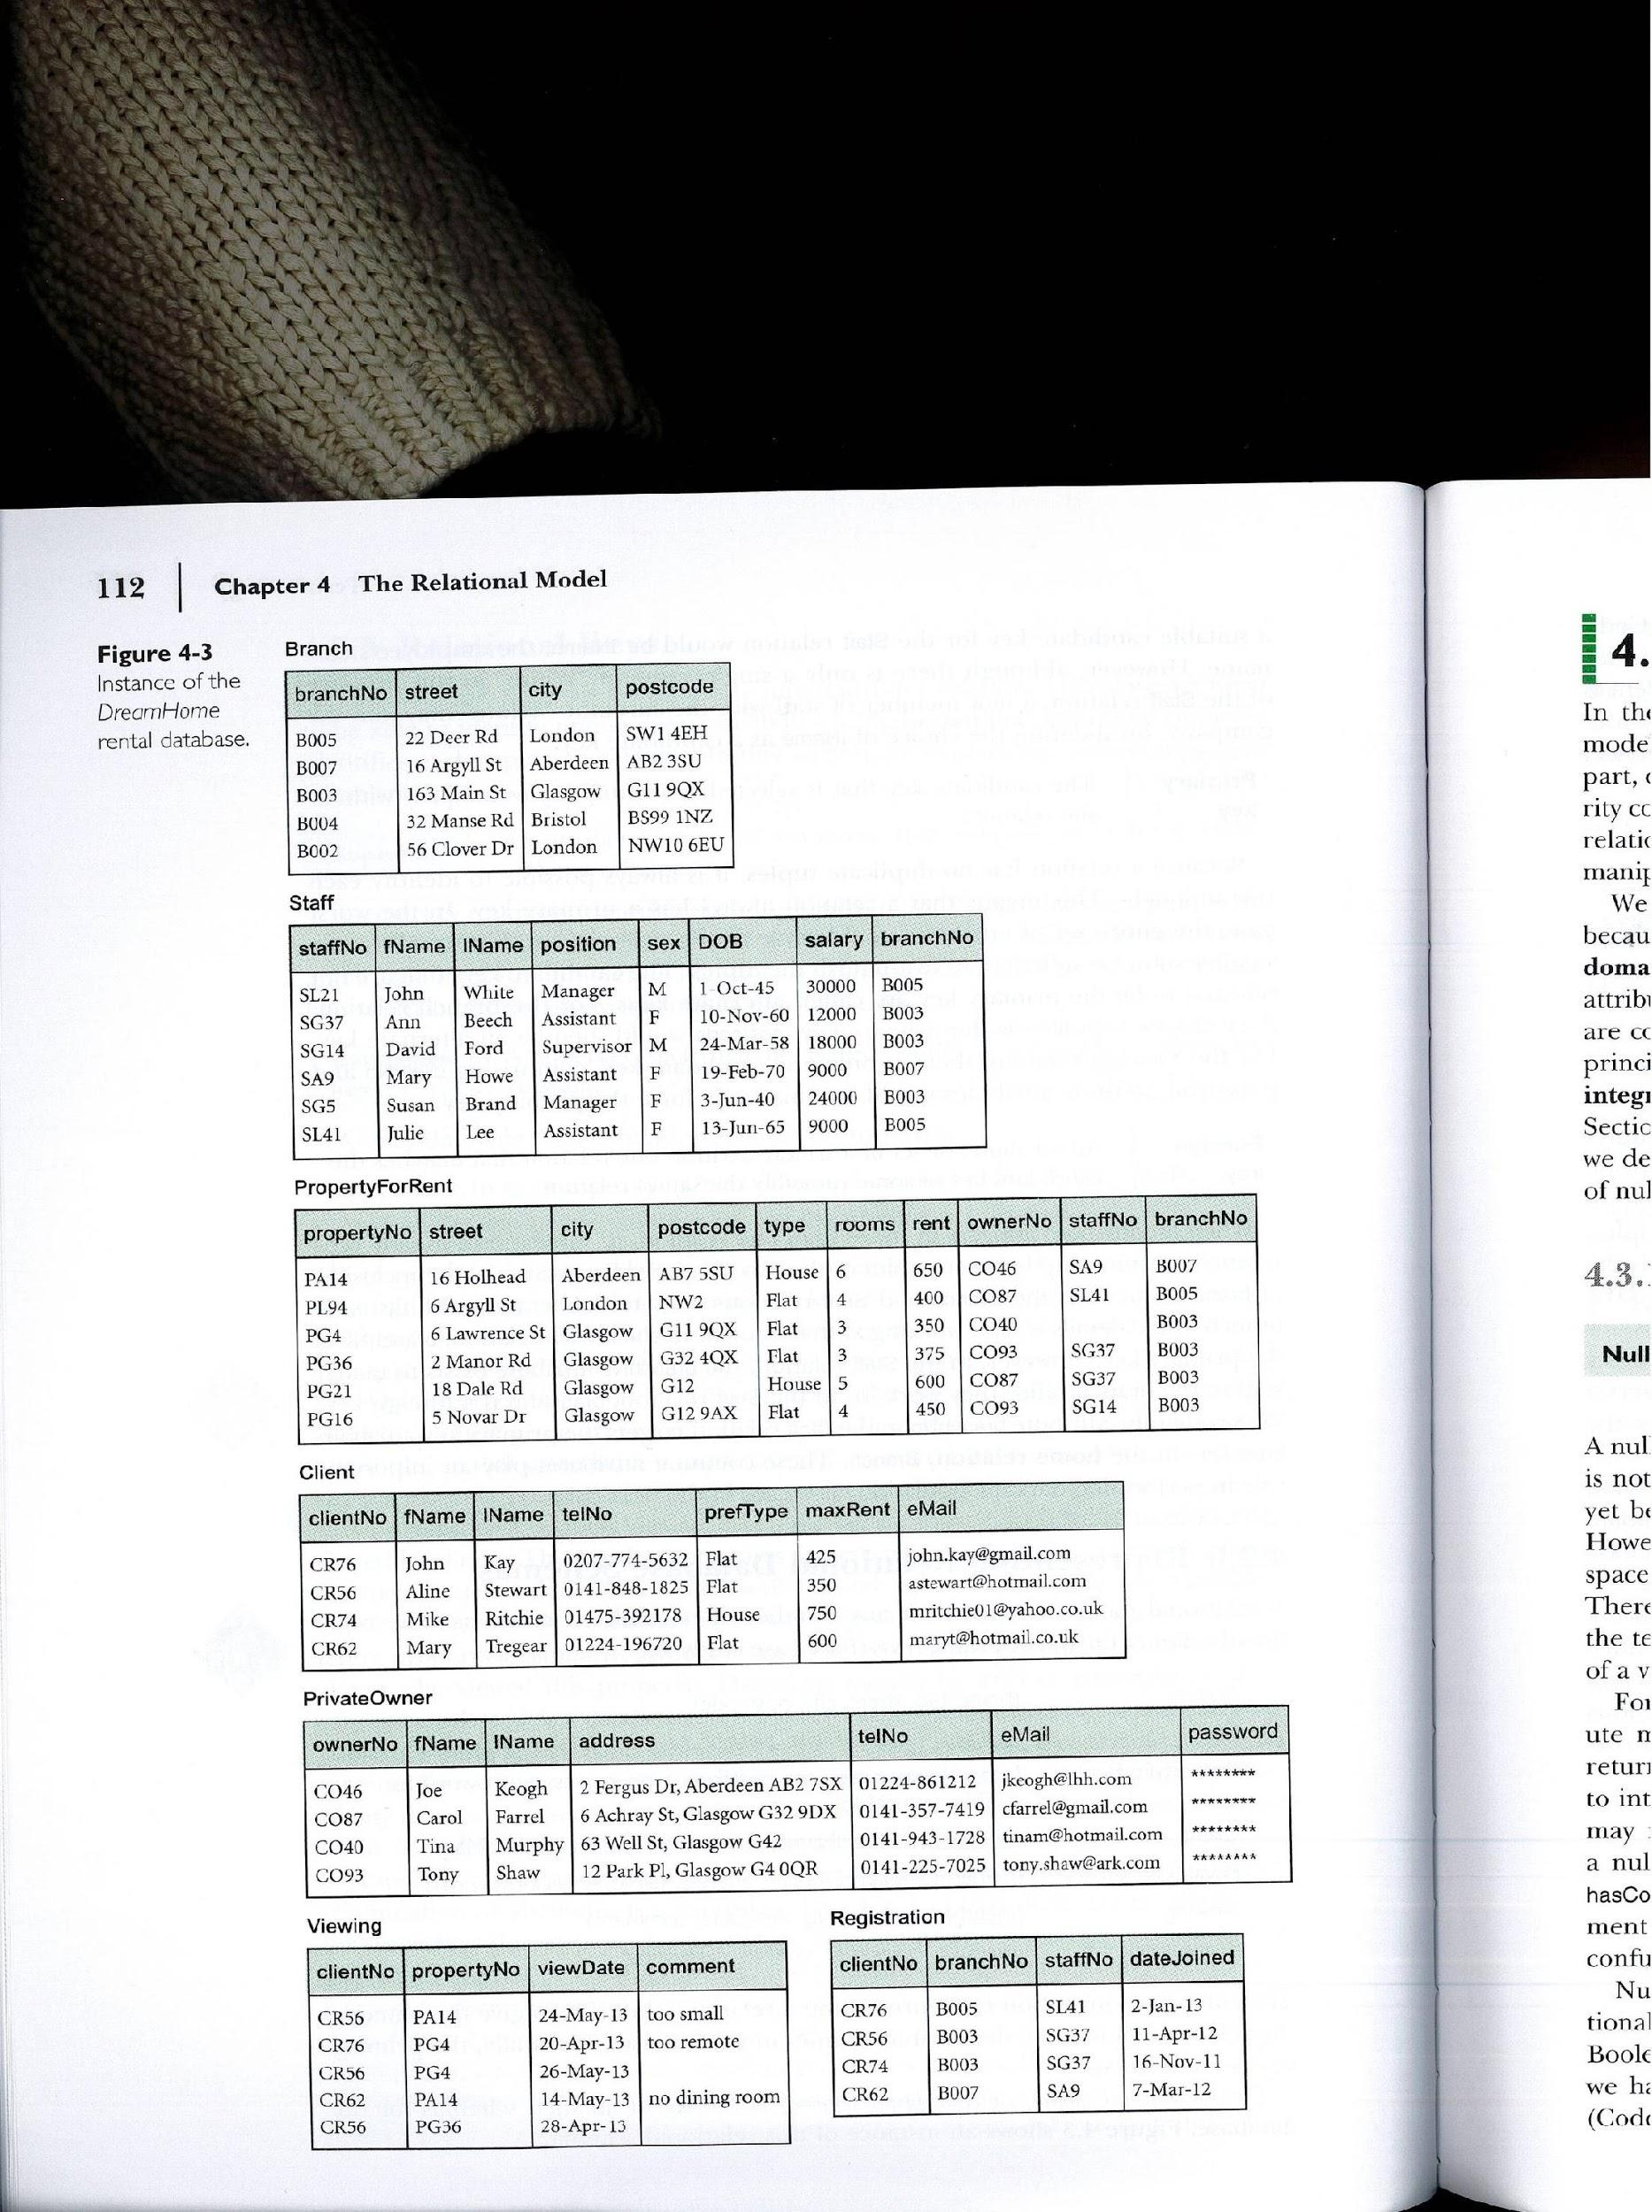
Simple Join
List the names of all clients who have viewed a property along with any comment supplied.
11/12/2014
Dr. Miriam Capretz SE3309a DBMS
‹#›
Notes:
‹#›

Slide 22
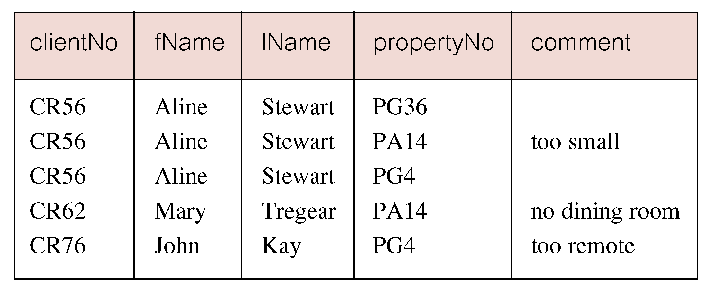
Simple Join
Only those rows from both tables that have identical values in the clientNo columns (c.clientNo = v.clientNo) are included in result.
Equivalent to natural join in relational algebra.
11/12/2014
Dr. Miriam Capretz SE3309a DBMS
‹#›
Notes:
‹#›

Slide 23
Alternative JOIN Constructs
SQL provides alternative ways to specify joins:
FROM Client c JOIN Viewing v ON c.clientNo = v.clientNo
FROM Client JOIN Viewing USING clientNo
FROM Client NATURAL JOIN Viewing
In each case, FROM replaces original FROM and WHERE. However, the first produces table with two identical clientNo columns.
11/12/2014
Dr. Miriam Capretz SE3309a DBMS
‹#›
Notes:
‹#›

Slide 24

Sorting a join
For each branch, list numbers and names of staff who manage properties, and the properties they manage.
11/12/2014
Dr. Miriam Capretz SE3309a DBMS
‹#›
Notes:
‹#›

Slide 25
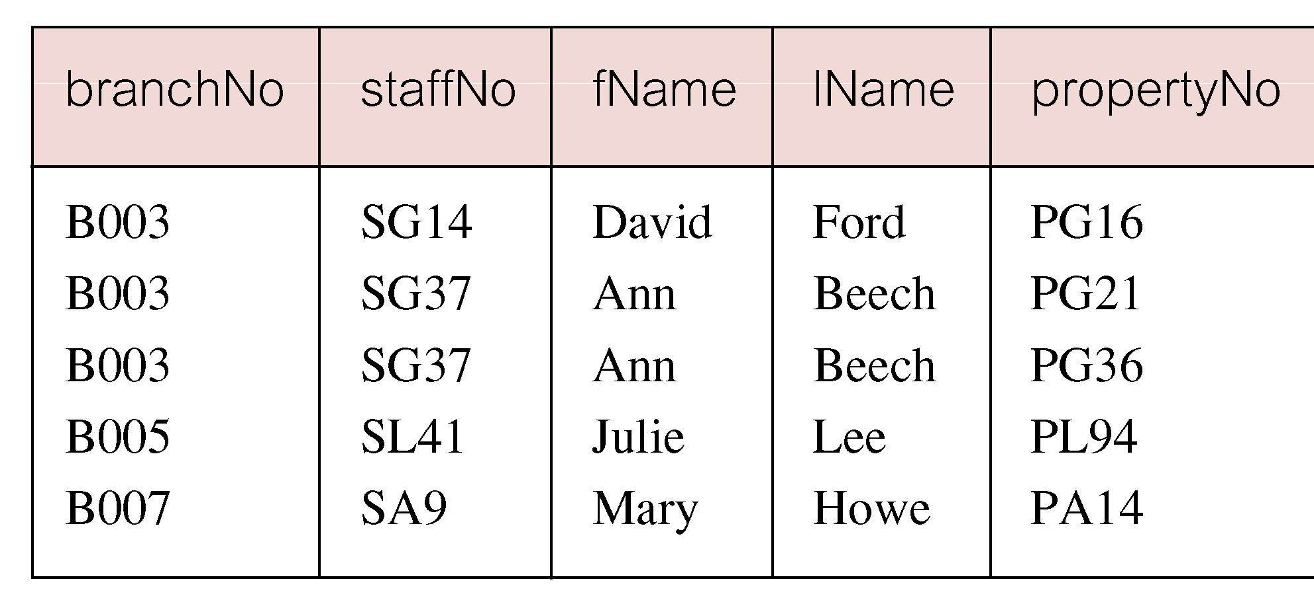
Sorting a join
11/12/2014
Dr. Miriam Capretz SE3309a DBMS
‹#›
Notes:
‹#›

Slide 26
Three Table Join
For each branch, list staff who manage properties, including city in which branch is located and the properties they manage.
11/12/2014
Dr. Miriam Capretz SE3309a DBMS
‹#›
Notes:
‹#›

Slide 27
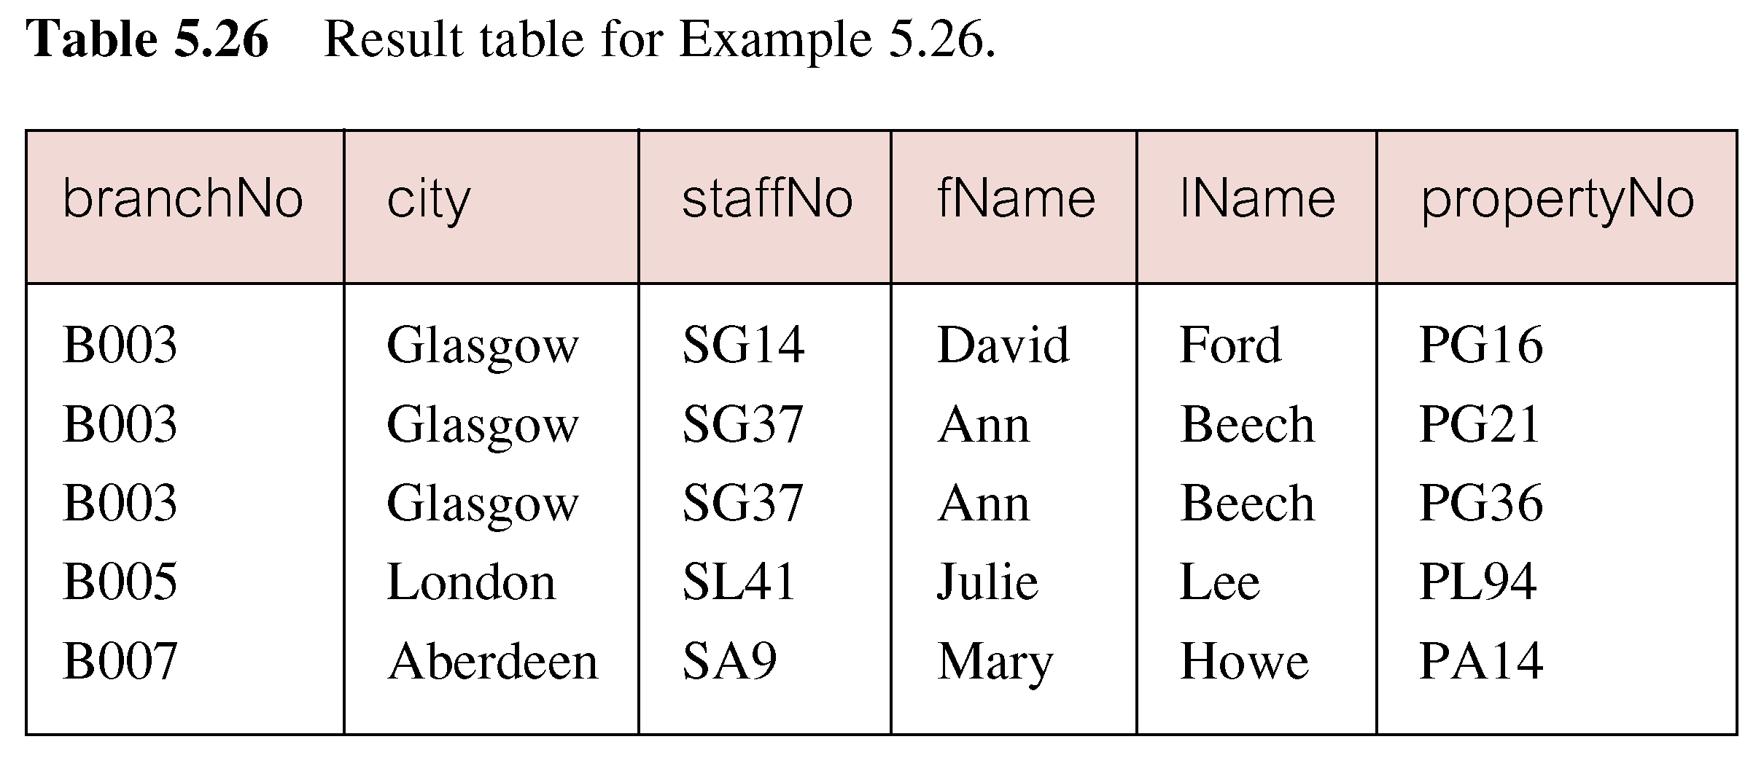
Three Table Join
Alternative formulation for FROM and WHERE:
FROM (Branch b JOIN Staff s USING branchNo) AS bs
JOIN PropertyForRent p USING staffNo
11/12/2014
Dr. Miriam Capretz SE3309a DBMS
‹#›
Notes:
‹#›

Slide 28
Multiple Grouping Columns
Find number of properties handled by each staff member, along with the branch number of the member of staff.
11/12/2014
Dr. Miriam Capretz SE3309a DBMS
‹#›
Notes:
‹#›

Slide 29
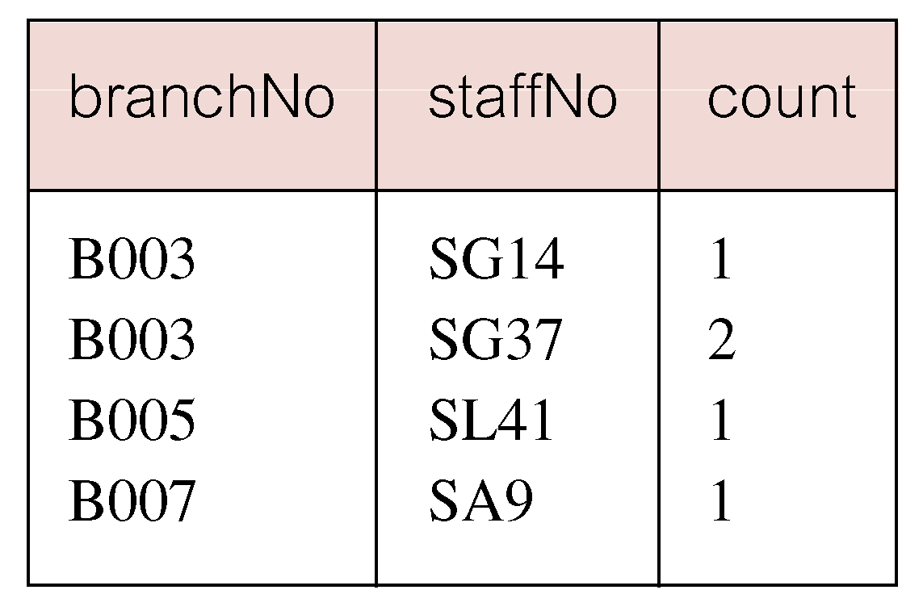
Multiple Grouping Columns
11/12/2014
Dr. Miriam Capretz SE3309a DBMS
‹#›
Notes:
‹#›

Slide 30
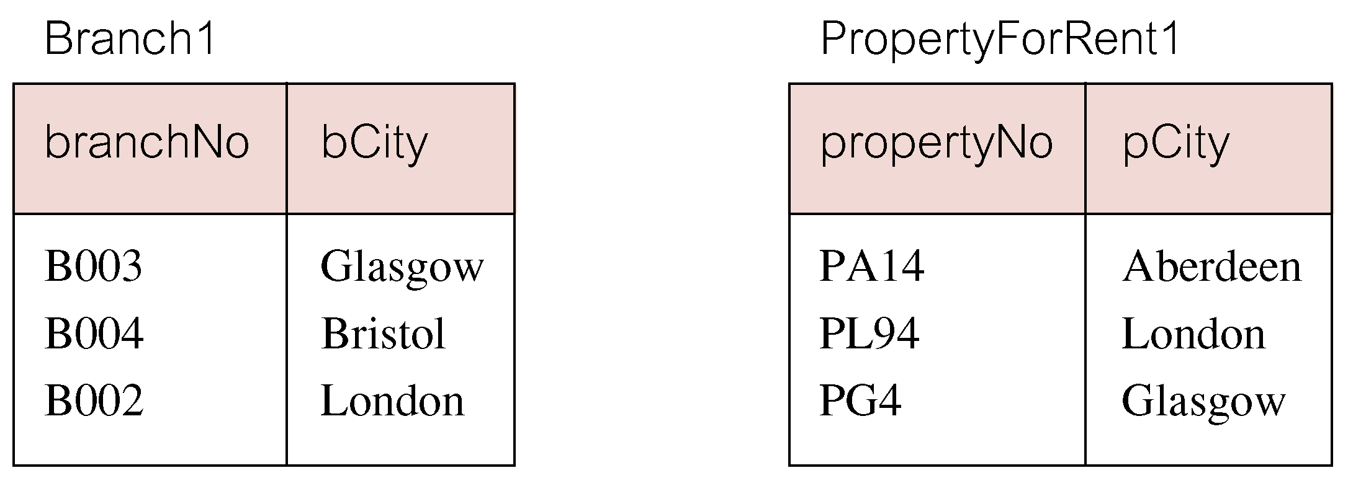
Outer Joins
If one row of a joined table is unmatched, the row is omitted from result table.
Outer join operations retain rows that do not satisfy the join condition.
Consider the following tables:
11/12/2014
Dr. Miriam Capretz SE3309a DBMS
‹#›
Notes:
‹#›

Slide 31
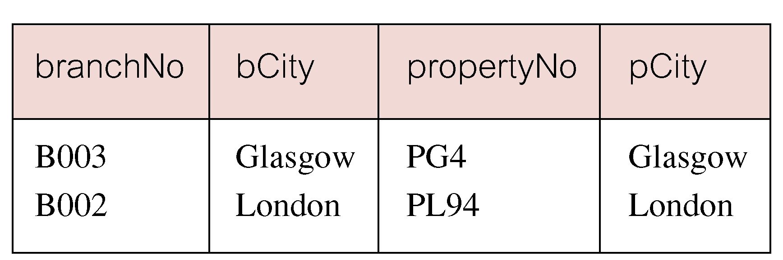
Outer Joins
The (inner) join of these two tables:
SELECT b.*, p.*
FROM Branch1 b, PropertyForRent1 p
WHERE b.bCity = p.pCity;
11/12/2014
Dr. Miriam Capretz SE3309a DBMS
‹#›
Notes:
‹#›

Slide 32
Outer Joins
The result table has two rows where cities are the same.
There are no rows corresponding to branches in Bristol and to properties in Aberdeen.
To include unmatched rows in the result table, use an Outer join.
11/12/2014
Dr. Miriam Capretz SE3309a DBMS
‹#›
Notes:
‹#›

Slide 33

Left Outer Join
List all branch offices and any properties that are in the same city.
11/12/2014
Dr. Miriam Capretz SE3309a DBMS
‹#›
Notes:
‹#›

Slide 34
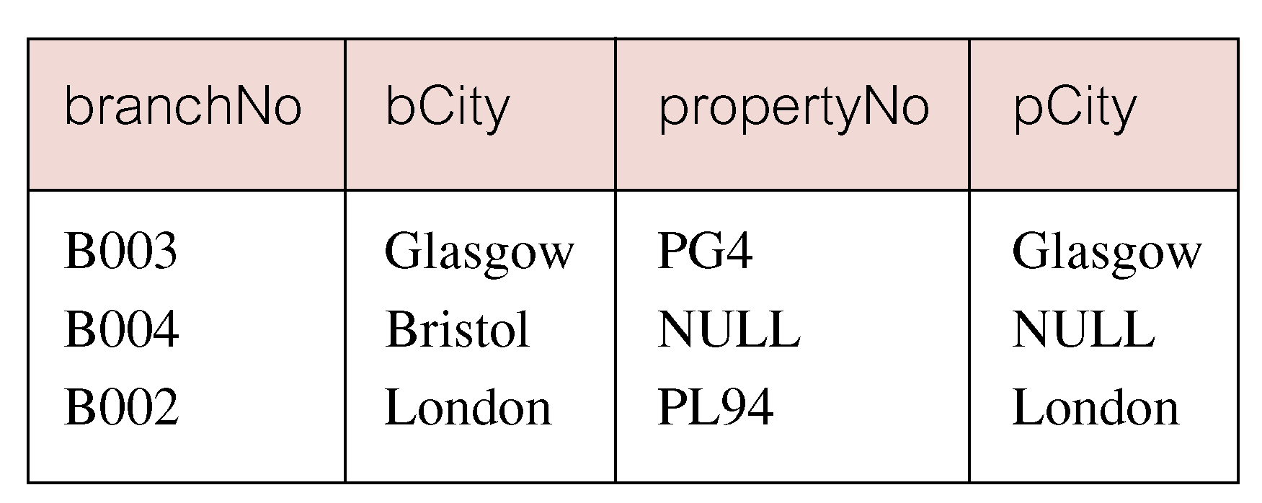
Left Outer Join
Includes those rows of first (left) table unmatched with rows from second (right) table.
Columns from second table are filled with NULLs.
11/12/2014
Dr. Miriam Capretz SE3309a DBMS
‹#›
Notes:
‹#›

Slide 35
Right Outer Join
List all properties and any branch offices that are in the same city.
SELECT b.*, p.*
FROM Branch1 b RIGHT JOIN PropertyForRent1 p ON b.bCity = p.pCity;
11/12/2014
Dr. Miriam Capretz SE3309a DBMS
‹#›
Notes:
‹#›

Slide 36
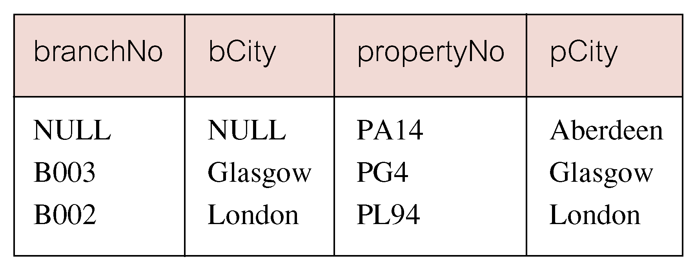
Right Outer Join
Right Outer join includes those rows of second (right) table that are unmatched with rows from first (left) table.
Columns from first table are filled with NULLs.
11/12/2014
Dr. Miriam Capretz SE3309a DBMS
‹#›
Notes:
‹#›

Slide 37
Full Outer Join
List branches and properties in the same city and any unmatched branches or properties.
SELECT b.*, p.*
FROM Branch1 b FULL JOIN PropertyForRent1 p ON b.bCity = p.pCity;
11/12/2014
Dr. Miriam Capretz SE3309a DBMS
‹#›
Notes:
‹#›

Slide 38
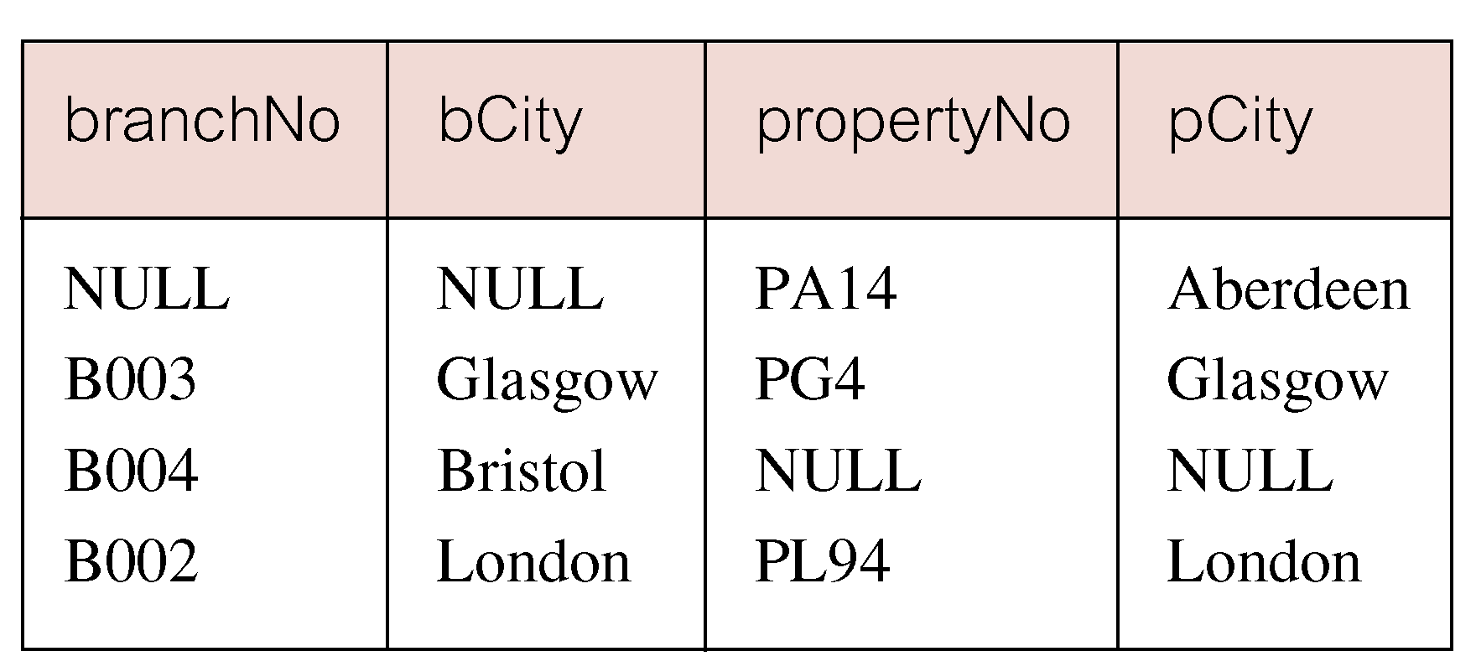
Full Outer Join
Includes rows that are unmatched in both tables.
Unmatched columns are filled with NULLs.
11/12/2014
Dr. Miriam Capretz SE3309a DBMS
‹#›
Notes:
‹#›

Slide 39
EXISTS and NOT EXISTS
EXISTS and NOT EXISTS are for use only with subqueries.
Produce a simple true/false result.
True if and only if there exists at least one row in the result table returned by subquery.
False if subquery returns an empty result table.
NOT EXISTS is the opposite of EXISTS.
11/12/2014
Dr. Miriam Capretz SE3309a DBMS
‹#›
Notes:
‹#›

Slide 40
EXISTS and NOT EXISTS
As (NOT) EXISTS check only for existence or non-existence of rows in the subquery result table, subquery can contain any number of columns.
Common for subqueries following (NOT) EXISTS to be of the form:
(SELECT * FROM...)
11/12/2014
Dr. Miriam Capretz SE3309a DBMS
‹#›
Notes:
‹#›

Slide 41
Query using EXISTS
Find all staff who work in a London branch.
SELECT staffNo, fName, lName, position
FROM Staff s
WHERE
11/12/2014
Dr. Miriam Capretz SE3309a DBMS
‹#›
Notes:
‹#›

Slide 42
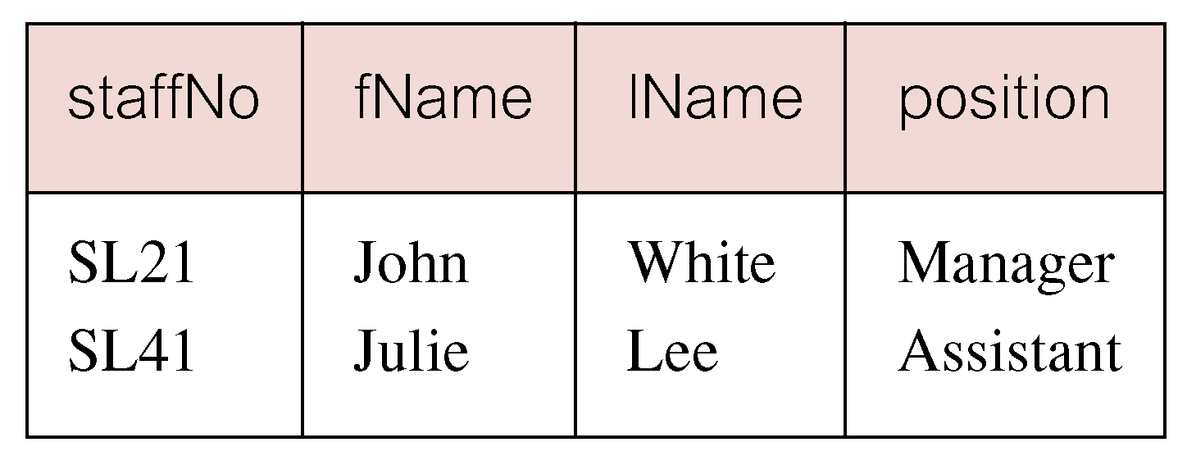
Query using EXISTS
11/12/2014
Dr. Miriam Capretz SE3309a DBMS
‹#›
Notes:
‹#›

Slide 43
Query using EXISTS
Note, search condition s.branchNo = b.branchNo is necessary to consider correct branch record for each member of staff.
If omitted, would get all staff records listed out because subquery:
SELECT * FROM Branch WHERE city=‘London’
would always be true and query would be:
SELECT staffNo, fName, lName, position FROM Staff
WHERE true;
11/12/2014
Dr. Miriam Capretz SE3309a DBMS
‹#›
Notes:
‹#›

Slide 44
Query using EXISTS
Could also write this query using join construct:
SELECT staffNo, fName, lName, position
FROM Staff s, Branch b
WHERE s.branchNo = b.branchNo AND
city = ‘London’;
11/12/2014
Dr. Miriam Capretz SE3309a DBMS
‹#›
Notes:
‹#›

Slide 45
Union, Intersect, and Difference (Except)
Can use normal set operations of Union, Intersection, and Difference to combine results of two or more queries into a single result table.
Union of two tables, A and B, is a table containing all rows in either A or B or both.
Intersection is a table containing all rows common to both A and B.
Difference is a table containing all rows in A but not in B.
Two tables must be union compatible.
11/12/2014
Dr. Miriam Capretz SE3309a DBMS
‹#›
Notes:
‹#›

Slide 46
Union, Intersect, and Difference (Except)
Format of set operator clause in each case is:
op [ALL] [CORRESPONDING [BY {column1 [, ...]}]]
If CORRESPONDING BY is specified, set operation performed on the named column(s).
If CORRESPONDING is specified but not BY clause, operation is performed on common columns.
If ALL specified, result can include duplicate rows.
11/12/2014
Dr. Miriam Capretz SE3309a DBMS
‹#›
Notes:
‹#›

Slide 47
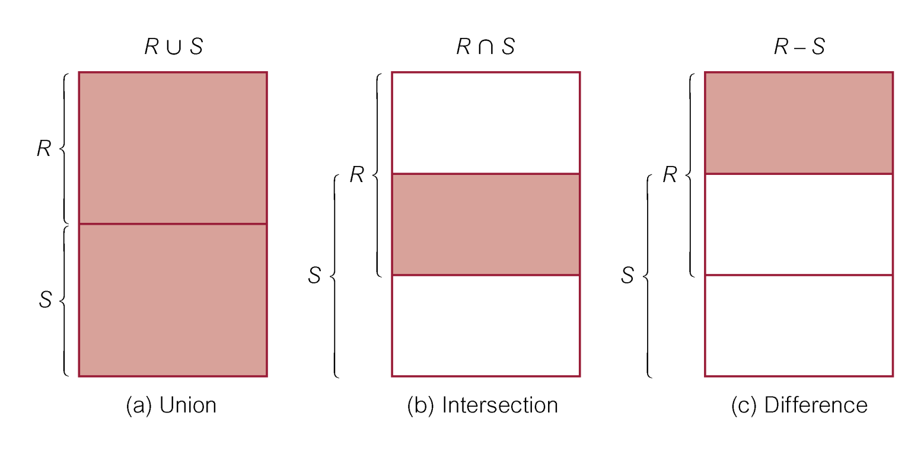
Union, Intersect, and Difference (Except)
11/12/2014
Dr. Miriam Capretz SE3309a DBMS
‹#›
Notes:
‹#›

Slide 48
Use of UNION
List all cities where there is either a branch office or a property.
11/12/2014
Dr. Miriam Capretz SE3309a DBMS
‹#›
Notes:
‹#›

Slide 49
Use of UNION
Or
(SELECT * FROM Branch WHERE city IS NOT NULL) UNION CORRESPONDING BY city (SELECT * FROM PropertyForRent WHERE city IS NOT NULL);
11/12/2014
Dr. Miriam Capretz SE3309a DBMS
‹#›
Notes:
‹#›

Slide 50
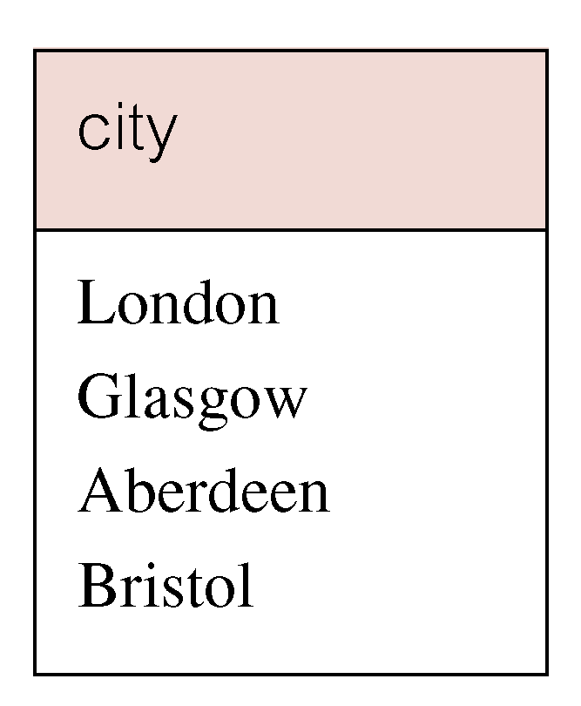
Use of UNION
Produces result tables from both queries and merges both tables together, with duplicate rows removed.
11/12/2014
Dr. Miriam Capretz SE3309a DBMS
‹#›
Notes:
‹#›

Slide 51
Use of INTERSECT
List all cities where there is both a branch office and a property.
11/12/2014
Dr. Miriam Capretz SE3309a DBMS
‹#›
Notes:
‹#›

Slide 52
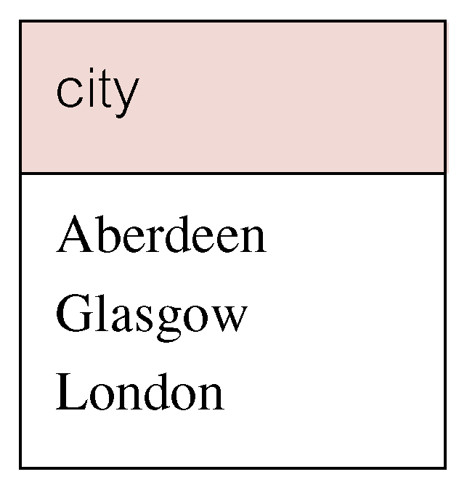
Use of INTERSECT
Or
(SELECT * FROM Branch)
INTERSECT CORRESPONDING BY city
(SELECT * FROM PropertyForRent);
11/12/2014
Dr. Miriam Capretz SE3309a DBMS
‹#›
Notes:
‹#›

Slide 53
Use of INTERSECT
Could rewrite this query without INTERSECT operator:
SELECT b.city
FROM Branch b PropertyForRent p
WHERE b.city = p.city;
Or:
SELECT DISTINCT city FROM Branch b
WHERE EXISTS
(SELECT * FROM PropertyForRent p
WHERE p.city = b.city);
11/12/2014
Dr. Miriam Capretz SE3309a DBMS
‹#›
Notes:
‹#›

Slide 54
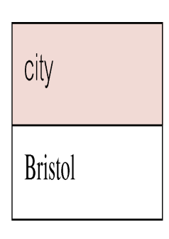
Use of EXCEPT
List of all cities where there is a branch office but no properties.
(SELECT city FROM Branch)
EXCEPT
(SELECT city FROM PropertyForRent);
Or
(SELECT * FROM Branch)
EXCEPT CORRESPONDING BY city
(SELECT * FROM PropertyForRent);
11/12/2014
Dr. Miriam Capretz SE3309a DBMS
‹#›
Notes:
‹#›

Slide 55
Use of EXCEPT
Could rewrite this query without EXCEPT:
SELECT DISTINCT city FROM Branch
WHERE city NOT IN
(SELECT city FROM PropertyForRent);
Or
SELECT DISTINCT city FROM Branch b
WHERE NOT EXISTS
(SELECT * FROM PropertyForRent p
WHERE p.city = b.city);
11/12/2014
Dr. Miriam Capretz SE3309a DBMS
‹#›
Notes:
‹#›

Slide 56
INSERT
INSERT INTO TableName [ (columnList) ]
VALUES (dataValueList)
columnList is optional; if omitted, SQL assumes a list of all columns in their original CREATE TABLE order.
Any columns omitted must have been declared as NULL when table was created, unless DEFAULT was specified when creating the column.
11/12/2014
Dr. Miriam Capretz SE3309a DBMS
‹#›
Notes:
‹#›

Slide 57
INSERT
dataValueList must match columnList as follows:
number of items in each list must be the same;
must be direct correspondence in position of items in two lists;
data type of each item in dataValueList must be compatible with data type of the corresponding column.
11/12/2014
Dr. Miriam Capretz SE3309a DBMS
‹#›
Notes:
‹#›

Slide 58
INSERT … VALUES
Insert a new row into Staff table supplying data for all columns.
INSERT INTO Staff
VALUES (‘SG16’, ‘Alan’, ‘Brown’, ‘Assistant’, ‘M’, Date‘1957-05-25’, 8300, ‘B003’);
11/12/2014
Dr. Miriam Capretz SE3309a DBMS
‹#›
Notes:
‹#›

Slide 59
INSERT using Defaults
Insert a new row into Staff table supplying data for all mandatory columns.
INSERT INTO Staff (staffNo, fName, lName,
position, salary, branchNo)
VALUES (‘SG44’, ‘Anne’, ‘Jones’,
‘Assistant’, 8100, ‘B003’);
Or
INSERT INTO Staff
VALUES (‘SG44’, ‘Anne’, ‘Jones’, ‘Assistant’, NULL,
NULL, 8100, ‘B003’);
11/12/2014
Dr. Miriam Capretz SE3309a DBMS
‹#›
Notes:
‹#›

Slide 60
INSERT … SELECT
Second form of INSERT allows multiple rows to be copied from one or more tables to another:
INSERT INTO TableName [ (columnList) ]
SELECT ...
11/12/2014
Dr. Miriam Capretz SE3309a DBMS
‹#›
Notes:
‹#›

Slide 61
INSERT … SELECT
Assume there is a table StaffPropCount that contains names of staff and number of properties they manage:
StaffPropCount(staffNo, fName, lName, propCnt)
Populate StaffPropCount using Staff and PropertyForRent tables.
11/12/2014
Dr. Miriam Capretz SE3309a DBMS
‹#›
Notes:
‹#›

Slide 62
INSERT … SELECT
INSERT INTO StaffPropCount
(SELECT s.staffNo, fName, lName, COUNT(*)
FROM Staff s, PropertyForRent p
WHERE s.staffNo = p.staffNo
GROUP BY s.staffNo, fName, lName)
UNION
(SELECT staffNo, fName, lName, 0
FROM Staff
WHERE staffNo NOT IN
(SELECT DISTINCT staffNo
FROM PropertyForRent));
11/12/2014
Dr. Miriam Capretz SE3309a DBMS
‹#›
Notes:
‹#›

Slide 63
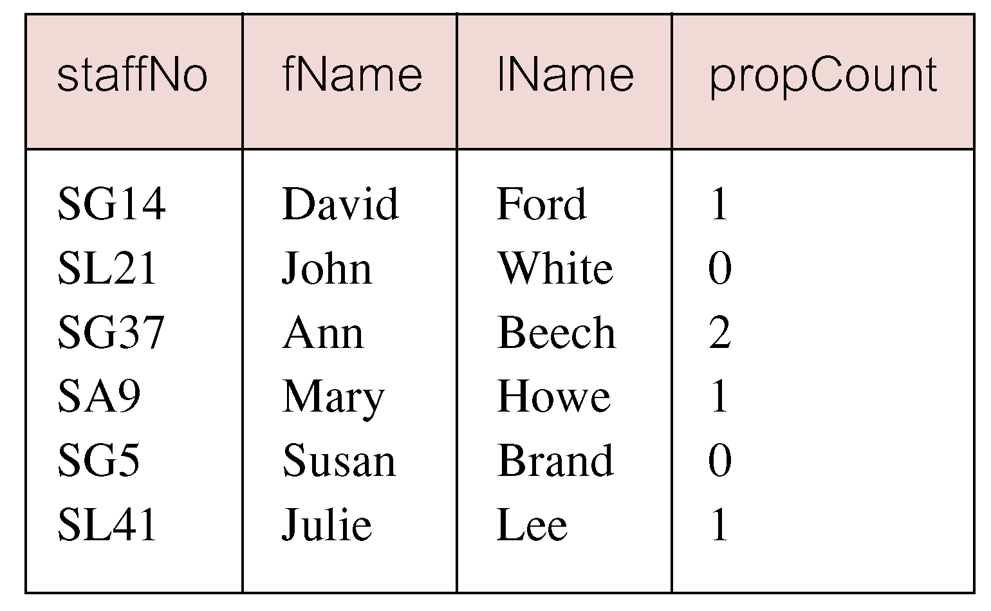
INSERT … SELECT
If second part of UNION is omitted, excludes those staff who currently do not manage any properties.
11/12/2014
Dr. Miriam Capretz SE3309a DBMS
‹#›
Notes:
‹#›

Slide 64
UPDATE
UPDATE TableName
SET columnName1 = dataValue1
[, columnName2 = dataValue2...]
[WHERE searchCondition]
TableName can be a name of a base table or an updatable view.
SET clause specifies names of one or more columns that are to be updated.
11/12/2014
Dr. Miriam Capretz SE3309a DBMS
‹#›
Notes:
‹#›

Slide 65
UPDATE
WHERE clause is optional:
if omitted, named columns are updated for all rows in table;
if specified, only those rows that satisfy searchCondition are updated.
New dataValue(s) must be compatible with data type for the corresponding column.
11/12/2014
Dr. Miriam Capretz SE3309a DBMS
‹#›
Notes:
‹#›

Slide 66
UPDATE All Rows
Give all staff a 3% pay increase.
11/12/2014
Dr. Miriam Capretz SE3309a DBMS
‹#›
Notes:
‹#›

Slide 67
Update Specific Rows
Give all Managers a 5% pay increase.
11/12/2014
Dr. Miriam Capretz SE3309a DBMS
‹#›
Notes:
‹#›

Slide 68
UPDATE Multiple Columns
Promote David Ford (staffNo=‘SG14’) to Manager and change his salary to $18,000.
11/12/2014
Dr. Miriam Capretz SE3309a DBMS
‹#›
Notes:
‹#›

Slide 69
DELETE
DELETE FROM TableName
[WHERE searchCondition]
TableName can be name of a base table or an updatable view.
searchCondition is optional; if omitted, all rows are deleted from the table. This does not delete the table. If search_condition is specified, only those rows that satisfy condition are deleted.
11/12/2014
Dr. Miriam Capretz SE3309a DBMS
‹#›
Notes:
‹#›

Slide 70
DELETE Specific Rows
Delete all viewings that relate to
property PG4.
Delete all records from the Viewing table.
11/12/2014
Dr. Miriam Capretz SE3309a DBMS
‹#›
Notes:
‹#›

