Slide 1
Database Management Systems SE 3309a
Lecture #17
SQL Data Definition, Constraints, Indexes and Views
Dr. Miriam Capretz
The University of Western Ontario
11/19/2014
Dr. Miriam Capretz SE3309a DBMS
‹#›
Notes:
‹#›

Slide 2
Objectives
Purpose of integrity enhancement feature of SQL.
How to define integrity constraints using SQL.
How to use the integrity enhancement feature in the CREATE and ALTER TABLE statements.
Indexes
Views
11/19/2014
Dr. Miriam Capretz SE3309a DBMS
‹#›
Notes:
‹#›

Slide 3
Integrity Enhancement Feature
Purpose: allows constraint checking to be centralized and standardized
It protects database from becoming inconsistent
Five types of integrity constraints:
Required data.
Domain constraints.
Entity integrity.
Referential integrity.
General constraints.
11/19/2014
Dr. Miriam Capretz SE3309a DBMS
‹#›
Notes:
‹#›

Slide 4
IEF – Required Data
In the CREATE and ALTER table:
position VARCHAR(10) NOT NULL
The system rejects any attempt to insert a NULL in the column
11/19/2014
Dr. Miriam Capretz SE3309a DBMS
‹#›
Notes:
‹#›

Slide 5
IEF – Domain Constraints
In the CREATE and ALTER table:
CHECK – check clause can reference
only the column being defined
CHECK (searchCondition)
11/19/2014
Dr. Miriam Capretz SE3309a DBMS
‹#›
Notes:
‹#›

Slide 6
IEF – Domain Constraints
ISO standard allows domain to be defined more explicitly using CREATE DOMAIN
CREATE DOMAIN DomainName [AS] dataType
[DEFAULT defaultOption]
[CHECK (searchCondition)]
For example:
CREATE DOMAIN SexType AS CHAR
DEFAULT ‘M’
CHECK (VALUE IN (‘M’, ‘F’));
When defining the column sex, we can use the domain name SexType
sex SexType NOT NULL
11/19/2014
Dr. Miriam Capretz SE3309a DBMS
‹#›
Notes:
‹#›

Slide 7
IEF – Domain Constraints
searchCondition can involve a table lookup:
ensures that the values entered correspond to an existing branch number in the Branch table
11/19/2014
Dr. Miriam Capretz SE3309a DBMS
‹#›
Notes:
‹#›

Slide 8
IEF – Domain Constraints
Domains can be removed using DROP DOMAIN:
DROP DOMAIN DomainName
[RESTRICT | CASCADE]
RESTRICT or CASCADE specifies the action to be taken if the domain is currently being used.
If RESTRICT is specified and the domain is used in an existing table or view or assertion definition, the drop will fail.
If CASCADE, table column is changed to use the domain’s underlying data type and any constraint or default clause is replaced by column constraint or default clause.
11/19/2014
Dr. Miriam Capretz SE3309a DBMS
‹#›
Notes:
‹#›

Slide 9
IEF - Entity Integrity
Primary key of a table must contain a unique, non-null value for each row.
ISO standard supports PRIMARY KEY clause in CREATE and ALTER TABLE statements:
Can only have one PRIMARY KEY clause per table. Can still ensure uniqueness for alternate keys using UNIQUE:
clientNo VARCHAR(5) NOT NULL,
propertyNo VARCHAR(5) Not NULL,
UNIQUE(clientNo, propertyNo)
11/19/2014
Dr. Miriam Capretz SE3309a DBMS
‹#›
Notes:
‹#›

Slide 10
IEF - Referential Integrity
FK is column or set of columns that links each row in child table containing foreign FK to row of parent table containing matching PK.
Referential integrity means that, if FK contains a value, that value must refer to existing row in a parent table.
ISO standard supports definition of FKs with FOREIGN KEY clause in CREATE and ALTER TABLE:
11/19/2014
Dr. Miriam Capretz SE3309a DBMS
‹#›
Notes:
‹#›

Slide 11
IEF - Referential Integrity
Any INSERT/UPDATE that attempts to create FK value in child table without matching candidate key value in parent is rejected.
Action taken that attempts to update/delete a candidate key value in the parent table with matching rows in the child table is dependent on the referential action specified using ON UPDATE and ON DELETE subclauses of the foreign key:
CASCADE - SET NULL
SET DEFAULT - NO ACTION
11/19/2014
Dr. Miriam Capretz SE3309a DBMS
‹#›
Notes:
‹#›

Slide 12
IEF - Referential Integrity
CASCADE: Delete row from parent and delete matching rows in child, and so on in cascading manner.
SET NULL: Delete row from parent and set FK column(s) in child to NULL.
SET DEFAULT: Delete row from parent and set each component of FK in child to specified default. Only valid if DEFAULT specified for FK columns.
NO ACTION: Reject delete from parent. Default setting.
11/19/2014
Dr. Miriam Capretz SE3309a DBMS
‹#›
Notes:
‹#›

Slide 13
IEF - Referential Integrity
In PropertyForRent table:
11/19/2014
Dr. Miriam Capretz SE3309a DBMS
‹#›
Notes:
‹#›

Slide 14
IEF - General Constraints
Could use CHECK/UNIQUE in CREATE and ALTER TABLE.
Also have:
CREATE ASSERTION AssertionName
CHECK (searchCondition)
which is very similar to the CHECK clause. However, when involves more than one table, ASSERTION is better than CHECK
11/19/2014
Dr. Miriam Capretz SE3309a DBMS
‹#›
Notes:
‹#›

Slide 15
IEF - General Constraints
Example: A rule that prevents a member of staff from managing more than 100 properties at the same time
CREATE ASSERTION StaffNotHandlingTooMuch
CHECK (NOT EXISTS (SELECT staffNo
FROM PropertyForRent
GROUP BY staffNo
HAVING COUNT(*) > 100))
11/19/2014
Dr. Miriam Capretz SE3309a DBMS
‹#›
Notes:
‹#›

Slide 16
Data Definition
SQL DDL allows database objects such as schemas, domains, tables, views, and indexes to be created and destroyed.
Main SQL DDL statements are:
CREATE SCHEMA DROP SCHEMA
CREATE/ALTER DOMAIN DROP DOMAIN
CREATE/ALTER TABLE DROP TABLE
CREATE VIEW DROP VIEW
Many DBMSs also provide (not covered by SQL standard)
CREATE INDEX DROP INDEX
11/19/2014
Dr. Miriam Capretz SE3309a DBMS
‹#›
Notes:
‹#›

Slide 17
Data Definition
Relations and other database objects exist in an environment.
Each environment contains one or more catalogs, and each catalog consists of set of schemas.
Schema is named collection of related database objects.
Objects in a schema can be tables, views, domains, assertions, etc. All have same owner and share a number of defaults.
11/19/2014
Dr. Miriam Capretz SE3309a DBMS
‹#›
Notes:
‹#›

Slide 18
CREATE SCHEMA
CREATE SCHEMA [Name |
AUTHORIZATION CreatorId ]
CREATE SCHEMA sqlTest AUTHORIZATION Smith;
DROP SCHEMA Name [RESTRICT | CASCADE ]
With RESTRICT (default), schema must be empty or operation fails.
With CASCADE, operation cascades to drop all objects associated with schema in order defined above. If any of these operations fail, DROP SCHEMA fails.
11/19/2014
Dr. Miriam Capretz SE3309a DBMS
‹#›
Notes:
‹#›

Slide 19
CREATE TABLE
CREATE TABLE TableName
{(colName dataType [NOT NULL] [UNIQUE]
[DEFAULT defaultOption]
[CHECK searchCondition] [,...]}
[PRIMARY KEY (listOfColumns),]
{[UNIQUE (listOfColumns),] […,]}
{[FOREIGN KEY (listOfFKColumns)
REFERENCES ParentTableName [(listOfCKColumns)],
[ON UPDATE referentialAction]
[ON DELETE referentialAction ]] [,…]}
{[CHECK (searchCondition)] [,…] })
11/19/2014
Dr. Miriam Capretz SE3309a DBMS
‹#›
Notes:
‹#›

Slide 20
CREATE TABLE
Creates a table with one or more columns of the specified dataType.
With NOT NULL, system rejects any attempt to insert a null in the column.
Can specify a DEFAULT value for the column.
Primary keys should always be specified as NOT NULL.
FOREIGN KEY clause specifies FK along with the referential action
11/19/2014
Dr. Miriam Capretz SE3309a DBMS
‹#›
Notes:
‹#›

Slide 21
Example - CREATE TABLE
CREATE DOMAIN OwnerNumber AS VARCHAR(5)
CHECK (VALUE IN (SELECT ownerNo FROM PrivateOwner));
CREATE DOMAIN StaffNumber AS VARCHAR(5)
CHECK (VALUE IN (SELECT staffNo FROM Staff));
CREATE DOMAIN PNumber AS VARCHAR(5);
CREATE DOMAIN PRooms AS SMALLINT
CHECK(VALUE BETWEEN 1 AND 15);
CREATE DOMAIN PRent AS DECIMAL(6,2)
CHECK(VALUE BETWEEN 0 AND 9999.99);
11/19/2014
Dr. Miriam Capretz SE3309a DBMS
‹#›
Notes:
‹#›

Slide 22
Example - CREATE TABLE
CREATE TABLE PropertyForRent (
propertyNo PNumber NOT NULL, ….
rooms PRooms NOT NULL DEFAULT 4,
rent PRent NOT NULL DEFAULT 600,
ownerNo OwnerNumber NOT NULL,
staffNo StaffNumber
Constraint StaffNotHandlingTooMuch ….
branchNo BranchNumber NOT NULL,
PRIMARY KEY (propertyNo),
FOREIGN KEY (staffNo) REFERENCES Staff
ON DELETE SET NULL ON UPDATE CASCADE ….);
11/19/2014
Dr. Miriam Capretz SE3309a DBMS
‹#›
Notes:
‹#›

Slide 23
PropertyForRent relation
CREATE TABLE PropertyForRent (
propertyNo PNumber NOT NULL,
street Street NOT NULL,
city City NOT NULL,
postcode PostCode,
type PropertyType NOT NULL DEFAULT ‘F’,
rooms PRooms NOT NULL DEFAULT 4,
rent PRent NOT NULL DEFAULT 600,
ownerNo OwnerNumber NOT NULL,
staffNo StaffNumber
Constraint StaffNotHandlingTooMuch ….
branchNo BranchNumber NOT NULL,
PRIMARY KEY (propertyNo),
FOREIGN KEY (staffNo) REFERENCES Staff
ON DELETE SET NULL ON UPDATE CASCADE,
FOREIGN KEY (ownerNo) REFERENCES PrivateOwner ON DELETE NO ACTION ON UPDATE CASCADE,
FOREIGN KEY (branchNo) REFERENCES Branch ON DELETE NO ACTION ON UPDATE CASCADE);
11/19/2014
Dr. Miriam Capretz SE3309a DBMS
‹#›
Notes:
‹#›

Slide 24
ALTER TABLE
Add a new column to a table.
Drop a column from a table.
Add a new table constraint.
Drop a table constraint.
Set a default for a column.
Drop a default for a column.
11/19/2014
Dr. Miriam Capretz SE3309a DBMS
‹#›
Notes:
‹#›

Slide 25
ALTER TABLE
ALTER TABLE TableName
[ADD [COLUMN] columName dataType [NOT NULL|UNIQUE]
[DEFAULT defaultOption] [CHECK (searchCondition)]]
[DROP [COLUMN] columnName [RESTRICT | CASCADE]]
[ADD [CONSTRAINT [constraintName]] tableConstraintDefinition]
[DROP CONSTRAINT constraintName [RESTRICT | CASCADE]]
[ALTER [COLUMN] SET DEFAULT defaultOption]
[ALTER [COLUMN] DROP DEFAULT]
11/19/2014
Dr. Miriam Capretz SE3309a DBMS
‹#›
Notes:
‹#›

Slide 26
Example - ALTER TABLE
Change Staff table by removing default of ‘Assistant’ for position column and setting default for sex column to female (‘F’).
11/19/2014
Dr. Miriam Capretz SE3309a DBMS
‹#›
Notes:
‹#›

Slide 27
Example - ALTER TABLE
Remove constraint from PropertyForRent that staff not allowed to handle more than 100 properties at time. Add new column to Client table.
11/19/2014
Dr. Miriam Capretz SE3309a DBMS
‹#›
Notes:
‹#›

Slide 28
DROP TABLE
DROP TABLE TableName [RESTRICT | CASCADE]
e.g. DROP TABLE PropertyForRent;
Removes named table and all rows within it.
With RESTRICT, if any other objects depend for their existence on continued existence of this table, SQL does not allow request.
With CASCADE, SQL drops all dependent objects (and objects dependent on these objects).
DELETE: removes rows from the table but retain the table structure
11/19/2014
Dr. Miriam Capretz SE3309a DBMS
‹#›
Notes:
‹#›

Slide 29
INDEX
Is a structure that provides accelerated access to the rows of a table based on the values of one or more columns
Can significantly improve the performance of a query
However, since indexes may be updated by the system every time the underlying tables are updated, additional overheads may be incurred.
Usually created to satisfy particular search criteria after the table has been in use for some time and has grown in size
INDEX is not in standard SQL
11/19/2014
Dr. Miriam Capretz SE3309a DBMS
‹#›
Notes:
‹#›

Slide 30
INDEX
CREATE [UNIQUE] INDEX IndexName
ON TableName (columnName [ASC| DESC] [,..])
Can be created only on base tables not on views.
DROP INDEX IndexName
11/19/2014
Dr. Miriam Capretz SE3309a DBMS
‹#›
Notes:
‹#›

Slide 31
Index
Example: Index for the Staff and PropertyForRent tables
CREATE UNIQUE INDEX StaffNoInd ON Staff (staffNo);
CREATE UNIQUE INDEX PropertyNoInd ON PropertyForRent (propertyNo);
Index for PropertyForRent table. Entries are alphabetically ordered by city and then by rent within each city
CREATE INDEX RentInd ON PropertyForRent (city, rent);
11/19/2014
Dr. Miriam Capretz SE3309a DBMS
‹#›
Notes:
‹#›

Slide 32
Views
Purpose of views.
How to create and delete views using SQL.
How the DBMS performs operations on views.
Under what conditions views are updatable.
View Resolution
Advantages and disadvantages of views
View Materialization
11/19/2014
Dr. Miriam Capretz SE3309a DBMS
‹#›
Notes:
‹#›

Slide 33
Views
Why use views?
To hide some data from users
To make certain queries easier or more natural to express
For modularity
Provides a certain degree of database security
Real database use lots and lots of views
11/19/2014
Dr. Miriam Capretz SE3309a DBMS
‹#›
Notes:
‹#›

Slide 34
Views
View
Dynamic result of one or more relational operations operating on base relations to produce another relation.
Virtual relation that does not necessarily actually exist in the database but is produced upon request, at time of request.
11/19/2014
Dr. Miriam Capretz SE3309a DBMS
‹#›
Notes:
‹#›

Slide 35
Views
Contents of a view are defined as a query on one or more base relations.
With view resolution, any operations on view are automatically translated into operations on relations from which it is derived.
With view materialization, the view is stored as a temporary table, which is maintained as the underlying base tables are updated.
11/19/2014
Dr. Miriam Capretz SE3309a DBMS
‹#›
Notes:
‹#›

Slide 36
SQL - CREATE VIEW
CREATE VIEW ViewName [ (newColumnName [,...]) ]
AS subselect
[WITH [CASCADED | LOCAL] CHECK OPTION]
Can assign a name to each column in view.
If list of column names is specified, it must have same number of items as number of columns produced by subselect.
If omitted, each column takes name of corresponding column in subselect.
11/19/2014
Dr. Miriam Capretz SE3309a DBMS
‹#›
Notes:
‹#›

Slide 37
SQL - CREATE VIEW
List must be specified if there is any ambiguity in a column name.
The subselect is known as the defining query.
WITH CHECK OPTION ensures that if a row fails to satisfy WHERE clause of defining query, it is not added to underlying base table.
11/19/2014
Dr. Miriam Capretz SE3309a DBMS
‹#›
Notes:
‹#›

Slide 38
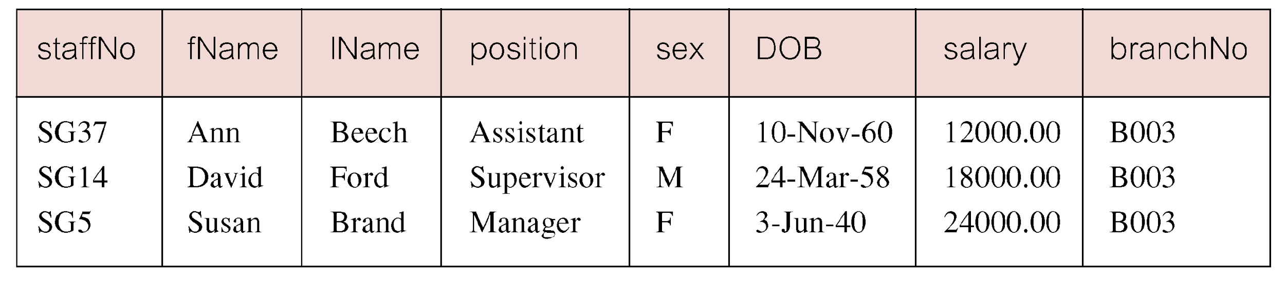
Example - Create Horizontal View
Create view so that manager at branch B003 can only see details for staff who work in his or her office.
11/19/2014
Dr. Miriam Capretz SE3309a DBMS
‹#›
Notes:
‹#›

Slide 39
Create Vertical View
Vertical views are used where the data stored in a table is used by various users or group of users
11/19/2014
Dr. Miriam Capretz SE3309a DBMS
‹#›
Notes:
‹#›

Slide 40
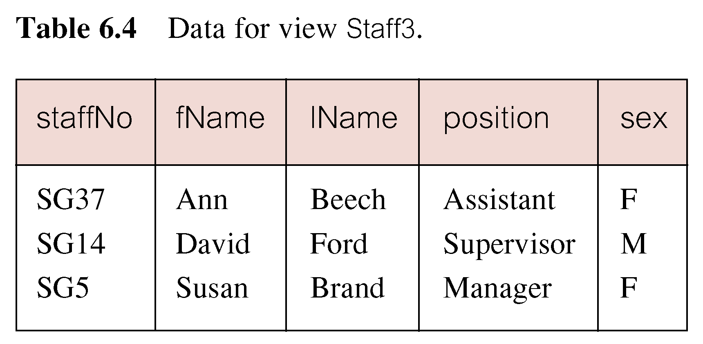
Example - Create Vertical View
Create view of staff details at branch B003 excluding salaries.
We could use Manager3Staff view instead of the Staff table
11/19/2014
Dr. Miriam Capretz SE3309a DBMS
‹#›
Notes:
‹#›

Slide 41
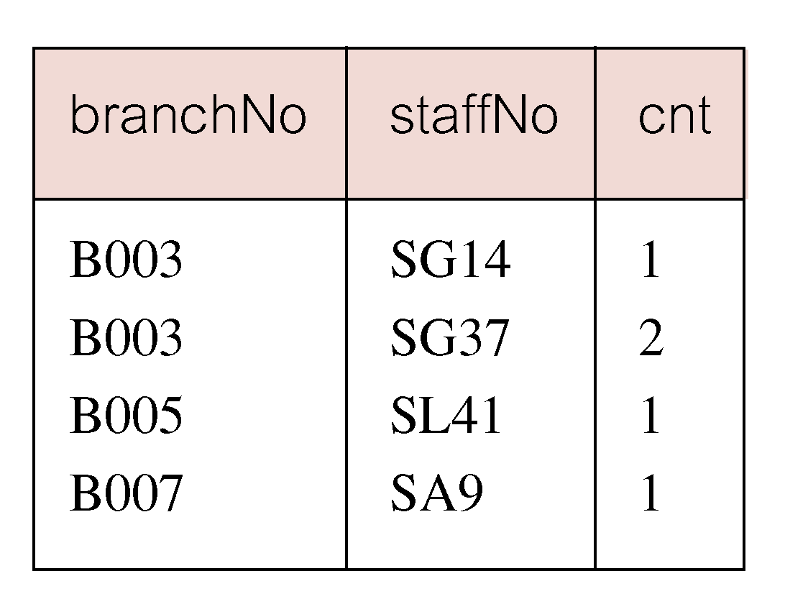
Example- Grouped and Joined Views
Create view of staff who manage properties for rent, including branch number they work at, staff number, and number of properties they manage.
11/19/2014
Dr. Miriam Capretz SE3309a DBMS
‹#›
Notes:
‹#›

Slide 42
SQL - DROP VIEW
DROP VIEW ViewName [RESTRICT | CASCADE]
Causes definition of view to be deleted from database.
For example:
DROP VIEW Manager3Staff;
11/19/2014
Dr. Miriam Capretz SE3309a DBMS
‹#›
Notes:
‹#›

Slide 43
SQL - DROP VIEW
With CASCADE, all related dependent objects are deleted; i.e. any views defined on view being dropped.
With RESTRICT (default), if any other objects depend for their existence on continued existence of view being dropped, command is rejected.
11/19/2014
Dr. Miriam Capretz SE3309a DBMS
‹#›
Notes:
‹#›

Slide 44
How Views Work
RDBMS merely stores the view definition and not any of the data in a view
Querying against a view versus the underlying tables does not change the way that data are retrieved or cached
Standard RDBMS views exist to make programming more convenient or to address security concerns
not to make data access more efficient
11/19/2014
Dr. Miriam Capretz SE3309a DBMS
‹#›
Notes:
‹#›

Slide 45
Example- Grouped and Joined Views
Create view of staff who manage properties for rent, including branch number they work at, staff number, and number of properties they manage.
CREATE VIEW StaffPropCnt (branchNo, staffNo, cnt)
AS SELECT s.branchNo, s.staffNo, COUNT(*)
FROM Staff s, PropertyForRent p
WHERE s.staffNo = p.staffNo
GROUP BY s.branchNo, s.staffNo;
11/19/2014
Dr. Miriam Capretz SE3309a DBMS
‹#›
Notes:
‹#›

Slide 46
View Resolution
Count number of properties managed by each member at branch B003.
SELECT staffNo, cnt
FROM StaffPropCnt
WHERE branchNo = ‘B003’
ORDER BY staffNo;
11/19/2014
Dr. Miriam Capretz SE3309a DBMS
‹#›
Notes:
‹#›

Slide 47
View Resolution
(a) View column names in SELECT list are translated into their corresponding column names in the defining query:
SELECT s.staffNo As staffNo, COUNT(*) As cnt
(b) View names in FROM are replaced with corresponding FROM lists of defining query:
FROM Staff s, PropertyForRent p
11/19/2014
Dr. Miriam Capretz SE3309a DBMS
‹#›
Notes:
‹#›

Slide 48
View Resolution
(c) WHERE from user query is combined with WHERE of defining query using AND:
WHERE s.staffNo = p.staffNo AND branchNo = ‘B003’
(d) GROUP BY and HAVING clauses copied from defining query:
GROUP BY s.branchNo, s.staffNo
(e) ORDER BY copied from query with view column name translated into defining query column name:
ORDER BY s.staffNo
11/19/2014
Dr. Miriam Capretz SE3309a DBMS
‹#›
Notes:
‹#›

Slide 49
View Resolution
(f) Final merged query is now executed to produce the result:
SELECT s.staffNo, COUNT(*)
FROM Staff s, PropertyForRent p
WHERE s.staffNo = p.staffNo AND
branchNo = ‘B003’
GROUP BY s.branchNo, s.staffNo
ORDER BY s.staffNo;
11/19/2014
Dr. Miriam Capretz SE3309a DBMS
‹#›
Notes:
‹#›

Slide 50
Restrictions on Views
ISO standard imposes several restrictions on the creation and use of views.
(a) If a column in the view is based on an aggregate function:
The column may appear only in SELECT and ORDER BY clauses of queries that access the view.
The column may not be used in WHERE nor be an argument to an aggregate function in any query based on the view.
11/19/2014
Dr. Miriam Capretz SE3309a DBMS
‹#›
Notes:
‹#›

Slide 51
Restrictions on Views
For example, the following query would fail:
SELECT COUNT(cnt)
FROM StaffPropCnt;
Similarly, the following query would also fail:
SELECT *
FROM StaffPropCnt
WHERE cnt > 2;
11/19/2014
Dr. Miriam Capretz SE3309a DBMS
‹#›
Notes:
‹#›

Slide 52
Restrictions on Views
(b) Grouped view may never be joined with a base table or a view.
For example, StaffPropCnt view is a grouped view, so any attempt to join this view with another table or view fails.
11/19/2014
Dr. Miriam Capretz SE3309a DBMS
‹#›
Notes:
‹#›

Slide 53
View Updatability
All updates to base table reflected in all views that encompass base table.
Similarly, may expect that if view is updated then base table(s) will reflect change.
11/19/2014
Dr. Miriam Capretz SE3309a DBMS
‹#›
Notes:
‹#›

Slide 54
View Updatability
However, consider again view StaffPropCnt.
If we tried to insert record showing that at branch B003, SG5 manages 2 properties:
INSERT INTO StaffPropCnt
VALUES (‘B003’, ‘SG5’, 2);
Have to insert 2 records into PropertyForRent showing which properties SG5 manages. However, we do not know which properties they are; i.e. we do not know the primary keys!
11/19/2014
Dr. Miriam Capretz SE3309a DBMS
‹#›
Notes:
‹#›

Slide 55
View Updatability
If change definition of view and replace count with actual property numbers:
CREATE VIEW StaffPropList (branchNo,
staffNo, propertyNo)
AS SELECT s.branchNo, s.staffNo, p.propertyNo
FROM Staff s, PropertyForRent p
WHERE s.staffNo = p.staffNo;
11/19/2014
Dr. Miriam Capretz SE3309a DBMS
‹#›
Notes:
‹#›

Slide 56
View Updatability
Now try to insert the record:
INSERT INTO StaffPropList
VALUES (‘B003’, ‘SG5’, ‘PG19’);
Still problem, because in PropertyForRent all columns except postcode/staffNo are not allowed nulls.
However, have no way of giving remaining non-null columns values.
11/19/2014
Dr. Miriam Capretz SE3309a DBMS
‹#›
Notes:
‹#›

Slide 57
PropertyForRent relation
CREATE TABLE PropertyForRent (
propertyNo PNumber NOT NULL,
street Street NOT NULL,
city City NOT NULL,
postcode PostCode,
type PropertyType NOT NULL DEFAULT ‘F’,
rooms PRooms NOT NULL DEFAULT 4,
rent PRent NOT NULL DEFAULT 600,
ownerNo OwnerNumber NOT NULL,
staffNo StaffNumber
Constraint StaffNotHandlingTooMuch ….
branchNo BranchNumber NOT NULL,
PRIMARY KEY (propertyNo),
FOREIGN KEY (staffNo) REFERENCES Staff
ON DELETE SET NULL ON UPDATE CASCADE,
FOREIGN KEY (ownerNo) REFERENCES PrivateOwner ON DELETE NO ACTION ON UPDATE CASCADE,
FOREIGN KEY (branchNo) REFERENCES Branch ON DELETE NO ACTION ON UPDATE CASCADE);
11/19/2014
Dr. Miriam Capretz SE3309a DBMS
‹#›
Notes:
‹#›

Slide 58
View Updatability
A view is updatable if and only if:
- DISTINCT is not specified (i.e., duplicate rows must not be eliminated from the query results)
- Every element in the SELECT list of a defining query is a column name (rather than a constant, expression, or aggregate function) and no column appears more than once.
11/19/2014
Dr. Miriam Capretz SE3309a DBMS
‹#›
Notes:
‹#›

Slide 59
View Updatability
A view is updatable if and only if:
- FROM clause specifies only one table, excluding any views based on a join, union, intersection or difference.
- No nested SELECT referencing outer table.
- No GROUP BY or HAVING clause.
- Also, every row added through view must not violate integrity constraints of base table.
11/19/2014
Dr. Miriam Capretz SE3309a DBMS
‹#›
Notes:
‹#›

Slide 60
Updatable View
For a view to be updatable, DBMS must be able to trace any row or column back to its row or column in the source table.
11/19/2014
Dr. Miriam Capretz SE3309a DBMS
‹#›
Notes:
‹#›

